Slide 1

Some Thoughts On Parallelization
Of Various Measurement Equations
O. Smirnov (ASTRON)
S. Salvini (Oxford e-Research Centre)

Slide 2
Context
SKADS DS2: sky/telescope simulations
Massive simulations using MeqTrees
  with interesting things like AA beams and ionospheres thrown in
...and then need to test calibratability
  by running calibration algorithms
So, lots of Measurement Equations involved at both stages
Has to be massively parallel

Slide 3
Some Measurement Equations

Slide 4
What Kind Of MEs Are We Dealing With?
Proper treatment of image-plane effects requires individual predicts for the brighter sources
  DFTs or shapelets or small images (if extended)
Fainter sources must be predicted en masse due to computational limitations
  FFTs + convolutional functions
Bottom line: our MEs are sums over heterogeneous sources

Slide 5
...so, something like:
G is a product of Jones matrices representing all uv-plane effects,
E^{(s)} is a product of Jones matrices representing all image-plane effects towards source s,
and B^{(s)} is the predicted coherency of source s (for point sources this is just a matrix, without a pq index)

Slide 6
Evaluting this ME requires
~2*Ntime*Nfreq*Nsrc*Nifr
matrix multiply (MM) ops per time/freq point.
...while the evaluating the individual terms requires ~ Nsrc and/or Nantenna ops.
So, let's assume G/E/B are already CPU-efficient, and concentrate on distributing the MM/summation ops.

Slide 7
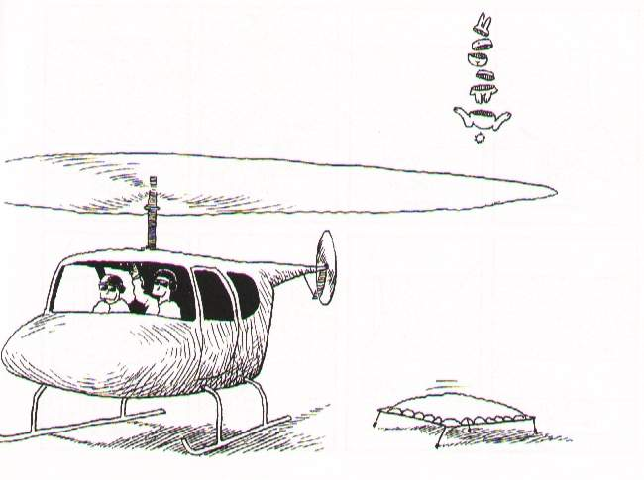
Partitioning Your Data

Slide 8
What To Partition By?
By time:
  possible for simulation, impractical for calibration
  and, data on disk tends to be sorted by time
By frequency (i.e. LOFAR BBS):
  if enough freq points and they can all be treated independently, then everything is peachy
  but that's not always the case...
By antenna/interferometer:
  less straightforward, but could provide an extra “degree of freedom”

Slide 9
Distributing The ME By Antenna & Baseline
Not straightforward to distribute, as this product is a “mix-in” operation – every p has to (eventually) meet every q.
But worth pursuing, as it offers an extra degree of freedom in parallelization
Complementary to time/freq parallelization, not mutually exclusive

Slide 10
A General Scheme For Partitioning By Ant/Ifr
Na antennas, Np processors (Na>>Np)
Segment antennas into Na/Np blocks, and assign each block to 1 processor
  blocks A1 to P1, A2 to P2
Per-antenna (Jones) terms computed on their designated processor
Each processor ends up with a fixed subset of the visibilities

Slide 11
Proc 1
Proc 2
Proc 3
Proc 4
comp.
E1
comp.
E2
comp.
E3
comp.
E4
comp
V11
send
E1
comp
V22
send
E2
comp
V33
send
E3
comp
V44
send
E4
comp
V14
send
E4
comp
V12
send
E1
comp
V23
send
E2
comp
V34
send
E3
comp
V13
E3
(half)
comp
V24
E4
(half)
comp
V13
E1
(half)
comp
V24
E2
(half)
V11 V14
V13 (half)
V22 V12
V24 (half)
V33 V23
V13 (half)
V44 V34
V24 (half)

Slide 12
A General Distribution Scheme By Ant/Ifr
Each processor computes a fixed subset of per-antenna terms
  A1, A2, A3, A4
Each processor computes a fixed subset of interferometers:
  A1-A1, A1-A4, half of A1-A3
  A2-A2, A1-A2, half of A2-A4
  etc.
More Jones terms may be applied via the same “mix-in” pattern

Slide 13
Some Op Counts
Each processor responsible for Na/Np antennas
At each step, computes O((Na/Np)²) datums
... and sends/receives O(Na/Np) datums
The ratio between compute and send is critical for parallelization

Slide 14
Na/Np Is Critical
Na/Np is the critical “parallelization factor”, determines the ratio Tcpu/Tcomm
  if sufficiently high, then antennas can be distributed efficiently
  the higher the number, the better we can exploit multicore processors
  scaling depends on exact form of ME
Back-of-the-envelope calculation for a simple ME:
  100 DFT sources, 100 antennas, 10 processors...
  hardware: GFLOP/core, Gigabit interconnect
  shows Tcpu/Tcomm ~ 3, meaning 4-core processors can be exploited efficiently (1 core communicates, 3 cores compute)

Slide 15
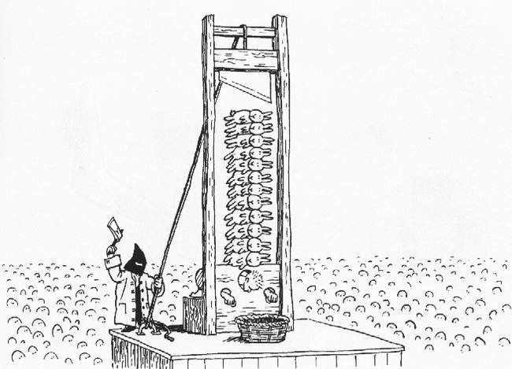
How To Increase Parallelism?

Slide 16
Increasing Parallelism 1:
Resampling
What is being communicated: Jones terms
If we can compute Jones terms on a coarser grid and interpolate on the spot:
  communication costs go down
  more computation, but interpolation is cheap
  Tcpu/Tcomm goes up => more parallelism!

Slide 17
Increasing Parallelism 2:
Deferring the mix-in

Slide 18
Increasing Parallelism 2:
Deferring the mix-in
Eq. (2) increases Tcpu, but eliminates an extra “mix-in” operation
  => better parallelism
Whether or not this is a good trade-off depends on the exact form of the Jones terms
We can go one step further...

Slide 19
Decomposing B
DFTs may be optimized further:

Slide 20
Decomposing B: Op Count
Our basic operation is a 2x2 complex matrix multiply. Let's count the number of MMs per time/freq point:
Eq. (2) has better scaling with Na
Can also save ops (at the expense of parallelism) by moving Gp outside the sum...

Slide 21
Decomposing B:
Implications For Parallelism
Eq. (2) parallelizes much better, since the “mix-in” operation between p-q indices is deferred until the end, and up to that point everything is independent by station.
Eq. (2) has only one mix-in per source, whereas Eq. (1) has one mix-in per source and per Jones term.
This also makes for more compact trees!

Slide 22
Decomposing B:
What's the catch?
The catch of course is that this only works for point sources. Bricks and other extended sources have Bpq in their equations, so this trick doesn't apply.
Still, point sources are the bread and butter of our simulations (and many sims contain point sources exclusively), so we're potentially saving a lot of CPU cycles!

Slide 23

Implementation Plans

Slide 24
Implementation Plans
Implementing a distributed version of MeqTrees later this year
  ...so that any tree can be partitioned across a cluster in arbitrary ways
The scheme described here then becomes just another way of partitioning a tree
  so does time/frequency partitioning

Slide 25
A Hybrid Implementation
MPI is used to communicate across processors
Multithreading is used within processors
  start with current mechanism, think about optimization later
Separate communication thread handles MPI send/receive
Pool of worker threads evaluates trees
Communication & computation proceeds in parallel!

Slide 26
Who Decides Where To Distribute?
Sticky question...
  would like to hide it from the user as much as possible
  in principle all information available on TDL side, so Python can decide
  but hints from the “user” are needed
If a framework (Siamese, Calico) is being used, then the framework can supply sufficient hints, hiding everything from the user

Slide 27
Conclusions
Measurement Equations can be parallelized and partitioned by antenna/interferometer
  ...and this can be efficient on modern clusters
There are various ways of fine-tuning this
This is complementary to partitioning by frequency/time

