Slide 1
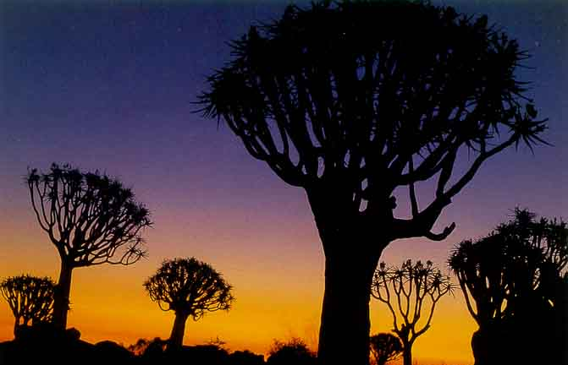
MeqTrees
Practical Session
O. Smirnov (ASTRON)

Slide 2
Getting Started
Copy over the exercise data:
> cp -a /data/lofarschool/data/Exercise-MeqTrees/Sim/* .
Init the environment:
> source meqtree-init.csh
Start it up!
> meqbrowser.py

Slide 3
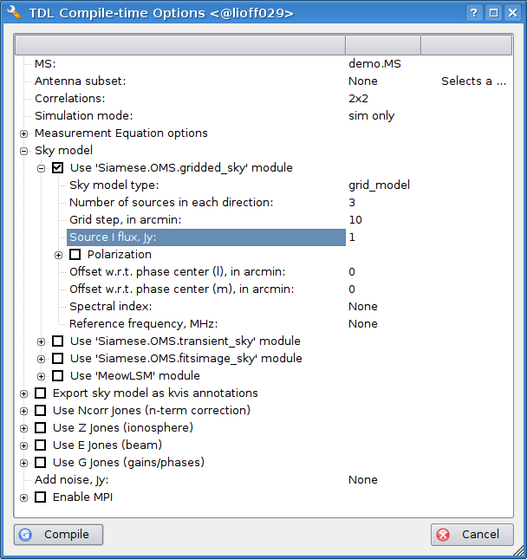
First Sim
Go to TDL > Load TDL Script (or just press Ctrl+T)
Load up exercise-sim.py
Set up options:
Click “Compile”

Slide 4
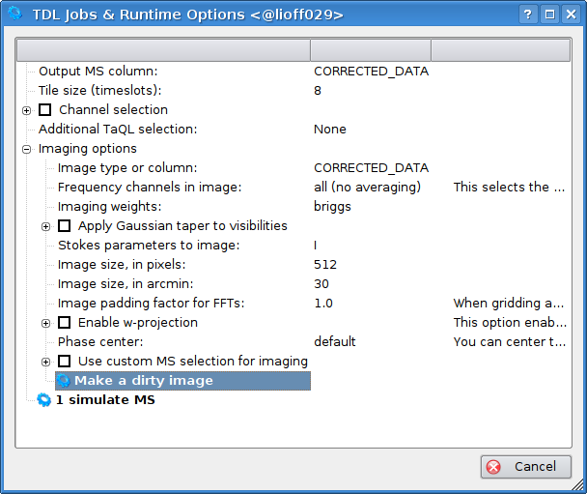
First Sim, cont'd
Click “simulate MS”
Set up options:
Click “Make a dirty image”

Slide 5
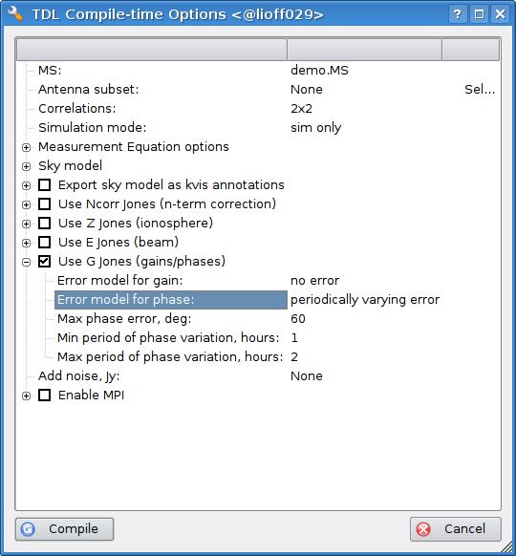
Adding Phase Errors
Enable “G Jones” in compile options:
Compile
Open bookmark!
Run “simulate MS” and make another image

Slide 6
Increasing Phase Error
Increase phase error to 120 degrees
Simulate MS, make another image

Slide 7
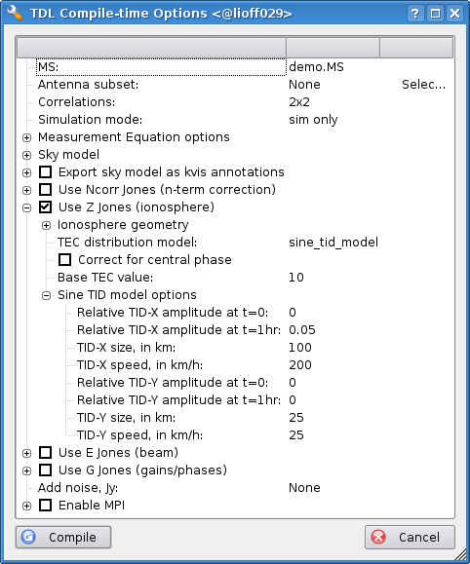
Adding An Ionosphere
Enable Z Jones, disable G Jones
Open some bookmarks
Simulate MS, then make an image

Slide 8
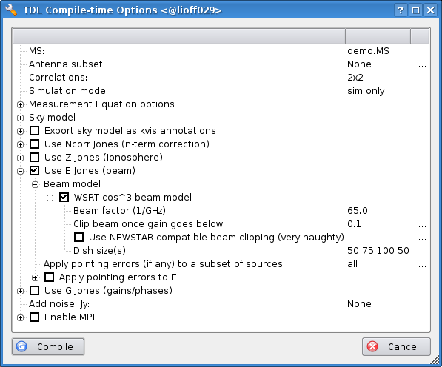
Adding a Primary Beam
Add E Jones, remove Z Jones:

Slide 9
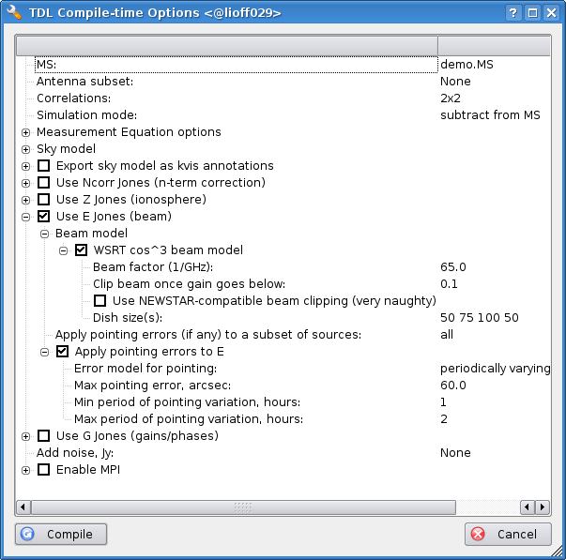
Adding Pointing Errors
Set simulation mode to “subtract from MS”
Enable pointing errors:
Compile...

Slide 10
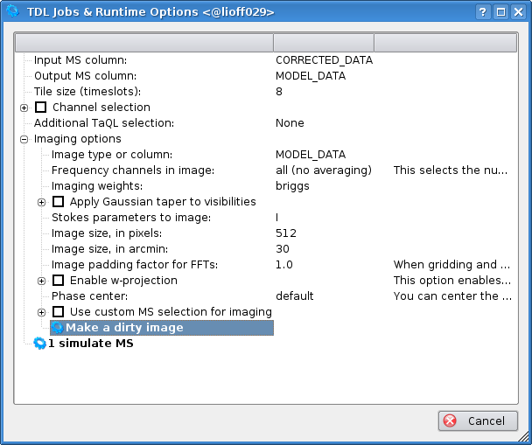
Adding Pointing Errors, cont'd
Set input and output columns correctly before running the sim:

Slide 11
Free-for-all
Time left? Play with the other options...

