Slide 1
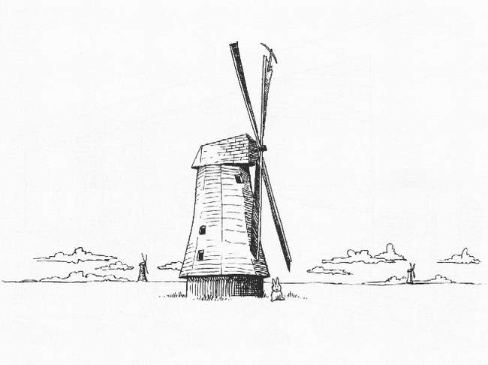
Day 5: Wide-Field Issues

Slide 2
Before we start...
$ cd ~/MCCT2009
$ svn up

Slide 3
Exercise: E2E S³ Simulation
1. Querying the S³ Database
http://s-cubed.physics.ox.ac.uk/
Click on “S3-SEX - Database query”
Enter your e-mail
Leave most fields as default, except “Spatial conditions”:
  Minimum X,Y: - 0 : 4 : 0.0
  Maximum X,Y: + 0 : 4 : 0.0
  This selects an 8' x 8' field
Click “Submit”
Follow the provided link and wait for the query to complete (may need to reload)

Slide 4
Exercise: E2E S³ Simulation
2. Making an LSM
Download the query results (.tar.gz file)
Move them to exercise directory:
  $ cd ~/MCCT2009/Week2-Sim
  $ mv ~/Desktop/xxx.tar.gz .
Run conversion script:
  $ ./s3_to_LSM_rad.py xxx.tar.gz lsm.txt
Examine lsm.txt
  this contains the 100 brightest sources from your query

Slide 5
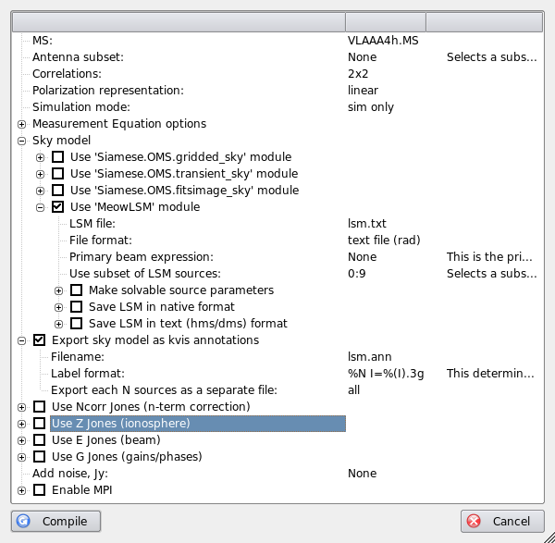
Exercise: E2E S³ Simulation
3. Compiling the simulator
Start meqbrowser, load e2e-sim.py
Setup options
Set LSM subset!!!
Compile the script

Slide 6
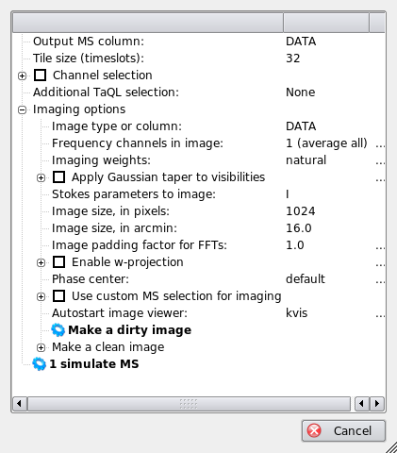
Exercise: E2E S³ Simulation
4. Running the sim
Click on “simulate MS”
Once things finish, click on “Make a dirty image”
Load kvis annotations (Overlay - Load annotations)

Slide 7
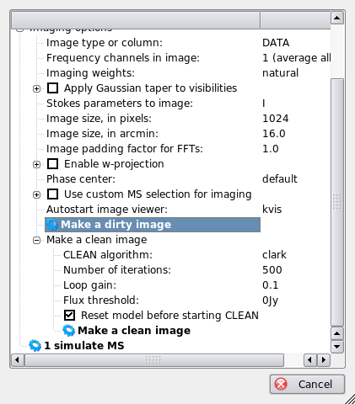
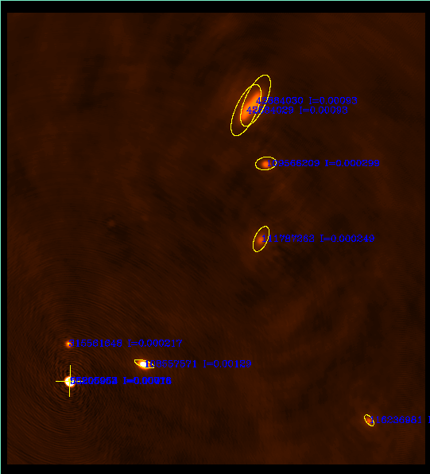
Exercise: E2E S³ Simulation
5. Make a clean image

Slide 8
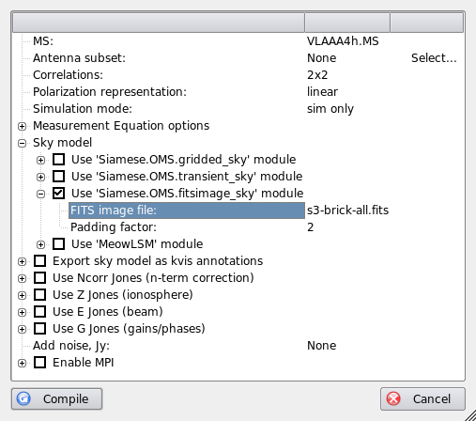
Exercise: E2E S³ Simulation
6. Redo the sim using a brick
Let's use a FITS image for an LSM, instead of a source list
We'll use the 'fitsimage_sky' module
View s3-brick-all.fits using kvis first

Slide 9
Exercise: E2E S³ Simulation
7. Run the brick sim
Compile
Set “Output column” to CORRECTED_DATA
Simulate MS
Make a dirty image, compare to previous
Make a clean image, compare to previous

Slide 10
Exercise: Beams & Instrumental Polarization
Set grid step to 20'
Enable the E-Jones
  set beam eccentricity to .1
Open an inspector for E
Make IQUV map (average all channels)
Enable P-Jones
Make another IQUV map.

Slide 11
Exercise: Pointing Errors
Enable pointing errors (see the submenu for E-Jones)
  set to periodic error of 5”
Open inspector for E and for dlm
Make an I map (average all channels)
Observe the difference (or lack thereof...)

Slide 12
So What's The Difference?
It's hard to see all that much in the map
(although you could make another map without pointing error, and subtract it...)
So let's build a differential sim instead, to compute the difference between visibliites with and without pointing errors
Set “simulation mode” to “subtract for MS”, for input column use CORRECTED_DATA, for output use MODEL_DATA.
Make an I map.

Slide 13
Differential Trees
(Or Simulations About Simulations)
Given infinite CPUs, we can implement m.e.'s of arbitrary precision.
In real life, we have to take shortcuts
(e.g. choosing time/freq intervals here).
The main question: how much error does a particular shortcut introduce?
  given infinite mathematical skill, we could work it out analytically...
  ...but given MeqTrees, we don't have to.

Slide 14
Exercise: N-correction
With wide fields, it is difficult to distinguish distortion introduced by the w-effect from other distortions
The “Ncorr-Jones” adds an artifical Jones term of:
This causes the sources to image perfectly
Alternative (slow): enable w-correction in the imager (use 1024 convolution funcs)

Slide 15
And Now For Something Completely Different:
Time & Bandwidth Smearing

Slide 16
And Now For Something Completely Different:
Time & Bandwidth Smearing

Slide 17
Simulating Smearing
The same effect occurs with other Jones terms, such as ionospheric or tropospheric phase, etc. (hence, decohaerency time).
How to simulate?
The brute force approach:
Enable resampling in supersim.py (use 5x5) and observe the results...

Slide 18
Exercise: Smearing
Set grid step to 30'
Disable all Jones terms
Enable resampling (use 5x5 factors)
Make I map (average all channels)
Optional: try this with the ionosphere, etc.

Slide 19
Divide And Conquer

Slide 20
A Sky Of Point Sources

Slide 21
Extended Sources & Patches
Any B that is not a delta-function gets interesting, especially if E is not trivial, and especially for wider fields (the “not quite an F.T.” problem.)
...but we need to solve this for two reasons.
Reason 1: spatially extended sources...
Reason 2: it is impractical to directly predict large numbers of fainter sources individually, so we need to organize them into “patches”, and find a faster way to predict a patch en masse.

Slide 22
First, Reduce To Center...

Slide 23
...Where Life Gets Easier
In other words, to predict a source at l0,m0, it is sufficient to predict it at the phase center (shifting E accordingly...), then apply the phase terms Kp0, Kq0 to “move” the source to its true position.
This is beautifully symmetric w.r.t. the ME for a point source:

Slide 24
So All We Need
To Figure Out Now...
  ...is how to predict extended sources at the phase center. We've simplified the problem considerably. If we now expand the K terms:
  ...and we only require the “Weak Assumption” that n→1 over the extent of the source.

Slide 25
Or Even More Optimistically...
  This is very good from a practical point of view, since:
    F.T.'s are easier than strange integrals
    phase shifts and (in the optimistic case) image-plane effects are applied in the same way to all kinds of sources
    we only need to worry about predicting the source (or patch) at the phase center

Slide 26
The Bad News
  This is only an approximation.
  Error levels will depend on:
    source flux (in a linear way, so we can talk about relative error);
    patch/source size (because of the n term);
    the variation in E over the extent of the patch.
  We need to develop some feeling for how small the patches/sources need to be to make the error suitably small.
  We can build some trees to simulate these errors (well this is actually good news, isn't it?)

Slide 27
The Bhatnagar Approach:
Coming Soon To a Tree Near You?
Convolution with a “small” kernel can be computed directly, fairly cheaply.
...and in fact the interpolation function used in the traditional FFT/gridding method to interpolate X to a given uv track is a form of convolution.
So we can apply E's during gridding, via a suitable modification to the convolution function.
(NB: the inverse process, for N, is w-projection)

Slide 28
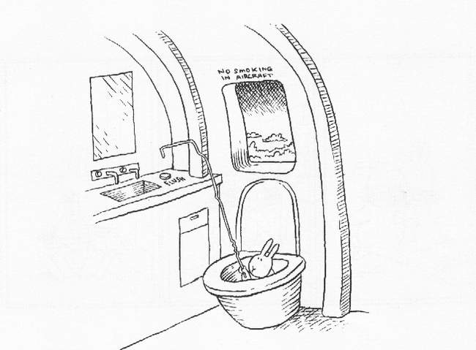
And That's All, Folks!

