Slide 1
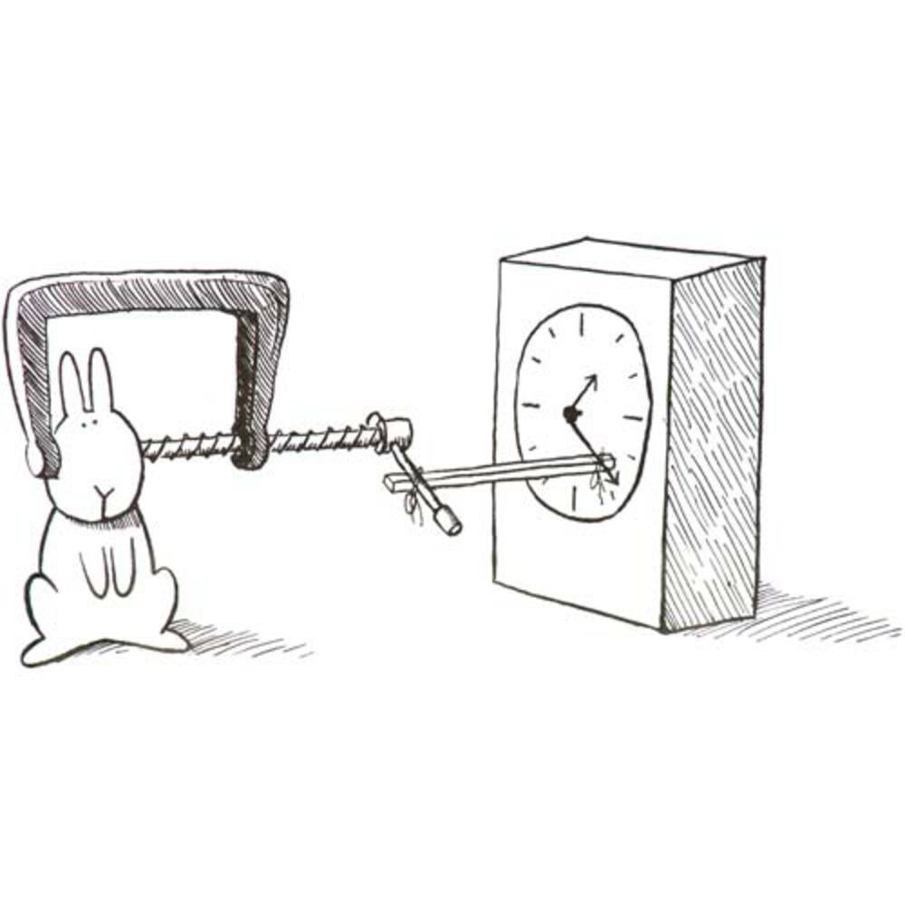
Observing Transients With Low-N, East-West Interferometers
For The Discerning Masochist
O. Smirnov (Rhodes University & SKA SA)

Slide 2
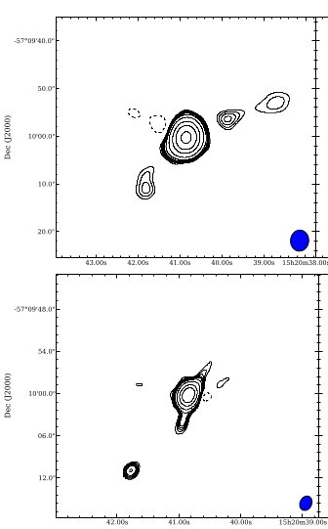
Introduction
Cir X-1 ATCA observations by Mickael Coriat
2.1, 5.5, 9 and 33/35 GHz
Goal: image the jets and
measure their angle,
variability with wavelength?

Slide 3
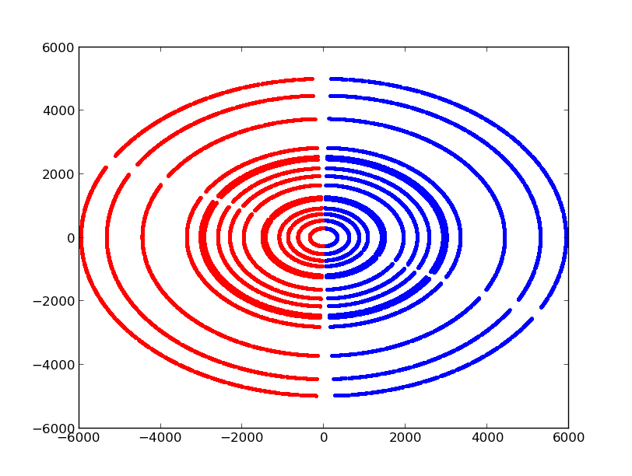
Problems
E-W array, instantaneous
uv-coverage is a line
Measurement of structure
completely degenerate
w.r.t. intrinsic variability
Jets are quite close to
source (given our resolution),
very delicate detection
~6 mJy source “too faint for selfcal?”
Relying on external calibration....

Slide 4
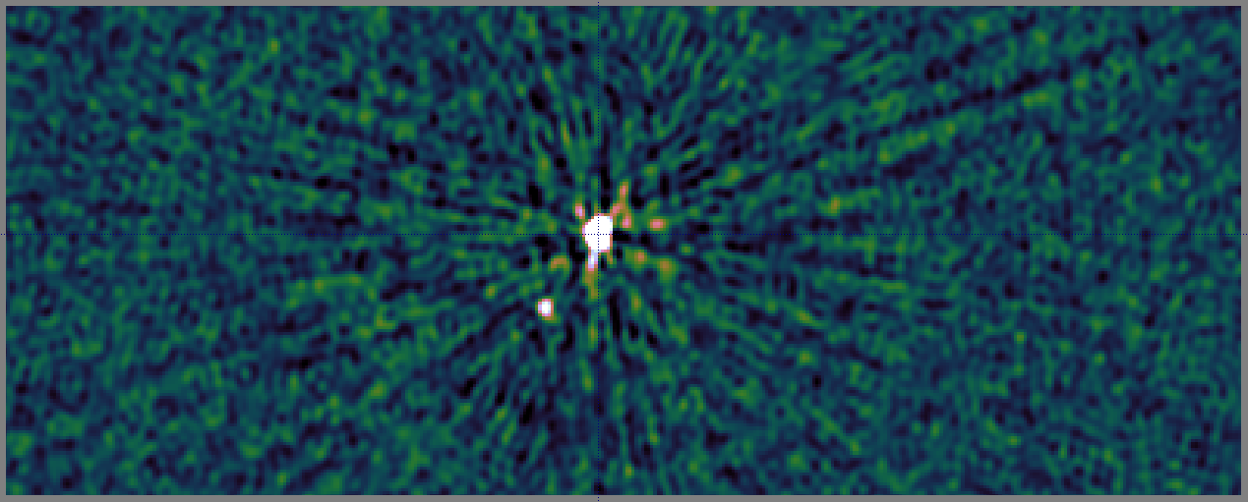
(a) External calibration
Tentative jet detection?

Slide 5
(a) External calibration
Dominated by radial artefacts (tropospheric phase?)
  Tentative jets detection, but doubtful due to artefacts
Bright northern source exhibits same artefacts
  ⇒ direction-independent effect
  ⇒ selfcal could (?) take care of it
But, not enough flux for selfcal (~6 mJy)

Slide 6
(b) Selfcal/stefcal
Fortunately, another 6 mJy in northern source
Can also increase SNR by imposing a slow and smooth variation on the calibration solutions
  Not possible with legacy software packages
  ...but doable with “stefcal” in MeqTrees
  (...and also with Cyril's filter approach)

Slide 7
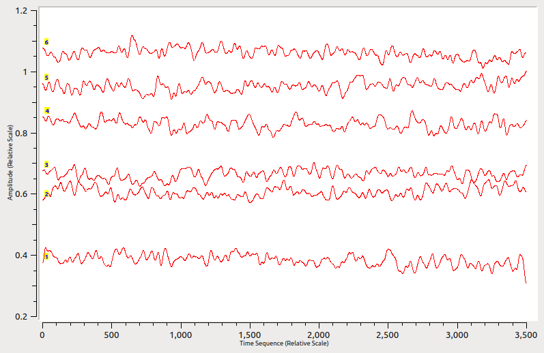
Stefcal Solutions

Slide 8
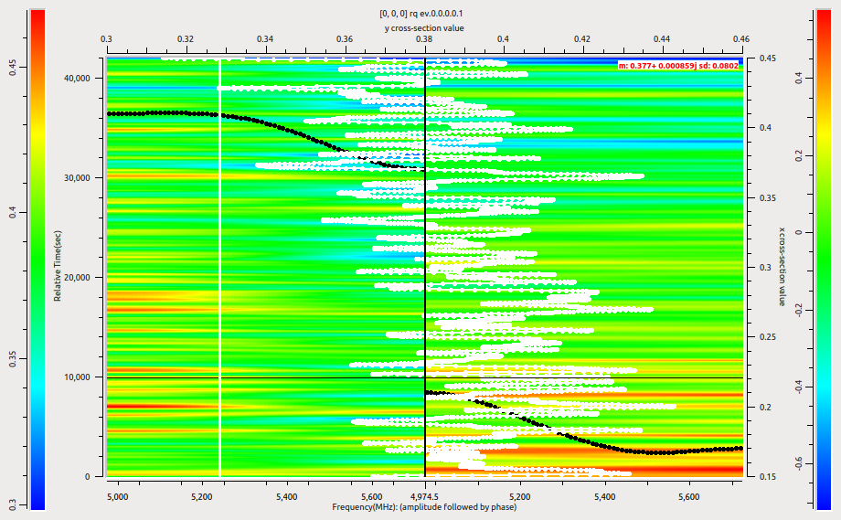
Stefcal Solutions

Slide 9
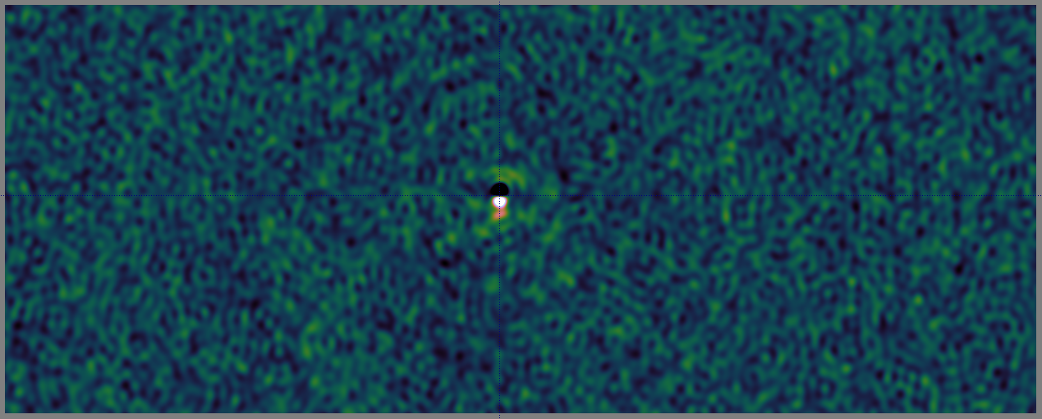
(b) After stefcal
Radial artefacts gone
  But so is the tentative jets detection (wasn't real)
Source position incorrect, not subtracted properly

Slide 10
(c) Differential gain on Cir X-1
Selfcal:
Differential gain:
  dE term slowly varying (G fast-varying), takes care of calibration errors towards source (and absorbs intrinsic variability and sky model errors)

Slide 11
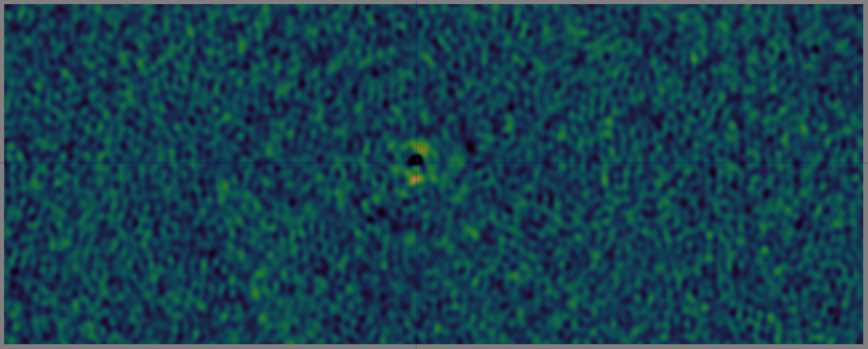
(c) Differential gain on Cir X-1
Hint of jets emerging...
Source position still not quite correct, let's update

Slide 12
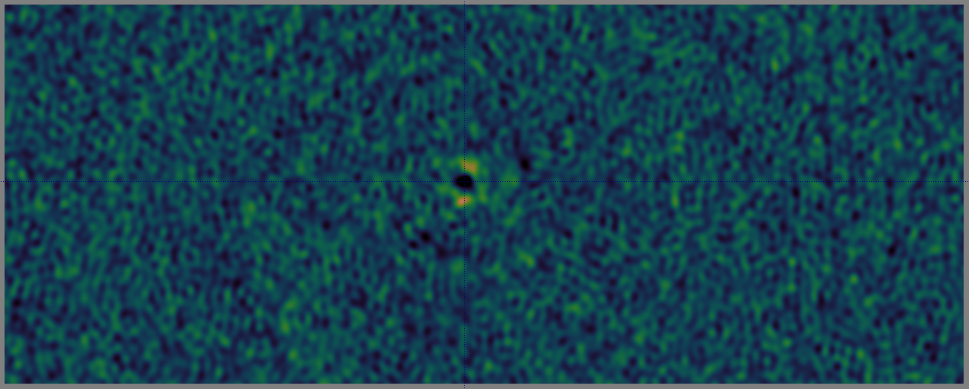
(d) Updated central source model
Very compelling jet detection
Note that jets are suppressed by selfcal and dE's
  Need to be included in sky model

Slide 13
Source Suppression
Any source not in sky model will be suppressed (by having its flux absorbed into the G and dE solutions)
How to mitigate:
  Update sky model to include source
  Minimize degrees-of-freedom in G and dE
  For dE, can try an amplitude-only, common-to-all antennas solution ( dEp≡ dE0 )

Slide 14
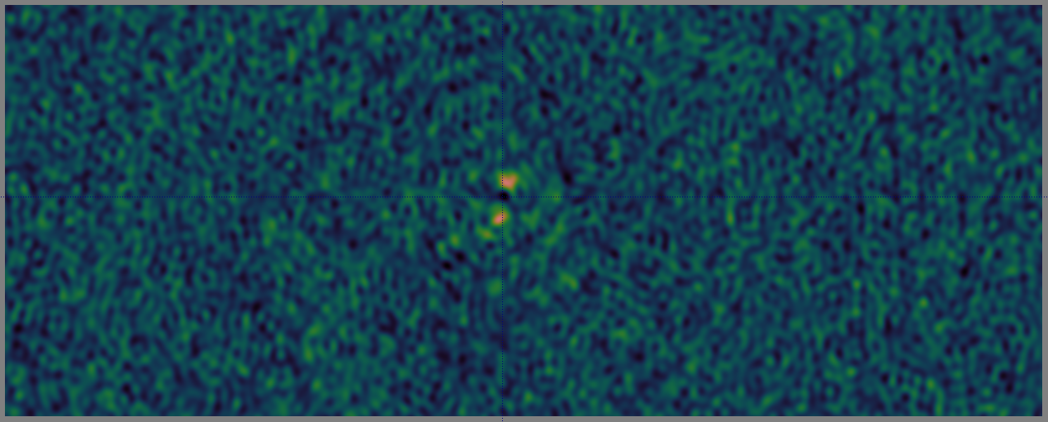
(e) Jets included in model, dEp≡ dE0
12 μJy noise, 96 μJy jet detection

Slide 15
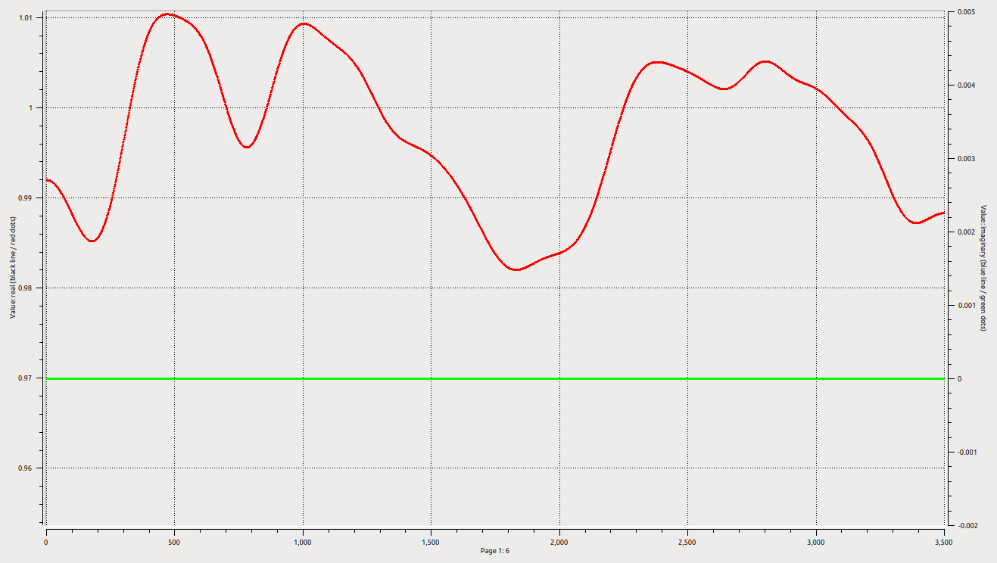
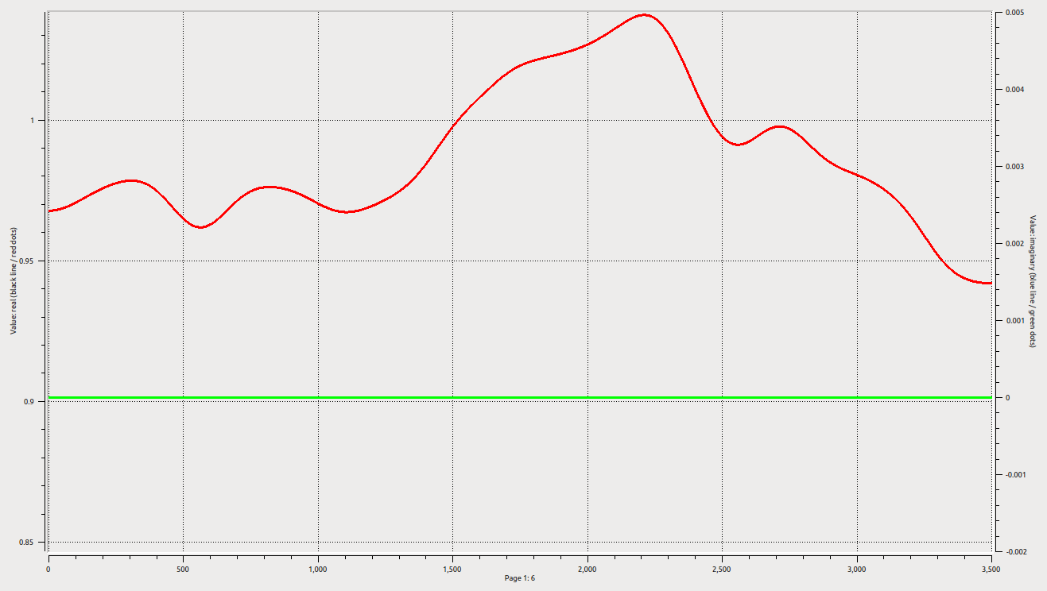
Light Curves (?)
dE solutions absorb intrinsic variability in I and Q
Proxy for light curves, but degenerate w.r.t. structure

Slide 16
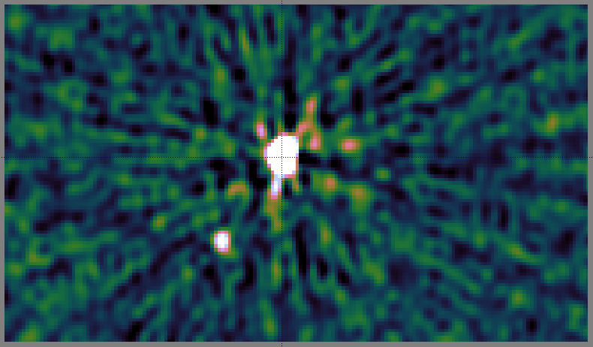
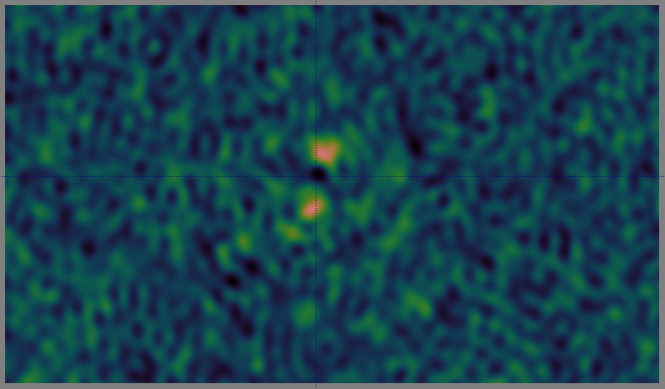
Pondering The Process...
“A high quality radio map is a lot like a sausage, you might be curious about how it was made, but trust me you really don't want to know.”
– Jack Hickish, Oxford
Bayesians have full posteriors.
Others have error bars, at least.
We have... plausible maps?
“If the sausage tastes good, it's probably kosh kudu.” – me, Kruger

Slide 17
What's The Answer?
Ideally, each pixel needs an error bar
  Better yet, an Npix × Npix covariance matrix
  Better yet, full posteriors (science fiction)
Somewhat out of reach for now
Short term: Bayesian source fitting?
  Fit source components, obtain full posteriors
  “The jets are at position angle θ±σθ”
  “The measurement is degenerate w.r.t. XYZ...”

Slide 18
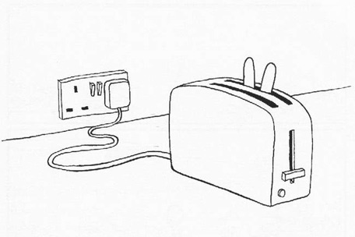
Conclusions
Transients on E-W arrays are for masochists
Nonetheless, with a bit of delicate processing, Cir X-1 jets can be detected reliably
  ...which only underscores what a dodgy business radio maps really are.
The future is in
posteriors?

