Slide 1


Calibration & Imaging:
2014+ Prospects
O. Smirnov
(Rhodes Centre for Radio Astronomy
Techniques & Technologies & SKA SA)
Aka: how many pictures can I cram into
a single 20-minute talk?

Slide 2
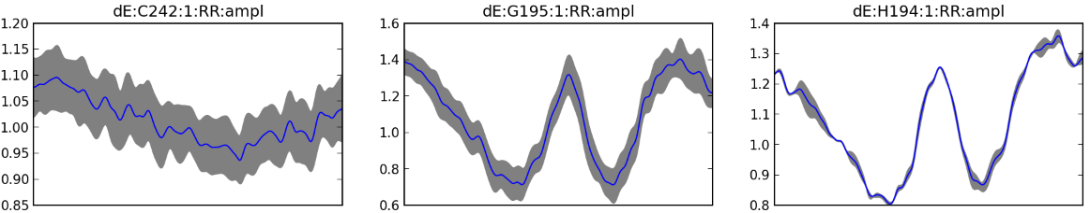
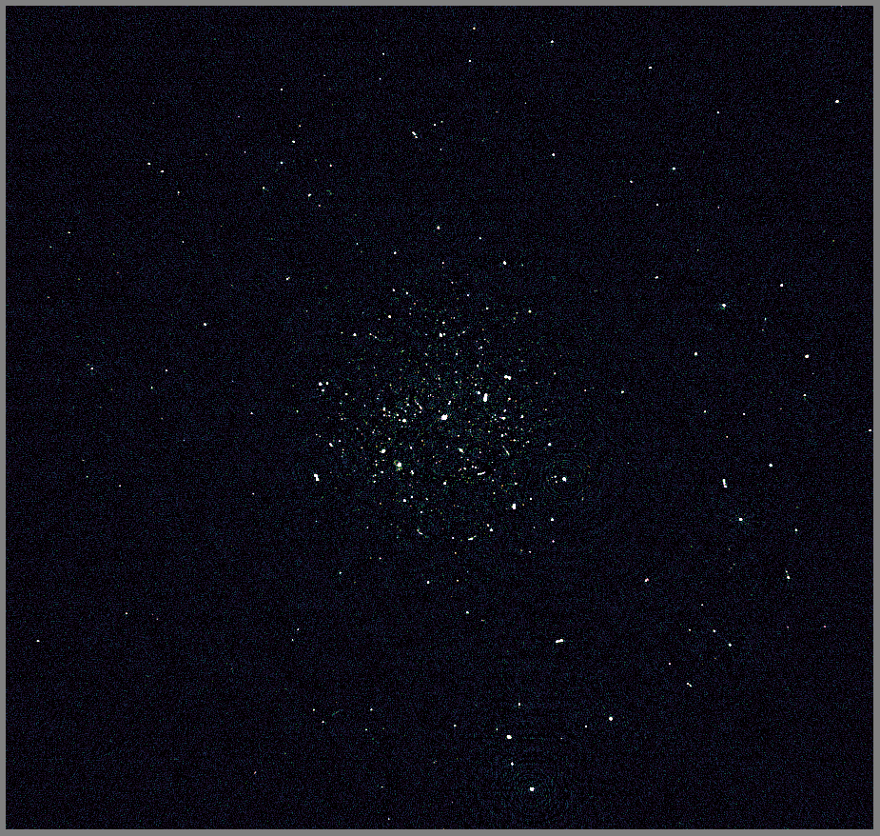

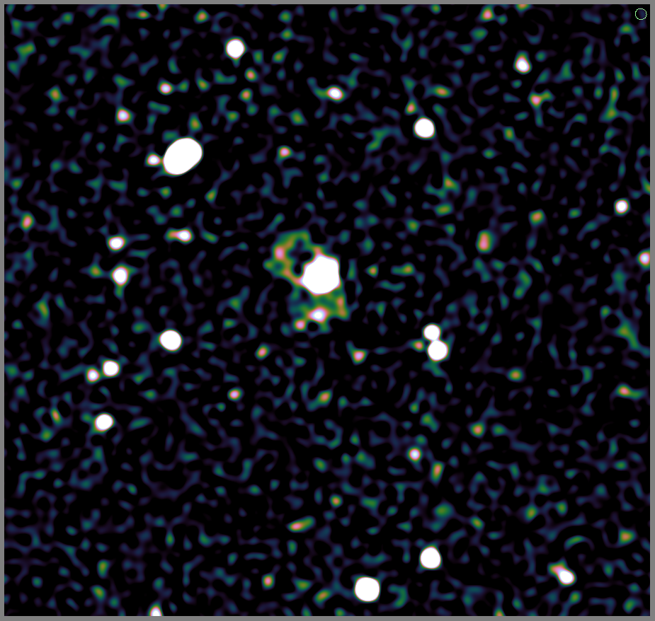
JVLA 3.2m vs. WSRT 1.6m
Differential gain solutions
VLA C+D
~14h 192MHz
WSRT 12h 200 MHz

Slide 3
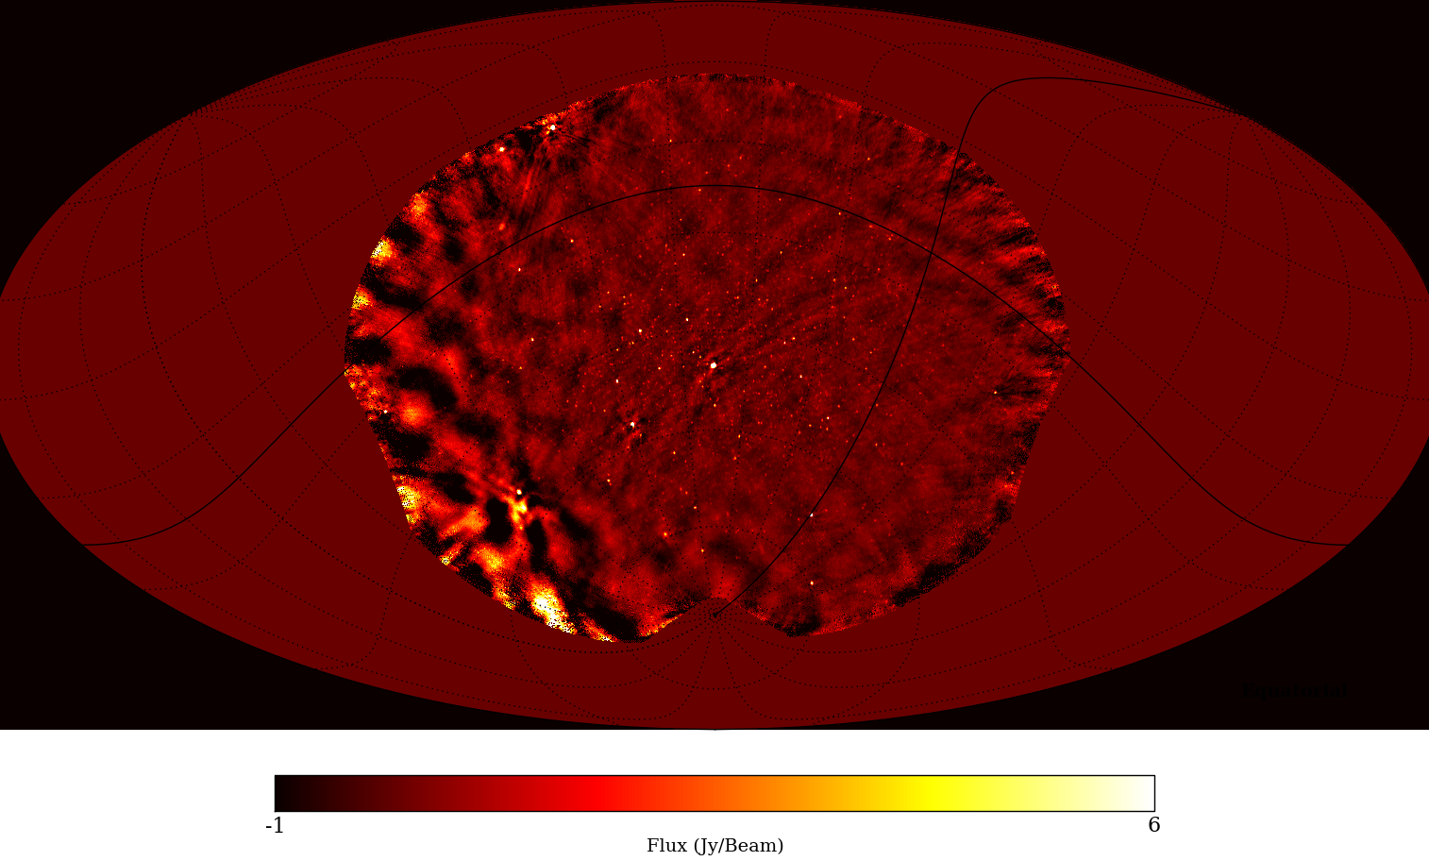
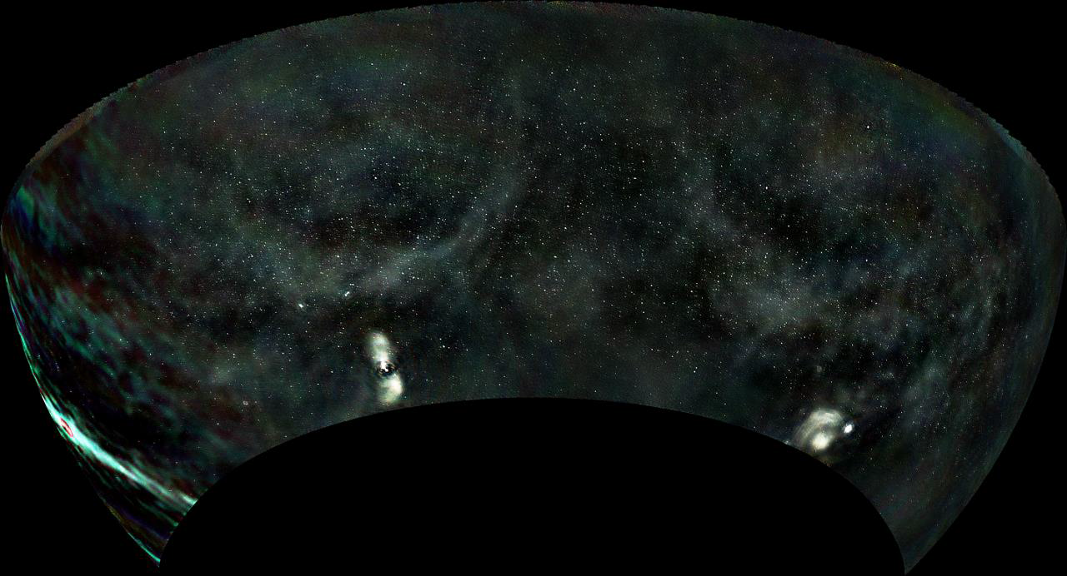
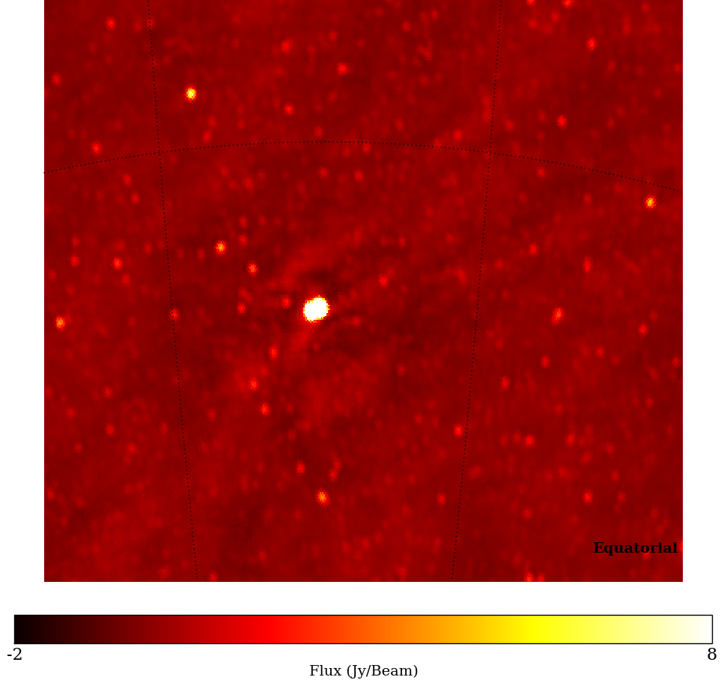
PAPER 32 Image
(courtesy G. Foster)
32 dipoles, 4h 100MHz
Max baseline ~300m
courtesy A. Offringa

Slide 4
PAPER Data Processing
PAPER looks straight up, no beamforming
Form (few) minute snapshots, calibrate individually
Correct for polarization (dipole projection)
Co-add on a HEALpix grid
Primary beam model in the works

Slide 5
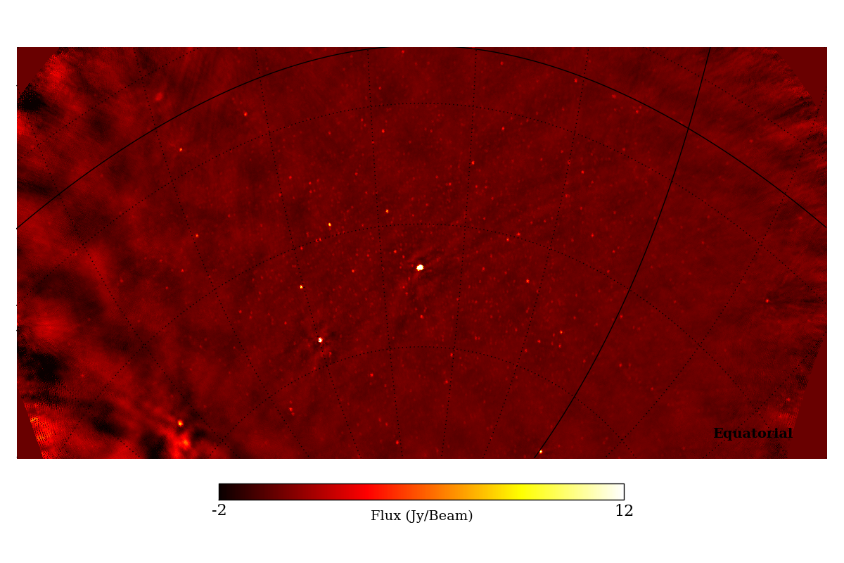
PAPER 32 IQU

Slide 6
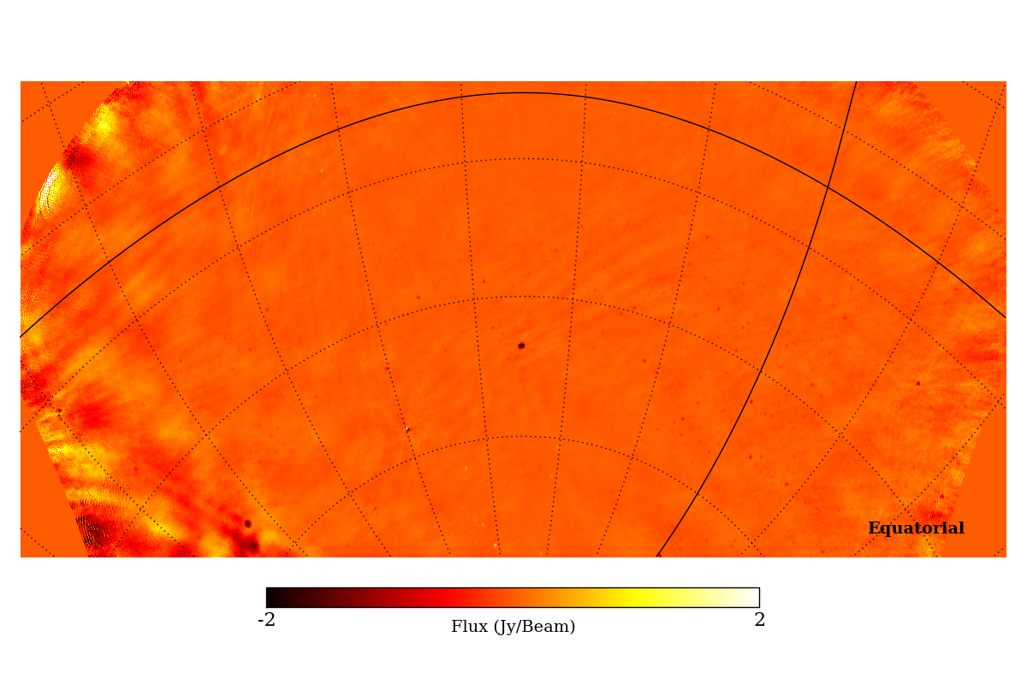
PAPER 32 IQU

Slide 7
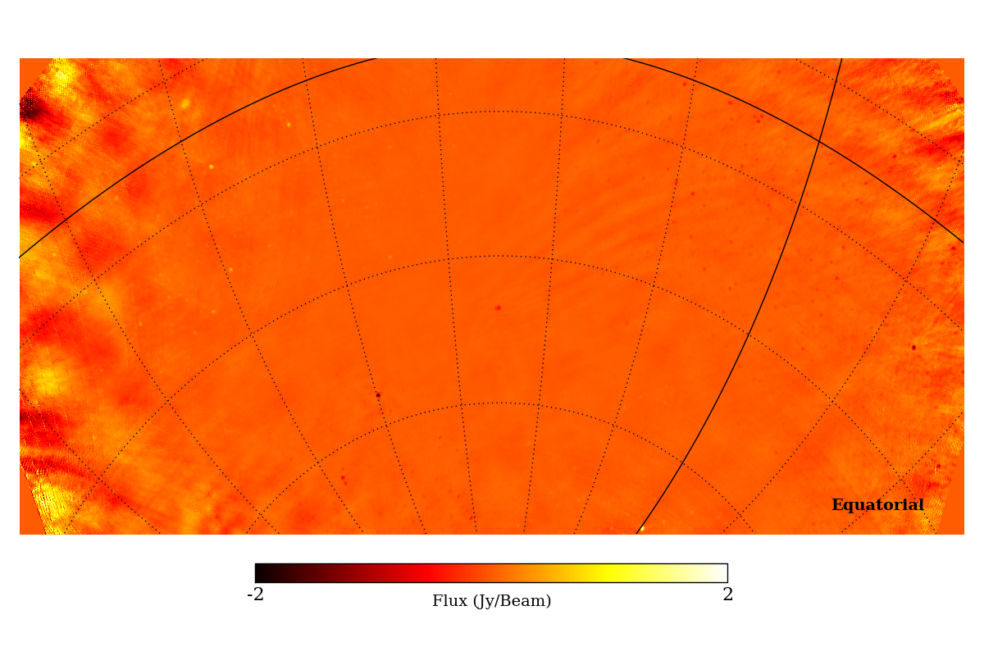
PAPER 32 IQU

Slide 8

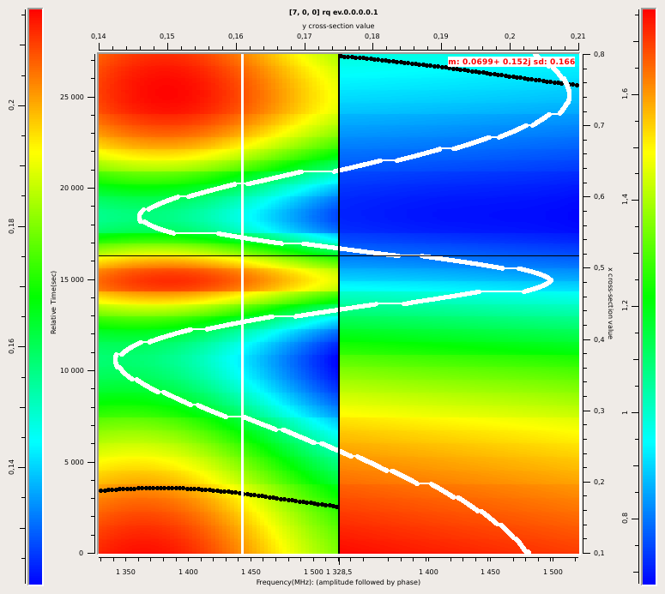
Primary Beams
Predicted beam gain using
W. Brisken's cassbeams model

Slide 9
Know Thy Beams
A-projection can in principle correct for known primary beam patterns
  From EM sims or fitted (see e.g. A. Young's work)
Currently:
  JVLA beam in CASA
  LOFAR beam in awimager
  +ionospheric phase screens in awimager
Need to generalize to generic beams
  Work ongoing under MIDPREP, expect this year

Slide 10
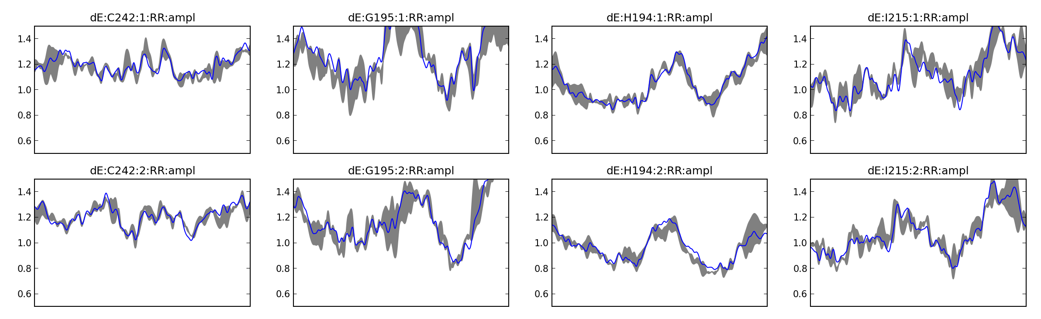
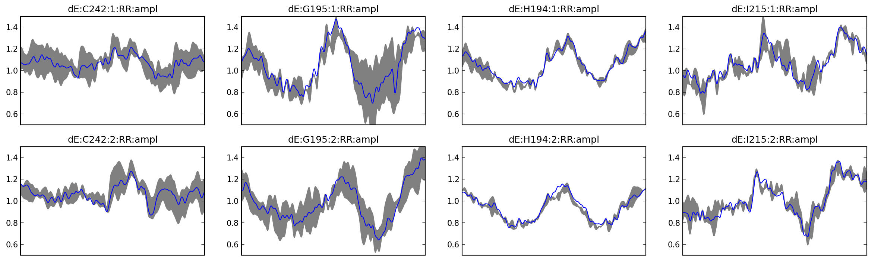
Better Source Models
(Courtesy M. Mitra & S. Makhathini)
Using MT-MFS do deconvolve with a multi-term frequency model
                Apply resulting
                spectral indices to calibration model
                Top: with spi
                Bottom:w/o spi

Slide 11
Better Deconvolution
New deconvolution algorithms coming of age
Compressive sensing
  SARA/PURIFY (Carrillo, Wiaux, McEwen)
  ...and see next slide
Bayesian image recovery
  Sutter et al.
  RESOLVE (Junklewitz 2013)

Slide 12
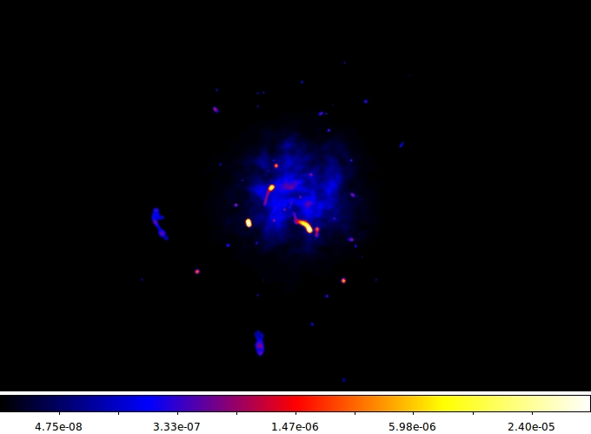
More Sane Deconvolution
(Courtesy A. Dabbech & C. Ferrari)
Simulated sky

Slide 13
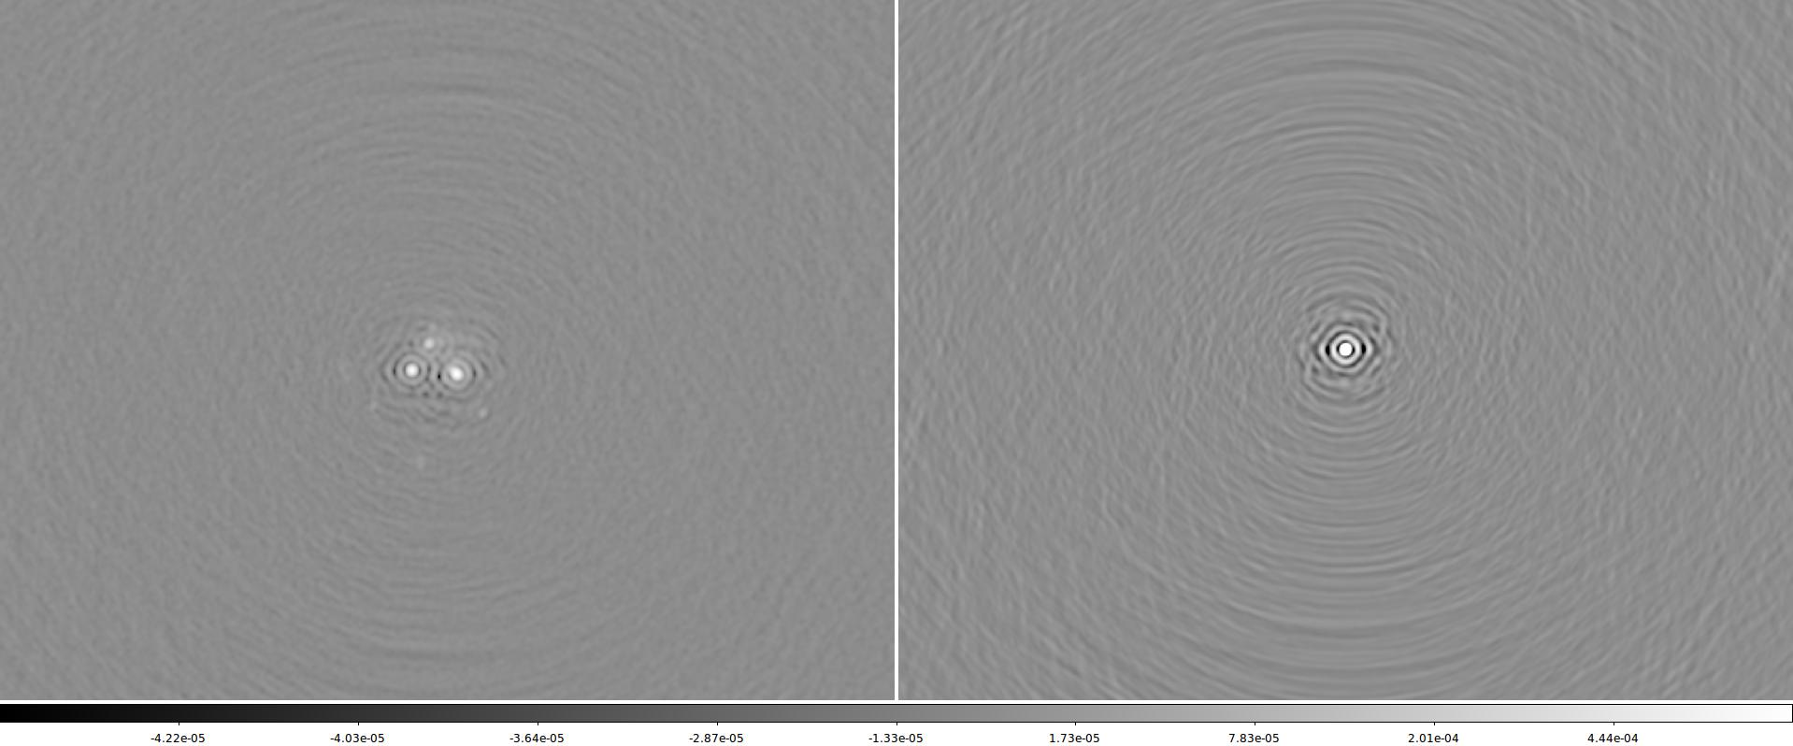
MeerKAT Dirty Image

Slide 14
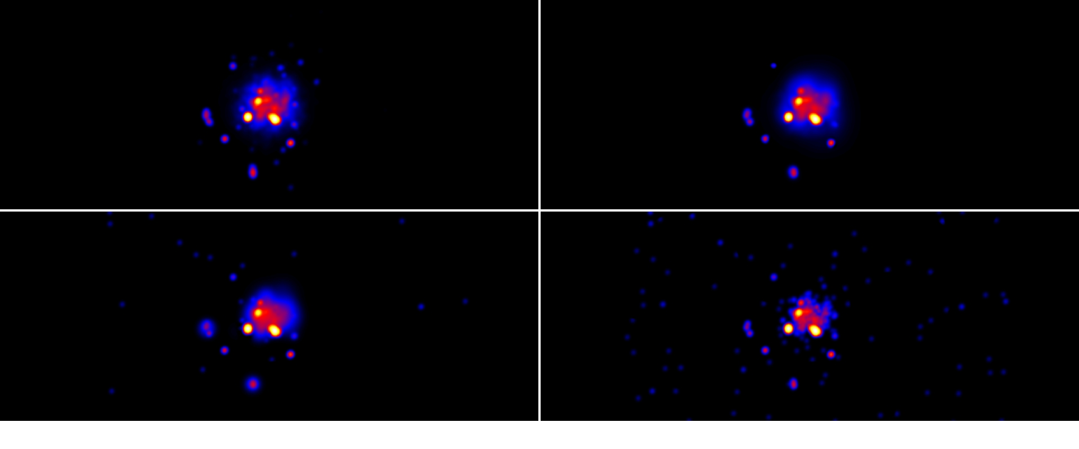
Deconvolved Images
True sky ● RB
MORESANE ● RB
MS-CLEAN ● RB
CLEAN ● RB

Slide 15
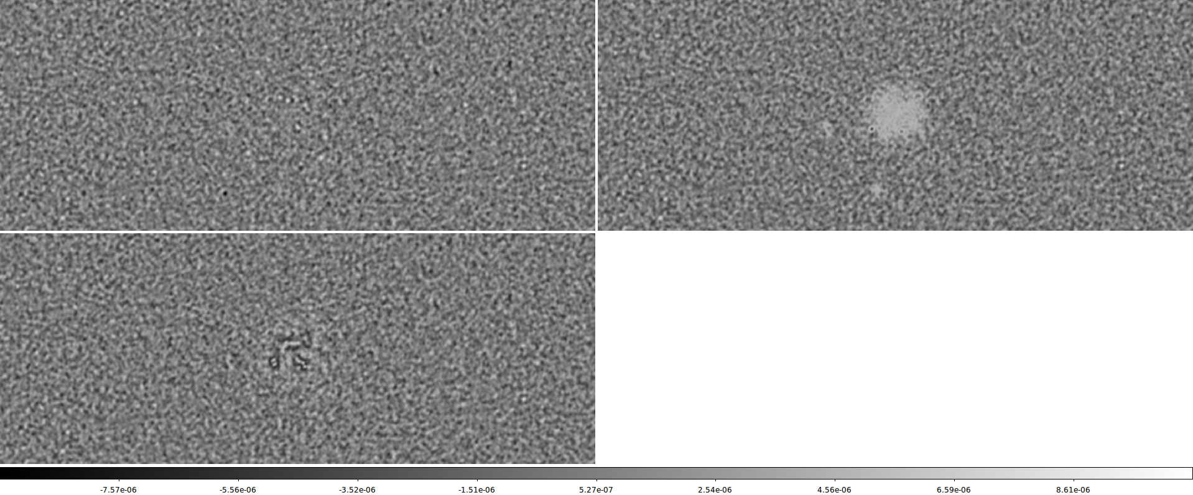
Residual Images

Slide 16
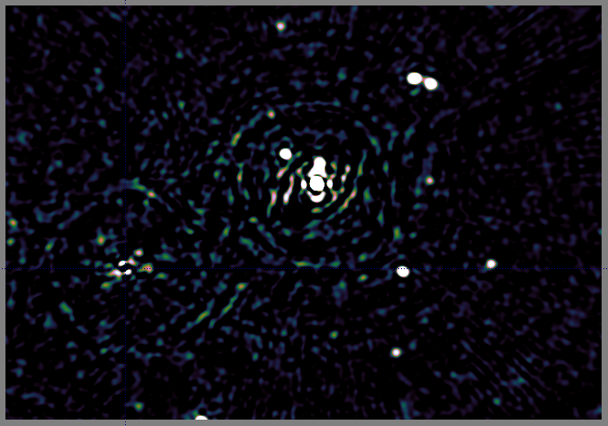
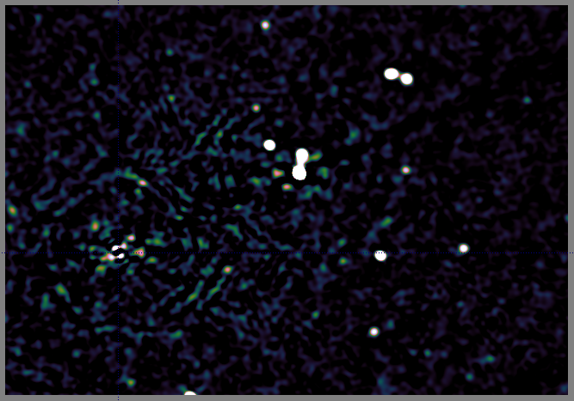
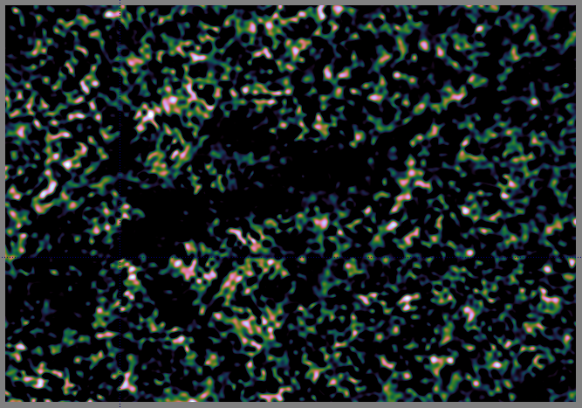
Works On Real Data, Too
Nasty neighbour
Bones of 3C147
Calibration
artefact

Slide 17
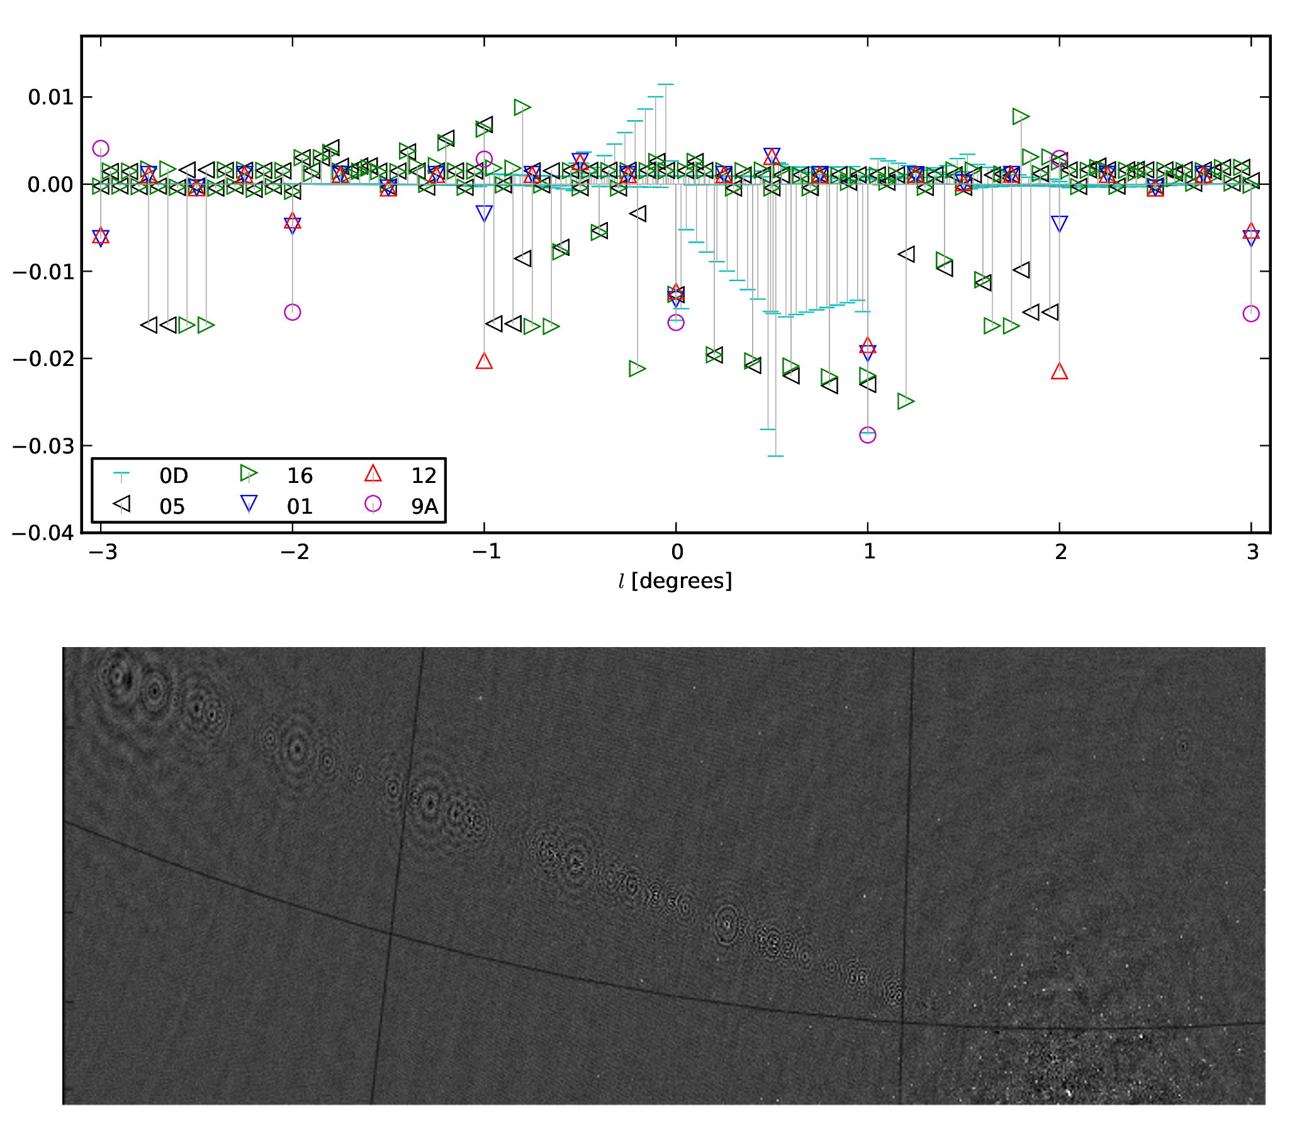
Ghosts
(Courtesy T. Grobler)

Slide 18
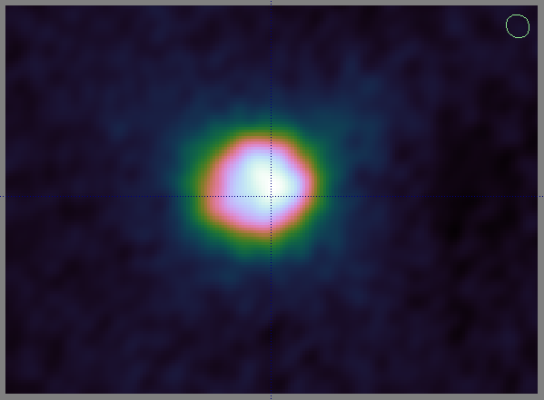
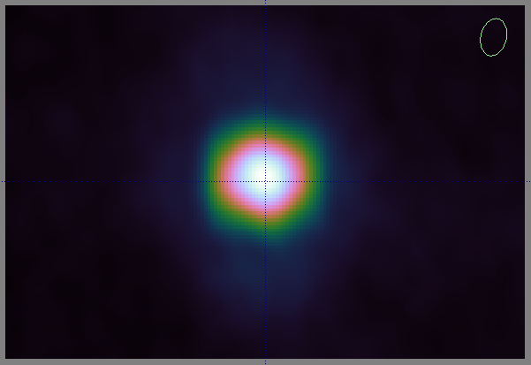
Sidelobe Confusion
CasA and CygA images ~60 and ~90deg off-axis
Guess the instrument...

Slide 19


MeerKAT/KAT-7 Sidelobes
KAT-7
MeerKAT

Slide 20
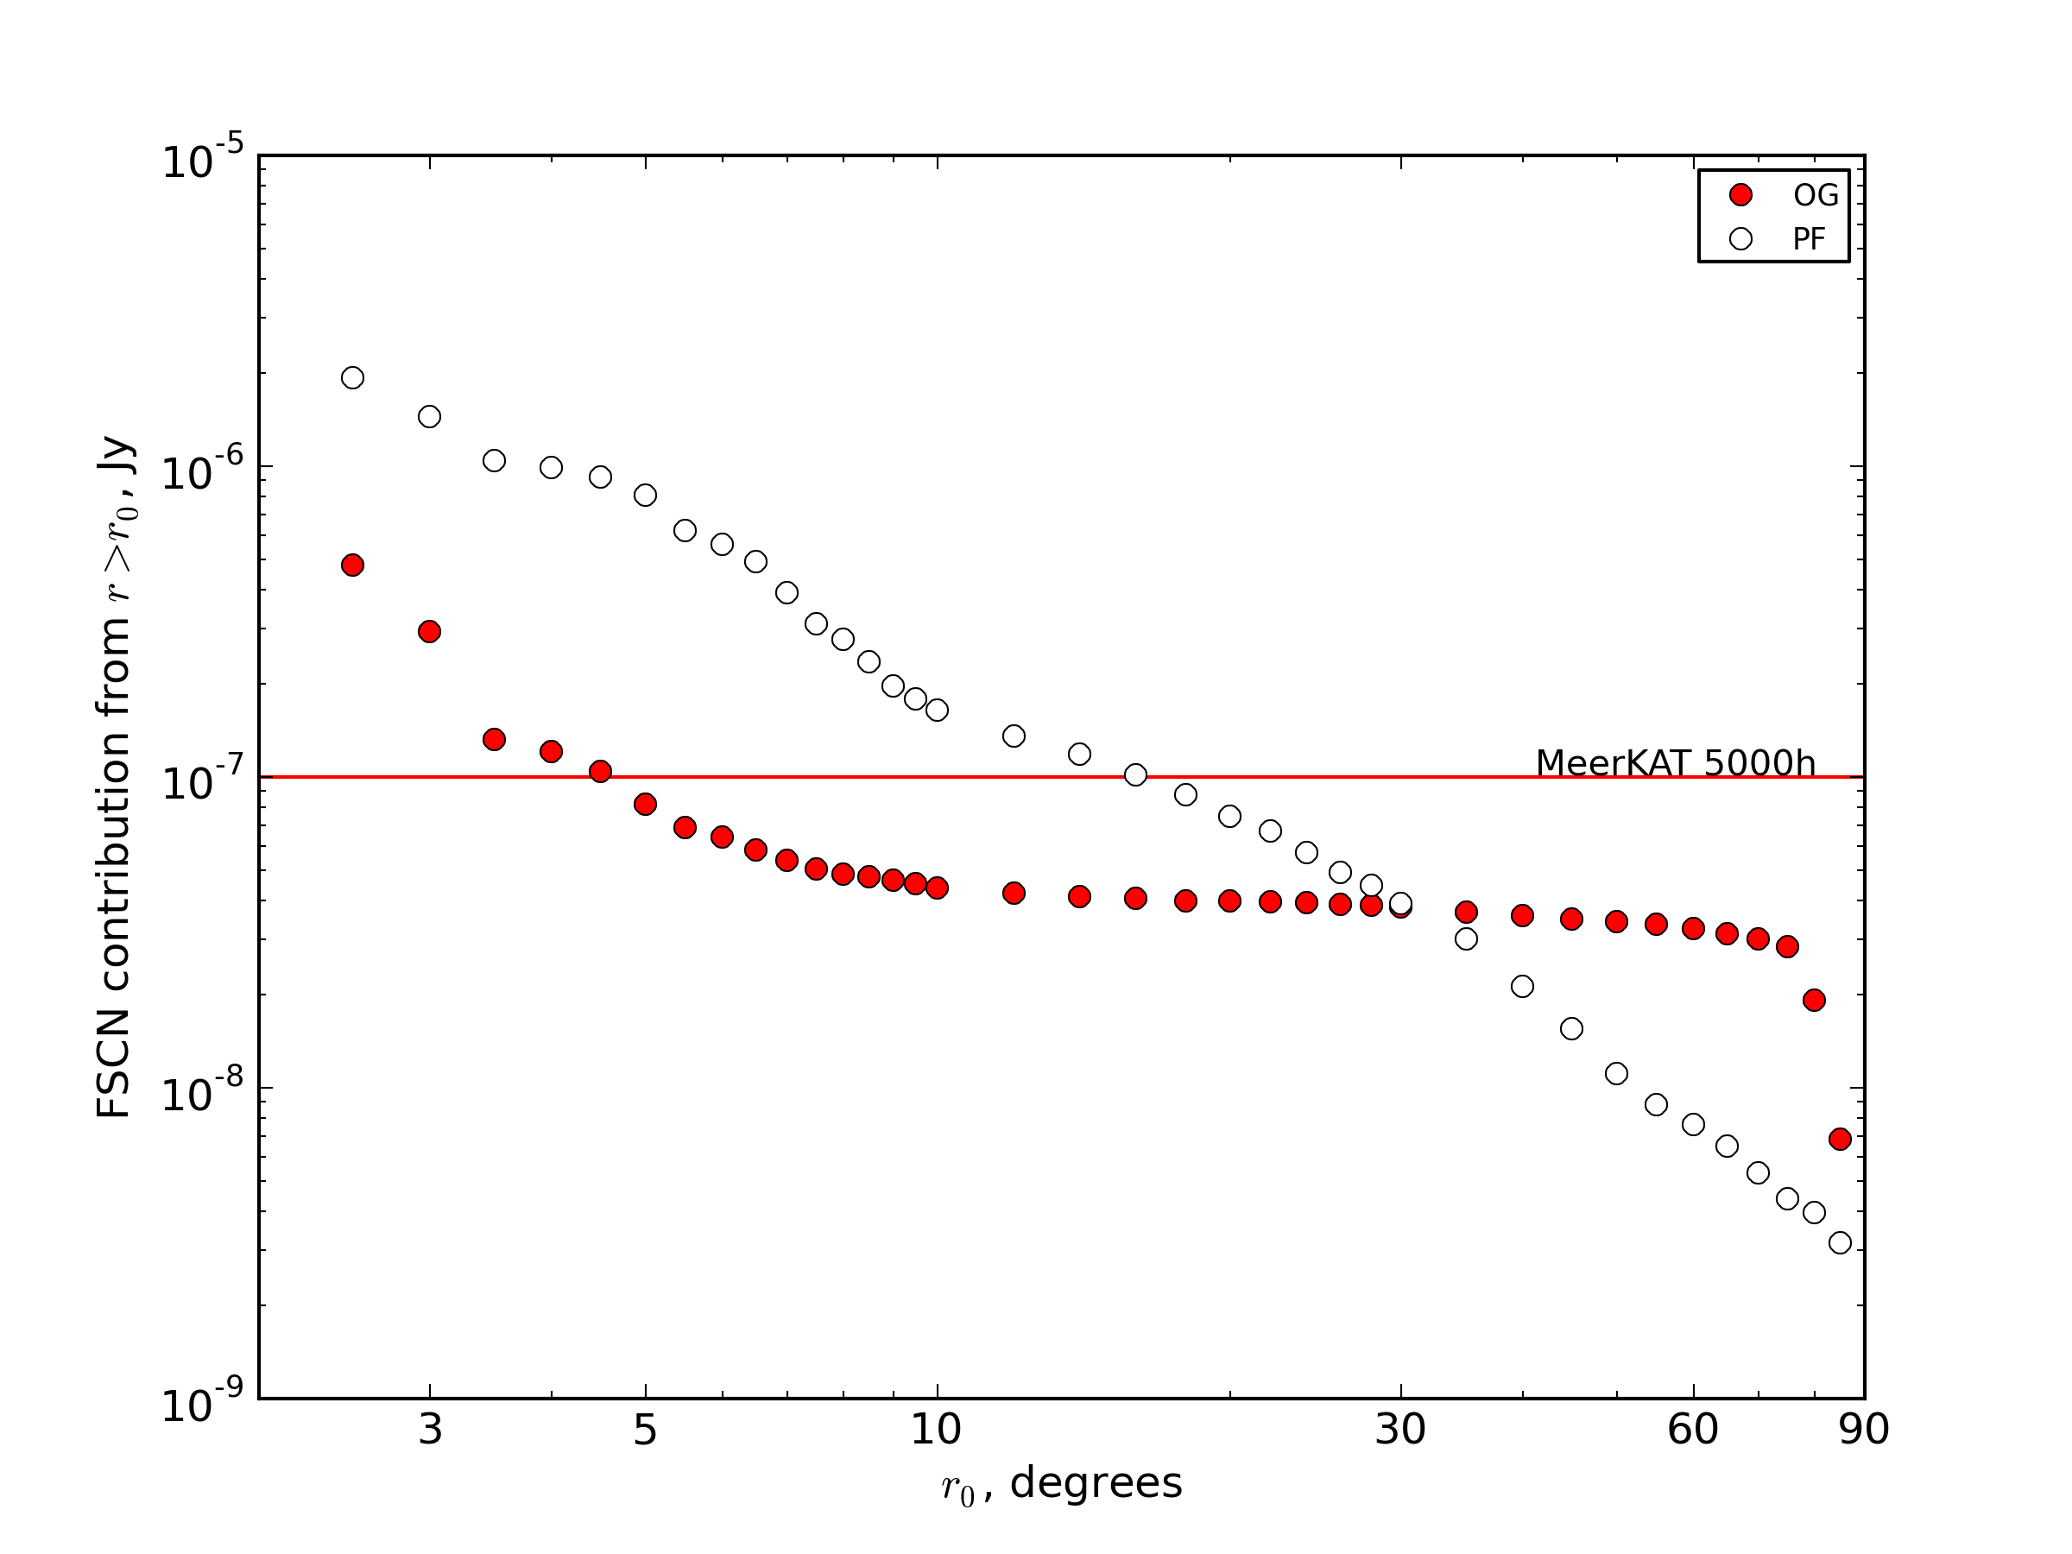
SCN Cost Curves
This shows, as a function of r, the SCN contribution from sources r≥r₀
i.e. how far out do
we have to image
& deconvolve
to drive SCN
below a given
level?

Slide 21
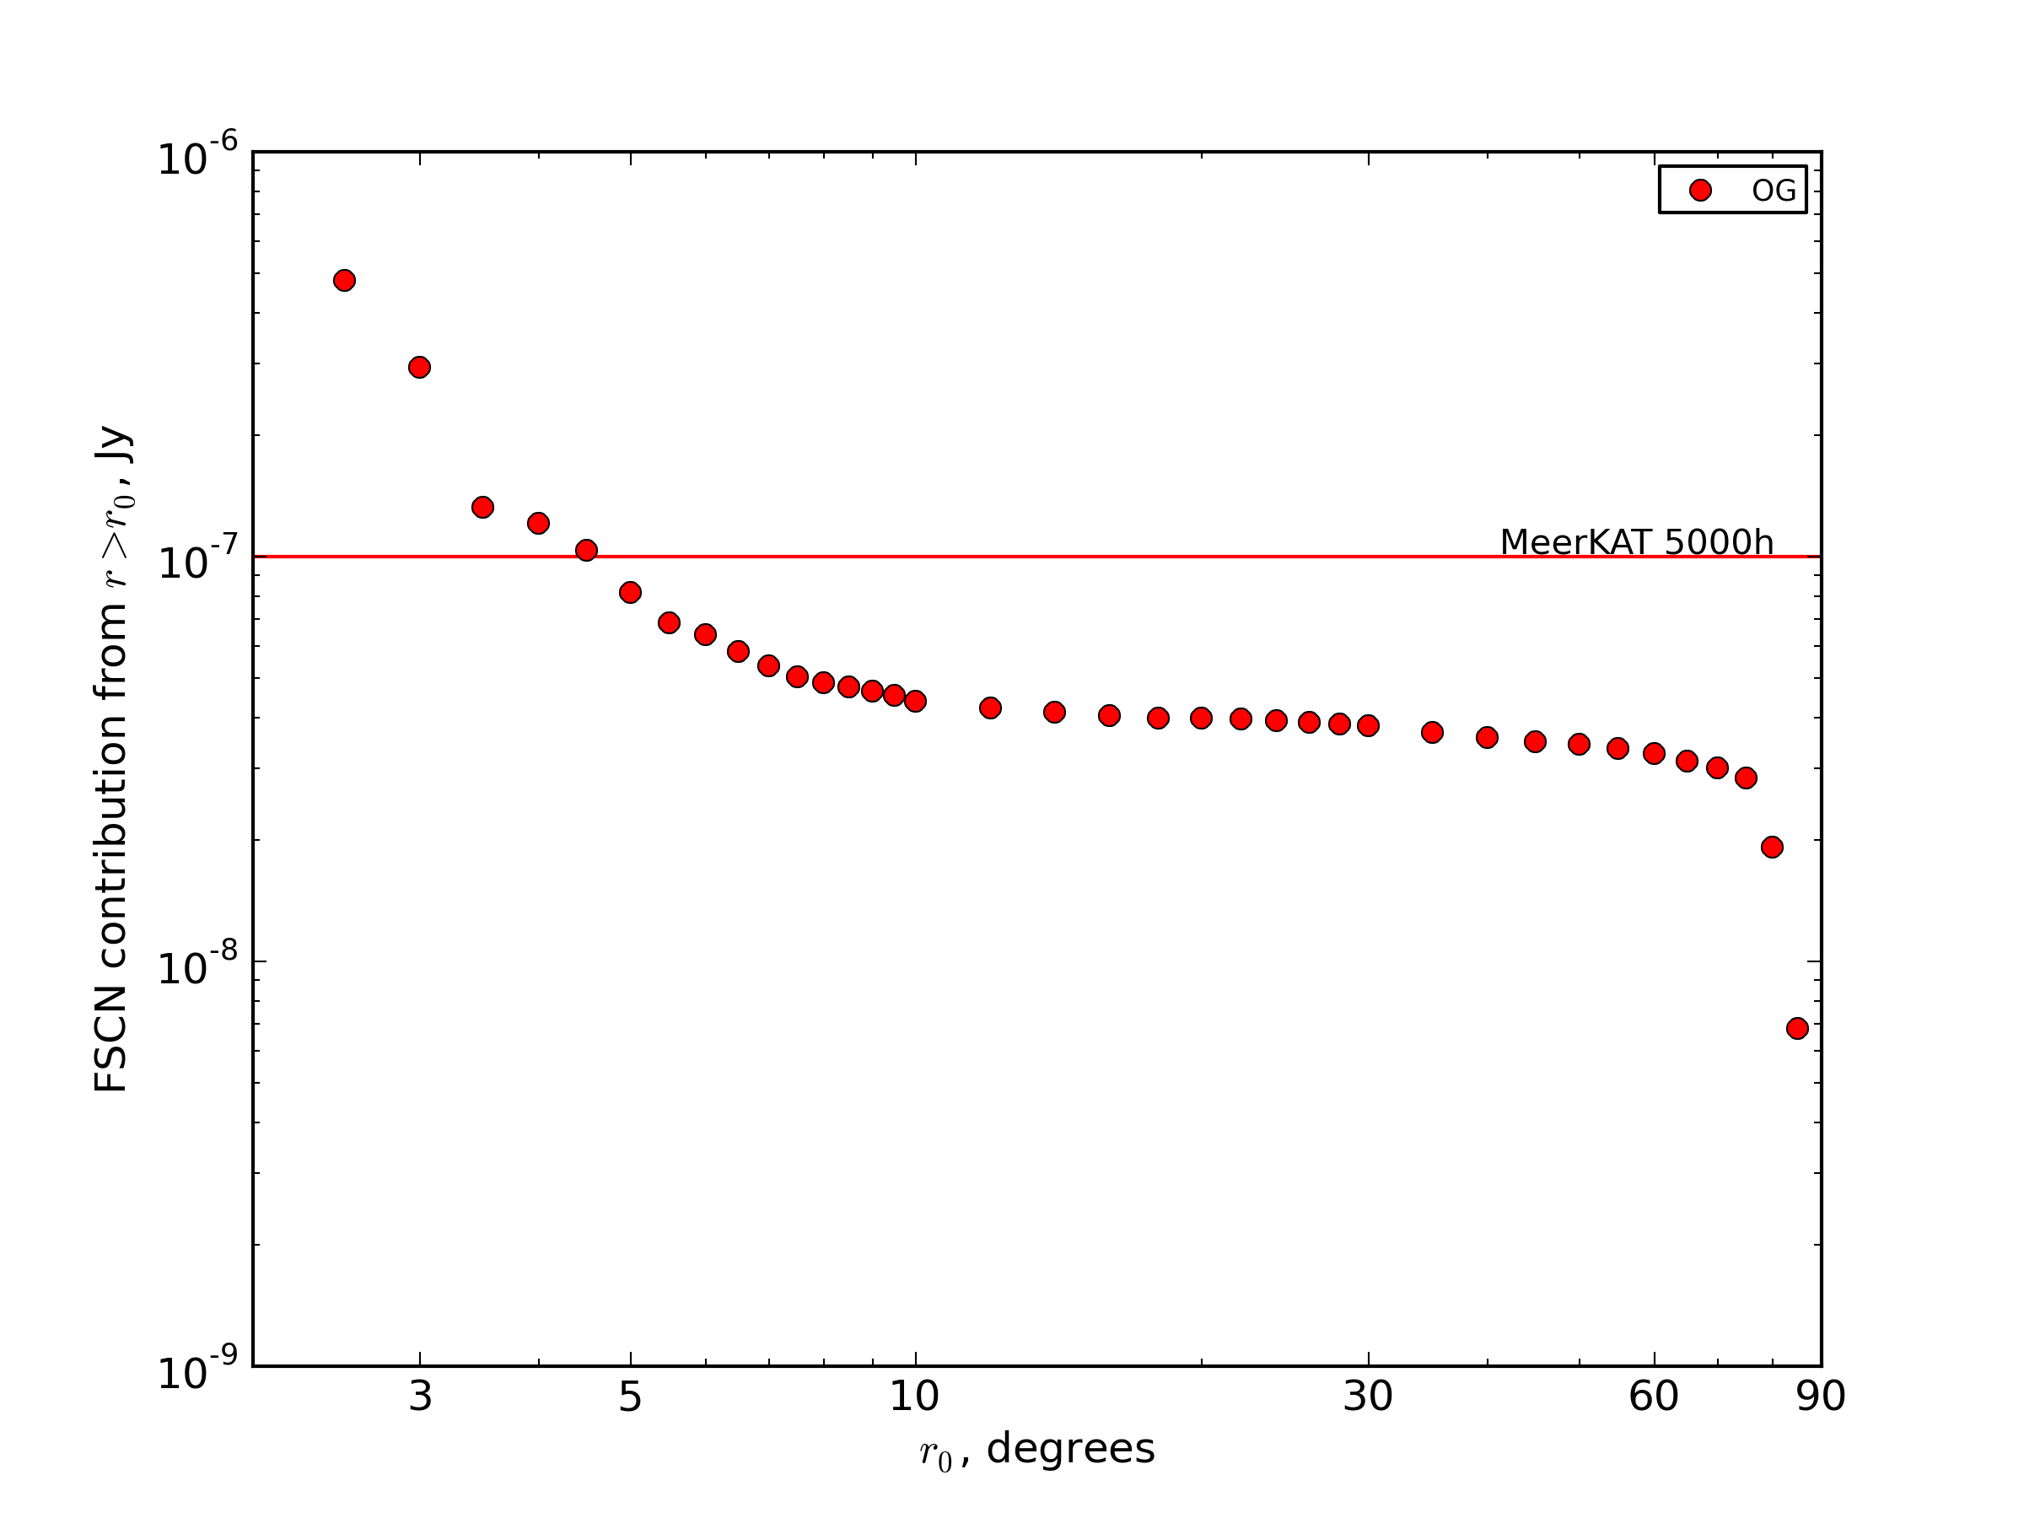
Cost Curve: Offset Gregorians

Slide 22
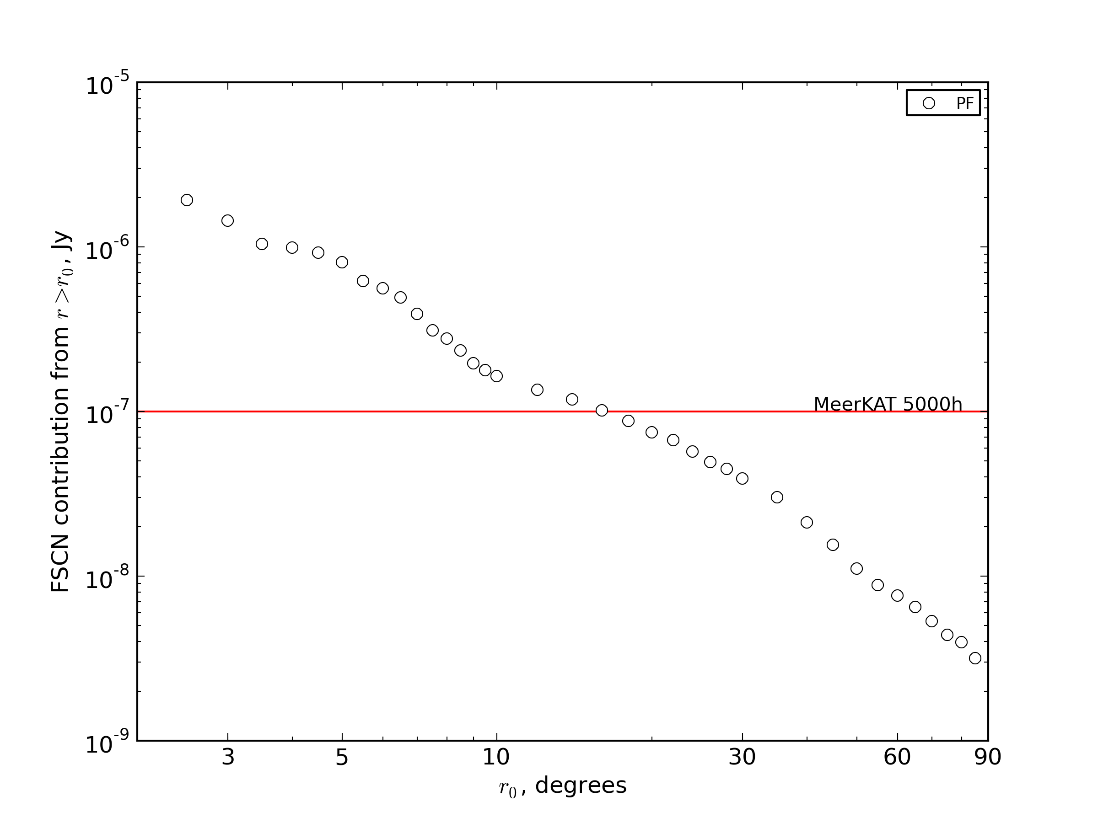
Cost Curve: Prime focus

Slide 23

The Picture For Many Dishes

Slide 24
What Determines FoV?
FoV = primary beam
  + sources coming in through the sidelobes
FoV = time/bandwidth averaging
  Off-centre sources get “smeared out” as the sampling point traverses the uv-plane
  Bad for in-field sources
  Good for sidelobe sources

Slide 25
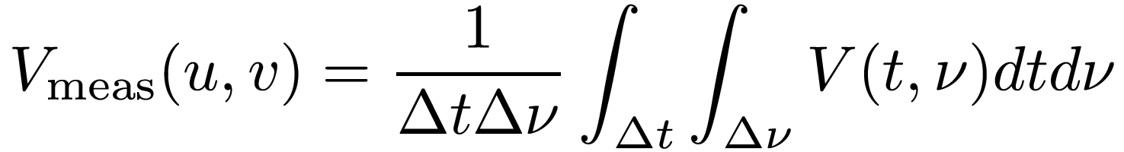
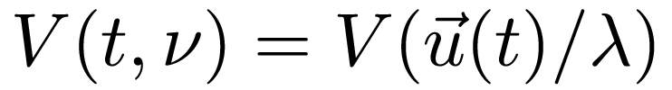
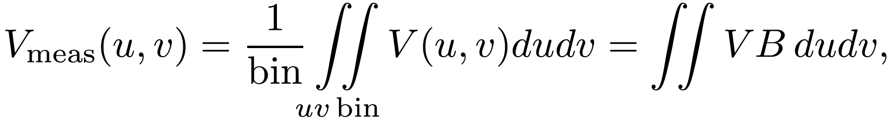
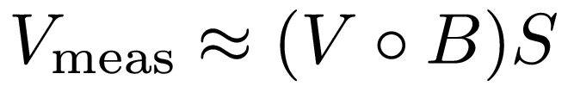
What Causes Averaging
Averaging:
where B is a boxcar (“tophat”) function for the bin. This is a convolution:

Slide 26
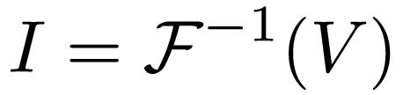
Averaging ≈ Convolution
Smearing
response
R

Slide 27
Windowing Functions
The smearing response R(l,m) = F⁻¹(B) falls off too rapidly/not rapidly enough
So, why not play with B to optimize smearing response?
  Replace it with some tunable windowing function W
  Bread-and-butter filter theory
The trade-off: increased thermal noise
  Noise is minimal when sum is unweighted

Slide 28
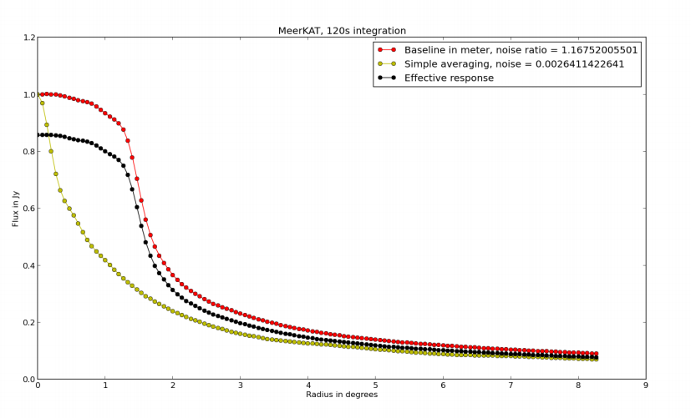
Early Results

Slide 29
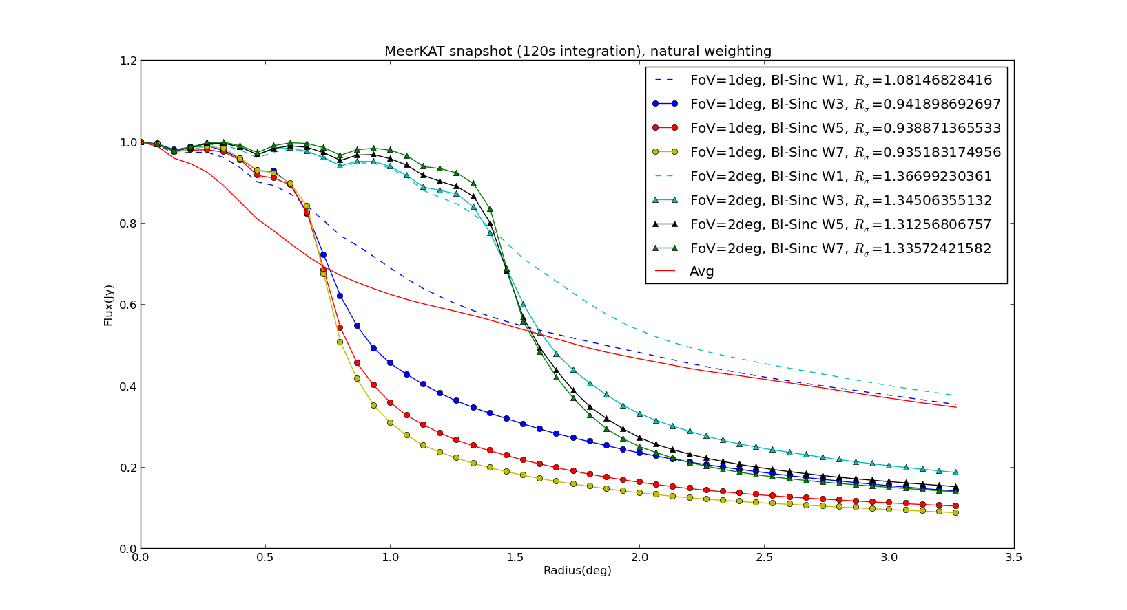
Results: Sinc Filter

Slide 30
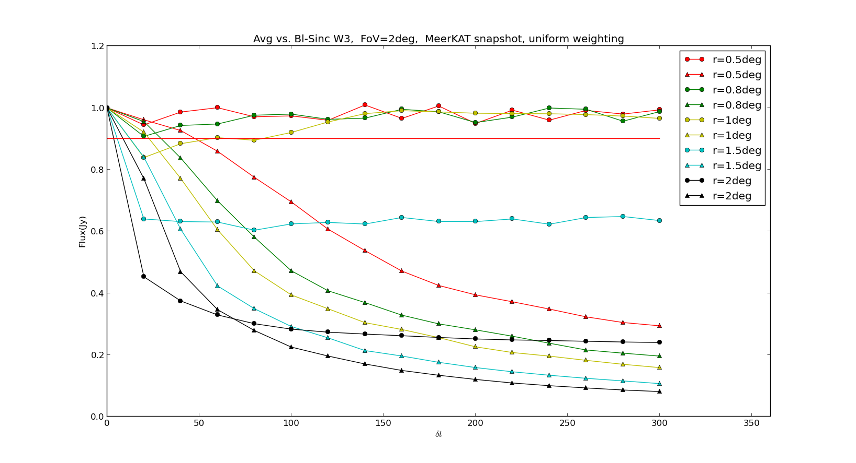
Increasing Integration Time

Slide 31
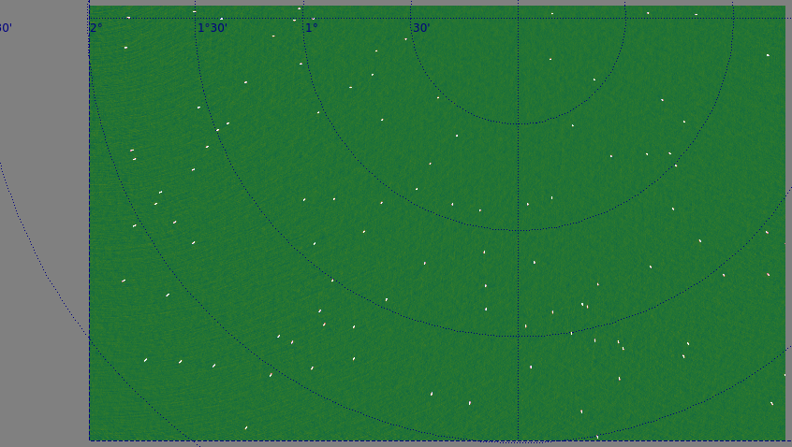
Normal Averaging
VLA-C, 5s 10MHz

Slide 32
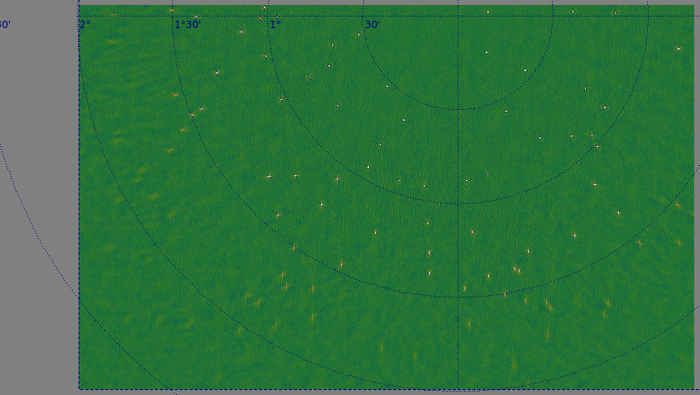
Sinc filter, FoV=2
VLA-C, 40s 50MHz

Slide 33
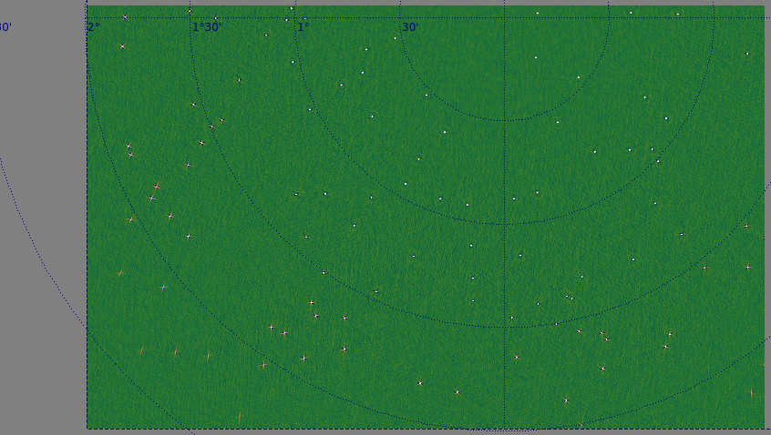
Sinc filter, FoV=3
VLA-C, 40s 50MHz

Slide 34
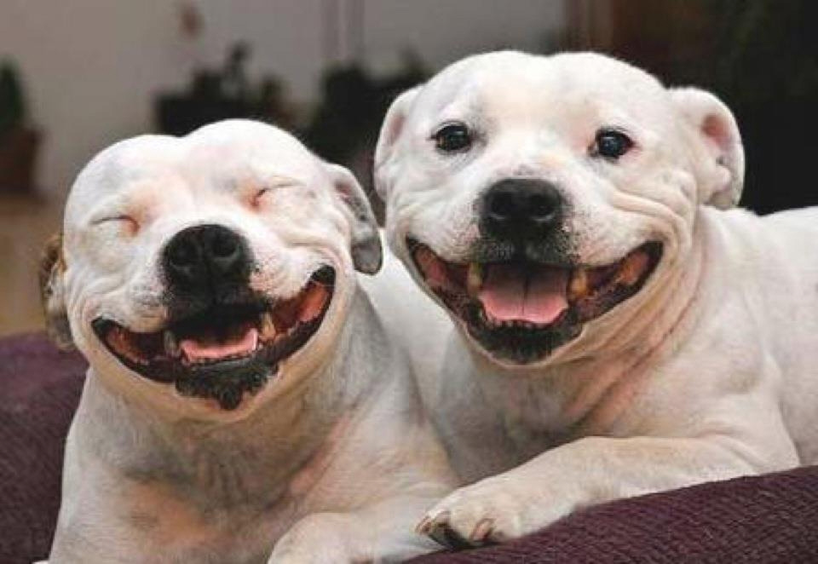
Conclusions
Prospects are good!

