Slide 1
SKA Array Layouts
& Weak Lensing
O. Smirnov (Rhodes & SKA SA)

Slide 2
Weak Lensing Requirements
Sensitivity at 0.5-1” scales
  Not the same thing as a 0.5” full-array PSF!
  BD longest baselines give ~0.25” limit
  Need 35-70 km @1100 MHz, 59-118 @650 MHz
  Could potentially “bring these in” and improve (or at least not degrade) WL performance
Examine alternative and rescaled layouts
Proper simulations expensive, so need to narrow down a few alternatives first

Slide 3
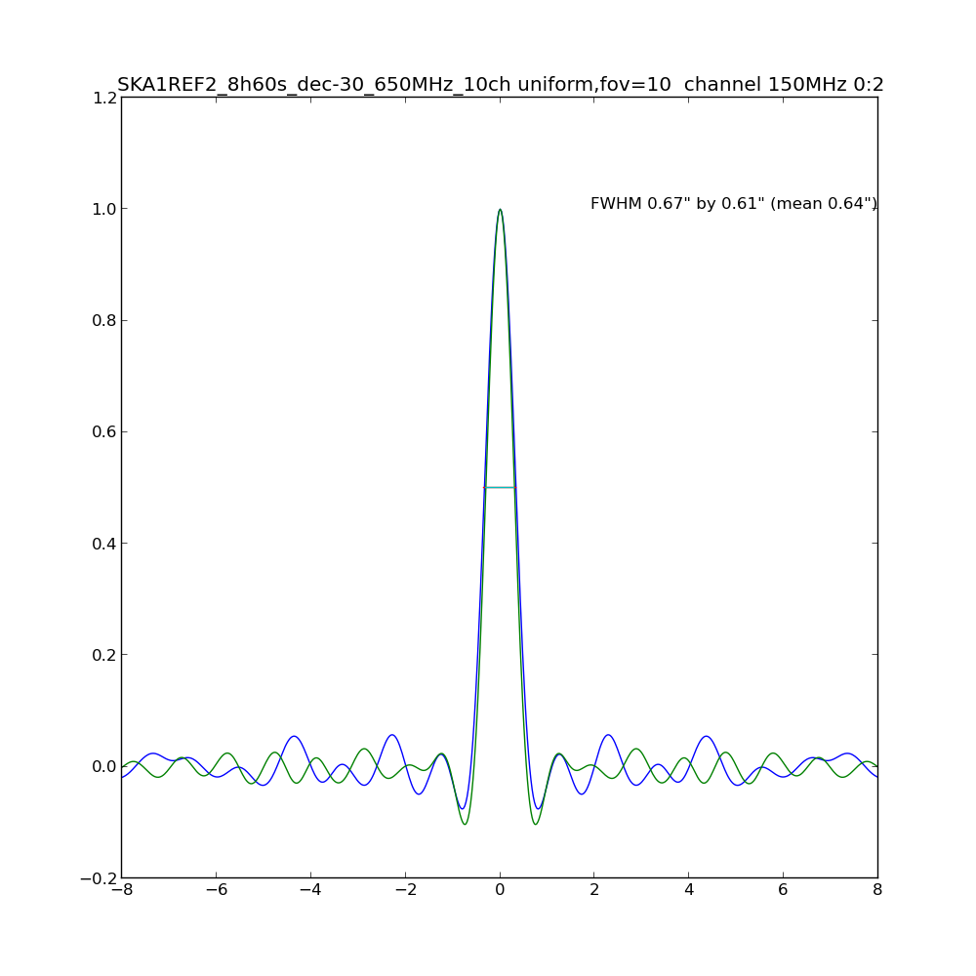
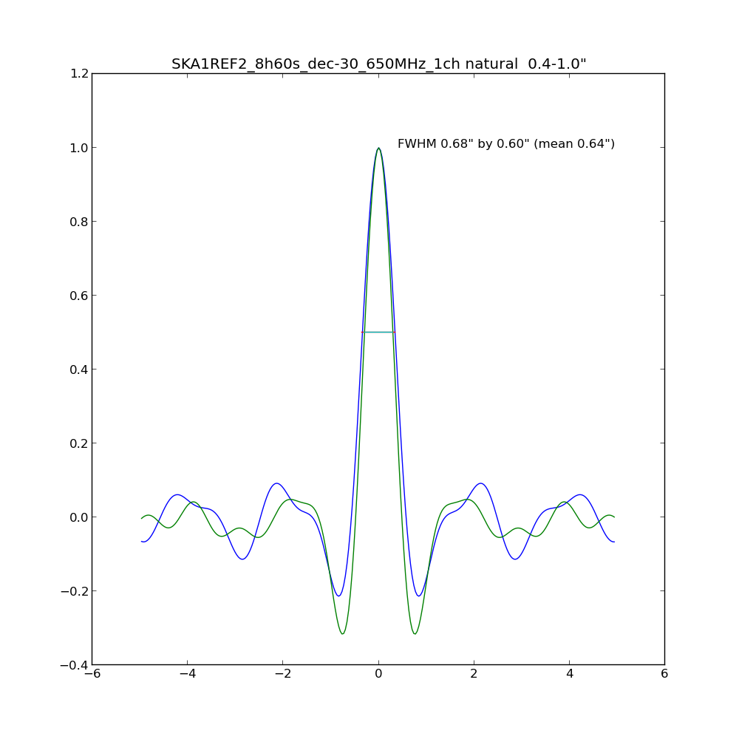
Full-array vs. subset PSFs

Slide 4
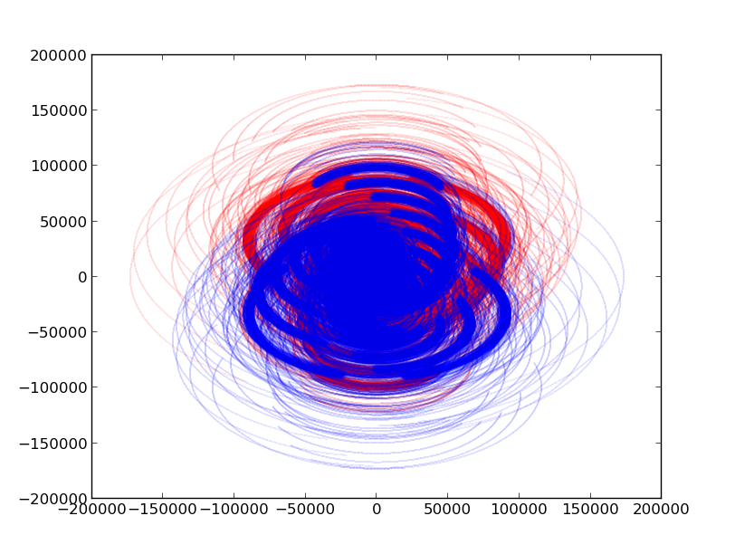
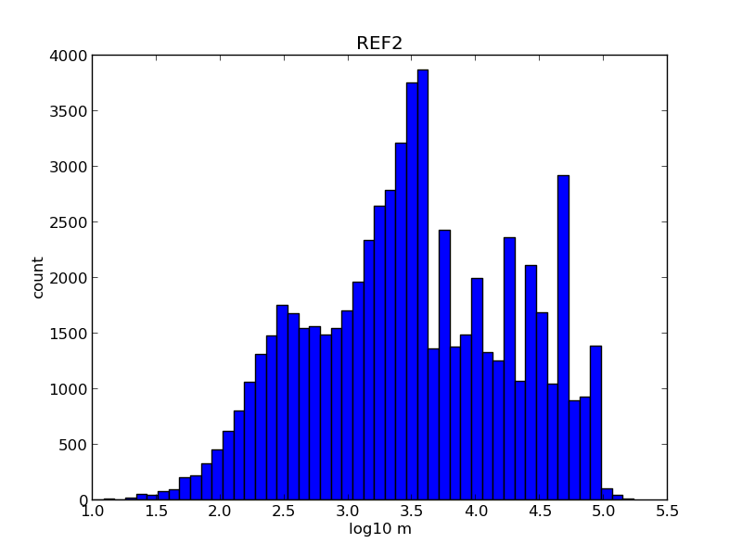
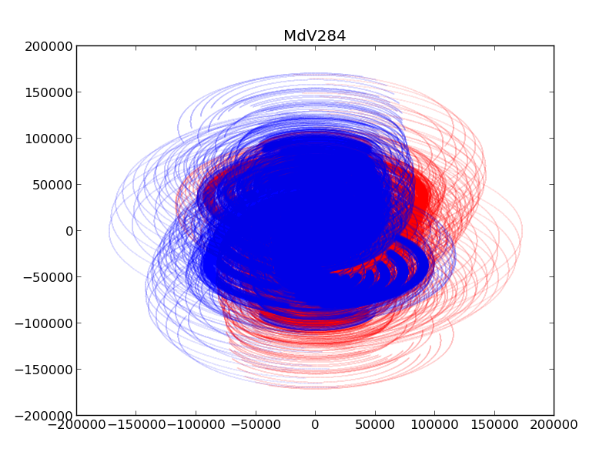
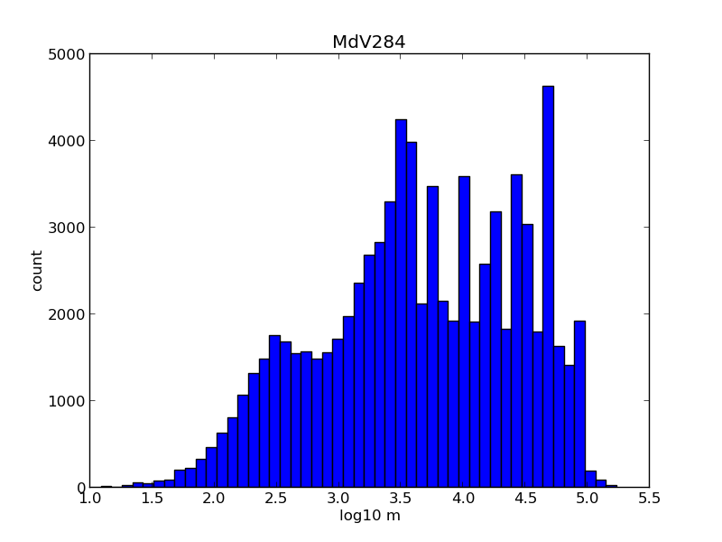
REF2 vs P30
(30 extra dishes)

Slide 5
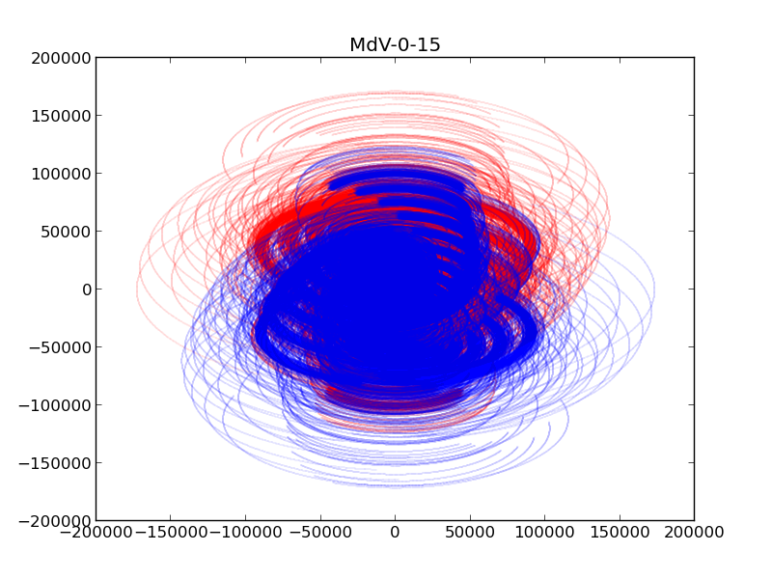
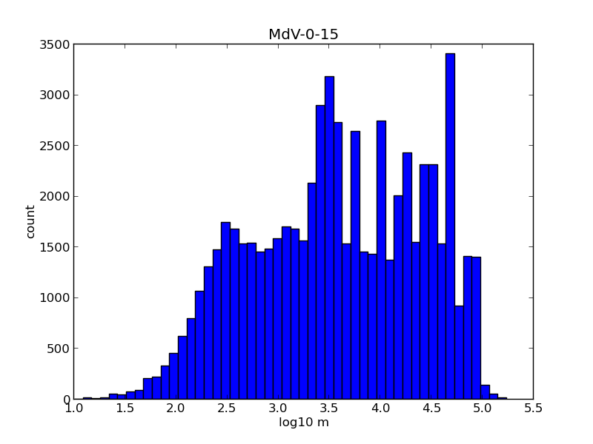
REF2 vs R15
(15 core dishes → arms)

Slide 6
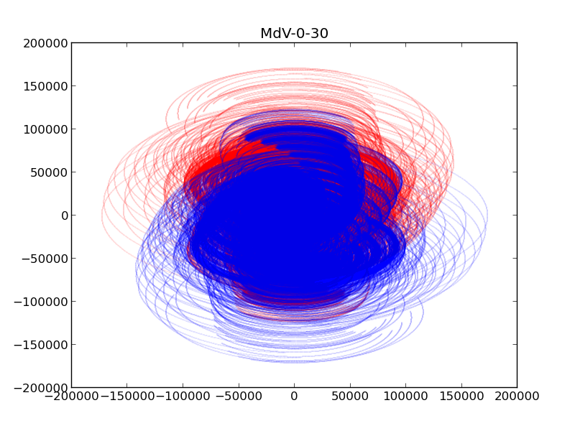
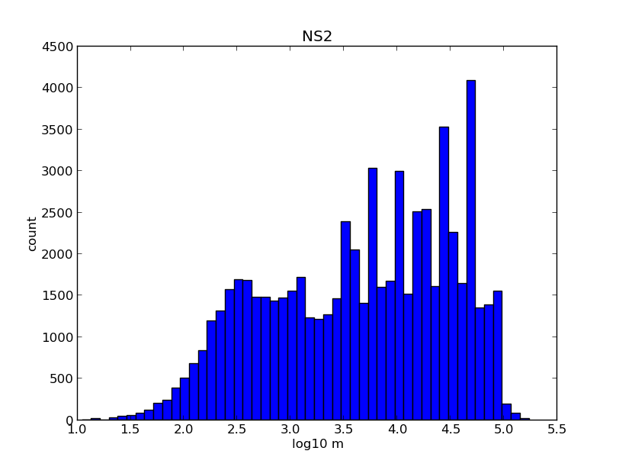
REF2 vs R30
(30 core dishes → arms)

Slide 7
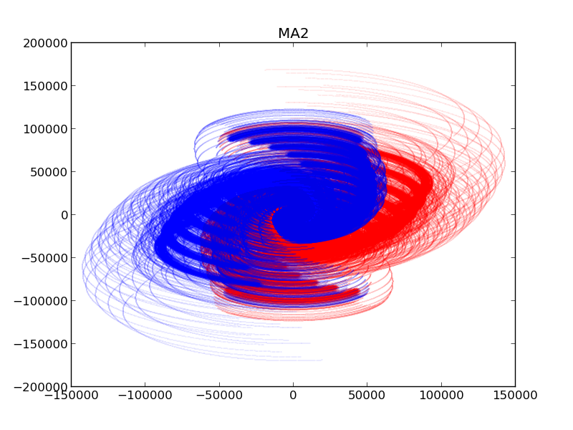
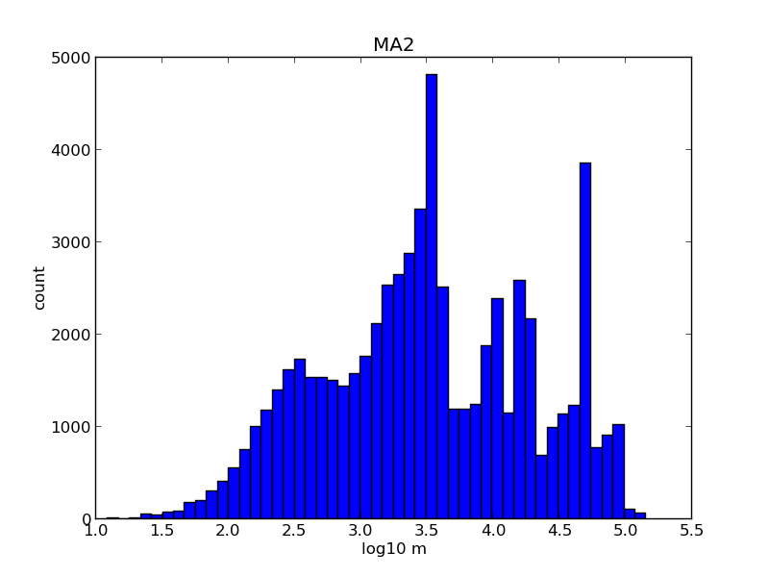
REF2 vs MA2
(two arms)

Slide 8
Rescaled Arrays
650 MHz |  | 800 MHz |  | 1100 MHz
a5 .5” | a7 .7” | b5 .5” | b7 .7” | c5 .5” | c7 .7”
~100km | ~72km | ~81km | ~58km | ~59km | ~42km
Naive attempt – geometrically rescale arms (not core!) to set the limiting resolution to 0.5” or 0.7”

Slide 9
Rules of thumb
How many hours do we need to observe a 10μJy⁽¹⁾ (@1100 MHz) source at SNR 10?
  That is, specifically at the 0.5-1” scales
  For reference: REF2, 8h, 50 MHz σ~0.92 μJy (total, naturally weighted)
Assume 500 MHz BW and -0.7 spectral index
  ~1.5x brighter @650 MHz (but lose resolution...)
Frequency/resolution trade-off
⁽¹⁾ actually less since some flux is resolved, factor ~2?

Slide 10
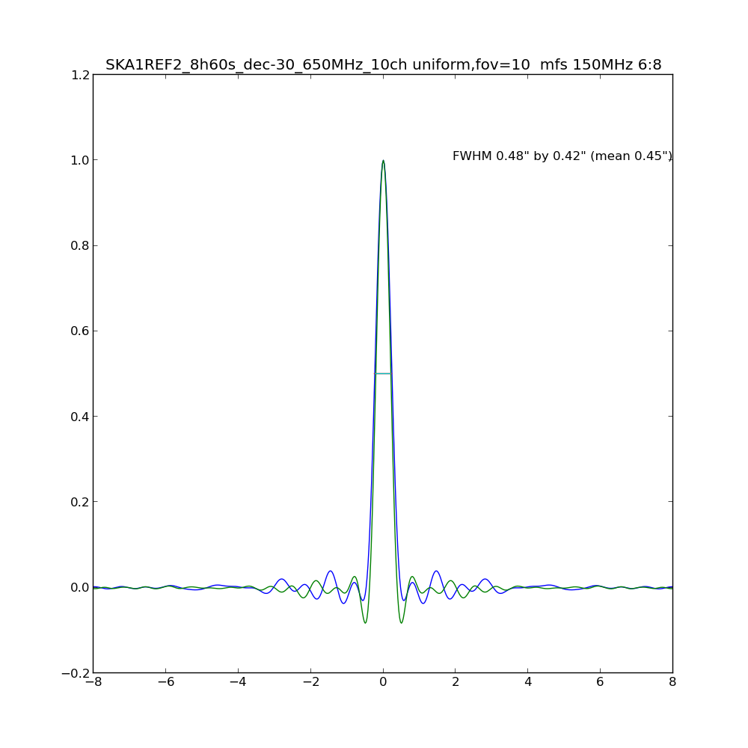
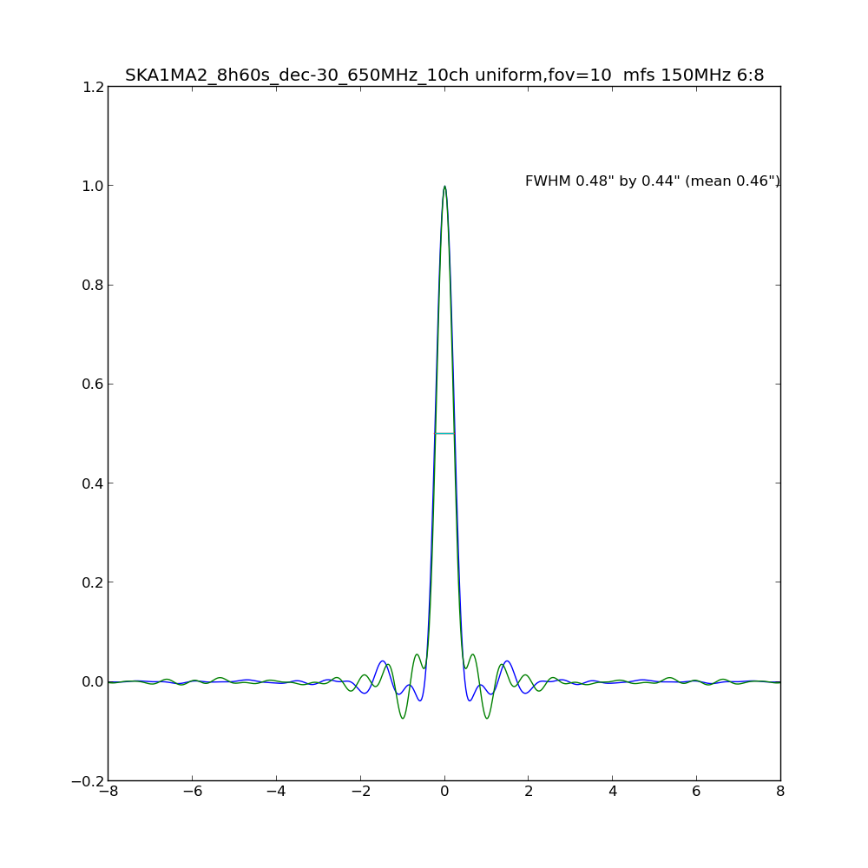
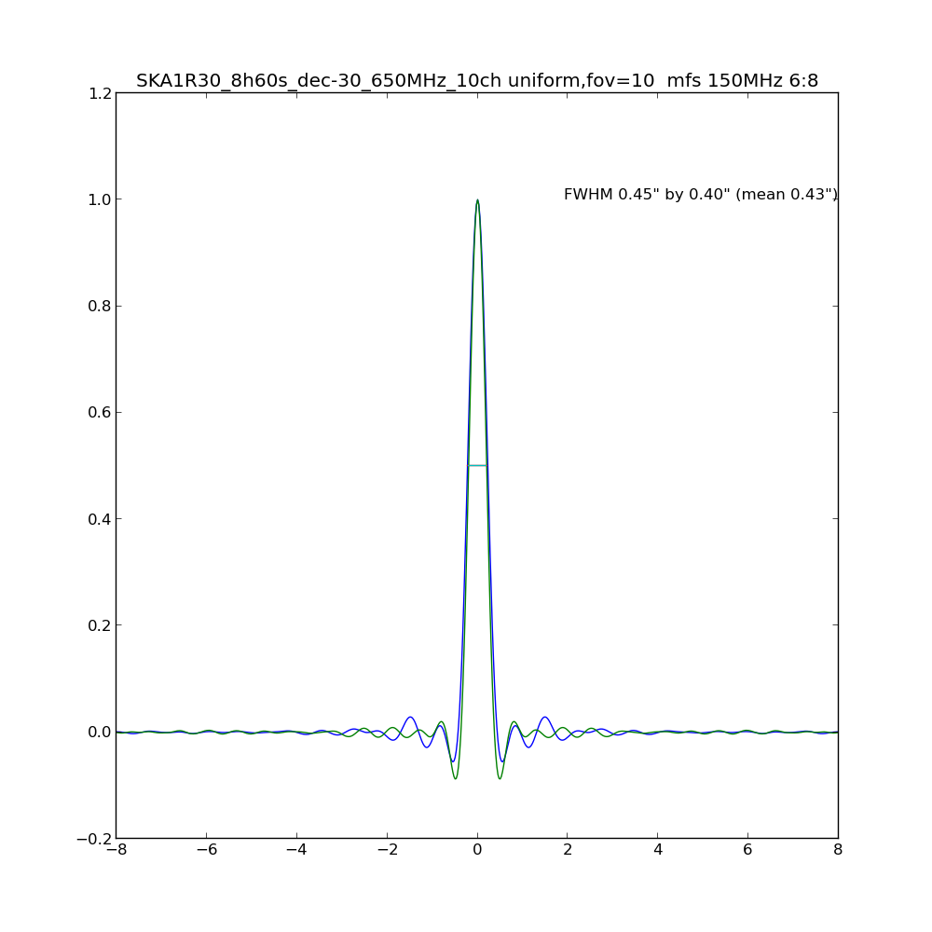
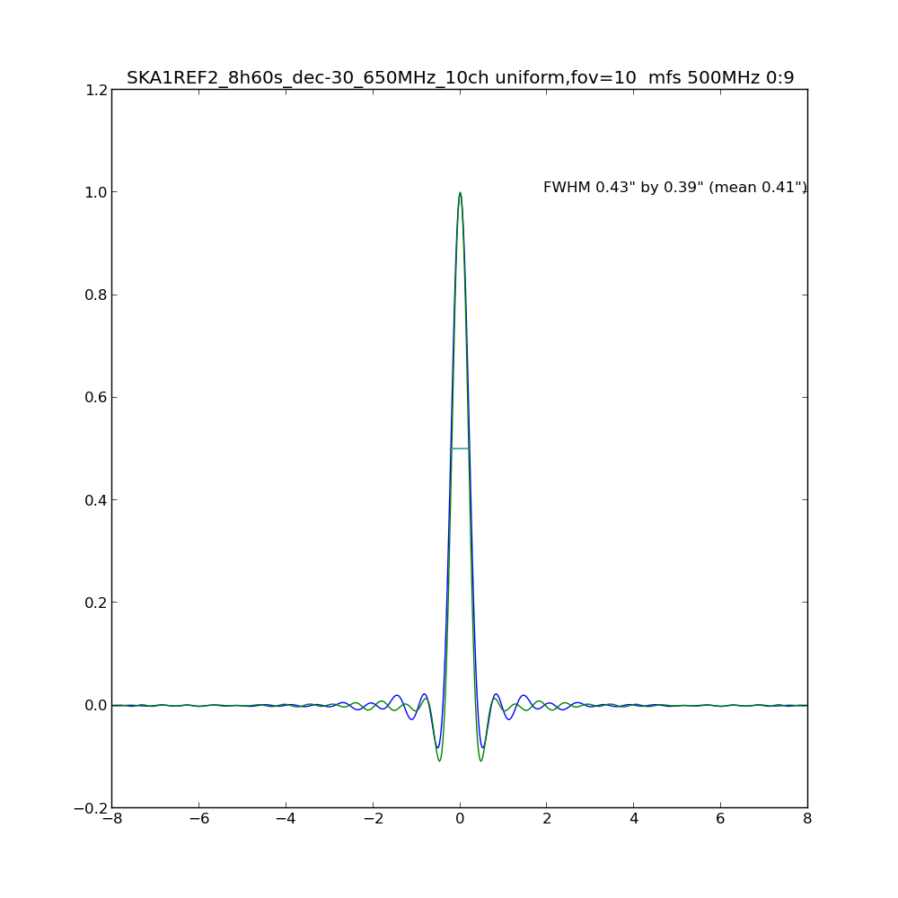
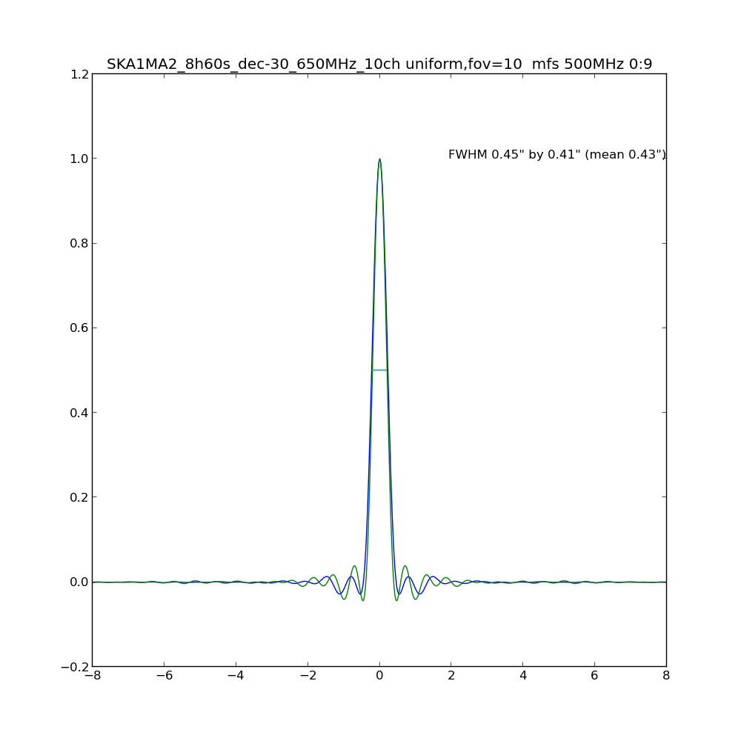
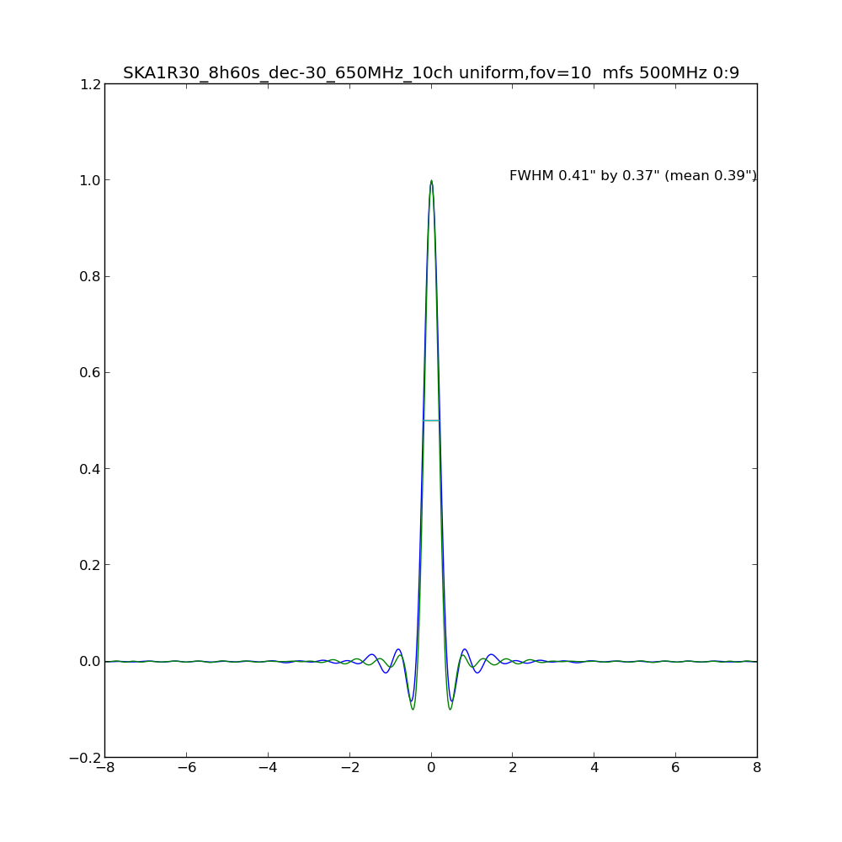
PSFs: REF2, MA2, R30
REF2
MA2
R30

Slide 11
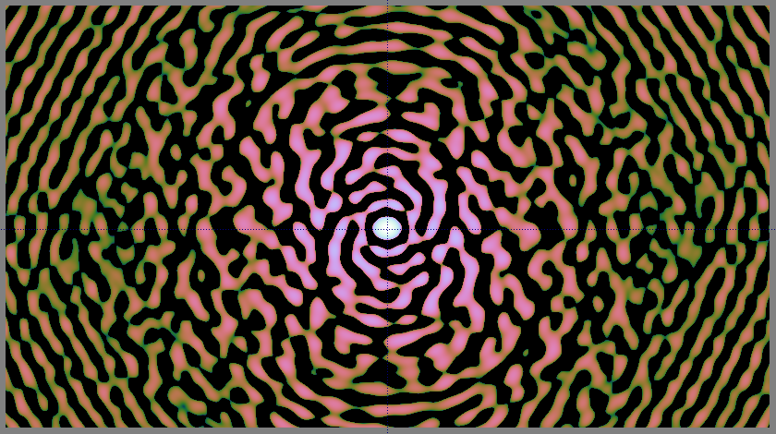
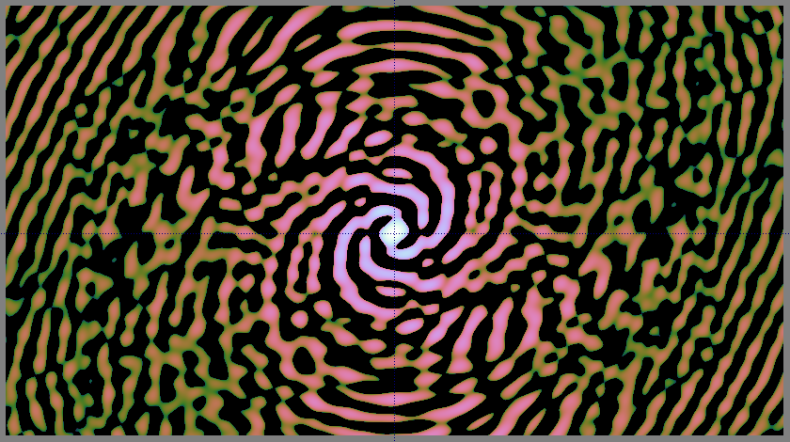
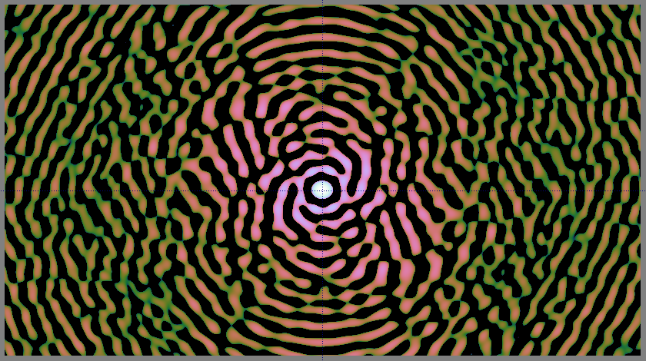
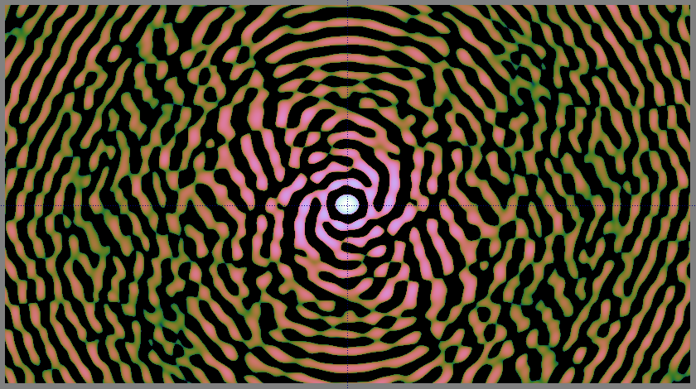
PSFs (to log scale)
REF2
MA2
R30
P30

Slide 12
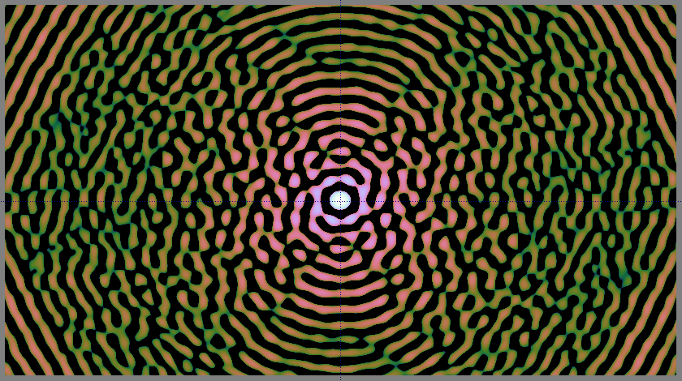
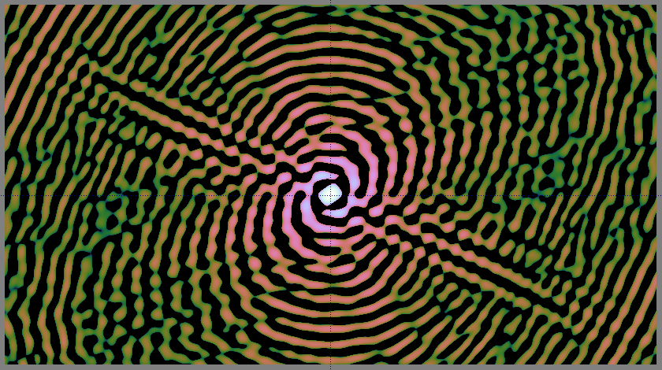
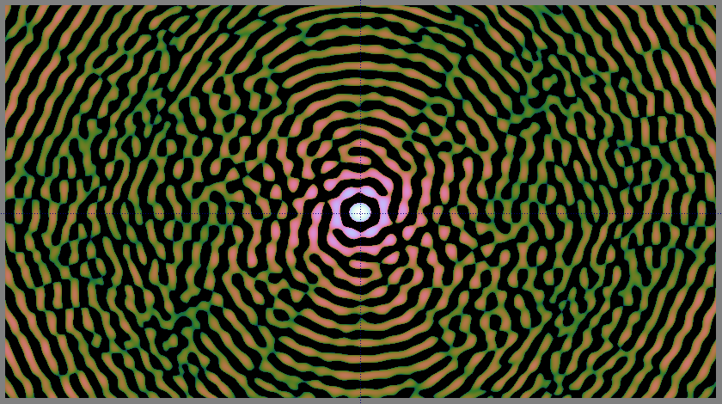
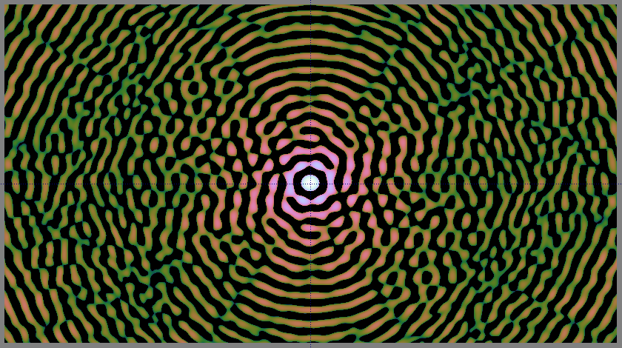
MSF PSFs (to log scale)
REF2
MA2
R30
P30

Slide 13
Results
Hours per pointing needed to reach SNR 10
  (may be x2 off)
5000 deg² survey: ~1700 pointings, 5-10 h/pp:
  1 to 2 years
But: layouts could be optimized further
REF2 | P30 | R15 | R30 | MA2 | R30a5
8.2-9.4 | 5.0-5.8 | 6.5-7.7 | 5.7-7.7 | 8.0-9.9 | 13.0-15.7

