Slide 1


TBD
O. Smirnov
(Rhodes Centre for Radio Astronomy
Techniques & Technologies
& SKA Africa)
BDT:
Beams, Data compression (& Deconvolution), Tasse (Cyril)

Slide 2
Part I: Beams & Far Sidelobe Confusion

Slide 3


MeerKAT/KAT-7 Sidelobes
KAT-7
MeerKAT

Slide 4
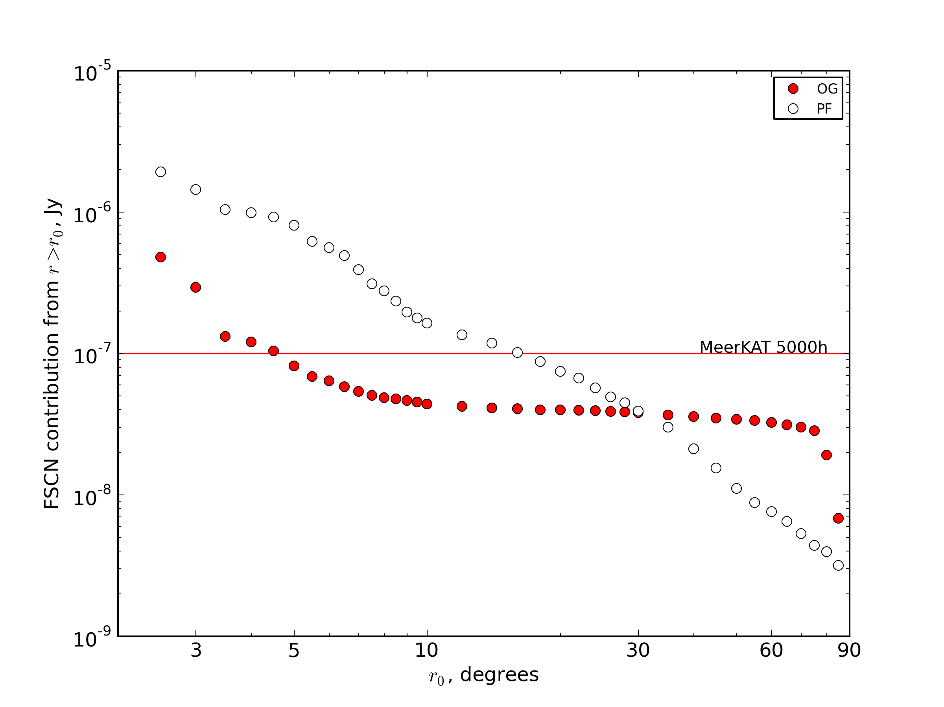
SCN Cost Curves
This shows, as a function of r, the SCN contribution from sources r≥r₀
i.e. how far out do
we have to image
& deconvolve
to drive SCN
below a given
level?

Slide 5
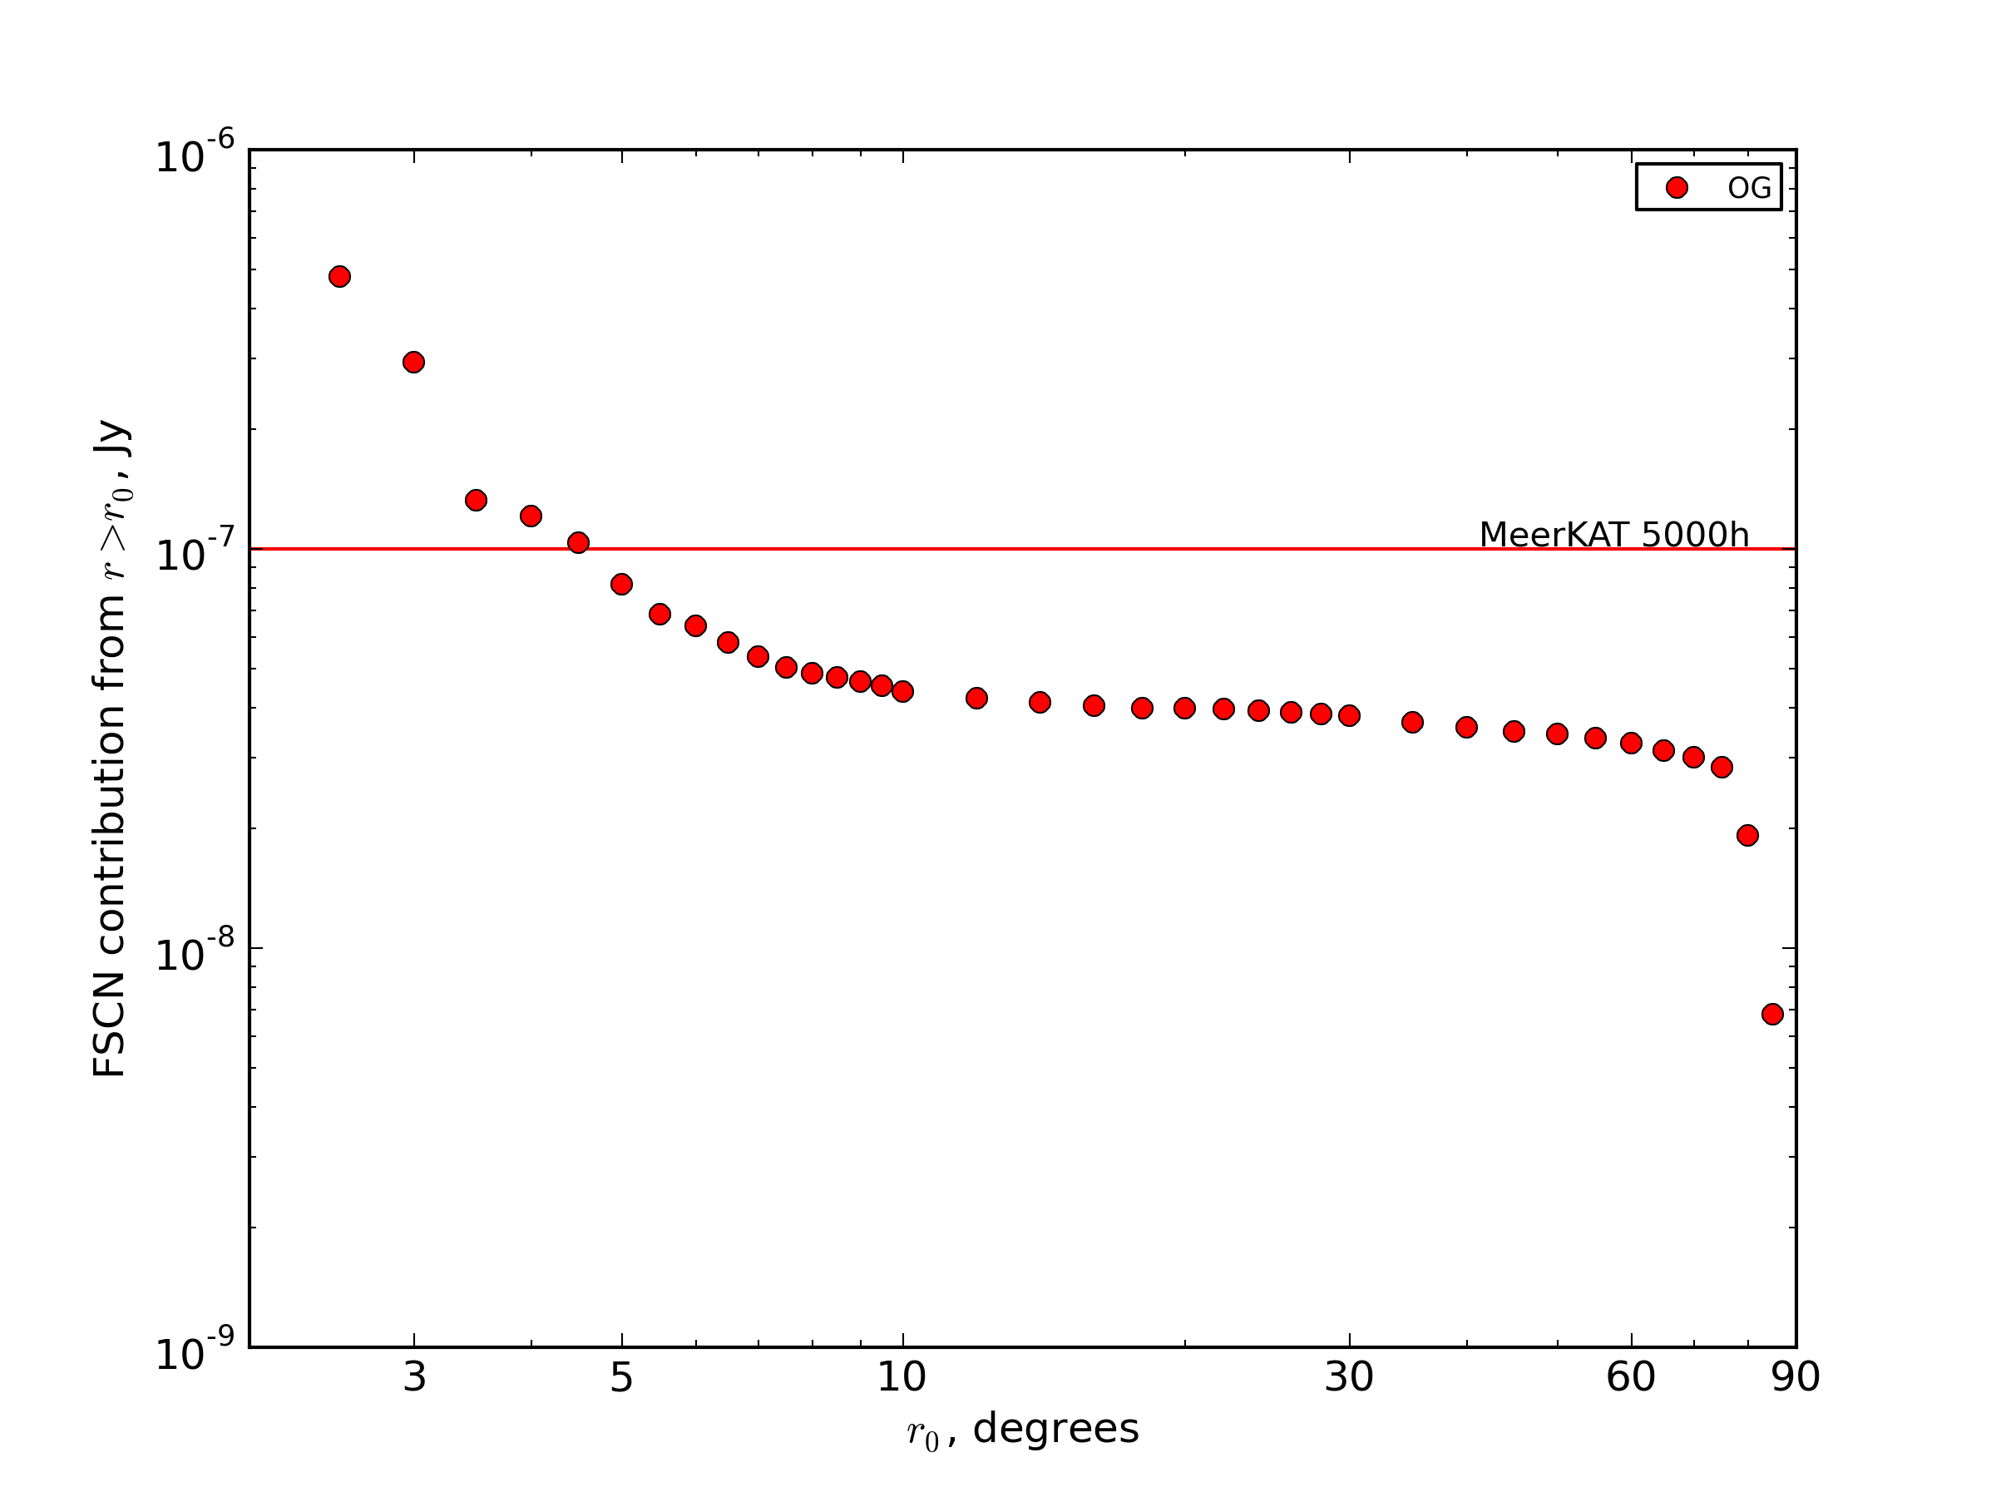
Cost Curve: Offset Gregorians

Slide 6
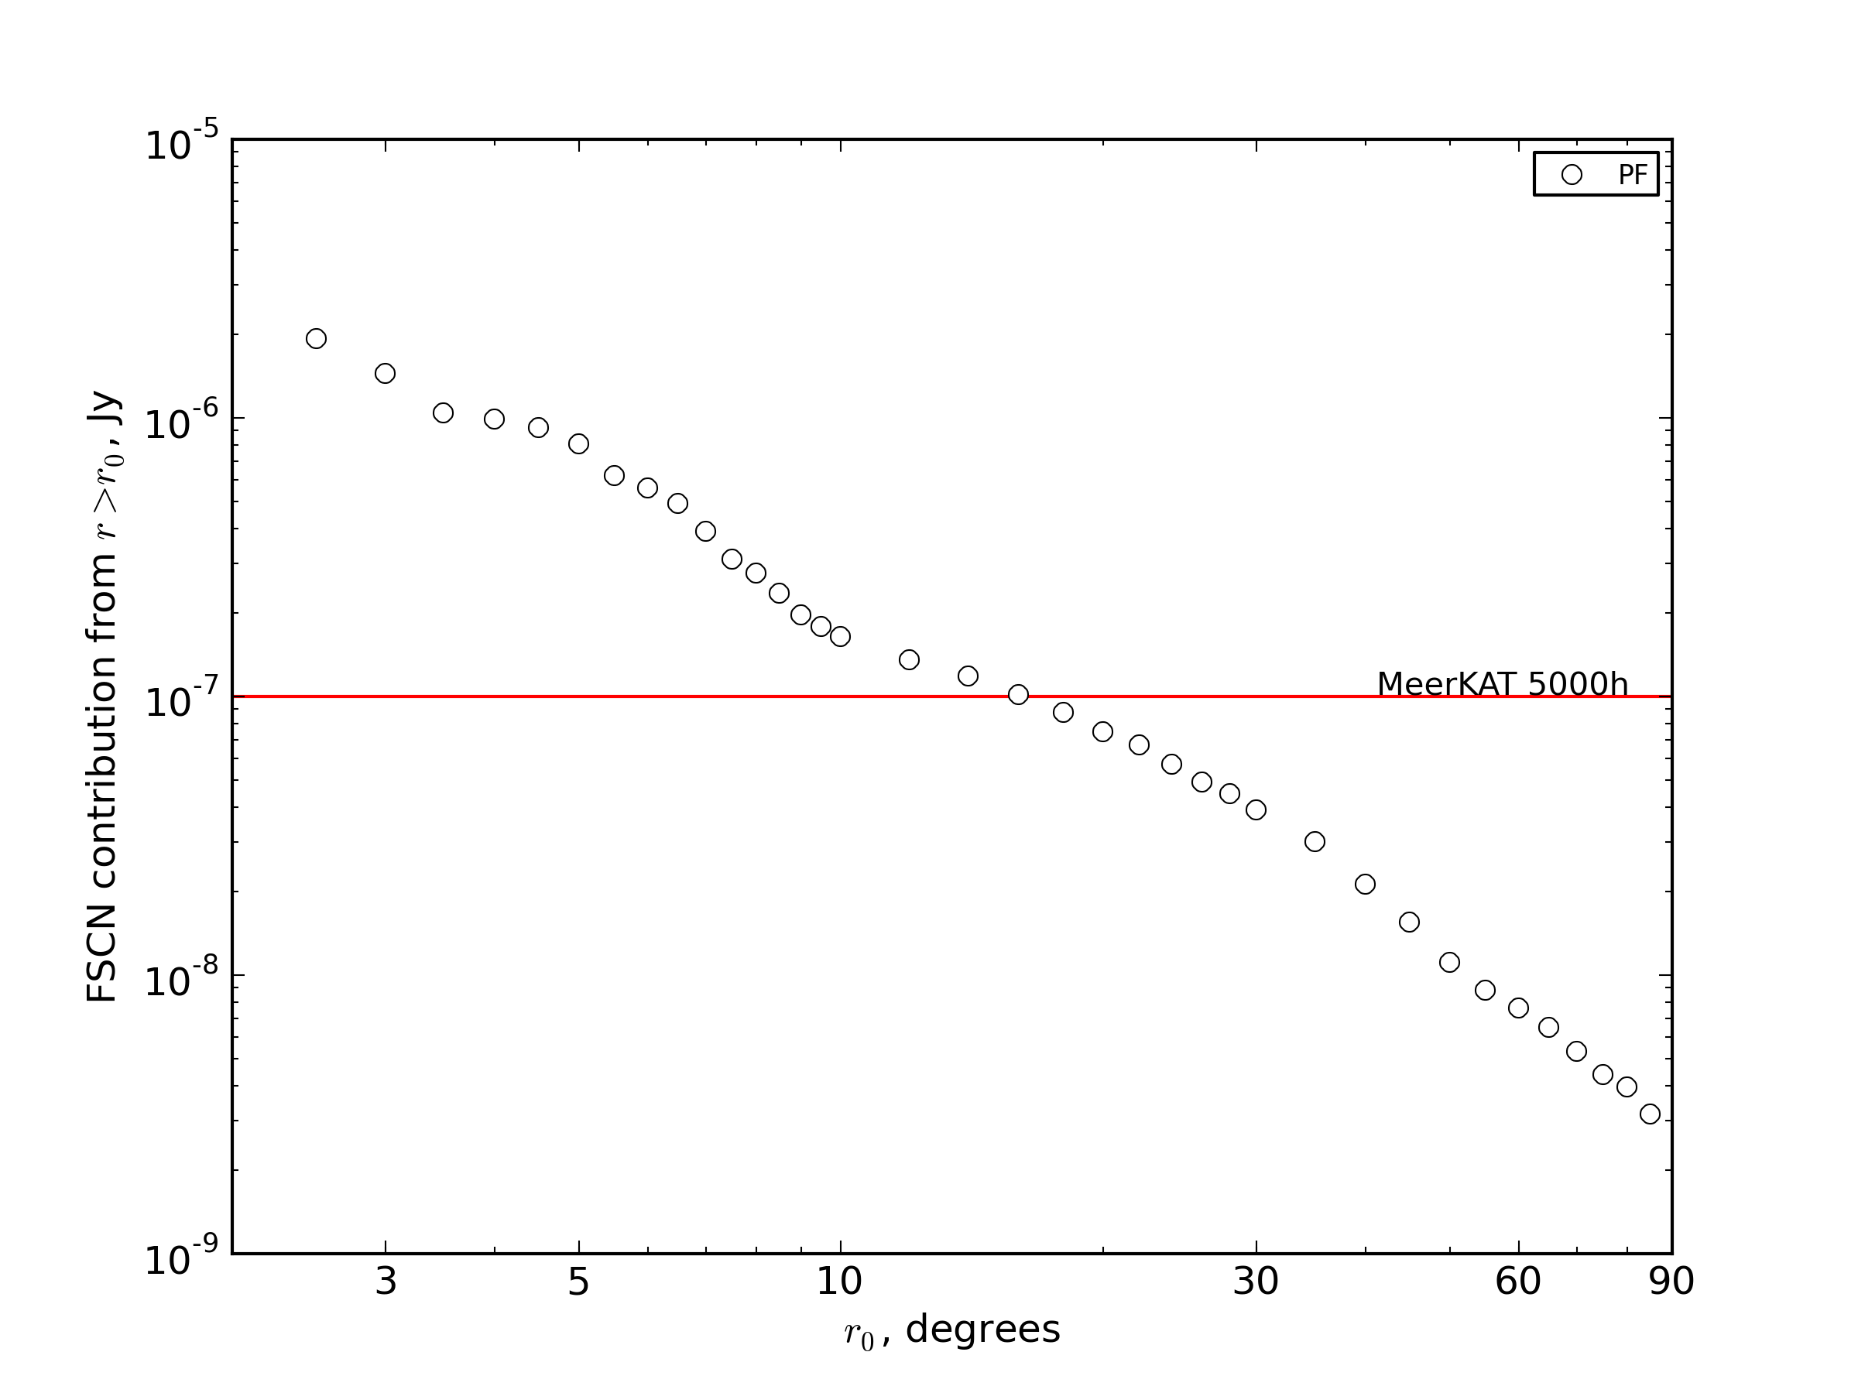
Cost Curve: Prime focus

Slide 7

The Picture For Many Dishes

Slide 8
Part II: Beam Smoothness
& “Calibration Noise”

Slide 9
Calibration “Noise”
We have been very successful at eliminating DDE-related artefacts via direction-dependent solutions
And by “eliminating” we mean “driving below the (thermal) noise”
  ...by which we really mean “sweeping under the carpet”
So, how do we estimate what we have “swept”, and can it come back to haunt us?

Slide 10
Distilling Out The Artefacts
Two simulations:
  (I) Full sky + instrumental errors + noise
  (II) Bright sources only + instrumental errors
  ...with the same instrumental errors
    Which include DI gains and pointing errors
Calibrate the “full sky”
Apply solutions to (II) and subtract model
  Result: “distilled” artefacts that would normally be below the noise

Slide 11

Example: MeerKAT
Residuals from a pair of 1 Jy sources
DI cal only
Here, rms
4.2 μJy

Slide 12
Distilling DDEs
But nevermind, because direction-dependent solutions can take care of it, right?
If we run a dE solution on the two contaminator sources, the resulting image (of the full residuals) becomes thermal noise limited; remaining artefacts are below the noise.
But we can repeat the same distillation trick to see what's left anyway

Slide 13

Calibration Noise, Post-dE
Rms 2.6 μJy

Slide 14
Why Do We Care?
Just an extra noise-like contribution that's below the thermal noise, so what's the big deal?
But it can be a big deal if it doesn't average out
Imagine repeating
this independently
for N pointings

Slide 15

Mean Of 10 dE-Distills
Structure shows up
Does not average out as sqrt(N)
1 distill, rms 2.6 μJy
10 distills, rms 1.2 μJy

Slide 16

PF vs OG
Repeat this experiment for PF and OG beam patterns
Calibration “noise” for OG lower by a factor ~3
PF: rms 3.6 μJy
OG: rms 1.2 μJy

Slide 17
Why Does This Happen?
My answer: beam smoothness
  “Smoother” PB pattern is less sensitive to pointing error
And now consider beam rotation...

Slide 18
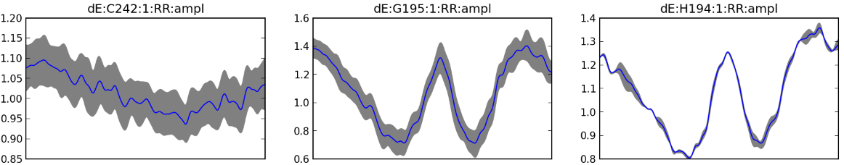
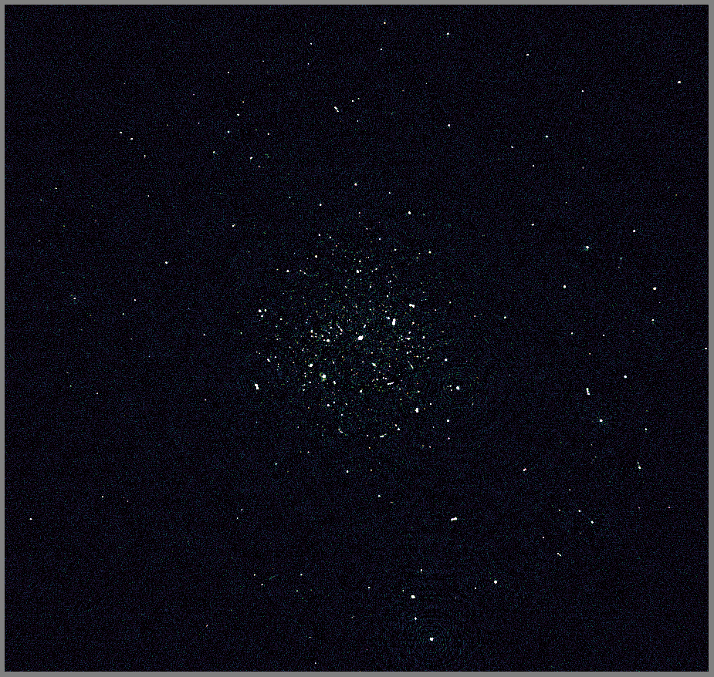

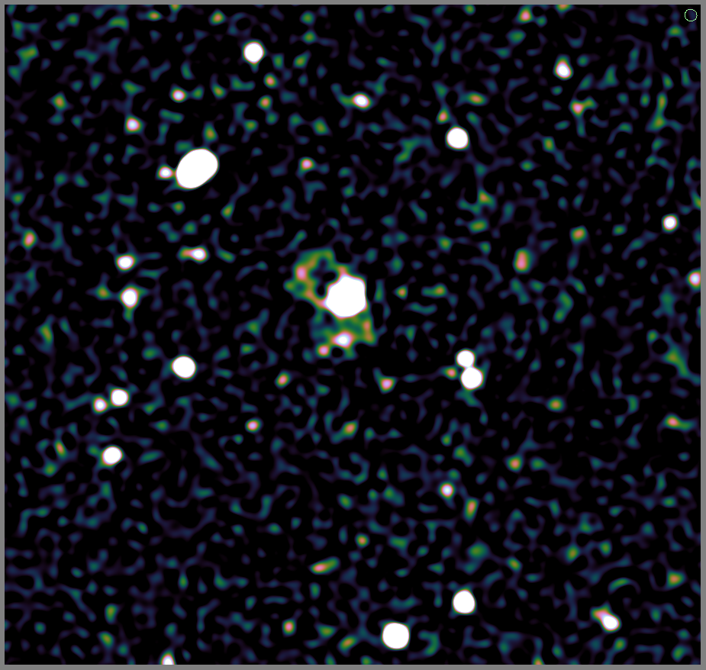
JVLA 3.2m vs. WSRT 1.6m
Uses stefcal for G and dE solutions
VLA C+D
~14h 192MHz
WSRT 12h 200 MHz

Slide 19
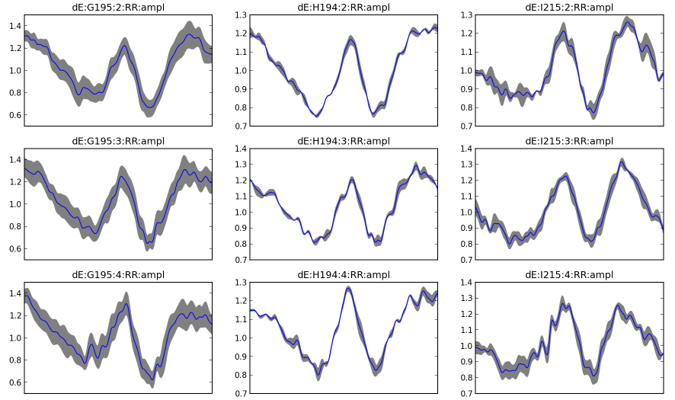
dE Solutions
Large time variation
  (A-Projections: higher cadence of recomputing deconvolution kernels)
Differences antenna-to-antenna

Slide 20
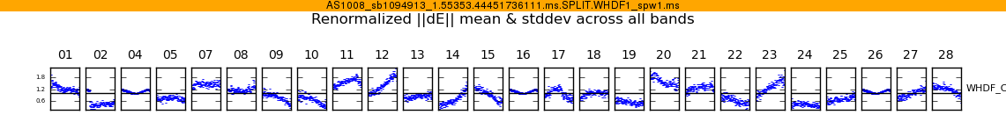


Even More Antenna Differences
X-band observation of
WHDF (Ian Heywood)
Phase calibrator at
first null
This is your science
(good luck!)
This is your
phase calibrator
The Worst Place In The World
to put a calibrator in.

Slide 21
Conclusion I
Smooth (or stationary) beams good
Non-smooth beams bad
OG smoother than PF

Slide 22
Part II: Data Compression
Why so much data?
Very high time/frequency resolution
  In order to avoid smearing of long baselines
Can we average more cleverly?

Slide 23
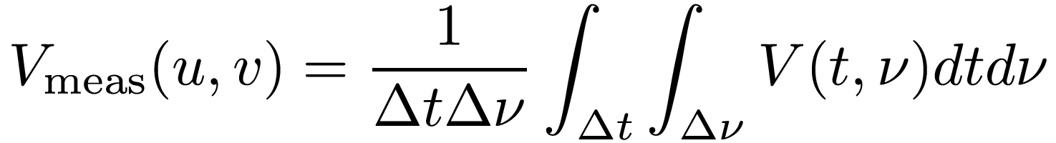
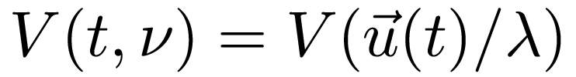
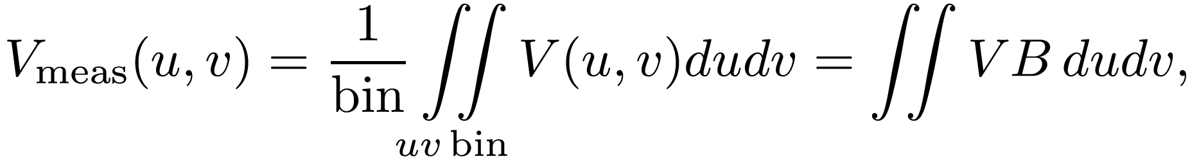
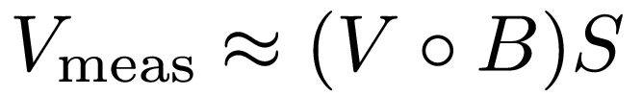
What Causes Averaging
Averaging:
where B is a boxcar (“tophat”) function for the bin. This is a convolution:

Slide 24
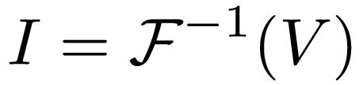
Averaging ≈ Convolution
Smearing
response
R

Slide 25
Windowing Functions
The smearing response R(l,m) = F⁻¹(B) falls off too rapidly/not rapidly enough
So, why not play with B to optimize smearing response?
  Replace it with some tunable windowing function W
  Bread-and-butter filter theory
The trade-off: increased thermal noise
  But Stefan tells us we won't reach it anyway...
  ...So maybe worth it across the field?

Slide 26
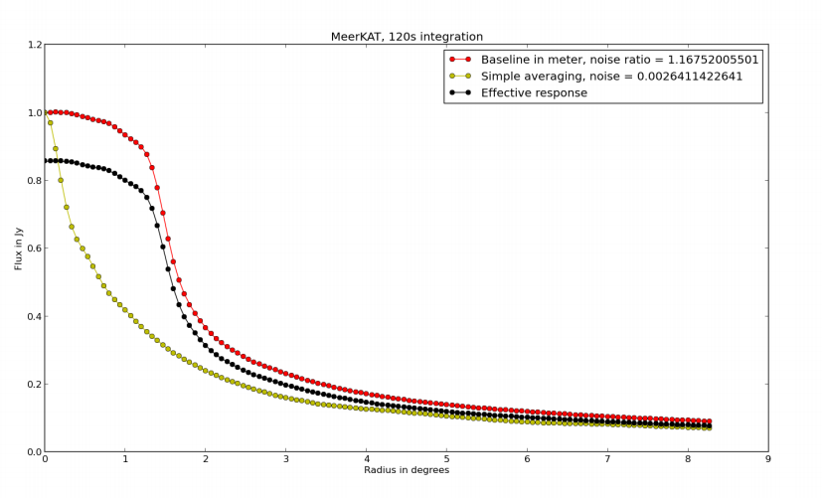
Early Results

Slide 27
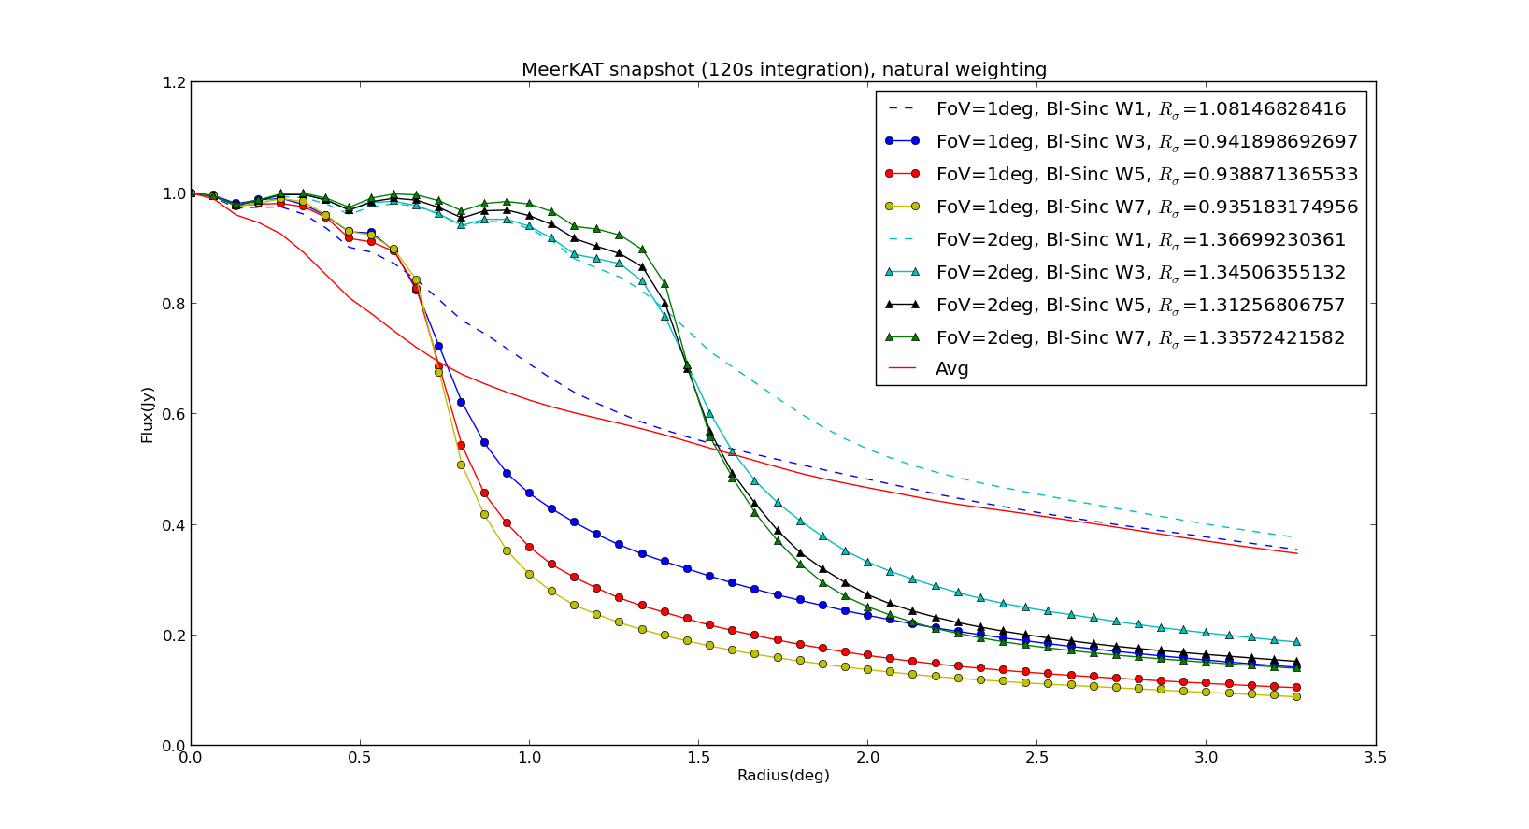
Results: Sinc Filter

Slide 28
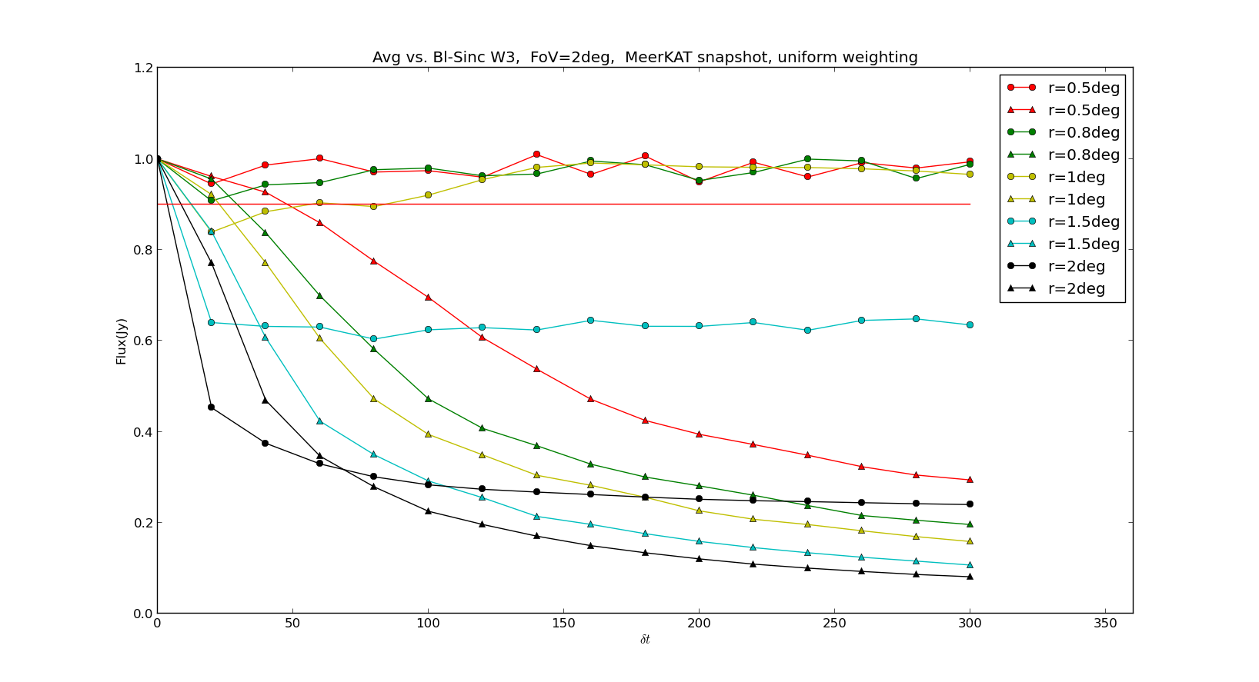
Increasing Integration Time

Slide 29
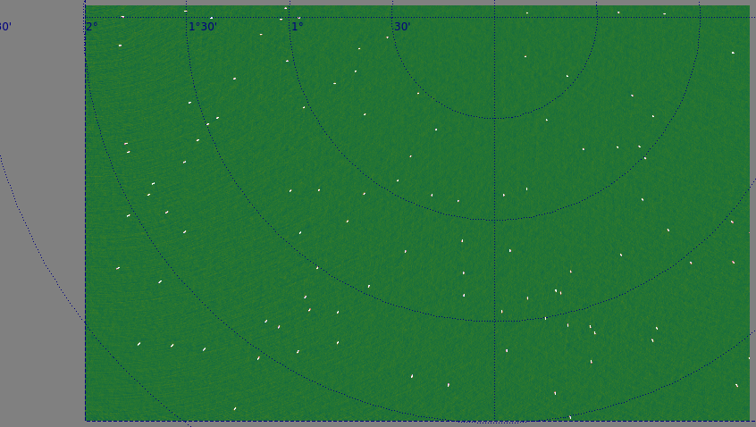
Normal Averaging
VLA-C, 5s 10MHz

Slide 30
Normal Averaging
VLA-C, 5s 10MHz

Slide 31
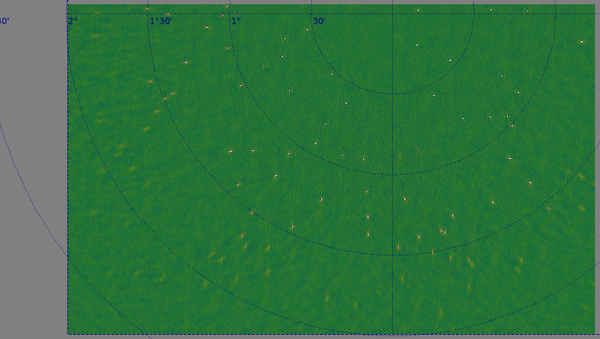
Sinc filter, FoV=2
VLA-C, 40s 50MHz (x40 compression)

Slide 32
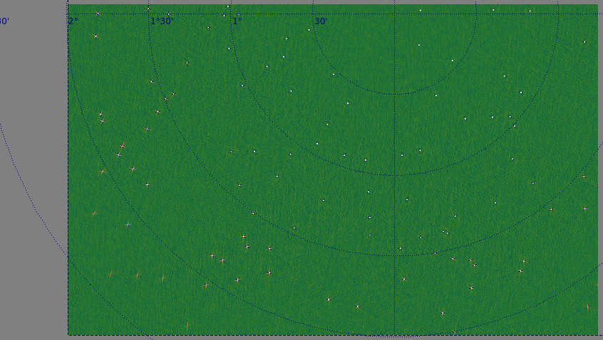
Sinc filter, FoV=3
VLA-C, 40s 50MHz (x40 comporession)

Slide 33
Part IIa: Deconvolution
Imaging is the ultimate data compression...

Slide 34
Better Deconvolution
New deconvolution algorithms coming of age
Compressive sensing
  SARA/PURIFY (Carrillo, Wiaux, McEwen)
  “More Sane” (see next slide):
    Image-plane only method, thus eliminates gridding/degridding cycle
Bayesian image recovery
  Sutter et al.
  RESOLVE (Junklewitz 2013)

Slide 35
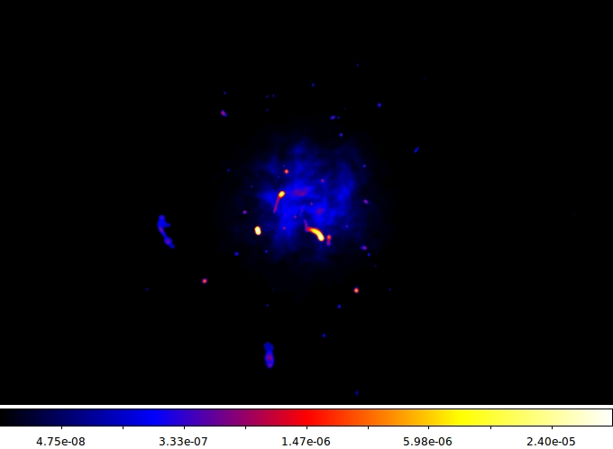
More Sane Deconvolution
(Courtesy A. Dabbech & C. Ferrari)
Simulated sky

Slide 36
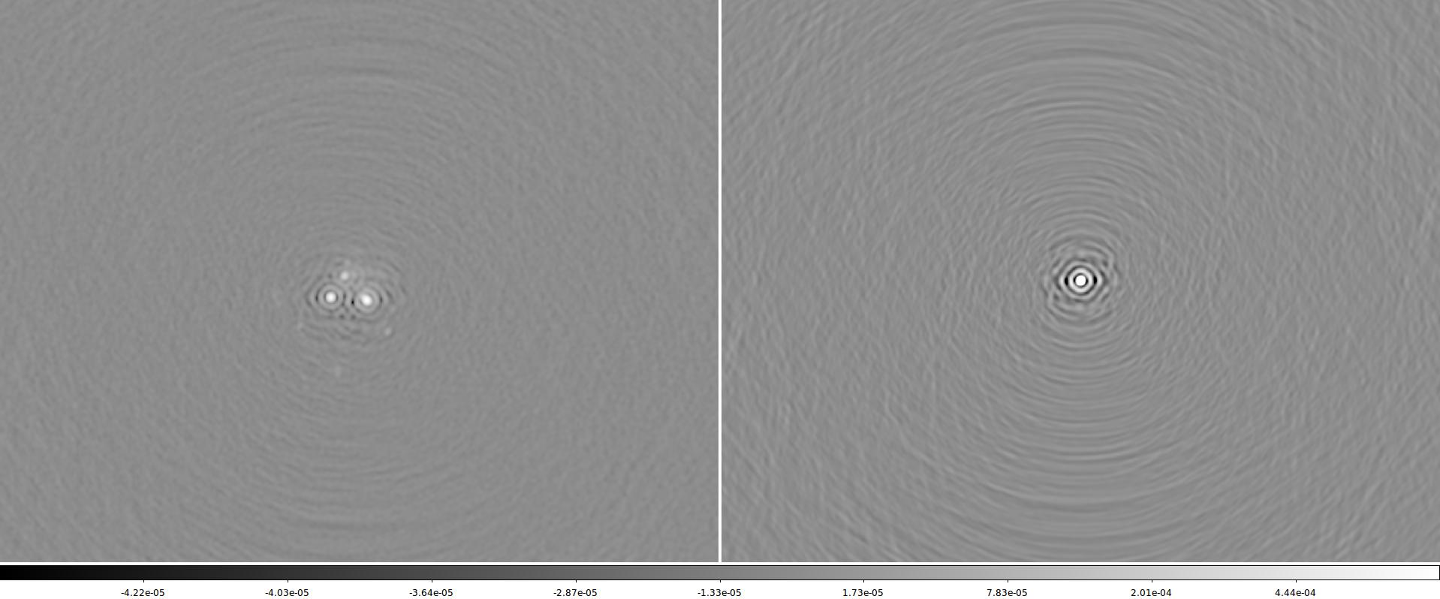
MeerKAT Dirty Image

Slide 37
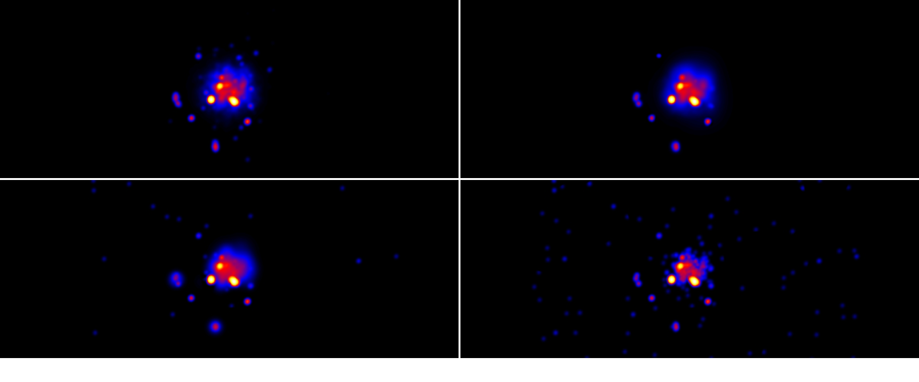
Deconvolved Images
True sky ● RB
MORESANE ● RB
MS-CLEAN ● RB
CLEAN ● RB

Slide 38
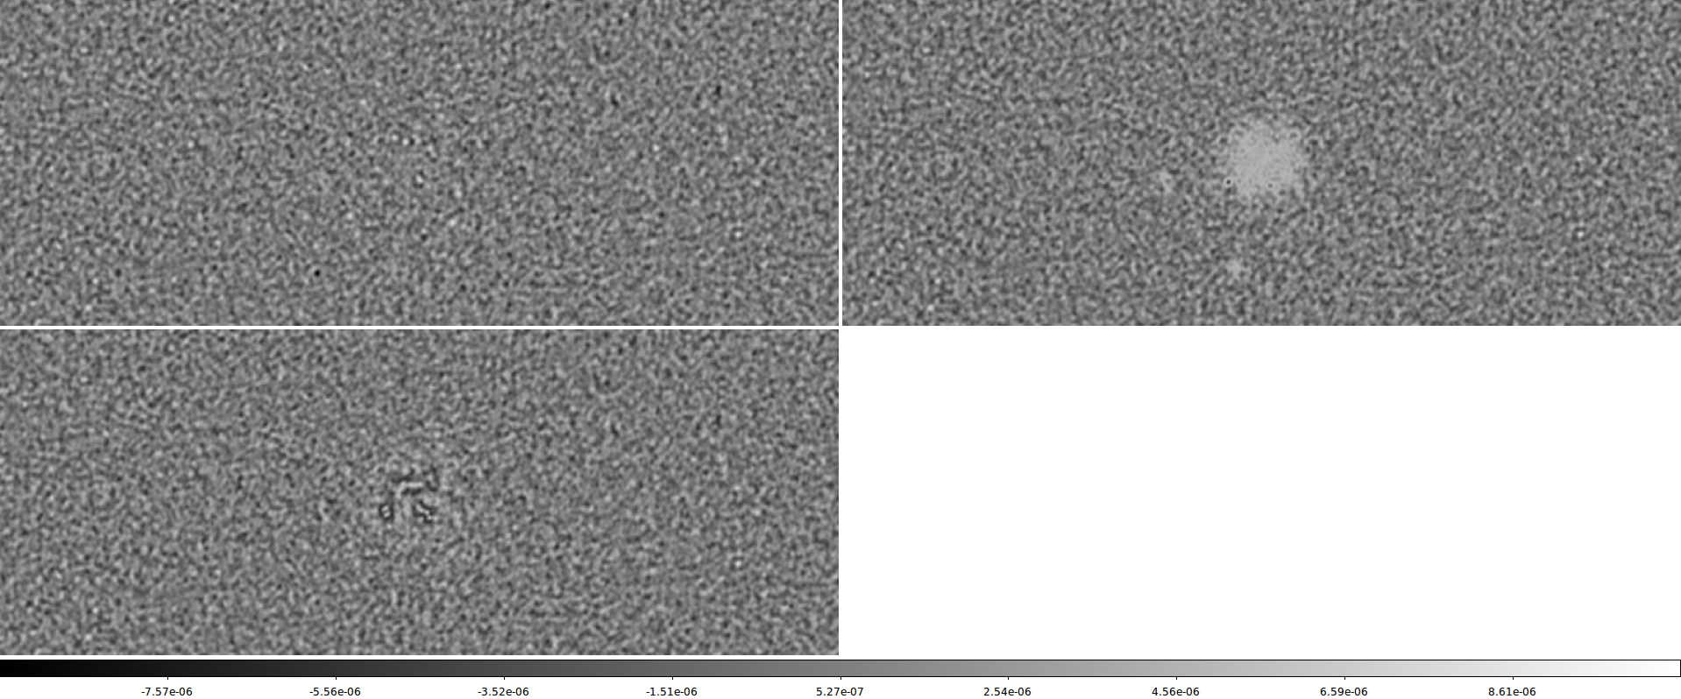
Residual Images

Slide 39
Part III: Filters
Compression assumes calibration
Online (streaming) calibration?
  Stefcal fast enough
  ...for regular gain calibration
  Unclear how to solve for slowly-evolving parameters
Filters vs. Solvers
  (Courtesy of C. Tasse)

Slide 40
Regularity in the process
Jones Matrix
Time
Solver output
True underlaying instrumental state

Slide 41
Regularity in the process
Jones Matrix
Frequency
Solver output
True underlaying instrumental state

Slide 42
Solvers Vs. Filters
Solver: finds the maximum likelihood solution
  e.g. over a range of time slots
  iterative
Filter
  “Solution” is process state + process variance-covariance matrix
  ...updated at each time step using “new” data
  Recursive (fixed cost at each step) & embarssingly parallel
Both approaches allow for arbitrary “physical” parameterization:
  But the filter remains single-step

Slide 43
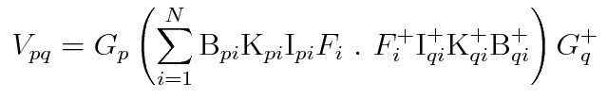
Non-linear Kalman Filters....
Data domain: Dim=10⁴-10⁶
Process domain: Dim=10²-10⁴
xt
h
Pt
- Ionosphere
- Clock
- Beam
- Sky
- etc.
“predicted” Data
h(xt, Pt)
Data

Slide 44
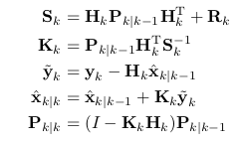
Non-linear Kalman Filters....
Data domain: Dim=10⁴-10⁶
Process domain: Dim=10²-10⁴
xt
h
Pt
- Ionosphere
- Clock
- Beam
- Sky
- etc.
“predicted” Data
h(xt, Pt)
Data
x_{t+1}
K
P_{t+1}

Slide 45
Example
Left: phase calibration with BBS
Right: fitting an analytic clock offset with a Kalman filter

Slide 46
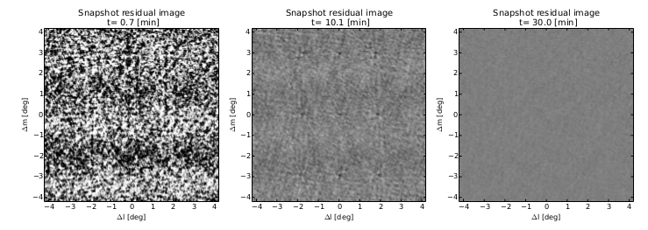
Example 2:
Ionospheric Simulation

