Slide 1
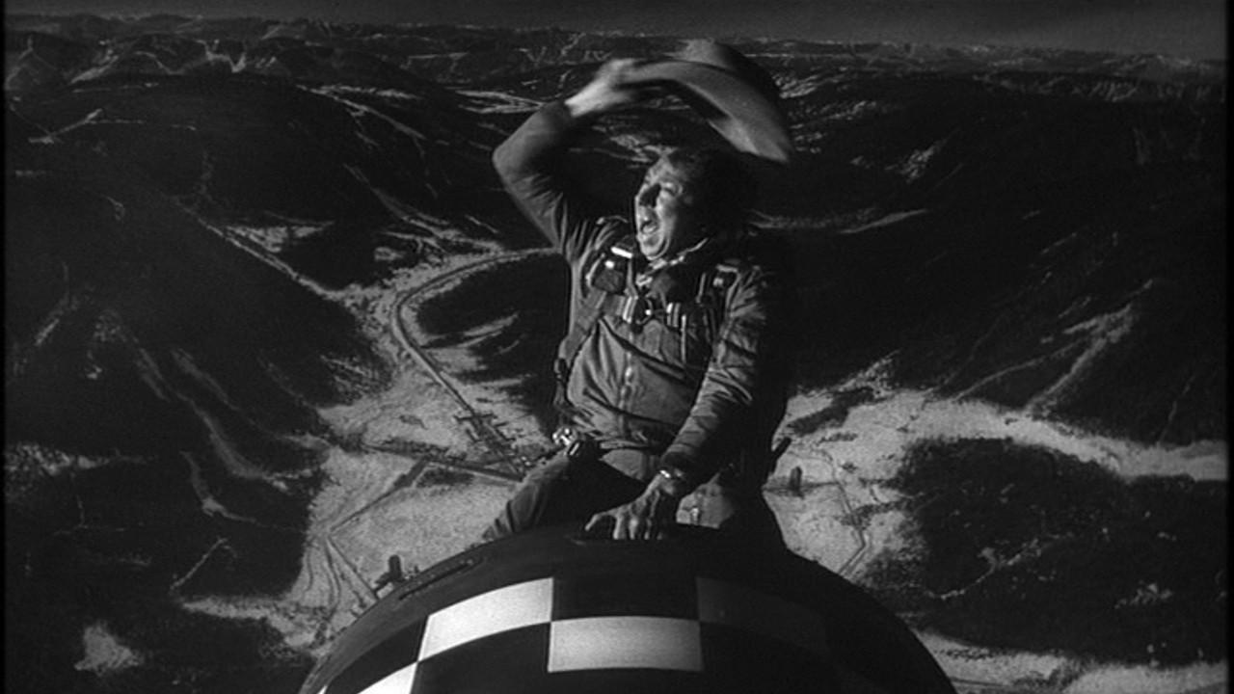
Dr. Sidelobes, Or How I Learned To Stop Worrying & Love Simulations
O. Smirnov (Rhodes University & SKA SA)

Slide 2
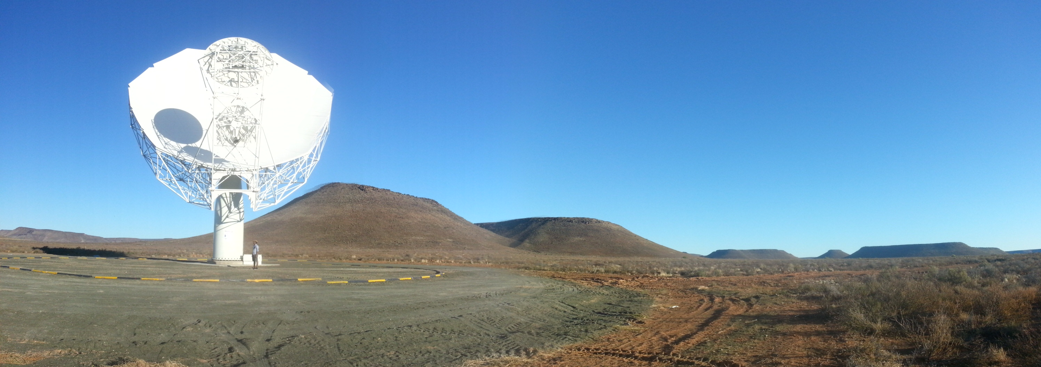
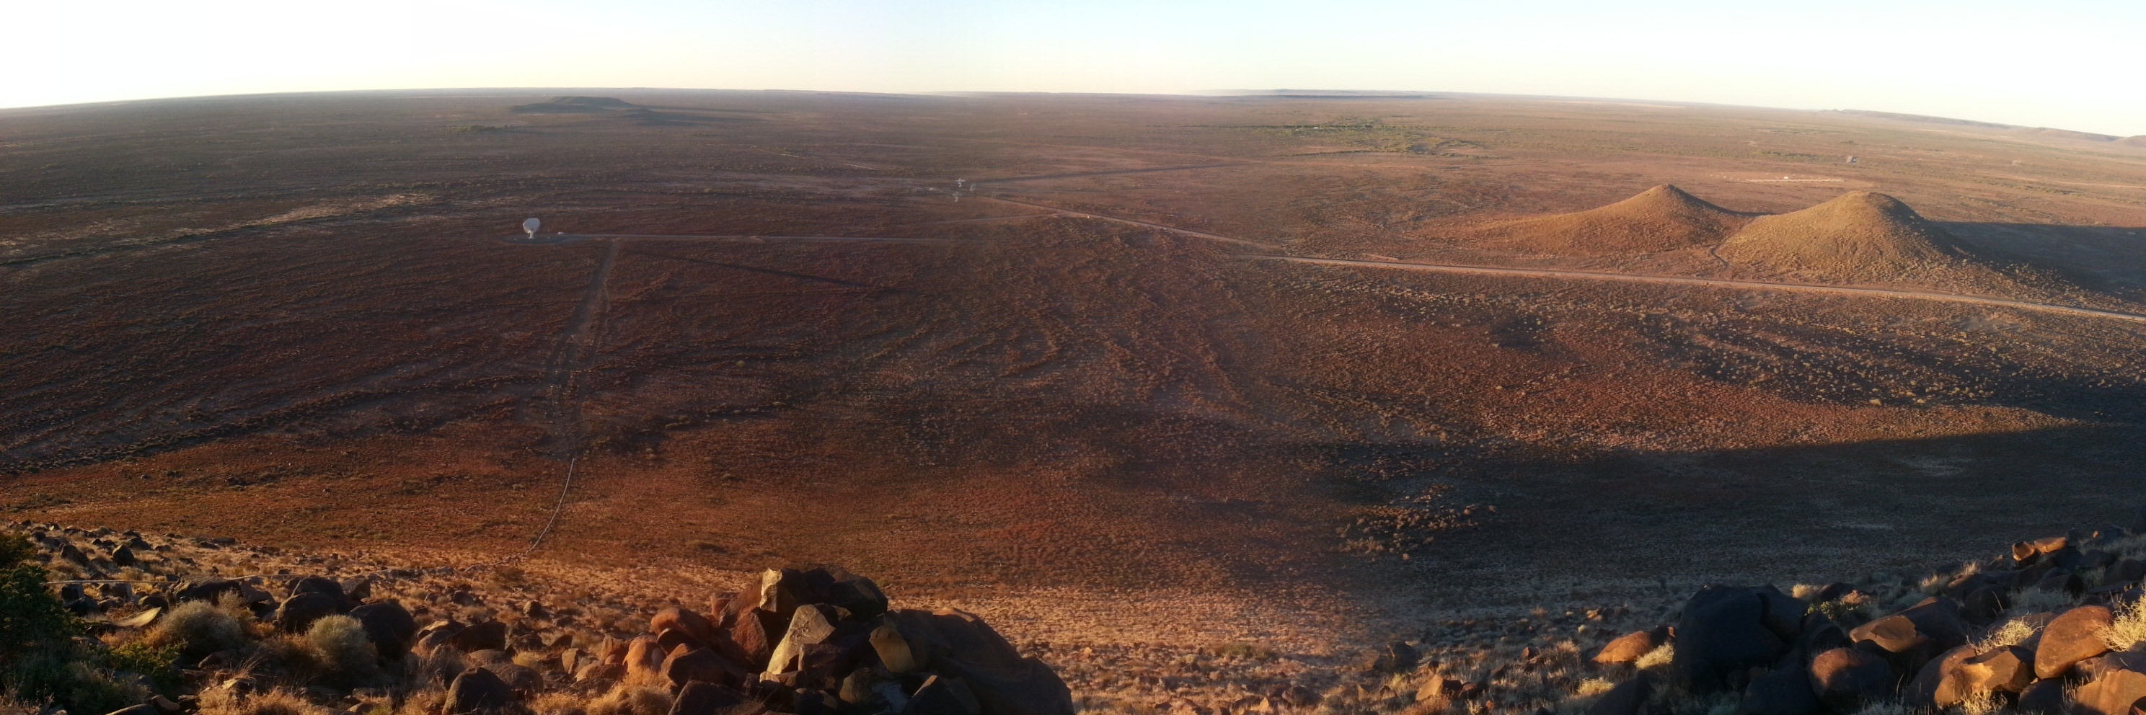
Radio telescopes, apropos of nothing

Slide 3
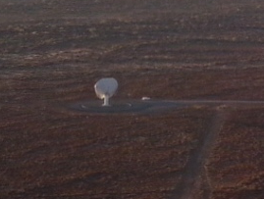
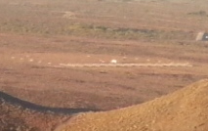
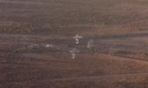

Slide 4
Introduction
“A high quality radio map is a lot like a sausage, you might be curious about how it was made, but trust me you really don't want to know.”
– Jack Hickish
Interferometry is hard and unintuitive, but we've carved out some comfort zones
New observatories and new surveys will be [are] boldly going where no man has made sausage before
...as we plunge into the SKA/exascale era

Slide 5
Radio Interferometer...
(In celebration of the passing of an extremely lame but blissfully short-lived internet meme)

Slide 6
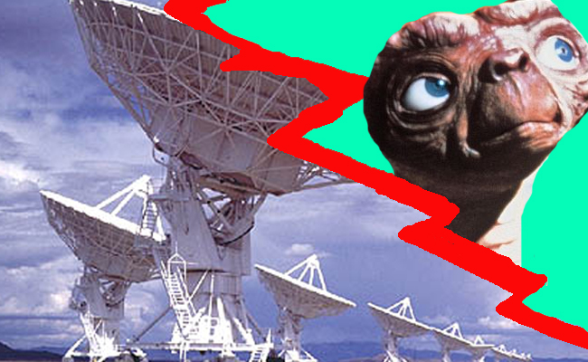
Radio Interferometer...
(In celebration of the passing of an extremely lame but blissfully short-lived internet meme)
What lay people think I do

Slide 7
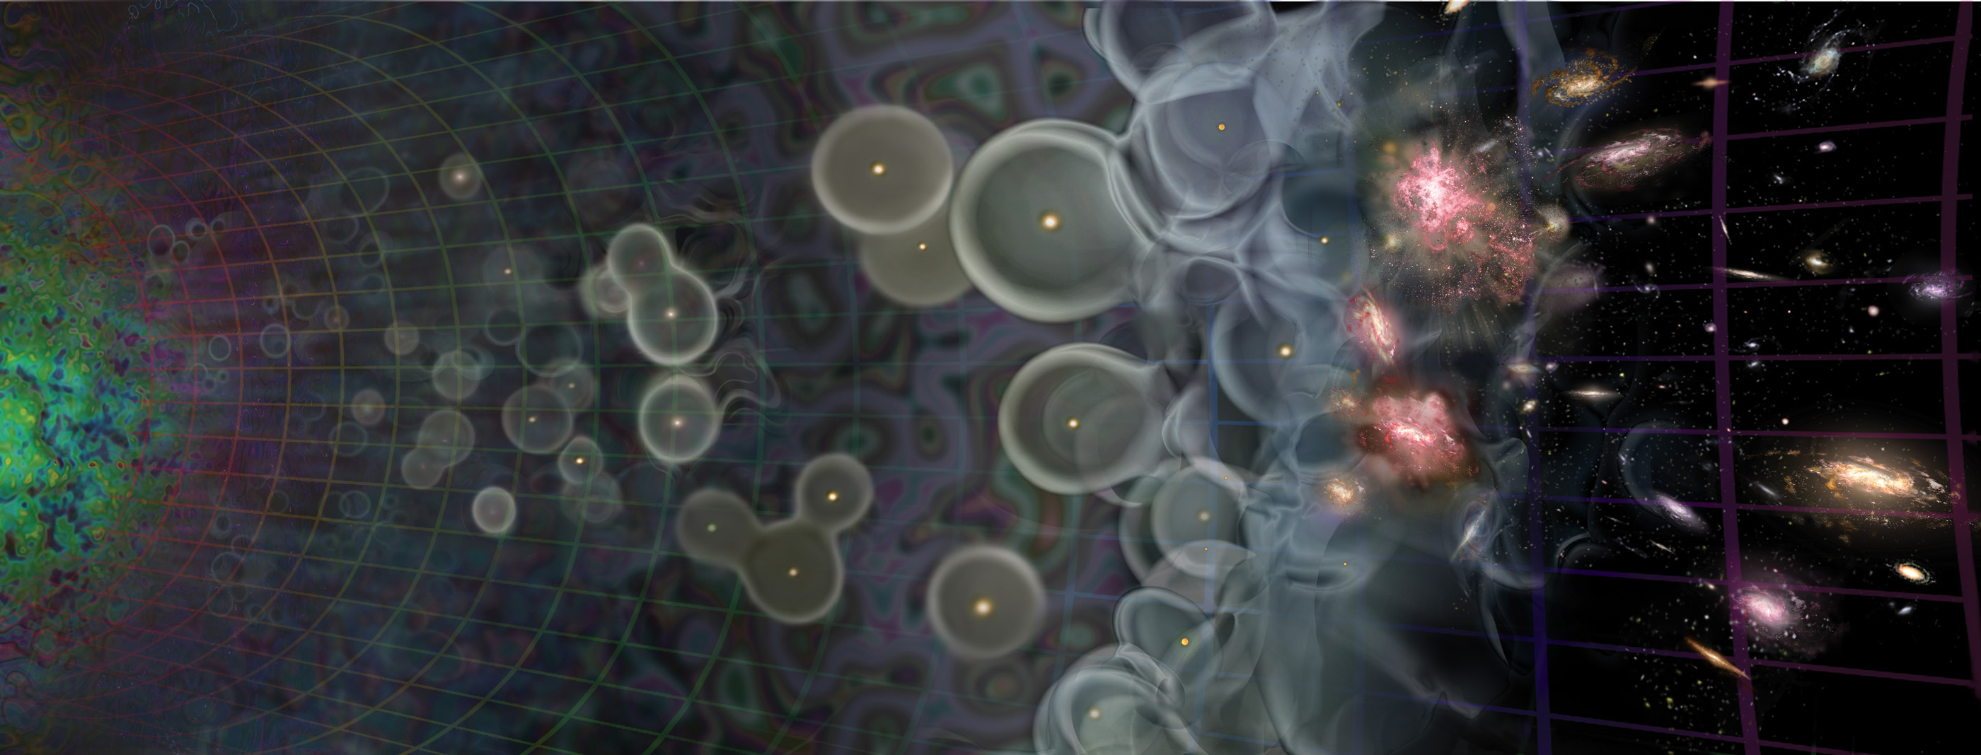
Radio Interferometer...
(In celebration of the passing of an extremely lame but blissfully short-lived internet meme)
What lay people think I do
What funding agencies
think I do

Slide 8
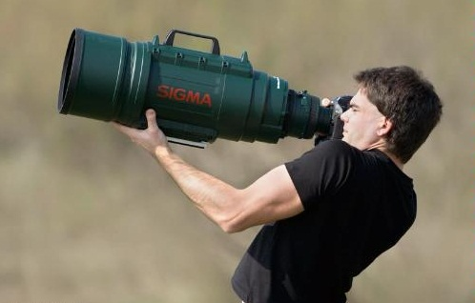
Radio Interferometer...
(In celebration of the passing of an extremely lame but blissfully short-lived internet meme)
What lay people think I do
What funding agencies
think I do
What cosmologists & astrophysicists think I do

Slide 9
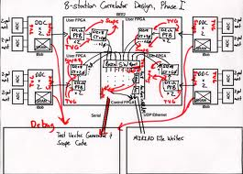
Radio Interferometer...
(In celebration of the passing of an extremely lame but blissfully short-lived internet meme)
What lay people think I do
What funding agencies
think I do
What cosmologists & astrophysicists think I do
What my engineers think I do

Slide 10

Radio Interferometer...
(In celebration of the passing of an extremely lame but blissfully short-lived internet meme)
What lay people think I do
What funding agencies
think I do
What cosmologists & astrophysicists think I do
What my engineers think I do
What I actually do

Slide 11

How To Make An Interferometer 1
Start with a normal reflector telescope....

Slide 12

How To Make An Interferometer 2
Then break it up into sections...

Slide 13

How To Make An Interferometer 3
Replace the optical path with electronics

Slide 14

How To Make An Interferometer 4
Move the electronics outside the dish
...and add cable delays

Slide 15

How To Make An Interferometer 5
Why not drop the
pieces onto the ground?

Slide 16

How To Make An Interferometer 6
...all of them

Slide 17
How To Make An Interferometer 7
And now replace them with proper radio dishes.
...and that's all! (?)
Well almost, what about the other pixels?

Slide 18

How Does Optical Imaging Do It?
This bit sees the EMF
from all directions,
added up together.
This bit sees the EMF
from all parts of the
dish surface,
added up together.

Slide 19
Fourier Transforms
An optical imaging system implicitly performs two Fourier transforms:
  1. Aperture EMF distribution = FT of the sky
  2. Focal plane = FT⁻¹ of the aperture EMF
A radio interferometer array measures (1)
  Then we do the second FT in software
  Hence, “aperture synthesis” imaging

Slide 20


The uv-Plane
Image plane
uv-plane
(12 hours!)
FT
One baseline samples
one visibility at a time
In a sense, the two are entirely equivalent

Slide 21
Where's The Catch?
We don't measure the full uv-plane, thus we can never recover the image fully (missing information)
Every visibility measurement is distorted (complex receiver gains, etc.), needs to be calibrated.

Slide 22



Catch 1: Missing Information
Response to a point source: Point Spread Function (PSF)
PSF = FT(uv-coverage)
Observed “dirty image” is convolved with the PSF
Structure in the PSF = uncertainty in the flux distribution (corresponding to missing data in the uv-plane)
PSF of WSRT.
The regular rings are due to the regular spacing of its antennas in the
East-West direction.
PSF of MeerKAT
4
2

Slide 23
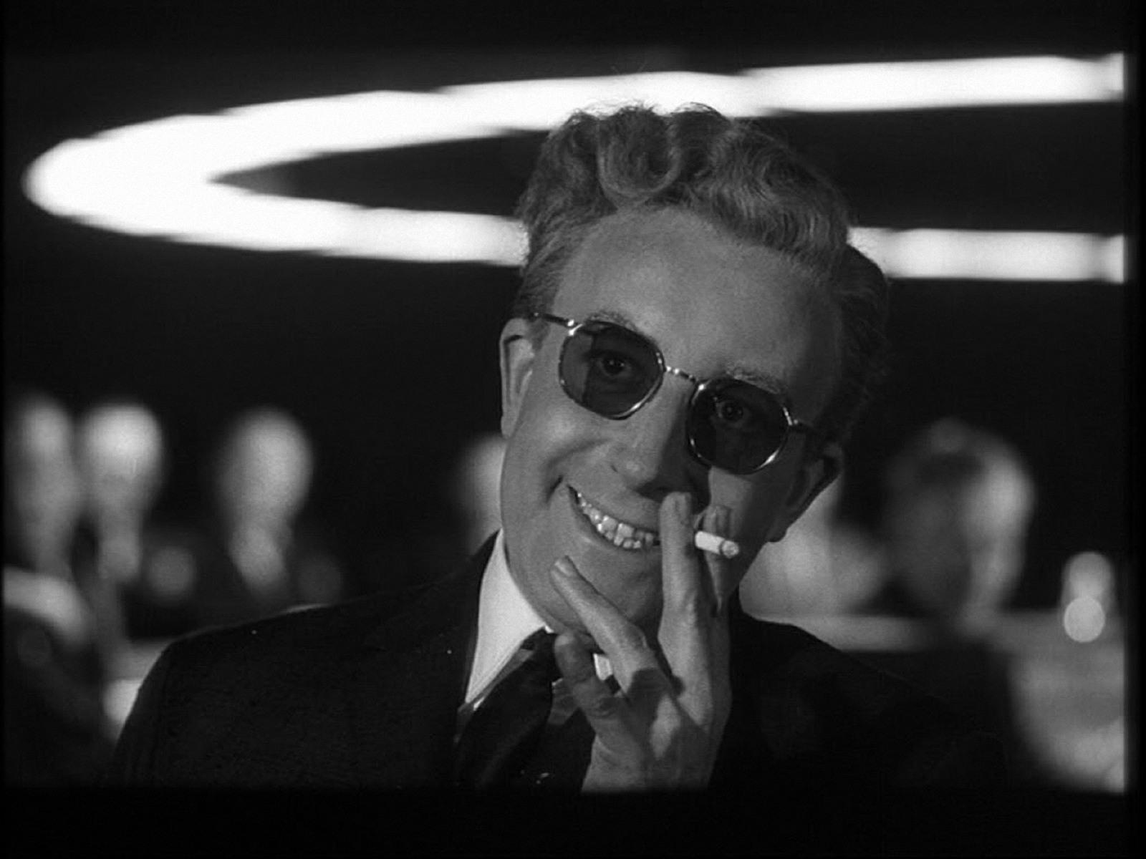
Dr. Sidelobes
The Villain of The Piece
PSF sidelobes
extend over the
entire sky

Slide 24

Deconvolution: from dirty to clean images
Real-life WSRT dirty image
Dirty image dominated by PSF sidelobes from the stronger sources
Deconvolution required to get at the faint stuff underneath.
A whole continuum of skies fits the dirty image (pick any value for the missing uv-components)
Deconvolution picks one = interpolates the missing info from extra assumptions (e.g.: “sources are point-like”).

Slide 25
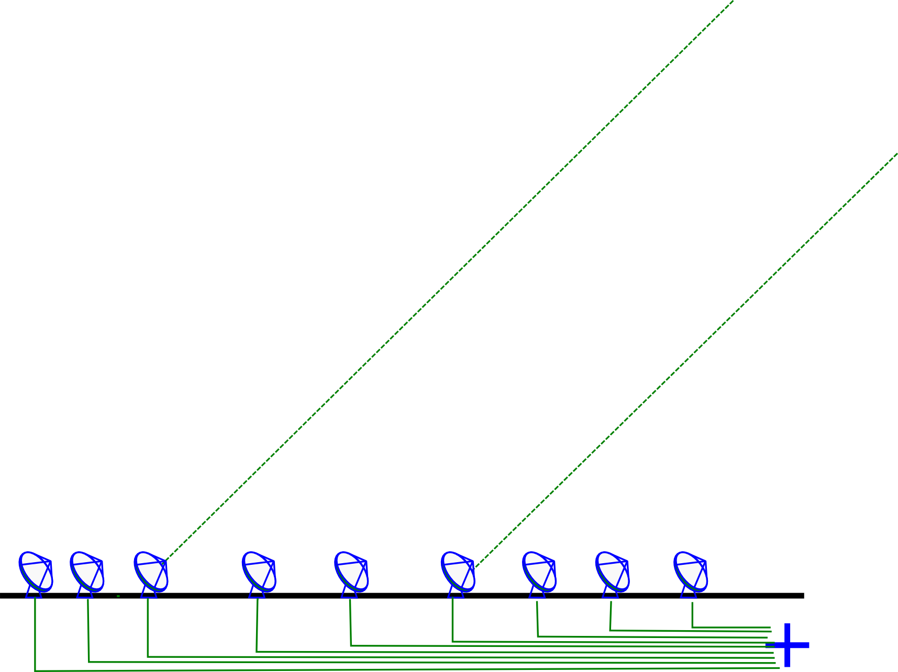
Catch 2: Measurement Errors
Incoming signal is subject to distortions (refraction, delay, amplitude loss)
  atmospheric and electronic

Slide 26
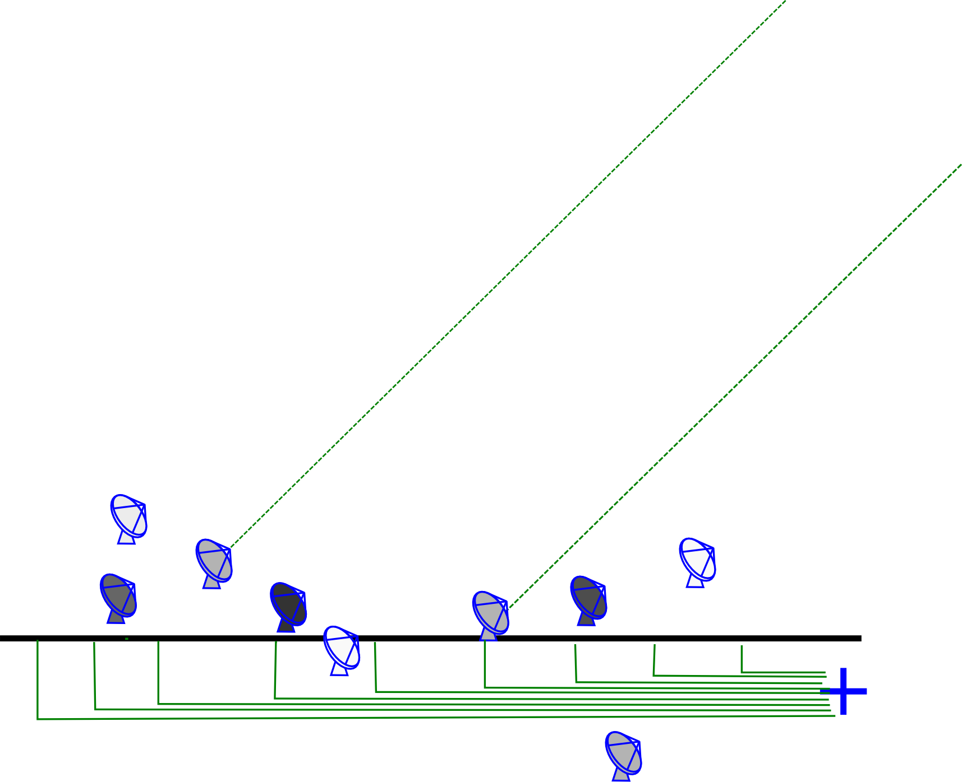
An Uncalibrated Interferometer
Complex gain error: signal multiplied by a amplitude and phase delay term
Delay errors correspond to differences in arrival time, i.e. random shifts of antennas towards and away from the source
Amplitude errors = different sensitivities

Slide 27
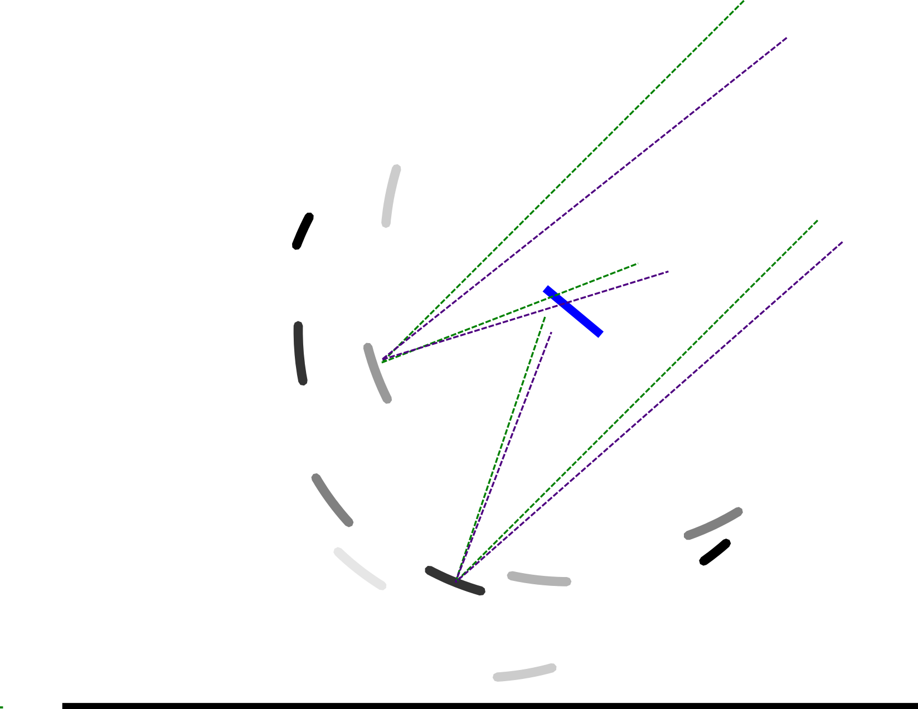
...And Its Optical Equivalent

Slide 28

And The Result...
One point-like source, but observed with phase errors
In the uv-plane, phase encodes information about location
Phase errors tend to spread the flux around
Amplitude errors distort structure
And Dr Sidelobes ensures that the damage is distributed democratically

Slide 29
How To Deal With This?
Radio interferometers can be calibrated
This is done by modelling the instrument and fitting this to the observed visibilities
  Even possible to fit for the instrument and the sky together (in alternating steps) = selfcal
Need a parameterized model, i.e. an equation describing the measurement

Slide 30

Radio Interferometer
Measurement Equation (RIME)

Slide 31
Radio Interferometer
Measurement Equation (RIME)

Slide 32
Radio Interferometer
Measurement Equation (RIME)
Jones matrices
(these describe
the instrument)
...more
Jones matrices
Coherency matrices
(these describe the sky)

Slide 33
The Devil Is In the Details!
“The Devil In
E-Jones”
A lot of
instrumental
subtlety
Also need more sophisticated
sky models

Slide 34

The Past: Paranoid Overengineering
(“Instrumental stability at any cost!”)

Slide 35

The Present: Four Sticks In The Ground (“We'll just fix the rest in software”)

Slide 36
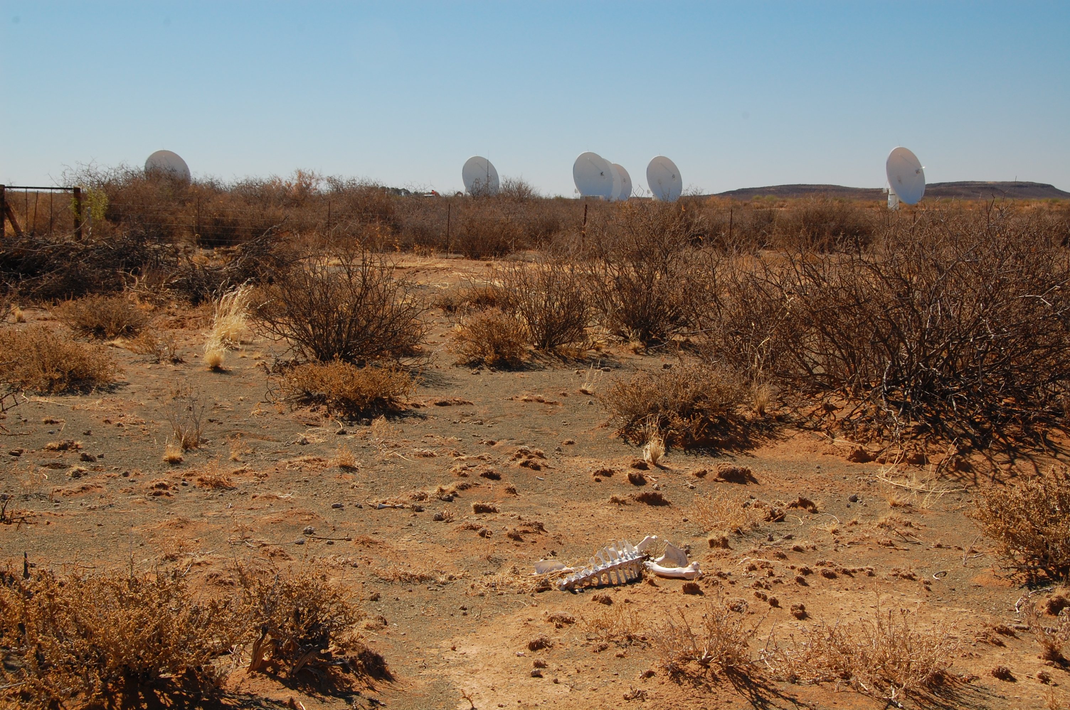
The Future: Telescopes Made
Of Cheap Junk

Slide 37
The Future: Telescopes Made
Of Cheap Junk
The lonesome death
of instrumental stability

Slide 38
Why MeqTrees
Future instruments need more flexible and subtle instrumental models
MeqTrees is a software system for implementing and running Measurement Equations (hence “Meq-”)
Interferometry simulations
  Science skies + instrumental model → simulated visibilities
Calibration = simulator plugged into a solver
  Fit parameterized models to observed visibilities

Slide 39
Trees = Expression Trees
Any mathematical expression can be represented by a tree:
b
x
b
x
b
x
c
y
*
*
1
+
α
sin
*

Slide 40
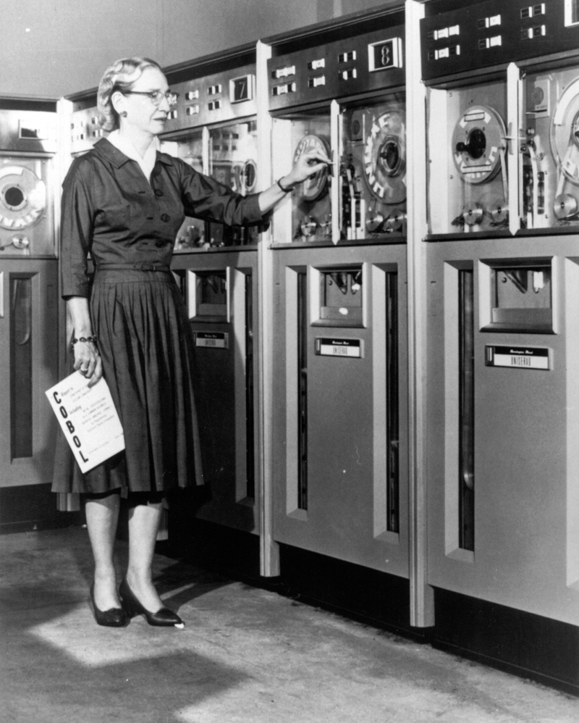
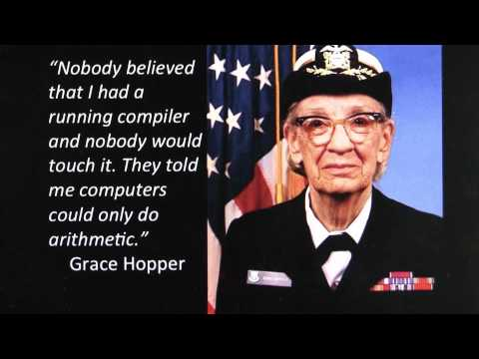
US Navy-Approved
First use: Hopper 1948

Slide 41
MeqTrees Architecture
TDL modules
(libraries)
(Python)
meqserver
(compute engine)
(mostly C++)
b
b
x
b
x
x
c
y
meqbrowser (Python GUI)
or Python session or script
*
*
1
TDL
script
(Python)
+
Config
file(s)
α
sin
*
control commands
results
data
(MS)

Slide 42
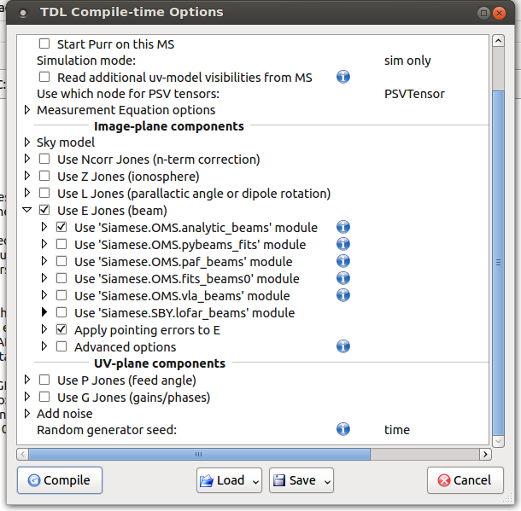
A Library Of RIME Components
TDL modules
(libraries)
(Python)
TDL
script
(Python)
Config
file(s)
TDL scripts essentially specify the structure of RIMEs on the meqserver side
Modules provide many “pre-cooked” components

Slide 43
Performance / Flexibility
Instrumental subtleties
can be implemented very
rapidly (10s of lines of Python
vs. 100s of lines of C++)
Without necessarily sacrificing
performance
For extra flexibility, particularly tricky nodes can be prototyped in Python
  (and historically, none of these “prototypes” have ever needed to be rewritten)
b
b
x
b
x
x
c
y
*
*
1
+
Python
interpreter
α
sin
*

Slide 44
“But What About The Overhead?”
meqserver
(compute engine)
(mostly C++)
b
b
x
b
x
x
c
y
Python MCMC script
*
*
1
TDL
script
(Python)
+
Config
file(s)
α
sin
*
parameter updates
predicted visibilities
x1,000,000 times

Slide 45

Wither MeqTrees
There are simulation capabilities in
other packages (CASA,
MIRIAD, etc.)
MeqTrees provides
unmatched flexibility in
terms of specifying
instrumental effects
When the going gets weird,
the weird install† MeqTrees
(†and the truly weird install it on a Mac)

Slide 46
Example Applications
High-DR calibration & imaging (DD calibration, etc.)
Evaluation of beam-related effects
  Prime focus vs offset Gregorian performance
  Element gain drifts in PAFs
  Fundamental sensitivity limits due to beam instability
Ionosphere and EoR sims (see talk by H. Shukla)
Weak lensing simulations (incl. SKA1)
MC & Bayesian sampling
Generating training data for ML

Slide 47

Good News First:
Radio Interferometry Is Possible...
3C147 @21cm
12h WSRT synthesis
160 MHz bandwidth
22 Jy peak (3C147)
13.5 μJy noise
1,600,000:1 DR
thermal noise-limited
Regular calibration does
not reach the noise,
leaves off-axis artefacts
due to direction-dependent
effects (left inset)
Addressed via differential
gains (right inset)
3C147 22Jy
30 mJy

Slide 48
Luxury Problem?
High-DR imaging has been called many names
  “Marketing gimmick”
  “Macho imaging”
  “Bragging rights”
  “Luxury problem”
    (...well we only came up with that one to annoy the NRAO folks)

Slide 49

Not Always a Luxury Problem
(Courtesy of Ian Heywood)
EVLA 8 GHz: Looking for sub-mm galaxies and QSOs in the William Herschel Deep Field.
Dominant effect: bright calibrator source rotating through first sidelobe of the primary beam.
(This also has a horrible PSF, being an equatorial field.)
This is your science
(good luck!)
This is your
phase calibrator
Brightness scale 0~50μJy

Slide 50

Keep Your Friends Close, and your calibrators as far away as you can...
An approximation of the primary beam response, overlaid on top of the image.
As the sky rotates, the sidelobes of the PB sweep over the source, thus making it effectively time-variable.
This is your science
(good luck!)
This is your
phase calibrator
(Brightness scale 0~50μJy)

Slide 51

Deconvolution Doesn't Help...
Residual image, after deconvolution.
The contaminating source cannot be deconvolved away properly, due to its instrumental time-variability.
...5 years ago this would observation would probably be a complete write-off.
(Brightness scale 0~50μJy)

Slide 52

Differential Gains To The Rescue
Residual image after applying differential gain solutions to the contaminating source
Brightness scale 0~50μJy

Slide 53

Multi-Band Image
Multi-band residual image:
noise-limited, no trace of contaminating source.
Phase calibrator
used to be here
Brightness scale 0~50μJy

Slide 54
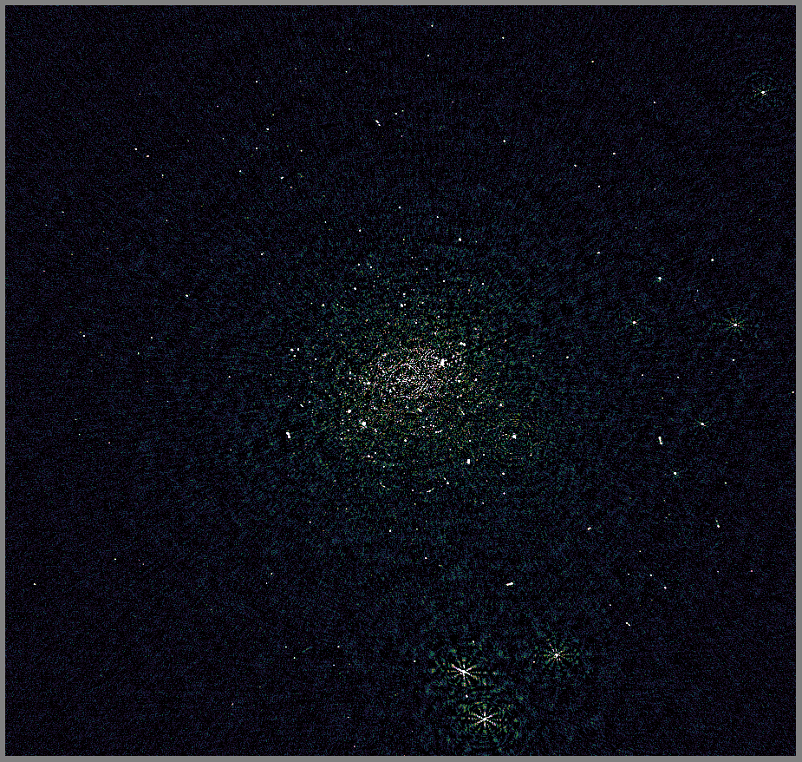
3C147+JVLA: New DR Record
Collaboration with
Rick Perley (NRAO)
3C147
JVLA-C @1.4 GHz
~192 MHz bandwidth used
Best image after
regular selfcal

Slide 55
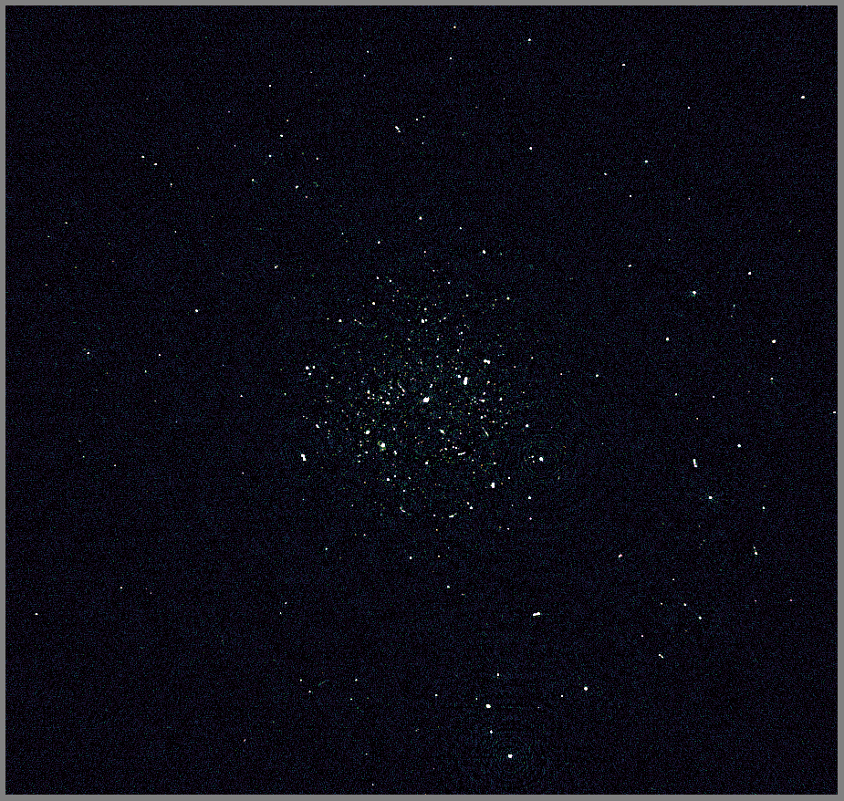
3C147+JVLA: New DR Record
Best image after
regular selfcal
DD calibration on a few sources
DR ~ 3.2 million

Slide 56
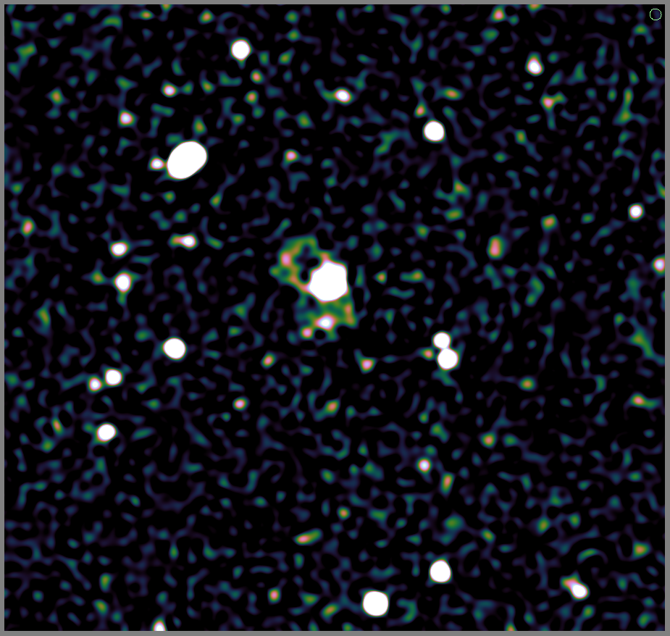
3C147+JVLA: New DR Record
Best image after
regular selfcal
DD calibration on a few sources
DR ~ 3.2 million
  more coming soon
The Perley Gates

Slide 57
High DR In The SKA Era
Today's extreme-DR is tomorrow's routine data reduction
All current showcase images produced in “hero mode”
  See e.g. talk by Pandey
This processing model does not scale!

Slide 58
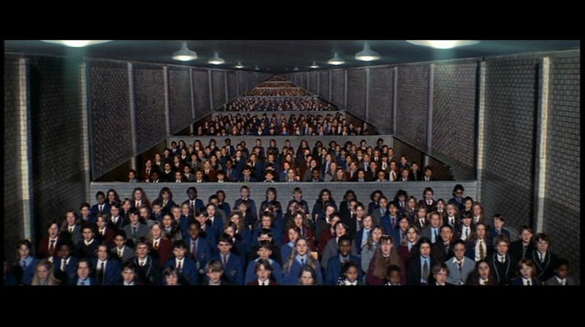
Exascale = Exapostdocs?

Slide 59
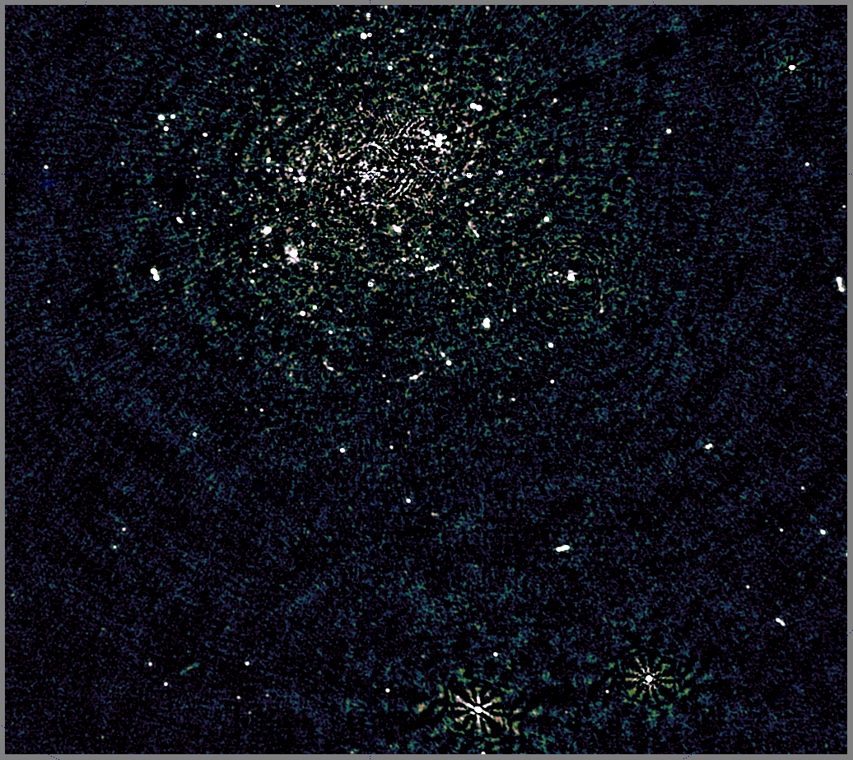
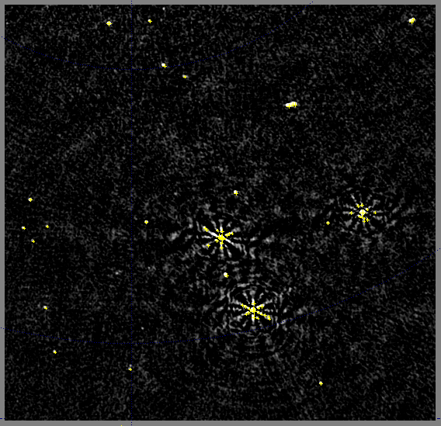
Obvious ML Application
Stage 1 calibration:
secondary sources generate artefacts
Stage 2: shallow source finding and
sky model update

Slide 60
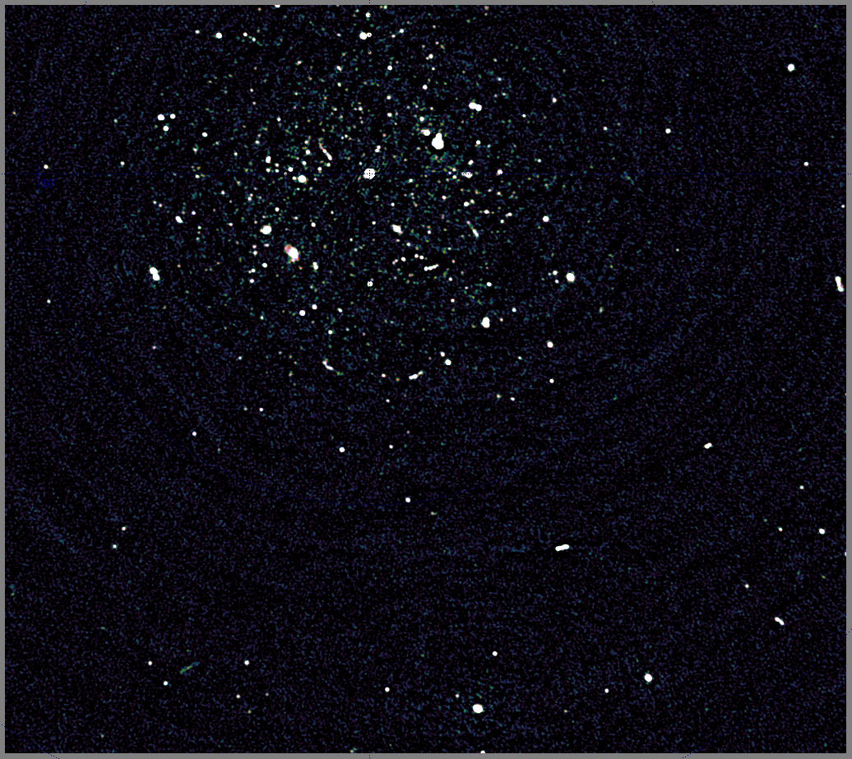
Obvious ML Application
Stage 3: designate troublesome
sources, apply direction-dependent solutions
Stage 4: Deeper source finder, update sky model,
rinse & repeat...

Slide 61
Moving Forward
b
b
x
b
x
x
c
y
Current implementation is
thread-level parallelized
Relatively efficient on a single
machine
  Can also provide GPU implementations of “critical” nodes
Primitive MPI support
  Trees can span clusters
  Problem is, how to do this efficiently?
*
*
1
+
α
sin
*

Slide 62
Self-optimizing Computation?
TDL scripts define the high-level (“human friendly”)
structure of the computation
The tree (graph) is a low-level
machine-friendly abstraction
  High parallelism in the tree itself
  (besides the obvious data parallelism)
Cost of computation and data transport in any given tree is knowable
The Holy Grail: automatically map a tree to any given cluster architecture in a reasonably efficient way?
b
b
x
b
x
x
c
y
*
*
1
+
α
sin
*

Slide 63
Conclusions
I have no answers, only questions
But they're good questions!
“May you live in interesting times.”
– wrongly attributed to ancient Chinese
“You may not be interested in the polarization,
but the polarization is interested in you.”
– wrongly attributed to Leon Trotsky

Slide 64
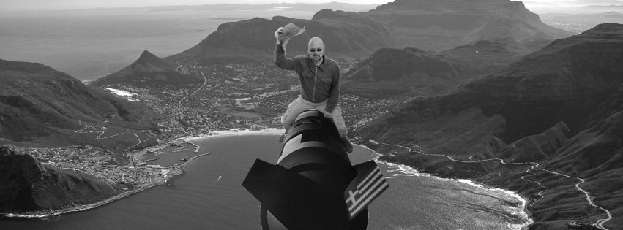
Thank You & Goodbye

