Slide 1
Calibration,
Model Fitting & Data Analysis in Radio Interferometric Imaging
O. Smirnov (Rhodes University & SKA SA)

Slide 2
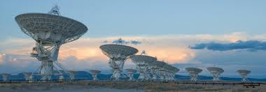
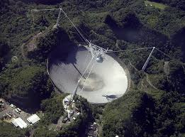


Problems
Radio astronomical signals are extremely faint
And easily corrupted:
10⁻⁸ seconds

Slide 3
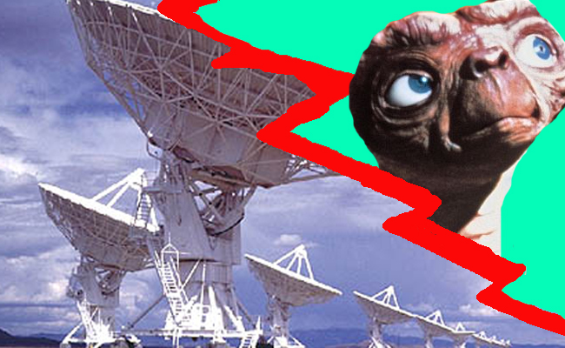
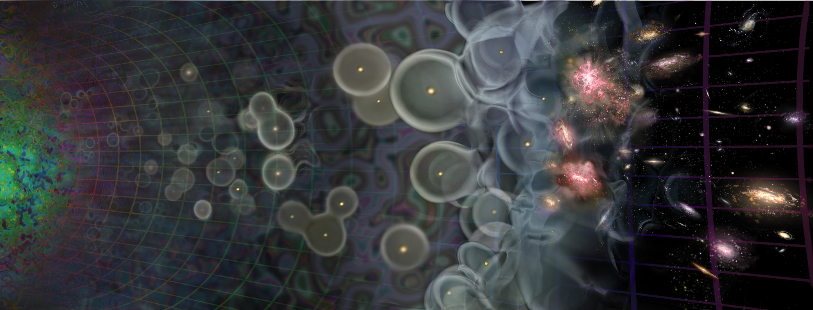


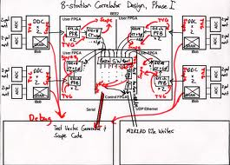
Radio Interferometer...
(In celebration of the passing of an extremely lame but blissfully short-lived internet meme)
What lay people think I do
What funding agencies
think I do
What cosmologists & astrophysicists think I do
What my engineers think I do
What I actually do

Slide 4
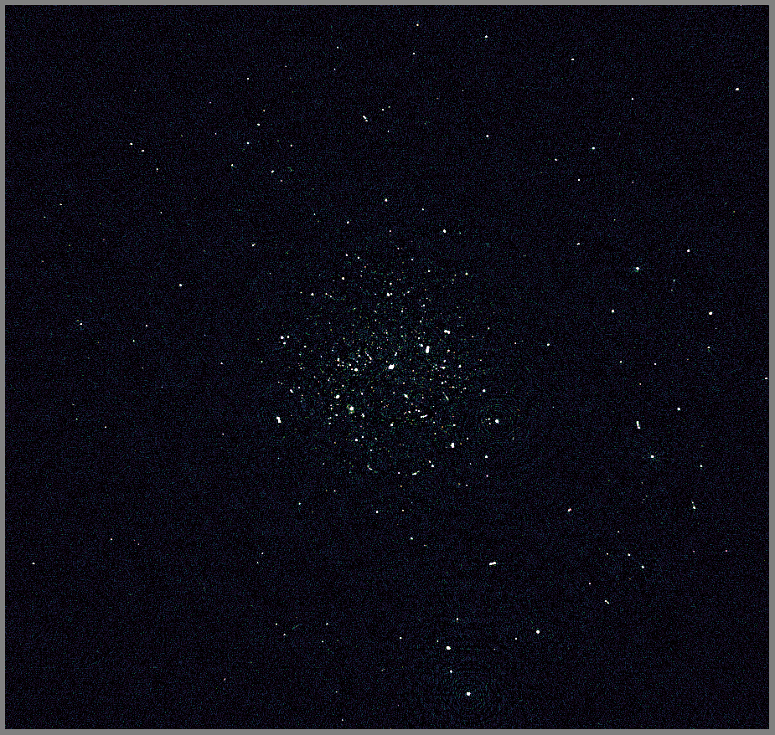
3C147+JVLA: New DR Record
Best image after
regular selfcal
DD calibration on a few sources
DR ~ 3.2 million

Slide 5
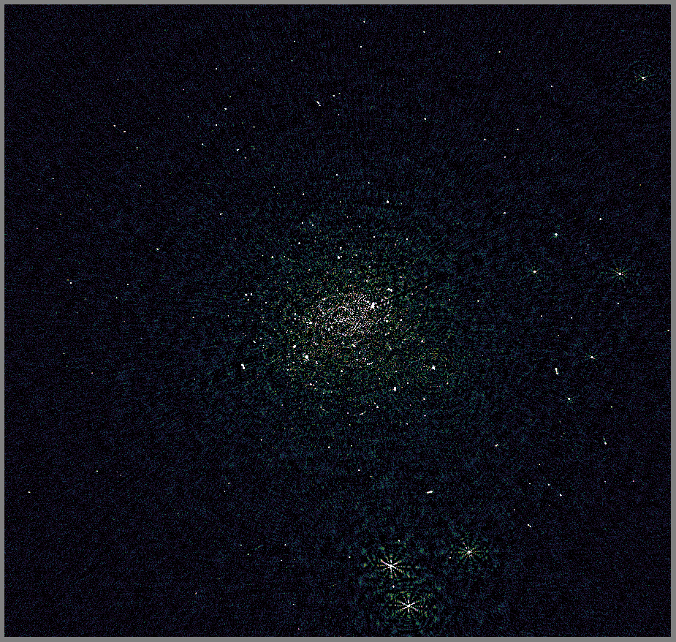
3C147+JVLA: New DR Record
Collaboration with
Rick Perley (NRAO)
3C147
JVLA-C @1.4 GHz
~192 MHz bandwidth used
Best image after
regular selfcal

Slide 6
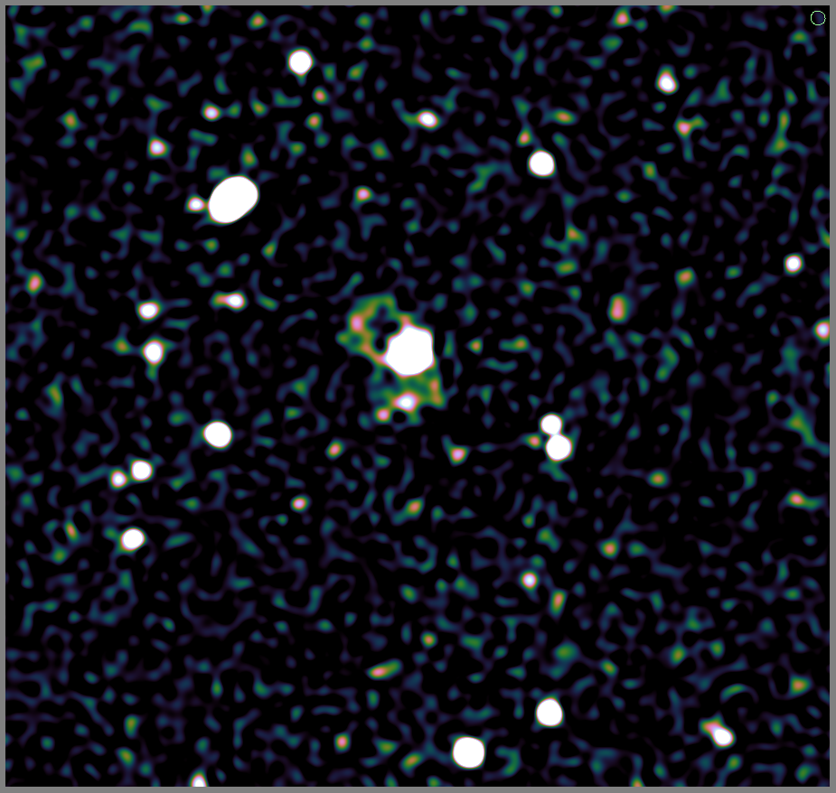
3C147+JVLA: New DR Record
Best image after
regular selfcal
DD calibration on a few sources
DR ~ 3.2 million
  more coming soon
The Perley Gates

Slide 7
Not Always a Luxury Problem
(Courtesy of Ian Heywood)
EVLA 8 GHz: Looking for sub-mm galaxies and QSOs in the William Herschel Deep Field.
Dominant effect: bright calibrator source rotating through first sidelobe of the primary beam.
(This also has a horrible PSF, being an equatorial field.)
This is your science
(good luck!)
This is your
phase calibrator
Brightness scale 0~50μJy

Slide 8

Differential Gains To The Rescue
Residual image after applying differential gain solutions to the contaminating source
Brightness scale 0~50μJy

Slide 9

Multi-Band Image
Multi-band residual image:
noise-limited, no trace of contaminating source.
Phase calibrator
used to be here
Brightness scale 0~50μJy

Slide 10
Calibration = Model Fitting
Calibration:
  Build a model of the instrument
  ...and the sky
  That best fits the data

Slide 11
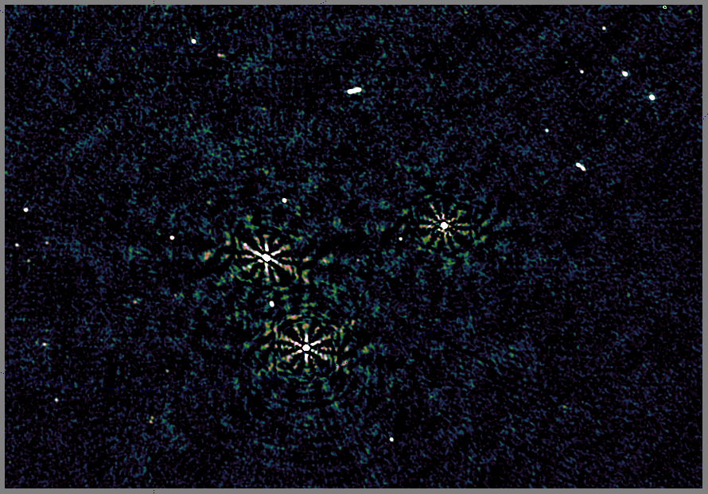
Real Or Instrumental?

Slide 12
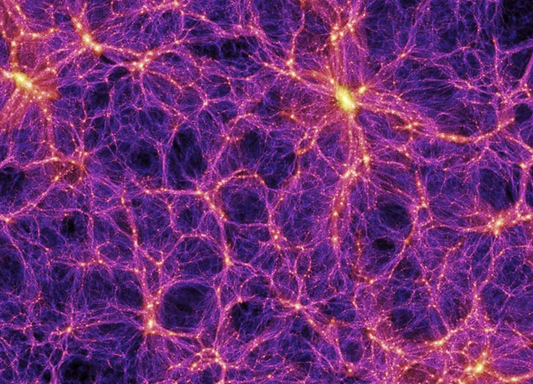
Statistical Approaches
Counting galaxies, rather than studying them...

Slide 13
Bayesian Approaches
Posterior
Probability of the model
given this set of data.
We want to find an
M that maximizes this.
Likelihood
Probability of this data
given the model.
From e.g. a ²-sum.
Prior
Probability of
the model
from prior
knowledge
or assumptions
Marginal probability
Unconditional probability
of this particular data,
assumed constant

