Slide 1


Slide 2
MeqTree Basics
“Meq” stands for the Measurement Equation
“Trees” stands for expression trees.

Slide 3
The Measurement Equation:
Putting The “Meq” Into MeqTrees
The Measurement Equation tells you what you can expect to observe with an interferometer, given a sky and the properties of your instrument.
Uses Jones matrices to describe signal propagation. E.g.:

Slide 4
“Trees” = Expression Trees
Any mathematical expression can be represented by a tree.
b
x
b
x
b
x
c
y
*
*
1
+
α
sin
*

Slide 5
A Measurement Equation Tree
subtree for Kq
subtree for Gq
I
Q
U
V
(lmn)
(uvw)p
subtree for B
subtree for Kp
Kp: ...
Kp: ...
Kp: ...
Kp: ...
Kp: ...
Kq: ...
Gq: ...
subtree for Gp
B: ...
Kp: ...
K†q:
ConjTranspose
G†q:
ConjTranspose
Gp: ...
Vpq: MatrixMultiply
...and repeat for all baselines.

Slide 6
Growing MeqTrees
The structure of a tree is declared using TDL (Tree Definition Language), which is built on top of Python
Trees are executed by a C++-based computing kernel
  fast (...within x2 of hand-optimized code)
  multithreaded
  soon to be distributed via MPI
Demo...
# now define predicted visibilities
for p,q in IFRS:
ns.predict(p,q) << Meq.MatrixMultiply(ns.G(p),ns.K(p),ns.B,ns.Kt(q),ns.Gt(q));

Slide 7
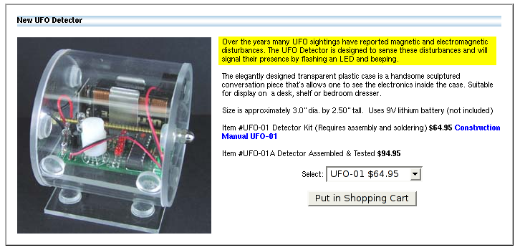
What's Big, Round & Shiny,
And Has l(t),m(t)?
If we were to track a UFO with a radio interferometer, what would we see?

Slide 8
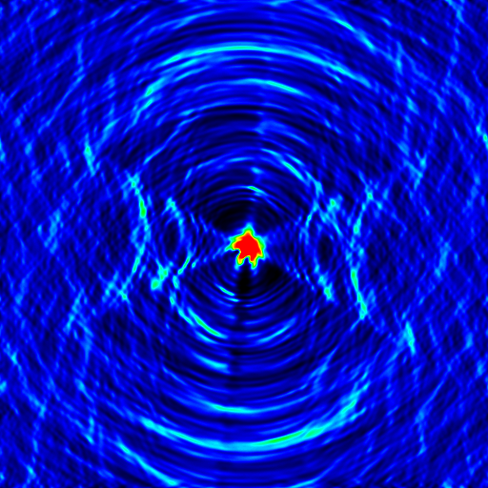
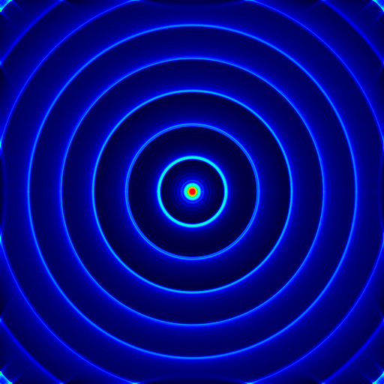
UFOs Over VLA & WSRT
Each frame of the animation corresponds to a full (8- or 12-hour) observation of a UFO. UFO speed increases with each frame.

Slide 9

Other Things That Move:
The Joys Of LOFAR
MeqTree simulation:
9 point sources on a grid
...corrupted by a very simple model ionosphere:
  sine/cosine TEC distribution, amplitude of TEC “waves” increases in time
animation composed of snapshot images
5'

Slide 10

A Self-Calibrated Ionosphere
Let's assume we can selfcal this perfectly...
We still have only one phase term per antenna, so we can only correct for phase at center.
This is the previous simulation, with the center phases divided out (2 lines of Python).
Relative movement is due to phase differences over the field of view.
This is a problem...
5'

Slide 11
The Zeta-Jones
Ionospheric phase delay:
TEC:
Ionospheric geometry:

Slide 12
Frameworks
A tree is like assembly language – the nuts'n'bolts view of what's going on.
Pure TDL is like C – a higher level language, but still very close to what the “tree machine” is doing.
An OO framework lets you construct trees in higher-level terms, by providing a “domain language”:
  I have an interferometer array of N antennas
  make me a point source here
  make me a Jones matrix
  make me a tree implementing this M.E.
Frameworks can be hierarchical

Slide 13
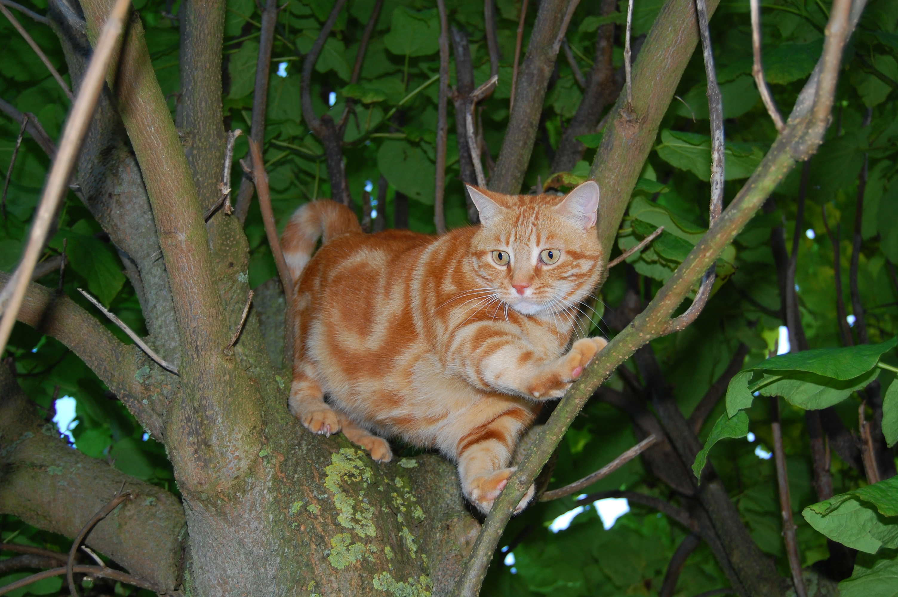
Meow
(Measurement Equation Object frameWork)
software
bloat

Slide 14
Meow
Highlights:
  we deal in “sky components”, “arrays”, “observations”
  details of sky sources are hidden, it just gives us the visibilities
also provides convenient utilities for
  GUI options
  Measurement Set I/O
  imaging, bookmarks, etc.

Slide 15
Meow Inheritance
RA, Dec
lmn()
Direction
visibility(nodes): None
SkyComponent
PointSource
GaussianSource
Patch
FITSImageComponent

Slide 16

Siamese
(How To Do Simulations In Your Sleep)

Slide 17
Siamese
Siamese is a Simulator Framework (based on Meow)
Problem 1: high threshold for astronomers
  not everybody wants to learn TDL/Python
  give them a button to click
  ideal UI (Tony WIllis):
Problem 2: many people working on implementing sky and/or instrumental models
GO
GO FASTER
DO WHAT
I MEAN!

Slide 18
Various simulation efforts
LOFAR
  dipole and station beams (S. Yatawatta)
  ionosphere (M. Mevius, J. Anderson)
  Local Sky Model (LSM) (everybody...)
WSRT (J. Noordam)
SKADS
  model skies (everybody...)
  ionosphere (I. van Bemmel)
  AA beams, pointing errors (C. Reynolds, S. Sundaram)
  FPA beams (T. Willis)
DIGESTIF (R. Boomsma, T. Oosterloo)

Slide 19
How to make things just fit together?
TDL is a good basis for exchanging trees
The ME provides a mathematical framework
  someone makes a sky model
  someone else makes a tree for computing Jones matrices
  at least you know how to plug them together (mathematically)
But we still have a software problem
  different styles, different conventions

Slide 20
Design By Contract
Design by contract (DBC) is an OOP design approach
  Common in modern semi-interpreted languages.
  Used in a lot of Python libraries and frameworks (including Meow).
  Like all powerful tools, has great potential for misuse and workplace injuries.
Main idea: interfaces specify behaviours, not types
Less effort to program for than conventional strongly-typed interfaces

Slide 21
C++lassic OOP:
Strong Typing, Inherit Everything
Consider Meow.Patch
  we say that a Patch can contain any number of any kinds of sources.
The C++ way: declare a Meow.SkyComponent parent class, and inherit all component classes from that.
The Patch interface then explicitly specifies that you can only add SkyComponents:
    void add (SkyComponent src); // C++
    if not isinstance(src,SkyComponent): # Python
      raise TypeError;

Slide 22
Strong Typing
Pros and Cons
Pros:
  catches errors early (compile-time, or at run-time during the function call)
Cons:
  If you want to add your own source type, you will ALWAYS have to inherit from SkyComponent, even if this brings in undesirable features or complications.

Slide 23
But What Does
A Patch Really Need?
Take a look at Meow/Patch.py, and think of the following: what essential properties must the “source” object have to work in a Patch?
Answer: only the following method:
  visibilities();
So anything with a visibilities() method can be part of a patch, not necessarily just subclasses of SkyComponent.
So why not allow it?

Slide 24
And That's a “Contract”
So we say: “you can add anything to a patch, as long as it implements a visibilities() method, which returns a set of per-baseline nodes that must be qualified with a p,q station pair, and that compute visibilities”
The above is a contract.
A contract is a much weaker requirement than having to derive everything from one parent class.

Slide 25
Contract Pros
A more flexible approach than strong typing.
No need to inherit from common base classes, objects fit together “on the fly”.
Easy to integrate objects when only one aspect of an object's behaviour is required.
With experience, your designs settle on a set of some “standard” contracts, which means your objects fit together easier and with far less work.
Leads to loose coupling.

Slide 26
Contract Cons
Strong typing imposes discipline, with design by contract you'll have to impose it yourself.
Much harder to catch errors early (since it's harder to check for a contract than to check for a specific type).
Contracts must be kept simple lest things get too confusing, and must be well-documented.

Slide 27
Another Contract Example
### caller returns a per-source, per-station Jones, but
### we only have a per-source Jones
def compute_Ejones (ns,source_list,array,observation):
for src in source_list:
ns.Esrc(src.name) << .......;
for p in array.stations():
ns.E(src.name,p) << Meq.Identity(ns.Esrc(src.name));
return ns.E;
What's the contract on the return value here (the ns.E object)?

Slide 28
Another Contract Example
Answer: it must be something that returns a Jones node when we do “(src,station)” on it.
So it doesn't have to be an “ns” object:
### a better way
def compute_Ejones (ns,source_list,array,observation):
for src in source_list:
ns.Esrc(src.name) << .......;
def source_jones (src_name,p):
return ns.Esrc(src_name);
return source_jones;
### or simply say:
# return lambda src_name,p: ns.Esrc(src_name);

Slide 29
Standard Siamese Contracts
see wiki:
  www.astron.nl/meqwiki/
  FrameWorks/StandardContracts
Defines contracts for, e.g.:
  “Jones term”
  “Station Jones Module”
  “Pointings Module”
  “uv-Jones Module”
  “Sky Model”

Slide 30
Siamese example
We the put together a measurement equation:
  “The” Measurement Equation refers to the generic mathematical framework:
  We make a measurement equation by plugging in specific terms:

Slide 31
Meow.MeqMaker:
Using The Power Of Contracts
Puts together trees implementing MEs from components that comply with standard contracts
Incorporates GUIs from components
! Provides visualizations
“Power user” writes simulators, provides one or more components for each Jones term
“Regular user” pushes buttons

Slide 32
Siamese example, cont'd
We (“power user”) list alternative modules for each component of the ME, e.g.:
  Z: ionosphere
  E: beams (AA, WSRT, CS1, etc.)
    ...and pointing errors
  G: gains/phases
  B: sky model
MeqMaker puts together a GUI based on the supplied set of modules
User pushes buttons to select modules and set them up

Slide 33
Currently Available Modules
http://www.astron.nl/meqwiki/JonesMatrices
beams:
  AA (Sundaram), LOFAR CS1 (Sarod), WSRT (Oleg)
pointing errors:
  random time-varying errors
ionosphere
  toy ionosphere (Oleg)
receiver gains
  random gains/phases (Oleg)

Slide 34
Sky models (B)
Gridded sky (Oleg)
Transient sky (Casey)
Local Sky Model (LSM: Sarod Yatawatta)
  meant to be a “generic” list of sky sources
  supports different types of sources: point sources, extended gaussians
  (future support: shapelets, images)
  interface to external formats: NVSS, NEWSTAR, VizieR, clean components, etc.
  easy to extend parser (Sundaram), it's just Python

Slide 35
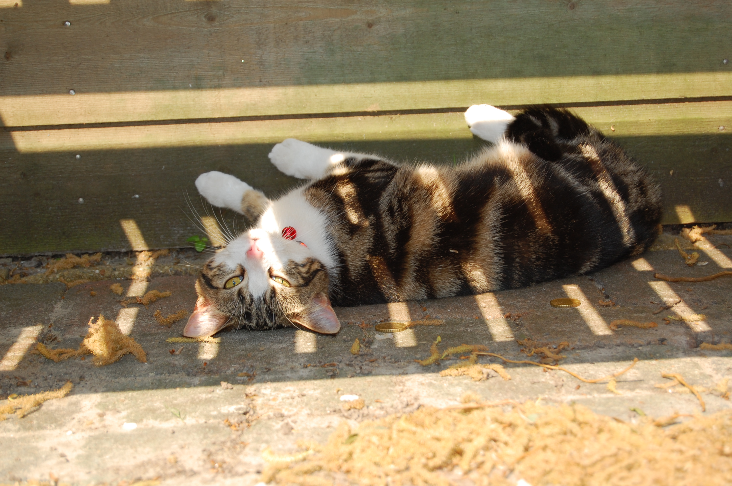
Calico
(Calibration Components)
I detect fringes...

Slide 36
Calico
Same idea as Siamese: power user collects Jones modules together into a calibration script.
Uses MeqMaker, so same contracts!
If modules contain any solvable parameters, Calico automatically provides options for calibration of these
...including GUIs and visualization

