Slide 1

Luxury Problems Of
High Dynamic Range Imaging
O. Smirnov

Slide 2

The Project Formerly Known As
The “Beat NEWSTAR” Project
Project “Tiger”
Aim: demonstrate the advantages of ME-based calibration
  by doing better than a legacy package
  pick the right target...
NEWSTAR (Netherlands East-West Synthesis Telescope Array Reduction)
  not a terribly wide user base
  WR holder in dynamic range
  (→2 million)
...but a very tall one!

Slide 3

3C147
NEWSTAR image
22Jy @21cm
12h, 8 bands
13.5 uJy noise
on-axis DR:
1500000:1
off-axis DR:
1000:1
Limited by direction-dependent effects
(DDEs) such as pointing errors, tropospheric refraction, etc.
No direct cure in selfcal.
polarized, 40 mJy
3C147, 22 Jy
35 mJy
20 mJy

Slide 4
Calibrating For DDE's I:
Peeling
“Peeling” is different things to different people, but here we'll define it as:
  selfcal on brightest source, subtract source
  shift phase center to next source
  selfcal, subtract, rinse & repeat
Proven to work...
  3C343, 3C84, 3C196, etc. (Ger de Bruyn, Tom Oosterloo, Michiel Brentjens – NEWSTAR, Miriad)
...but cumbersome to use (miles of scripts)

Slide 5
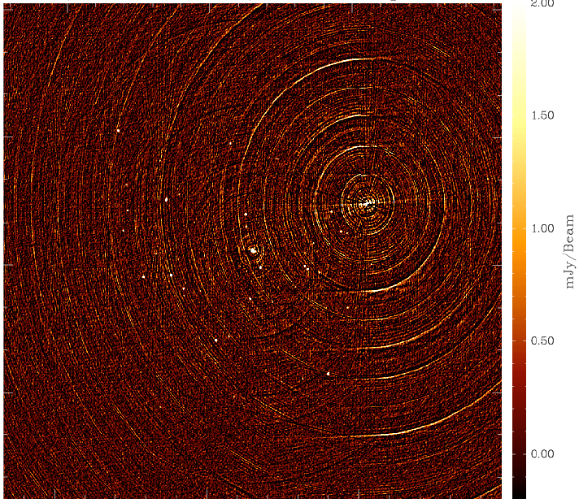
3C343: A Typical
Peeling Candidate

Slide 6
Calibrating For DDE's II:
Beyond Peeling
Weakness of peeling: interacting solutions when sources have comparable flux
  need to iterate back and forth
  Not clear how deep one can go
Alternative: simultaneous off-axis gain solutions (some call it “peeling” too.)
  3C343 (Michiel Brentjens -- MeqTrees)
Alternative: solving for pointing errors
  Sanjay Bhatnagar – CASA
  EVLA Memo 84
  So far, only validated on simulated data

Slide 7
The MeqTree Approach
Implement calibration via a Measurement Equation. For example:

Slide 8


Bandpass Artifacts
Residual pattern from 3C147 due to bandpass instability.
We do a separate B solution every 30 min.
Error pattern caused by variations in actual bandpass over the solution interval
  error ~ 1/10,000
We can mitigate this by making B a 1st-degree polynomial in time
  error ~ 1/500,000
  close to noise level but plainly visible
Further increase polynomial degree?
  or spline?

Slide 9
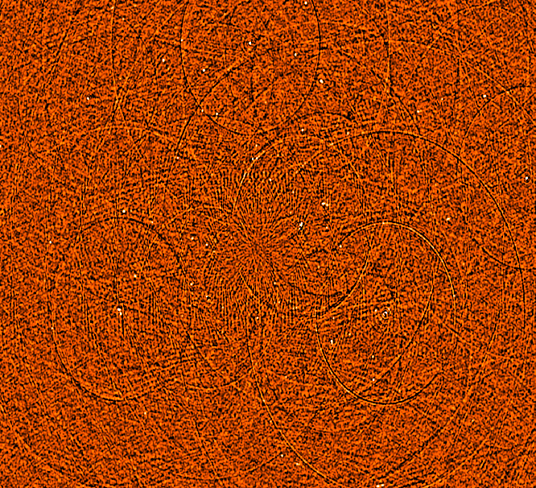
Limits Of Bandpass Stability
B solution every 7.5 minutes
G solution every 30 sec.
Followed by smoothing of B and repeated G solution
We're still left with a DR-limiting error pattern left over from 3C147 itself.
My tentative conclusion: WSRT bandpass is “jittery” on short timescales.
...but you need to get past 100,000:1 DRs for this to bite you!
  A luxury problem

Slide 10
Dropping The Bandpass
Do a per-channel selfcal
  with sufficient S/N, why not?
  this is what Ger does in NEWSTAR
In M.E. terms:

Slide 11

Seeing The DDE's
Residual image, 298 sources subtracted
Per-channel selfcal + closure errors
Dominant features are residuals from off-axis sources.
Some of it is due to missing/too much flux in the sky model and can be CLEANed away.
But not all of it! (and this is what causes artifacts in the final map.)
polarized, 40 mJy
3C147, 22 Jy
20 mJy
35 mJy

Slide 12
Solving For Pointing Errors
Bhatnagar's approach, in terms of our ME:

Slide 13
Differential Gains
Or we can introduce differential gains:

Slide 14
Flyswatter I
The “before” image.

Slide 15

Flyswatter II
Solved for ΔE for
5 sources.

Slide 16

Flyswatter III
Solved for ΔE for
10 sources.
In the end 10 sources proved unnecessary (deconvolution helps as well!), so in the final images I only solved for 6 sources.

Slide 17
3C147
NEWSTAR image
22Jy @21cm
12h, 8 bands
13.5 uJy noise
on-axis DR:
1500000:1
off-axis DR:
1000:1
Limited by direction-dependent effects
(DDEs) such as pointing errors, tropospheric refraction, etc.
No direct cure in selfcal.

Slide 18

3C147
MeqTrees image
22Jy @21cm
12h, 8 bands
13.5 uJy noise
Same DR as NEWSTAR, but no off-axis artifacts.

Slide 19

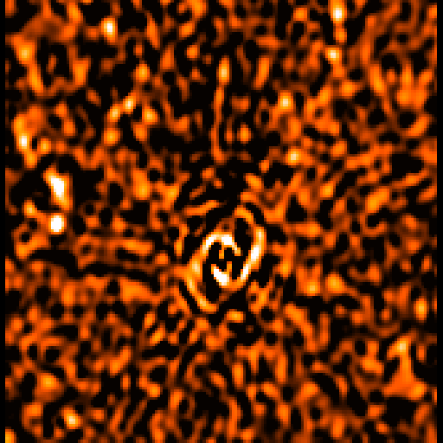
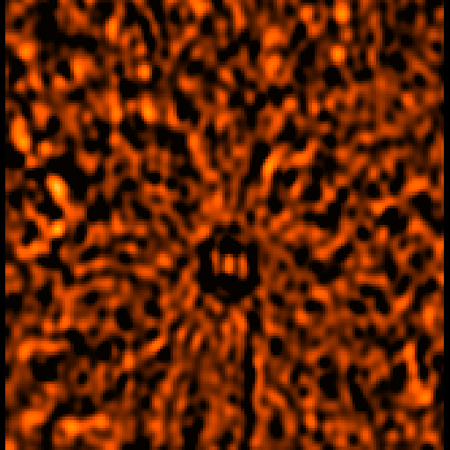
Perils Of (Degrees Of) Freedom
MeqTrees can try to solve for anything
...which does not necessarily make it a good idea!
Case in point: closure errors
  12h vs 1h solutions
12h
1h
No man, no problem.
– J. Stalin

Slide 20
Differential gains:
What Would Uncle Joseph Say?
The Flyswatter also does a “no sources, no problem” operation.
How do we know this is not a Peril?
  per-channel selfcal (14 antennas, 85 baselines):
  14 complex gains per t/ν point,
  85 complex measurements per t/ν point
  one extra ΔE term:
  14 complex gains per 60*30 t/ν points,
  ~.015 of a parameter per t/ν point!
...but 1h closure errors: 85 complex gains per 120*30 t/ν points, and that went quite badly

Slide 21
Differential gain analysis
For each source/antenna, we have independent ΔE solutions per each band (8), per 30 minutes.
Studying the t/ν behaviour should tell us something about:
  whether we have solved for a physical effect,
  the nature of that effect.

Slide 22

Note the high S/N in frequency
Continuity in time and space suggests dominant large-scale effect, as opposed to per-antenna things like pointing

Slide 23
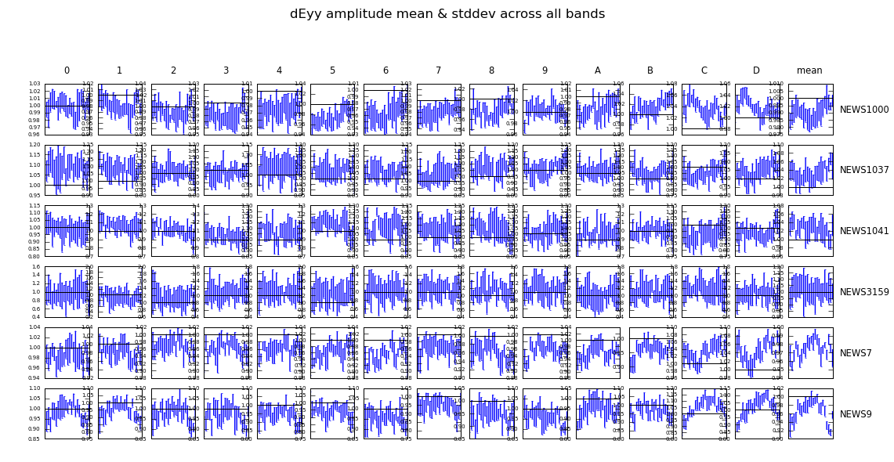
But perhaps most importantly, this shows we can solve for DDEs with relatively weak (~few mJy) sources!
Good news for calibration of future instruments: we should have enough calibration beacons.

Slide 24
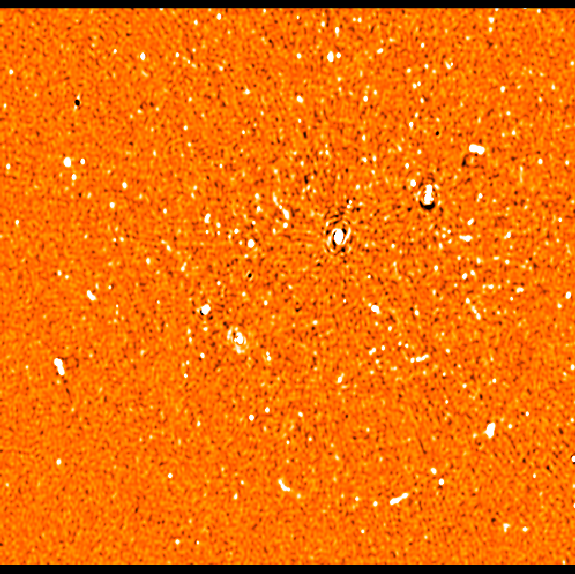
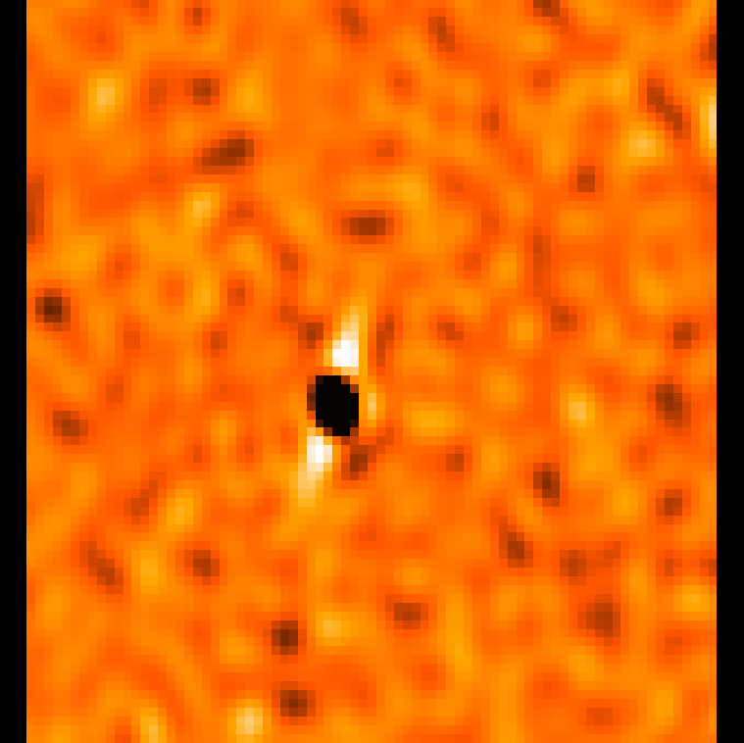
More Perils
One of my intermediate images. Note artists' impression of a black hole with relativistic jets.

Slide 25
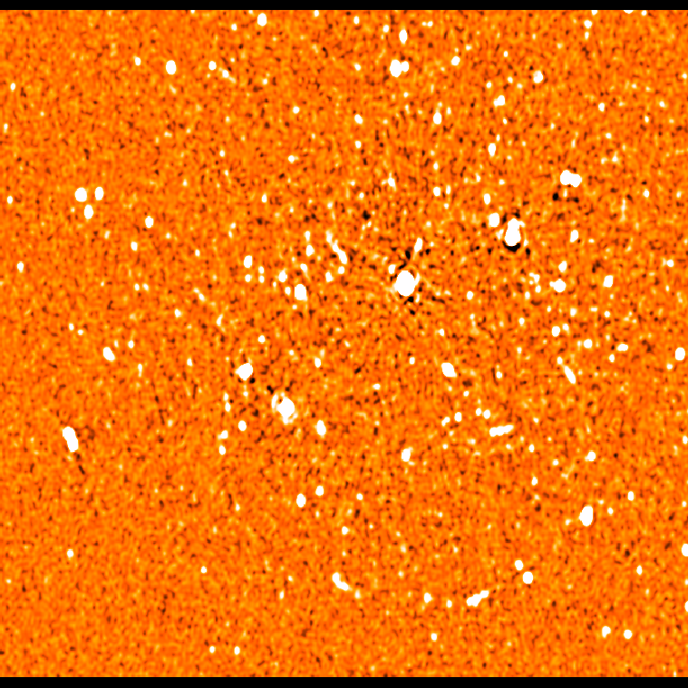
A Good Image, For Comparison
Spot the differences
Bright off-axis sources have negative counterparts symmetric w.r.t. 3C147
(≠ phase centre!!!)

Slide 26
Has anyone figured it out?

Slide 27
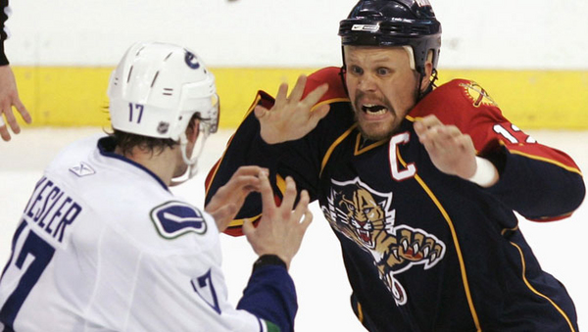
Perils Of Flagging
Gawd!
I've flagged
too much data
again!

Slide 28
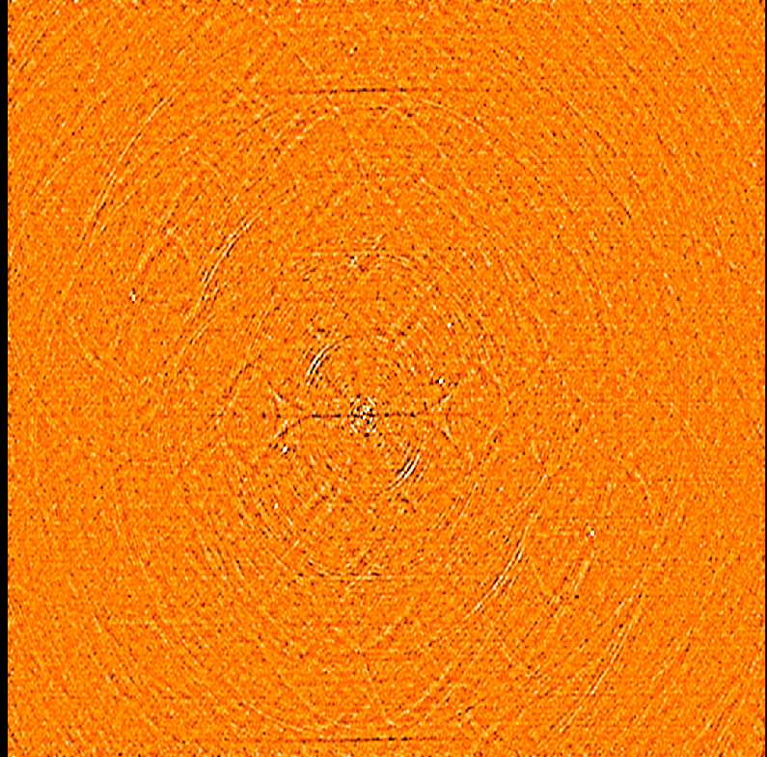
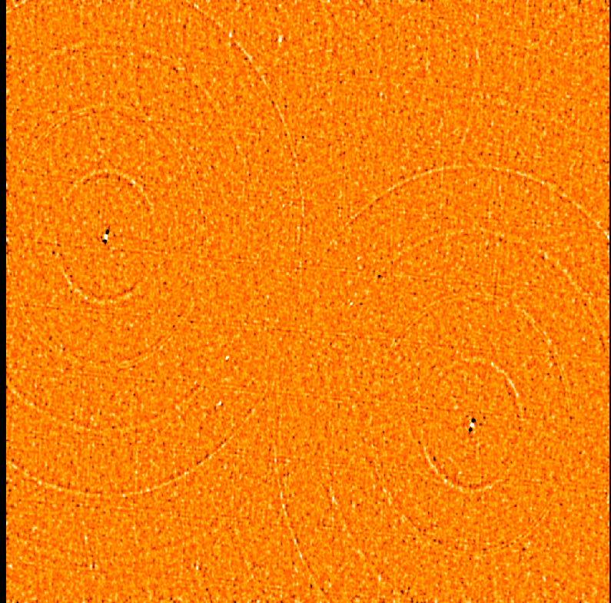
“Flagging Bias”
Amplitude-based flagging in the presence of significant flux can introduce coherent structure into your final maps!!!
Difference between flagged and unflagged:
uvbin method
timemed method

Slide 29
The S.E.P. Field
(And The BA++ Field)
“An SEP is something we can't see, or don't see, or our brain doesn't let us see, because we think that it's somebody else's problem.... The brain just edits it out, it's like a blind spot. If you look at it directly you won't see it unless you know precisely what it is. Your only hope is to catch it by surprise out of the corner of your eye.” – D. Adams
Radio astronomers are familiar with a related phenomenon: the Blame AIPS++ (BA++) Field.
  induces currents of hilarity, and pumps in warm fuzzy energy
A much rarer (and catastrophic) phenomenon is the Collapsing BA++ Field.

Slide 30
The Mysterious Spokes

Slide 31
3C147
NEWSTAR image
Note the radial spokes – Ger de Bruyn detects them in all(?) his high-DR maps.
(But you really have to push a million DR to see them!)

Slide 32
3C147
MeqTrees image
Spokes recreated perfectly with MeqTrees calibration. Therefore not a NEWSTAR processing artifact.
Spokes mitigated by aggressive flagging on baselines to RTC.

Slide 33
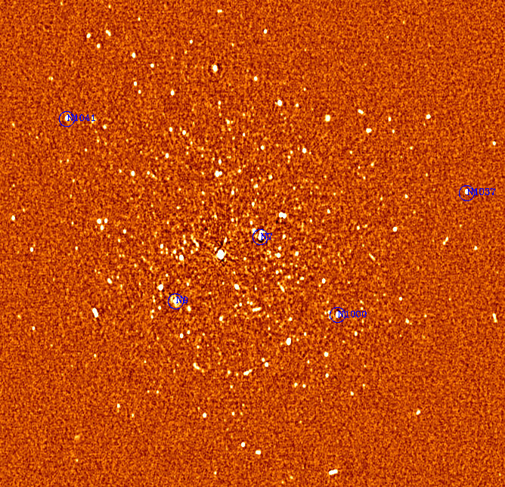
3C147
MeqTrees image 2
Spokes disappear entirely when imaging without RTC.

Slide 34
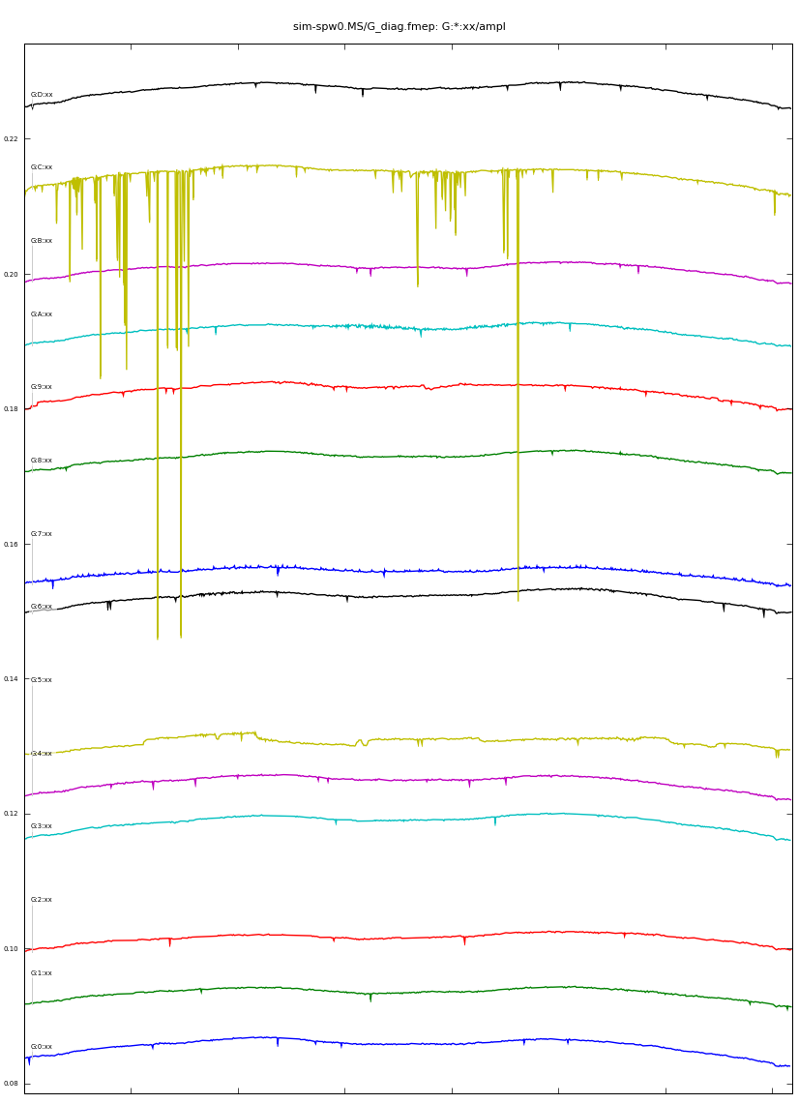
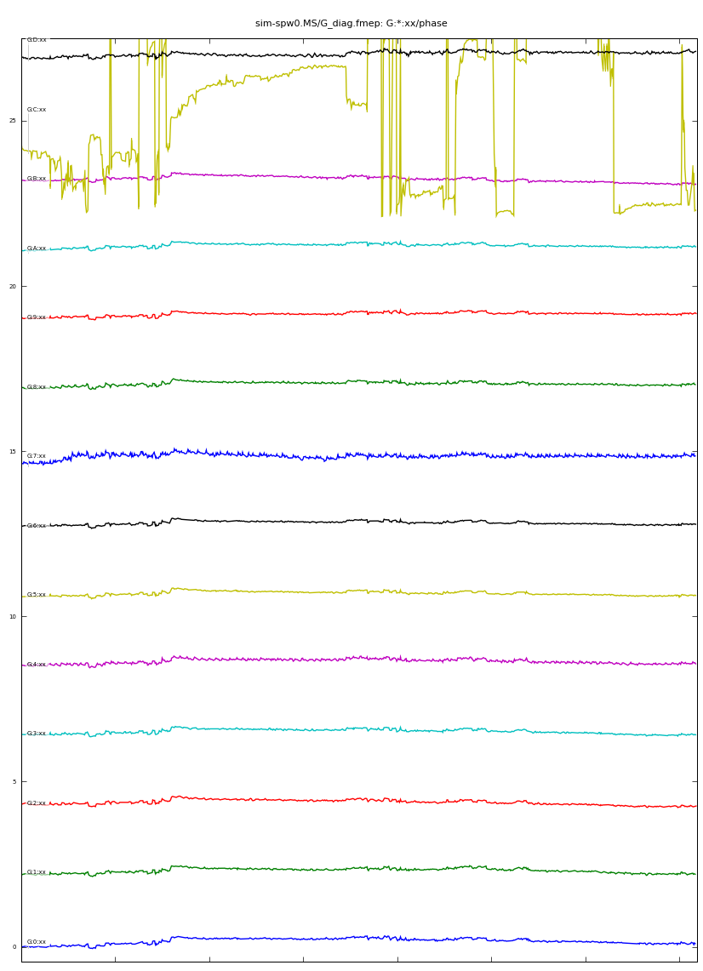
Possible counterpart in the selfcal solutions?

Slide 35
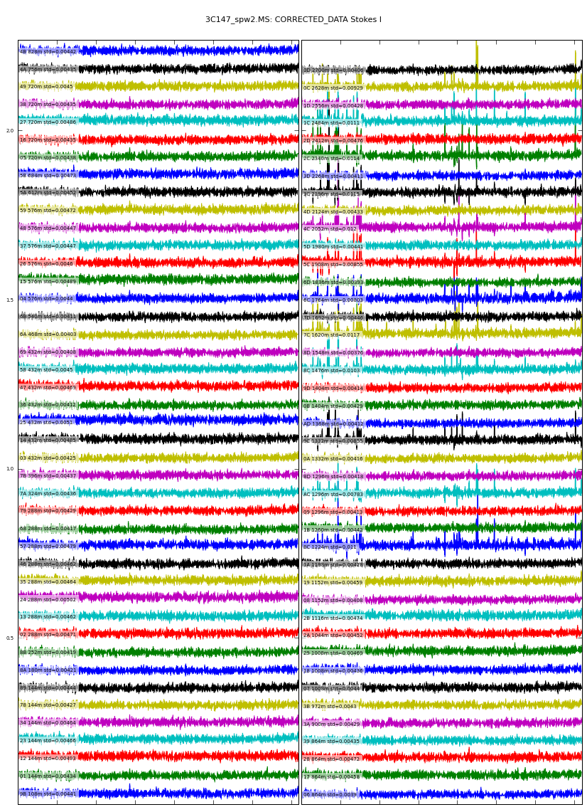
“Jumps” in the residual amplitudes correspond to drops in amplitude solutions, and to the most prominent spokes.
Difficult to imagine a physical error source that is not taken care of by selfcal
???

Slide 36
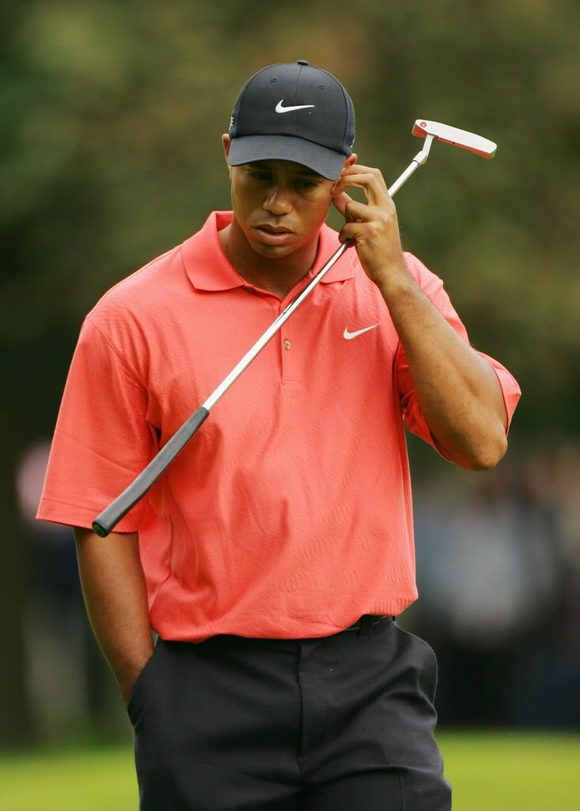
Conclusions
The luxury problems of today will be on your basic health policy of tomorrow, so prepare early!
3C147 differential gains result
suggest calibration beacons
will be plentiful.
Flaggers beware!
Many challenges and
mysteries remain.

