Slide 1
BeamSims
O. Smirnov (Rhodes & SKA SA)
B. Frank (UCT & SKA SA)

Slide 2
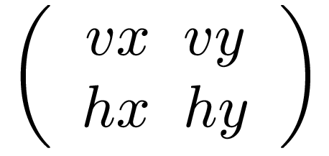
Making FITS Beam Patterns
Size & resolution
cp -a /home/data/beams .
cd beams
./emss2fits.py --freqs=1450 --labels=a,b,c,d,e,f
-R 0.01 -r 1000
beam-patterns/TU3e20_centre_h_@freq_@label.pat
-y
--ampl
ampl_og.fits
tigger ampl_og.fits
Beam type:
(K7s,
TU3e20h,
TS3e15h)
J element: hy hx
vy vx
J element:
Output filename

Slide 3
Part II. Calibration “Noise”
We have been very successful at eliminating DDE-related artefacts via direction-dependent solutions (peeling, SAGEcal, differential gains)
And by “eliminating” we mean “driving below the (thermal) noise”
...by which we really mean “sweeping under the carpet”
So, how do we estimate what we have “swept”, and can it come back to haunt us?

Slide 4
Distilling Out The Artefacts
Use the NVSS + S³-SEX to make a deep LSM (limited FoV)
Add a pair of 1 Jy sources at the half-power point (the contaminators)
Make two full interferometric simulations, including [direction independent] gains (G-Jones) and pointing errors (E-Jones)
  of the full LSM + thermal noise → simulated DATA
  of just the contaminators → CONTAM_DATA
  with the same simulated G & pointing errors

Slide 5
Distilling G
1. Run selfcal to obtain G solutions on DATA using some bright subset of the LSM
2. Image the residuals: this contains artefacts, noise and fainter sources. How to tease these apart?
3. Subtract the contaminators alone from CONTAM_DATA while applying these G solutions
4. Make an image of the residuals from (3)
This is an image of distilled artefacts, i.e. exactly the contribution of the contaminator sources to image obtained at step 2.

Slide 6

Calibration Noise, Post-G
We've isolated “calibration noise” per unit flux!
Here, rms
4.2 μJy
(but very
non-Gaussian)

Slide 7
Distilling DDEs
But nevermind, because direction-dependent solutions can take care of it, right?
If we run a dE solution on the two contaminator sources, the resulting image (of the full residuals) becomes thermal noise limited; remaining artefacts are below the noise.
But we can repeat the same trick with CONTAM_DATA to distill them out anyway

Slide 8

Calibration Noise, Post-dE
Here, rms 2.6 μJy, and far less spatially correlated

Slide 9
Why Do We Care?
Just an extra noise-like contribution that's below the thermal noise, so what's the big deal?
But it can be a big deal if its statistics are non-Gaussian

Slide 10
Scenario: Deep Survey
Consider a deep survey where we obtain many pointings of the same field
  MIGHTEE/LADUMA: 5000 hours
Each pointing must have independent DDE solutions
  Beam stability, ionosphere, etc. always different
  So for each pointing we leave an independent set of calibration artefacts buried in the thermal noise
We now combine the pointings – thermal noise adds up as √n (0.1 μJy after 5000 hours)
How do the artefacts add up?

Slide 11
Distill, Rinse, Repeat
We can repeat the distillation experiment multiple times, with different random realizations of G/dE errors
...and add up the “distilled” maps

Slide 12

Mean Of 10 dE-Distills
Structure shows up
Does not scale as a Gaussian
1 distill, rms 2.6 μJy
10 distills, rms 1.2 μJy

Slide 13

PF vs OG
Repeat this experiment for PF and OG beam patterns
Calibration “noise” for OG lower by a factor ~3
PF: rms 3.6 μJy
OG: rms 1.2 μJy

Slide 14
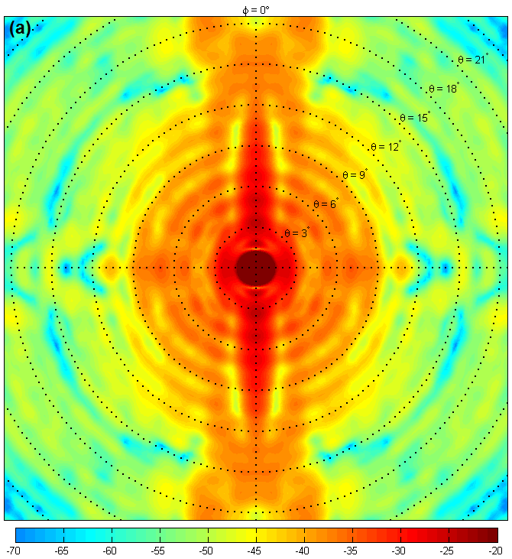
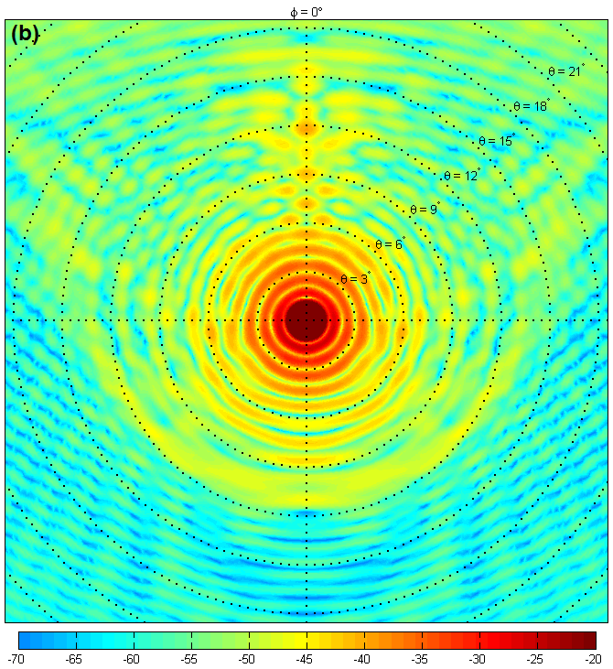
Why The Difference?
Difference probably due to OG's smoother beam pattern
same amount of pointing error causes more gain variation in the PF case

Slide 15
Conclusions II
All calibration, including direction-dependent solutions leave non-Gaussian artefacts buried in the noise
May become a DR limitation for deep surveys
  can be mitigated by dynamically scheduling deep observations during favourable conditions (wind etc.)
Calibration “noise” due to pointing error significantly higher (x3) for the KAT-7 PF design than for the MeerKAT OG design
More study needed!
  AA factors: beam stability, ionosphere

