Slide 1
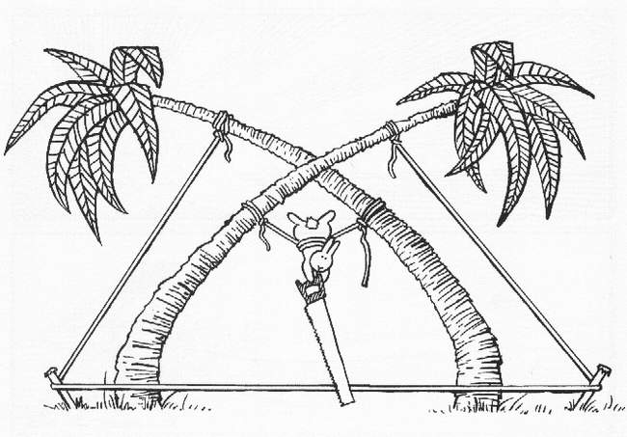
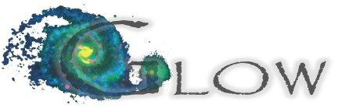
MeqTrees, Measurement Equations, And All That
O. Smirnov (ASTRON)

Slide 2
Today's Menu
(A Fourier Transform Of The Official Program)
Measurement Equations
MeqTrees
Practicals
  ...all interspersed
Questions welcome at any time

Slide 3
The Measurement Equation – a quick flyover

Slide 4
The Measurement Equation
(of a generic radio interferometer)
First formulated by Hamaker, Bregman & Sault (and further developed by Hamaker.)
A mathematically complete and elegant description of what you actually measure with an interferometer
  all we had before were hints and approximations
Absolutely crucial for simulating and calibrating the next generation of radio telescopes; everything literally revolves around it.
Like most great things, is utterly obvious in hindsight.

Slide 5
A Wafer-Thin Slice of Physics:
EM Field Propagation

Slide 6

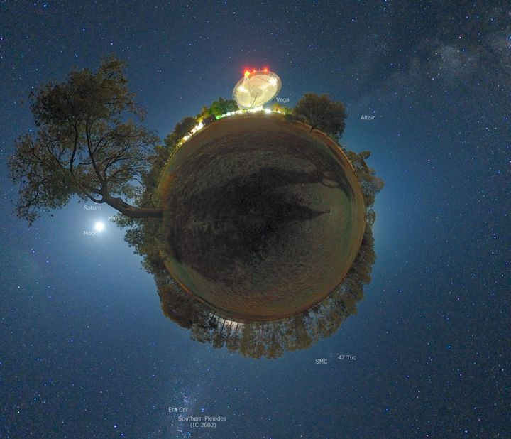
Single Dish
measured voltages are a complex 2-vector (vx,vy) -- we have two polarized feeds

Slide 7

Interferometry

Slide 8
A Wafer-Thin Slice of Physics:
Correlations & Visibilities

Slide 9
A Wafer-Thin Slice of Physics:
The M.E. Emerges

Slide 10
And That's The Measurement Equation!
Or in more pragmatic terms:
NB: it is also possible to write the ME with a circular polarization basis (RR, LL, etc.) We'll use linear polarization throughout.

Slide 11
Jones Matrices
J is called a Jones matrix
Total J is a product of individual Jones terms:
Order of Js corresponds to the physical order of effects in your signal path.
Matrices (usually) don't commute!

Slide 12
Accumulating Jones Terms

Slide 13
Why Is This Great?
A complete and mathematically elegant framework for describing all kinds of signal propagation effects.
...including those at the antenna, e.g.:
  beam & receiver gain
  dipole rotation
  receptor cross-leakage
Effortlessly incorporates polarization:
  think in terms of a B matrix and never worry about polarization again.
Applies with equal ease to heterogeneous arrays, by using different Jones chains.

Slide 14
Why Is This Even Greater?
Most effects have a very simple Jones representation:

Slide 15
Three Layers Of Intuition
Physical
  Beam pattern of X and Y dipoles different, causes instrumental polarization of off-center sources
  Parallactic angle rotates angle of polarization
Geometrical
  A Jones matrix is also a coordinate tranform
  gain is stretching => instrumental polarization
  P.A. is a rotation
  The two do not commute
Mathematical: matrix properties

Slide 16
ME ME ME
The general formulation above is “The Measurement Equation” (of a generic radio interferometer...)
When we want to simulate a specific instrument, we put specific Jones terms into the ME, and derive a measurement equation for that instrument.
We then implement that specific m.e. in software (e.g. with MeqTrees)
Existing packages implicitly use specific m.e.'s of their own.

Slide 17
Obfuscating The M.E., Part 1:
Evil Mueller's Evil 4×4 Formalism
The M.E. is, at core, very simple
Unfortunately, some approaches (prevalent in literature!) tend to make it complicated
Outer products and Mueller matrices is one of them
  Used in Hamaker et al.'s original ME paper (“Paper I”, 1996)
  Picked up for Noordam's Note 185
  Firmly entrenched with the imaging crowd
  2x2 version not proposed by Hamaker until Paper IV.

Slide 18
Evil Mueller's Formalism

Slide 19
Why Evil Mueller?
Disadvantages of Mueller formalism are obvious: non-intuitive, too many indices to keep straight
  Human mind only keeps track of 7 things at once
Advantages:
  Emphasizes that observed visibilities are linear w.r.t. input Stokes images
    And thus beloved by imaging people
  Makes simple things complicated
    And thus beloved by the High Priesthood

Slide 20
MeqTrees Intro

Slide 21

MeqTrees, What And Why
A software system for building
numerical models – simulation
...and solving for their
parameters – calibration
Models are usually derived via
a measurement equation
  (we are, after all, in the measurement
  business)
...and specified as trees
  because this is a very flexible way to specify low-level mathematical expressions
  the high-level user may be (blissfully) oblivious to this

Slide 22
MeqTree Components
meqbrowser
  GUI front-end, provides controls & visualization,
meqserver
  Computational back-end to do the heavy work
TDL (Tree Definition Language)
  Python-based scripting language to define trees
  Runs on the browser side
Frameworks
  High-level TDL frameworks for implementing M.E.s, simulation, calibration, etc.
Ancillary tools (PURR, etc.)

Slide 23

MeqTree Clientele
Group 1: Developers
Developers:
overworked
underpaid
grouchy
...but covered in reflected glory
NB: this is not
a picture of Oleg

Slide 24

MeqTree Clientele
Group 2: Power Users
Power Users:
have more fun
steal glory from developers
NB: this is also not
a picture of Oleg

Slide 25

MeqTree Clientele Group 3: Button-Pushing Astronomers
The ideal astronomer GUI (Tony Willis):
GO
GO FASTER
DO WHAT
I MEAN!

Slide 26
Which Group Are You?
do not
reproduce
going
extinct
The Future!

Slide 27
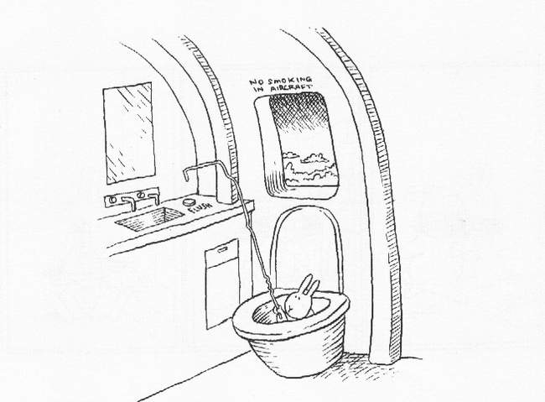
The Two Cardinal Rules
Of Doing Live Demos
1. Don't do live demos
2. If you're forced to do a live demo, call it a practical exercise
  (Anything breaks, it's the student's fault)

Slide 28
A Very Basic Tree
Any mathematical expression can be represented by a tree.
b
x
b
x
b
t
c

*
*
1
+
a
sin
*

Slide 29
Exercise 0: A Basic Tree
Demo: Basic Tree
$ cd ~
$ ./glow-meqtrees-update.sh
$ cd GLOW2010
$ svn up
$ meqbrowser
“Start” to start a meqserver
TDL | Load TDL script
Select ex0-basic-tree.py
Bookmarks | result of 'f'
“test forest”

Slide 30
And that's all there is to it!
t,  are variables (can be arbitrary)
A node is a function of N variables
  (a constant is a trivial kind of function)
a data source (e.g. MS, FITS image) is also a kind of function: V(t, ) or B(x,y)
Parent nodes combine their children into compound functions
The tree as a whole evaluates some complicated function
  such as a some kind of an M.E...
  And all intermediate steps can be visualized.

Slide 31
TDL: Python for trees
def _define_forest (ns,**kwargs):
ns.b << 1;
ns.c << 2;
ns.x << Meq.Time;
ns.y << Meq.Freq;
a = ns.a << 297.61903062068177;
ns.f << a*Meq.Sin(ns.b*ns.x + ns.c*ns.y + 1);
def _test_forest (mqs, parent):
domain = meq.domain(10,20,0,10);
cells = meq.cells(domain,num_freq=200, num_time=100);
request = meq.request(cells, rqtype='ev');
result = mqs.execute('f',request);

Slide 32
Simple ME's

Slide 33
Observing a point source with a perfect instrument
K accounts for the pathlength difference
  (and is what makes interferometry possible in the first place...)

Slide 34
The (familiar?) Scalar Case

Slide 35
Implicit m.e.'s
(“What Would AIPS Do?”)
Pre-ME packages use some implicit, specific, form of the ME
For example, a perfect point source:

Slide 36
Introducing Complex Gains
The “classic” view: each receiver has a complex amplitude and phase term (troposphere/electronics/etc.)

Slide 37
Gains: The ME View

Slide 38
Simulations Intro

Slide 39
MeqTree Frameworks
By having the ME defined in Python, we get endless flexibility...
...and also (as it turns out) endless confusion
  even the simplest ME involves many details to keep track of
  and not everybody wants to be a programmer
On the other hand, the same building blocks are reused over and over again
  sources, Jones matrices, etc.
Frameworks to the rescue...

Slide 40
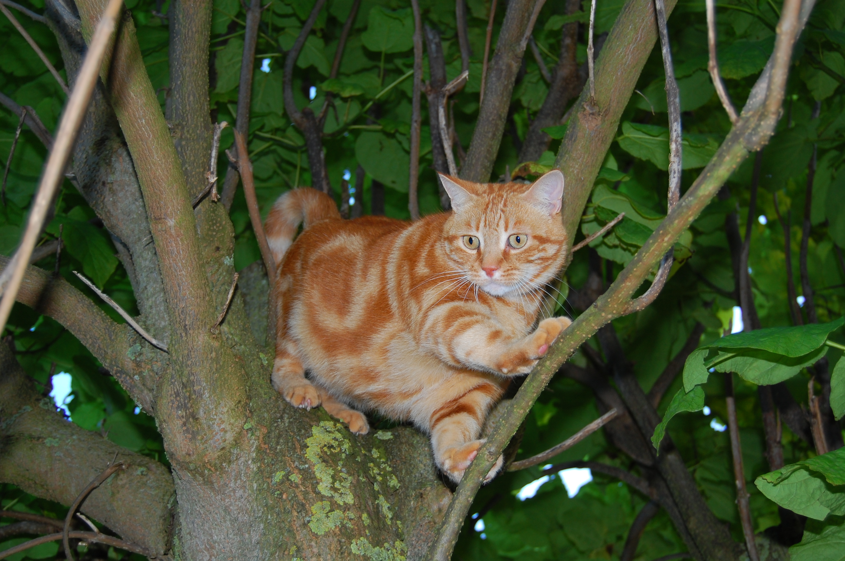
Meow
(Measurement Equation Object frameWork)
software
bloat

Slide 41
Meow
Object-oriented framework for putting together ME-related trees
Better than “pure TDL”
  but still (kind of) low-level
  intended for the advanced MeqTree user
Deals with objects such as Observation, IfrArray, SkyComponent, PointSource, GaussianSource, etc.
Base for higher-level frameworks

Slide 42

Siamese
(Simulations In Your Sleep)
Siamese is a Meow-based simulator framework

Slide 43
Exercise: Make MS
$ cd ~/GLOW2010/MS
$ sudo apt-get install makems
$ makems WSRT_makems.cfg
$ mv WSRT.MS_p0 WSRT.MS
The makems tool makes empty Measurement Sets that we can the fill with simulated data
Uses a config file to specify an observation
  Look inside!
  (Also need an antenna positions table)

Slide 44
Exercise: Simulation 1
(a perfect point source)
$ cd ~/GLOW2010/Sim
$ meqbrowser
TDL | Load TDL Script | example-sim.py
You see a dialog of “Compile-time options”
  Click on “Load” and “exercise1”
Options defined by script itself
  MeqTrees provides GUI and config file support
Tour of options:
  Measurement Set, Local Sky Model, Jones terms
Press “Compile”

Slide 45

PURR
“PURR is Useful for Remembering Reductions”
Disciplined people keep notes
Undisciplined people write software

Slide 46
Using PURR
The object of PURR is to make note-keeping as effortless as possible
PURR watches your working directory for new or modified files (“data products”)
  configuration files, images, screenshots
Offers to save them to a log
  ...along with descriptive comments
  And useful rendering of things like images
Purrlogs are natively saved in HTML and may be immediately published or shared

Slide 47
Example PURR Logs
Calibrating 3C147:
http://www.astron.nl/meqwiki-data/users/oms/
3C147-Calibration-Tutorial/purrlog/
Enthroned chicken:
http://www-astro.physics.ox.ac.uk/~ianh/ PURRLOGS/enthroned/

Slide 48
Exercise: Simulation 1 cont'd
Compile script
Bookmarks | Output visibilities inspector
Jobs & Runtime options
  All sorts of I/O etc. settings
  ...and “Jobs” you can execute
Start “Simulate MS”
Once it's done, go to “Imaging options: Make a dirty image”
Admire your first image, and don't forget to save it to a purrlog entry

Slide 49
Exercise: Simulation 2
(complex gains)
We'll throw a G Jones into the mix
The G Jones module provided here implements a simple error model: sine wave
More realistic error models may be plugged in
  Implementation is just a bit of Python code
Rerun script
  Grid model, 5x5 mJy sources at 5', 1 Jy at center
  enable G Jones phase error
  120 degrees, 2-4 hours
  Add .1 Jy noise
Open bookmarks

Slide 50
Visualization Everywhere
One of the guiding principles of MeqTrees: everything can be visualized
  any intermediate calculation or result may be published into the browser and plotted
But some visualizations are more interesting than others
  the script (i.e. its author) knows which these are
Scripts can define “bookmarks” for interesting visualizations
Run, make image, etc.
  Set output column to DATA (we'll try to calibrate it later)

Slide 51
End-To-End Simulations: some practical uses
Appeasing managers
Getting funding
Keeping idle PhD students out of one's hair
Filling up disk space with simulated data
Honing programming skills
By the time you've finished your e2e simulator, the goalposts have moved and your initial assumptions have become meaningless. And the final instrument is going to be different yet again. So why bother generating garbage “data”?

Slide 52
Simulations: Some Real Uses
Study effects in isolation to understand them better
Stick to small, self-contained simulations to
  Increase your understanding
  Explore parameter spaces and boundaries of problems
Increase sophistication when studying interaction between effects

Slide 53
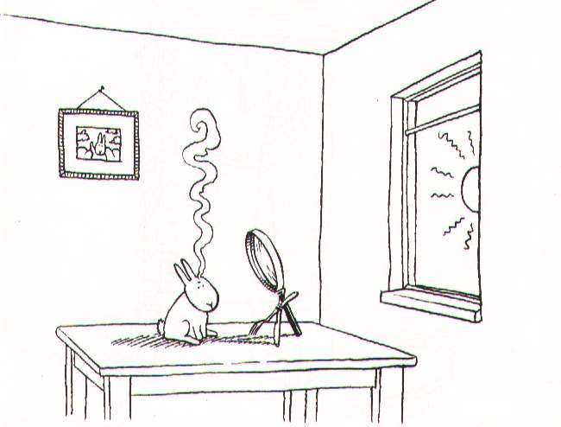
Polarization

Slide 54

The Classical Approach To Polarization

Slide 55

...and why it doesn't work
"You may not be interested in the polarization, but the polarization is interested in you."
– (wrongly) attributed to Leon Trotsky

Slide 56
Example:
Differential Faraday Rotation
Early testing of LOFAR Ef-Ex baseline showed puzzling signal
  strong XY/YX, dropouts on XX/YY, on unpolarized source
Eventually realized it was caused by differential Faraday rotation
Was predicted (& forgotten) by Hamaker et al. in original ME paper
According to James Anderson, was known in the VLBI community during the 1960-70s, hence choice of circularly polarized feeds

Slide 57
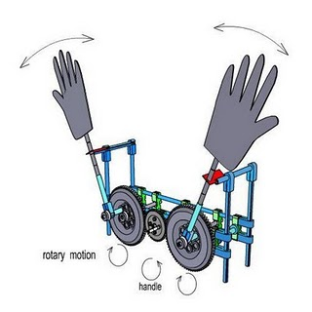
DFR: The Physical View vs. The M.E. View
Physical view: (lots of handwaving)

Slide 58
DFR: The Physical View vs. The M.E. View
Assume a 1 Jy unpolarized source at the phase centre, and no other corruptions:

Slide 59
DFR: The M.E. View vs. The Evil Mueller View

Slide 60
Exercise: Simulating DFR
Don't have a proper sim for DFR
  requires a 3D ionosphere and a model for the Earth Magnetic Field
  Implementations will be gratefully accepted!
But we can get an idea of the effect by rotating the dipoles around a bit
Load the simulator, and enable P-Jones
  Or load the exercise3 profile
Simulate, make an IQUV image, and try to figure out what's going on

Slide 61
More Gratuitous Polarization:
Dipole Projection
Aperture array with fixed NS and EW dipoles
Projection of dipoles onto tangential plane determines sensitivity to polarization
Equivalent to conventional dipole pair only at zenith
=90˚
=45˚ =45˚
=45˚ =15˚
N
=90˚
=15˚
W
E
S

Slide 62
Dipole Projection Jones Matrix
Projection can be described by a Jones matrix:
Function of azimuth/elevation, so:
  Varies with time
  Varies with source position, given a wide field
  Varies with station position, given a large array

Slide 63
Exercise: L-Jones Simulation
Sky model: 5x5 cross at 30'
Enable L Jones
  Per-source but not per-station
Open bookmarks to check az/el and L Jones
Make an IQUV image
  Note distortions in I map due to time-varying sensitivity of the dipoles
  Note instrumental QU polarization – direction-dependent!

Slide 64
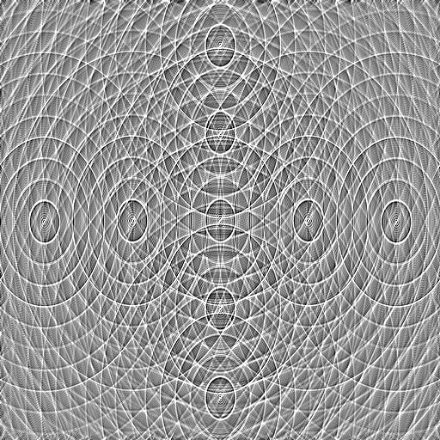
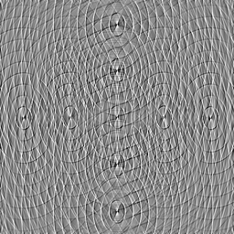
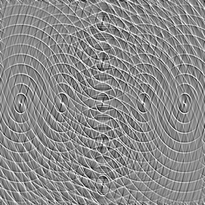
Stokes I map.
Note distortions in source shape. These are caused by time-varying sensitivity of the dipoles to total flux.
Peak flux is ~.6 Jy (would be
1 Jy without this effect!)
Q and U maps.
Note instrumental polarization
(direction-dependent!)
Peak flux is
±0.1 Jy

Slide 65
Optional Exercises
Instrumental polarization
  Differences in G-Jones
  VLA beam squint
Effects of parallactic angle

Slide 66
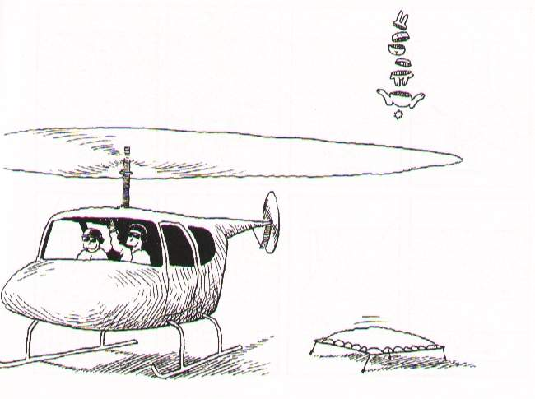
Perils Of The Ionosphere

Slide 67
The Full-Sky ME

Slide 68
The Full-Sky ME

Slide 69
Image-plane vs. uv-plane

Slide 70
And Back To The ME....

Slide 71
The Fourier Transform
The integral then becomes a 2D Fourier transform of the “apparent sky”.

Slide 72
The Fourier Transform 2
This is essentially the van Cittert-Zernike theorem
  ...as a simple consequence of the M.E. and our K Jones term.
Note that the original M.E. (Hamaker-Bregman-Sault, “ME Paper I”) was formulated purely in terms of cohaerency:
...so here we extend the M.E. into the image plane.

Slide 73
Apparent Skies & Apparent Cohaerencies
In other words, each antenna pair p-q measures an apparent cohaerency distribution Xpq(u,v) that corresponds to a 2D Fourier Transform of its own apparent projected sky Bpq.
...at a single point in time!

Slide 74
Time Is Not On Our Side
Cohaerencies are sampled along a “uv track” over some period of time:
The true sky B is probably constant(?) in time
Image-plane effects (beam shapes, ionosphere) will vary:
  ...both in time
  ...and across antennas
All this is especially relevant with low-frequency and/or wide-field observations.

Slide 75
The “Classic” Assumptions
Only under these assumptions can we consider a single F.T. of the sky as being an accurate representation of what an interferometer sees.

Slide 76
Conclusions
Under the “classic” assumptions, the visibilities measured by an array correspond to ONE cohaerency distribution X that is in an F.T. relationship with ONE apparent sky.
In the presence of non-trivial image plane effects – such as the ionosphere -- each interferometer p-q measures its “own” cohaerency Xpq(t), corresponding to its “own” apparent sky Bpq(t) -- variable in time!

Slide 77
Ionosphere In The M.E.

Slide 78
Some Ballpark Numbers

Slide 79
The Famous Four Regimes: the trivial...

Slide 80
The Famous Four Regimes: the simple, and the nasty

Slide 81
Exercise: Ionospheric Sim
Need a low-frequency MS:
$ cd ~/GLOW2010/MS
$ makems WSRT_lf_makems.cfg
$ mv WSRT_lf.MS_p0 WSRT_lf.MS
$ cd ../Sim
LSM: 5x5 grid at 10'
Sine-TIDs ~ 100-200km, amplitude 0.01-0.02
Make per-channel images
  And then repeat with “correct for center phase”

Slide 82
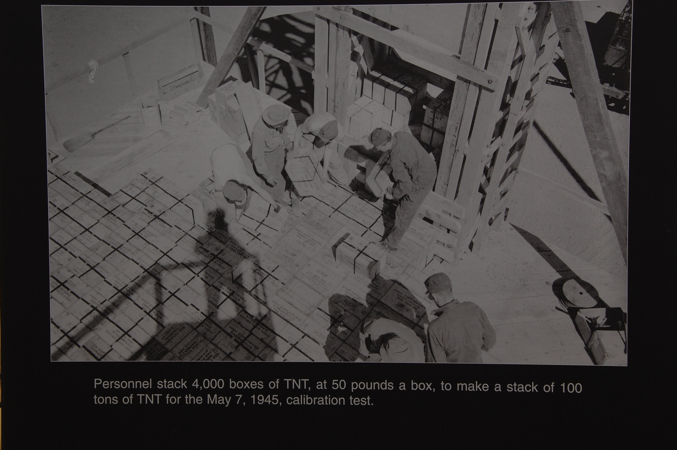
Calibration (Can Be Fun)

Slide 83
Classic (Scalar) Selfcal
Start with a sky model (point source at center, etc.)
Solve for complex gains by fitting observed data:
Iteratively refine sky model, rinse, repeat

Slide 84
M.E.-based (Matrix) Selfcal
Start with a sky model (point source at center, etc.)
Solve for G Jones elements by fitting observed data:
Iteratively refine sky model, rinse, repeat
Arbitrary Jones terms may be added (and solved for!)

Slide 85
The M.E. Calibration Loop

Slide 86
Or In Broad Terms...
Predict corrupted visibilities
  we already do this with Siamese
Fit to observed visibilities
  solving for parameters of the sky and/or the instrument
(Optional: subtract bright sources)
Correct
Rinse & repeat
  aka the “major loop”: source extraction, updating sky model, etc.

Slide 87
Calibration Of An MS?
A model tree computes corrupted visibilities X'pq(t,)
  we've used Siamese for this
MS DATA column contains observed data Vpq(t,)
We can take the difference and form up a ² sum...
...and try to minimize it w.r.t. the solvable parameters.
Which is the same as fitting the model to the data, in a least-squares sense.
We can thus solve for any (reasonable) subset of parameters of a measurement equation.

Slide 88
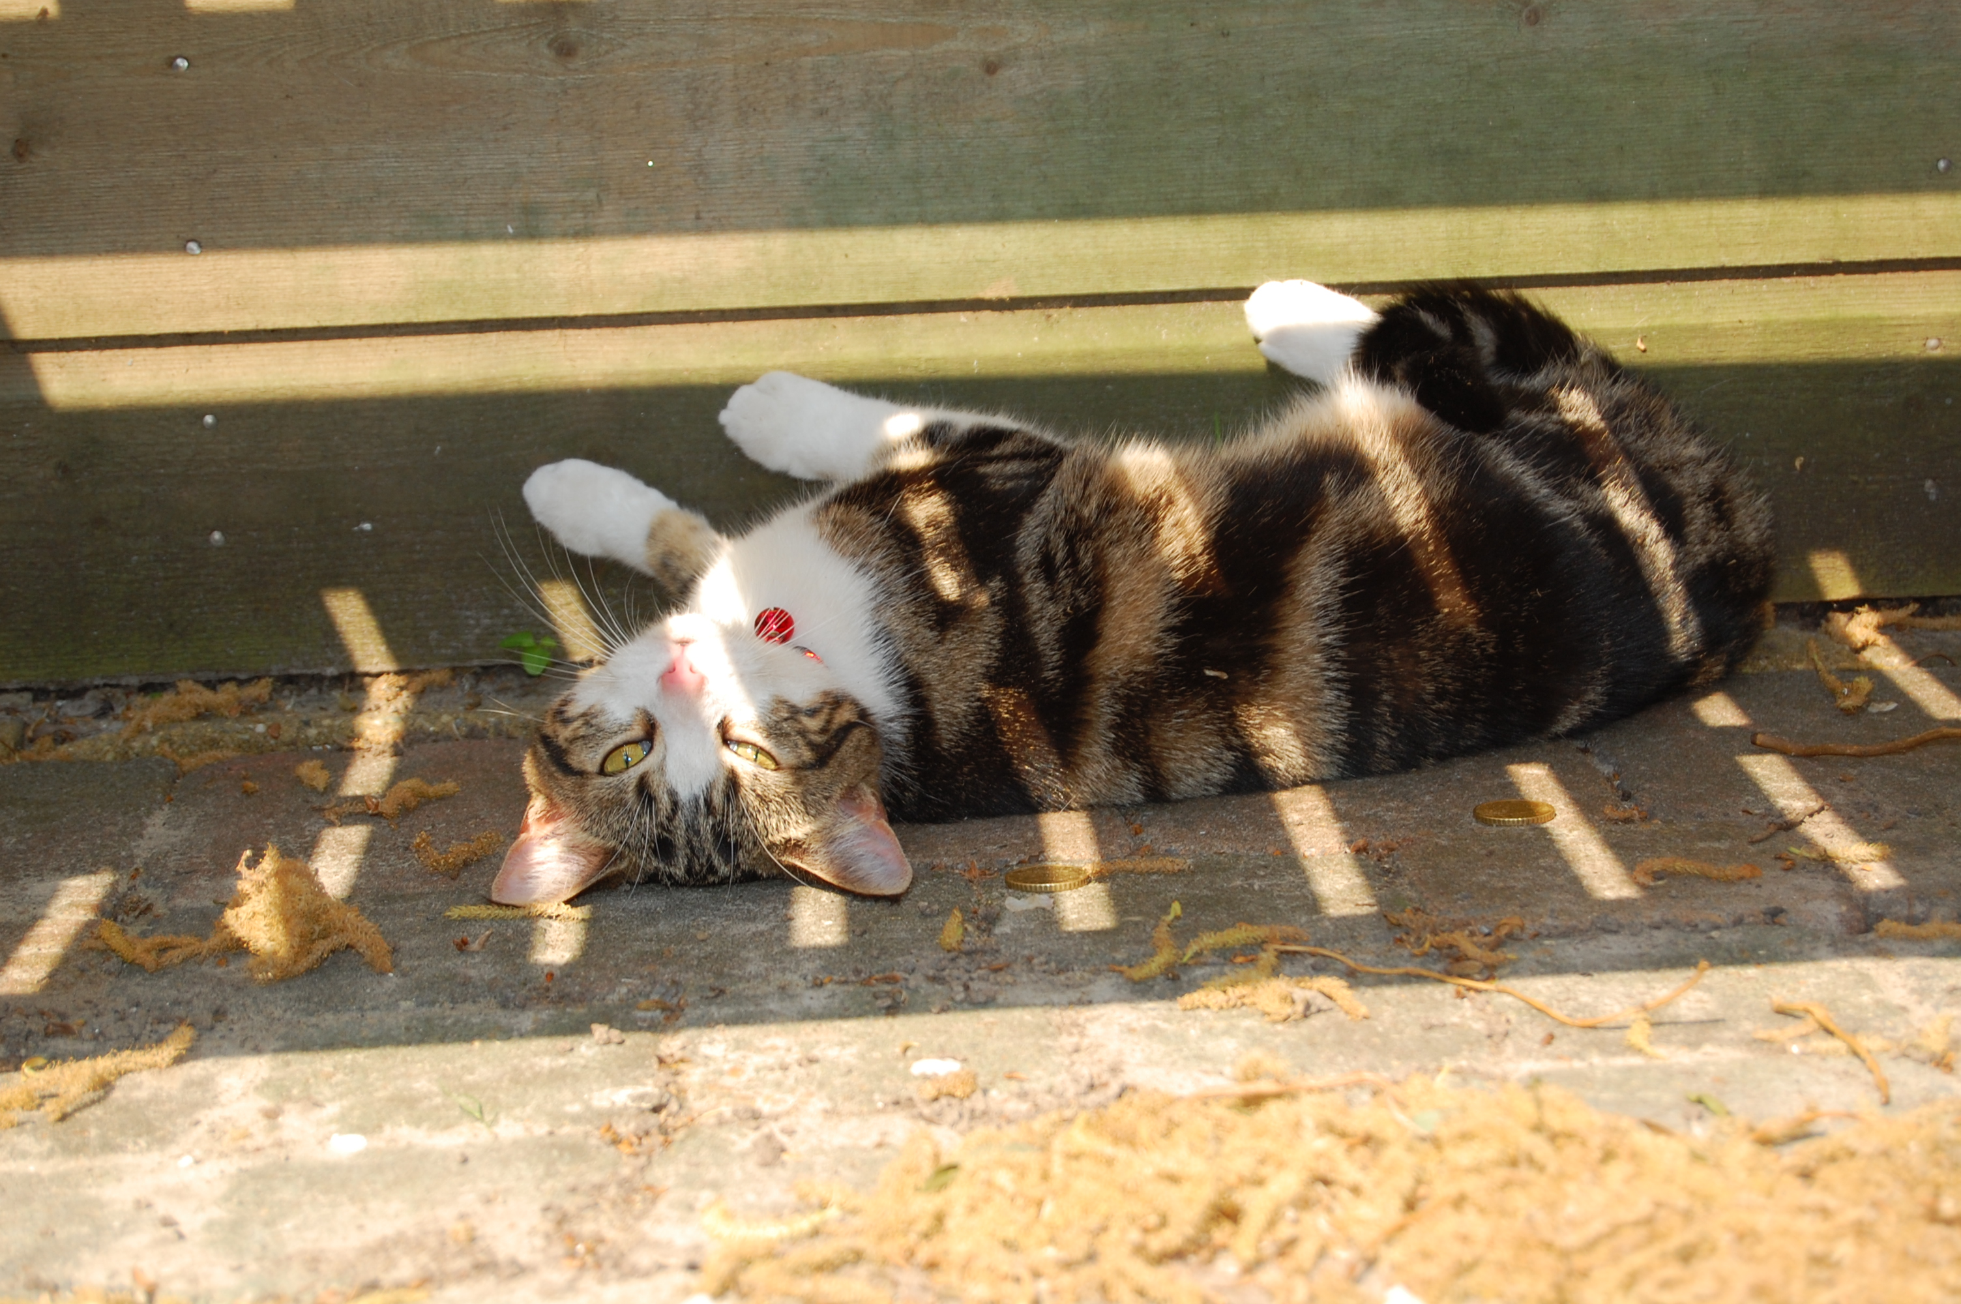
Calico
(Calibration Components)
I detect fringes...

Slide 89
Calico
Siamese's calibration cousin.
Same principle: build a measurement equation from a sky model + plug-in Jones modules.
  Siamese modules are fully compatible
...but, modules can also specify their solvable parameters.
Calico provides a standard solving interface to these.
cd Workshop2008/Day2

Slide 90
Exercise: Calibration 0
Load example-cal.py
  Use 2x2 data, diagonal terms only
  Enable calibrate & correct
  Use sky model with 1 source at center
  Enable G Jones (FullRealImag)
Open bookmarks for inspectors
Solve for G diagonal terms
  Subtiling of 1 in time
  Tile size 20
Make an image of the corrected data
  Make a cleaned image, save to purrlog
  Go back and do corrected residuals....

Slide 91
Calibration is...
Calibration is HARD
  Lots of details that you need to get right
  One little mistake, and everything goes south
  (North if you're in Australia?...)
Calibration is EASY
  One little mistake, and everything goes south

Slide 92
M.E. Calibration Terminology

Slide 93
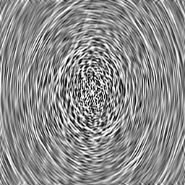
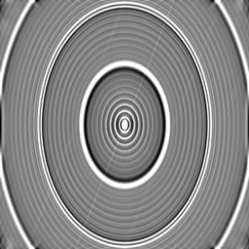
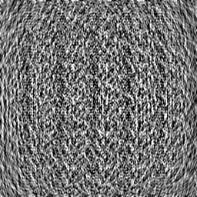
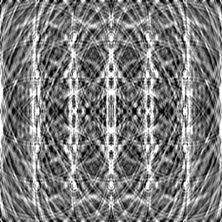
Jy
level
mJy
level

Slide 94
Major Loop Of Calibration
Make initial sky model
Calibrate, subtract sky model, and generate corrected residuals
Use corrected residuals (deconvolution, etc.) to improve sky model
Repeat until satisfied
What is satisfaction?

Slide 95
Calibration (Noordam Definition)

Slide 96
Real-Life Residuals
Real-life residuals are always contaminated by imperfect subtraction of sources (due to calibration error)
Causes of error:
  Contamination from sources
  not included in sky model
  Imperfect instrument models
  RFI, insufficient flagging
Can even have ghosts!

Slide 97
Optional Exercise: Selfcal Ghosts
For the brave only!
Simulate 1 Jy source at center →MODEL_DATA
Add 1 mJy “contaminator” source, 10° away →DATA
Calibrate, using sky model of 1 Jy source at center, write residuals →CORRECTED_DATA
  Make image (30° across)
  Dominated by contaminator
Generate corrected residuals from MODEL_DATA to CORRECTED_DATA
  This is now contaminator-free
  Observe the ghosts

Slide 98
Polarisation Selfcal

Slide 99

Classical Equation For
Polarization Selfcal
(With thanks to Huib Jan van Langevelde)

Slide 100
The Measurement Equation
For Polarization Selfcal
The only difference w.r.t. the previous m.e. is that the G matrix has off-diagonal terms.
Polarization not so scary after all!

Slide 101
Thinking About Polarization 1
Diagonal Jones matrices will intermix I↔Q and U↔V:
Off-diagonal terms will intermix IQUV
Pure real terms won't touch V
  e.g. a rotation matrix mixes QU, but not V
Thinking in terms of matrices will help you understand everything about polarization!

Slide 102
Faraday Rotation
F.R. rotates the angle of polarization
  i.e. intermixes Q and U.
Interstellar medium: “intrinsic” F.R.
  same for all antennas (ϕ=ψ), varies slowly/not at all
Ionospheric F.R.
  effectively “intrinsic” for short wavelengths and small arrays
  for LOFAR long baselines: differential F.R.

Slide 103
Exercise: Calibrating 3C286
3C286 is a standard WSRT calibrator
  has significant QU (~10%)
We'll try to calibrate a short WSRT 1.4GHz observation.
  ~15 mins at 10 sec. integration
$ cd ~/GLOW2010/MS
$ tar zxvf 3C286.MS.tgz
$ cd ../Cal

Slide 104
Thinking About Polarization 2
WSRT is an equatorial mount, so (to first order) it only has diagonal Jones terms
  for off-center sources, we do get significant instrumental Q (on the diagonal)
  this occurs after any F.R.
  in fact, there are small off-diagonal Jones terms: “polarization leakage”
  but if the source is intrinsically unpolarized, we can ignore the off-diagonal correlations
With an alt-az mount, the sky rotates, so you'll see instrumental Q and U.

Slide 105
What Causes
Polarization Leakage?
Simple errors in dipole geometry:
  these vary in time (slowly) due to the telescope mechanically deforming as it elevates
Electromagnetic cross-talk:
Both cases correspond to small values off the main diagonal of J

Slide 106
Obfuscating The M.E., Part 2:
Death by a million Jones matrices
The M.E. is, at core, very simple
The literature (M.E. papers, AIPS++ Note 185, etc.) is full of interminable M.E.s of the form:
(or, to add insult to injury, the same in Evil Mueller form)
Product of late-90s AIPS++ enthusiasm, driven by the discovery of the ME:
  “We'll just quickly catalog every Jones matrix there is!”
  “All we need to do is implement these Jones matrices now, and we're sitting pretty forever!”
This is not “The Measurement Equation”, so please don't use it to scare impressionable students

Slide 107
The Simple View:
Build Your Own M.E.s
Start with your basic equation:
and tailor to taste.
For simulation: what physics are we trying to simulate?
  full-on simulations: insert as many Jones terms as you understand
  specific simulations: one or two Jones terms can be is sufficient
For calibration:
  what can we measure? We do, after all, only measure the cumulative effect of all Jones terms.
  insert the Jones terms you know apriori (beam, parallactic rotation, etc.)
  Insert generic solvable matrices for the rest

Slide 108
Phenomenological M.E.s
A phenomenological M.E. expresses the effect of a corruption without regard to the underlying physics
For example, we can calibrate WSRT using the following M.E.:
  G (diagonal): short-term freq-independent variations
  B (full 4-element): long-term freq-dependent component (bandpass and polarization leakage)
Unlike simulations, neither G nor B is all that physical – each combines several physical effects
  Only distinguishable by their time/freq behaviour
  We don't care, as long as there's enough degrees of freedom in our model to fit the physics
  Can't fit more DoF anyway, they're all rolled up in the measurement

Slide 109
Correcting For Multiple Jones Terms

Slide 110
Calibrating 3C286
Load calico-286.py and look at Options
This is the M.E. we're going to use:
  G (diagonal): short-term phase and gain variations
  B (full 4-element): bandpass and pol. leakage

Slide 111
The Local Sky Model
Instead of pretty grid, we obviously want to calibrate on a realistic sky
The LSM module will read in a file and create a sky model based on it.
  various formats supported
lsm286.txt is our model for this calibrator
cat lsm286.txt

Slide 112
MS/data selection options
This menu (in TDL Exec) determines what subset of the data we solve for
  Input column is always DATA (for observed data)
  Select channels 8 through 55, step 1
  No Hanning tapering
  “Data description ID” determines the spectral window. Pick one...

Slide 113
Step 1: Solving For G
G represents receiver + troposphere/ionosphere gain/phases
  diagonal (i.e. no cross-terms)
  same across all channels
  would like a separate solution per timeslot.
Build the tree, and open up the “Calibrate G diagonal terms” option.

Slide 114
Tiles And Solution Intervals
We go through the MS in chunks of time called tiles (a full MS wouldn't fit in memory...)
  a tile contains N consecutive timeslots, and all [selected] channels of a spectral window
By default, each parameter has one solution per tile (constant or polynomial in time/freq)
  but you can use a smaller solution interval via the “solution subinterval” option. This cannot be be bigger than the tile itself.
Bigger tiles are (to a point) faster, but too big can lead to poor convergence.

Slide 115
Step 1: Solving For G
Set “solution subinterval (time)” to 1
Set tile size to e.g. 20
Load the “inspector:G” and “inspect corrected residuals” bookmarks
Run “Calibrate G diagonal terms”
Watch the χ² display at the bottom of the browser window.
Make a residual IQUV image and save it to the purrlog

Slide 116
MEP tables
Parameter solutions are stored in MEP (ME Parameter) tables.
  these are called “*.mep” or “*.fmep”, and are generally kept within the MS directory
Once a solution is stored in the table, it is reused in all subsequent runs
  so we can go on and solve for B, while including our G estimate in the predict
To clear out solutions and start anew:
rm -fr xxxxx.MS/*mep

Slide 117
Step 2: Solving For B (diagonal terms)
Open up “Calibrate for B diagonal terms”
We want separate solutions per each channel, for all timeslots.
  set “solution subinterval (freq)” to 1
  set tile size to 100
Load the “inspect corrected data” bookmarks, and some “B diagonal terms”
Run “Calibrate B diagonal terms”
Observe results... check also the XY/YX residuals
Make a residual IQUV image, save it to the purrlog

Slide 118
Step 3: Solving For B (off-diagonal terms)
Open up “Calibrate for B off-diagonal terms”
Select a simultaneous solution for B diag.
Run “Calibrate B off-diagonal terms”
Observe results... check also the XY/YX residuals
Make a residual IQUV image and save it to the purrlog

Slide 119
Exercise: A Wrong LSM
We'll start with the wrong sky model: lsm286-1.lsm.html (check it with Tigger)
Clear out previous calibrations:
rm -fr ../MS/3C286.MS/*mep
Repeat solutions for G-diag, B-offdiag+B-diag
  May need to repeat G-diag – why?
  Make intermediate images, and compare to those obtained during the previous exercise
Think about what we should see at the end. Should we expect to be able to calibrate?

Slide 120
Limitations Of Selfcal a.k.a. self-alignment (Hamaker)
So, we can only “know” the sky to within a (non-singular) Jones factor of Y.
What can this do to polarization?
  anything...

Slide 121
Thinking About Polarization 3
Diagonal Jones matrices will intermix I↔Q and U↔V
Off-diagonal terms will intermix IQUV
So, starting with an unpolarized source, I flux can be moved into Q, Q can be rotated into U, and U can be phase-shifted into V.

Slide 122

The Evil Leprechaun
Principle
If evil leprechauns were to come and tamper with your telescope in the middle of the night, would you notice?
  without knowledge of the sky, that is.
...not if they changed them all by the same factor of Y.
  e.g.: rotate all dipoles by the same angle
  e.g.: change gain of all X dipoles
  etc.
Moral: we can only get so far without known calibrators.

Slide 123
Direction-Dependent Effects

Slide 124
Calibrating For Dipole Projection?
The ME we are using is:
For calibration, we can use the same ME and solve for G Jones again
No need to solve for L Jones since we know it analytically
  we simply incorporate it into the ME at the predict stage
But can we really correct for it?

Slide 125
Problem 1:
Inverting Jones Terms
The ME allows us to write out corrected visibilities or residuals:
What happens if we can't invert L?
=90˚
=45˚ =45˚
=45˚ =15˚
N
=90˚
=15˚
W
E
S

Slide 126
Limitations Of Correction
Matrix inversion has its pitfalls
What happens if J is singular?
  and what physics does this correspond to?

Slide 127
Limitations Of Correction 2
If a Jones matrix is singular, then we don't have enough information to begin with
  e.g. if a dipole gain is 0, then we haven't measured the EM field in one direction...
It is also possible for a Jones term to be ill-conditioned
  numerical inversion of an ill-conditioned matrix breaks down due to precision limitations
  e.g.: projection matrix of an aperture array (Tobia Carozzi)

Slide 128
Problem 2: Correcting For Direction-Dependent Effects
w/o DD effects
with DD effects

Slide 129
Exercise: Correcting At Center
In general, visibility data can only be “corrected” for a single direction on the sky.
Hence, e.g., facet imaging.
Bhatnagar (EVLA Memo 100) suggests an approximate method to apply on-the-fly corrections during imaging
Correction Demo:
  Repeat L-Jones simulation (to DATA column)
  Run example-cal-lj.py
  Enable correct, disable calibrate and subtract
  Apply L Jones correction (for center of field) and make an image

Slide 130
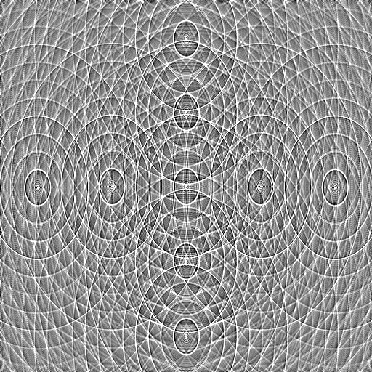
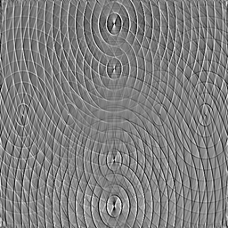
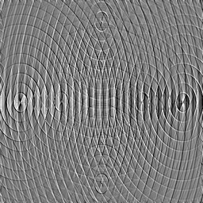
Stokes I map.
Distortions in source shape no longer visible (though from the math we know they must remain, on a low level.) Peak flux is 1 Jy.
Q and U maps.
Note how instrumental polarization corrects perfectly at center, but increases towards edge of field.
Peak flux is ±50 mJy.

Slide 131
Dealing With DD Effects
The same issue arises with other DDEs:
  Ionosphere
  Beam shapes & pointing errors
Becoming critical for LOFAR & pother new instruments, and will be even more so for the SKA itself
Solution: subtract sources bright enough to cause trouble
  Since we can predict them “perfectly” (within the limits of calibration error)

Slide 132


Example:
WSRT Off-Axis Effects
Single band (56 channels)
298 sources subtracted
σ ~ 30uJy
dominated by residuals from imperfectly-subtracted fainter sources
...which are caused by:
(a) imperfect sky model (more deconvolving would help)
(b) image plane effects: pointing errors, tropospheric refraction, ...
  no direct cure in NEWSTAR
polarized, 40 mJy
3C147, 22 Jy
20 mJy
35 mJy

Slide 133

Luxury Problems Of Calibration

Slide 134
More On Phenomenological M.E.s
Adding a beam to the previous M.E.:

Slide 135


Bandpass Artifacts
Residual pattern from 3C147 due to bandpass instability.
We do a separate B solution every 30 min.
Error pattern caused by variations in actual bandpass over the solution interval
  error ~ 1/10,000
We can mitigate this by making B a 1st-degree polynomial in time
  error ~ 1/200,000
  close to noise level but plainly visible
Further increase polynomial degree?
  or spline?

Slide 136
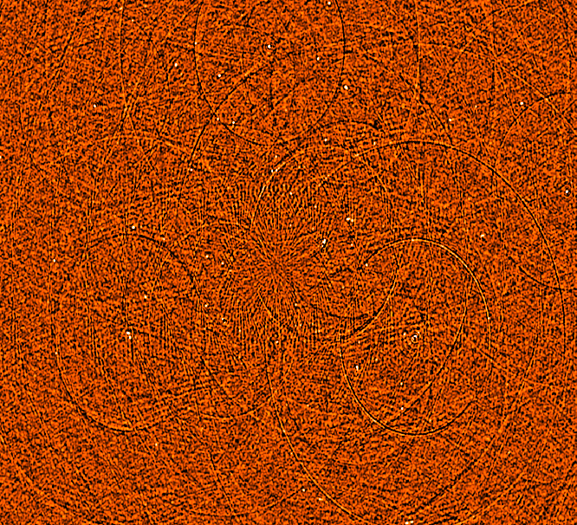
Limits Of Bandpass Stability
B solution every 7.5 minutes
G solution every 30 sec.
Followed by smoothing of B and repeated G solution
We're still left with a DR-limiting error pattern left over from 3C147 itself.
My tentative conclusion: WSRT bandpass is “jittery” on short timescales.
...but you need to get past 100,000:1 DR for this to bite you!
  A luxury problem

Slide 137
Dropping The Bandpass
Do a per-channel selfcal
  with sufficient S/N, why not?
  this is what Ger does in NEWSTAR
In M.E. terms:

Slide 138

Seeing The DDE's
Residual image, 298 sources subtracted
Per-channel selfcal + closure errors
Dominant features are residuals from off-axis sources.
Some of it is due to missing/too much flux in the sky model and can be CLEANed away.
But not all of it! (and this is what causes artifacts in the final map.)
polarized, 40 mJy
3C147, 22 Jy
20 mJy
35 mJy

Slide 139
Solving For Pointing Errors
Bhatnagar “Pointing selfcal” approach, in terms of our ME:

Slide 140
Differential Gains
Or we can introduce differential gains:

Slide 141
Flyswatter I
The “before” image.

Slide 142

Flyswatter II
Solved for ΔE for
5 sources.

Slide 143

Flyswatter III
Solved for ΔE for
10 sources.
In the end 10 sources proved unnecessary (deconvolution helps as well!), so in the final images I only solved for 6 sources.

Slide 144

3C147
NEWSTAR image
22Jy @21cm
12h, 8 bands
13.5 uJy noise
on-axis DR:
1500000:1
off-axis DR:
1000:1
Limited by direction-dependent effects
(DDEs) such as pointing errors, tropospheric refraction, etc.
No direct cure in selfcal.

Slide 145

3C147
MeqTrees image
22Jy @21cm
12h, 8 bands
13.5 uJy noise
Same DR as NEWSTAR, but no off-axis artifacts.

Slide 146
Exercise: Differential Gains
We'll repeat this exercise on an even more interesting field.
$ cd ~/GLOW2010/dEs
$ ./reset-ms.sh
(You can always redo this later if you mess up your MS.)

Slide 147
dE's: Step 1
Load example-cal.py
  And also ./tigger qmc2-new.lsm.html
Load “fill model” options and run “Generate predict”
  Load an inspector for visibilities
Load “Calibrate G”
  Load an inspector for corrected residuals. Run the calibration.
  Make an image and save it to your purrlog.
  Right-click on an inspector to save a PNG file to the purrlog

Slide 148
dE's: Step 2
Now load “calibrate dEs”
Run the calibration
  Look at inspectors, compare to previous purrlog entry
  Make a residual image, compare to previous entry.

Slide 149
The End!

