Slide 1

A Quick Meq In MeqTrees
O. Smirnov (ASTRON)

Slide 2
Building a Tree for a measurement equation
See Intro1/demo4-predict-ps.py
The Meq.MatrixMultiply node implements matrix multiplication.
We repeat this for all interferometers (all p-q pairs), in a for loop.

Slide 3
Building a Tree:
Creating a B Matrix
The Meq.Matrix22 shortcut creates a matrix from four children (using a Meq.Composer node).
IQUV's will be hardwired constants (for now)

Slide 4
Building a Tree:
VisPhaseShift
The Meq.VisPhaseShift node computes the a phase term as follows:
Takes two “vector” children for uvw's (in meters) and lmn's.
The Meq.ConjTranspose shortcut implements the “†” operation.
We can explicitly form up an (l,m,n-1) vector using a Meq.Composer node.
But where do we get the uvw's?

Slide 5
Building a Tree:
Where to get UVWs?
Where do uvw's come from?
uvw's can be computed by a Meq.UVW node from first principles:
  antenna positions (from MS)
  phase centre RA/Dec: (from MS)
  time
...or can be read from the Measurement Set.
We used to prefer doing it the former way, but that can lead to inconsistencies between the simulation and the imager.
Now we prefer reading them from the MS.

Slide 6
Working With
Visibility Data
MeqTrees interface with AIPS++ Measurement Sets
  an MS is a container for visibility data + metadata
For calibration, you already have an MS presumably
  can be imported from UVFITS, etc.
For simulations, an “empty” MS has to be pre-fabricated
  e.g. Workshop2008/demo.MS
  see Workshop2008/demo_sim.g script

Slide 7
Working With Visibility Data
MeqTrees interface with AIPS++ Measurement Sets
  an MS is a container for visibility data + metadata
For calibration, you already have an MS presumably
  can be converted from UVFITS, etc.
For simulations, an “empty” MS has to be pre-fabricated. This provides a time/frequency grid for our simulations.

Slide 8
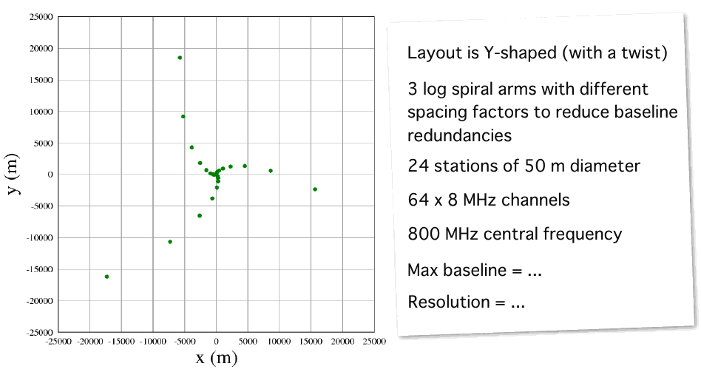
Meet The VLAAA
Very Large Array Of Aperture Arrays, brought to you by Ian Heywood

Slide 9
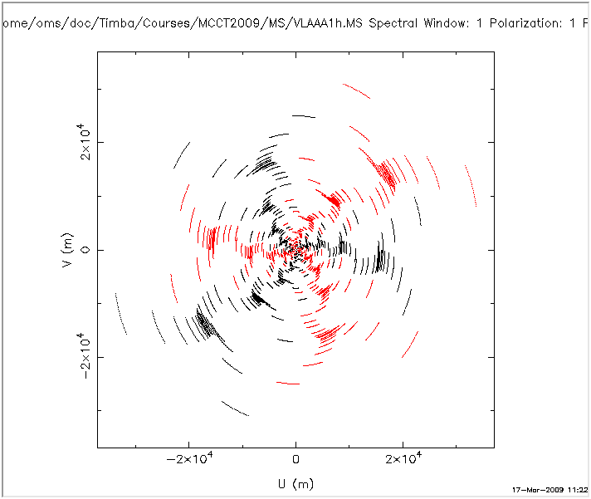
VLAAA uv-coverage
1 hour

Slide 10
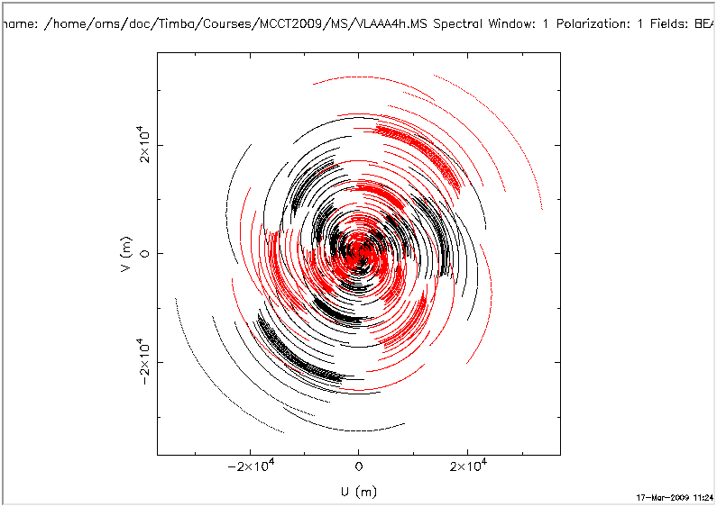
VLAAA uv-coverage
4 hours

Slide 11
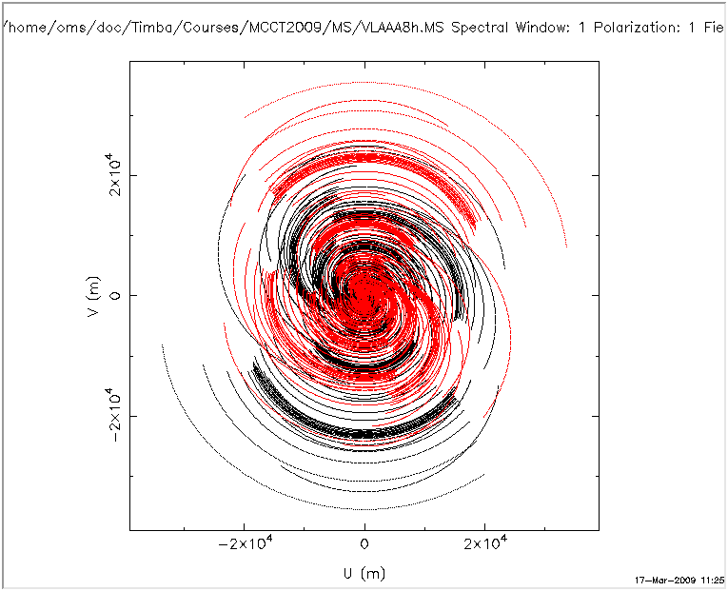
VLAAA uv-coverage
8 hours

Slide 12
An MS Is A “Skeleton”
An MS provides a time/frequency grid (e.g., for use in simulations)
  thus, “skeleton”: we ignore the data in the MS (and write our own)
Sink nodes turn this grid into a request and send it up the tree.
  one Sink per interferometer
When a result comes back, this can be written out to a visibility column in the MS.
MSs are processed in chunks of time called “tiles”.

Slide 13
Building a Tree:
Sinks & Spigots
A Spigot node reads data from an MS, and returns it (as a function of freq/time...)
  this can be the UVWs
  but can also be observed visibilities (later...)
A Sink node writes data to an MS
  model visibilities, in this case
Typically, we create one Spigot/Sink per interferometer

Slide 14
Introducing (Complex)
Gain Errors

Slide 15
Building a Tree With Gains
See ME1/demo5-predict-ps-gain.py
It's trivial to add extra Jones terms to Meq.MatrixMultiply.
The biggest effort is actually figuring out what numbers to plug in.
  for now, let's assign a random, time-variable gain-phase to each antenna...

Slide 16
Time Variability
On the Cheap
Remember that we get a “time grid” with each request.
The Meq.Time node returns f(t) = t, combine it with a Meq.Sin node to compute A*sin(Bt+C)
Generate random A,B,C's per dipole (using Python's random module)
Meq.Polar builds x*exp(iy)
Run the tree (load up the bookmarks).
Make a map.
  note that we can now select a column to image, the new simulation is in DATA, the old one is in MODEL_DATA.

