Slide 1

The Johan Hamaker Meqsperience
O. Smirnov (ASTRON)

Slide 2
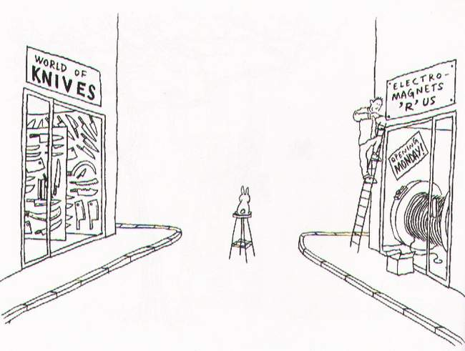

Part 1: The Unknown Knowns
Part 1: Fundamentals

Slide 3
The Measurement Equation:
Putting the “Meq” into MeqTrees!
The Measurement Equation tells you what you can expect to observe with an interferometer, given a sky and the properties of your instrument.
Absolutely crucial for simulating and calibrating the next generation of radio telescopes; everything literally revolves around it.
Therefore: no-one gets any beer tonight until we achieve full harmony and understanding!

Slide 4
A Wafer-Thin Slice of Physics:
EM Field Propagation

Slide 5
A Wafer-Thin Slice of Physics:
Jones Matrices

Slide 6
A Wafer-Thin Slice of Physics:
Correlations & Visibilities

Slide 7
A Wafer-Thin Slice of Physics:
The M.E. Emerges

Slide 8
And That's The Measurement Equation!
Or in more pragmatic terms:
NB: it is also possible to write the ME with a circular polarization basis (RR, LL, etc.) We'll use linear polarization throughout.

Slide 9
Accumulating Jones Terms

Slide 10
Jones' Anatomy
Jp is “cumulative”: more effects correspond to additional multiplicative Jones terms.
Therefore, the “total” Jp is a matrix product of a “Jones chain” of individual effects:
Jp = Jpn Jpn-1 ... Jp1
The order of the J terms corresponds to the physical order of the effects. In general, the matrices don't commute!

Slide 11
Why is this great?
A complete and mathematically elegant framework for describing all kinds of signal propagation effects.
...including those at the antenna, e.g.:
  beam & receiver gain
  dipole rotation
  receptor cross-leakage
Effortlessly incorporates polarization:
  think in terms of a B matrix and never worry about polarization again.
Applies with equal ease to heterogeneous arrays, by using different Jones chains.

Slide 12
Why is this even greater?
Most effects have a very simple Jones representation:

Slide 13
Three Layers Of Intuition
Physical: e.g. beam gain, parallactic angle
  beam pattern of X and Y dipoles different, causes polarization of off-center sources
  P.A. rotates polarization angle
Geometrical: stretching, rotation
  do not commute...
Mathematical: matrix properties

Slide 14
ME ME ME
The general formulation above is “The Measurement Equation” (of a generic radio interferometer...)
When we want to simulate a specific instrument, we put specific Jones terms into the ME, and derive a measurement equation for that instrument.
We then implement that specific m.e. in software (e.g. with MeqTrees)
Existing packages implicitly use specific m.e.'s of their own.

Slide 15
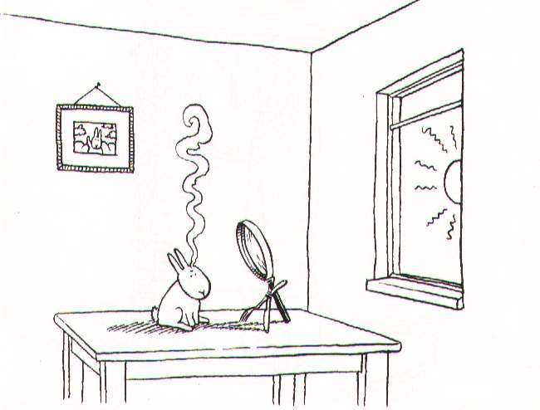
Part 2: Lonely Lowly Point Source

Slide 16
Observing a point source with a perfect instrument

Slide 17
The (familiar?)
Scalar Case

Slide 18
Antenna UVWs and Antenna Phase
P
Q

Slide 19
The (familiar?)
Scalar Case

Slide 20
K: A Jones In Its Own Right
The interferometer phase term is traditionally considered separately; however, it fits the Jones formalism like a glove.
K combines two physical effects:
  pathlength difference
  time delays (i.e. fringe stopping)
Scalar matrices commute with everything, so we're allowed to “merge” these two effects and shift the resulting K's around.
NB: K is scalar only for co-located receivers:
  moral: keep your dipoles together!
Forget about the Fourier Transform for now...

Slide 21
Implicit m.e.'s
(“What Would AIPS Do?”)
Pre-ME packages use some implicit, specific, form of the ME
For example, a perfect point source:

Slide 22
Introducing Complex Gains
The “classic” view: each receiver has a complex amplitude and phase term (troposphere/electronics/etc.)

Slide 23
Gains: The ME View

Slide 24
Polarization Leakage
In real life, some of the X dipole signal is picked up by Y and vice versa
This is caused by dipole orientation errors, electrical cross-talk, etc.
Must be calibrated out, unfortunately
The “classic” formulation handles this by introducing cross-talk terms into the equations...

Slide 25
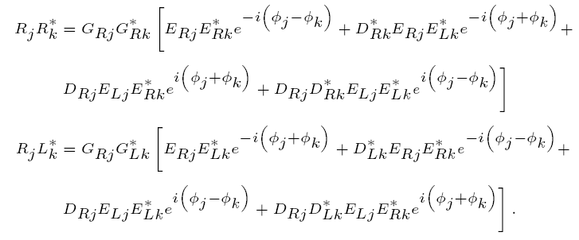
“Didn't your mother ever warn you not to play with polarization?”
(With thanks to Huib Jan van Langevelde)

Slide 26
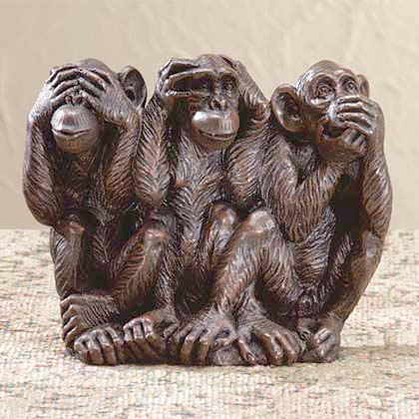
The Classical Approach
To Polarization Calibration

Slide 27
Leakage: The ME View
The only difference w.r.t. the previous m.e. is that the G matrix has off-diagonal terms.

Slide 28
The ME & MeqTrees
What do we need to do?
Simulation
  build an ME to model your simulated instrument/observation
  evaluate this ME over a frequency/time grid
  store “model” visibilities to disk
Calibration (self-cal)
  build an ME to model your observation
  evaluate over frequency/time grid
  compare to observed visibilities, and adjust model for best fit
  optional: subtract model from data, store “residual” visibilities to disk

Slide 29
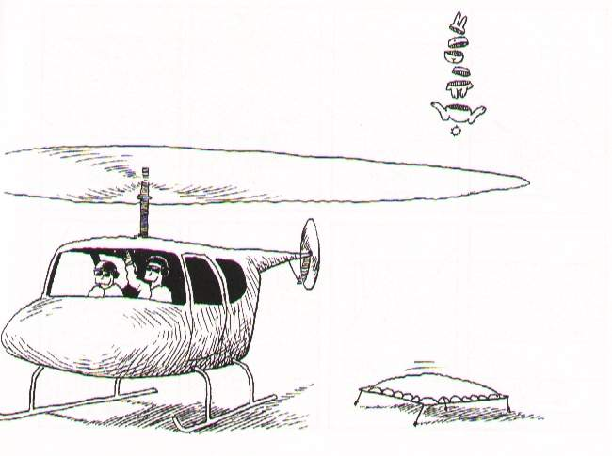
Part 3: Full Skies

Slide 30
A Sky Of Point Sources

Slide 31
A Sky Of Point Sources
uv-plane effects apply to all directions (i.e. all sources) equally
  e.g. receiver gain
image-plane effects depend on direction
  e.g. beam pattern
source coherency is (in a sense) intrinsic, so we will often just use Xpq from here on.

Slide 32
The Full-Sky ME

Slide 33
The Full-Sky ME

Slide 34
Image-plane vs. uv-plane

Slide 35
And Back To The ME....

Slide 36
The Fourier Transform
The integral then becomes a 2D Fourier transform of the “apparent sky”.

Slide 37
The Fourier Transform 2
This is essentially the van Cittert-Zernike theorem
  ...as a simple consequence of the M.E. and our K Jones term.
Note that the original M.E. (Hamaker-Bregman-Sault, “ME Paper I”) was formulated purely in terms of cohaerency:
...so here we extend the M.E. into the image plane.

Slide 38
The Fly In The Ointment
In the general case, the exponent is not quite an F.T. kernel.
Let's collect the n-terms into an “N-Jones”, and define an “apparent projected sky”:

Slide 39
Apparent Skies & Apparent Cohaerencies
In other words, each antenna pair p-q measures an apparent cohaerency distribution Xpq(u,v) that corresponds to a 2D Fourier Transform of its own apparent projected sky Bpq.
...at a single point in time!

Slide 40
Time Is Not On Our Side
Cohaerencies are sampled along a “uv track” over some period of time:
The true sky B is probably constant(?) in time
Image-plane effects (beam shapes, ionosphere) will vary:
  ...both in time
  ...and across antennas
All this is especially relevant with low-frequency and/or wide-field observations.

Slide 41
The “Classic” Assumptions
Only under these assumptions can we consider a single F.T. of the sky to be an accurate representation of what an interferometer sees.

Slide 42
Conclusions
Under the “classic” assumptions, the visibilities measured by an array correspond to ONE cohaerency distribution X that is in an F.T. relationship with ONE apparent sky.
In the presence of non-trivial image plane effects, and/or with wide fields and noncoplanar arrays, each interferometer p-q measures its “own” cohaerency Xpq(t), corresponding to its “own” apparent sky Bpq(t) -- variable in time!
The K term becomes an F.T. kernel with narrow FOVs/coplanar arrays, but is “not quite” an F.T. otherwise.

Slide 43
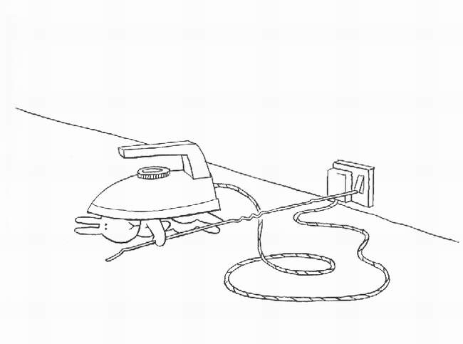
Part 3.1: Perils Of The Ionosphere

Slide 44
Ionosphere In The M.E.

Slide 45
Some Ballpark Numbers

Slide 46
The Famous Four Regimes: the trivial...

Slide 47
The Famous Four Regimes: the simple, and the nasty

Slide 48
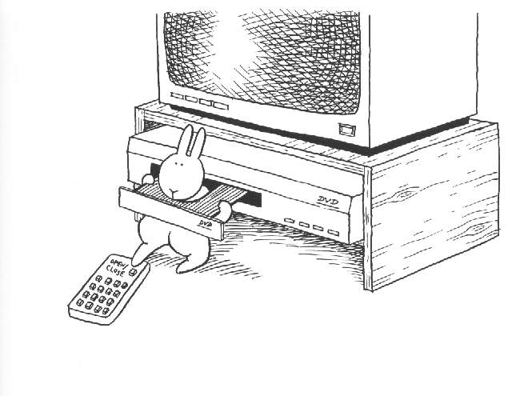
Part 4: Calibration

Slide 49
“Classic” Self-calibration
(for phases/gains)

Slide 50
The M.E. Analogue

Slide 51
Can We Correct Visibilities?
In general, no. Recall the full-sky ME:
uv-plane effects (the Gs) can be taken out by simple matrix inversion/multiplication
Image-plane effects (the Es) cannot

Slide 52
Can We Correct Visibilities?
Image-plane effects correspond to convolution in the uv-plane:
  ...with time-variable kernels
  ...and with each baseline's uv-plane sampled along just a single track
(Note: Bhatnagar et al. (EVLA Memo 100) suggest a method for approximate correction during the imaging step. We'll return to this later.)

Slide 53
Correcting At
A Single Point
In general, uv-data can only be “corrected” for a single point on the sky.
Hence, e.g., multifacet imaging.

Slide 54
Implications?
For calibration, we need to predict & subtract bright sources accurately in the presence of image-plane effects
The M.E. provides all the mathematical apparatus to do this right
The residuals may still need to be corrected...

Slide 55
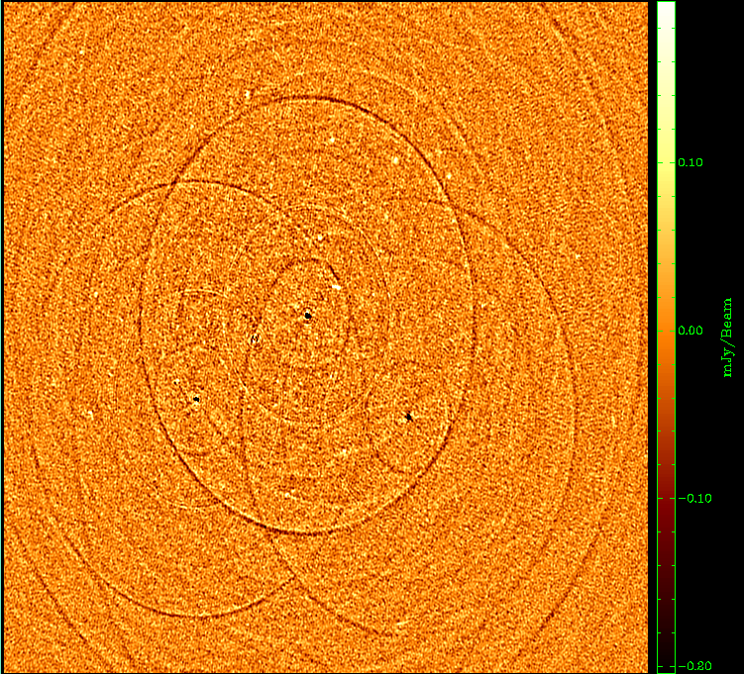
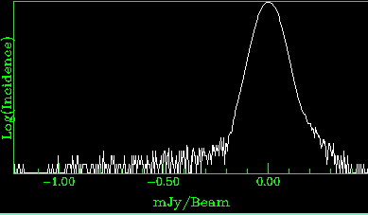
Example:
WSRT Off-Axis Effects
Single band (56 channels)
298 sources subtracted
σ ~ 30uJy
dominated by residuals from imperfectly-subtracted fainter sources
...which are caused by:
(a) imperfect sky model (more deconvolving would help)
(b) image plane effects: pointing errors, tropospheric refraction, ...
  no direct cure in NEWSTAR
polarized, 40 mJy
3C147, 22 Jy
20 mJy
35 mJy

Slide 56
Differential Gains
We can write an m.e. with differential gains:

Slide 57
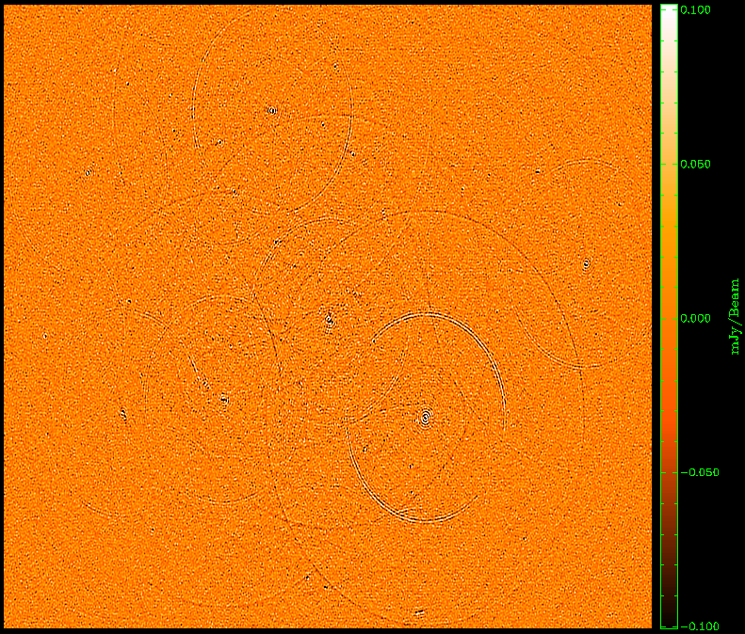
Flyswatter I
The “before” image.
polarized, 40 mJy
3C147, 22 Jy
20 mJy
35 mJy

Slide 58
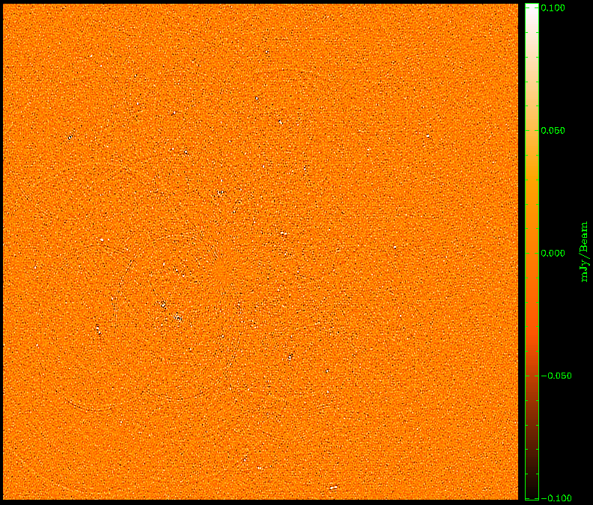
Flyswatter II
Solved for ΔE for
5 sources.
polarized, 40 mJy
3C147, 22 Jy
20 mJy
35 mJy

Slide 59

Flyswatter III
Solved for ΔE for
10 sources.
polarized, 40 mJy
3C147, 22 Jy
20 mJy
35 mJy

Slide 60
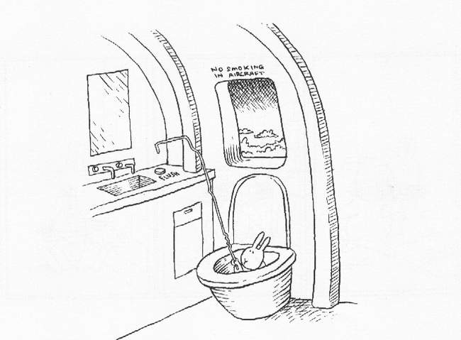
The End!

