Slide 1
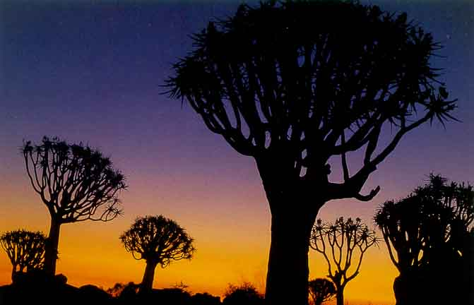
MeqTrees
Simulation & Calibration
Frameworks
O. Smirnov (ASTRON)

Slide 2
MeqTree Basics
Any computation can be represented by a tree
You write Python (TDL) scripts to define a tree of some kind
  e.g. one that computes some measurement equation
This is mapped (at run-time) onto C++ structures and executed by a fast computational kernel
What computation? The Measurement Equation, of course...

Slide 3
Your Basic M.E.
Or in more pragmatic terms:

Slide 4
Some Measurement Equations

Slide 5
Why Frameworks?
By having the ME defined in Python, we get endless flexibility...
...and also (as it turns out) endless confusion
  even the simplest ME involves many details to keep track of
  and not everybody wants to be a programmer
On the other hand, the same building blocks are reused over and over again
  sources, Jones matrices, etc.
Frameworks to the rescue...

Slide 6
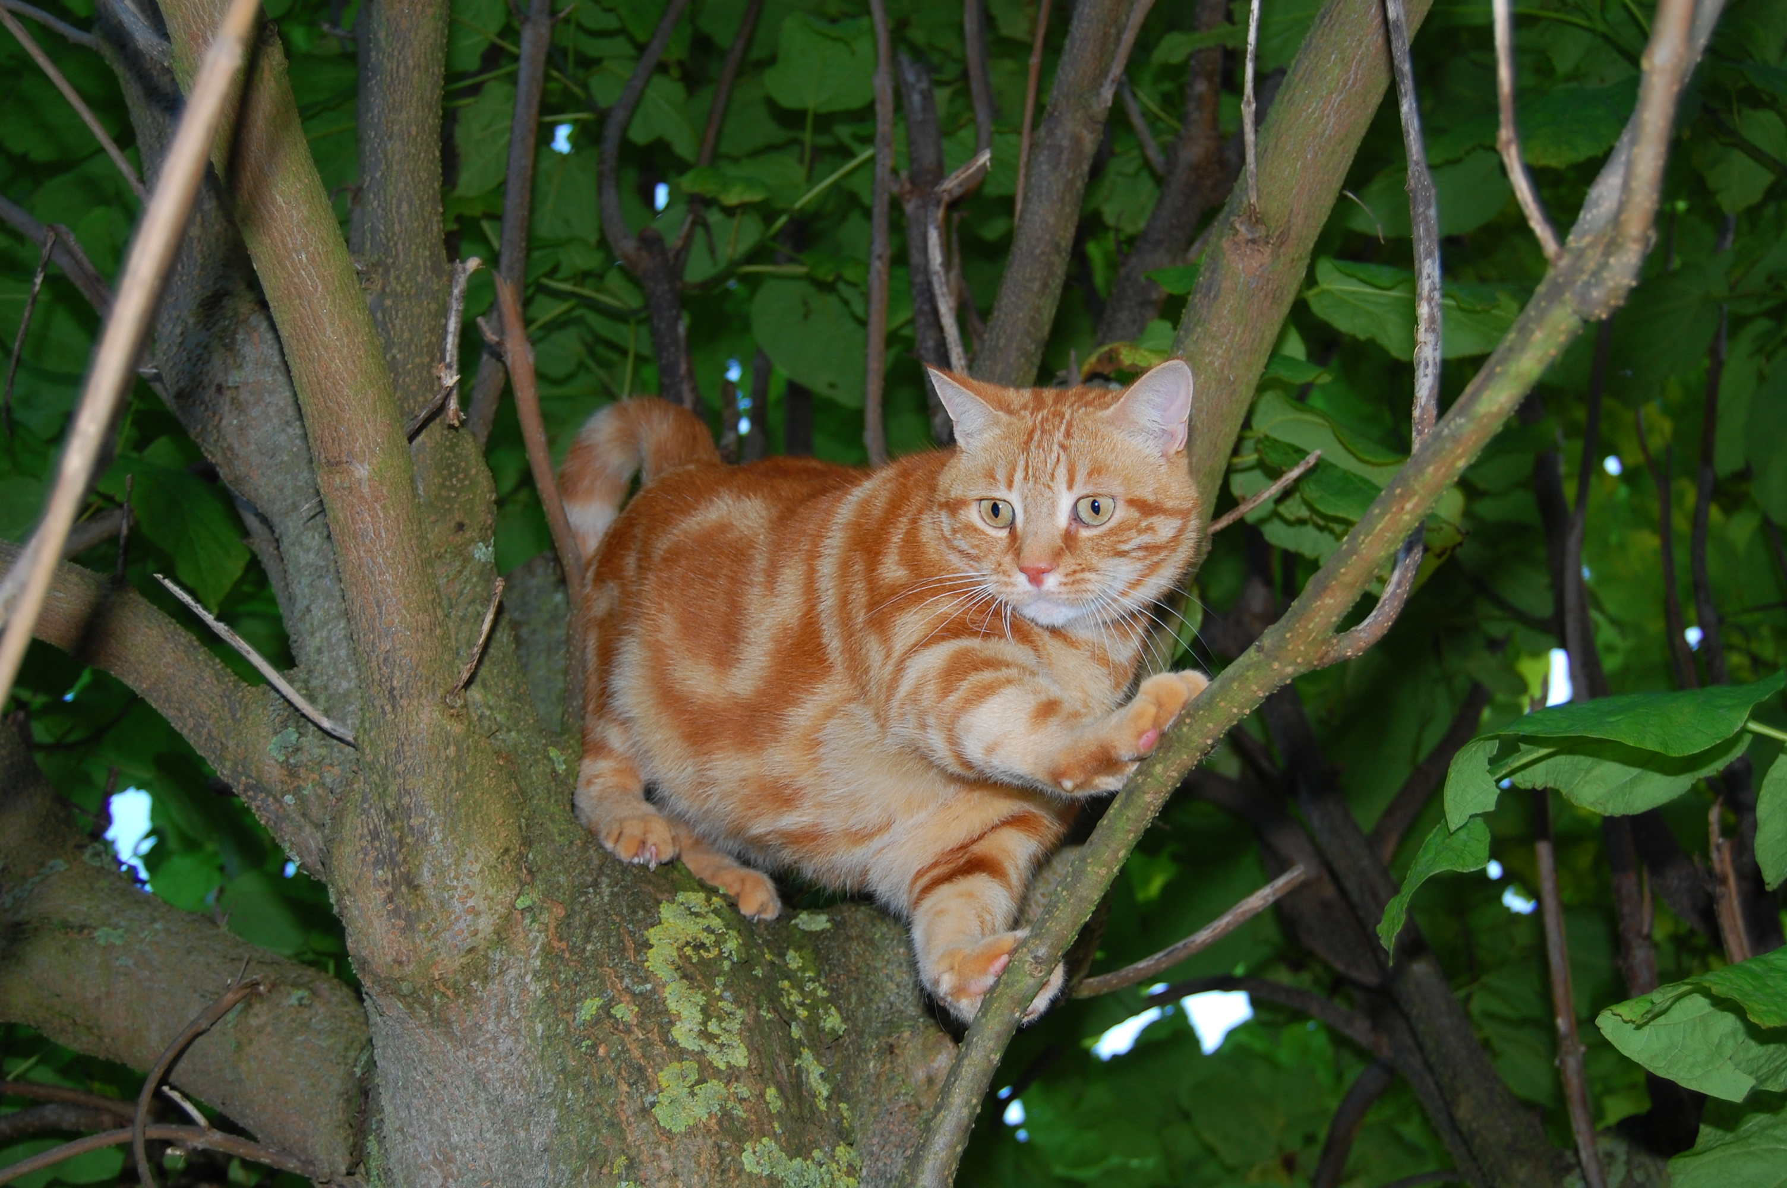
Meow
(Measurement Equation Object frameWork)
software
bloat

Slide 7
Meow
Object-oriented framework for putting together ME-related trees
Better than “pure TDL”
  but still (kind of) low-level
  intended for the advanced MeqTree user
Deals with objects such as Observation, IfrArray, SkyComponent, PointSource, GaussianSource, etc.
Base for higher-level frameworks

Slide 8

Siamese
(Simulations In Your Sleep)

Slide 9
Various simulation efforts
LOFAR
  dipole and station beams (S. Yatawatta)
  ionosphere (M. Mevius, J. Anderson, I. van Bemmel)
SKADS
  model skies (Oxford)
  ionosphere (I. van Bemmel)
  AA beams, pointing errors (C. Reynolds, S. Sundaram)
  FPA beams (T. Willis)
How to make things just fit together?
  there's actually three kinds of clients...

Slide 10

Three Kinds Of Clients
Developers:
overworked
underpaid
grouchy
...but covered in reflected glory
Developers work on things like implementing Jones matrices, sky models, etc.
programming required...

Slide 11

Three Kinds Of Clients
Power Users:
have more fun
steal glory from developers
Power users collect the modules implemented by developers, and put them together into simulators.

Slide 12

Three Kinds Of Clients
Button-Pushing Astronomers:
have even more fun
...without even learning Python
The ideal astronomer user interface (Tony Willis):
GO
GO FASTER
DO WHAT
I MEAN!

Slide 13
Siamese:
The Developer's Hat
Siamese is a set of contracts for implementing modules in TDL:
  “Jones term”
  “Sky Jones Module”
  “Pointing Offsets Module”
  “uv-Jones Module”
  “Sky Model”
Modules may define arbitrary options
See wiki:
  http://www.astron.nl/meqwiki/
  FrameWorks/StandardContracts

Slide 14
Siamese:
The Power User's Hat
Decide what ME we want to implement
Collect appropriate modules into a simulator script.
This mostly involves editing boilerplate code:
# specify available sky models
# these will show up in the menu automatically
import gridded_sky
import transient_sky
import Meow.LSM
lsm = Meow.LSM.MeowLSM(include_options=False);
meqmaker.add_sky_models([gridded_sky,transient_sky,lsm]);
# Z - ionosphere
import oms_ionosphere
meqmaker.add_sky_jones('Z','ionosphere',oms_ionosphere);

Slide 15
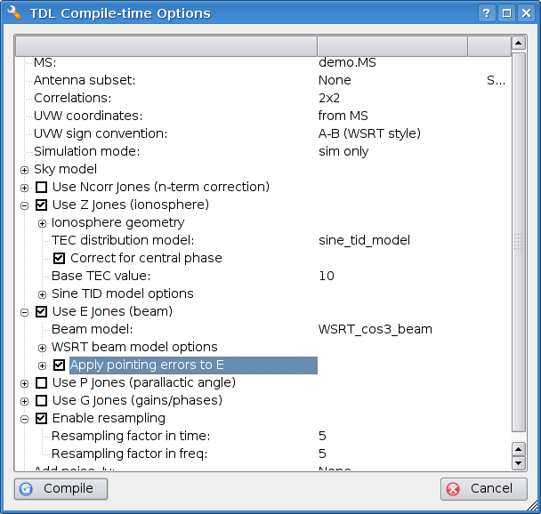
Siamese:
The Astronomer's Hat
Load a simulator script and start clicking...

Slide 16
Fringe Benefits of Siamese
Contracts ensure that various people's efforts are mutually compatible
Visualization provided for free
Module options are organized into a sensible GUI

Slide 17
From Simulation To Calibration
Simulation:
  build an ME (sky model + Jones terms)
  evaluate the ME over the time/frequency space defined by a Measurement Set
Calibration:
  build an ME (sky model + Jones terms)
  evaluate the ME and compare to observed data (from a Measurement Set)
  adjust ME parameters for best fit
So a similar framework should apply.

Slide 18
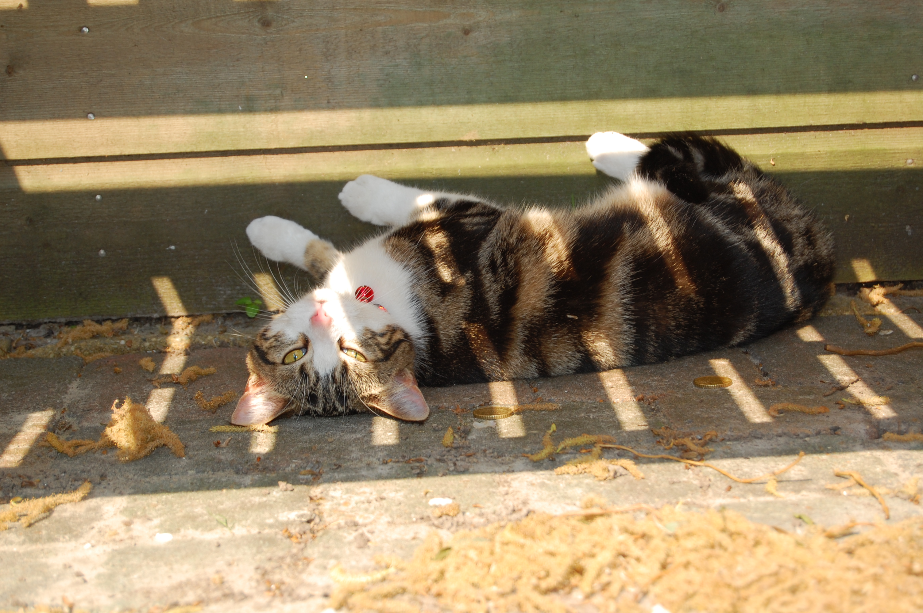
Calico
(Calibration Components)
I detect fringes...

Slide 19
Calico
Same idea as Siamese, uses the same set of contracts
  modules may also expose solvable parameters
Siamese and Calico modules are entirely compatible
Boilerplate calibration scripts are a bit more sophisticated, since parameter management is involved
  but that's for the Power User to worry about
Typical MEs are different:
  what can we fit (Calico), as opposed to what physics do we simulate (Siamese)?

Slide 20

Calico In Action:
“Beat NEWSTAR” Project
Aim: demonstrate the advantages of ME-based calibration
  by doing better than a legacy package
  pick the right target...
NEWSTAR (Netherlands East-West Synthesis Telescope Array Reduction)
  not a terribly wide user base
  WR holder in dynamic range
  (→2 million)
...but a very tall one!

Slide 21


Best NEWSTAR Image
Single band (56 channels)
298 sources subtracted
σ ~ 30uJy
dominated by residuals from imperfectly-subtracted fainter sources
...which are caused by:
(a) imperfect sky model (more deconvolving would help)
(b) image plane effects: pointing errors, tropospheric refraction, ...
  no direct cure in NEWSTAR
polarized, 40 mJy
3C147, 22 Jy
20 mJy
35 mJy

Slide 22
Differential Gains
Let's write an ME with differential gains:

Slide 23

Flyswatter I
The “before” image.
polarized, 40 mJy
3C147, 22 Jy
20 mJy
35 mJy

Slide 24

Flyswatter II
Solved for ΔE for
5 sources.
polarized, 40 mJy
3C147, 22 Jy
20 mJy
35 mJy

Slide 25

Flyswatter III
Solved for ΔE for
10 sources.
polarized, 40 mJy
3C147, 22 Jy
20 mJy
35 mJy

Slide 26
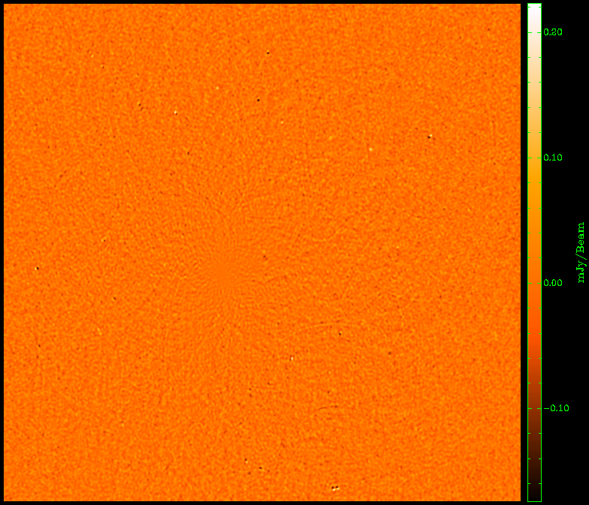
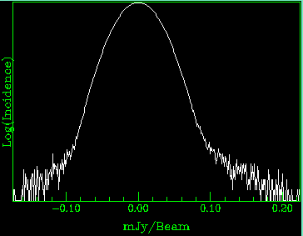
The Best Map So Far
Solved for ΔE for
12 sources.
Small problems remain, but the improvement over NEWSTAR is undeniable.

Slide 27
Conclusions
Wait for the practical session, then draw your own!

