Slide 1
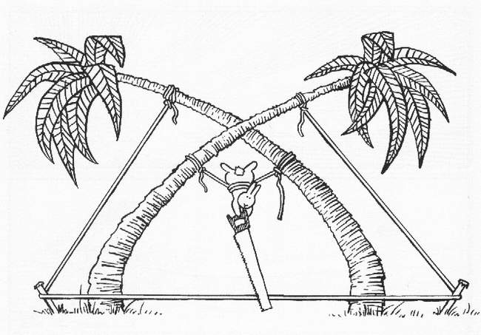
MeqTrees, Measurement Equations, And All That
O. Smirnov (ASTRON)

Slide 2
Plans
MeqTrees
Measurement Equations
Live Demos

Slide 3

MeqTrees, What And Why
A software system for building
numerical models – simulation
...and solving for their
parameters – calibration
Models are usually derived via
a measurement equation
  (we are, after all, in the measurement
  business)
...and specified as trees
  because this is a very flexible way to specify low-level mathematical expressions
  the high-level user may be (blissfully) oblivious to this

Slide 4
The Measurement Equation
(of a generic radio interferometer)
First formulated by Hamaker, Bregman & Sault (and further developed by Hamaker.)
A mathematically complete and elegant description of what you actually measure with an interferometer
  all we had before were hints and approximations
Absolutely crucial for simulating and calibrating the next generation of radio telescopes; everything literally revolves around it.
Like most great things, is utterly obvious in hindsight.

Slide 5
A Wafer-Thin Slice of Physics:
EM Field Propagation

Slide 6

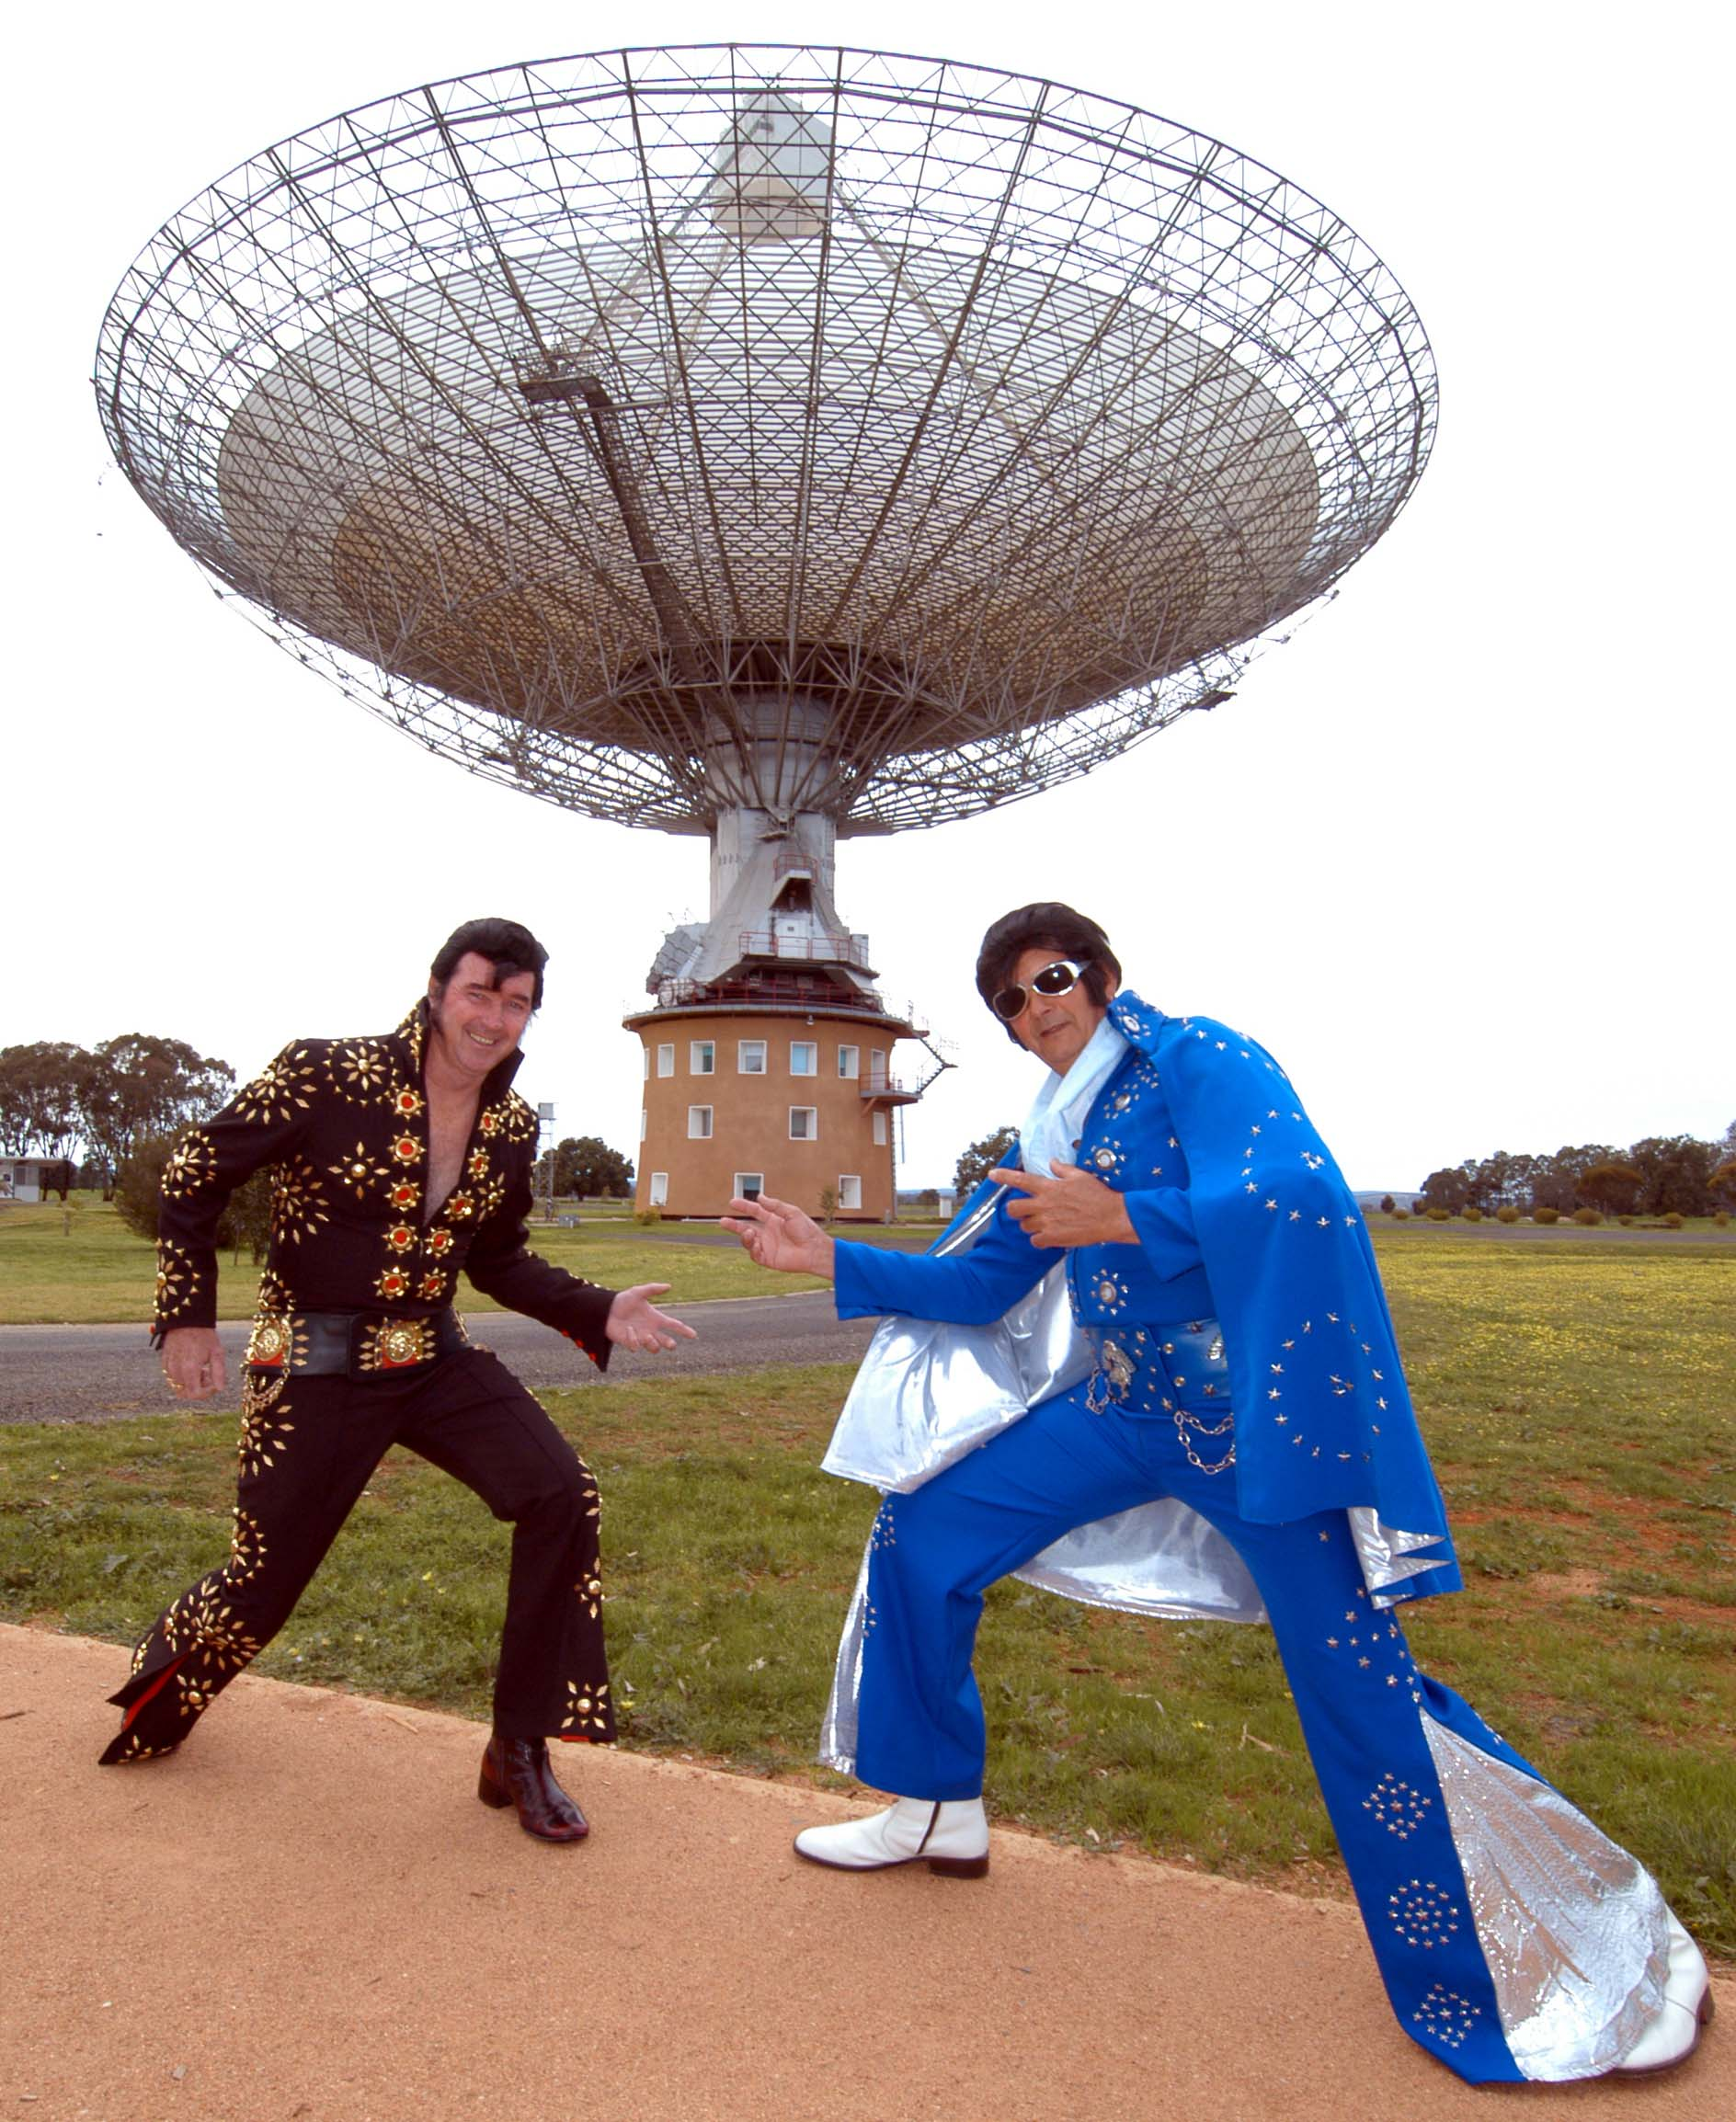
Single Dish
measured voltages are a complex 2-vector (vx,vy) because we have two polarized feeds

Slide 7

Interferometry

Slide 8
A Wafer-Thin Slice of Physics:
Correlations & Visibilities

Slide 9
A Wafer-Thin Slice of Physics:
The M.E. Emerges

Slide 10
And That's The Measurement Equation!
Or in more pragmatic terms:
NB: it is also possible to write the ME with a circular polarization basis (RR, LL, etc.) We'll use linear polarization throughout.

Slide 11
Jones Matrices
J is called a Jones matrix
Total J is a product of individual Jones terms:
Order of Js corresponds to the physical order of effects in your signal path.
Matrices (usually) don't commute!

Slide 12
Accumulating Jones Terms

Slide 13
Why Is This Great?
A complete and mathematically elegant framework for describing all kinds of signal propagation effects.
...including those at the antenna, e.g.:
  beam & receiver gain
  dipole rotation
  receptor cross-leakage
Effortlessly incorporates polarization:
  think in terms of a B matrix and never worry about polarization again.
Applies with equal ease to heterogeneous arrays, by using different Jones chains.

Slide 14
Why Is This Even Greater?
Most effects have a very simple Jones representation:

Slide 15
Three Layers Of Intuition
Physical
  Beam pattern of X and Y dipoles different, causes instrumental polarization of off-center sources
  Parallactic angle rotates angle of polarization
Geometrical
  A Jones matrix is also a coordinate tranform
  gain is stretching => instrumental polarization
  P.A. is a rotation
  The two do not commute
Mathematical: matrix properties

Slide 16
ME ME ME
The general formulation above is “The Measurement Equation” (of a generic radio interferometer...)
When we want to simulate a specific instrument, we put specific Jones terms into the ME, and derive a measurement equation for that instrument.
We then implement that specific m.e. in software (e.g. with MeqTrees)
Existing packages implicitly use specific m.e.'s of their own.

Slide 17
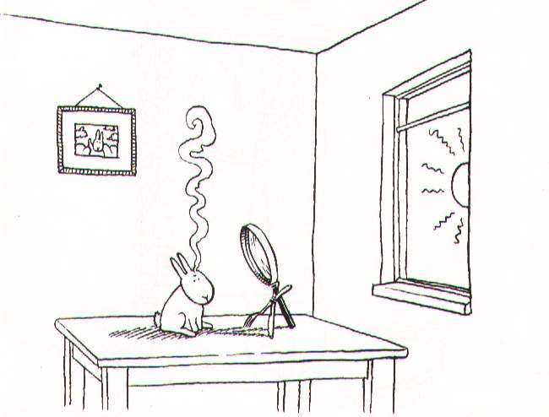
Example 1: A Lonely Point Source

Slide 18
Observing a point source with a perfect instrument
K accounts for the pathlength difference
  (and is what makes interferometry possible in the first place...)

Slide 19
The (familiar?) Scalar Case

Slide 20
Implicit m.e.'s
(“What Would AIPS Do?”)
Pre-ME packages use some implicit, specific, form of the ME
For example, a perfect point source:

Slide 21
MeqTree Components
meqbrowser
  GUI front-end, provides controls & visualization,
meqserver
  Computational back-end to do the heavy work
TDL (Tree Definition Language)
  Python-based scripting language to define trees
  Runs on the browser side
Frameworks
  High-level TDL frameworks for implementing M.E.s, simulation, calibration, etc.
Ancillary tools (PURR, etc.)

Slide 22

Group 1: Developers
Developers:
overworked
underpaid
grouchy
...but covered in reflected glory
NB: this is not
a picture of Oleg

Slide 23

Group 2: Power Users
Power Users:
have more fun
steal glory from developers
NB: this is also not
a picture of Oleg

Slide 24

Group 3: Button-Pushing Astronomers
The ideal astronomer GUI (Tony Willis):
GO
GO FASTER
DO WHAT
I MEAN!

Slide 25
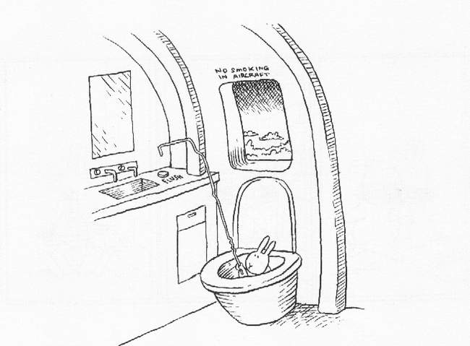
The Two Cardinal Rules
Of Doing Live Demos
1. Don't do live demos
2. Don't use unstable code

Slide 26
Simulation Demo 1
Run the browser (meqbrower.py)
Start a meqserver from the browser
Load a TDL script (sim.py)
Setup options
  MS: WSRT
  sky model: single point source at center of field
  no Jones terms
Compile script, run the tree to fill MS with simulated visibilities
Run the imager to make a dirty image of the simulation

Slide 27

PURR
“PURR is Useful for Remembering Reductions”
Disciplined people keep notes
Undisciplined people write software

Slide 28
Using PURR
The object of PURR is to make note-keeping as effortless as possible
PURR watches your working directory for new or modified files (“data products”)
  configuration files, images, screenshots
Offers to save them to a log
  ...along with descriptive comments
  And useful rendering of things like images
Purrlogs are natively saved in HTML and may be immediately published or shared

Slide 29
Example PURR Logs
Calibrating 3C147:
http://www.astron.nl/meqwiki-data/users/oms/
3C147-Calibration-Tutorial/purrlog/
Enthroned chicken:
http://www-astro.physics.ox.ac.uk/~ianh/ PURRLOGS/enthroned/

Slide 30
Introducing Complex Gains
The “classic” view: each receiver has a complex amplitude and phase term (troposphere/electronics/etc.)

Slide 31
Gains: The ME View

Slide 32
Simulation Demo 2
We'll throw a G Jones into the mix
The G Jones module provided here implements a simple error model: sine wave
More realistic error models may be plugged in
  Implementation is just a bit of Python code
Rerun sim.py
  Grid model, 5x5 mJy sources at 5', 1 Jy at center
  enable G Jones phase error
  120 degrees, 2-4 hours
  Add some noise
Open bookmarks

Slide 33
Visualization Everywhere
One of the guiding principles of MeqTrees: everything can be visualized
  any intermediate calculation or result may be published into the browser and plotted
But some visualizations are more interesting than others
  the script (i.e. its author) knows which these are
Scripts can define “bookmarks” for interesting visualizations

Slide 34
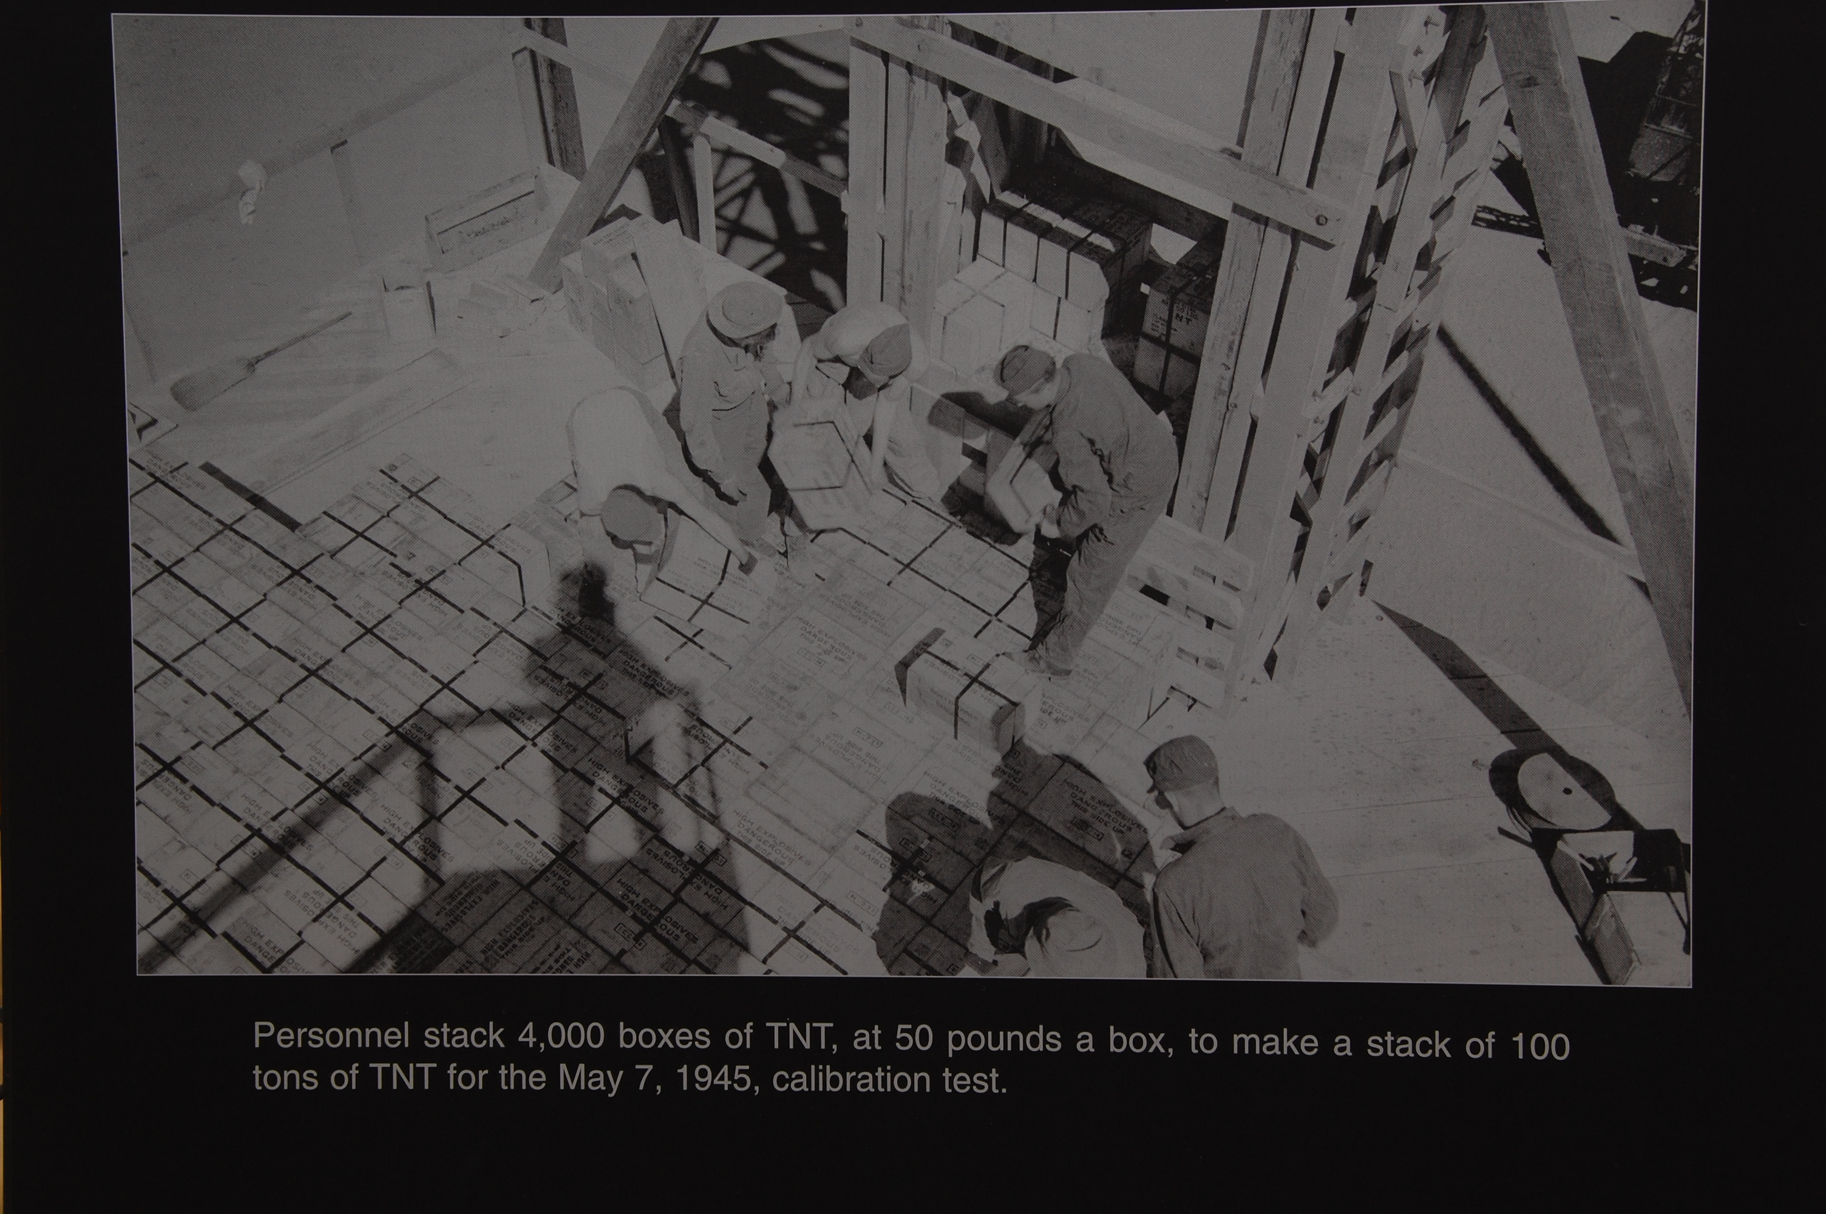
Calibration (Can Be Fun)

Slide 35
Classic (Scalar) Selfcal
Start with a sky model (point source at center, etc.)
Solve for complex gains by fitting observed data:
Iteratively refine sky model, rinse, repeat

Slide 36
M.E.-based (Matrix) Selfcal
Start with a sky model (point source at center, etc.)
Solve for G Jones elements by fitting observed data:
Iteratively refine sky model, rinse, repeat
Arbitrary Jones terms may be added (and solved for!)

Slide 37
Calibration Demo 1
Load cal.py
  Use 2x2 data, diagonal terms only
  Enable calibrate & correct
  Use sky model with 1 source at center
  Enable G Jones (FullRealImag)
Open bookmarks for G and for corrected residuals
Solve for G diagonal terms
  Subtiling of 1 in time
  Tile size 20
Make an image of the corrected data

Slide 38
M.E. Calibration Terminology

Slide 39
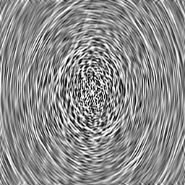
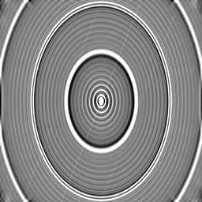
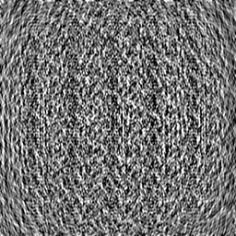
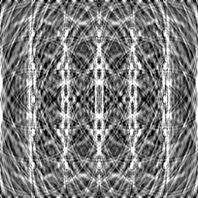
Jy
level
mJy
level

Slide 40
Major Loop Of Calibration
Make initial sky model
Calibrate, subtract sky model, and generate corrected residuals
Use corrected residuals (deconvolution, etc.) to improve sky model
Repeat until satisfied
What is satisfaction?

Slide 41
Calibration (Noordam Definition)

Slide 42
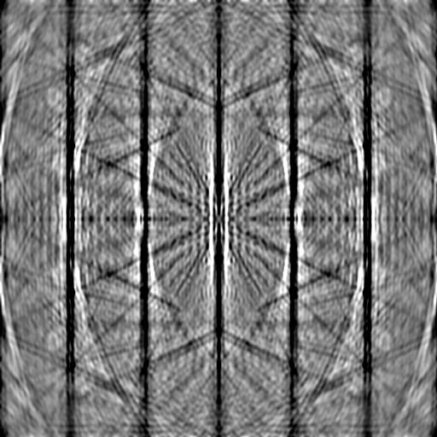
Real-Life Residuals
Real-life residuals are always contaminated by imperfect subtraction of sources (due to calibration error)
Causes of error:
  Contamination from sources
  not included in sky model
  Imperfect instrument models
  RFI, insufficient flagging
Error level here ~0.01 mJy
  (dynamic range: 1:100,000)

Slide 43

The Classical Approach
To Polarization

Slide 44

Classical Equation For
Polarization Selfcal
(With thanks to Huib Jan van Langevelde)

Slide 45
The Measurement Equation
For Polarization Selfcal
The only difference w.r.t. the previous m.e. is that the G matrix has off-diagonal terms.
Polarization not so scary after all!

Slide 46
A Case Study: Dipole Projection
Aperture array with fixed NS and EW dipoles
Projection of dipoles onto tangential plane determines sensitivity to polarization
Equivalent to conventional dipole pair only at zenith
=90˚
=45˚ =45˚
=45˚ =15˚
N
=90˚
=15˚
W
E
S

Slide 47
Dipole Projection Jones Matrix
Projection can be described by a Jones matrix:
Function of azimuth/elevation, so:
  Varies with time
  Varies with source position, given a wide field
  Varies with station position, given a large array

Slide 48
Simulation Demo 3
We'll simulate dipole projection
Run sim2.py
Sky model: 5x5 cross at 30'
Enable L Jones
  Per-source but not per-station
Open bookmarks to check az/el and L Jones
Make an IQUV image
  Note distortions in I map due to time-varying sensitivity of the dipoles
  Note instrumental QU polarization – direction-dependent!

Slide 49
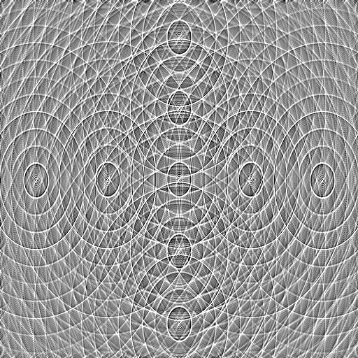
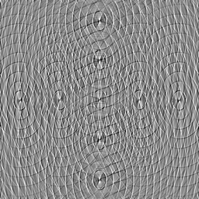
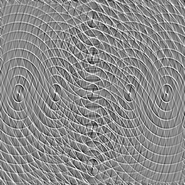
Stokes I map.
Note distortions in source shape. These are caused by time-varying sensitivity of the dipoles to total flux.
Peak flux is ~.6 Jy (would be
1 Jy without this effect!)
Q and U maps.
Note instrumental polarization
(direction-dependent!)
Peak flux is
±0.1 Jy

Slide 50
Calibrating For Dipole Projection?
The ME we are using is:
For calibration, we can use the same ME and solve for G Jones again
No need to solve for L Jones since we know it analytically
  we simply incorporate it into the ME at the predict stage
But can we really correct for it?

Slide 51
Problem 1:
Inverting Jones Terms
The ME allows us to write out corrected visibilities or residuals:
What happens if we can't invert L?
=90˚
=45˚ =45˚
=45˚ =15˚
N
=90˚
=15˚
W
E
S

Slide 52
Problem 2: Correcting For Direction-Dependent Effects
w/o DD effects
with DD effects

Slide 53
Demo: Correcting
For a Single Direction
In general, visibility data can only be “corrected” for a single direction on the sky.
Hence, e.g., facet imaging.
Bhatnagar (EVLA Memo 100) suggests an approximate method to apply on-the-fly corrections during imaging)
Correction Demo:
  Run cal2.py
  Enable correct, disable calibrate and subtract
  Apply L Jones correction (for center of field) and make an image

Slide 54
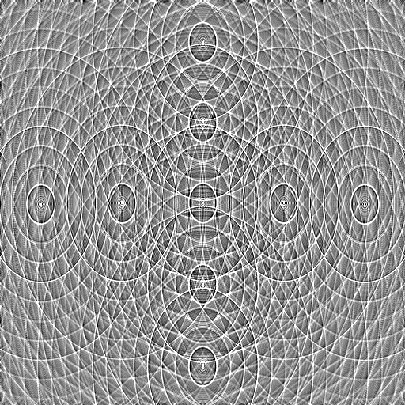
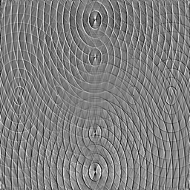
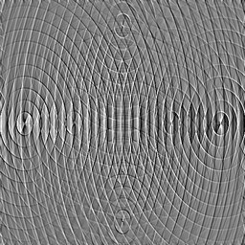
Stokes I map.
Distortions in source shape no longer visible (though from the math we know they must remain, on a low level.) Peak flux is 1 Jy.
Q and U maps.
Note how instrumental polarization corrects perfectly at center, but increases towards edge of field.
Peak flux is ±50 mJy.

Slide 55
Dealing With D-D Effects
The same issue arises with other D-D effects:
  Ionosphere
  Beam shapes & pointing errors
Becoming critical for today's SKA pathfinders, and will be even more so for the SKA itself
Solution: subtract sources bright enough to cause trouble
  Since we can predict them “perfectly” (within the limits of calibration error)

Slide 56


Example:
WSRT Off-Axis Effects
Single band (56 channels)
298 sources subtracted
σ ~ 30uJy
dominated by residuals from imperfectly-subtracted fainter sources
...which are caused by:
(a) imperfect sky model (more deconvolving would help)
(b) image plane effects: pointing errors, tropospheric refraction, ...
  no direct cure in NEWSTAR
polarized, 40 mJy
3C147, 22 Jy
20 mJy
35 mJy

Slide 57
Differential Gains
We can write an m.e. with differential gains:

Slide 58

Flyswatter I
The “before” image.
polarized, 40 mJy
3C147, 22 Jy
20 mJy
35 mJy

Slide 59

Flyswatter II
Solved for ΔE for
5 sources.
polarized, 40 mJy
3C147, 22 Jy
20 mJy
35 mJy

Slide 60

Flyswatter III
Solved for ΔE for
10 sources.
polarized, 40 mJy
3C147, 22 Jy
20 mJy
35 mJy

Slide 61
Nancay Workshop, SSSC
MCCT SKADS Workshop
“Towards 3rd Generation Calibration In Radio Astronomy”
Nancay, Sep 27 – Oct 10, 2009
http://mcct.skads-eu.org/nancay/nancay-mcct.php
Qualification via the SKADS Set Of Standard Challenges:
http://www-astro.physics.ox.ac.uk/~ianh/SSSC/index.html

Slide 62
The End!

