Slide 1

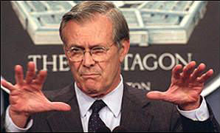
Ghostbusters: The Unknown Unknowns Of Selfcal
O. Smirnov

Slide 2
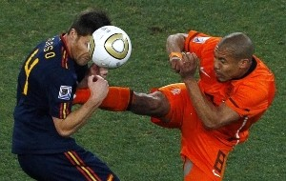
Football: 18:30 at De Borken

Slide 3

2004: The Ghosts of Cyg A
WSRT 92cm observation of J1819+3845 by Ger de Bruyn
String of ghosts from brightest source to CygA
(20° away!)
Perfectly circular
Present in all 8 bands
Position and size distribution does not depend on frequency
Wasn't clear if they were “in the data”, or a calibration artifact

Slide 4

2008: LOFAR Ghosts

Slide 5

2010: QMC2
(The Field That Keeps On Giving)
WSRT 21cm observation
String of ghosts connecting dominant sources A (220 mJy) and B (160 mJy)
Second, fainter, string from source A towards NNE (Do not cross the streams!)
Qualitatively similar to
2004 ghosts

Slide 6
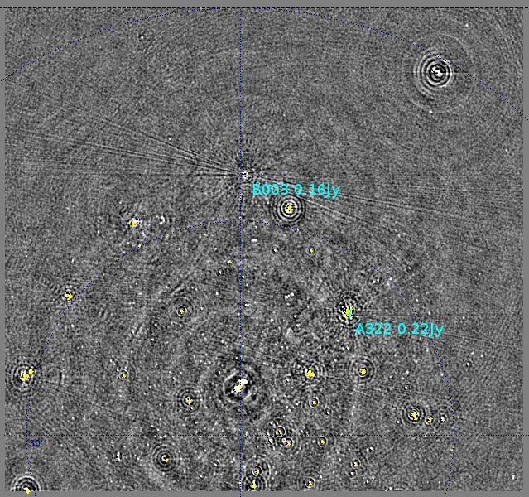
2010: QMC2
Busted!
...and then I busted them.
“Maybe now you'll never slime a guy with a positron collider!”
– Dr. Peter Venkman

Slide 7
To Bust Something Is To Understand It?
QMC2 calibration steps:
  Selfcal
  Differential gain solutions for A, B, and 6 other sources
  Repeat selfcal ← ghosts disappear
Repeated selfcal for J1819+3845 observation, with a frequency-dependent differential gain on Cyg A: ghosts busted
Independently, Ger de Bruyn repeated selfcal using an improved Cyg A model: ghosts busted

Slide 8
Poll: Who Understands Selfcal?
“If you are not completely confused by quantum mechanics, you do not understand it.”
– <John Wheeler|Niels Bohr>
“It is safe to say that nobody understands quantum mechanics”
– Richard Feynman
Second Law Of Smirnov:
You do not understand selfcal.

Slide 9
Ghostbusters: The Movie

Slide 10
Ghosts = Selfcal Contamination
MS1: Simulated 1 Jy source at phase centre
MS2: added three 1 mJy sources at various distances from centre (from 10' to 20°)
Did selfcal on MS2 using a sky model composed of only the 1 Jy source
  Selfcal solutions are thus slightly “contaminated” by the three off-axis sources
Applied these solutions to MS1, and subtracted central source
Result is “distilled artifacts”: flux from the central source that has been scattered by applying contaminated selfcal solutions

Slide 11
Ghastly Properties
On a line from contaminator to dominator
  ...and extend beyond both
Perfect circles
Sit at (some) natural harmonics
  1/2, 1/5, 4/5, 3/7, 4/7
  ...but not e.g. 2/5 or 2/7!!
Decrease in intensity with more baselines and more channels (for WSRT)
Full of surprises...

Slide 12
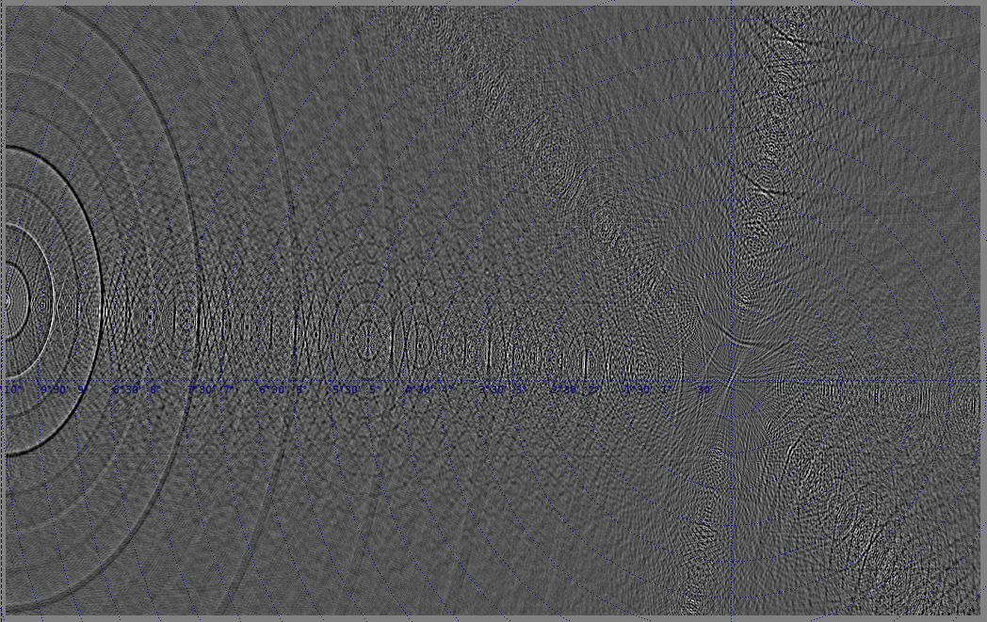
Ghastly Surprises
Going from 91 baselines (down with redundancy)...

Slide 13
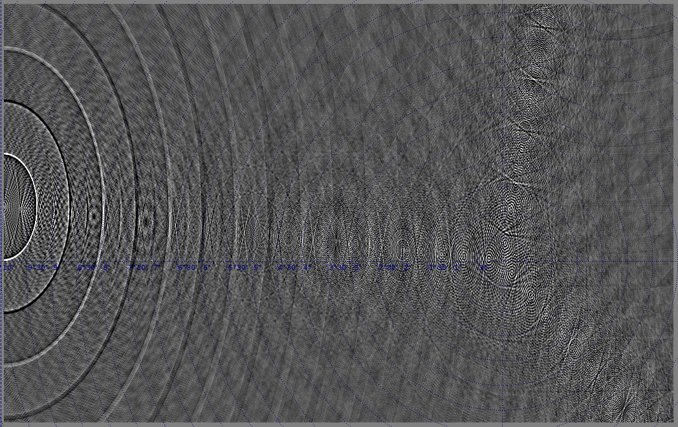
Ghastly Surprises
...to 40 baselines

Slide 14
Pop Quiz 1
What changes if we make the dominant source twice as bright?
  2 Jy dominator, 1 mJy contaminators

Slide 15
Ghastly Properties 2
Answer: NOTHING
Ghosts are proportional to contaminator flux, independent of dominator flux
Quite faint: <μJy for a mJy contaminator
  explains why we haven't been seeing more of them
  a luxury problem, formerly
  the 2004 case: a lot of Cyg A flux went unmodelled, due to frequency-dependent primary beam

Slide 16
Ghastly Mysteries
Why are they on a line?
Why the natural harmonics?
  Error modes correspond to ratios phase gradients?
Why the perfect circles?
  source needs to be sufficiently far for perfect circles to form up
Don't fully understand them, but we can simulate them into submission...

Slide 17
Pop Quiz 2
Ghosts don't change if we increase the dominator flux
...but what happens if we put that extra flux somewhere else, i.e. add a weaker source off-center?
  2 Jy source at center
  1 Jy off-center

Slide 18
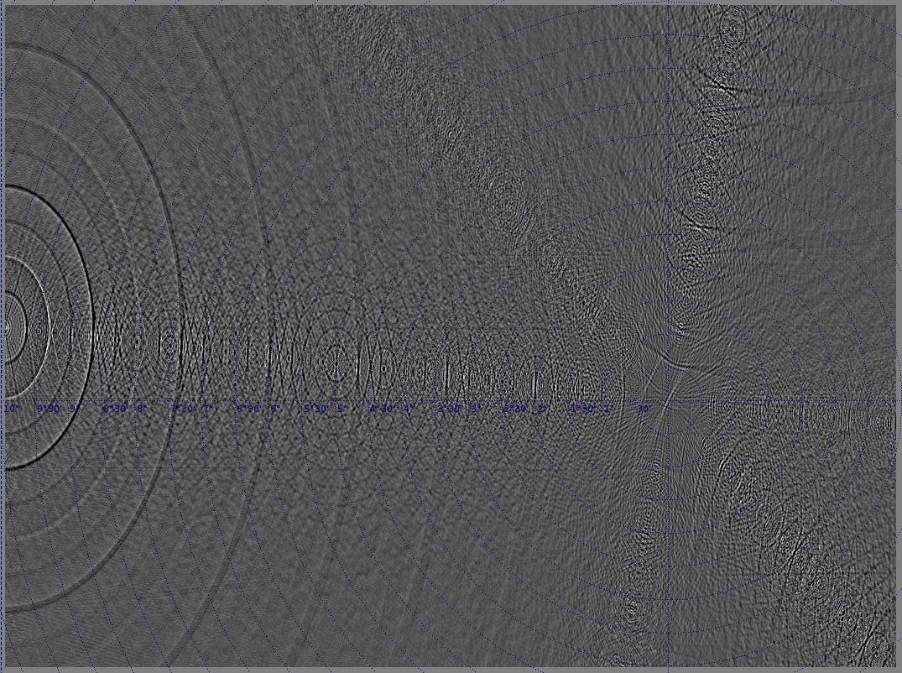
2 Jy central source – what if we add a second, 1Jy, source?

Slide 19
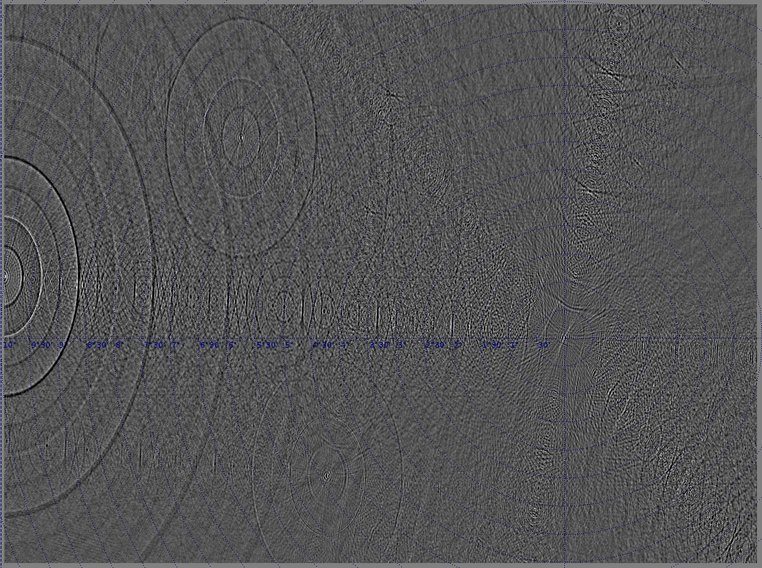
2 Jy central source, 1 Jy SE – now what if we flip them?

Slide 20
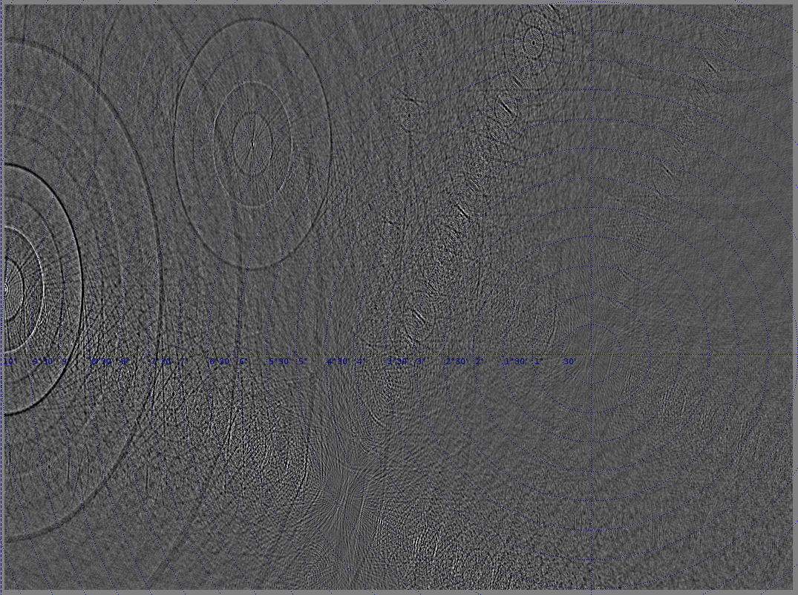
1 Jy central source, 2 Jy SE – now what if we make them equal?

Slide 21
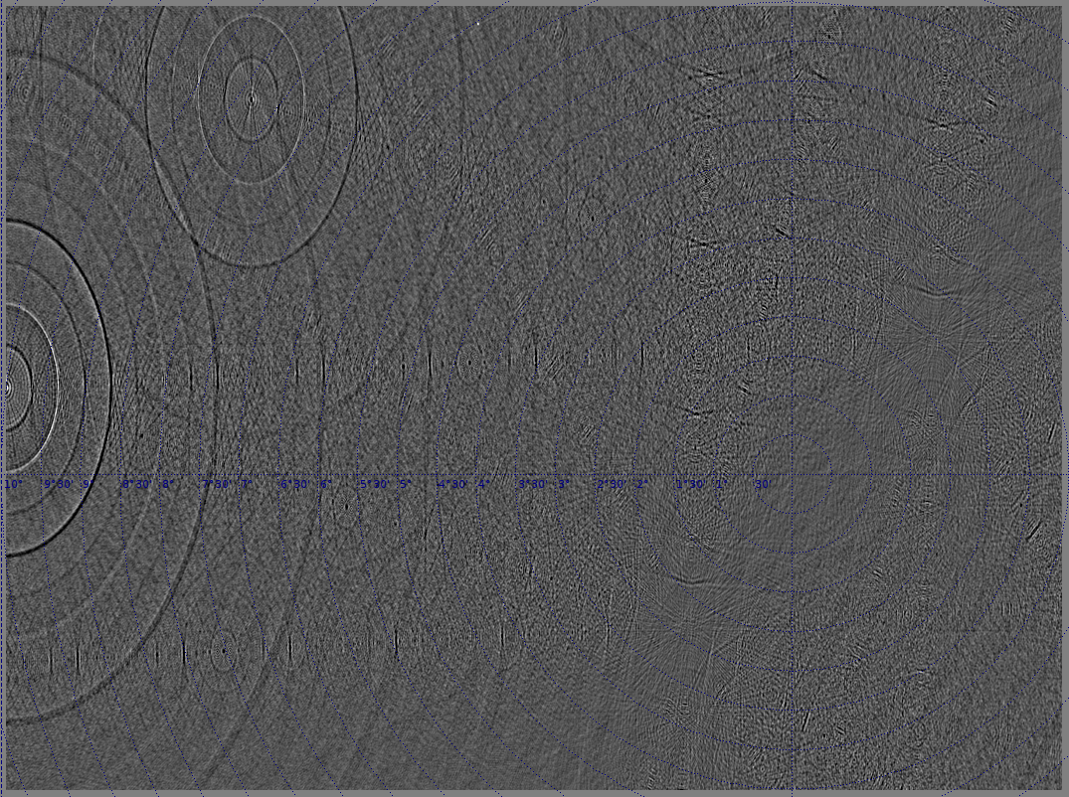
1 Jy source SE, 1 Jy NW

Slide 22
Array Configuration?
Conjectures: ghosts related to redundancy and/or periodicity and/or E-W config
Tested other telescopes (thanks to Ian Heywood for the layouts):
HEWT (Heywood East-West Telescope):
a log-WSRT
VLA Oranje: VLA-C, teleported to Holland
Vanilla VLAAA: a VLA-like log-spiral of 24 antennas

Slide 23

WSRT = 240 nJy

Slide 24
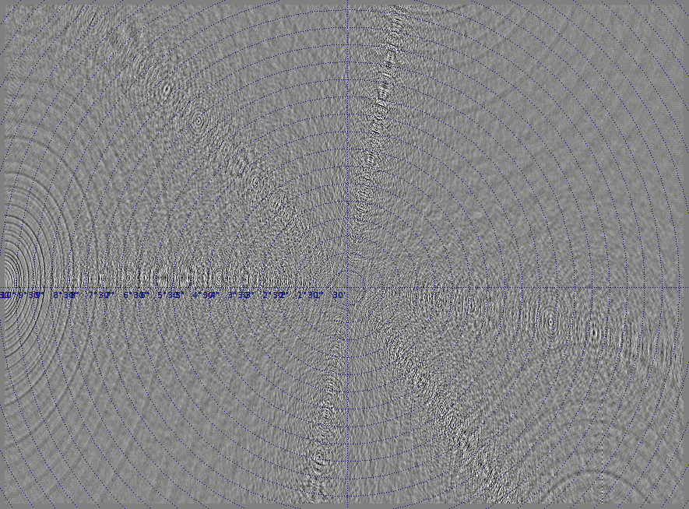
HEWT = 250 nJy

Slide 25

VLA = 93 nJy

Slide 26
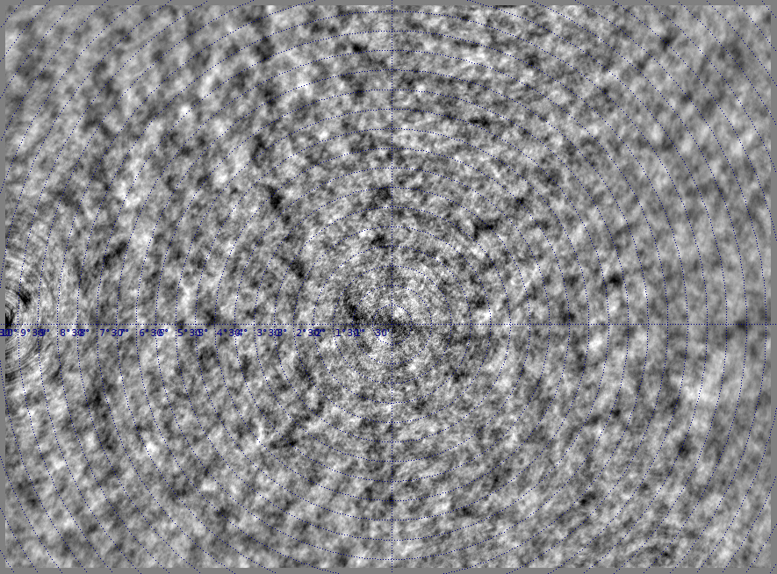
VLAAA = 330 nJy (worse than WSRT?!)

Slide 27
Implications & Burning Issues
We will always have contamination, so:
Possibility of coherent structures
  can they bias blind surveys?
Contamination adds to image noise
  Is this a dynamic range limitation?
“Strange” noise statistics
  How does this affect our ability to e.g. detect the EOR?
Non-trivial dependence on array config
  Both in terms of overall level, and distribution
  Does this follow from an existing Figure Of Merit?

Slide 28
Why Do We Trust Selfcal?
Peer pressure
Brainwashed as a PhD student
Stockholm syndrome
But mostly, because it
  Makes better maps
  And the gain/phase solutions make physical sense
We use priors to discriminate false results
  So can we feed our priors into calibration?
  Can we even trust our priors?

Slide 29
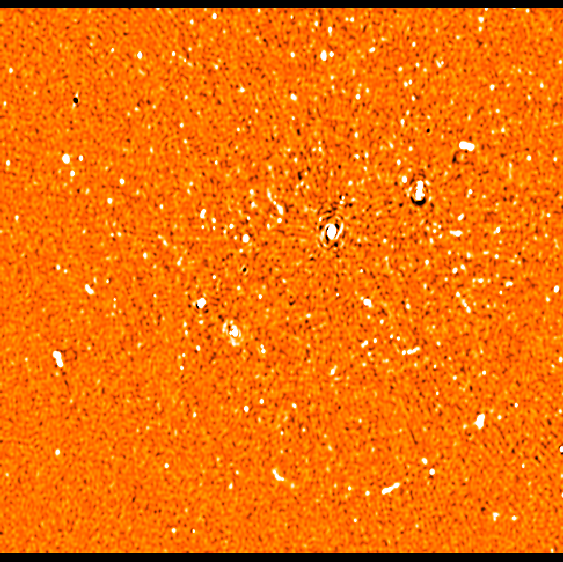
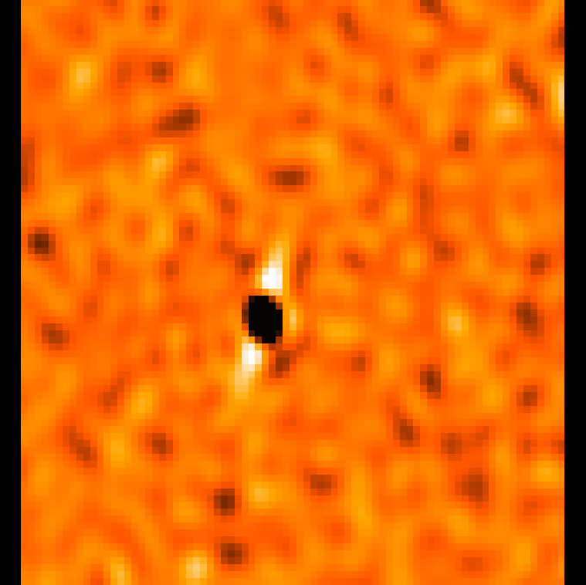
A Different Kind Of Ghost
A residual image from one of my HDR 3C147 experiments
Note artists' impression of an AGN...

Slide 30
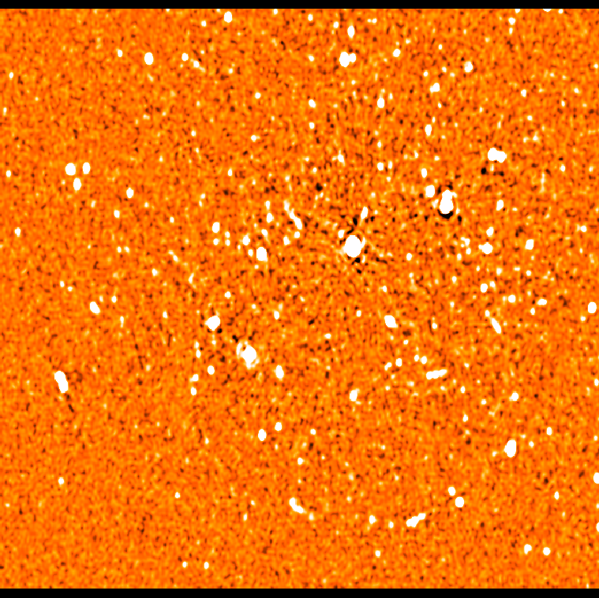
A Good Image, For Comparison
Spot the differences
Bright off-axis sources have negative counterparts symmetric w.r.t. dominant source (≠ phase centre!!!)
Can you guess what caused it?

Slide 31
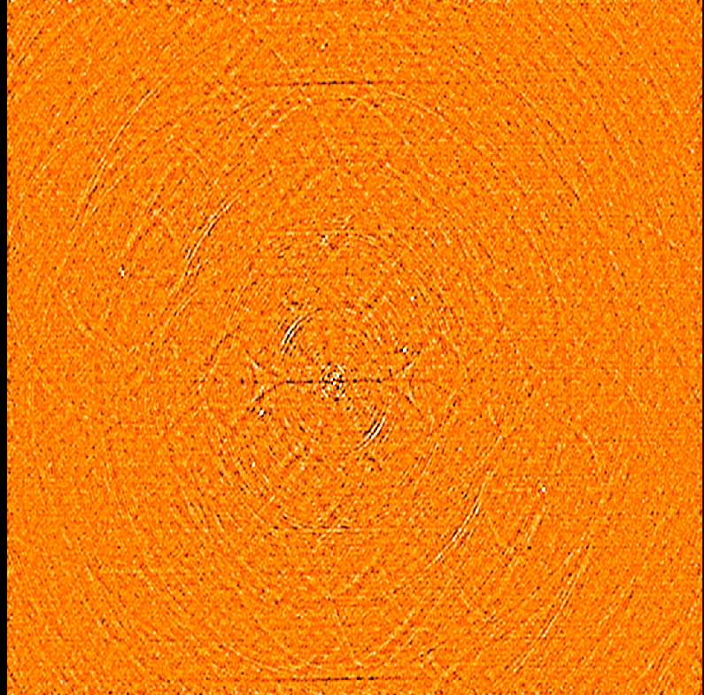
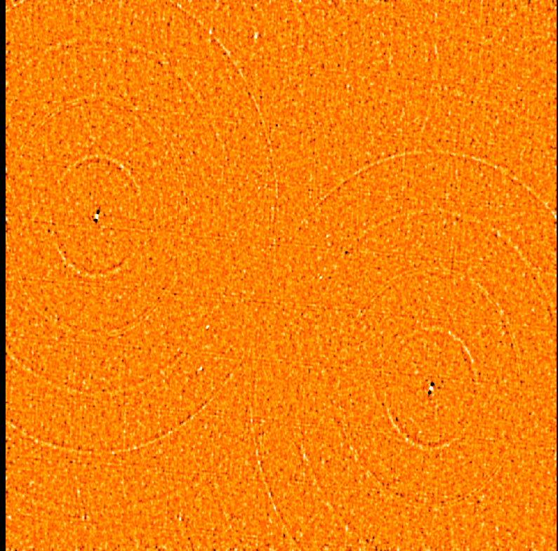
“Flagging Bias”
Amplitude-based flagging in the presence of significant flux can introduce coherent structure into the maps
Difference between flagged and unflagged:
uvbin method
timemed method

Slide 32
Exit Poll: Does Anybody Still Understand Selfcal?
Second Law Of Smirnov:
You do not understand selfcal.

