Slide 1

Of Luxury Problems &
Limp Instruments
(DDE! WSRT!)
O. Smirnov

Slide 2

3C147
NEWSTAR image
22Jy @21cm
12h, 8 bands
13.5 uJy noise
on-axis DR:
1500000:1
off-axis DR:
1000:1
Limited by direction-dependent effects
(DDEs) such as pointing errors, tropospheric refraction, etc.
No direct cure in selfcal.

Slide 3

3C147
MeqTrees image
22Jy @21cm
12h, 8 bands
13.5 uJy noise
Same DR as NEWSTAR, but no off-axis artifacts.

Slide 4
Differential Gains
Off-axis artifacts eliminated using this M.E.:

Slide 5

Note the high S/N in frequency
Continuity in time and space suggests dominant large-scale effect, as opposed to per-antenna things like pointing

Slide 6

QMC Project
Find a field containing a cluster of moderately bright sources
Introduce deliberate (and secret) pointing errors into a few WSRT antennas
  “limp noodle” mode
Attempt to recover pointing errors by solving for differential gains

Slide 7
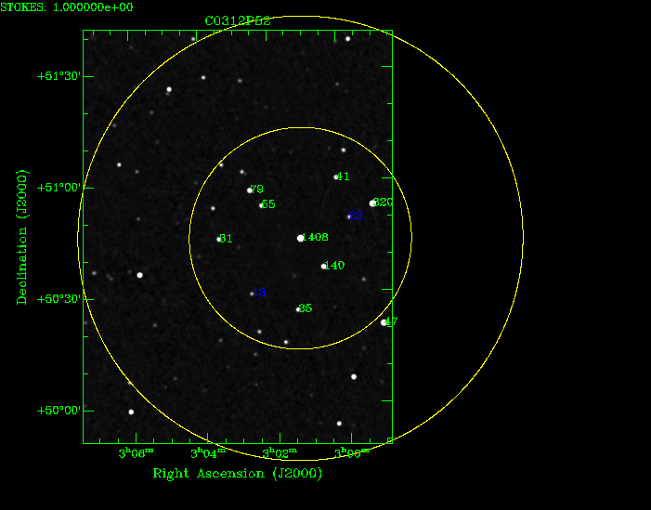
The QMC Field
(Quality Monitoring Committee)

Slide 8
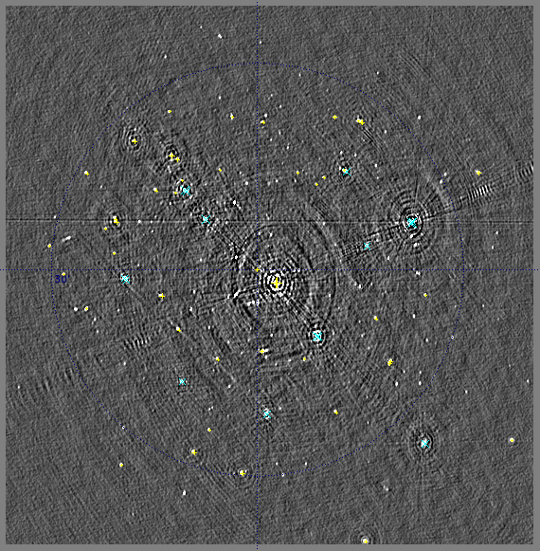
QMC Proves Tricky...

Slide 9
QMC Issues
A number of slightly resolved sources
  Including central 1.4 Jy one
Difficult to distinguish source structure from gain effects
  an extended source will have an HA-dependent visibility amplitude (on long baselines)
  how to distinguish this from real gain errors on antennas C and D?
Need to bootstrap a sky model!

Slide 10
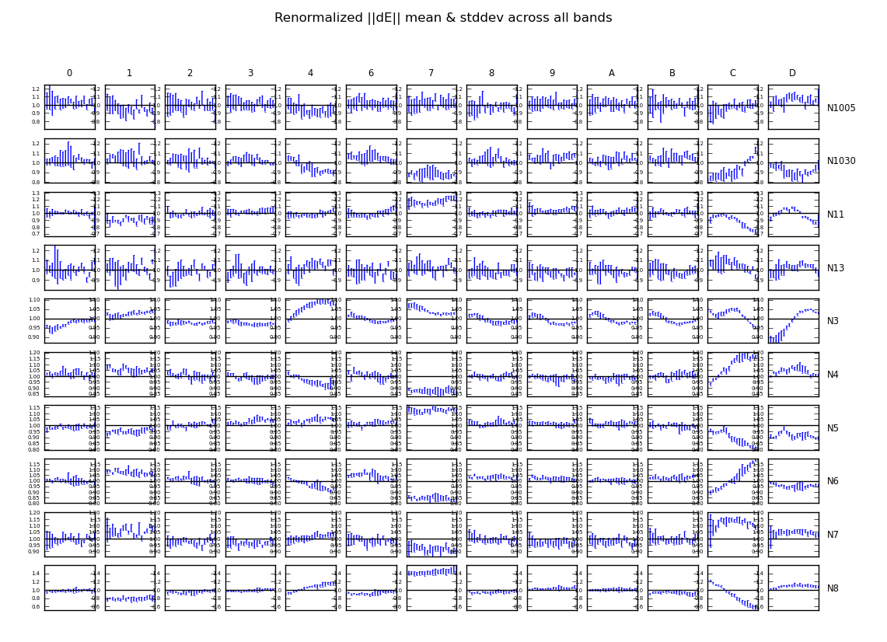
The Evidence

Slide 11
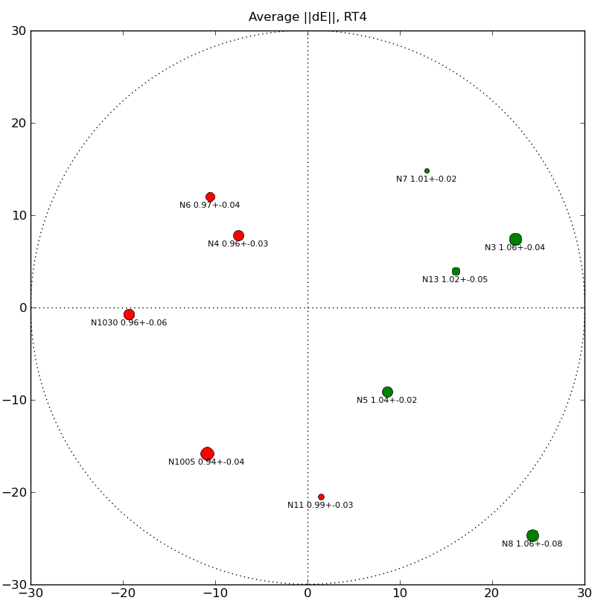
Another Way To Visualize ||dE||

Slide 12
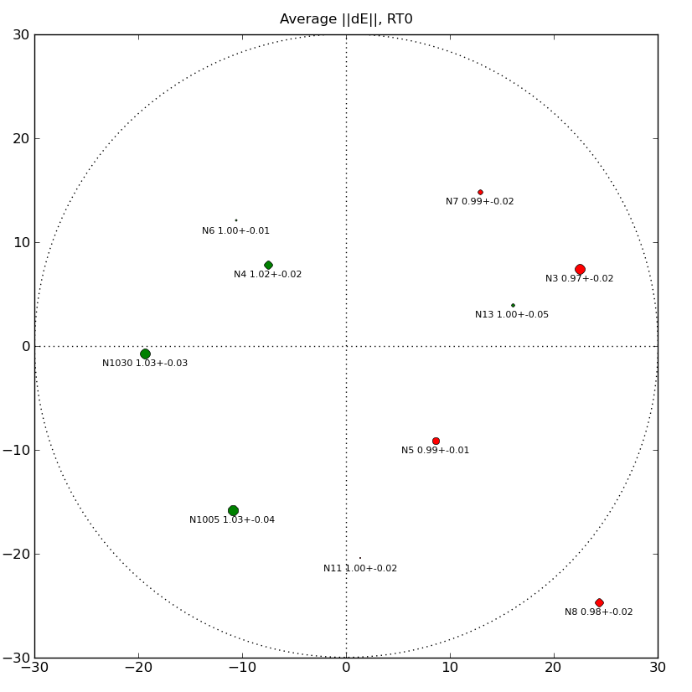
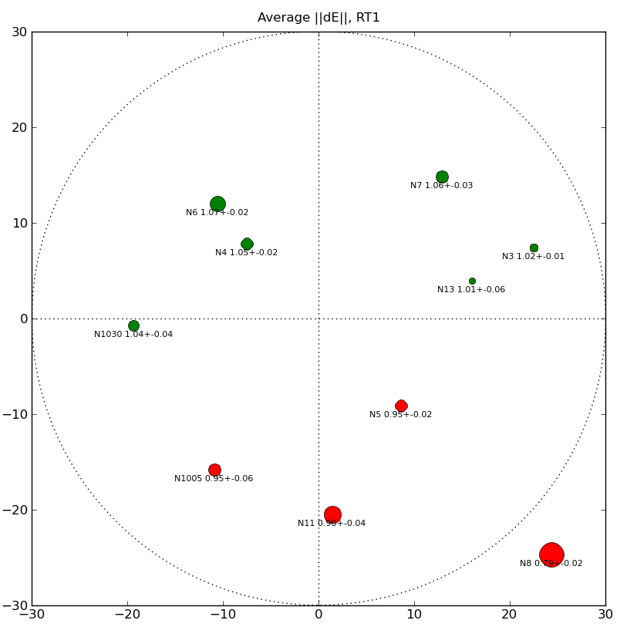
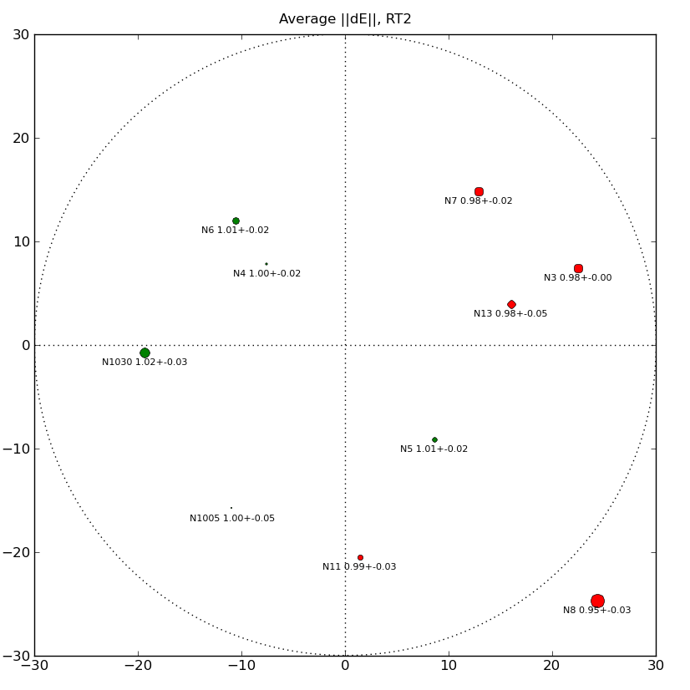
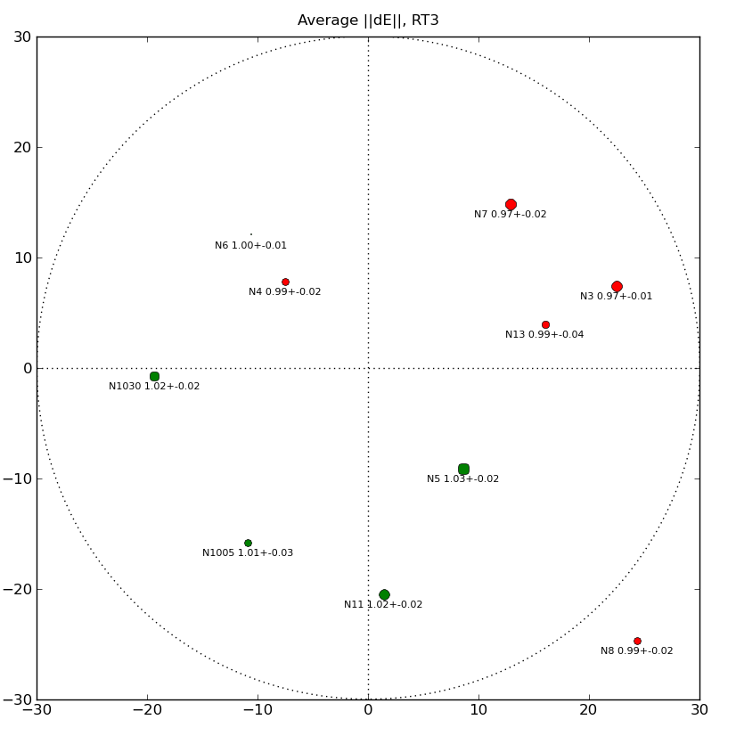
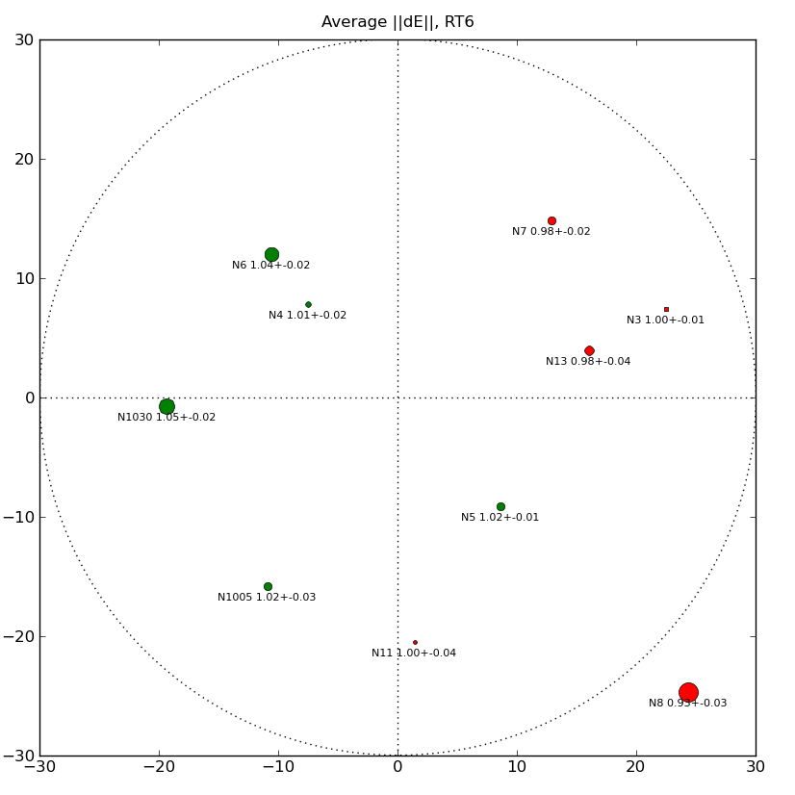
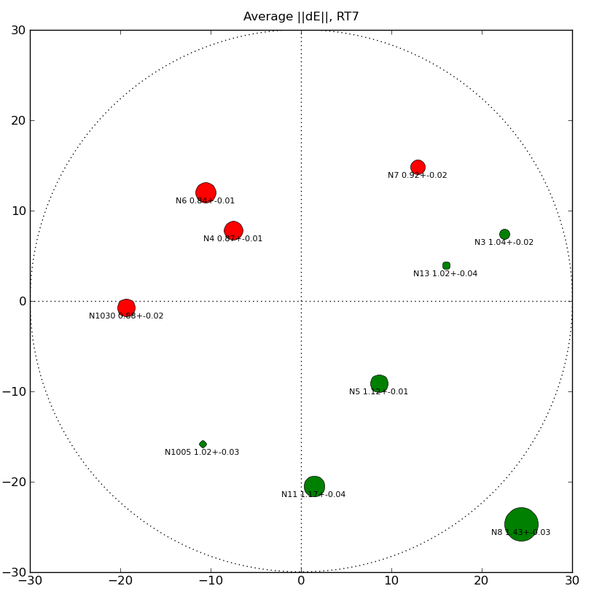
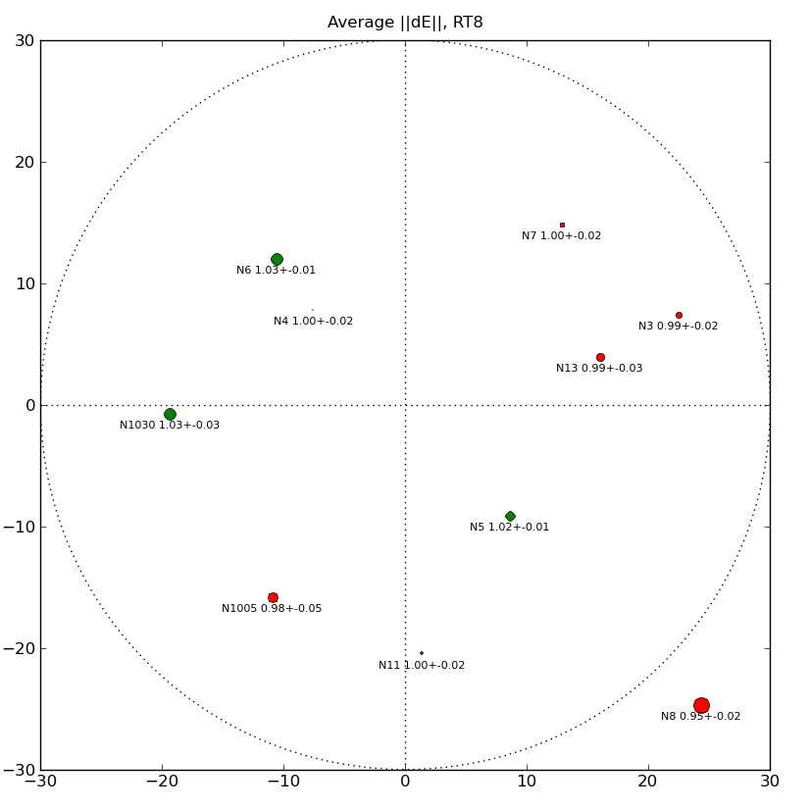
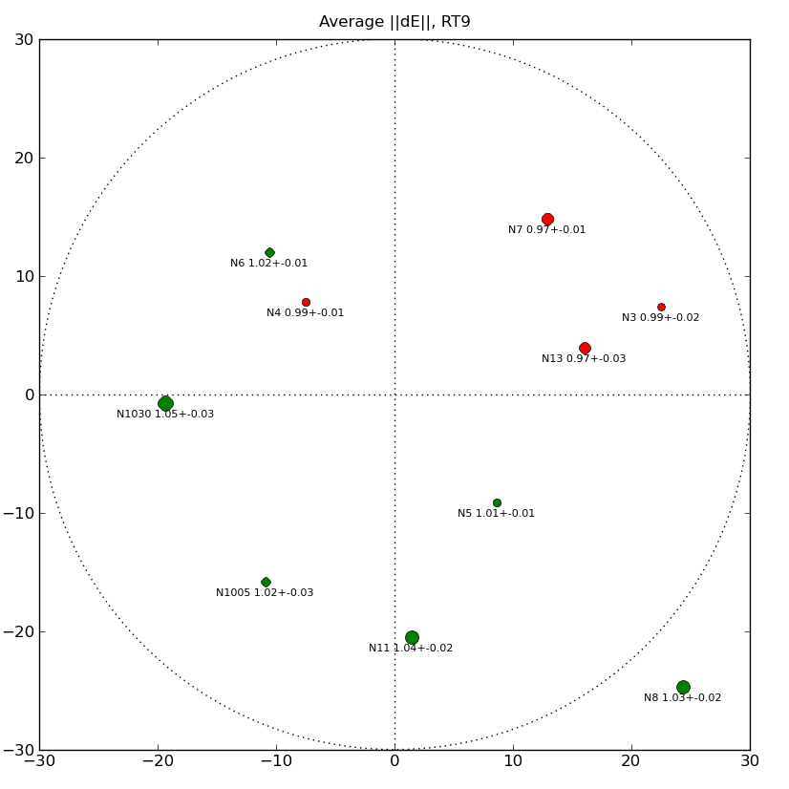
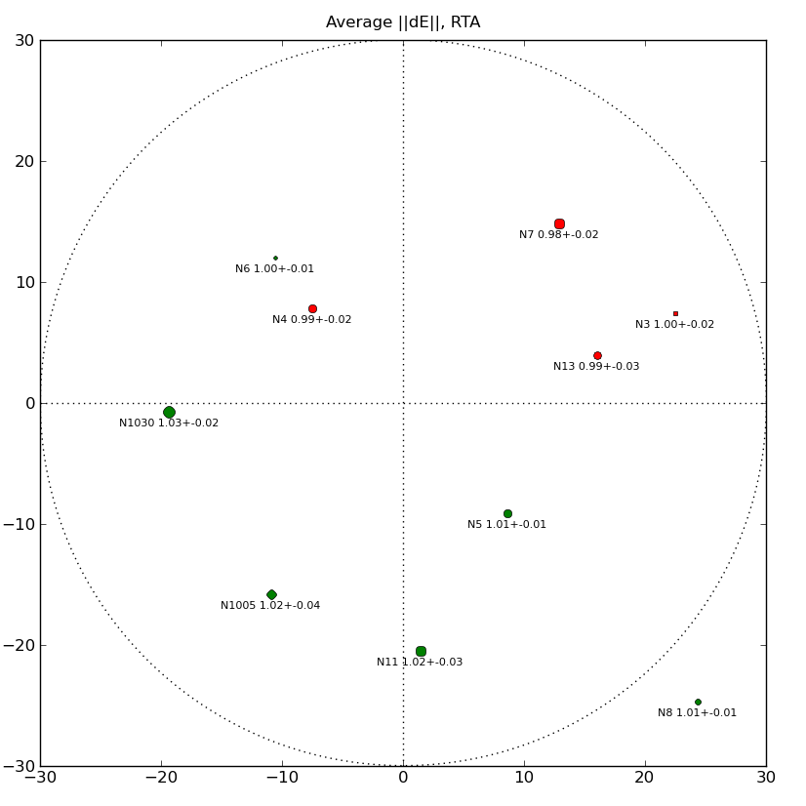
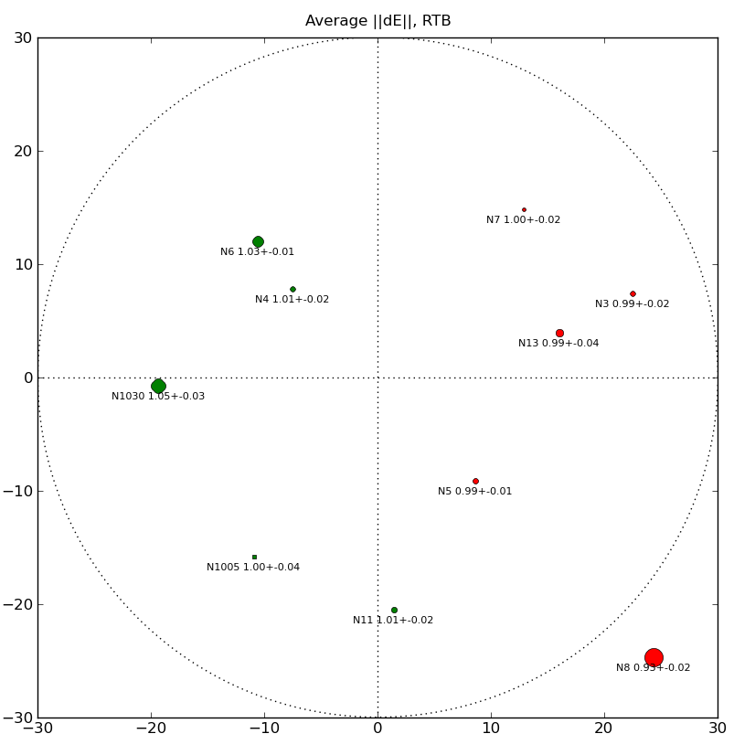
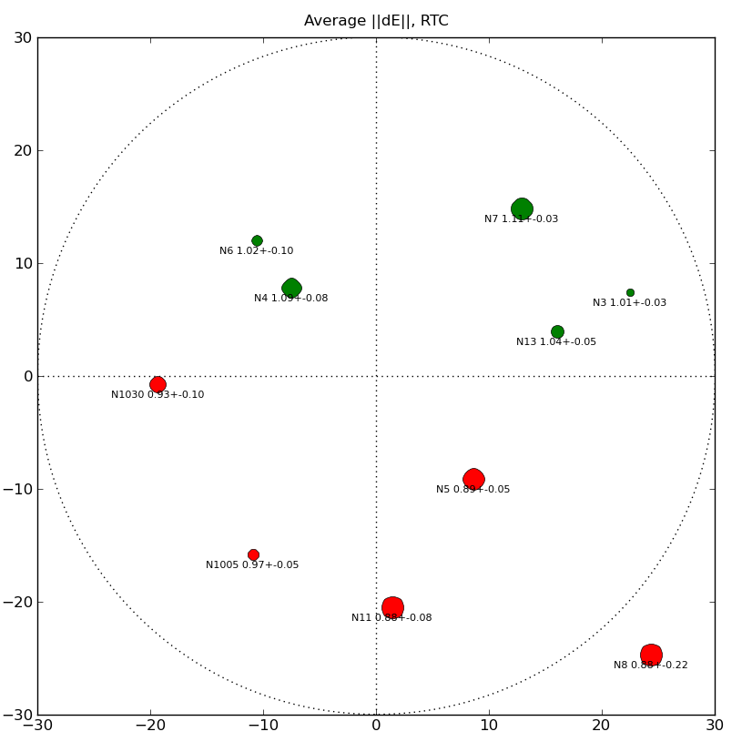
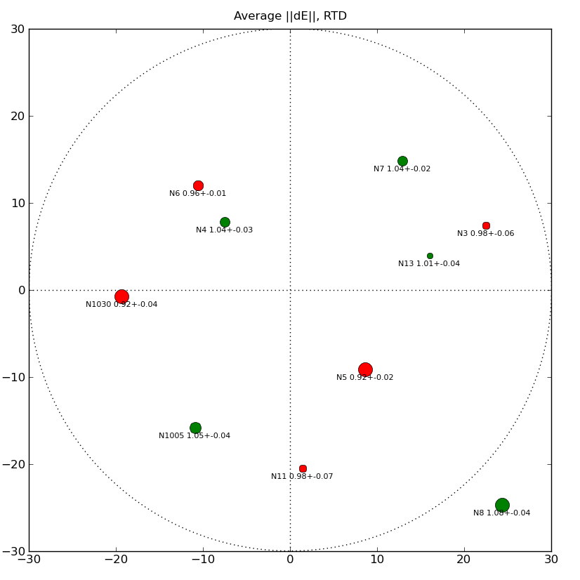
Rogues' Gallery

Slide 13
The Evidence
Hans's surprise!

Slide 14
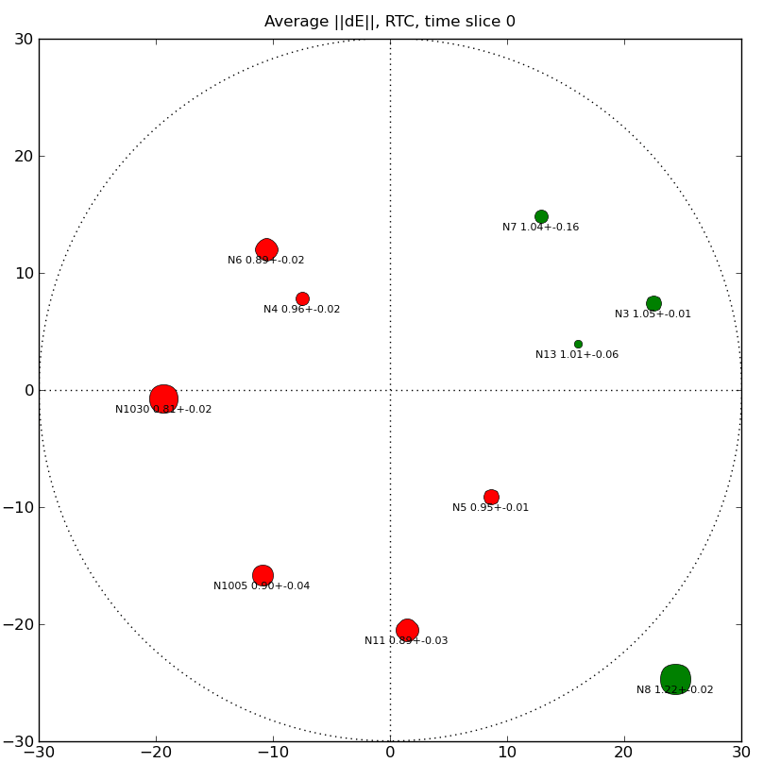
RTC in motion

Slide 15
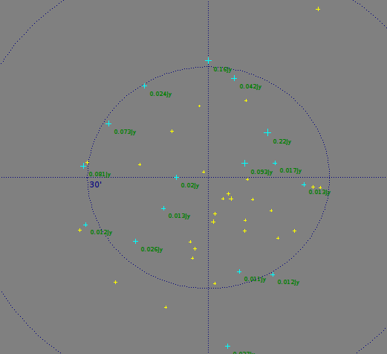
QMC2: Son Of QMC
Offered extra time at RA=0h
Found suitable field
  No bright central source
  160, 200 mJy brightest
  Nice spread of 10+ mJy sources
  3C source at almost 1°
Asked for an error-free observation to build up sky model

Slide 16

Error-free?
(Ger: “I have never seen such terrible WSRT maps!”)

Slide 17
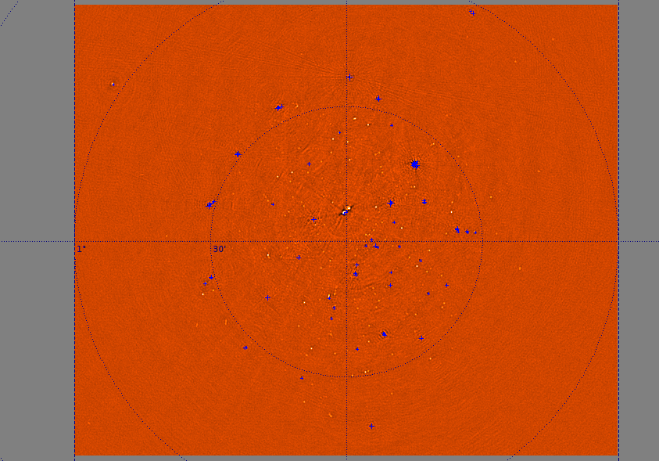
dEs Prevail, Yet Again...

Slide 18
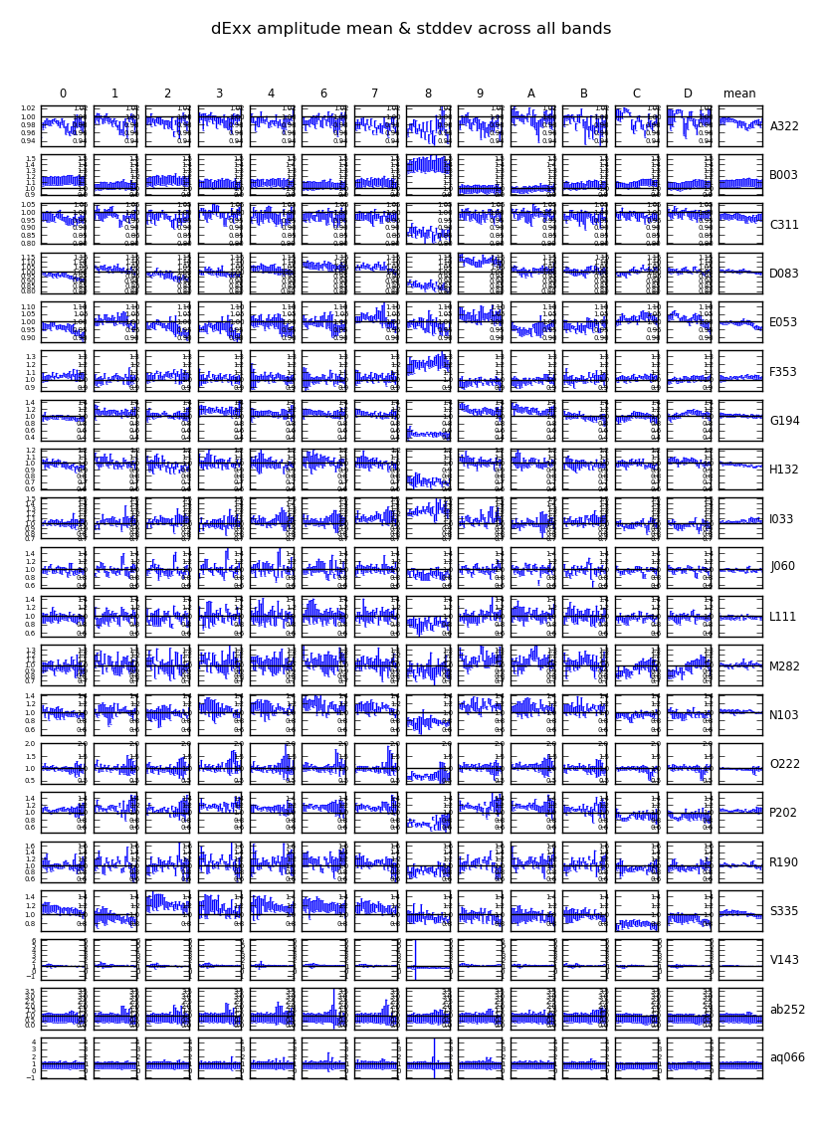
Spot The
Limp Noodle
Faintest source is
~5 mJy!
Source of error is obvious...

Slide 19
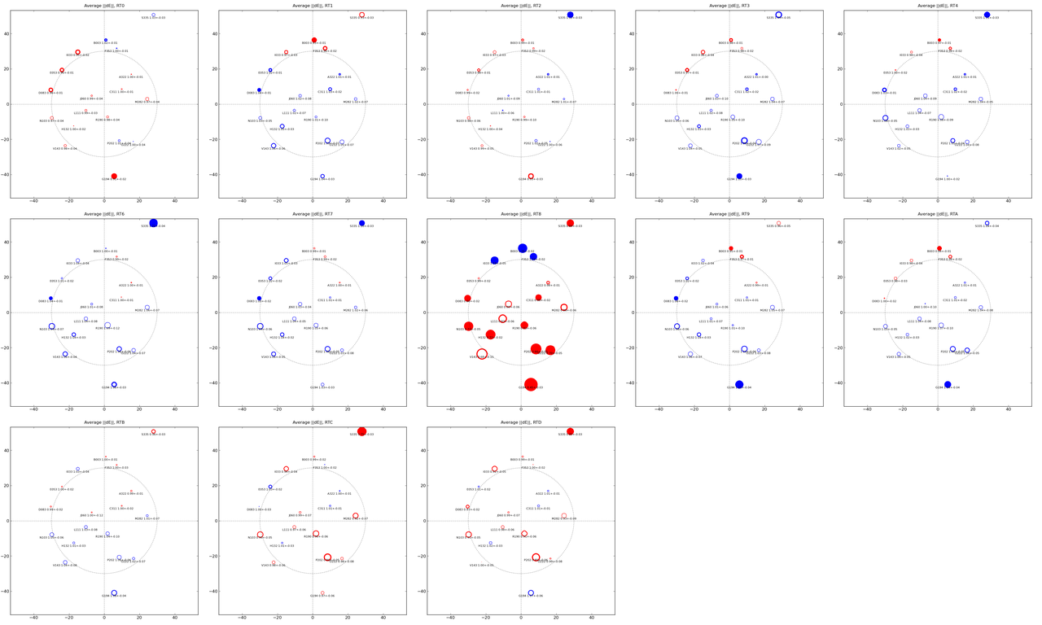
Spot The Culprit II

Slide 20
RT8 Problems
Turned out to be a tracking problem with RT8 (bad elevation encoder)
...which we could “predict” from the data!
Observations were repeated on July 21 with fixed RT8
  ...but new deliberate errors on other dishes

Slide 21

QMC2, Jul 21 observation

Slide 22

QMC2
Jul 21
3 static mispointings
1 time-variable one

Slide 23
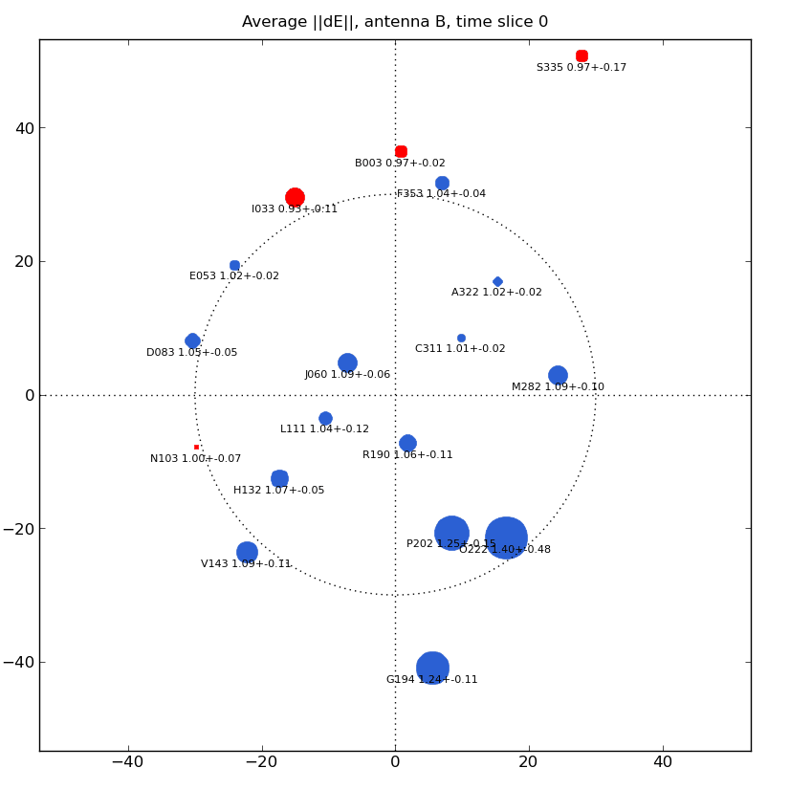
QMC2
Jul 21
RTB

Slide 24
QMC2 Jul 21 Conclusions
Static mispointing on RT2, RT6, RT8
Time-variable (N-S) mispointing on RTB
Confirmed by Hans van Someren
Bad pointing on RT9
  not deliberate!
3C source is on sidelobe: has opposite gain behaviour

Slide 25
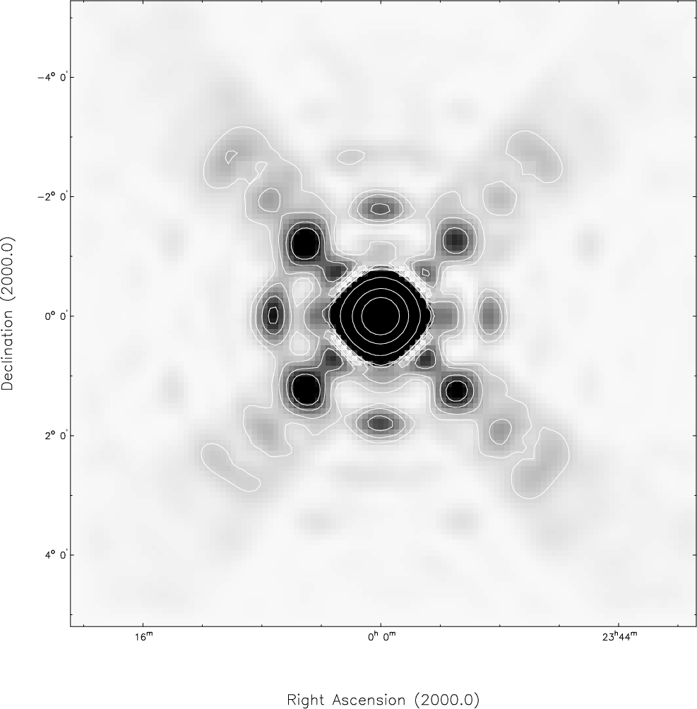
WSRT Primary Beam
(Popping & Braun)

Slide 26
Future Plans
Repeat QMC2 observations on short (<4h) synthesis
  smaller pointing errors?
Observe highly polarized field
  haven't touched instrumental polarization yet
Set up as a “QC pipeline”
  Use QMC2 as an APERTIF/EMBRACE test?
Fit a global beam model
  A-la “pointing selfcal” of S. Bhatnagar
  Need a decent model first
Further mysteries...

Slide 27
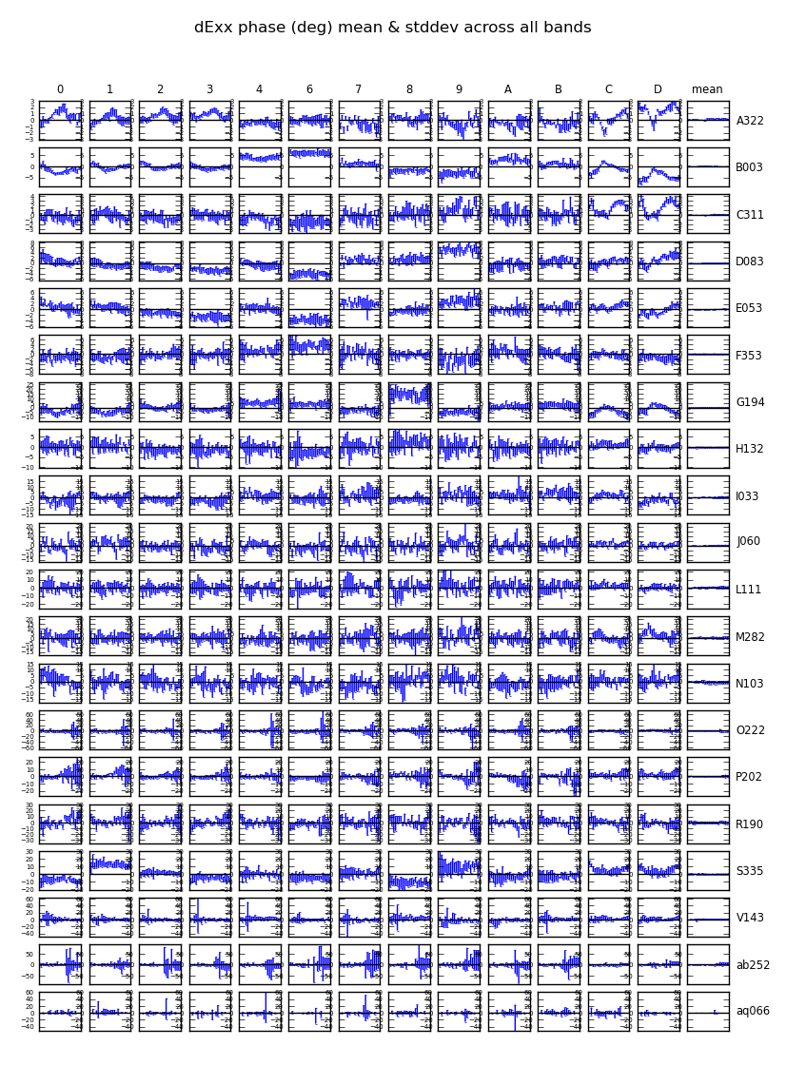
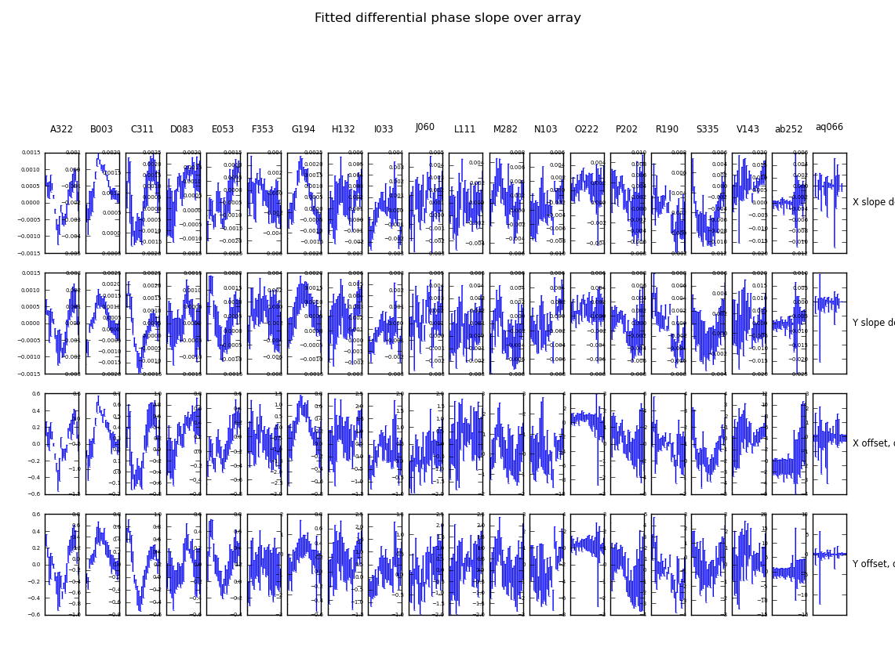
Phase Slopes?
Structure in dE phases
Phase slopes over array
  different in X and Y
Still lots to figure out....

Slide 28
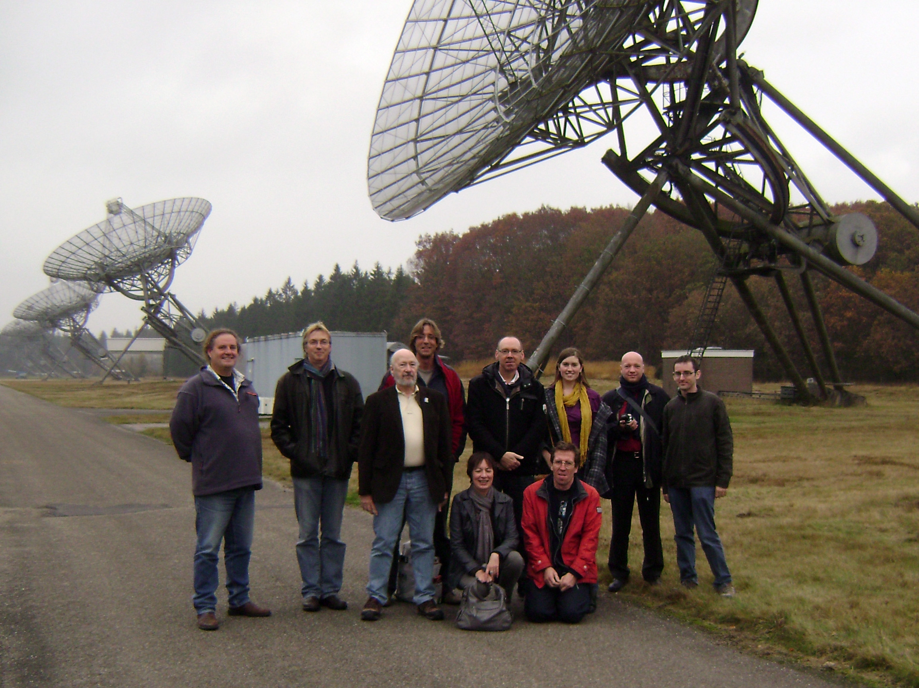
Epilogue:
Google Images Solves Mystery of RT8

