Slide 1


On Pointing Errors &
Limp Instruments
O. Smirnov

Slide 2

3C147
NEWSTAR image
22Jy @21cm
12h, 8 bands
13.5 uJy noise
on-axis DR:
1500000:1
off-axis DR:
1000:1
Limited by direction-dependent effects
(DDEs) such as pointing errors, tropospheric refraction, etc.
No direct cure in selfcal.

Slide 3

3C147
MeqTrees image
22Jy @21cm
12h, 8 bands
13.5 uJy noise
Same DR as NEWSTAR, but no off-axis artifacts.

Slide 4
Differential Gains
Or we can introduce differential gains:

Slide 5

Note the high S/N in frequency
Continuity in time and space suggests dominant large-scale effect, as opposed to per-antenna things like pointing

Slide 6

QMC Project
Find a field containing a cluster of moderately bright sources
Introduce deliberate (and secret) pointing errors into a few WSRT antennas
  “limp noodle” mode
Attempt to recover pointing errors by solving for differential gains

Slide 7
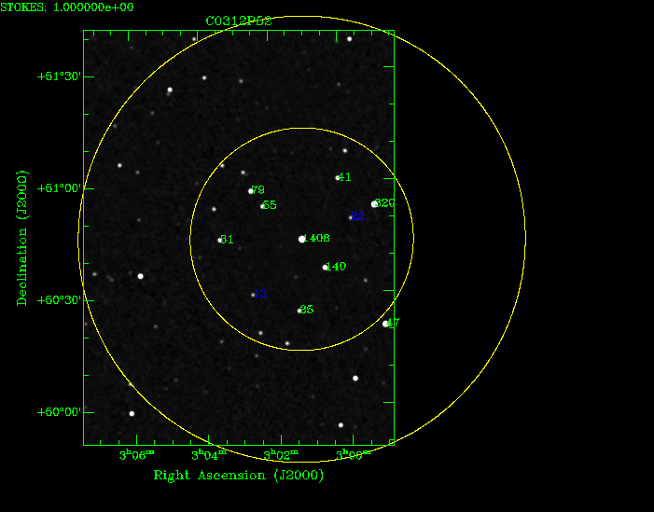
The QMC Field
(Quality Monitoring Committee)

Slide 8
Issues...
A number of slightly resolved sources
  Including central 1.4 Jy one
Difficult to distinguish source structure from gain effects
  an extended source will have an HA-dependent visibility amplitude (on long baselines)
  how to distinguish this from real gain errors on antennas C and D?
Need to bootstrap a sky model!
  see FITS images

Slide 9
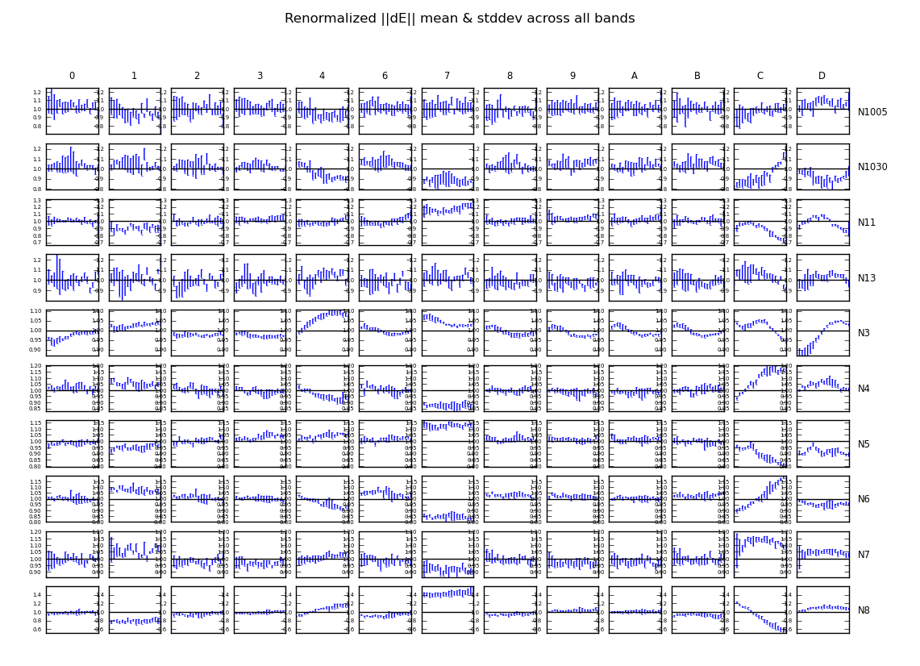
The Evidence

Slide 10
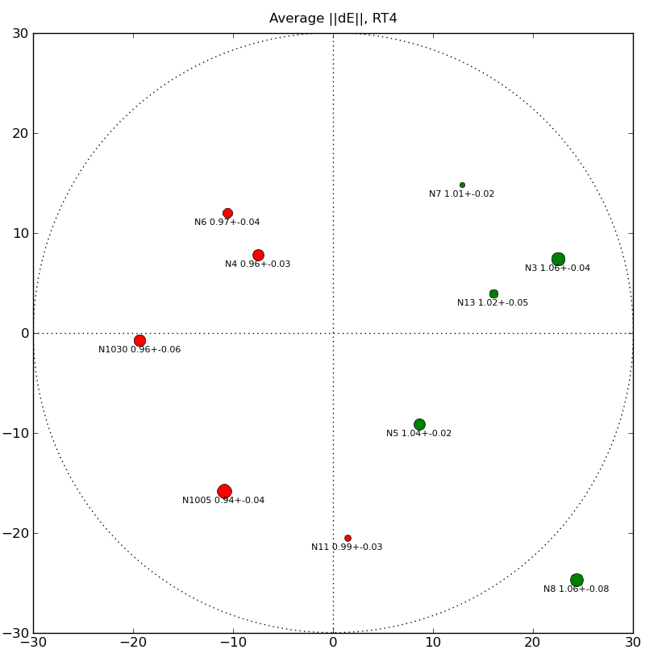
Another Way To Visualize ||dE||

Slide 11
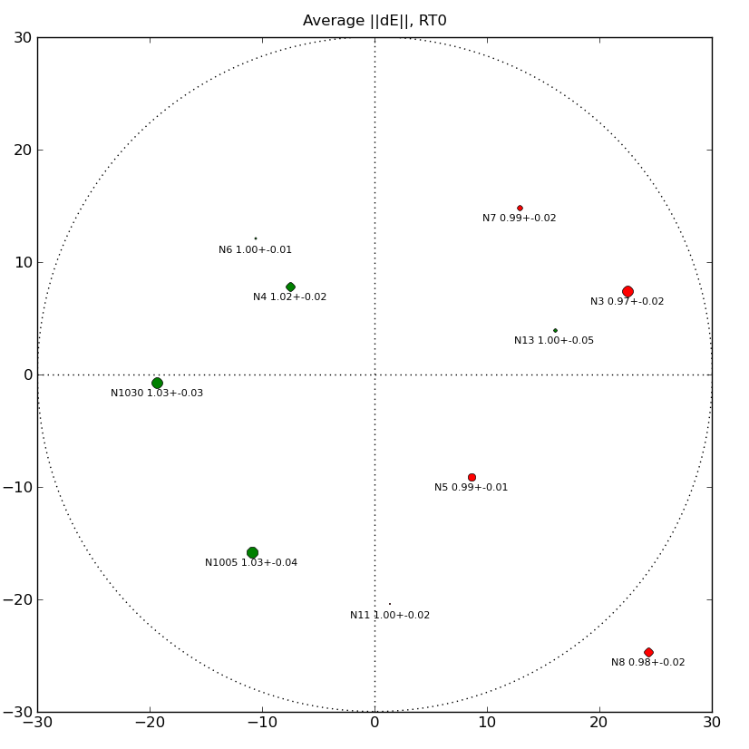
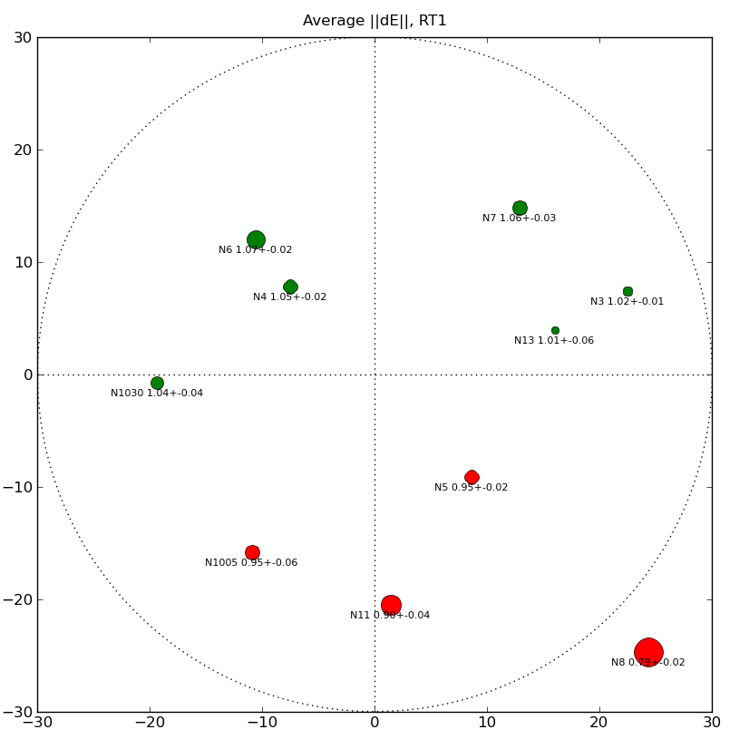
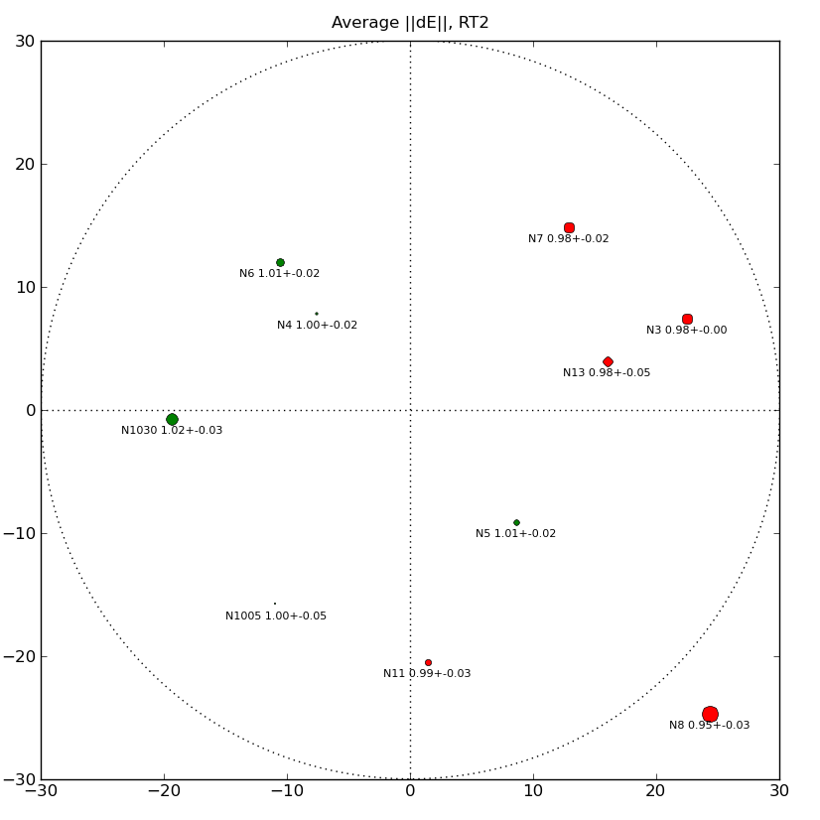
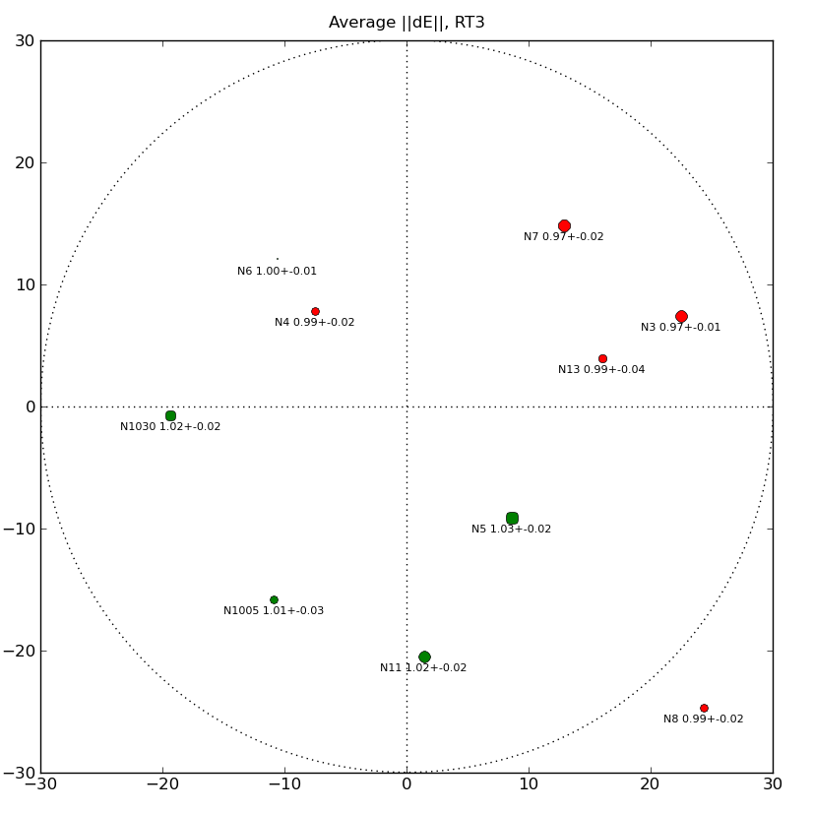
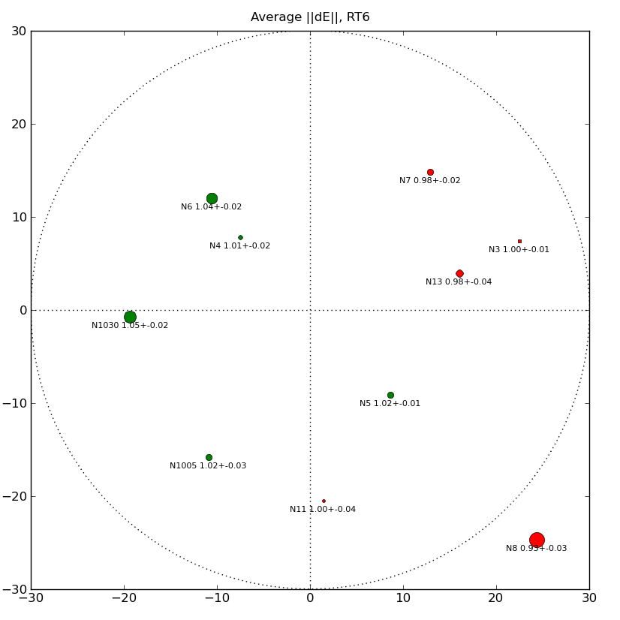
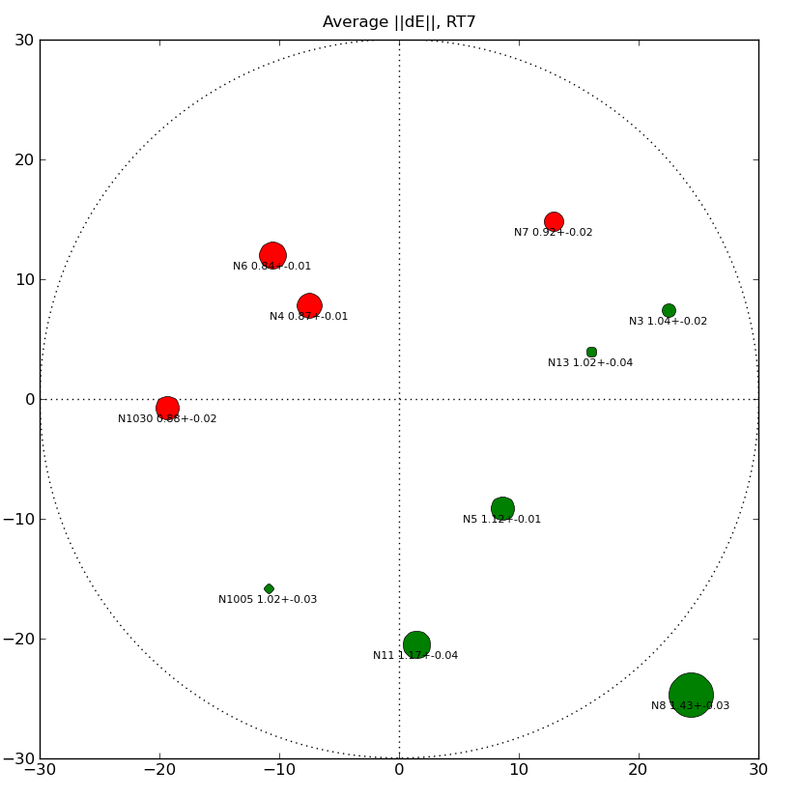
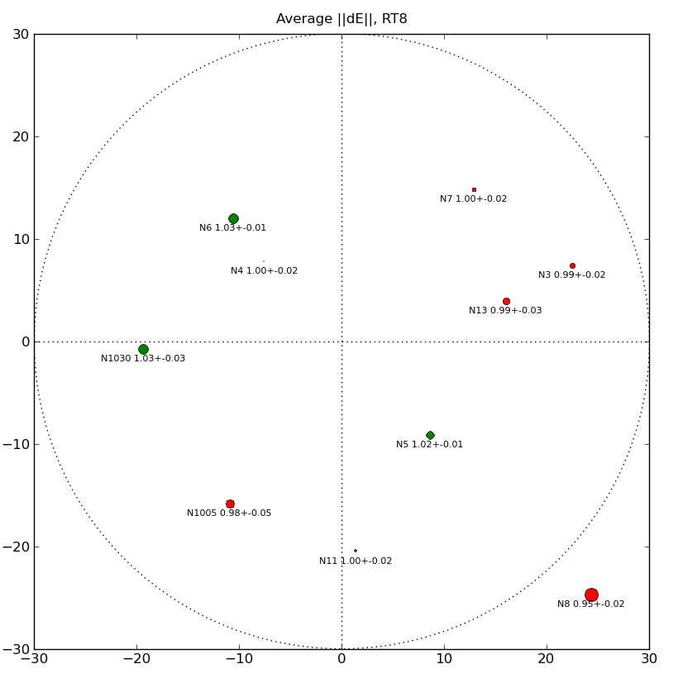
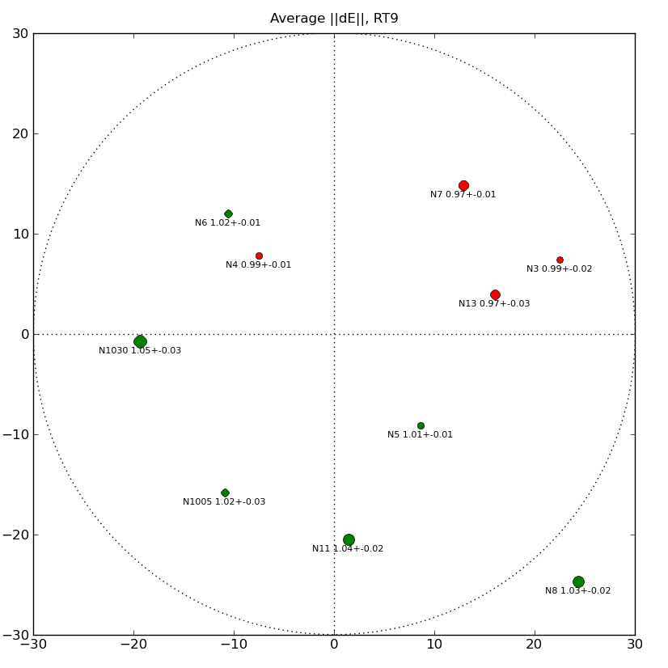
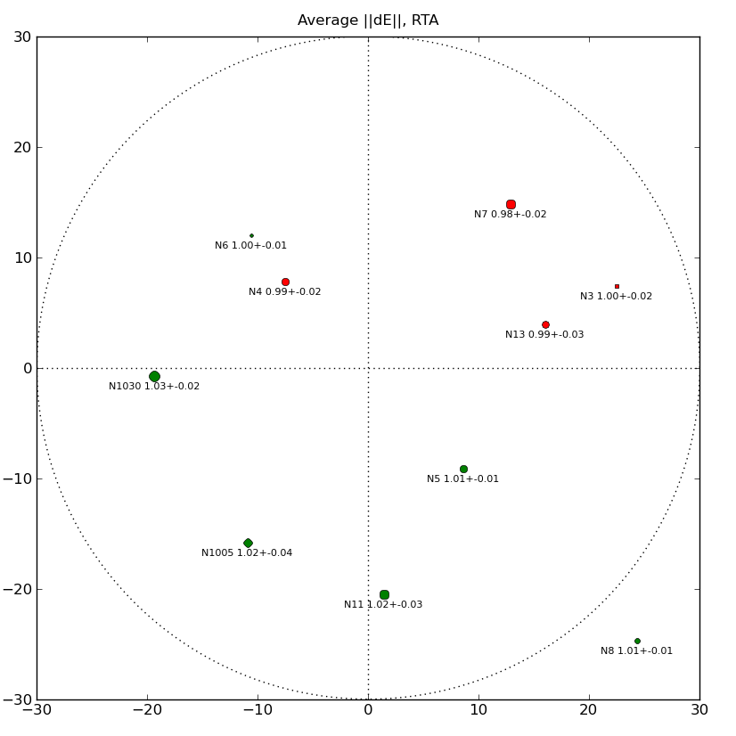
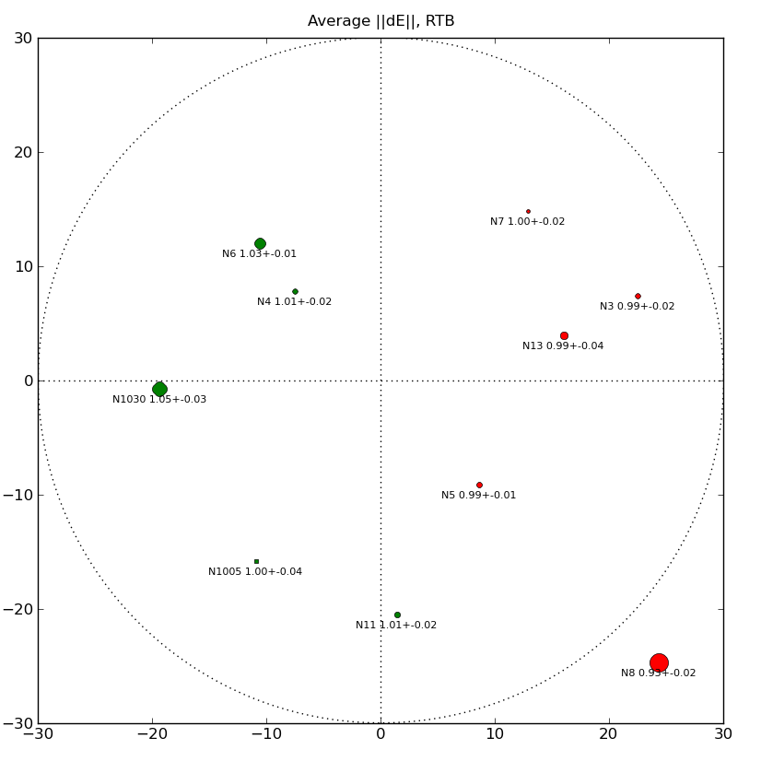
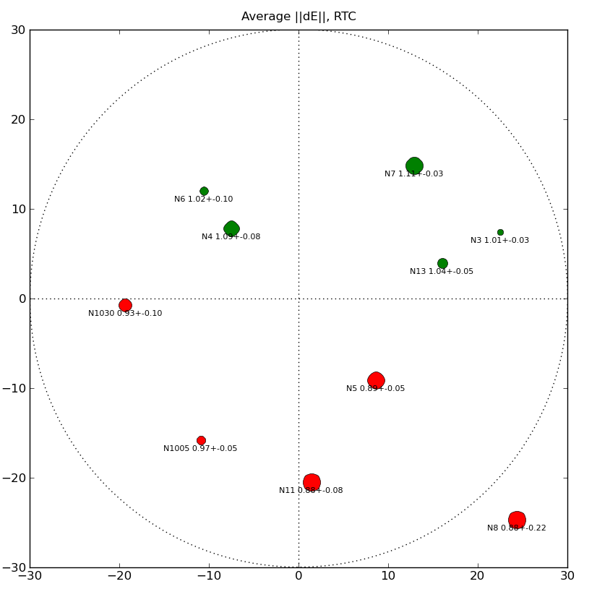
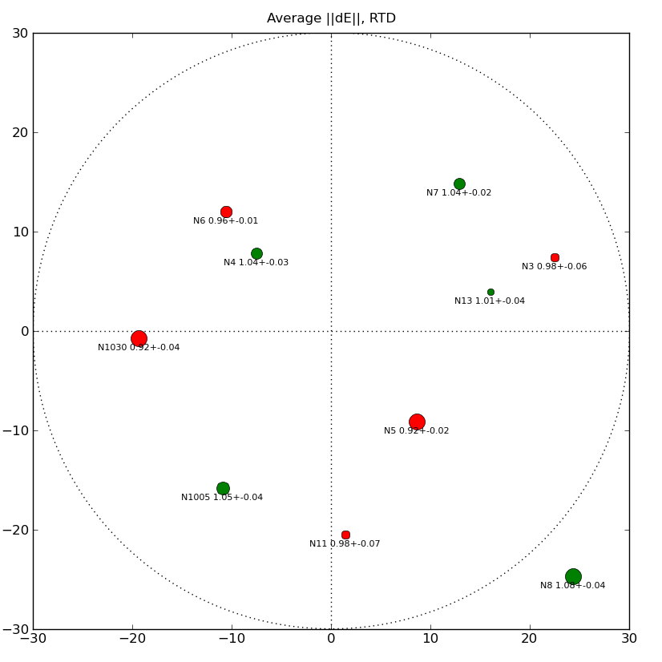
Rogues' Gallery

Slide 12
The Evidence
Hans's surprise!

Slide 13
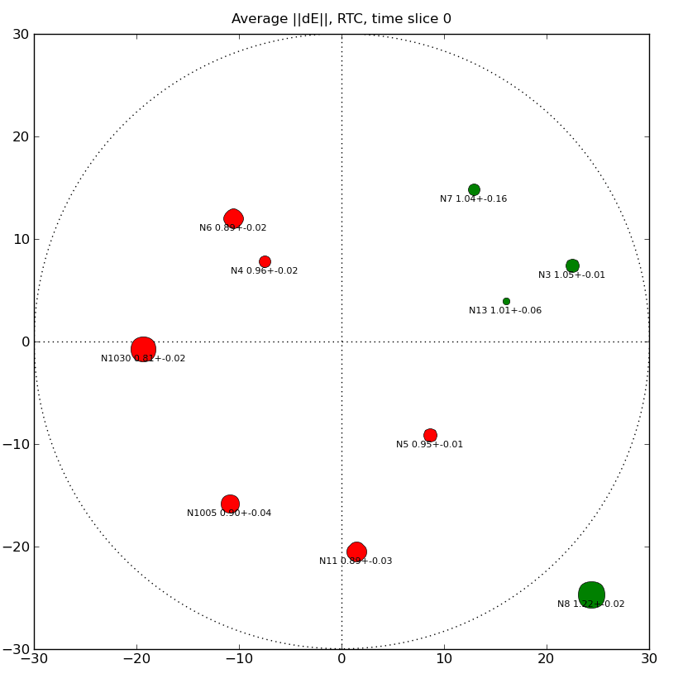
RTC in motion

Slide 14
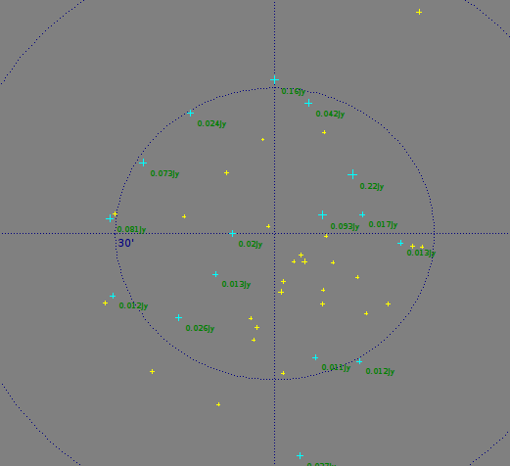
QMC2: Son Of QMC
Offered extra time at RA=0h
Found suitable field
  No bright central source
  160, 200 mJy brightest
  Nice spread of Cat-II sources
Asked for an error-free observation to build up sky model

Slide 15

Error-free?
(Ger: “I have never seen such terrible WSRT maps!”)

Slide 16
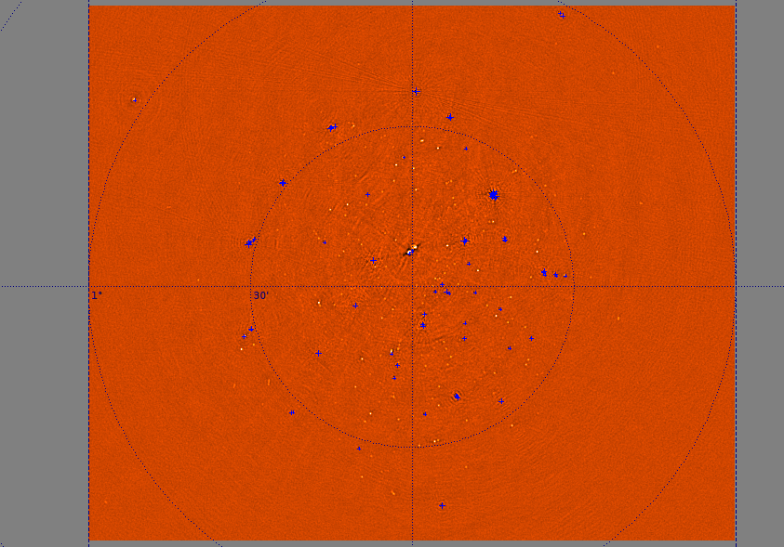
dEs Prevail, Yet Again...

Slide 17
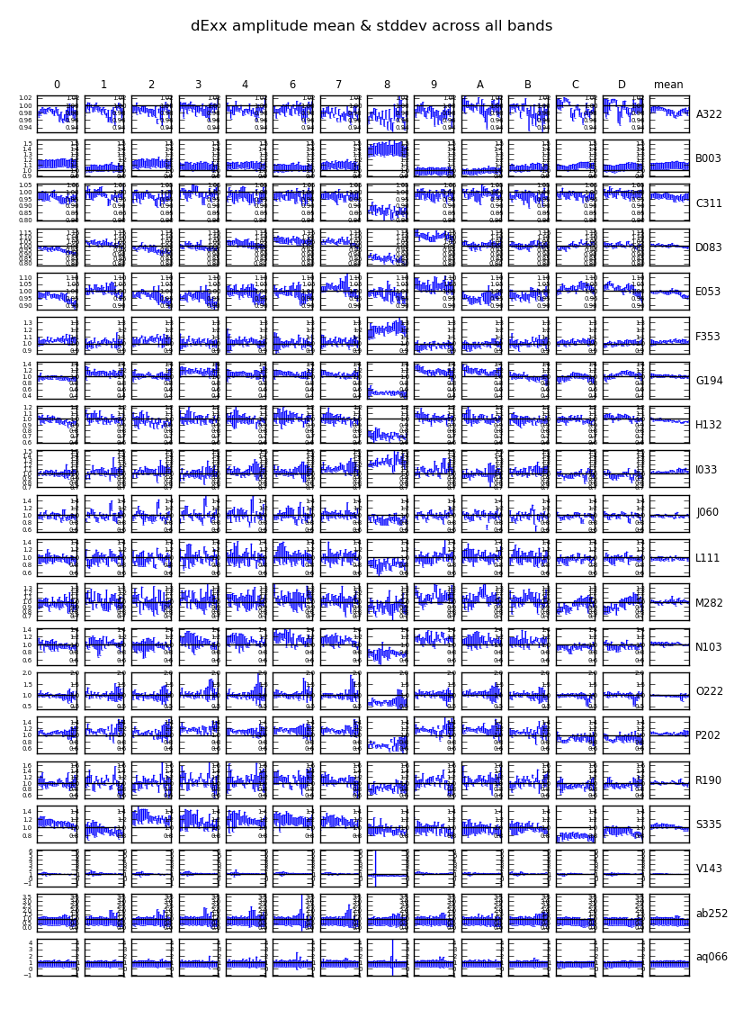
Spot The
Limp Noodle
Faintest source is
~5 mJy!
Source of error is obvious...

Slide 18
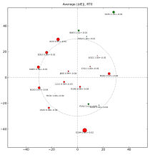
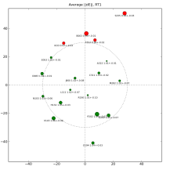
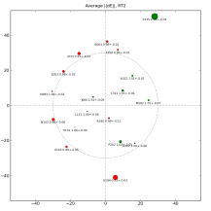
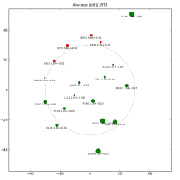
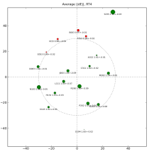
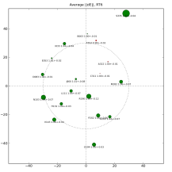
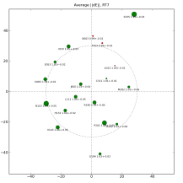
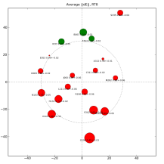
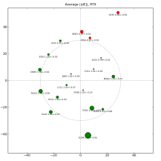
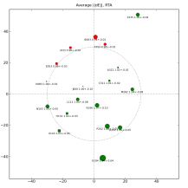
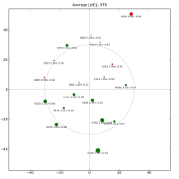
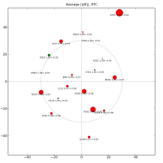
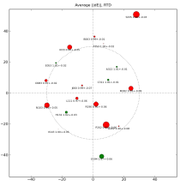
Spot The Culprit II

Slide 19
RT8 Problems
Turned out to be a tracking problem with RT8
...which we could “predict” from the data!
New observations being done with fixed (?) RT8
  ...but new deliberate errors on other dishes

Slide 20
Future Plans
Repeat QMC2 observations on short (<4h) synthesis
Observe highly polarized field
  haven't touched instrumental polarization yet
Set up as a “QC pipeline”
  Use QMC2 as an APERTIF/EMBRACE test?
Further mysteries...

Slide 21
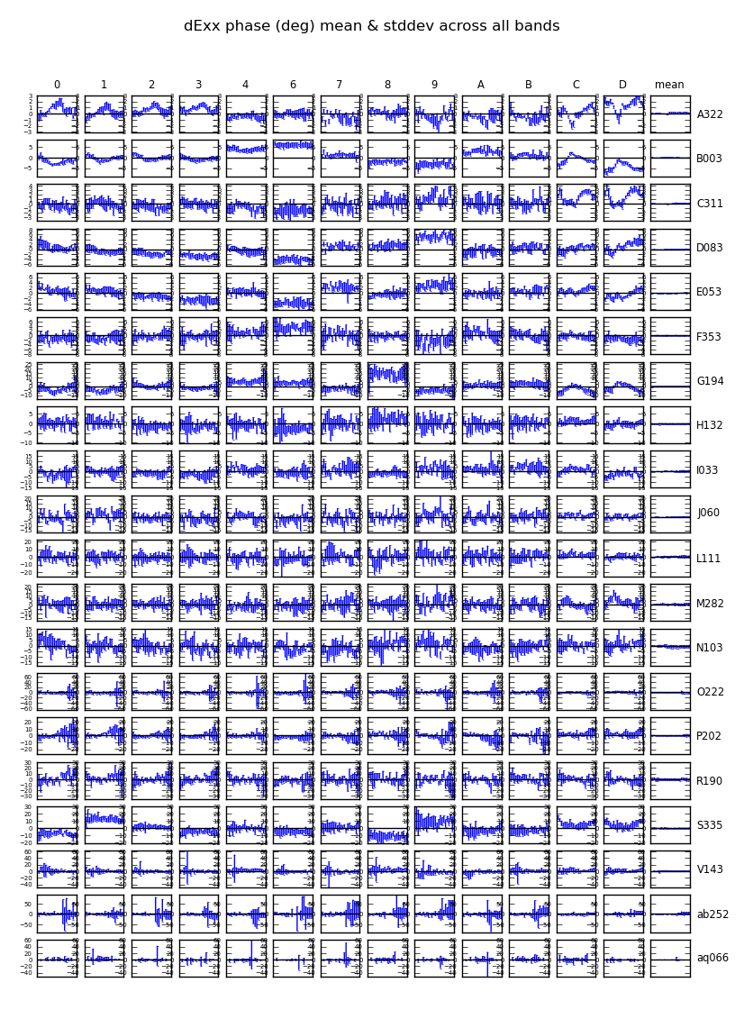
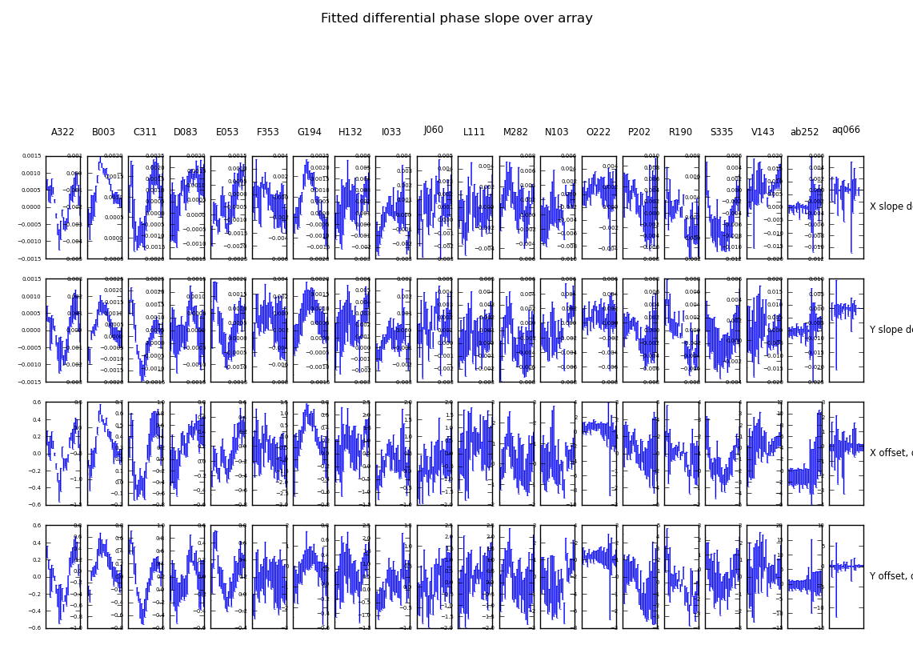
Phase Slopes?
Structure in dE phases
Phase slopes over array
  different in X and Y
Still lots to figure out....

Slide 22
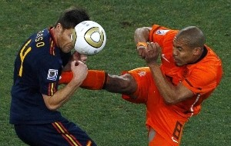
But we shall persevere...

