Slide 1
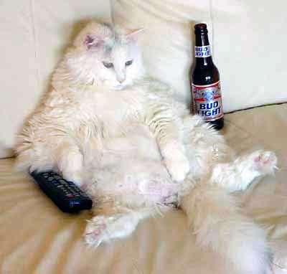
PURR: Notes,
Communication & Laziness
O. Smirnov

Slide 2
Some of the most important things we do in our jobs...
Keep notes
Communicate
...both of the above are a problem for lazy people.

Slide 3
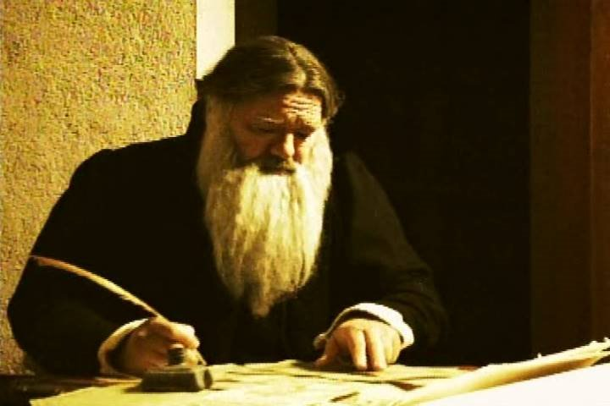
Keeping Notes,
The Traditional Approach

Slide 4
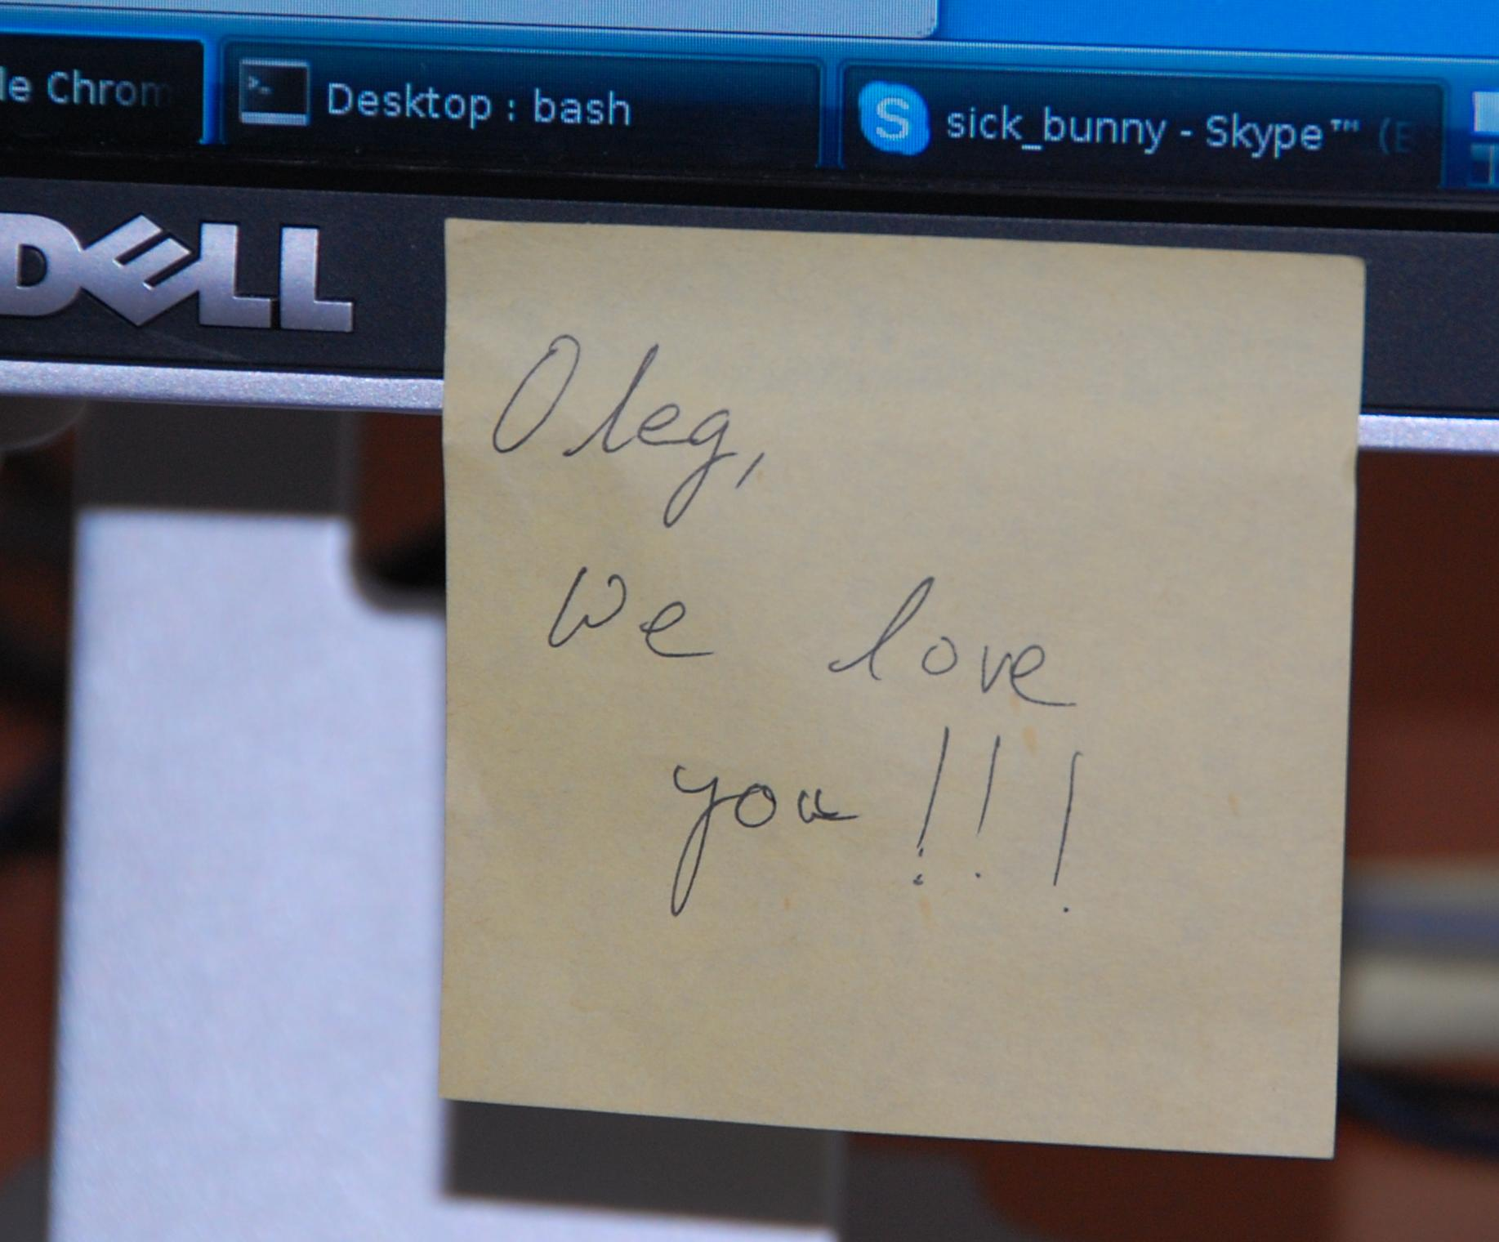
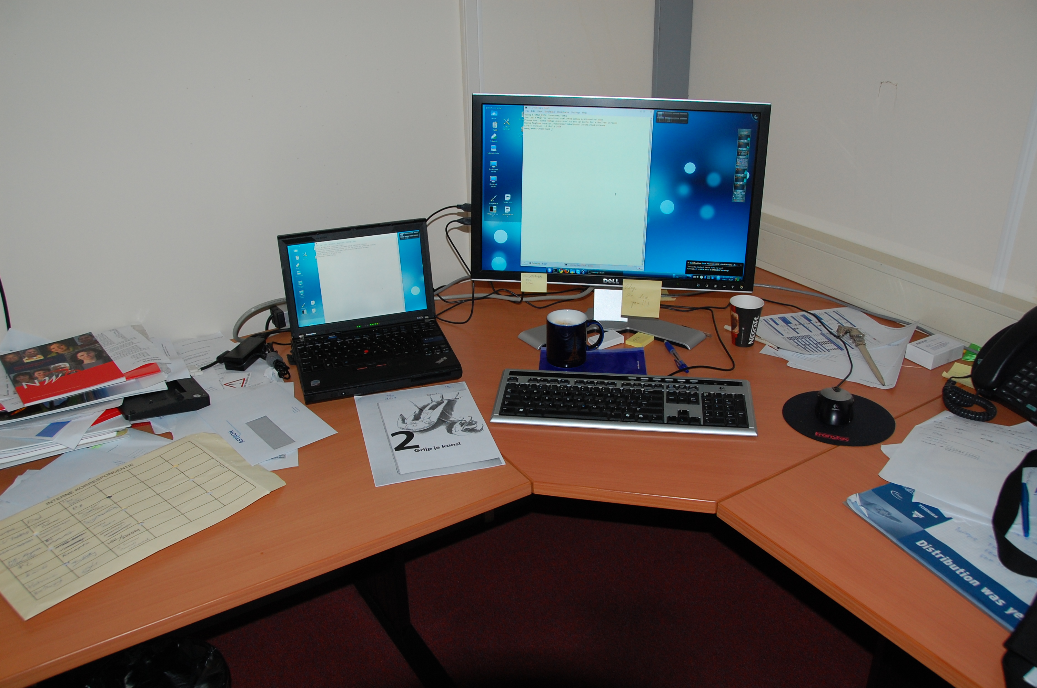
...perils of the traditional approach

Slide 5
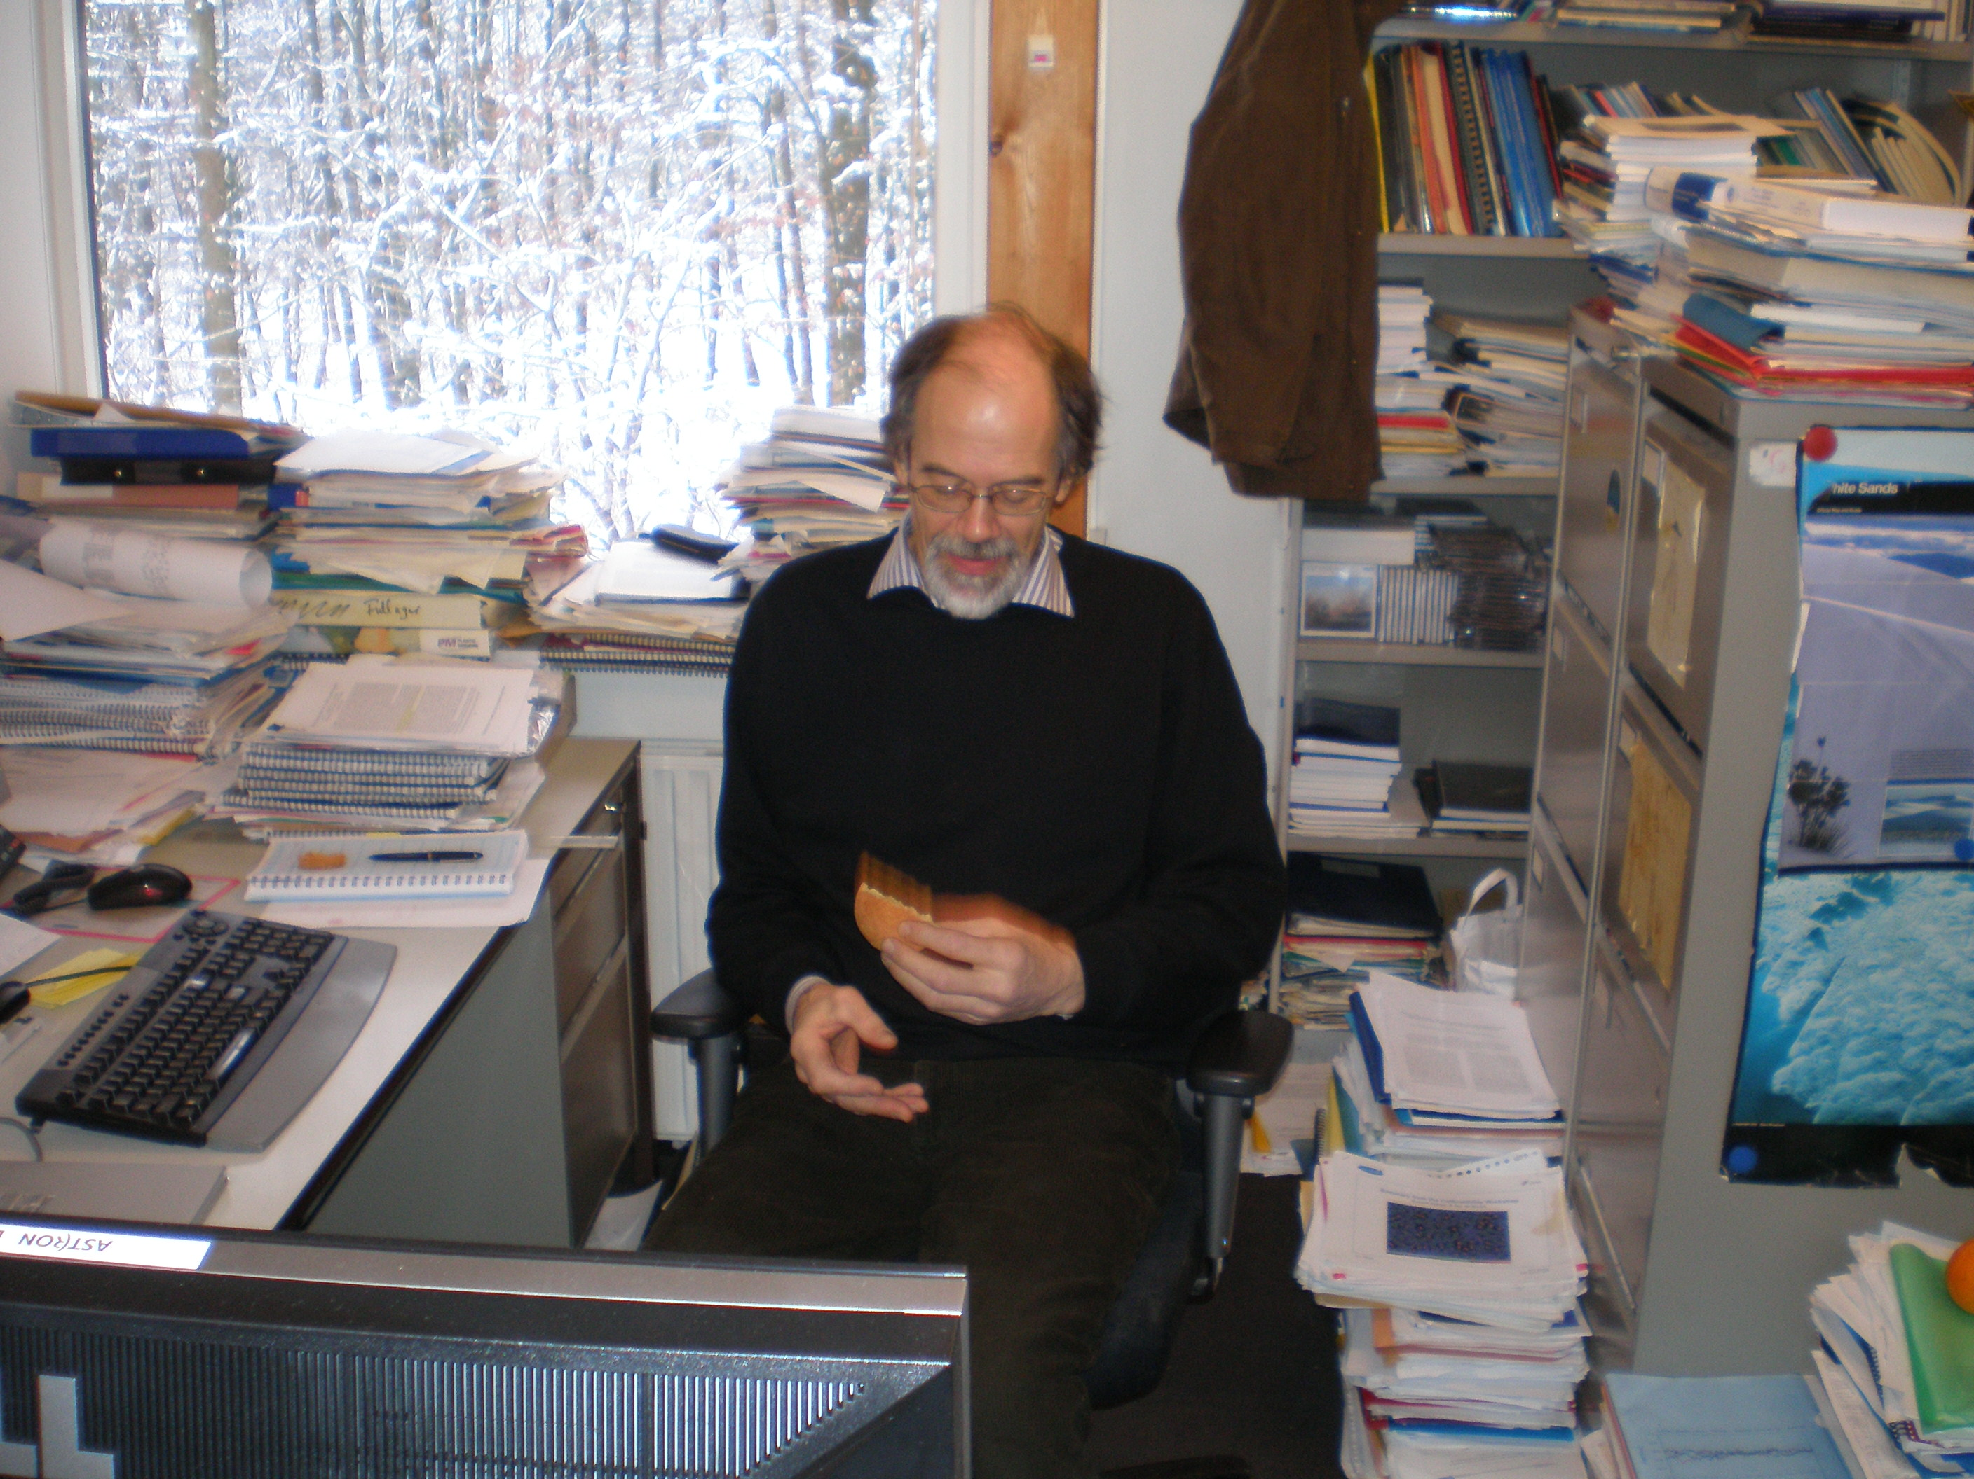

Slide 6
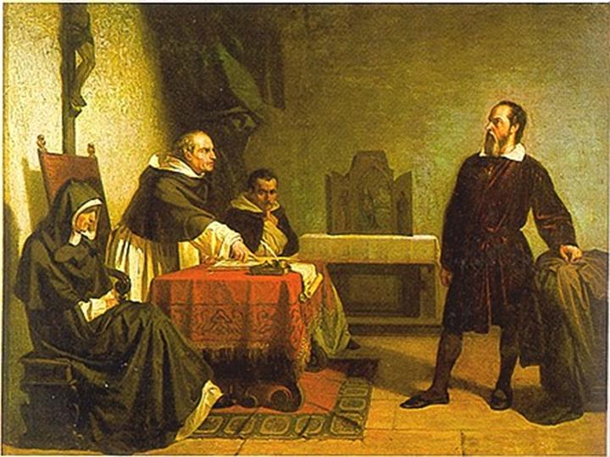
Communication:
Early Experiments In Peer Review
Galileo Galilei facing the Roman Inquisition, Cristiano Banti, 1857

Slide 7
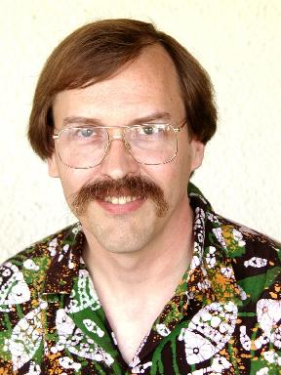
Larry Wall On The Three Great Virtues of a Programmer
Laziness - The quality that makes you go to great effort to reduce overall energy expenditure. It makes you write labor-saving programs that other people will find useful, and document what you wrote so you don't have to answer so many questions about it. Hence, the first great virtue of a programmer. Also hence, this book. See also impatience and hubris.
Impatience - The anger you feel when the computer is being lazy. This makes you write programs that don't just react to your needs, but actually anticipate them. Or at least pretend to. Hence, the second great virtue of a programmer. See also laziness and hubris.
Hubris - Excessive pride, the sort of thing Zeus zaps you for. Also the quality that makes you write (and maintain) programs that other people won't want to say bad things about. Hence, the third great virtue of a programmer. See also laziness and impatience.

Slide 8
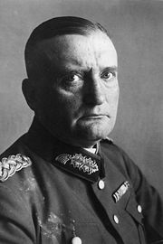
Laziness: An HR View
(from a Very Stern German)
“I divide my officers into four classes; the clever, the lazy, the industrious, and the stupid. Most often two of these qualities come together. The officers who are clever and industrious are fitted for the highest staff appointments. Those who are stupid and lazy make up around 90% of every army in the world, and they can be used for routine work. The man who is clever and lazy however is for the very highest command; he has the temperament and nerves to deal with all situations. But whoever is stupid and industrious is a menace and must be removed immediately!”
Gen. Kurt von Hammerstein-Equord, Chief of Army High Command, Truppenführung (1933)

Slide 9
PURR
PURR maintains purrlogs – that is, notes of your activities
Start a new purrlog by running purr in a directory
Create a few entries using the “Add New Entry” dialog

Slide 10
Purrlogs are HTML
Load purrlog/index.html in a browser
HTML is the native Purr format (i.e. always there, no need to “export” a purrlog to HTML explicitly)

Slide 11
Purr Watches Files
Most of our activities involve creating or modifying files (data products)
Purr will watch for this
Create an image in the current directory
Purr automatically adds it to the New Entry dialog
  Can also pop up the dialog
Knows how to render images

Slide 12
Purr Knows About FITS
...and potentially other image formats
Make a FITS file in a watched directory
Note-taking AND communication rolled into one!

Slide 13
Purr is also a log-keeping tool
Most activities involve creating or modifying files (i.e. data products)
...some of which you may want to archive
e.g. calibration tables
http://www.astron.nl/meqwiki-data/users/oms/3C147/3C147_spw2.MS.purrlog/fullindex.html

Slide 14
Purr has many uses
E.g. creating tutorials: http://www.astron.nl/meqwiki-data/users/oms/3C147-Calibration-Tutorial/purrlog/
...not only for radioastronomy (some data products may be edible):
http://www-astro.physics.ox.ac.uk/~ianh/PURRLOGS/enthroned/
And as a communications tool
  The SSSC

Slide 15
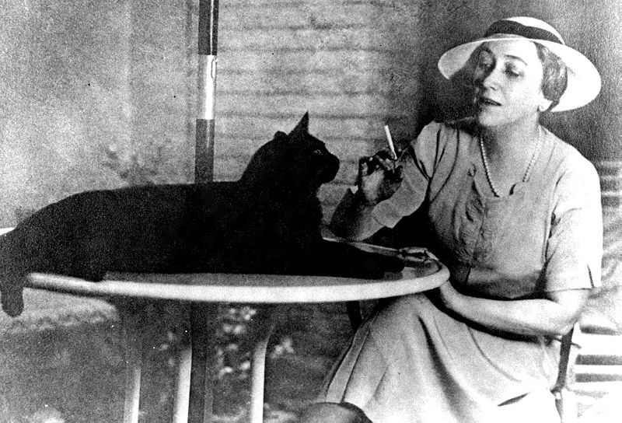
"An industrious sinner I much prefer to a lazy saint." – Sophie Kerr

