Slide 1

Luxury Problems Of
High Dynamic Range Imaging
O. Smirnov (ASTRON)

Slide 2

The “Beat NEWSTAR” Project
Aim: demonstrate the advantages of calibration with an explicit Measurement Equation
  by doing better than a legacy package
  pick the right target...
NEWSTAR (Netherlands East-West Synthesis Telescope Array Reduction)
  not a terribly wide user base
  (but a very tall one)
  WR holder in dynamic range
  (→2 million)

Slide 3

3C147
NEWSTAR image
22Jy @21cm
12h, 8 bands
13.5 uJy noise
on-axis DR:
1,600,000:1
off-axis DR:
1000:1
Limited by direction-dependent effects
(DDEs) such as pointing errors, tropospheric refraction, etc.
No direct cure in selfcal.

Slide 4
What Causes DDEs?
Differences and time-variability in voltage beams across antennas
  Pointing errors are a special case of this
Ionosphere
Differential tropospheric refraction
???
Already limit WSRT in spectral line modes (NOT a luxury problem!)
All of these will be a far bigger issue for the SKA

Slide 5
3C147
NEWSTAR image
22Jy @21cm
12h, 8 bands
13.5 uJy noise
on-axis DR:
1,600,000:1
off-axis DR:
1000:1
Limited by direction-dependent effects
(DDEs) such as pointing errors, tropospheric refraction, etc.
No direct cure in selfcal.

Slide 6

3C147
MeqTrees image
22Jy @21cm
12h, 8 bands
13.5 uJy noise
Off-axis
artifacts
eliminated

Slide 7
The MeqTree Approach
Implement calibration via a Measurement Equation. For example:

Slide 8
Differential Gains
Just like peeling, only faster and more robust:

Slide 9

Flyswatter I
The “before” image.

Slide 10

Flyswatter II
Solved for ΔE for
5 sources.

Slide 11

Flyswatter III
Solved for ΔE for
10 sources.
In the end 10 sources proved unnecessary (deconvolution helps as well!), so in the final images I only solved for 6 sources.

Slide 12
3C147
MeqTrees image
22Jy @21cm
12h, 8 bands
13.5 uJy noise
Same DR as NEWSTAR, but across whole field

Slide 13
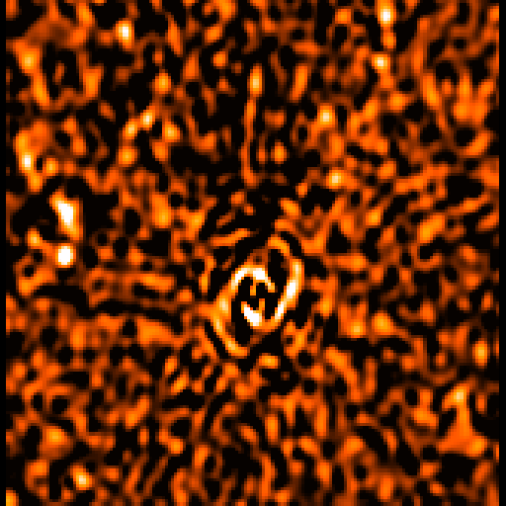
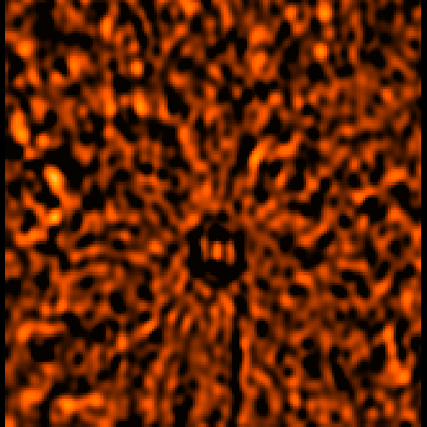
Perils Of (Degrees Of) Freedom
MeqTrees can try to solve for anything
...which does not necessarily make it a good idea!
Case in point: closure errors
  12h vs 1h solutions
12h
1h

Slide 14

Perils Of (Degrees Of) Freedom
MeqTrees can try to solve for anything
...which does not necessarily make it a good idea!
Case in point: closure errors
  12h vs 1h solutions
12h
1h
No man, no problem.
– J. Stalin

Slide 15
Differential gains:
What Would Joseph Say?
The Flyswatter also does a “no sources, no problem” operation.
How do we know this is not a Peril?
  per-channel selfcal (14 antennas, 85 baselines):
  14 complex gains per t/ν point,
  85 complex measurements per t/ν point
  one extra ΔE term:
  14 complex gains per 60*30 t/ν points,
  ~.008 of a parameter per t/ν point, per source (x6)
...but 1h closure errors:
  85 complex gains per 120*30 t/ν points,
  ~.02 of a parameter per t/ν point
(How do we know selfcal itself can be trusted?)

Slide 16
Why do we trust selfcal?
Peer pressure
Brainwashed as a PhD student
Stockholm syndrome
But mostly, because it
  Makes better maps
  And the gain/phase solutions make physical sense

Slide 17
Differential gain analysis
For each source/antenna, we have independent ΔE solutions per each band (8), per 30 minutes.
Studying the t/ν behaviour should tell us something about:
  whether we have solved for a physical effect,
  the nature of that effect
Since we expect only weak ν dependence (~10% fractional b/w), the 8 per-band solutions can give us a “noise” estimate

Slide 18

Differential phase component
Note the high S/N
Continuity in time and space suggests dominant large-scale effect

Slide 19
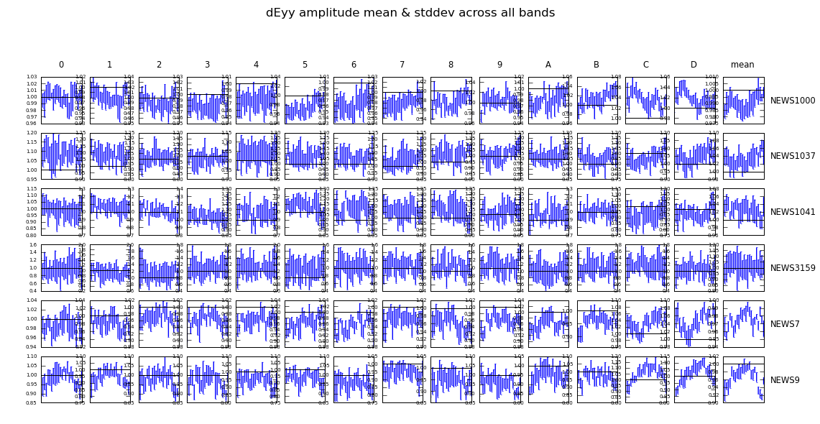
Differential amplitude component

Slide 20
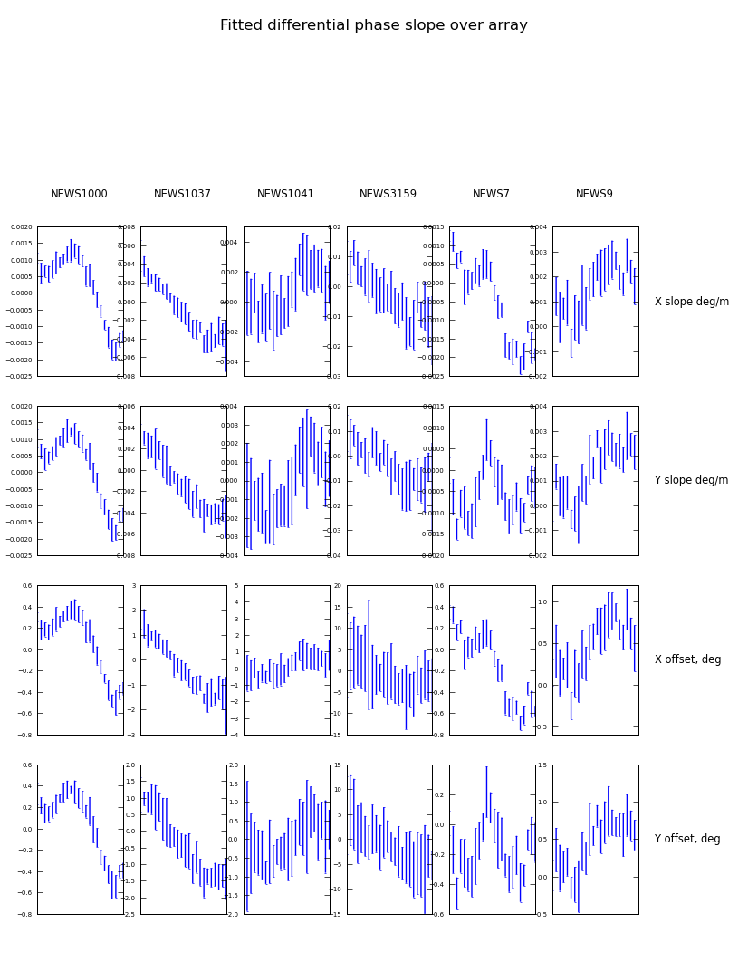
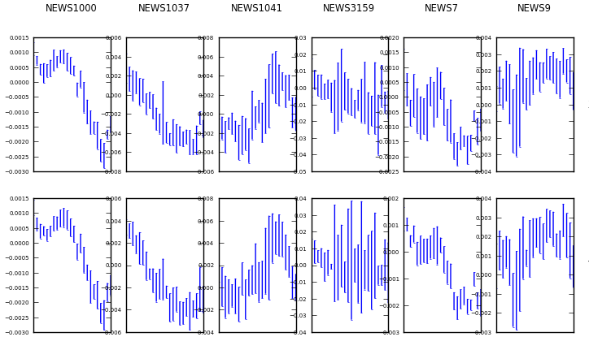
Consistent with (per-source) phase slopes over array
2003 observation
2006 observation
Improved sky model
for polarized source

Slide 21
So what is it?
“Global” effect
Not simply a mispointing of a few antennas
  though wind can cause “global” mispointings
Too big for tropospheric refraction
Phases consistent to first order with a field rotation
  but second-order “kinks” clearly visible
Global amplitude behaviour yet to be explained

Slide 22
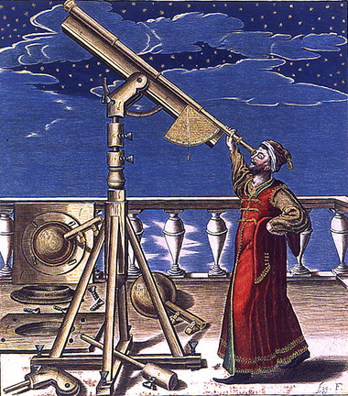
The Most Important Question In Science?
WTF?
“And, if history is any guide, the SKA will raise more questions about the Universe than answer old ones.”
– SKA Fact Sheet, this conf.

Slide 23
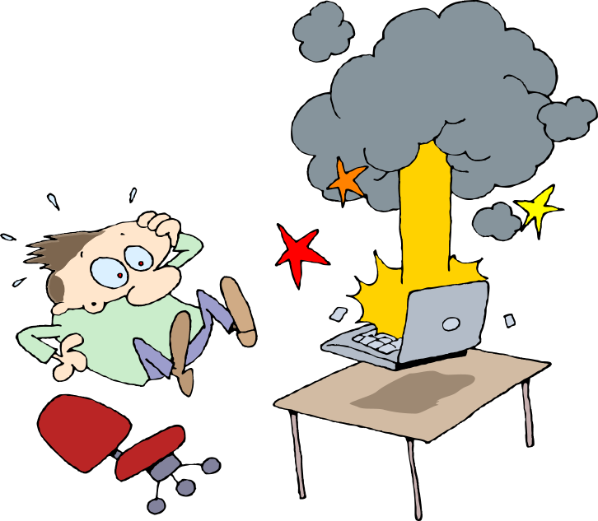
(...though not in software)
WTF!
Welcome to MeqCASA++!
Unknown exception in
module 'unknown',
terminating user
$

Slide 24
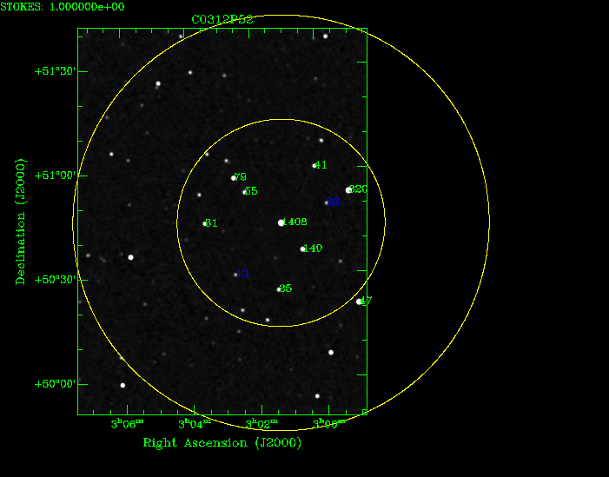
What next?
Requesting WSRT (with G. de Bruyn & J. Noordam) and KAT-7 observations (with I. Heywood, R. Deane, R. Armstrong) of suitable fields to refine the technique, and study off-axis effects in more detail.
Will deliberately mispoint
two antennas (WSRT)
NVSS candidate
field with good
spread of off-axis
sources:

Slide 25
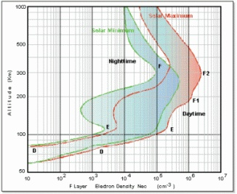
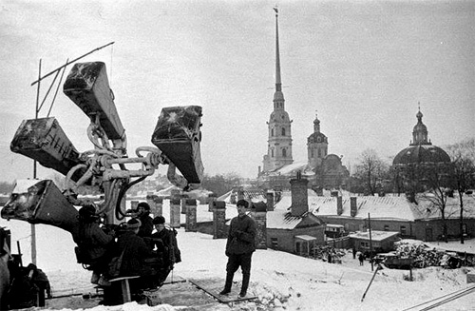
Implications for the SKA
Closed-loop calibration of direction-dependent effects requires ”calibration beacons”

Slide 26
Availability of beacons
We have enough measurements
  Differential gain parameter counts prove this
  Provided beams are smooth in time/freq
Just how many beacons do we need?
  enough to constrain a few degrees of freedom in phase and amplitude, at least
Let's say we need 10 beacons per sq. deg – have we got them?
  An emphatic yes for LOFAR
  Has been a concern at higher frequencies, since we had assumed that beacons need to be bright

Slide 27
Beacons can be fainter than we think!
3C147 result suggests sources down to a few mJy can be useful WSRT beacons
SKA per-dish sensitivity ≈ WSRT
NVSS: ~20 sources of 10+ mJy per sq. deg.
Prospects are good:
we will have enough beacons.
35 5 4 1.3 31 12 mJy

Slide 28
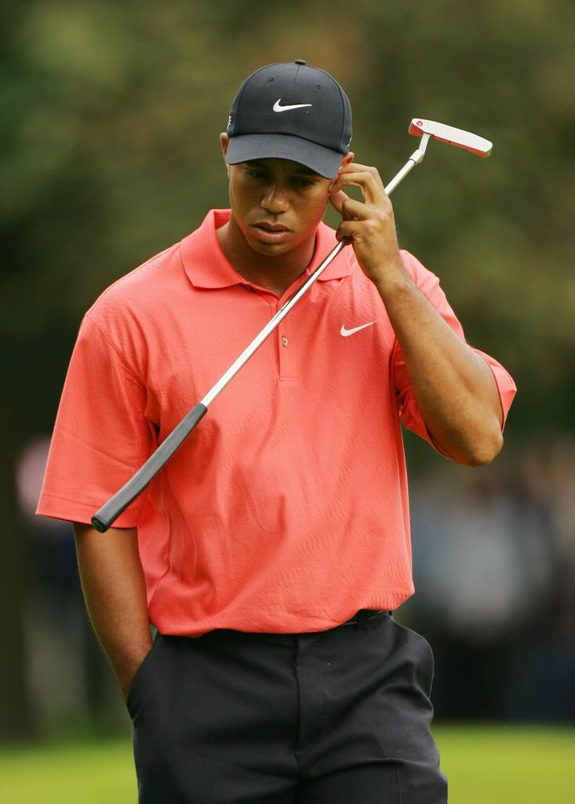
Conclusions
Complex differential gains can be used to calibrate direction-dependent effects
  … also towards relatively weak sources!
SKA closed-loop calibration of
(smooth) DDEs is feasible.
SKA is coming! Start dealing with luxury
problems now, before they hit
you over the head with a golf club!

