Slide 1
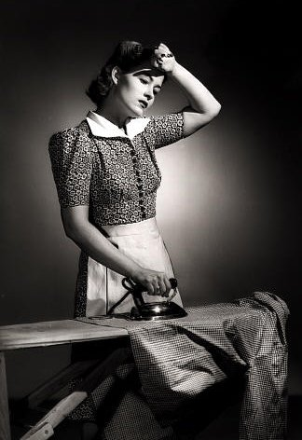
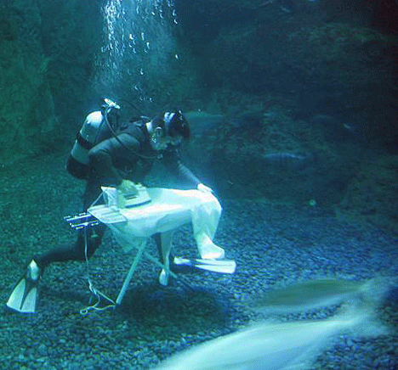
The Perils Of Calibration:
Measurement Equations, DDEs,
And Other Dirty Laundry
Oleg Smirnov (ASTRON)

Slide 2
The Radio Interferometry Measurement Equation (RIME): Why?
Got along fine for ~50 years, why do we need it?
Radio telescopes used to be beautiful machines
  Designed for the most benign instrumental response possible
  Massively overengineered (because we thought we wouldn't be able to calibrate them at all otherwise)
  Then self-calibration came along, and things really blossomed.
Now we build telescopes from cheap junk
  ...and trust in calibration software

Slide 3

The Past:
Feats Of Mechanical Engineering

Slide 4

The Future:
Four Sticks In The Ground (+Software)

Slide 5

...and Dishes Made Of Plastic
(+Compatible Software)

Slide 6
What is The RIME
First formulated by Hamaker, Bregman & Sault (1996), further developed by Hamaker.
A mathematically complete and elegant description of what you actually measure with an interferometer
  all we had before were hints and approximations
Like most great things, is utterly obvious in hindsight
  once the lightbulb is inserted and lights up, it's hard to believe it's taken 50 years to come up with!

Slide 7


The Basics:
Signal Propagation
A transverse EM field can be described by a complex vector:
x
A dual-receptor feed measures two complex voltages
(polarizations):
z
y
We assume propagation is
a linear effect. Any linear transformation of a vector can be described by a matrix:

Slide 8
The Basics, Verbose Version

Slide 9

Correlation
The same signal reaches antennas p and q along two different paths. We then correlate the two sets of complex voltages.

Slide 10
A Wafer-Thin Slice of Physics:
Correlations & Visibilities

Slide 11
Coherency & Stokes Parameters

Slide 12
And That's The RIME!
The RIME, in its simplest form:
measured
antenna p
source
antenna q

Slide 13
Jones Matrices:
The Crucial Ingredient
Each J is called a Jones matrix
For multiple effects in the signal path, overall J is a product of individual Jones terms:
Order of Js corresponds to the physical order of effects in your signal path.
Matrices (usually) don't commute!

Slide 14
Accumulating Jones Terms

Slide 15
On Terminology...
The general formalism above is “The Radio Interferometry Measurement Equation”
When we want to simulate a specific instrument, we put together specific Jones terms, and derive a measurement equation for that instrument.
For example:

Slide 16
A Simple Example

Slide 17
Why Is This Great?
A complete and simple framework for describing all kinds of signal propagation effects.
...including those in the sky & at the antenna, e.g.:
  Ionosphere, troposphere
  beam & receiver gain
  parallactic angle rotation
  receptor cross-leakage
  ”weird” antenna designs (aperture arrays, etc.)
Effortlessly incorporates polarization.

Slide 18
Why Is This Even Greater?
Most effects have a very simple Jones representation:

Slide 19
Obfuscating The RIME:
Evil Mueller's Discombobulating 4×4 Formalism
The RIME is, at core, very simple
Unfortunately, some approaches (prevalent in literature!) tend to make it complicated
Outer products and 4x4 Mueller matrices is one of them:
  First used in Hamaker et al.'s original RIME paper (“Paper I”, 1996)
  Picked up by Noordam for AIPS++ Note 185
  Firmly entrenched with the imaging crowd
  2x2 version, unfortunately, not proposed by Hamaker until “Paper IV” (2000)

Slide 20
Evil Mueller's Formalism
Mueller
matrix

Slide 21
Why Evil Mueller?
Disadvantages of Mueller formalism are obvious: non-intuitive, too many indices to keep straight
  Human mind only keeps track of 7 things at once
Advantages:
  Emphasizes that observed visibilities are linear w.r.t. input Stokes images
    And thus beloved by imaging people
  Makes simple things complicated
    And thus beloved by the High Priesthood

Slide 22

Polarization
“You may not be interested in the polarization, but the polarization is interested in you.”
– (wrongly) attributed to Leon Trotsky
Older telescopes were designed
to minimize instrumental polarization effects
So unless you were a masochpolarimetrist, you could dodge the issue entirely
Not so for the new regimes:
  Focal plane or aperture arrays, offset feeds: severe instrumental polarization
  Low frequencies: ionospheric FR

Slide 23

The Classical (“Banana Republic”) Approach To Polarization
V
Q
U

Slide 24

Scalar Equations For
Polarization Selfcal
RIME version:
(With thanks to Huib Jan van Langevelde)

Slide 25
Example:
Differential Faraday Rotation
Early testing of first LOFAR long baseline (Effelsberg-Exloo) showed puzzling signal:
  very strong XY/YX, very weak XX/YY, on unpolarized source
Caused much excitement in the corridors, but was eventually explained by differential Faraday rotation
Had actually been predicted (& forgotten) by Hamaker et al. in the original RIME paper
According to James Anderson, was known in the VLBI community during the 1960-70s, hence choice of circularly polarized feeds

Slide 26
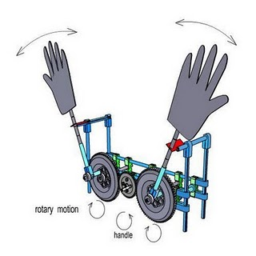
DFR: The Physical View vs. The RIME View
Physical view: (lots of handwaving)

Slide 27
DFR: The Physical View vs. The RIME View
Assume a 1 Jy unpolarized source at the phase centre, and no other corruptions:

Slide 28
DFR: The RIME View vs. The Evil Mueller View

Slide 29
Going Full-sky

Slide 30
The Van Cittert-Zernike Theorem
all are functions of l,m
”apparent sky”
Fourier transform
kernel

Slide 31
The All-Sky RIME: integrating over the sky
DDEs: Direction-dependent effects
(a.k.a. Image-plane, or off-axis effects)
DIEs: direction-independent effects
(a.k.a. uv-plane effects, or on-axis effects)
w-term
(non-coplanar
baselines)
Antenna
gains
Flux density

Slide 32
”Classic” Radio Interferometery vs. The New Regimes
In a ”classic” interferometer, each baseline p-q samples some bit of the Fourier transform of the sky:
In the presense of DDEs, each baseline samples its own ”apparent sky”
...which is also variable in time!

Slide 33
What Causes DDEs
Az-el mounts: sky rotation w.r.t. the primary beam
  Bottleneck at the VLA (A-projection may help)
  Will be a problem for MeerKAT
Non-identical beamshapes (pointing error, thermal or gravitational deformation)
  Need decent dynamic range to see it
Ionosphere
  At low-frequencies, with wide FoVs (otherwise ignore...)

Slide 34
DDEs: A Luxury Problem?
You DON'T worry about DDEs when you have:
  narrow fields (thus little variation over the FoV)
  higher frequencies (no ionosphere)
  equatorial mounts (beam stationary on the sky)
  compact arrays
  low sensitivity
This is why classic selfcal did just fine all these years
...but won't do for the new telescopes.

Slide 35

Ionosphere:
The Joys Of Low Frequency
MeqTree simulation:
9 point sources on a grid
...corrupted by a model ionosphere: sine-like travelling ionospheric disturbances (TIDs), amplitude of TIDs increases in time
animation composed of snapshot images

Slide 36

A Self-Calibrated Ionosphere
Let's assume we can selfcal the ionosphere perfectly...
We have only one phase term per antenna, so we can only correct for phase at center.
This is the previous simulation, with the center phases divided out.
Relative movement is due to phase differences over the field of view.
This is a problem...

Slide 37

Pointing Error
Pointing error shifts the beam pattern of each antenna over the sky,
...causing the apparent flux of off-axis sources to vary by baseline
...causing artifacts in the final maps.
Left image: WSRT 21 cm observation, with a large p.e. on one antenna.

Slide 38

WSRT
3C147 @21cm
Single 12h
synthesis
22 Jy peak
13.5 μJy noise
1,600,000:1 DR
DDEs
(“Luxury problems”)

Slide 39

Solving for DDEs:
Spot The Mispointed Antennas

Slide 40
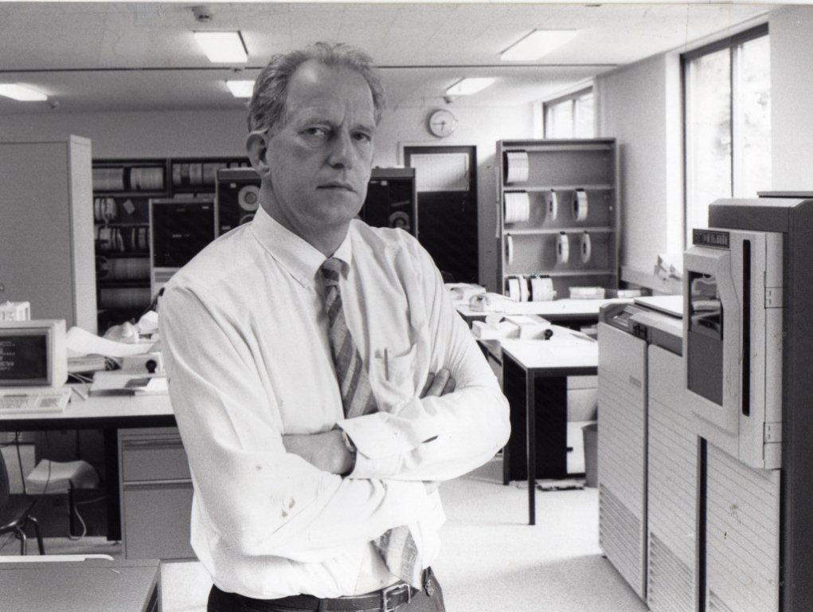
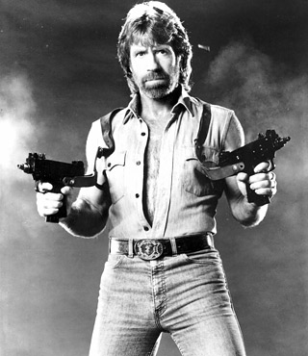
Telescope Design: Past...
WSRT (at age 40!) can achieve such feats due to being massively overengineered
  designed for extreme stability, since that was thought to be the only way to calibrate
Reduction software was but an afterthought
  Built by Wim Brouw over a cigar on a quiet afternoon
  ...while not busy directing ASTRON
  One of these people to whom the keeping-7-things-in-mind-at-once limit does not apply.

Slide 41
The Magical Era Of Selfcal
The selfcal magically came along, and allowed everyone to exceed design specs by orders of magnitude
Suddenly, we had:
  Instruments that were designed so that they could be approximated by a simple model
  An extremely powerful processing technique
Which in turn led to all-singing all-dancing software packages (AIPS, etc.)
...but the theory remained ad hoc, opaque, and full of refrigerator-sized formulae.

Slide 42

The Evolution Of
The Button-Pushing Astronomer
This contributed to a whole generation of astronomers that could reduce their data by following simple recipes
...without necessarily understanding them
Black-box calibration: why do you trust your results?
  (Because the rest of the troop does?)
The ideal astronomer user interface
(after Tony Willis):
GO
GO FASTER
DO WHAT
I MEAN!

Slide 43
...And The Future
Things are getting more complicated...
  Can't get away with thoughtless button-pushing anymore!
  Fortunately, the RIME simplifies the theory
Complicated, because we've factored in the expectation of magic, and design huge (but practically uncalibratable) telescopes:
  ...and trust in software to deliver
  ...and trust in Moore's Law to give us the FLOPS
  ...and trust in the engineers to come up with brilliant solutions on the cheap

Slide 44
Managing Large Projects
In The XXI Century
“A camel is a horse designed by committee.”
– Sir Alec Issigonis, or Lester Hunt, or Vogue magazine
“Progress is a byproduct of waste.” – Jan Noordam (?)
“A compromise is that solution which makes all parties equally unhappy.” – Larry David, after Henry Clay
“LOFAR is the first radio telescope built entirely by managers.”
– Deep Throat
“SKA will be the first radio telescope built entirely by funding agencies.”
– Deep Throat II
A working camel is more use than a perfectly conceived idea of a horse.
“You can't probe the EoR with Platonic ideals.” – me

Slide 45
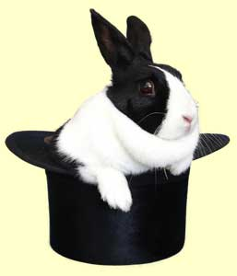
In Conclusion:
Calibrating The SKA
Clearly, we're going to build the best SKA we can afford (once we've paid off the consultants.)
It's going to be a fantastic instrument
  ...but probably compromised to
  the point of near-uncalibratability.
It will be up to some of the people in
this room to pull the requisite rabbits
out of the available hats.
For the rest, forget about the days of button-pushing: understand your instruments instead.

Slide 46
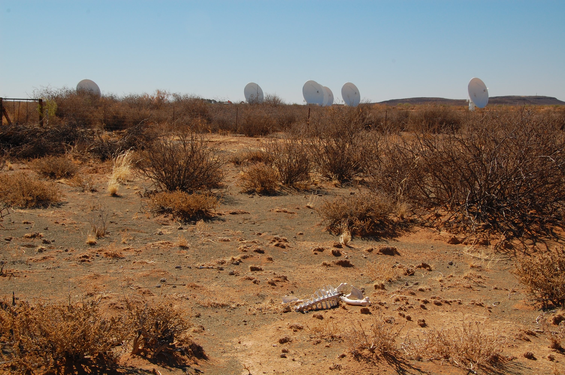
The End
(Of The Button-Pushing Astronomer?)

