Slide 1

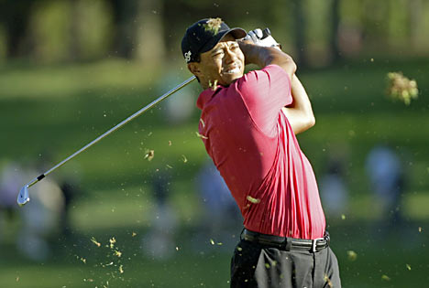
Tigger: Luxury Software
For Luxury Problems
O. Smirnov

Slide 2
Local Sky Models
(and source catalogs)
Information overload!
3C147 project (“Luxury problems of HDR imaging”):
  300 sources
  ...some need differential gains solutions
  Others can probably be moved to an image
  Need to deal with subsets, etc.
Hybrid models (components plus images plus shapelets)

Slide 3
Hybrid models
Sources plus images plus shapelets...

Slide 4
Image Viewing
Inspired by Karma (kvis), the world's most advanced FITS viewer...
...with the world's most abysmal user interface
  The little-appreciated “Infinite Number of Green Windows” paradigm (Steve Jobs, eat your heart out)

Slide 5
Python Is Faster
Than Most People Think
Still thought of as a “scripting language” by some
Is actually an excellent general purpose language
  Only really “too slow” for very specific things
  Can be slow if badly written
  (...but then badly written C++ doesn't work at all)
Choice of language is a form of premature optimization
Bottleneck is wetware, not software

Slide 6
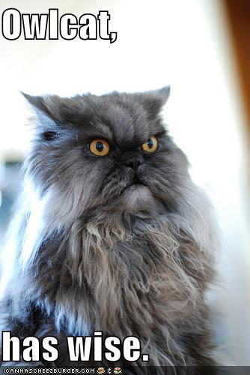
Owlcat
Collection of scripts for:
MS manipulation
  Split/combine
  Proper weighting!
Simple flagging
Non-interactive plotting
J2convert?
pyrap/cacacore is crucial!
  And very shoddily treated...

Slide 7
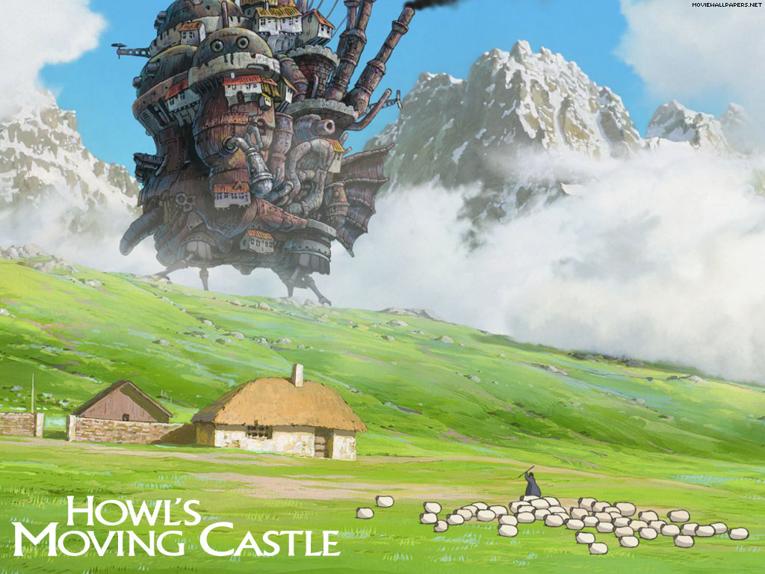

Slide 8
The End

