Slide 1

Solving For
Primary Beams, Pointing Errors
And The Westerbork Wobble
O. Smirnov (ASTRON)

Slide 2

DDEs Westerbork-Style
(Luxury Problems?)
3C147 @21cm
Single 12h
WSRT synthesis
1,600,000:1 DR
Such DR made possible by
WSRT's extremely stable
design (equatorial mounts
⇒stationary beams, etc.)
Nonetheless, this map is
deep enough to show
DDEs.
Cleaned up via application
of differential gains.

Slide 3

Just a Luxury Problem?

Slide 4

DDEs: Not Always a Luxury Problem
(Courtesy of Ian Heywood)
EVLA 8 GHz: Looking for sub-mm galaxies and QSOs in the William Herschel Deep Field.
Dominant effect: bright calibrator source rotating through first sidelobe of the primary beam.
(This also has a horrible PSF, being an equatorial field.)
This is your science
(good luck!)
This is your
phase calibrator
Brightness scale 0~50μJy

Slide 5

Keep Your Friends Close, and your calibrators as far away as you can...
An approximation of the primary beam response, overlaid on top of the image.
As the sky rotates, the sidelobes of the PB sweep over the source, thus making it effectively time-variable.
This is your science
(good luck!)
This is your
phase calibrator
Brightness scale 0~50μJy

Slide 6

Deconvolution Doesn't Help...
Residual image, after deconvolution.
The contaminating source cannot be deconvolved away properly, due to its instrumental time-variability.
Brightness scale 0~50μJy

Slide 7

Differential Gains To The Rescue
Residual image after applying differential gain solutions to the contaminating source
Brightness scale 0~50μJy

Slide 8

Multi-Band Image
Multi-band residual image:
noise-limited, no trace of contaminating source.
Phase calibrator
used to be here
Brightness scale 0~50μJy

Slide 9
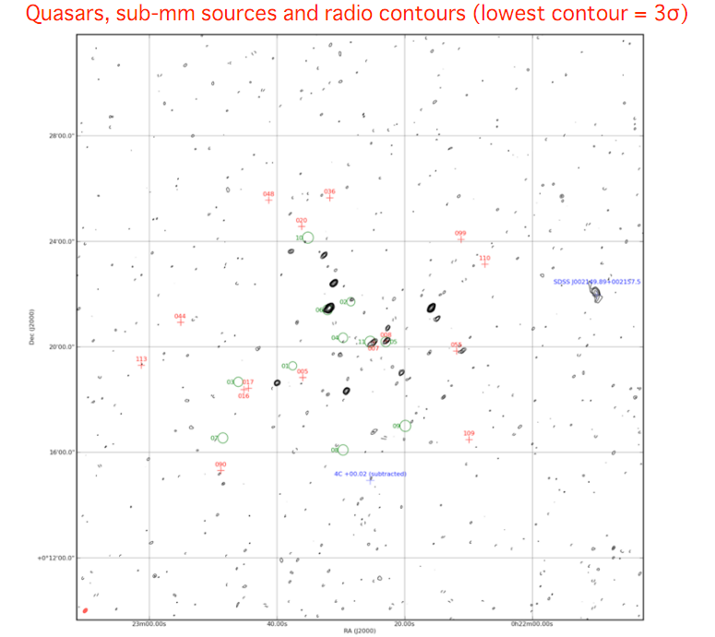

Slide 10
Differential Gains, In a Nutshell

Slide 11
A.k.a. “The Flyswatter”
The Good:
  dE's can completely eliminate contaminating sources, making for great maps!
  See also talks by Ian Heywood, Panos Labropoulos
The Bad:
  Computationally feasible for a “handful” of sources at most
  Proliferation of degrees of freedom
The Ugly:
  Mashes together all information on both the source and all instrumental effects towards it

Slide 12
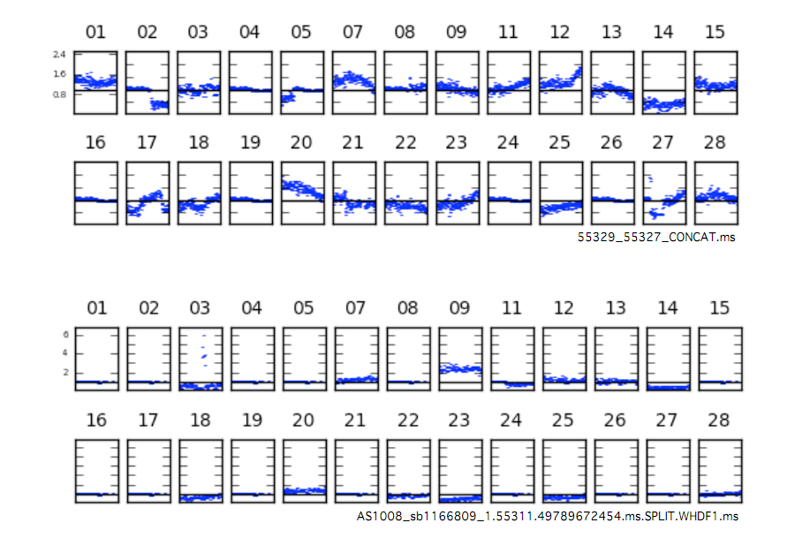

The Ugly, continued...
...and makes no use of the fact that DDEs must have spatial continuity.
Example: 3C147 field, dE-phase solutions as a function of time, per source, per antenna:

Slide 13
Alternatives:
Fitting a “Global” DDE Model
Pointing selfcal (S. Bhatnagar)
  Uses EVLA PB model, with a solvable pointing offset Δl,Δm
  First-order approximation to ∂χ²/∂(Δl), ∂χ²/∂(Δm)
  using FFTs and convolutional functions
  Uses entire sky model (image) as input
  Results (so far): seems to improve pointing solutions, but little reduction in imaging artefacts
  Possibly due to inadequate PB model?
AW-projection can apply “global” correction during imaging

Slide 14
The QMC* Project
Pick a field containing a cluster of reasonably bright off-axis sources
Observe with WSRT @21cm
Introduce deliberate (and secret!) pointing errors during observation
Attempt to recover these during the reduction
*) Named in honour of the long-defunct WSRT Quality Monitoring Committee. Yes, the Dutch do love their committees. Fortunately, so do the Russians.

Slide 15
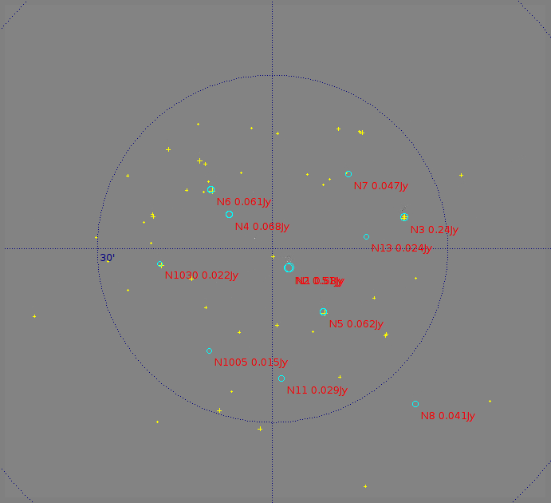
The QMC Field (04518+5045)
Found via an automated NVSS search (Python script...)
1.4 Jy 4C source at center
Unfortunately, many sources proved to be slightly extended, thus complicating matters enormously

Slide 16

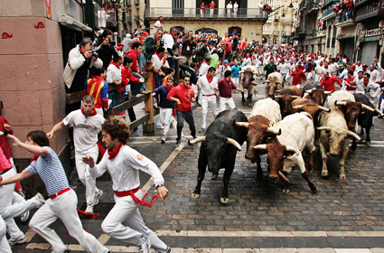
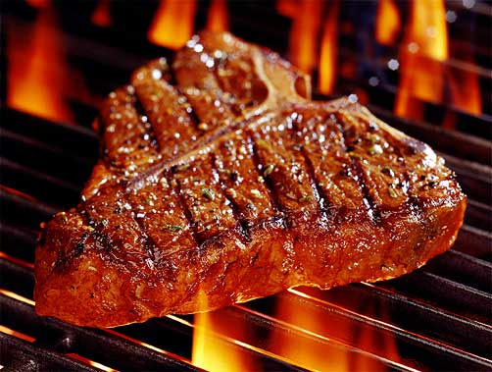
The QMC2 Field (01515+6736)
(a radio astronomer's worst nightmare)
>10 moderately bright off-center sources
The type of field that usually has radio astronomers running away screaming...
But perfect for our purposes!

Slide 17
The QMC2 Field (01515+6736)
Added at the Observatory's insistence (thanks!)
RA=1h: easy to find WSRT observing time
Dominant sources: 220, 160 mJy
3C source to NW, attenuated by 10⁻³
Most sources are unresolved

Slide 18

Gifts Of QMC2
Initial observation (2010Jul3) was an “error-free” 12h synthesis, in order to build up a sky model
“I have never seen such
a terrible WSRT map!”
– Ger de Bruyn
Differential gains sorted
out the issue as usual

Slide 19


QMC2 2010Jul3 dE amplitudes
||dE|| solutions show large offsets on RT8, consistent with a significant mispointing to the North
Problem was reported to the Observatory, and they discovered a faulty encoder on RT8's declination axis

Slide 20

QMC2 2010Jul21:
Now mispointed
||dE|| solutions suggest a static mispointing of RT2, RT6, RT8
...and a time-variable mispointing of RTB
(“Hans's susprise”)
Hans confirmed that this was consistent with the mispointings he had put in.

Slide 21

“Rogues' Gallery” Plot
Plots of mean ||dE|| per antenna, at proper positions within the field.
Colour/size indicates
||dE||>1, <1.
(Note 3C source at NW!)

Slide 22
Phase II: Solving For Pointing Errors
This was where things stood at the last CALIM
...where Sanjay suggested I should solve for pointing offsets on the same field
A MeqTrees variation on pointing selfcal: DFT pointing solutions.
MeqTrees can “solve for anything”: we need to construct a suitable model where the pointing offsets are parameters, then designate them as solvable and say “go”.

Slide 23
DFT Pointing Solutions

Slide 24

P.E. Solutions (QMC2 2011Jul21)
Recovered solutions consistent with deliberate mispointings, but underestimate them:

Slide 25

Fancy plots are all very nice, but...
SHOW ME
THE
SYNTHESIS
IMAGE!

Slide 26

Not so impressive...
Residual image,
post-selfcal

Slide 27

A Marginal Improvement
Residual image,
post-selfcal,
with pointing error solutions
(Note how this relative lack of improvement is consistent with Sanjay's pointing selfcal results.)

Slide 28

Nowhere Near The Flyswatter...
Residual image,
post-selfcal,
with differential
gains.

Slide 29
Parameterizing The Beam
The advantage of the DFT approach is that we can introduce other parameters into the primary beam model.
Just as a random example, we can introduce a per-antenna beam scale sp:
And then treat sp as a solvable.

Slide 30
P.E. Solution Only
Residual image,
post-selfcal,
with pointing error solutions

Slide 31

P.E. + Beam Extent
Residual image,
post-selfcal,
with pointing error and beam extent solutions
...not as good as differential gains, but an improvement!

Slide 32


Now Back To The Pretty Plots
Beam extent and pointing offset solutions are strongly coupled
Beam extent solutions are non-physical (±10%!)
More of the poitning
Obviously the extra degree of freedom is compensating for something else, but what exactly?

Slide 33
Compare To The PE-Only Case
P.E. solutions without a beam extent show more variance
...and underestimate the true mispointing to a larger degree
Tentative conclusion: P.E. solutions are limited by the accuracy of the beam model
...as are the final maps
There may also be a directional coupling determined by the configuration of sources in the field.

Slide 34
QMC2 “8-Way” Observations
To check for directional coupling, we asked for another observation of QMC2 with 8 antennas mispointed to 8 points of the compass (by 60 mdeg each)
This was done in March 2011, but due to some problems only 90 minutes of data were taken
Thus no imaging was possible
...but we could still do P.E. solutions
  (we'd been solving at 30-minute intervals before)

Slide 35


8-Way Pointing Solutions
Expected vs. fitted pointing offsets
With a solvable beam extent
Without a solvable beam extent

Slide 36
Know Thy Beams
(and the incestousness of selfcal)
Why not throw more parameters at the beam model?
We do NOT have absolute, intrinsic source fluxes. Selfcal gives us fluxes attenuated by some average primary beam.
Our solution is then only sensitive to differences between antennas (and timeslots).
Given a perfectly-pointed observation and identical PBs, our method is completely insensitive to beamshape.
Pointing errors give us a handle on the gradient of the beamshape.
  (this also explains why the beam extent solutions above are non-physical!)

Slide 37
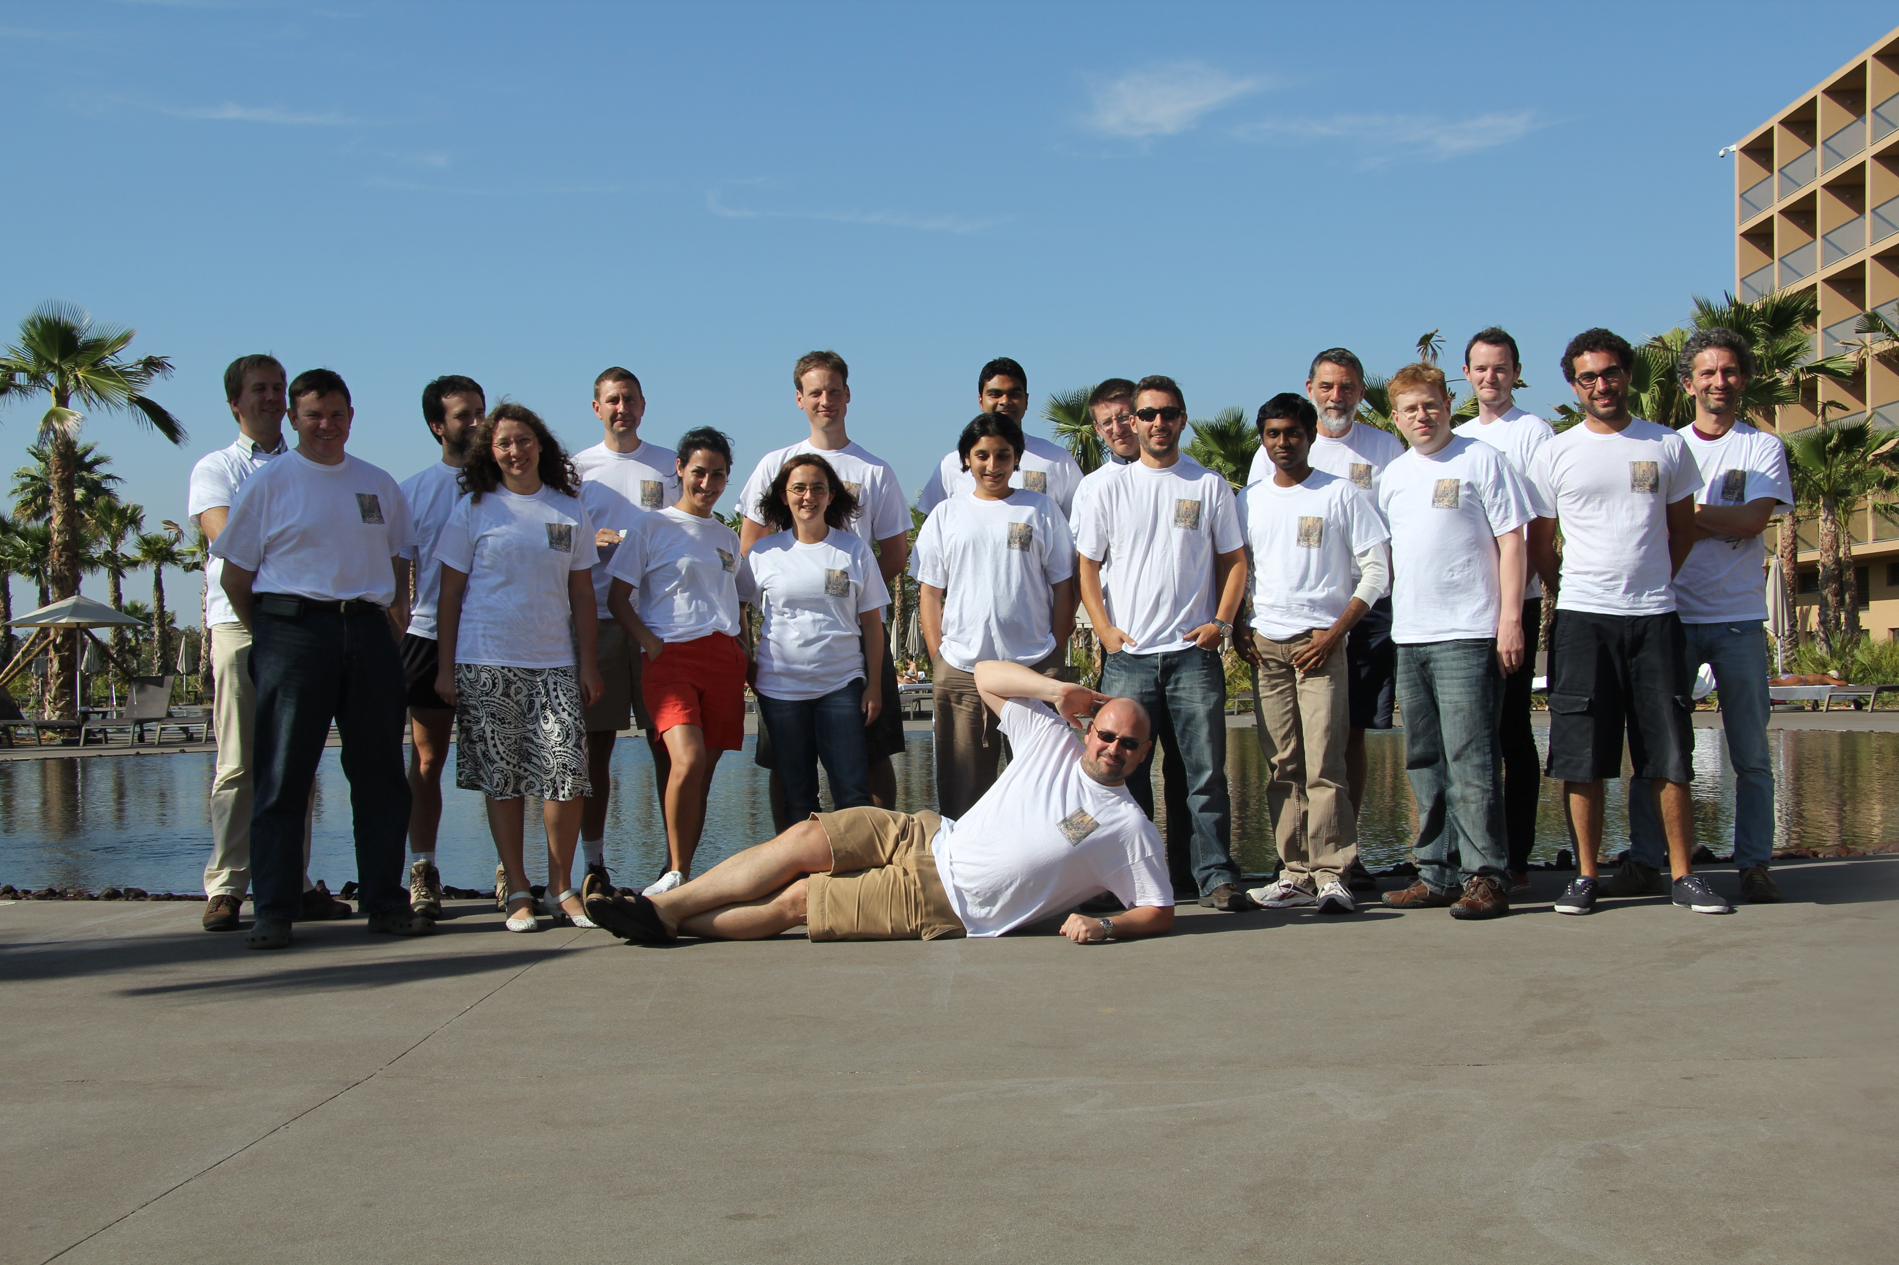
Hence, Portugal:
The 3GC-II “Beams” Workshop

Slide 38
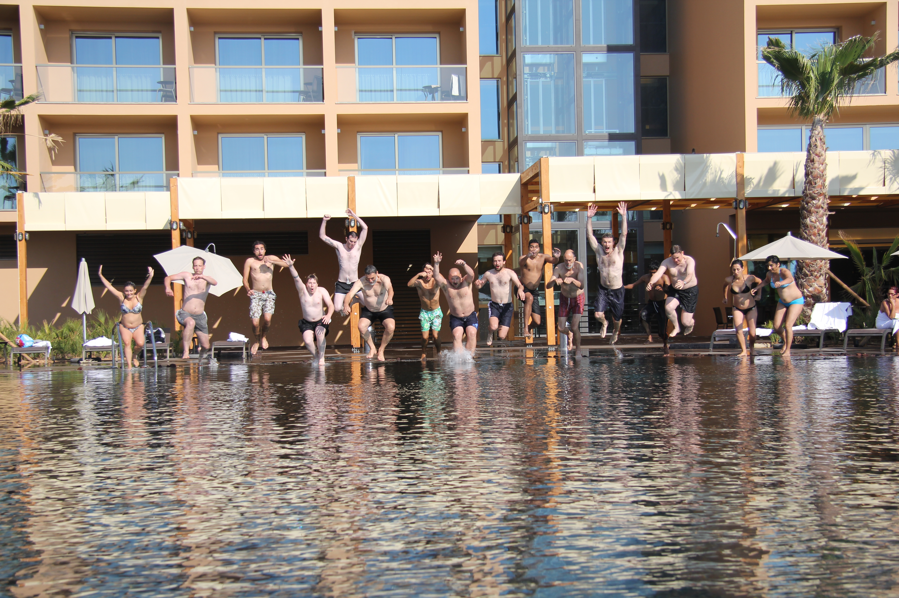
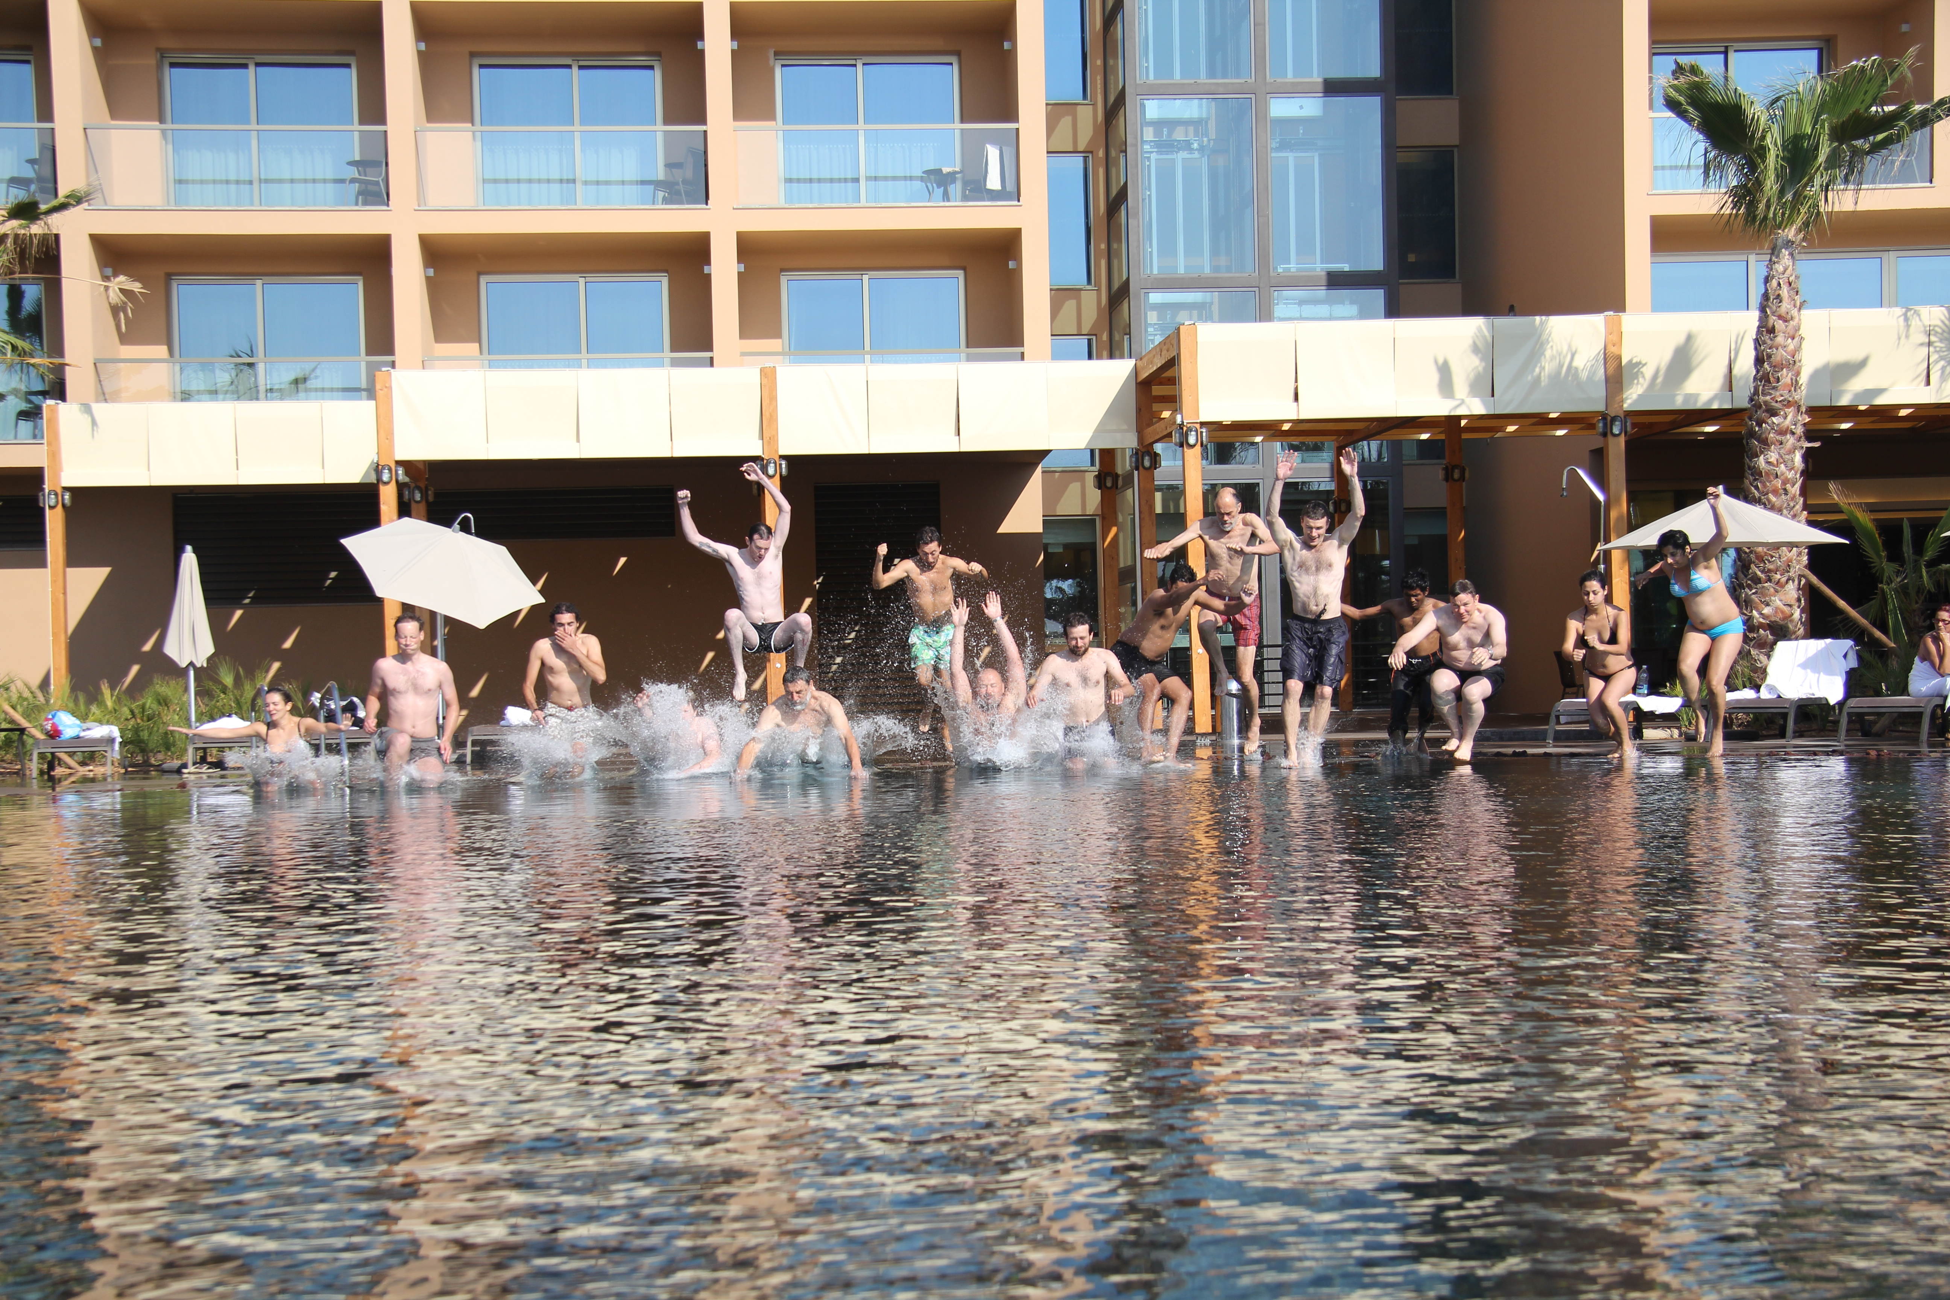
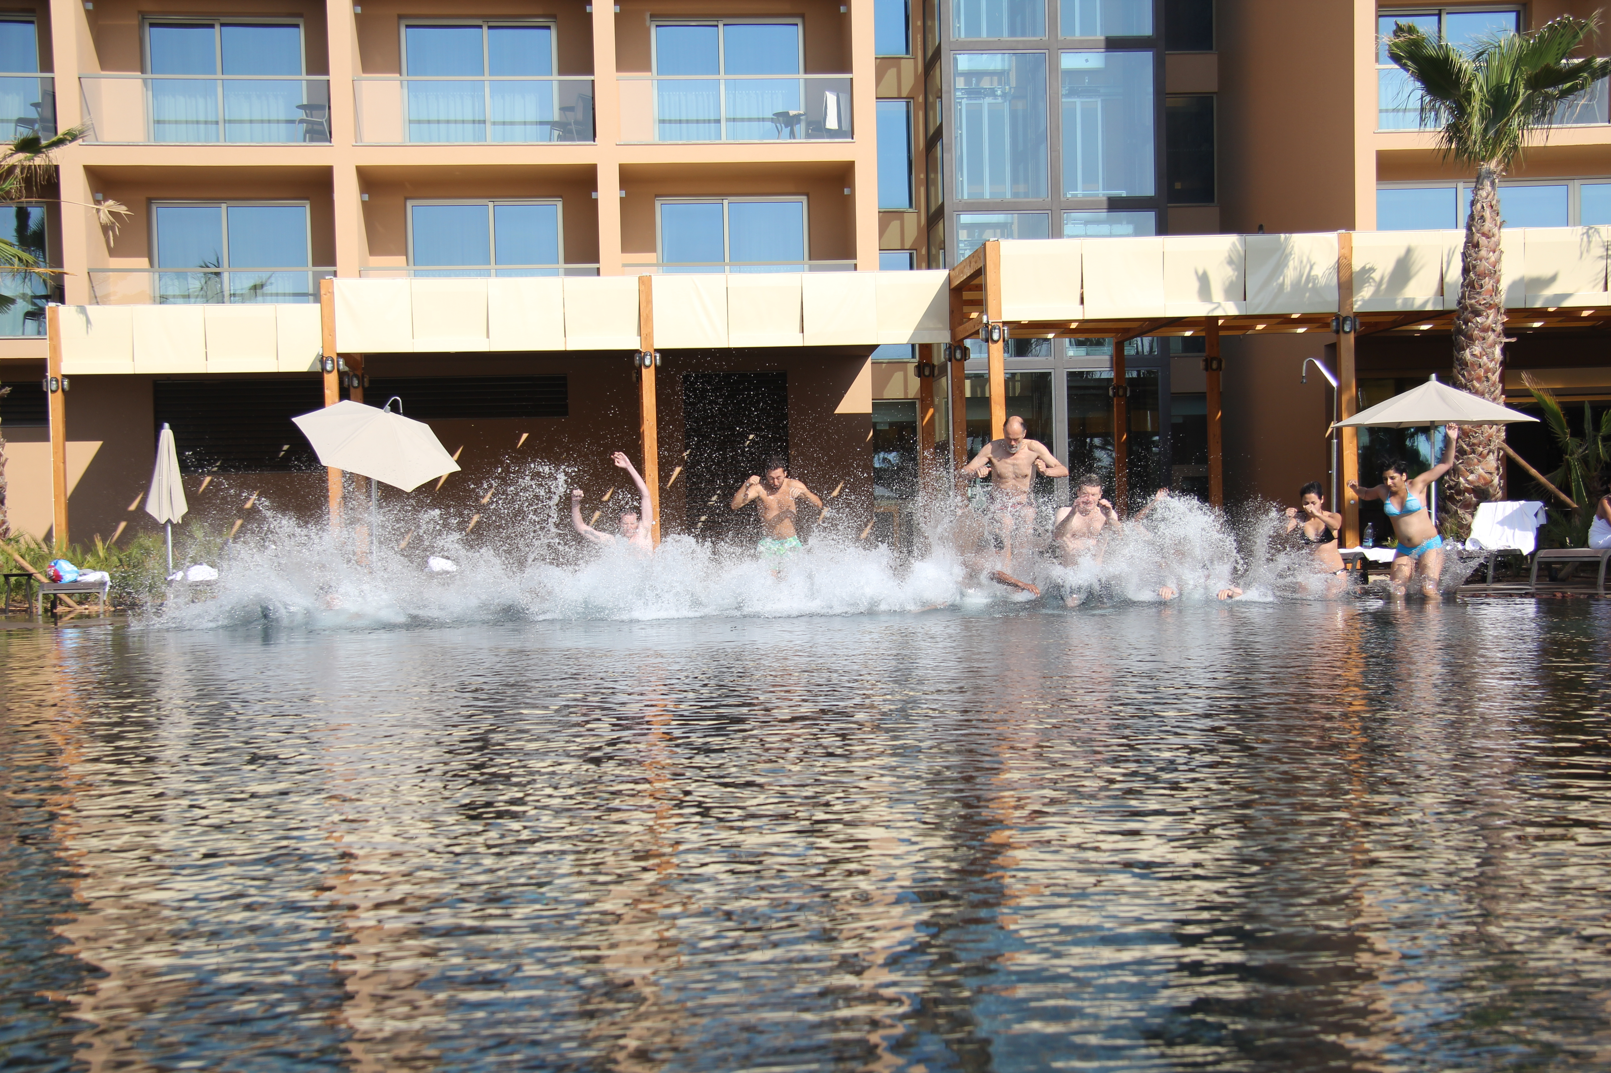
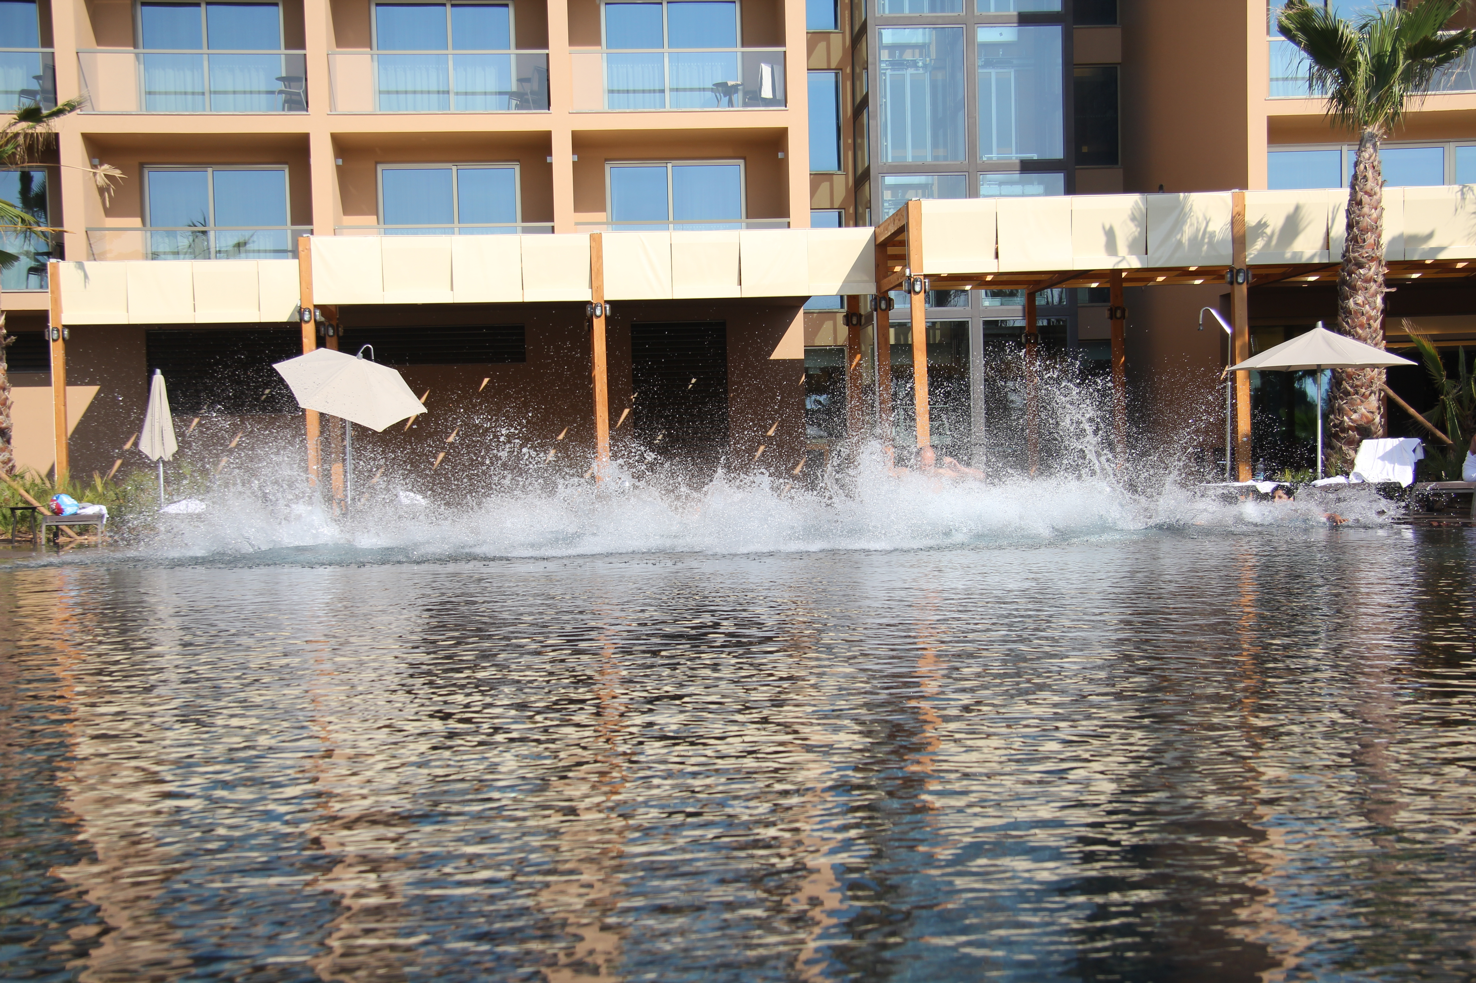

Slide 39
The Next Step: A QMC2 Mosaic
Latest observation (2011Jul17): a 10-pointing mosaic, ~1 hour per pointing.
1 pointing to field centre,
9 pointings to off-axis
sources around the
half-power point.
8-way mispointed.
Will use this to
simultaneously constrain
source fluxes and PB
models.

Slide 40

Yet Another Twist: Solving For P.E.
On Shorter Time Scales
Solutions every 30 sec, 2.5 min and 5 min.
Longer time scales: decreased variance (higher SNR)
Diminishing returns above 5 min.
Show a striking feature unnoticed on the previous
(30 min.) plots...

Slide 41

And Now, Applying Sophisticated
Model Fitting Techniques...
Westerbork Wobble!
WW

Slide 42

The Wobble
A periodic (~20 min) variation in the pointing of 10-20 mdeg.
Shows up in other observations, on other antennas (to varying extent)
Fourier transform the pointing offsets, and plot the amplitudes of the Fourier components:

Slide 43
Wobbling Across 5 Epochs (RA)

Slide 44
Wobbling Across 5 Epochs (Dec)

Slide 45
Wobbly Features
RA & Dec coupled, Dec wobbles more
Only some antennas wobble
  But they differ epoch-to-epoch
Wobble amplitude varies epoch-to-epoch
  Can reach 20 mdeg (10 is nominal accuracy!)
  Some epochs much worse than others, why? (waiting for wind data)
Wobble period is 5 to 60 minutes
  Quite stable (up to 4 hours)

Slide 46
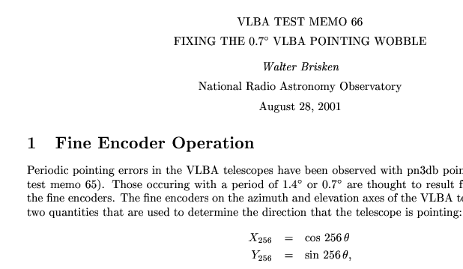
Seen Before, Perhaps?

Slide 47
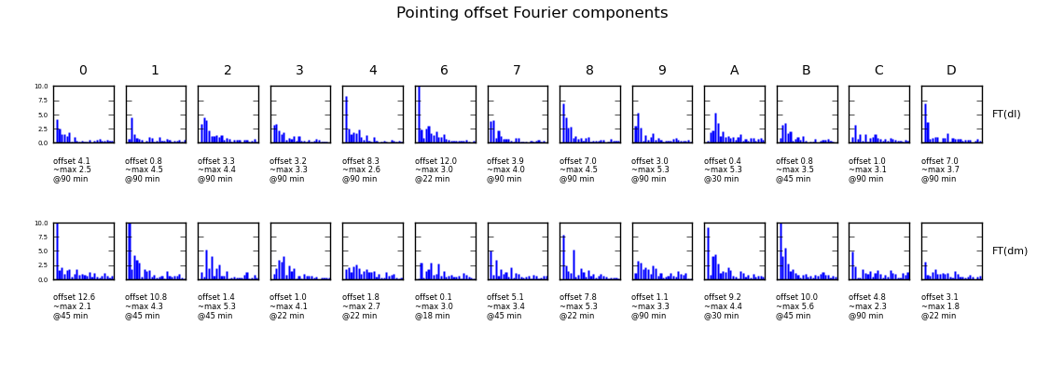
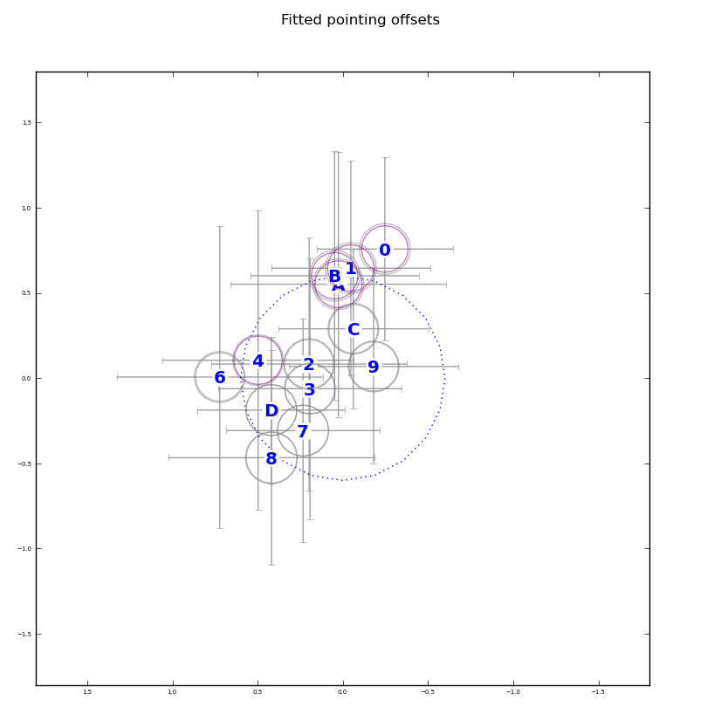
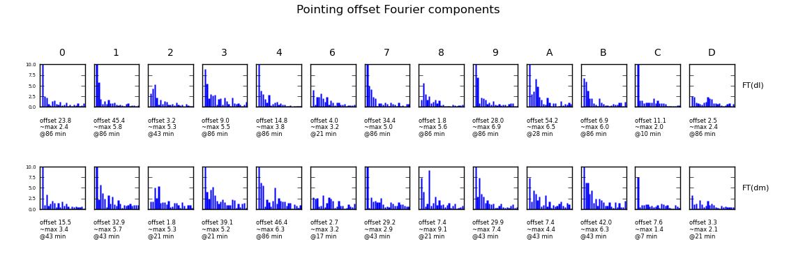
The Promise of a QMC
60 ~ 90 minutes of data is enough to characterize both the static and the dynamic pointing quality.
WSRT schedule always has suitable small gaps

Slide 48
Conclusions I
Differential gains (dE's) can completely eliminate contaminating sources
  ...but only feasible for a few (tens) of sources
“Global model” DDE solutions (pointing selfcal, DFT pointing, etc.) are also feasible
  ...but don't (yet) eliminate artefacts to the same extent
The future is hybrid: high-DR imaging at SKA sensitivities will require:
  dE's (or some variation thereof) on Cat I sources
  “global model” DDE solutions on Cat II sources

Slide 49
Conclusions II
Pointing error solutions are limited by the PB model
  as are the remaining imaging artefacts
KNOW THY BEAMS!
  and we don't, really (so come to Portugal!)
Westerbork Wobbles, and we ought to figure out why (APERTIF is coming)
Would be nice to apply this to other observatories
(Will the VLA Vaccilate? Must MeerKAT Meander?)
I make really bad puns sometimes...

