Slide 1

Calibrating And Correcting
Direction-Dependent Effects
In Radio Interferometry
Oleg Smirnov

Slide 2
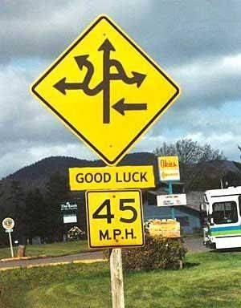
Introduction: DDEs
Classical interferometry assumes that every antenna “sees” the same sky attenuated by the same antenna spatial response pattern, a.k.a. the “primary beam” (PB).
  ...we calibrate for a single per-antenna gain (thus, direction-independent)
Direction-dependent effects (DDEs): antenna-, time- and direction-dependent gain variations:
  PB stability (sky rotation, pointing errors,
  mechanical dish deformation, etc.)
  Ionospheric refraction (at lower frequencies)
Generally not known a priori.

Slide 3
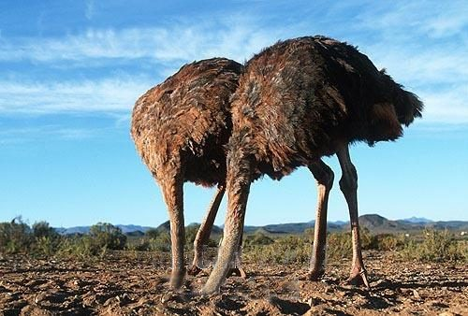
DDEs: The Traditional Approach
Pick your battles:
choose the field of view
carefully, keeping all the
bright stuff in the center
Traditional calibrations absorbs
all effects towards the dominant
source
DDEs cause increasing distortion towards the edges, but only the faint stuff is subject to them, so we ignore them
NOT possible with the new brood of telescopes:
  Wider fields of view, new regimes, higher sensitivity
  “Low unit cost” (i.e. we build them out of cheap junk)

Slide 4

DDEs Westerbork-Style
(Luxury Problems?)
3C147 @21cm
Single 12h
WSRT synthesis
1,600,000:1 DR
Such DR made possible by
WSRT's extremely stable
design (equatorial mounts
⇒stationary beams, etc.)
Nonetheless, this map is
deep enough to show
DDEs.
Cleaned up via application
of differential gains.

Slide 5

Just a Luxury Problem?

Slide 6

DDEs: Not Always a Luxury Problem
(Courtesy of Ian Heywood)
EVLA 8 GHz: Looking for sub-mm galaxies and QSOs in the William Herschel Deep Field.
Dominant effect: bright calibrator source rotating through first sidelobe of the primary beam.
(This also has a horrible PSF, being an equatorial field.)
This is your science
(good luck!)
This is your
phase calibrator
Brightness scale 0~50μJy

Slide 7

Keep Your Friends Close, and your calibrators as far away as you can...
An approximation of the primary beam response, overlaid on top of the image.
As the sky rotates, the sidelobes of the PB sweep over the source, thus making it effectively time-variable.
This is your science
(good luck!)
This is your
phase calibrator
Brightness scale 0~50μJy

Slide 8

Deconvolution Doesn't Help...
Residual image, after deconvolution.
The contaminating source cannot be deconvolved away properly, due to its instrumental time-variability.
Brightness scale 0~50μJy

Slide 9

Differential Gains To The Rescue
Residual image after applying differential gain solutions to the contaminating source
Brightness scale 0~50μJy

Slide 10
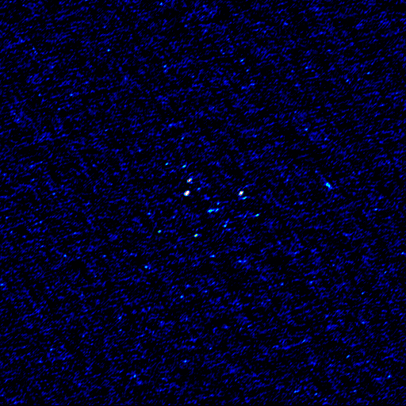
Multi-Band Image
Multi-band residual image:
noise-limited, no trace of contaminating source.
Phase calibrator
used to be here
Brightness scale 0~50μJy

Slide 11
Two Broad Approaches
To DDE Calibration
Direction-dependent solutions (peeling, differential gains, etc.)
  Treat the gain towards each direction as an independent solvable parameter
Model-based approaches (pointing selfcal, ionospheric models, warped snapshot imaging, etc.)
  Fit a “global” model to the DDE in question, solve for model parameters

Slide 12
Direction-Dependent Gains
(and subtraction in the uv-plane)
Given a model for the dominant source components, solve for direction-dependent gain terms:
Image the residual visibilities {R=V-D}
  These are still subject to the same relative level of DDEs, but the absolute error level is lower.
The subtracted source components can always be “restored” back into the resulting image
2×2
visibility matrix
2×2
Jones matrix

Slide 13
Differential Gains
DoFs proliferate quickly, so it is better to use e.g.:
Direction-independent gains G vary on short time-frequency scales
Nominal beam model E accounts for the bulk of the DDE
dE accounts for the small and slow direction-dependent variations (… hopefully)

Slide 14
A.k.a. “The Flyswatter”
The Good: it swats sources
  Point-and-shoot: dE's can completely eliminate contaminating sources, making for great maps.
The Bad: it swats sources
  Mashes together all information on both the source and all DDEs towards it
The Ugly: it proliferates degrees of freedom
  Fundamental and computational limits on how many dE's you can have
  LOFAR EoR project: up to 60 per antenna

Slide 15

The Ugly, continued...
...and makes no use of spatial continuity.
So we'd really like to learn to fit some “global” DDE models instead
Example: 3C147 field, dE-phase solutions:

Slide 16
The QMC* Project: a “controlled” experiment
Pick a field containing a cluster of reasonably bright off-center sources
Observe this at Westerbork
Introduce deliberate (and secret!) pointing errors during observation
Attempt to recover these during the reduction
*) Named in honour of the now-defunct WSRT Quality Monitoring Committee. Yes, the Dutch do love to establish committees. Fortunately, so do the Russians.

Slide 17

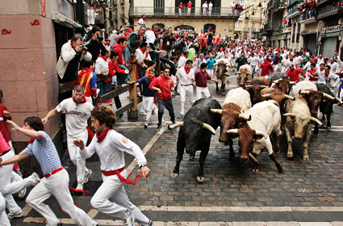
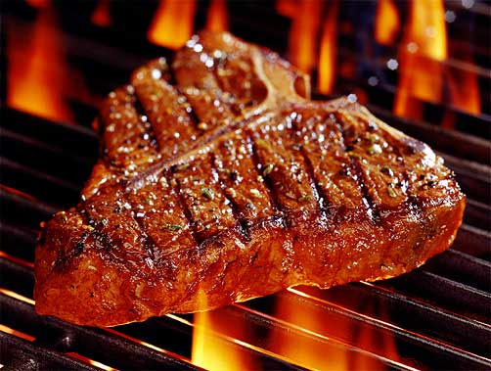
The QMC2 Field (01515+6736)
(a radio astronomer's worst nightmare)
>10 moderately bright off-center sources
The type of field that usually has radio astronomers running away screaming...
But perfect for our purposes!

Slide 18

QMC2 2010Jul21
||dE|| solutions suggest a static mispointing of three antennas
...and a time-variable mispointing of RTB
(“Hans's susprise”)
Observatory confirmed that this was consistent with the mispointings they had put in.

Slide 19

“Rogues' Gallery” Plot
Plots of mean ||dE|| per antenna, at proper positions within the field.
Colour/size indicates
||dE||>1, <1.

Slide 20
Solving For Pointing Errors
||dE|| plots are a reliable indicator of mispointing
  But only a very rough one...
Can we recover the actual pointing offsets?
Pointing selfcal algorithm (S. Bhatnagar)
  Solves for first-order approximation via FFT
DFT-based pointing solutions
  A brute-force modeling approach
  Not as efficient, but more flexible

Slide 21
DFT Pointing Solutions

Slide 22

P.E. Solutions as a function of time
Recovered solutions consistent with deliberate mispointings, but underestimate them:

Slide 23

Not so impressive...
Residual image,
post-selfcal

Slide 24

A Marginal Improvement
Residual image,
post-selfcal,
with pointing error solutions
(Note how this relative lack of improvement is consistent with S.Bhatnagar's pointing selfcal results.)

Slide 25

Nowhere Near The Flyswatter...
Residual image,
post-selfcal,
with differential
gains.

Slide 26
Parameterizing The Beam
The advantage of the DFT approach is that we can introduce other parameters into the primary beam model.
Just as a random example, we can introduce a per-antenna beam scale sp:
And then treat sp as a solvable.

Slide 27
P.E. Solution Only
Residual image,
post-selfcal,
with pointing error solutions

Slide 28

P.E. + Beam Extent
Residual image,
post-selfcal,
with pointing error and beam extent solutions
...not as good as differential gains, but an improvement!

Slide 29


Now Back To The Pointing Plots
Beam “extent” and pointing offset solutions are strongly coupled
“Extent” solutions are non-physical (±10%!)
Pointing offsets are recovered better

Slide 30
Compare To The PE-Only Case
P.E. solutions without a beam “extent” show more variance
...and underestimate the true offsets
Obviously the extra degree of freedom is compensating for something else, but what exactly?
Tentative conclusion: P.E. solutions are limited by the accuracy of the beam model.
...as are the final maps: KNOW THY BEAMS!

Slide 31


A Different Observation
(8 antennas mispointed in 8 directions)
Plot of actual vs. fitted pointing offsets
With a solvable beam extent
Without a solvable beam extent

Slide 32

Yet Another Twist: Solving For P.E.
On Shorter Time Scales
Solutions every 30 sec, 2.5 min and 5 min.
Longer time scales: decreased variance (higher SNR)
Diminishing returns above 5 min.
Show a striking feature unnoticed on the previous
(30 min) plots...

Slide 33
Yet Another Twist: Solving For P.E.
On Shorter Time Scales
Solutions every 30 sec, 2.5 min and 5 min.
Longer time scales: decreased variance (higher SNR)
Diminishing returns above 5 min.
Show a striking feature unnoticed on the previous
(30 min) plots...

Slide 34

And Now, Applying Sophisticated
Model Fitting Techniques...

Slide 35
And Now, Applying Sophisticated
Model Fitting Techniques...
Westerbork Wobble!
WW

Slide 36

The Wobble
A periodic (~20 min) variation in the pointing of 10-20 mdeg.
Shows up in other observations, on other antennas (to varying extent)
We can identify dominant “wobbly modes” by taking a Fourier transform of the P.E. solutions, and examining the amplitudes:

Slide 37
Wobbling Across 5 Epochs

Slide 38
Two Approaches To Correction
Subtraction in the uv-plane
  Subtract a model of each “corrupted” source directly from the raw visibility data
AW-projection or facet imaging
  Applies a single (convolution-based) or per-facet correction during imaging
  Requires “global” DDE model (or interpolation between solutions?)
  Accuracy limited by DDE model

Slide 39

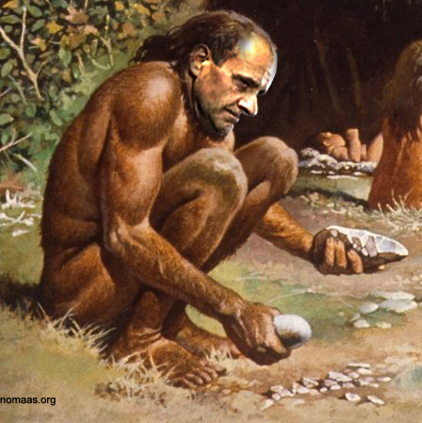
The Relative Trade-Offs
(A wholly inaccurate but fully management-compliant graph)
“accuracy”
Differential gains +
uv-plane subtraction
Differential gains +
A-proj or facets
“Global” model fit +
uv-plane subtraction
“Global” model fit +
A-proj or facets
Traditional
FFT-based
imaging
“efficiency”
(# of DoFs, scalability)

Slide 40
DDEs vs. Source Structure
We've been taking sky models for granted
In real life, these need to be bootstrapped from the observations themselves.
...where it can be very difficult to decouple DDEs from spatial source structure.
  Our QMC2 field has point-like sources only
Unmodeled source structure...
  ...is either partially absorbed into differential gain solutions
  ...or else contaminates the “global” model fits

Slide 41
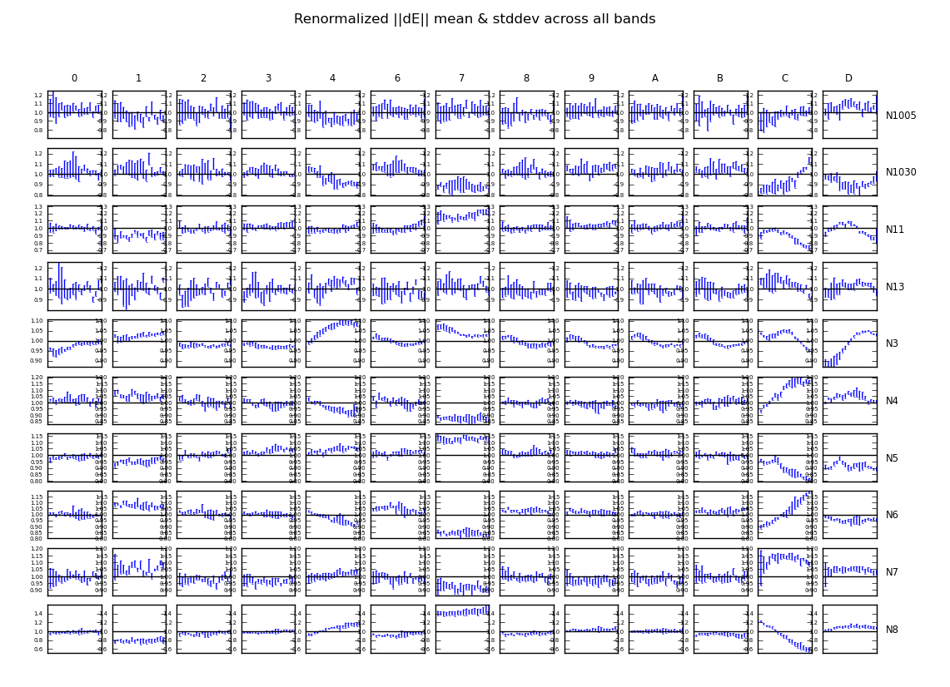
DDEs vs. Source Structure II:
(an example from a different observation)

Slide 42
Conclusions
Differential gains work
  ...slowly
“Global model” DDE solutions (pointing selfcal, DFT pointing, etc.) work faster
  ...but less accurately
Can be combined / traded off
Accuracy limited by models, so
  KNOW THY BEAMS!
  DEAL WITH THY SOURCE STRUCTURE!

