Slide 1
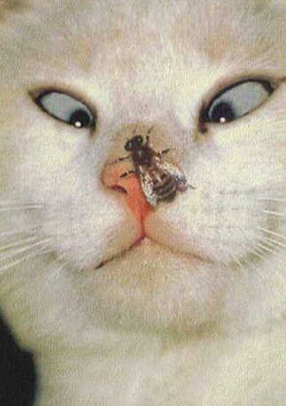
BeamSims:
Are Unstable Primary Beams
Going To Bite Us In The X?
(And what is X, anyway?)
(And should you be worried?)
O. Smirnov, G. Heald (ASTRON), L. Schwardt, J. Horrell (SKA SA), B. Frank (UCT), I. Heywood (Oxford), T. Willis (DRAO),
B. Veidt (U. Calgary) M. Ivashina (Chalmers U.)

Slide 2
Project Overview
Characterize the impact of primary beams (PB) on a number of upcoming telescopes
  MeerKAT, APERTIF, ASKAP, SKI-hi
  LOFAR & EMBRACE
Develop simulations framework and figure out some figures of merit (FoM)
  different depending on science
  Imaging DR, spectral DR, polarization purity, etc.
CASA: setup of measurement sets, imaging
MeqTrees: simulation & calibration

Slide 3
Why Beams?
Selfcal deals with direction-independent effects (DIEs), as we go deeper we need to deal with DDEs.
Of these, PB variation is the “scariest”
  at low frequencies: ionosphere
PBs vary in time and between antennas
  Az/el: rotating sky
  Pointing error
  Wind/gravity/thermal deformations
  PAFs: element LNA gains

Slide 4
Why worry?
PB variation translates into time-variable DDE (different towards each source)
  imaging artefacts: DR limit
  DD bandpass: spectral DR
  DD (and time-dependent) instrumental polarisation
Implication for transients?
  Overall quality of calibration
  Sources rotating through nulls (or steep parts of the PB)

Slide 5
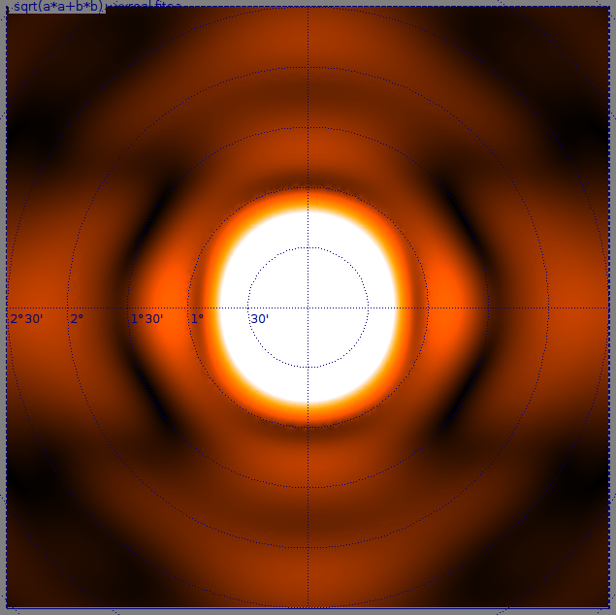
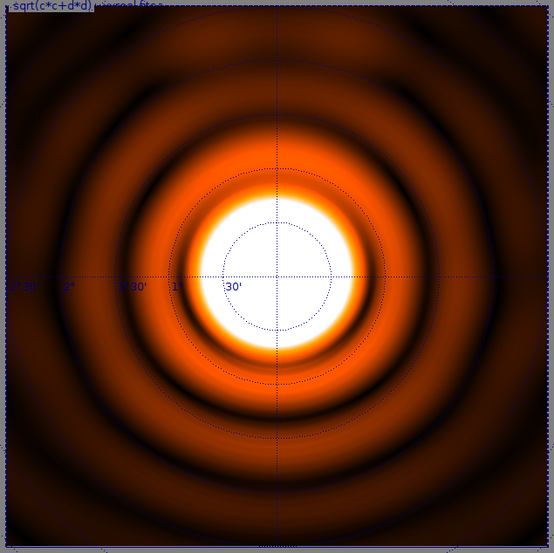
MeerKAT Beams prime-focus vs. gregorian

Slide 6
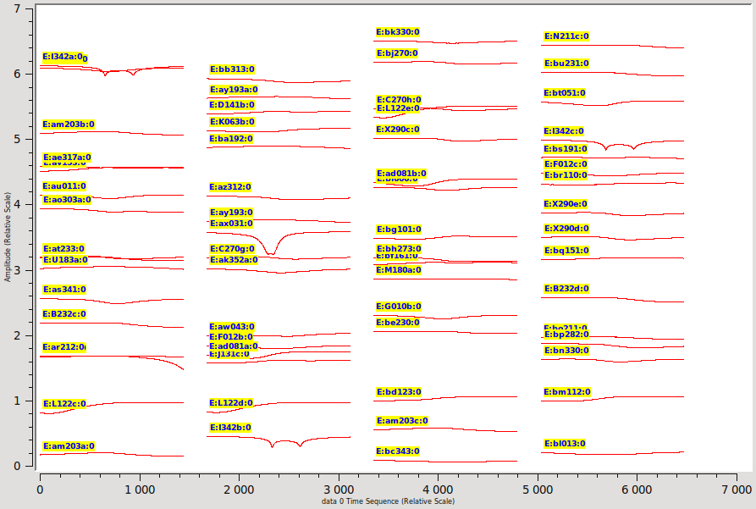
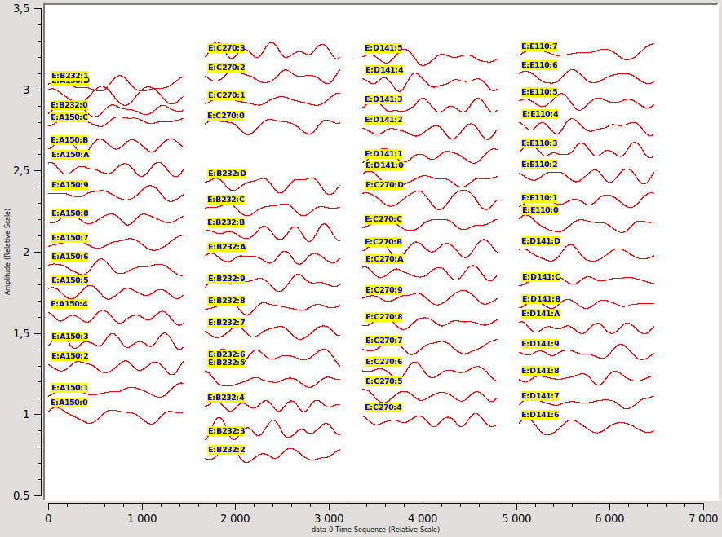
Beam gain (E-Jones, Exx) per source/antenna as a function of time

Slide 7
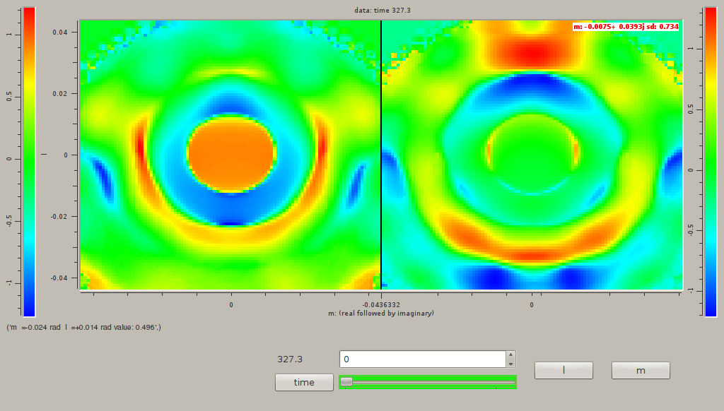
(Very preliminary) APERTIF beams
Off-axis compound beam, simple max-SNR weighting. LOTS of room for improvement here, so do not be alarmed.

Slide 8
What Can Be Simulated Today
Beam patterns specified via FITS files
  e.g. MeerKAT, APERTIF, ASKAP etc. beams from EM simulations
Full Jones formalism (incl. cross-terms)
Sky rotation (w.r.t. beam pattern)
Pointing error, thinking about deformation
PAF beam forming
  Including element gain drifts
Sky: images, point sources, Gaussian components
  including transients

Slide 9
What Can't Be Simulated (For Now)
Cannot apply pointing error (& other image-plane effects) to images
  A-deprojection required (hopefully UCT will help)
For now, done on a per-source basis, expense (CPU, RAM) scales as Nsrc×Nbaselines
For MeerKAT, can reasonably do 20~100 sources

Slide 10
Simulation Strategy
Simulated sky split into
  “bright” vs. “faint”
  “known” (“calibration model”) vs. “unknown”
“Faint” sky simulated w/o errors for performance reasons
“Bright” sky simulated with full errors
Perform calibration using the known calibration model
Evaluate our ability to recover the “unknown” sky properly

Slide 11
BeamSim Simulation Pipeline*
*) just a shell/Python script actually
FITS
images
≈
CASA/
lwimager
“unknown” sky
MS
MeqTrees
Cal script(s)
Beam patterns,
error levels,
etc.
MeqTrees
Sim script
“known” sky
“known” sky
CASA
sm
Array config &
observational
setup

Slide 12
BeamSim Results
No hard answers yet
  GIGO syndrome: need real numbers for errors such as pointing, etc.
Differential sims already meaningful
  How does setup A differ from setup B, assuming everything else is identical?
  What's the difference with and without effect X?
Very early result (from this Monday)

Slide 13
MeerKAT vs. WesterKAT
WesterKAT: WSRT with MeerKAT gregorian offset dishes
  14 antennas, 12 hour synthesis
  sky rotation and 40'' pointing error
64-dish MeerKAT, same dishes
  2 hour synthesis
  sky rotation and 40'' pointing error
3C147 field
  Sky models readily available
  Everyone knows & loves 3C147

Slide 14
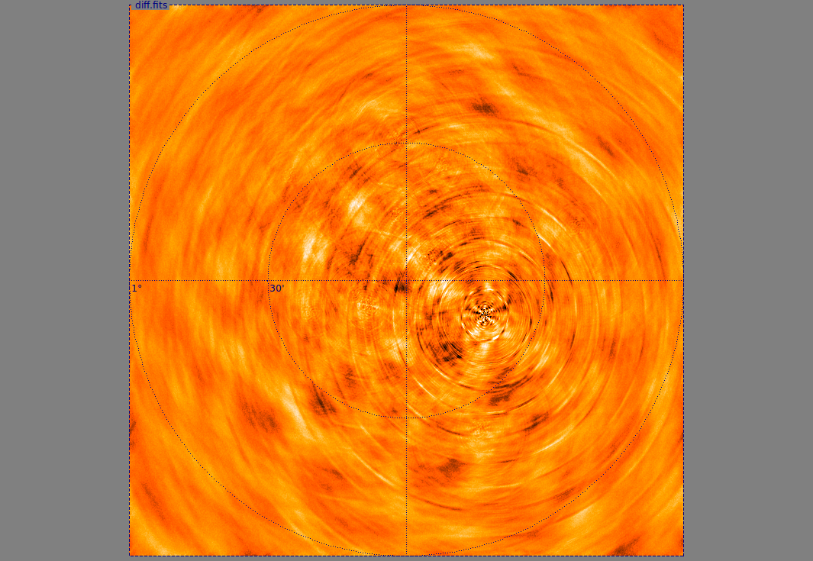
WesterKAT off-axis imaging artefacts
limits
±75 μJy
σ =15 μJy

Slide 15
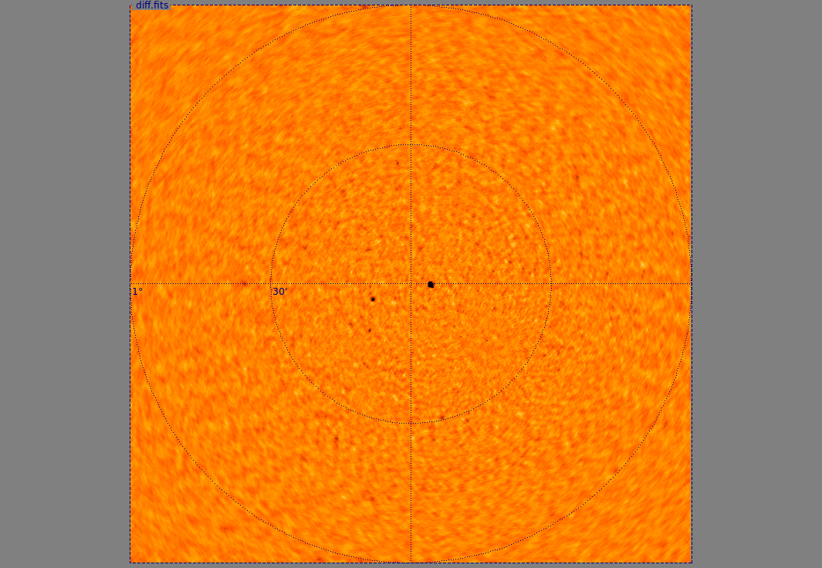
MeerKAT off-axis imaging artefacts
limits
±75 μJy
σ =10 μJy

Slide 16
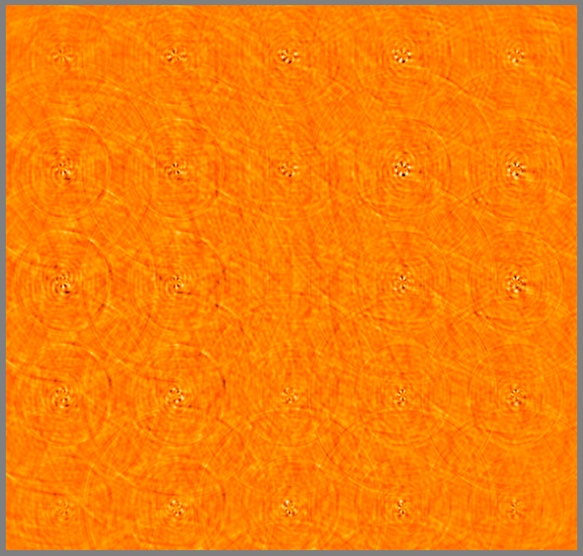
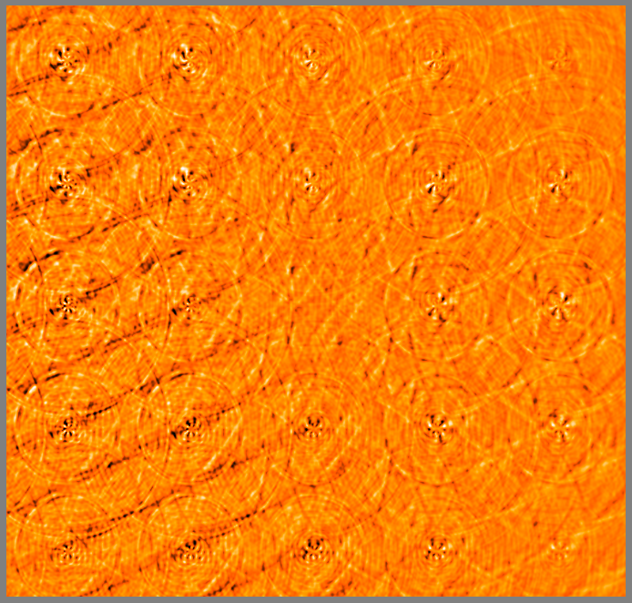
APERTIF
“Gridded skies” showing calibration residuals as a function of position for an on-axis and an off-axis compound beam.

Slide 17
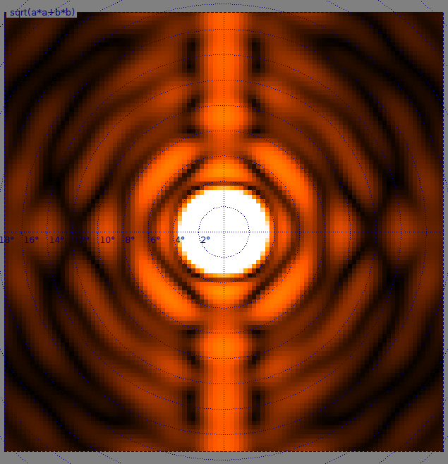
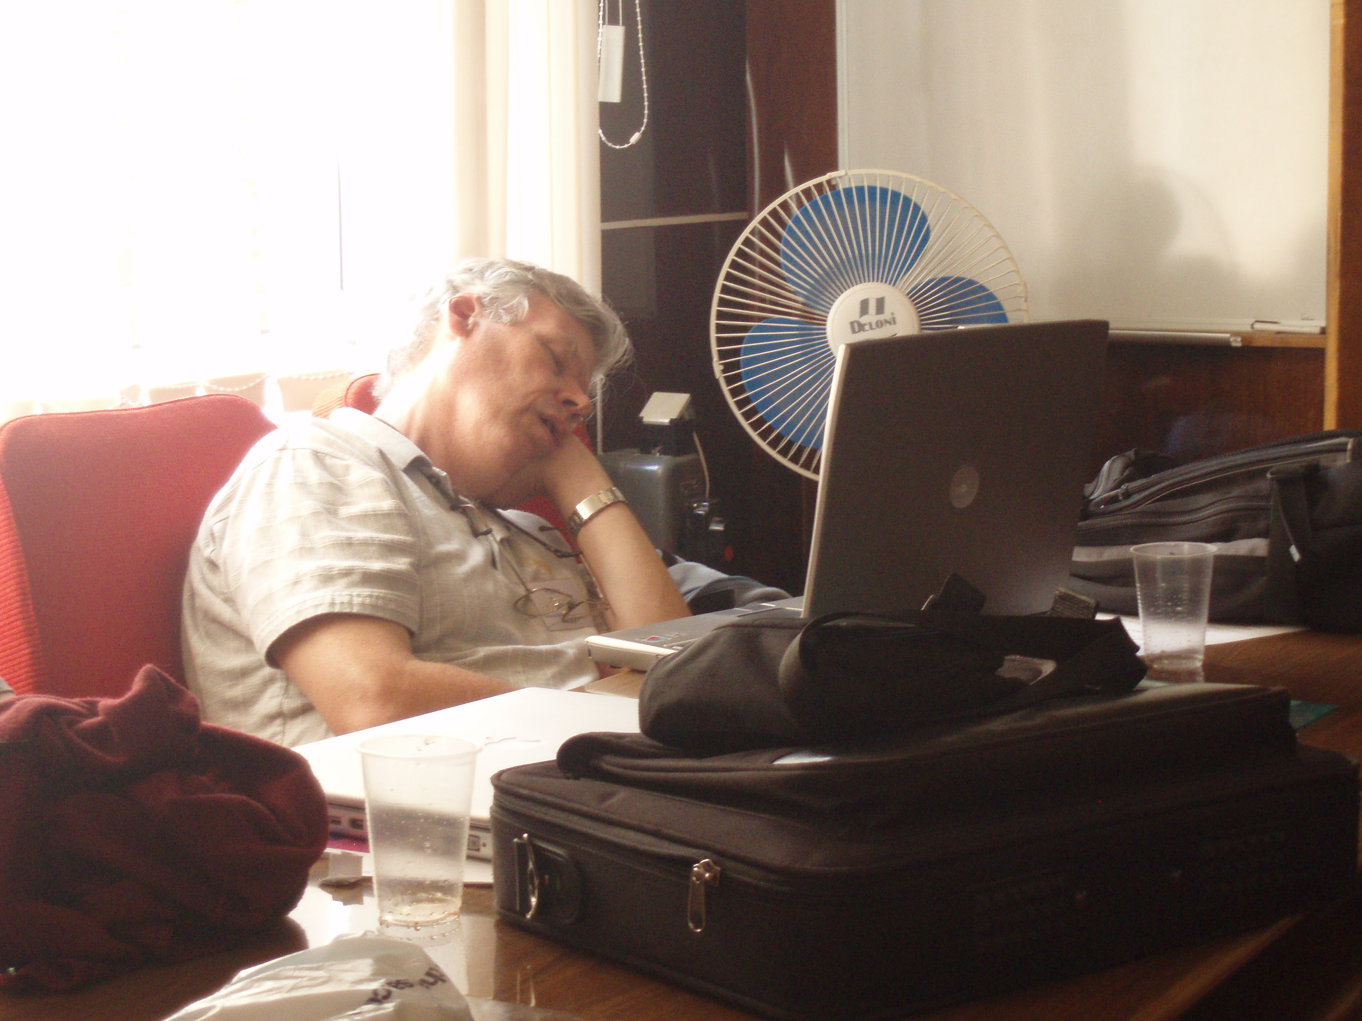
ASKAP Beams
Lead: Tony Willis, DRAO
Tony concentrating on a particularly difficult point of Oleg's MeqTrees talk.
Puschino, Russia
(AJDI 05/08/2007)

Slide 18
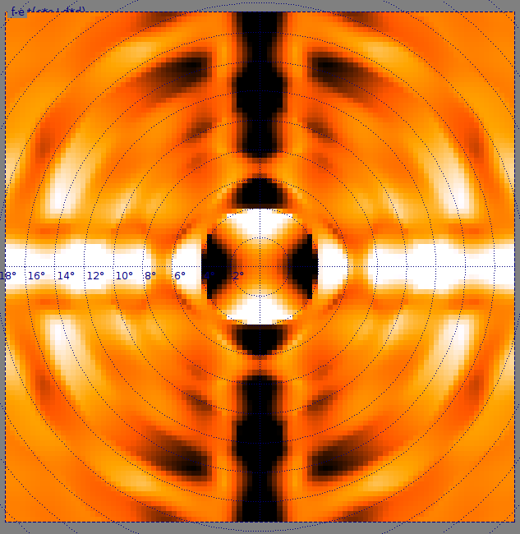
ASKAP Issues
POSSUM (Polarisation Sky Survey of the Universe's Magnetism)
  Co-PI: Russ Taylor, U. of Calgary
  Instrumental polarization (and its stability) critical
The Willis simulations:
  ASKAP project provides the
  PB patterns
  UC provides polarized skies
  Tony develops MeqTrees scripts
  & runs simulations
ASKAP Exx & Eyy-Exx

Slide 19
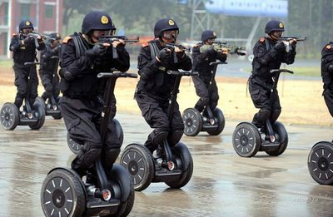
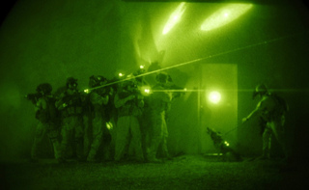
ASKASS Strikes
In an audacious raid, the Australian SKA Secret Service descends on the Willis residence and confiscates the top-secret ASKAP beam patterns.

Slide 20
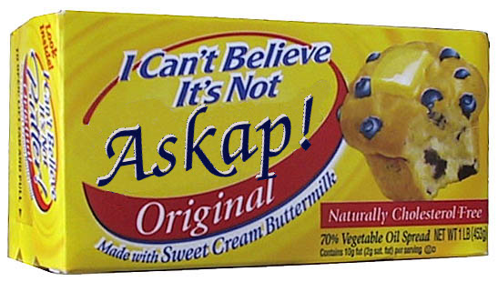
NASKAP
Despite this setback, answers still needed, not (currently) provided by ASKAPsoft
Tony & Bruce Veidt to simulate from scratch an instrument that is NOT ASKAP, but acts just like one

Slide 21
What We Can Do For You
Brad has a working MeerKAT sim pipeline
Some scaling issues, but simple stuff readily available
  Sky images + a few point sources
Want a snapshot or a transient sim?
  Give us a sky image and a source list (can even do transient sources, light curves etc.)
  Bribe Brad

