Slide 1

Subtracting Foreground Sources In The Presence Of DDEs
O. Smirnov (ASTRON)

Slide 2

The Good:
3C147 @21cm
Single 12h
WSRT synthesis
22 Jy peak
13.5 μJy noise
1,600,000:1 DR
Deep enough to
show DDEs, even
with WSRT's
ultra-stable
design.

Slide 3
The Bad:
Direction-Dependent Effects
Ionosphere
Beam patterns
  Sky rotation (unless an equatorial mount is used)
  Pointing errors, dish deformation, other uncertainties
  Heterogeneous arrays
How to calibrate?
How to remove or correct?
  Cannot correct visibilities!

Slide 4
The Radio Interferometer Measurement Equation (RIME)
(The Jones formalism, and why an interferometer does NOT actually measure a Fourier transform, on a single slide.)
Interferometric response to a single source:
Response to the full sky:
DDEs: Direction-dependent effects
(a.k.a. image-plane, or off-axis effects)
Fourier
transform
DIEs: direction-independent effects
(a.k.a. uv-plane effects, or on-axis effects)

Slide 5

The Ugly: The Ghosts of Cyg A
WSRT 92cm observation of J1819+3845 (Ger de Bruyn)
String of ghosts from brightest source to CygA
(20° away!)
Perfectly circular
Present in all 8 bands
Position and size distribution does not depend on frequency
Wasn't clear if they were “in the data”, or a calibration artifact

Slide 6

2010: Spotted Again
WSRT 21cm observation
String of ghosts connecting dominant sources A (220 mJy) and B (160 mJy)
Second, fainter, string from source A towards NNE (Do not cross the streams!)
Qualitatively similar to
2004 ghosts

Slide 7
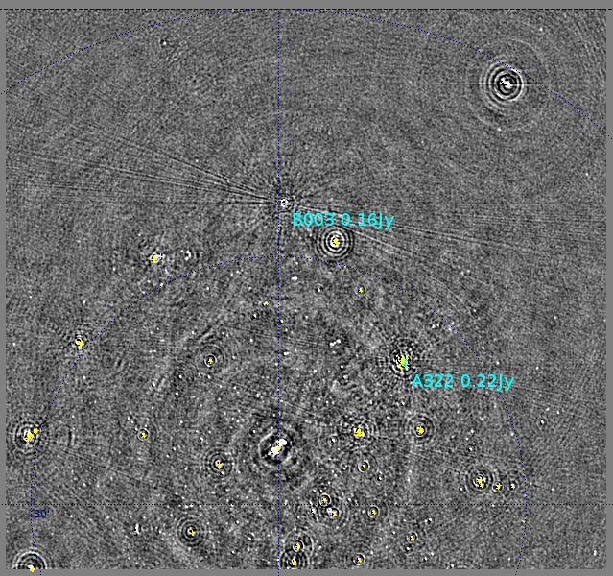
And Busted...
(so now we know what causes them)
Ghosts are caused by selfcal contamination, or the contamination of our calibration solutions by unmodelled flux.

Slide 8

WSRT = 240 nJy

Slide 9

VLA = 93 nJy

Slide 10
The Ugly: Ghosts & Backgrounds
Ghosts are caused by errors in the calibration model:
  Unaccounted-for DDEs
  Missing flux in the sky model
They are present in every single interferometric image ever made by selfcal
  ...but usually buried in the noise
Is this a concern for statistical detection of sub-noise signal (EoR?)

Slide 11
The Good:
3C147 @21cm
Single 12h
WSRT synthesis
22 Jy peak
13.5 μJy noise
1,600,000:1 DR
Deep enough to
show DDEs, even
with WSRT's
ultra-stable
design.

Slide 12
Differential Gains
Use a per-source solvable term to capture the DDE in that direction:

Slide 13

Differential gain solutions as a function of time
High SNR, temporal continuity
...even on moderately faint sources
...which suggests we can use them as
calibration beacons

Slide 14

The “QMC” Experiments: recovering a deliberately introduced DDE
Find a field containing a cluster of moderately bright sources
Introduce deliberate (and secret) pointing errors into a few WSRT antennas
Attempt to recover pointing errors by solving for differential gains

Slide 15
Pointing Errors
Traditionally, we assume each antenna in the interferometer observes the true sky attenuated by the same antenna beam pattern |E|²(l,m):
P.E. shifts this pattern by a per-antenna offset:

Slide 16

The Effect Of Pointing Error

Slide 17

Differential Gains To The Rescue

Slide 18

QMC2 Differential Gain Solutions
Differential gain-amplitudes
as a function of time
Rows = sources
Columns = antennas
The mispointed antennas
are rather obvious

Slide 19

“Rogues Gallery” Plot

Slide 20
The DoF Problem
Differential gains produce beautiful images, but at a cost:
  Selfcal: 1 complex gain per feed
  DGs: +1 complex gain per antenna, per source
  Only reasonable to use DGs for a small number of sources, otherwise we proliferate degrees of freedom
But, the underlying error can be modelled by only 2 parameters per antenna: Δlp,Δmp.

Slide 21
Solving For Pointing Offsets
Given a beam model, we can directly solve for pointing offsets
Pointing selfcal (S. Bhatnagar) is an algorithm for doing this quickly and approximately via FFT
Given a set of discrete sources, we can also do it precisely via DFT

Slide 22
The Effect Of Pointing Error

Slide 23

Solving For The Pointing Offset
Meaningful solutions obtained, but very little improvement to the images
Consistent with Sanjay's results

Slide 24

Pointing Error Solutions

Slide 25
Solving For The Pointing Offset

Slide 26

Pointing Offset + Beam Extent?
Adding a free “beam extent” parameter improves the map
Although the extent solutions are non-physical (±10%!)
Obviously, the extra DoF compensates for something else, but what?

Slide 27
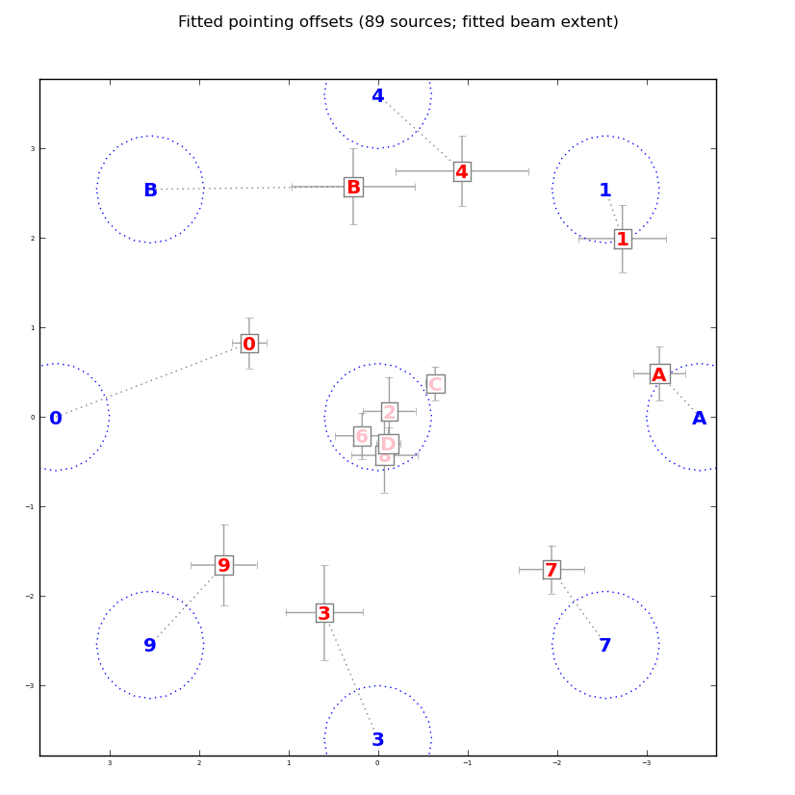
New (8-way Mispointed) Observations
Short (90 minute) observation with 8 antennas mispointed by the same amount, to 8 points of the compass
Can't image, but can solve for pointing offsets
This plot: pointing solutions, with a free beam extent parameter

Slide 28
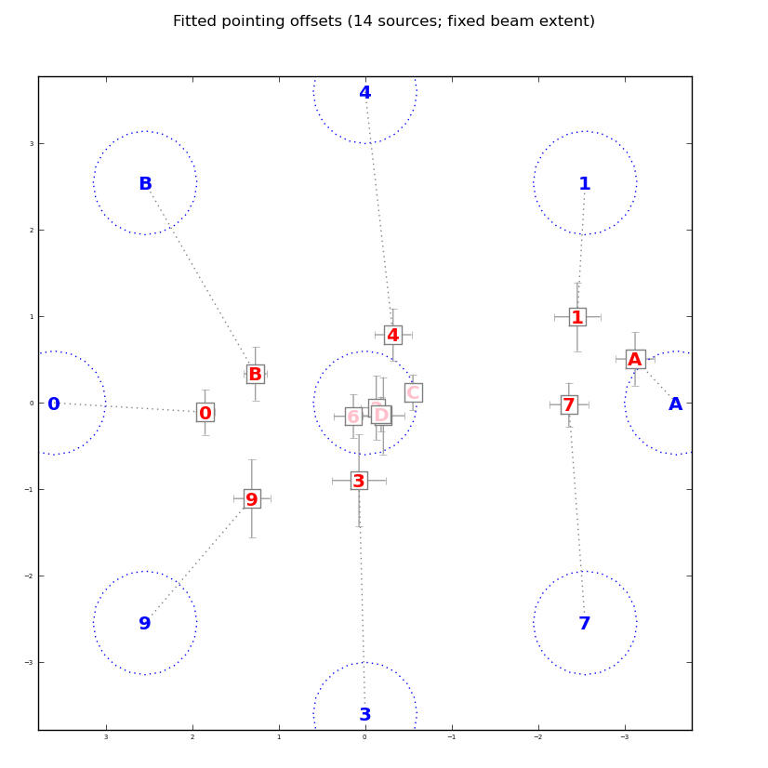
New (8-way Mispointed) Observations
This plot: pointing solutions, without a free beam extent
“Beam extent” is not physical, obviously compensates for some other inadequacy in our beam model
The WSRT beam is not that well known!
More work needed...

Slide 29
Conclusions
If you're not terrified by DDEs, you should be
Differential gains can address DDEs
  ...but only for a handful of the brighter sources
Fainter sources can be used to solve for parameterized DDEs
  e.g. pointing offsets
...but this is only as good as the (beam) model, so accurate models are crucial.
And this is why we're gathering on that beach in Portugal.

