Slide 1
To Be Announced
by Candidate Confirmed
(A Leading University)

Slide 2


Calibration, DDEs and New Science With New & [Very] Old Instruments
Oleg “not Olaf” Smirnov
osmirnov@gmail.com

Slide 3

DDEs WSRT-Style
(Luxury Problems?)
3C147 @21cm
Single 12h
WSRT synthesis
22 Jy peak
13.5 μJy noise
1,600,000:1 DR
Deep enough to show
DDEs, even with WSRT's
ultra-stable design.
Cleaned up via application
of differential gains.
NB: this is a typical HDR
observation.

Slide 4

Differential Gains & MeqTrees
MeqTrees: a software package for implementing arbitrary measurement equations
For example:

Slide 5
A.k.a. “The Flyswatter”
The Good: it swats sources
  Point-and-shoot: dE's can completely eliminate contaminating sources, making for great maps.
The Bad: it swats sources
  Mashes together all information on both the source and all DDEs towards it
The Ugly: it proliferates degrees of freedom
  Both fundamental and computational limits on how many dE's you can have
  What does this do to our residuals??

Slide 6

The Ugly, continued...
...and makes no use of spatial continuity.
So we'd really like to learn to fit some “global” DDE models instead
Example: 3C147 field, dE-phase solutions:
WTH is
it doing
that?

Slide 7
The QMC* Project
Pick a field containing a cluster of reasonably bright off-axis sources
Observe with WSRT @21cm
Introduce deliberate (and secret!) pointing errors during observation
Attempt to recover these during the reduction
*) Named in honour of the now-defunct WSRT Quality Monitoring Committee. Yes, the Dutch do love to establish committees. Fortunately, so do the Russians.

Slide 8

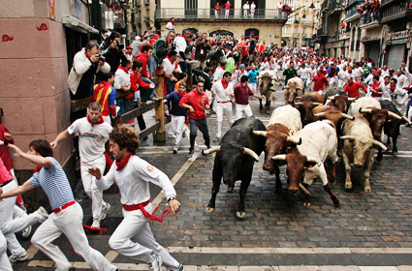
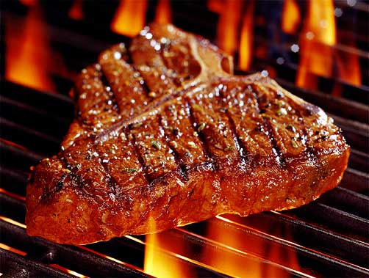
The QMC2 Field (01515+6736)
(a radio astronomer's worst nightmare)
>10 moderately bright off-center sources
The type of field that usually has radio astronomers running away screaming...
But perfect for our purposes!

Slide 9

QMC2 2010Jul21
||dE|| solutions suggest a static mispointing of RT2, RT6, RT8
...and a time-variable mispointing of RTB
(“the Easter egg”)
Observatory confirmed that this was consistent with the mispointings they had put in.

Slide 10

“Rogues' Gallery” Plot
Plots of mean ||dE|| per antenna, at proper positions within the field.
Colour/size indicates
||dE||>1, <1.

Slide 11
Solving For Pointing Errors
||dE|| plots are a reliable indicator of mispointing
  But only a very rough one...
Can we recover the actual pointing offsets?
A MeqTrees variation on pointing selfcal: DFT pointing solutions (see also “pointing selfcal” by S. Bhatnagar)
MeqTrees can “solve for anything”: we need to construct a suitable model where the pointing offsets are parameters, then designate them as solvable and say “go”.

Slide 12
DFT Pointing Solutions

Slide 13

Know Thy Beams
P.E. solutions underestimated, unless we introduce an extra solvable “beam scale”
Which makes no sense physically
Obviously the extra degree of freedom is compensating for something else.
Conclusion: P.E. solutions are severely limited by the accuracy of the primary beam model.
...as are the final images: KNOW THY BEAMS!

Slide 14


A Different Observation
(8 antennas mispointed in 8 directions)
Plot of actual vs. fitted pointing offsets
With a solvable beam extent
Without a solvable beam extent
WTH is
it doing
that?

Slide 15

Yet Another Twist: Solving For P.E.
On Shorter Time Scales
Solutions every 30 sec, 2.5 min and 5 min.
Longer time scales: decreased variance (higher SNR)
Diminishing returns above 5 min.
Show a striking feature unnoticed on the previous
(30 min) plots...

Slide 16
Yet Another Twist: Solving For P.E.
On Shorter Time Scales
Solutions every 30 sec, 2.5 min and 5 min.
Longer time scales: decreased variance (higher SNR)
Diminishing returns above 5 min.
Show a striking feature unnoticed on the previous
(30 min) plots...

Slide 17

And Now, Applying Sophisticated
Model Fitting Techniques...

Slide 18
And Now, Applying Sophisticated
Model Fitting Techniques...
Westerbork Wobble!
WW

Slide 19

The Wobble
A periodic (~20 min) variation in the pointing by 10-20 mdeg.
Shows up in other observations, on other antennas (to varying extent)
We can identify dominant “wobbly modes” by taking a Fourier transform of the P.E. solutions, and examining the amplitudes:

Slide 20
Wobbling Across 5 Epochs

Slide 21

More Scary Stories:
The Ghosts Of Cyg A (2006)
WSRT 92cm observation
of J1819+3845 by
Ger de Bruyn
String of ghosts from brightest source to CygA
(20° away!)
Perfectly circular
Present in all 8 bands
Position and size distribution does not depend on frequency
Wasn't clear if they were “in the data”, or a calibration artifact
WTH is
it doing
that?

Slide 22
Ghostbusters, The Movie
Turns out that when we calibrate, we always produce such artefacts, and then proceed to bury them in the noise (i.e. sweep them under the carpet)
The Second Law Of Smirnov: if you think you understand interferometry, you're not doing it enough.

Slide 23
An Inconvenient Question
All very interesting and
challenging for it own sake,
but where's the science?
That is, what results has
this enabled that we
couldn't have achieved
otherwise?

Slide 24

An Inconvenient Question
The answer (as of 6 months ago) was, not very much
But if so, then high DR...
  ...consumes an excessive amount
  of time and resources
  ...and is only good for showing off?
Is it the trophy wife of
radio interferometry?
(of course not, EoR detection would be inconceivable without it, see talk by Leon)

Slide 25
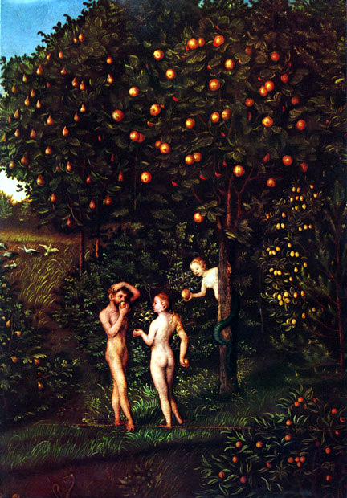

The Tree Of Radio Astronomical Knowledge
EoR
SKA
25 years of selfcal have conditioned us to go for the low-hanging fruit
  Which have been plentiful
And it is only now that new instruments and new algorithms are forcing us to reach higher
LOFAR,
MeerKAT
3GC
2GC (selfcal)
Lucas Cranach The Elder, “PhD supervisor enticing gullible students to take on a First Light Shared Risk research project”, oil on canvas, first half XVI cen.
1GC

Slide 26

Example 1: EVLA 8 GHz, WHDF
(Courtesy of Ian Heywood)
EVLA 8 GHz: Looking for sub-mm galaxies and QSOs in the William Herschel Deep Field.
Dominant effect: bright calibrator source rotating through first sidelobe of the primary beam.
(This also has a horrible PSF, being an equatorial field.)
This is your science
(good luck!)
This is your
phase calibrator
Brightness scale 0~50μJy

Slide 27

Keep Your Friends Close, and your calibrators as far away as you can...
An approximation of the primary beam response, overlaid on top of the image.
As the sky rotates, the sidelobes of the PB sweep over the source, thus making it effectively time-variable.
This is your science
(good luck!)
This is your
phase calibrator
(Brightness scale 0~50μJy)

Slide 28

Deconvolution Doesn't Help...
Residual image, after deconvolution.
The contaminating source cannot be deconvolved away properly, due to its instrumental time-variability.
...5 years ago this would observation would probably be a complete write-off.
(Brightness scale 0~50μJy)

Slide 29

Differential Gains To The Rescue
Residual image after applying differential gain solutions to the contaminating source
Brightness scale 0~50μJy

Slide 30

Multi-Band Image
Multi-band residual image:
noise-limited, no trace of contaminating source.
Phase calibrator
used to be here
Brightness scale 0~50μJy

Slide 31
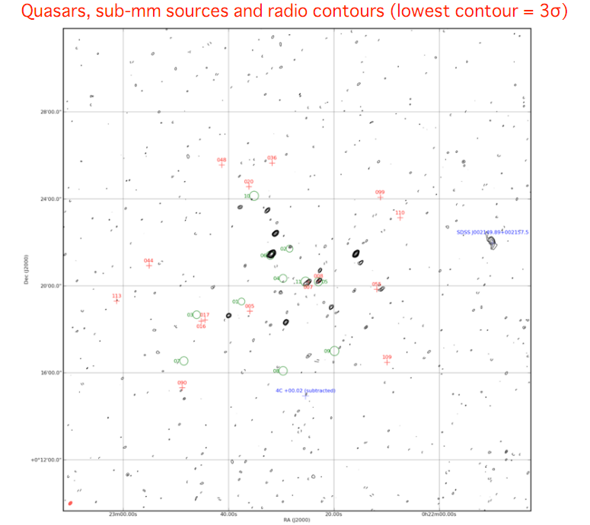

Slide 32
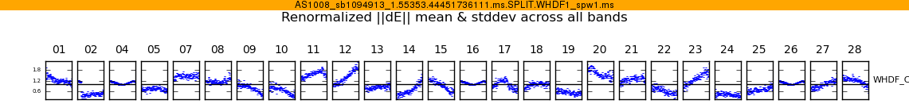
WTH Is It Doing That?
Above: Differential gain-amplitude solutions, as a function of time, per each antenna.
To first order beam patterns are identical across antennas and rotate the same way, so why the huge differences?
Answer: small pointing errors.
This is your science
(good luck!)
This is your
phase calibrator
Not a bad spot to put a calibrator in --
– it's The Worst Place In The World
to put a calibrator in.

Slide 33
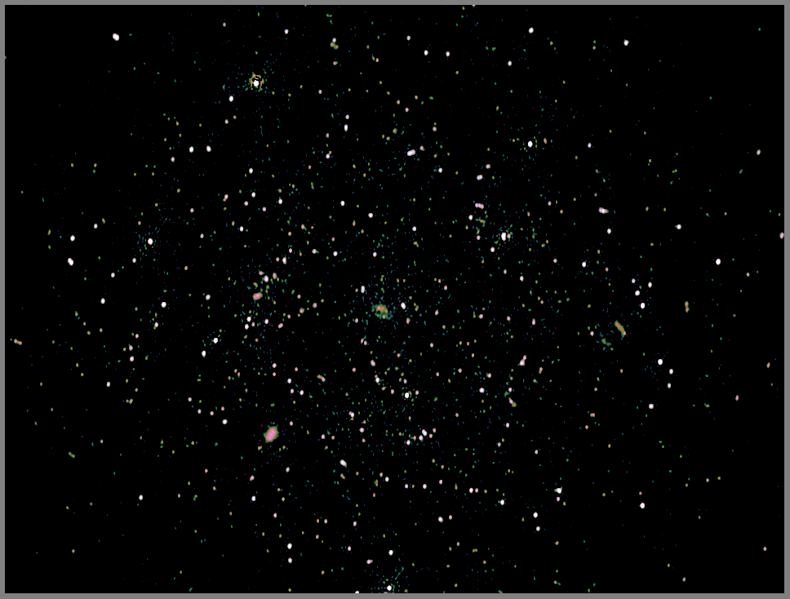
Example 2: Galaxy Clusters,
Radio Halos & Relics (PI: R. Pizzo)
a.k.a. “The Italian Job”
See talks by Chiara, Sergio
WSRT multi-wavelength project (18, 21, 25, 92cm).
Looking for very faint extended emission.
Very steep spectrum, so mostly visible at 92cm...
! ...where DDEs (from the ionosphere) are at their worst.
! Lots of bright sources in the field.

Slide 34
Abell 773: Preliminary Results
Reduction of a single 92cm band (6x12h), so only 1/8th of the data
  ...initial reduction done just two weeks ago
Extremely preliminary results, so not to be revealed outside this room

Slide 35
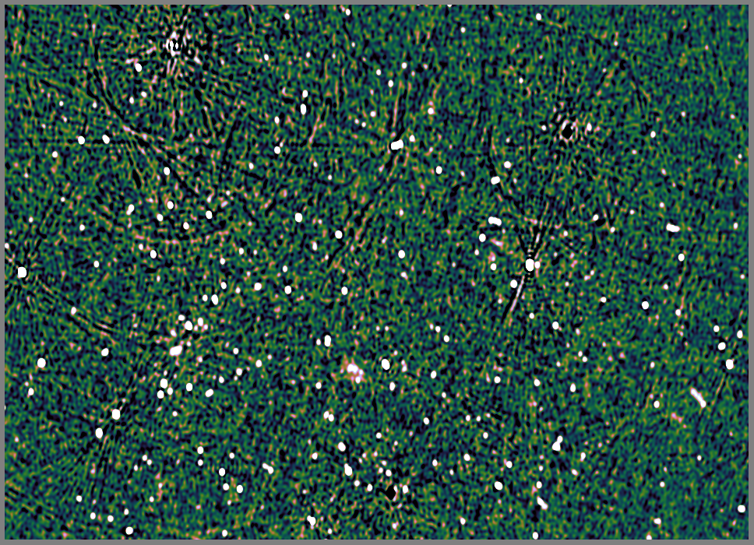
A773: Classic Selfcal + Peeling

Slide 36
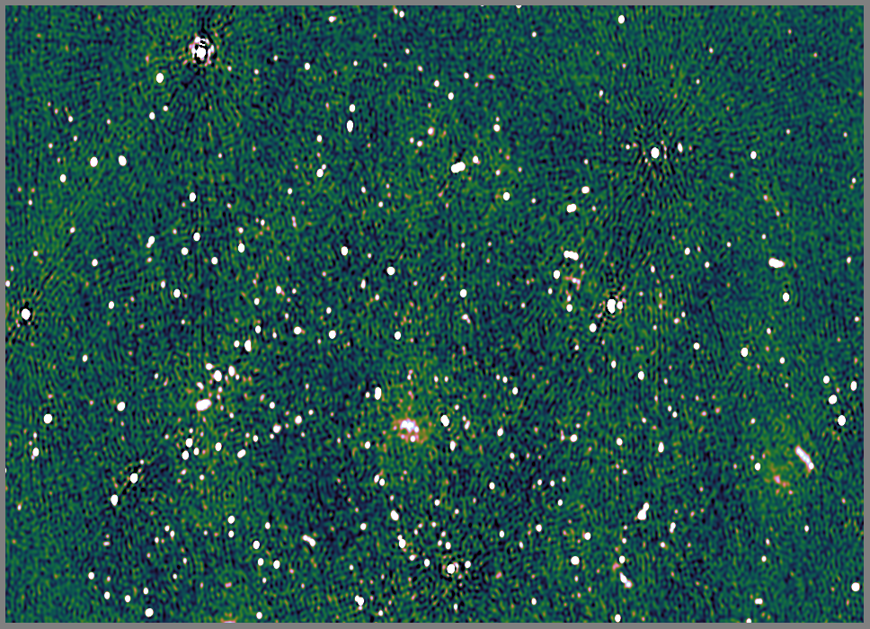
A773: Differential Gains ++

Slide 37
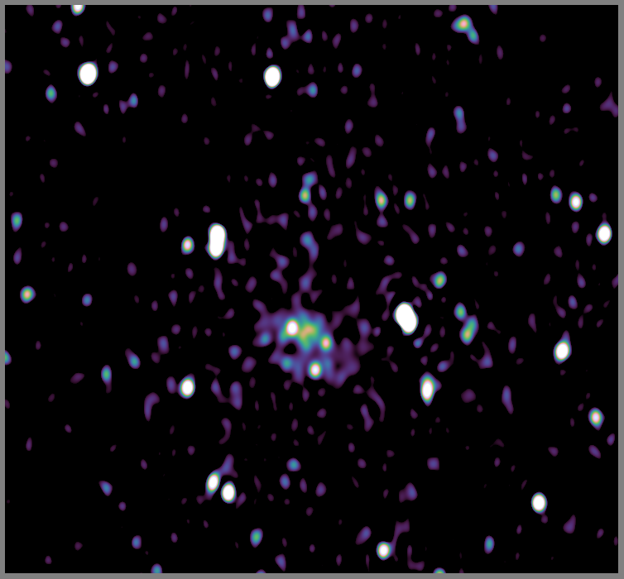
...and zooming in
Threshold .6 mJy (~3σ)

Slide 38
In Conclusion: Where To Now?
In terms of algorithms and techniques, there's a real “3GC Revolution” going on, driven by the new crop of telescopes
But every new breakthrough seems to spawn 10 more questions
We need better mathematics
  We don't even understand selfcal properly (e.g. ghosts!), and are only beginning to understand CLEAN
  Better deconvolution, better beam models
We need better algorithms and faster implementations
...But the scientific upshot is tremendous (and this is even before the new telescopes arrive!)

