Slide 1

Addressing
Direction-Dependent Effects
With MeqTrees
Oleg Smirnov, Ger de Bruyn

Slide 2
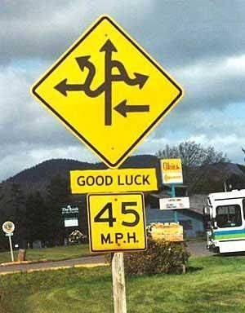
Introduction: DDEs
Direction-dependent effects (DDEs): effects that vary with direction on the sky, station (and time...)
  self-calibration solves for a single direction-independent gain per station
Beamshape variations (mispointing, sky rotation, beamforming effects, etc.)
Ionosphere (Bill Cotton's talk on Monday)

Slide 3

DDEs WSRT-Style
(Luxury Problems?)
3C147 @21cm
Single 12h
WSRT synthesis
22 Jy peak
13.5 μJy noise
1,600,000:1 DR
Deep enough to show
DDEs, even with WSRT's
ultra-stable design.
Cleaned up via application
of differential gains
using MeqTrees.

Slide 4

DDEs: Not Always a Luxury Problem
(Courtesy of Ian Heywood)
EVLA 8 GHz: Looking for sub-mm galaxies and QSOs in the William Herschel Deep Field.
Dominant DDE: bright calibrator source rotating through first sidelobe of the primary beam.
(This also has a horrible PSF, being an equatorial field.)
This is your science
(good luck!)
This is your
phase calibrator
Brightness scale 0~50μJy

Slide 5

CLEAN Doesn't Help...
Residual image, after cleaning.
The contaminating source cannot be deconvolved properly!
Brightness scale 0~50μJy

Slide 6

Differential Gains To The Rescue
Residual image after applying differential gain solutions to the contaminating source
Brightness scale 0~50μJy

Slide 7
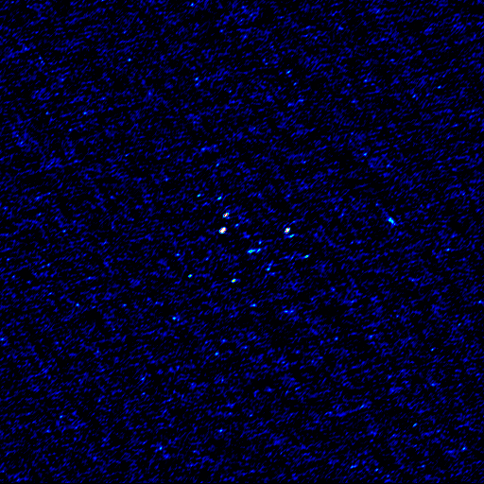
Multi-Band Image
Multi-band residual image:
noise-limited, no trace of contaminating source.
Phase calibrator
used to be here
Brightness scale 0~50μJy

Slide 8

Differential Gains & MeqTrees
MeqTrees: a software package for implementing arbitrary measurement equations
For example:

Slide 9
A.k.a. “The Flyswatter”
The Good: it swats sources
  Point-and-shoot: dE's can completely eliminate contaminating sources, making for great maps.
The Bad: it swats sources
  Mashes together all information on both the source and all DDEs towards it
The Ugly: it proliferates degrees of freedom
  Fundamental and computational limits on how many dE's you can have
  LOFAR EoR project: up to 60 per station

Slide 10

The Ugly, continued...
...and makes no use of spatial continuity.
So we'd really like to learn to fit some “global” DDE models instead (a-la SPAM and FBC)
Example: 3C147 field, dE-phase solutions:

Slide 11
The QMC* Project
Pick a field containing a cluster of reasonably bright off-axis sources
Observe with WSRT @21cm
Introduce deliberate (and secret!) pointing errors during observation
Attempt to recover these during the reduction
*) Named in honour of the now-defunct WSRT Quality Monitoring Committee. Yes, the Dutch do love to establish committees. Fortunately, so do the Russians.

Slide 12

The QMC2 Field (01515+6736)
(a radio astronomer's worst nightmare)
>10 moderately bright off-axis sources
Perfect for our purposes!

Slide 13

QMC2 2010Jul21
||dE|| solutions suggest a static mispointing of RT2, RT6, RT8
...and a time-variable mispointing of RTB
(“Hans's susprise”)
Hans confirmed that this was consistent with the mispointings he had put in.

Slide 14

“Rogues' Gallery” Plot
Plots of mean ||dE|| per antenna, at proper positions within the field.
Colour/size indicates
||dE||>1, <1.

Slide 15
Solving For Pointing Errors
||dE|| plots are a reliable indicator of mispointing
  But only a very rough one...
Can we recover the actual pointing offsets?
A MeqTrees variation on pointing selfcal: DFT pointing solutions (see also “pointing selfcal” by S. Bhatnagar)
MeqTrees can “solve for anything”: we need to construct a suitable model where the pointing offsets are parameters, then designate them as solvable and say “go”.

Slide 16
DFT Pointing Solutions

Slide 17

P.E. Solutions as a function of time
Recovered solutions consistent with deliberate mispointings, but underestimate them:

Slide 18

Not so impressive...
Residual image,
post-selfcal

Slide 19

A Marginal Improvement
Residual image,
post-selfcal,
with pointing error solutions
(Note how this relative lack of improvement is consistent with S.Bhatnagar's pointing selfcal results.)

Slide 20

Nowhere Near The Flyswatter...
Residual image,
post-selfcal,
with differential
gains.

Slide 21
Parameterizing The Beam
The advantage of the DFT approach is that we can introduce other parameters into the primary beam model.
Just as a random example, we can introduce a per-antenna beam scale sp:
And then treat sp as a solvable.

Slide 22
P.E. Solution Only
Residual image,
post-selfcal,
with pointing error solutions

Slide 23

P.E. + Beam Extent
Residual image,
post-selfcal,
with pointing error and beam extent solutions
...not as good as differential gains, but an improvement!

Slide 24


Now Back To The Pointing Plots
Beam “extent” and pointing offset solutions are strongly coupled
“Extent” solutions are non-physical (±10%!)
Pointing offsets are recovered better

Slide 25
Compare To The PE-Only Case
P.E. solutions without a beam “extent” show more variance
...and underestimate the true offsets
Obviously the extra degree of freedom is compensating for something else, but what exactly?
Tentative conclusion: P.E. solutions are limited by the accuracy of the beam model.
...as are the final maps: KNOW THY BEAMS!

Slide 26


A Different Observation
(8 antennas mispointed in 8 directions)
Plot of actual vs. fitted pointing offsets
With a solvable beam extent
Without a solvable beam extent

Slide 27

Yet Another Twist: Solving For P.E.
On Shorter Time Scales
Solutions every 30 sec, 2.5 min and 5 min.
Longer time scales: decreased variance (higher SNR)
Diminishing returns above 5 min.
Show a striking feature unnoticed on the previous
(30 min) plots...

Slide 28
Yet Another Twist: Solving For P.E.
On Shorter Time Scales
Solutions every 30 sec, 2.5 min and 5 min.
Longer time scales: decreased variance (higher SNR)
Diminishing returns above 5 min.
Show a striking feature unnoticed on the previous
(30 min) plots...

Slide 29

And Now, Applying Sophisticated
Model Fitting Techniques...

Slide 30
And Now, Applying Sophisticated
Model Fitting Techniques...
Westerbork Wobble!
WW

Slide 31

The Wobble
A periodic (~20 min) variation in the pointing of 10-20 mdeg.
Shows up in other observations, on other antennas (to varying extent)
We can identify dominant “wobbly modes” by taking a Fourier transform of the P.E. solutions, and examining the amplitudes:

Slide 32
Wobbling Across 5 Epochs

Slide 33
Conclusions I
Differential gains (dE's) can completely eliminate contaminating sources
  ...but only feasible for a few (tens) of sources
“Global model” DDE solutions (pointing selfcal, DFT pointing, etc.) are also feasible
  ...but don't (yet) eliminate artefacts to the same extent
The future is hybrid: high-DR imaging at SKA sensitivities will require:
  dE's (or some variation thereof) on Cat I sources
  “global model” DDE solutions on Cat II sources

Slide 34
Conclusions II
Pointing error solutions are limited by the PB model
  as are the remaining imaging artefacts
KNOW THY BEAMS!
Westerbork Wobbles, and we ought to figure out why (APERTIF is coming)

