Slide 1



The Fastest Selfcal In The West, or How Much LOFAR
Can You Calibrate
In 2 Minutes?
Stef Salvini (Oxford e-Research Centre),
Oleg Smirnov (ASTRON)

Slide 2
Contents
Algorithm
Application to Antenna Calibration
Selfcal
  WSRT
  LOFAR
  MeerKAT
  Juicy images

Slide 3
Algorithm
Some of the material already presented in December at AAVP
  Sorry ...
  Revised and extended since
O(N²) floating-point operations throughout
L₂ (least-squares) minimisation
  For minimizing || M – G D G^{H} ||2
    M: model; D: data; G: diagonal or block-diagonal
  Distance between model sky and calibrated observation
Accuracy and robustness
In particular w.r.t. Incomplete visibilities
  Missing baselines
  Partial cross-correlation
Limited dependency on the model sky complexity

Slide 4
The L₂ step
Levenberg-Marquardt etc. very expensive
ADI has very slow convergence
The new algorithm relies on “jumping” between different convergence curves
  Number of operations: O(N²)
  It relies on heuristics
    But so, much of optimization
  Theoretical foundations not altogether clear
  Currently not using weights
    Under consideration

Slide 5
Three Algorithms in one?
It can minimise
  difference between dominant eigenspaces of Model and observed visibilities
    Complex purging steps not described here (still O(N²))
  difference between model and observed visibilities (“brute force” – used for selfcal)
  difference between observed visibilities and leading eigenvalues of model
    Fastest and very robust

Slide 6
Some further considerations
From the measurement equation
Where
  Complex gain Γ is diagonal
Hence
  Error of phases only, unitary transformation: easy problem
  Error of gains: difficult problem – it “scrambles” the eigenvalues

Slide 7
Chilbolton LBA LOFAR Station
Chilbolton LBA LOFAR station data
  Thanks to Griffin Foster (OU)!
Channel 300: 58.4 MHz
  Other channels also available
  Sequence of snapshots
  Observations spaced by ~520 seconds
Model sky of increasing complexity
  2 sources
  500 sources
  5,000 sources

Slide 8
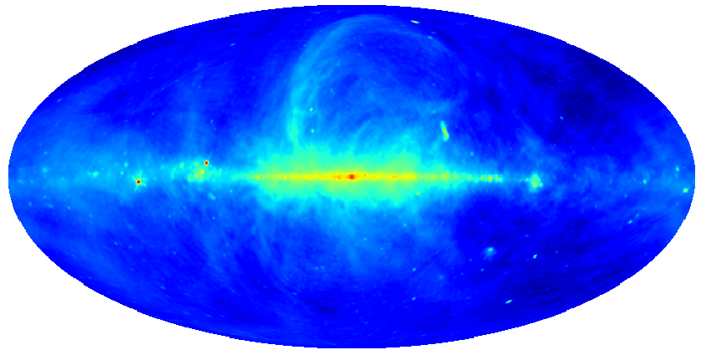
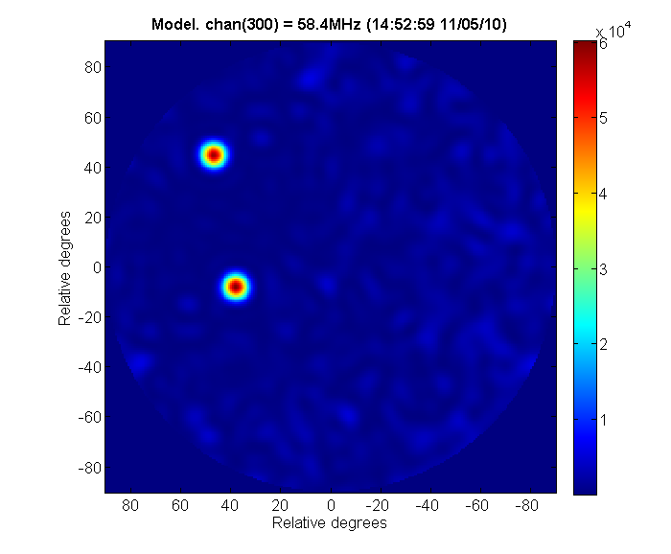
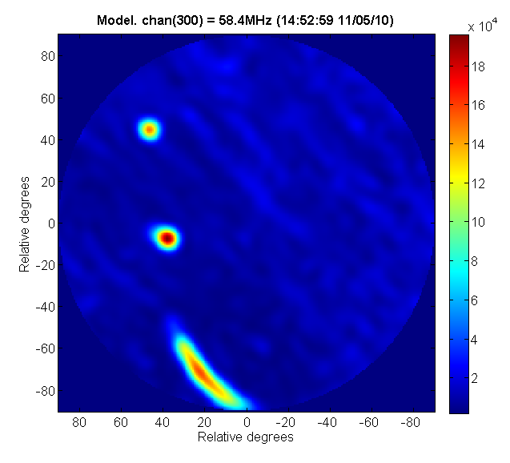
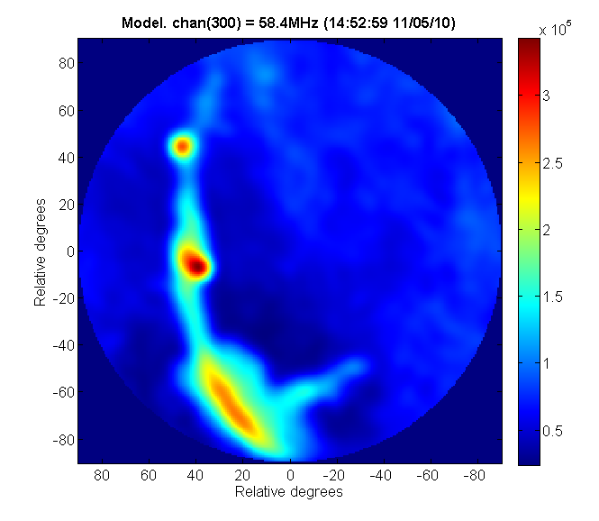
Model Sky
2 sources
500 sources
5000 sources

Slide 10
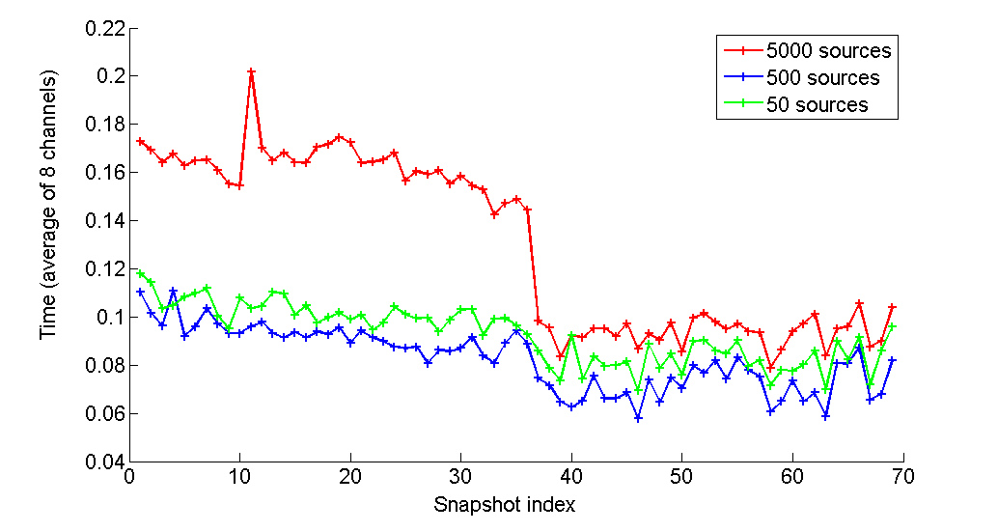
Timing and performance

Slide 11
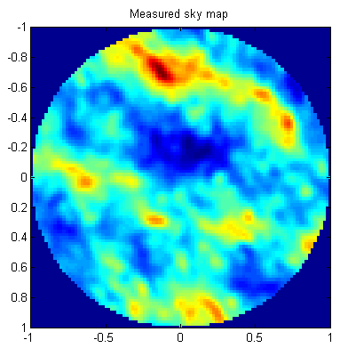
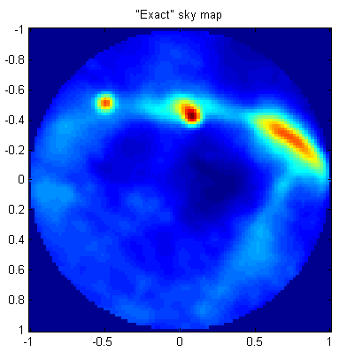
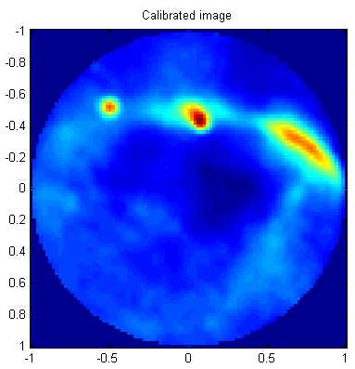
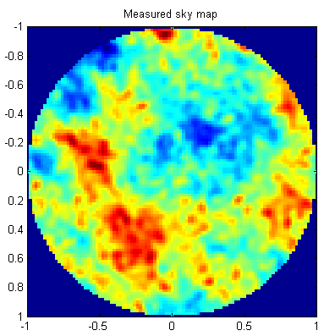
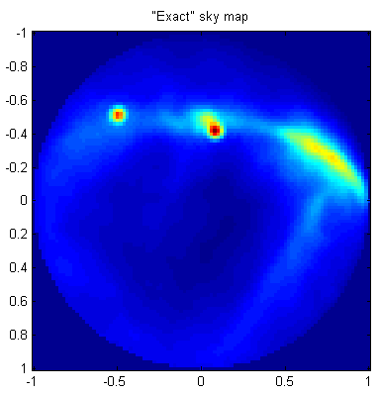

Simulated Sky
Observed
Exact
Calibrated
96 antennas
(LOFAR)
351 antennas
(~ SuperTerp)

Slide 12
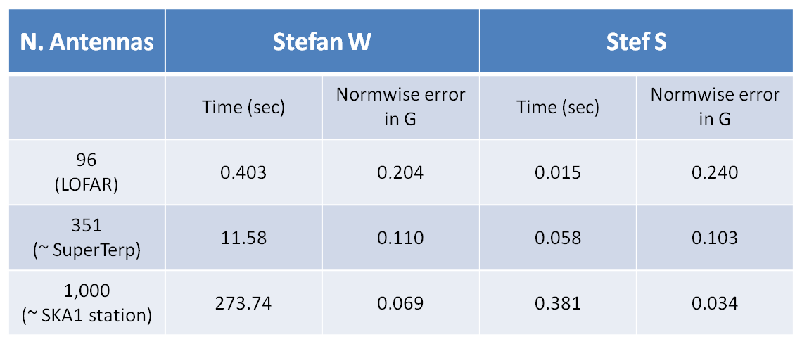
Some performance figures
Simulated sky (GSM – 25,000 sources) + receiver noise
200 sources used for calibration
MATLAB code
My own laptop (Intel Core 2 i7, 2.0 GHz, Windows)

Slide 13
Simulated Sky – missing baselines
Observed
Exact
Calibrated
96 antennas
(LOFAR)
351 antennas
(~ SuperTerp)

Slide 14
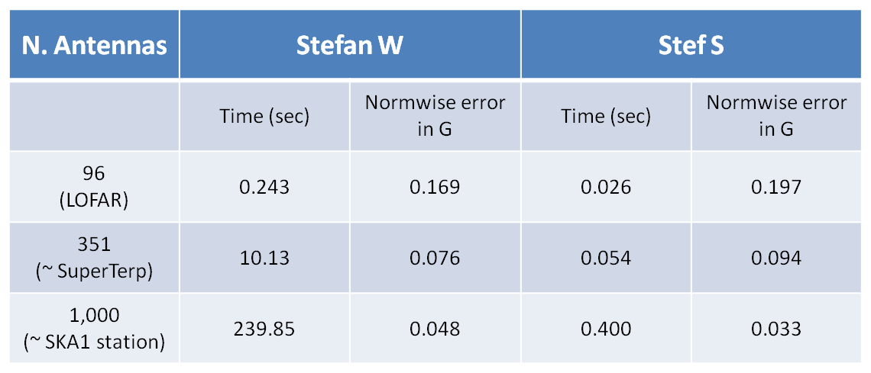
Some more performance figures
Same as previous table
Reduced baselines: (>= 35% of maximum baselines)

Slide 15
Stefcal: Adapting To Selfcal
The same math should (in principle) work for the interferometer calibration case
  i.e. use a prior sky model (LSM), and solve for per-station gains
Main difference is, everything is a function of frequency and time
  as opposed to single snapshot
Quick-and-dirty Python implementation now available in MeqTrees

Slide 16
Stefcal With WSRT
Using 3C147 as a test case
~1500 timeslots, 28 channels, 74 baselines
Runtime ~1m40s (of which ~half in the solver)
Compare to MeqTrees+LSQ selfcal: ~10m
  ...or just to regenerate the residuals (or corrected data) using prior LSQ solutions: ~3m
Faster to recalibrate than to load solutions!

Slide 17

But Are The Results Identical?
In a nutshell: YES
Same residuals (to all intents and purposes)
Remaining artefacts (both selfcal and stefcal):
  (DDEs)
  interferometer
  errors
MeqTrees can
solve for the
latter in a
separate pass, in
3~4m

Slide 18

Per-interferometer errors
Extended stefcal to solve for these too
Runtime: ~0s
Integrated into the regular solve loop at virtually zero cost
  (strictly speaking,
  need a second
  stefcal pass to
  apply)

Slide 19
Full-pol Stefcal
Original algorithm formulated for a “scalar” case
Dpq = Gp Mpq Gq^{H}
  where G's are diagonal
  (and this was used for the 3C147 reduction)
LOFAR needs 2x2 right off the bat
Reformulated the algorithm to use full 2x2 Jones matrices instead

Slide 20
LOFAR Double-Double
D-D observation (thanks, Manu)
  Flagged, demixed and averaged in time
  1240 timeslots (7h), 1 channel, 990 baselines
  ~40 sources in the LSM
Doing full 2x2 G-Jones solution w/o the beam
MeqTrees+LSQ runtime: ~15m
  (BBS ~30m)
MeqTrees+Stefcal: ~2m
  of which ~half in the solver

Slide 21
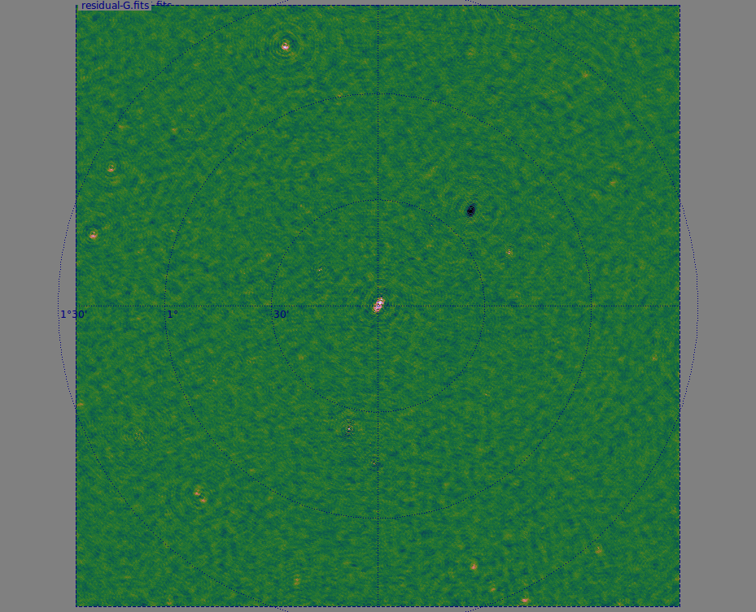
LOFAR DD

Slide 22
Scaling
 | WSRT (14) 74 baselines 28 ch 1437 t/s 300 sources | LOFAR (45) 990 baselines 1 ch x 1280 t/s 42 sources full 2x2 solution | MeerKAT (64) 2016 baselines 8 ch x 480 t/s 884 sources | SKA1 (256)
MeqTrees stefcal time | 1m40s | 2m20s | 3m
MeqTrees selfcal (LSQ) time | 10m | 15m | 24m
“pure” stefcal time (minus I/O and model predict) | 1m | 1m15s | 1m20s
“pure” selfcal time | ~9m | ~13m | ~22m
speedup | x9 | x11 | x16 | xSilly
The Salvini time

Slide 23
What's going on here?
Selfcal: find G to minimize Dpq - Gp Mpq Gq^{H}
Each t/f point is a set of χ²-equations (per baseline)
  toss them all into
  the solver box, with
  ∂χ²/∂Gp
  Out pop updated G values
  Rinse and repeat, until it converges
Time
Frequency
LM
solver
Gp Mpq Gq^{H}
Dpq

Slide 24
The Stefcal Version:
Linearizing the RIME
Find G to minimize Dpq - Gp Mpq G(0)q^{H}
  Where G(0) is the value from the previous iteration
But this is just a linear equation!
Can just write out the G updates directly:
This gives us one approximate update step
Rinse & repeat until it converges
  (With some clever averaging – essential to achieve convergence)

Slide 25
The Stefcal Advantage
For N antennas, model predict scales as N²
  There are N² baselines after all...
LM (or any least-squares) scales as N³ due to matrix inversion
Stefcal update step scales as N²
  ...and is very cheap to compute
  ...so we can do many fast iterations
No need for derivatives!
  Cheap on RAM
  Can process entire WSRT/LOFAR MS in one gulp

Slide 26
What about DDEs?
Can we adapt stefcal to direction-dependent solutions?
Recall differential gains (dE's):

Slide 27

Stefcal & differential gains
1. Set initial dE's to 1
2. Use stefcal to solve for G's
3. Compute
4. Use stefcal to solve
5. Repeat step 3 & 4 for every direction
6. Repeat “major cycle” (steps 2-5)
a few times
Anybody recognize this?

Slide 28
Peeling (The Remake)
Solutions are not simultaneous
Compensate for this by running a few major cycles, since it's so cheap
WSRT 3C147:
3 directions,
3 major cycles
~4m for G and
dE solutions
together

Slide 29

Peeling (The Remake II)
Solutions are not simultaneous
Compensate for this by running a few major cycles, since it's so cheap
WSRT 3C147:
3 directions,
3 major cycles
~4m for G and
dE solutions
together

Slide 30
Does it work for LOFAR?
Yes, though more testing needed
LOFAR DD field,
2 directions: 13m
Scales linearly
with # of directions
(9 directions ~1h)

Slide 31
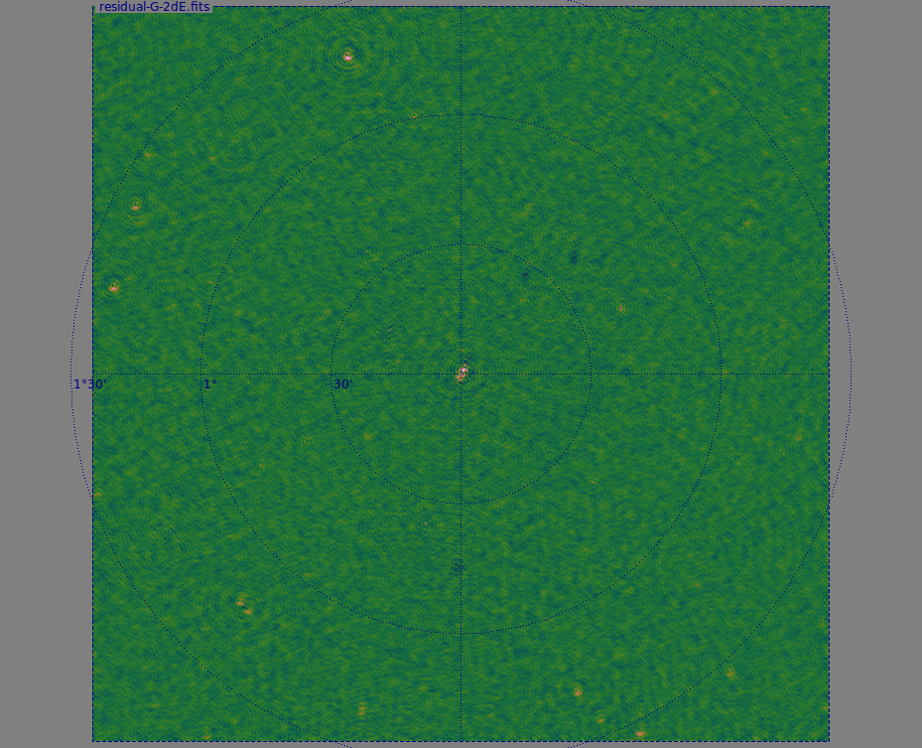
Does it work for LOFAR?
Yes, though more testing needed
LOFAR DD field,
2 directions: 13m
Scales linearly
with # of directions
(9 directions ~1h)
Bonus:
improves G
at the same time

Slide 32
Solution Intervals
Direction-dependent solutions need to be solved for on longer time intervals than G
Up till now, we achieved this by solving for e.g. one dE value per block of M timeslots
Very difficult to mix-and-match intervals in LSQ
  Hence, first do G (Δt=1),
  then dE (Δt=120)
equations for first dE
equations for second dE
Gp Mpq Gq^{H}
Dpq

Slide 33
Solution Intervals In Stefcal
In the stefcal update step calculation, larger solution intervals are just an extra summation. Instead of
...we use:
Trivial to mix-and-match solution intervals
...But we can do even better

Slide 34

The Ugly
This is a typical dE solution
Stepwise: each step corresponds to an interval
Nonphysical: causes artefacts at interval boundaries
To reduce artefacts, we're forced to make the intervals smaller

Slide 35
Can Something Be Done?
In principle, we could produce a “smooth” solution by solving for dE at every time point using a “sliding window” around that time point
With classical selfcal, this is utterly impractical: consider e.g. 1000 timeslots split into 10 intervals of 100 timeslots each:
  A stepwise dE requires 10 solutions
  A smooth dE requires 1000 solutions...
Thus a “sliding selfcal” requires 100 times more computational time

Slide 36
Smoothing In Stefcal
However, in stefcal we have this implicit summation over t:
Essentially, this averages equations over each discrete time interval
So why not do a sliding average instead?
  Or better yet, convolve with a Gaussian?
  Moderate extra CPU cost (~20%)
  Same result as “sliding selfcal”

Slide 37

Piecewise vs. smooth dEs

Slide 38

Effect on The Maps
For 3C147, the improvement is subtle, same scale as thermal noise
Difference
map
(piecewise dE
minus
smooth dE)

Slide 39
In Conclusion: What's The Catch?
Classic selfcal (and Levenberg-Marquardt) is not necessarily optimal, so why does there have to be one?
We don't understand the convergence heuristics
  ...but then, we don't understand selfcal either really
  so stefcal we don't understand too, just x10 faster
More testing needed, especially the 2x2 case
  And especially peeling...
Convergence can be (?) improved
Quick-and-dirty Python implementation can be rewritten
The “fast” version (SVD) can be adapted to stefcal
More gains (factor of several) readily available

Slide 40
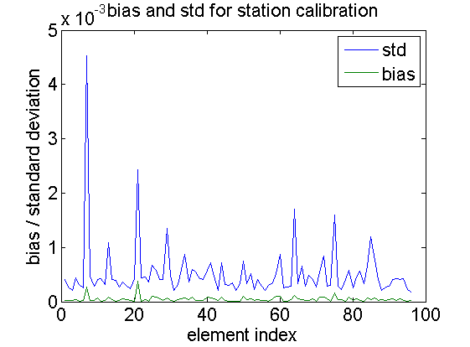
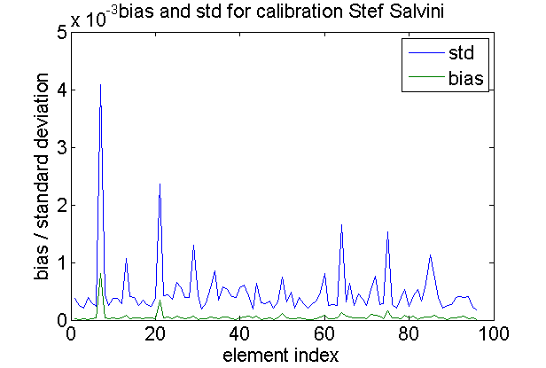
Bias & STD compared to Stefan W

