Slide 1
Primary Beams &
Radio Interferometric
Imaging Performance
(“BeamSims”)
Oleg Smirnov (Rhodes University & SKA South Africa)
Bradley Frank (University of Cape Town)
Isak Theron (EMSS Antennas)
Ian Heywood (Oxford Astrophysics)

Slide 2
Introduction
SKA Dish CoDR (2011), as summarized by Tony Willis:
“My sidelobes are better than your sidelobes.”
What makes “good” sidelobes, anyway?
  or more broadly, a “good” primary beam (PB)?
Big gap between our understanding of scientific performance and engineering specs
Difficult to make progress analytically
  (Though see work by Carozzi, Wijnholds, Braun)

Slide 3
BeamSims: the MeerKAT Context
KAT-7 pathfinder uses prime focus (PF) design
Offset Gregorian (OG) design chosen for final MeerKAT dish (end 2010)
Present work (BeamSims) attempts to measure relative performance via simulations

Slide 4


MeerKAT BeamSims
Prime focus vs. offset Gregorian
Pick your poison?

Slide 5
What Limits Dynamic Range?
Thermal noise ← T_{sys}/A_{eff}, BW, integration
  lucky if we can reach it
Classical confusion ← resolution
Sidelobe confusion noise (SCN)
  ← PB sidelobes
Residual calibration artefacts
(calibration “noise”)
  ← beamshape smoothness
  ← other PB properties (?)
this
talk

Slide 6
Sidelobe Confusion Noise
PSF is in principle unbounded, so every pixel contains contributions from all sources in the sky
  Needs deconvolution (for sources within the image)
Distant sources are attenuated by
  PSF sidelobes →0
  PB sidelobes →0
  Time/bandwidth smearing
LOFAR, WSRT LFFE: brightest (A-team) sources almost always visible, at any distance
At SKA sensitivities, we start to worry about the far more numerous fainter sources

Slide 7
Sidelobe Confusion Noise II
No such thing as an “empty” field:
  You may image and deconvolve to a radius r₀ from the phase centre
  ...but even assuming perfect deconvolution (ha ha)...
  ...each pixel will have a non-zero, noise-like contribution from the “sea” of sources at r > r₀
  This is sidelobe confusion noise (SCN)
In principle, can be driven down by imaging and deconvolving the entire sky
  hard limit with single pointing (sink into the noise!)
  this is a serious cost driver

Slide 8
Primary Beams & SCN
Does choice of PB influence SCN?
  of course, PB sidelobes are a modulator
So how do we
  estimate this
  quantify this
  ...and turn it into a performance metric?

Slide 9
BeamSims
Strategy: “brute force” interferometric simulation
NVSS: a realistic all-sky LSM
  Cutoff I>.5 Jy (for performance reasons)
  Use S³-SEX to derive correction factor (to account for sources <.5 Jy)
Use full-EM PB simulations provided by EMSS
  full 2x2 complex voltage patterns, given as gridded “images” (in spherical coordinates)
MeqTrees module interpolates per-source beam gains, and generates visibilities

Slide 10
Doughnut LSMs
Split the sky into n rings
For each ring i, simulate sources at r_{i}≤r<r_{i+1} Image the [nominally] empty sky in the middle
The rms pixel value is the SCN contribution from ring I
Typical sim size:
  1000~4000 LSM sources, 2016 baselines, full per-source beam pattern interpolation, 8h visibility track
  .5~1 hour using 8 cores

Slide 11
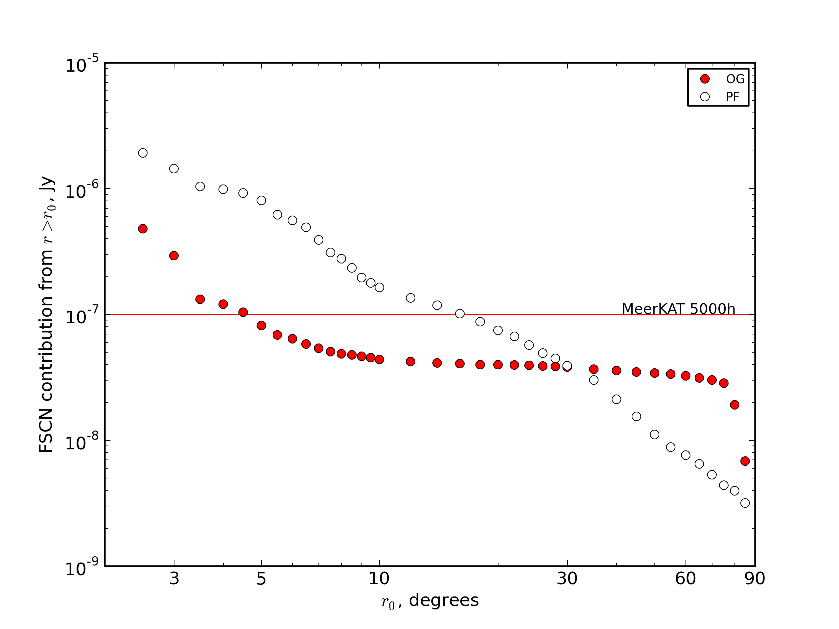
SCN Cost Curves
This shows, as a function of r, the SCN contribution from sources r≥r₀
i.e. how far out do
we have to image
& deconvolve
to drive SCN
below a given
level?

Slide 12
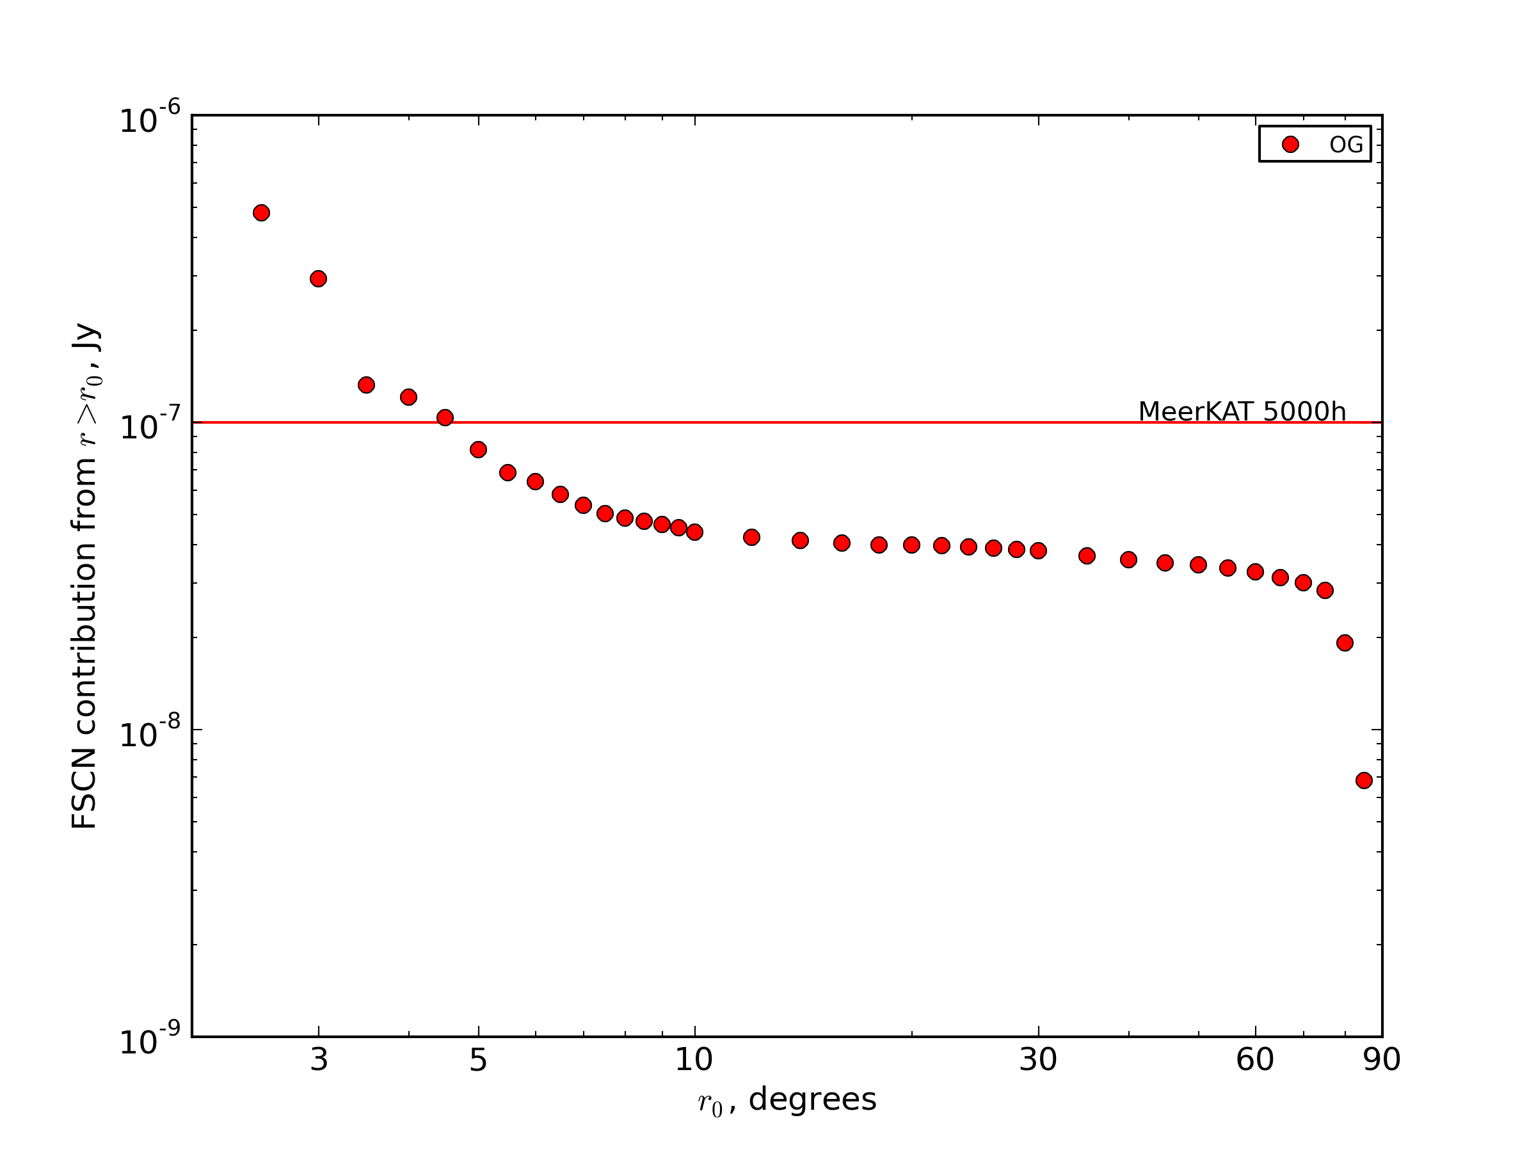
Cost Curve: Offset Gregorians

Slide 13
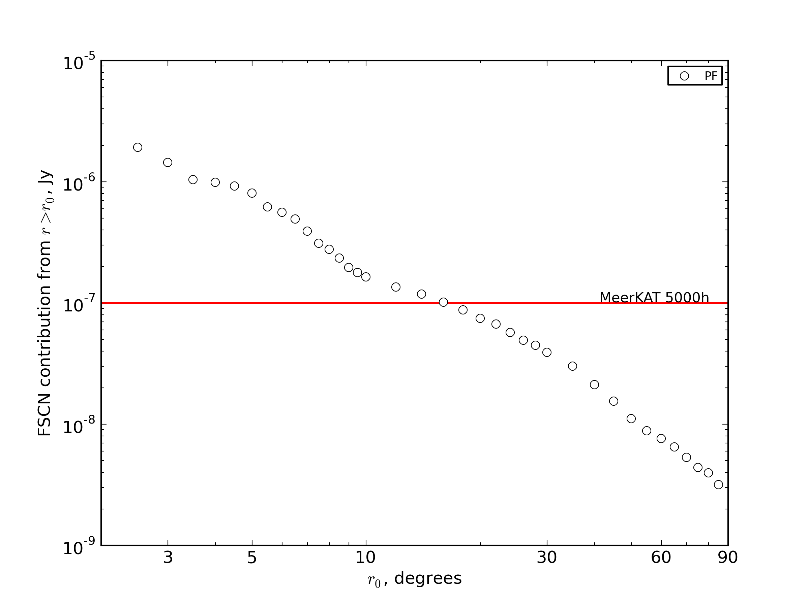
Cost Curve: Prime focus

Slide 14

For Many Different Dishes

Slide 15
Asymptotic SCN
The results above implicitly assume that we can deconvolve and subtract ALL sources
  Thus, only provide an upper bound on performance
In practice, some fraction of the sources will not be accessible
  Too close to the noise
  Too complicated to deconvolve
  Uncertainty in sidelobe beam patterns
Thus, a fraction of the SCN becomes “locked in”
  rough sim: “lock in” the fainter X% of sources

Slide 16
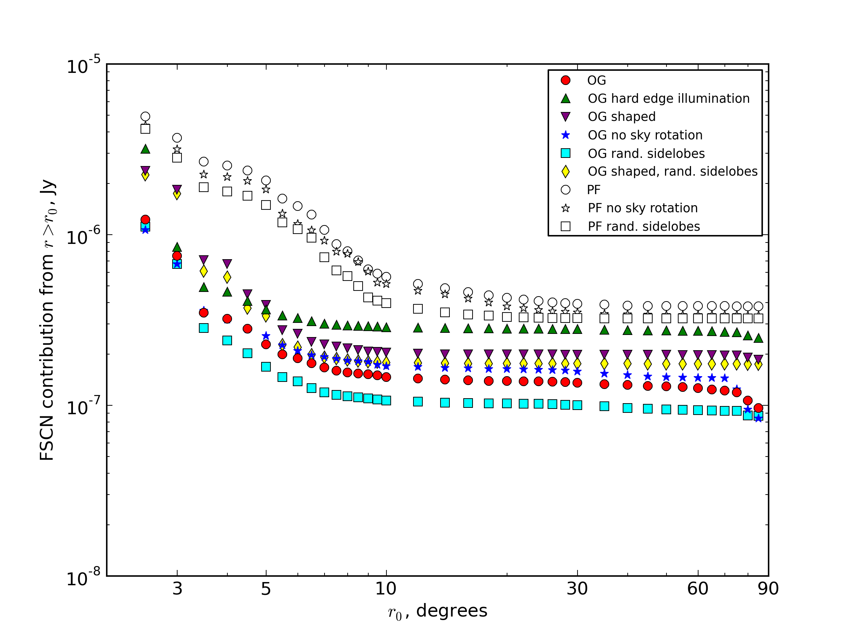
Asymptotic SCN
EXTREMELY
PRELIMINARY!

Slide 17
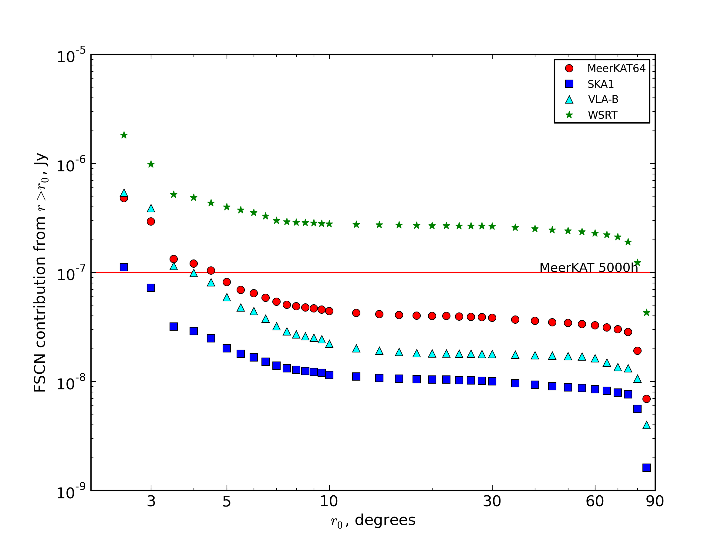
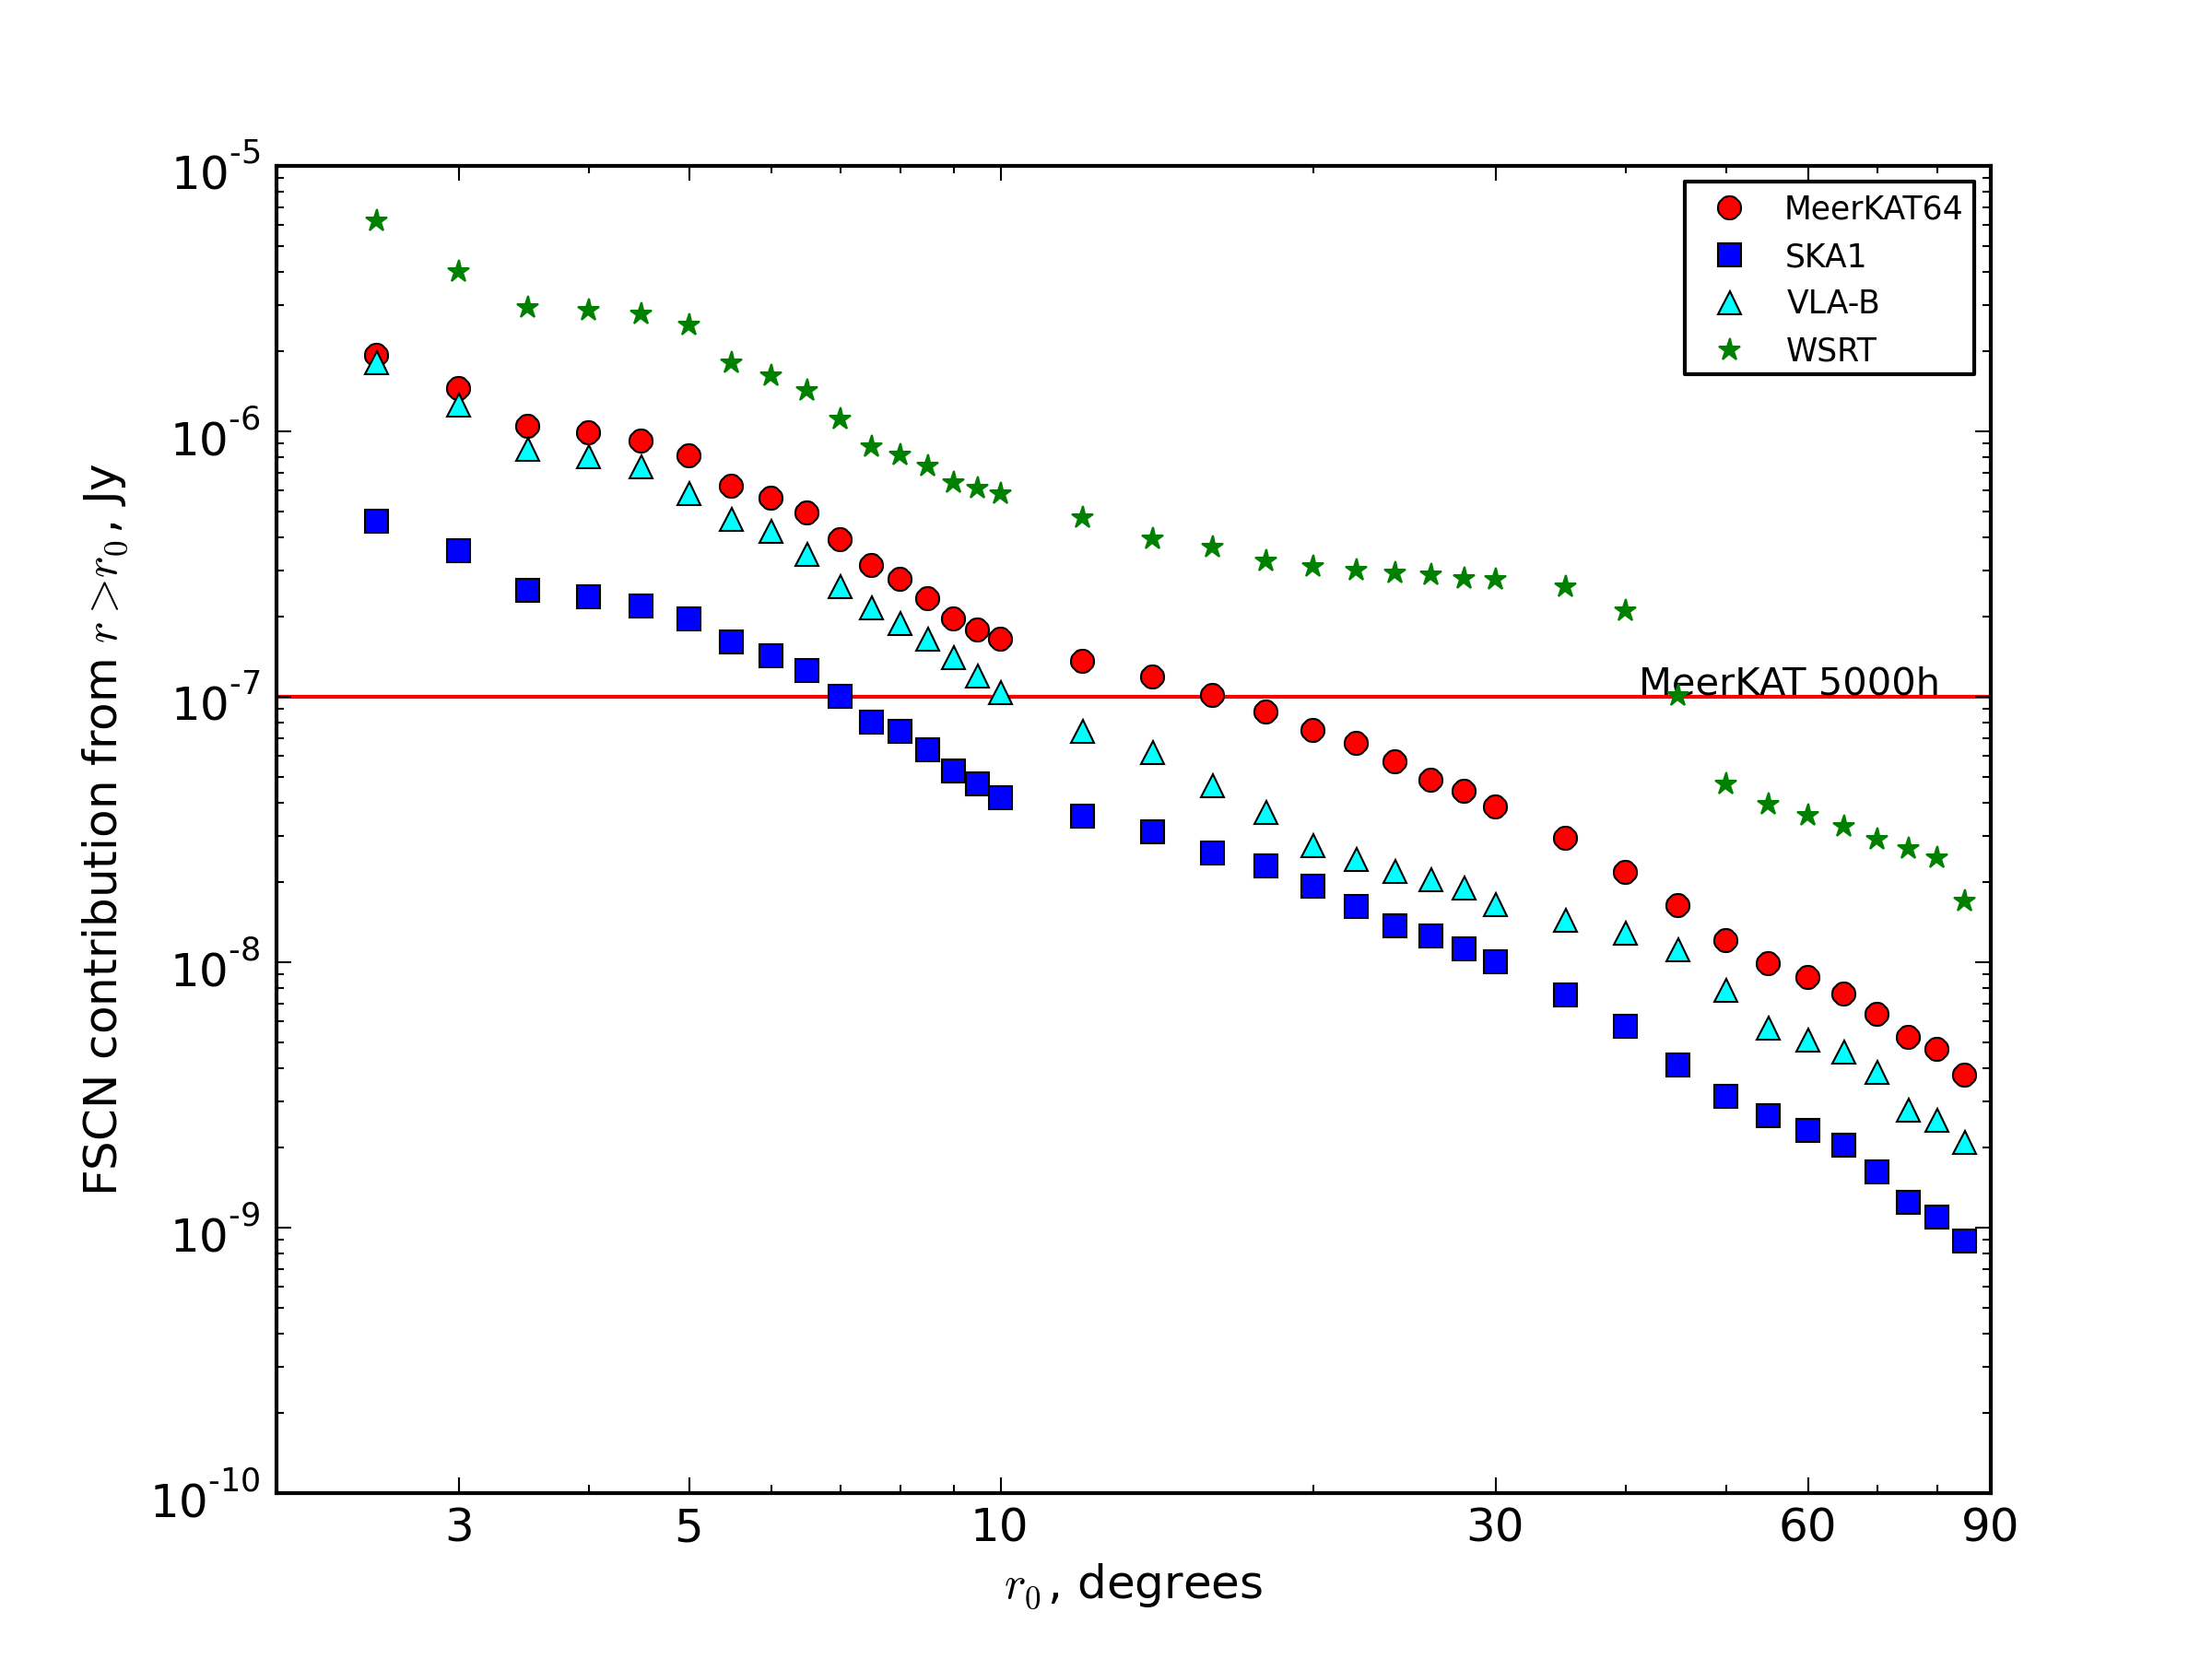
SCN & Array Size
Same simulation for OG/PF dish with WSRT, VLA-B and SKA1 layouts.
To first order O(N), but interaction with interferometer PSF evident
EXTREMELY
PRELIMINARY!

Slide 18
Conclusions I
(for the first half of the talk)
SCN can be ignored for less-sensitive telescopes, but can become a DR limitation at MeerKAT sensitivities (and @SKA even more so)
SCN induces a computing cost vs. noise floor trade-off, as we need to image larger areas in order to suppress SCN
SCN (and the trade-off curves) can be significantly influenced by choice of primary beam
A well-designed large-N layout essential for deep sensitivities

Slide 19
Part II. Calibration “Noise”
We have been very successful at eliminating DDE-related artefacts via direction-dependent solutions (peeling, SAGEcal, differential gains)
And by “eliminating” we mean “driving below the (thermal) noise”
...by which we really mean “sweeping under the carpet”
So, how do we estimate what we have “swept”, and can it come back to haunt us?

Slide 20
Distilling Out The Artefacts
Use the NVSS + S³-SEX to make a deep LSM (limited FoV)
Add a pair of 1 Jy sources at the half-power point (the contaminators)
Make two full interferometric simulations, including [direction independent] gains (G-Jones) and pointing errors (E-Jones)
  of the full LSM + thermal noise → simulated DATA
  of just the contaminators → CONTAM_DATA
  with the same simulated G & pointing errors

Slide 21
Distilling G
1. Run selfcal to obtain G solutions on DATA using some bright subset of the LSM
2. Image the residuals: this contains artefacts, noise and fainter sources. How to tease these apart?
3. Subtract the contaminators alone from CONTAM_DATA while applying these G solutions
4. Make an image of the residuals from (3)
This is an image of distilled artefacts, i.e. exactly the contribution of the contaminator sources to image obtained at step 2.

Slide 22

Calibration Noise, Post-G
We've isolated “calibration noise” per unit flux!
Here, rms
4.2 μJy
(but very
non-Gaussian)

Slide 23
Distilling DDEs
But nevermind, because direction-dependent solutions can take care of it, right?
If we run a dE solution on the two contaminator sources, the resulting image (of the full residuals) becomes thermal noise limited; remaining artefacts are below the noise.
But we can repeat the same trick with CONTAM_DATA to distill them out anyway

Slide 24

Calibration Noise, Post-dE
Here, rms 2.6 μJy, and far less spatially correlated

Slide 25
Why Do We Care?
Just an extra noise-like contribution that's below the thermal noise, so what's the big deal?
But it can be a big deal if its statistics are non-Gaussian

Slide 26
Scenario: Deep Survey
Consider a deep survey where we obtain many pointings of the same field
  MIGHTEE/LADUMA: 5000 hours
Each pointing must have independent DDE solutions
  Beam stability, ionosphere, etc. always different
  So for each pointing we leave an independent set of calibration artefacts buried in the thermal noise
We now combine the pointings – thermal noise adds up as √n (0.1 μJy after 5000 hours)
How do the artefacts add up?

Slide 27
Distill, Rinse, Repeat
We can repeat the distillation experiment multiple times, with different random realizations of G/dE errors
...and add up the “distilled” maps

Slide 28

Mean Of 10 dE-Distills
Structure shows up
Does not scale as a Gaussian
EXTREMELY
PRELIMINARY!
1 distill, rms 2.6 μJy
10 distills, rms 1.2 μJy

Slide 29

PF vs OG
Repeat this experiment for PF and OG beam patterns
Calibration “noise” for OG lower by a factor ~3
PF: rms 3.6 μJy
OG: rms 1.2 μJy

Slide 30
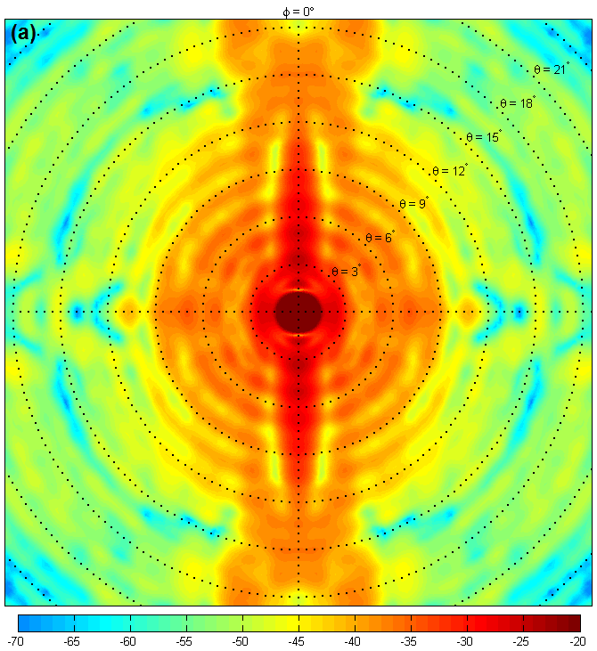
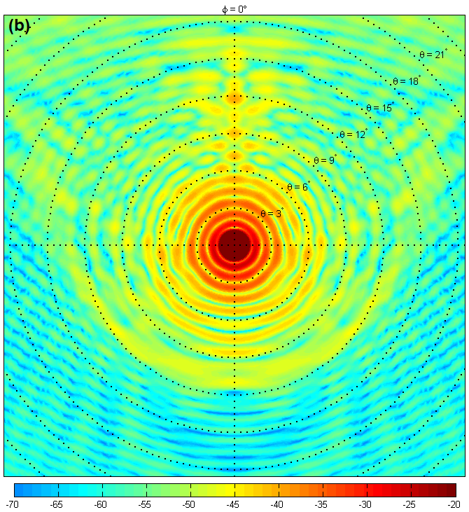
Why The Difference?
Difference probably due to OG's smoother beam pattern
same amount of pointing error causes more gain variation in the PF case

Slide 31
Conclusions II
All calibration, including direction-dependent solutions leave non-Gaussian artefacts buried in the noise
May become a DR limitation for deep surveys
  can be mitigated by dynamically scheduling deep observations during favourable conditions (wind etc.)
Calibration “noise” due to pointing error significantly higher (x3) for the KAT-7 PF design than for the MeerKAT OG design
More study needed!
  AA factors: beam stability, ionosphere

