Slide 1



The Fastest Selfcal In The West, or How Much LOFAR
Can You Calibrate
In 2 Minutes?
Stef Salvini (Oxford e-Research Centre),
Oleg Smirnov (ASTRON)

Slide 2
Stefcal History
Developed for AA station calibration by Stef Salvini
Adapted to interferometer selfcal, with full polarization, by Oleg Smirnov
  ...and christened “Stefcal” despite Stef's [not very convincing] objections
Stefan Wijnholds came up with proof of convergence
  …and the “Statistically Efficient & Fast Calibration” backronym

Slide 3
Basic Selfcal
Selfcal: find G to minimize ||Dpq - Gp Mpq Gq^{H}||
Each t/f point is a set of χ²-equations (per baseline)
  toss them all into
  the solver box, with
  ∂χ²/∂Gp
  Out pop updated G values
  Rinse and repeat, until it converges
Time
Frequency
LM
solver
Gp Mpq Gq^{H}
Dpq

Slide 4
The Stefcal Approach:
Linearizing the RIME
Find G to minimize ||Dpq - Gp Mpq G(0)q^{H}||
  Where G(0) is the value from the previous iteration
But this is just a linear equation!
Can just write out the G solution directly:
This gives us one approximate update step
Rinse & repeat until it converges
  (With some clever averaging – essential to achieve convergence)

Slide 5
The Stefcal Advantage
For N antennas, model predict scales as N²
  There are N² baselines after all...
Standard LM scales as N³ due to matrix inversion
Stefcal update step scales as N²
  ...and is very cheap to compute
  ...so we can do many fast iterations
No need for derivatives!
  Cheap on RAM
  Can process entire WSRT/LOFAR MS in one gulp

Slide 6
Stefcal With WSRT
Quick and dirty Python implementation
Using 3C147 as a test case
~1500 timeslots, 28 channels, 74 baselines
Runtime ~1m40s (of which ~half in the solver)
Compare to MeqTrees+LSQ selfcal: ~10m
  ...or just to regenerate the residuals (or corrected data) using prior LSQ solutions: ~3m
Faster to recalibrate than to load solutions!

Slide 7

But Are The Results Identical?
In a nutshell: YES
Same residuals (to all intents and purposes)
Remaining artefacts (both selfcal and stefcal):
  (DDEs)
  interferometer
  errors
MeqTrees can
solve for the
latter in a
separate pass, in
3~4m

Slide 8

Per-interferometer errors
Extended stefcal to solve for these too
Runtime: ~0s
Integrated into the regular solve loop at virtually zero cost
  (strictly speaking,
  need a second
  stefcal pass to
  apply)

Slide 9
Bragging Rights
Is it robust?
  ...not sure what that means
Is it efficient?
  'course not, it's a “Python prototype”
Is it fast?
  Hell yeah!
Is it The Fastest/The Future/The One?
  Hmmmm....

Slide 10
Scaling
 | WSRT (14) 74 baselines 28 ch 1437 t/s 300 sources | EVLA (27) 351 baselines 8 ch 1700 t/s 11 sources + image full 2x2 | LOFAR (45) 575 baselines 1 ch x 1280 t/s 42 sources full 2x2 solution | MeerKAT (64) 2016 baselines 8 ch x 480 t/s 884 sources | SKA1 (256)
MeqTrees stefcal time | 1m40s |  | 2m | 3m
MeqTrees selfcal (LSQ) time | 10m |  | 15m | 24m
“pure” stefcal time (minus I/O and model predict) | 1m | 40s | 1m | 1m20s
“pure” selfcal time | ~9m |  | ~13m | ~22m
speedup | x9 |  | x13 | x16 | xSilly
The Salvini time

Slide 11
What about DDEs?
Can we adapt stefcal to direction-dependent solutions?
Recall differential gains (dE's):
The “stefcal” building block:

Slide 12

Stefcal & differential gains
1. Set initial dE's to 1
2. Use stefcal to solve for G's above
3. Compute
4. Use stefcal to solve
5. Repeat step 3 & 4 for every direction
6. Repeat “major cycle” (steps 2-5)
a few times
Anybody recognize this?

Slide 13
Peeling (The Remake)
Solutions are not simultaneous
Compensate for this by running a few major cycles, since it's so cheap
WSRT 3C147:
3 directions,
3 major cycles
~4m for G and
dE solutions
together

Slide 14

Peeling (The Remake II)
Solutions are not simultaneous
Compensate for this by running a few major cycles, since it's so cheap
WSRT 3C147:
3 directions,
3 major cycles
~4m for G and
dE solutions
together

Slide 15
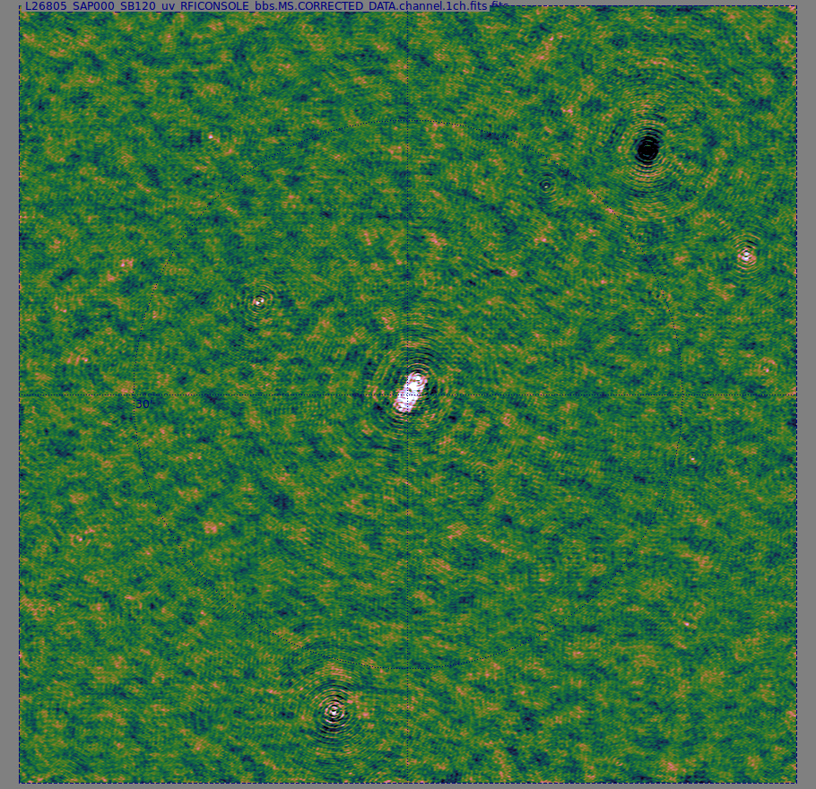
Does it work for LOFAR?
Yes, though more testing needed
LOFAR DD field,
2 directions: 7m
Scales linearly
with # of directions
9 directions: ~20m
Bonus:
improves G
at the same time
G only

Slide 16
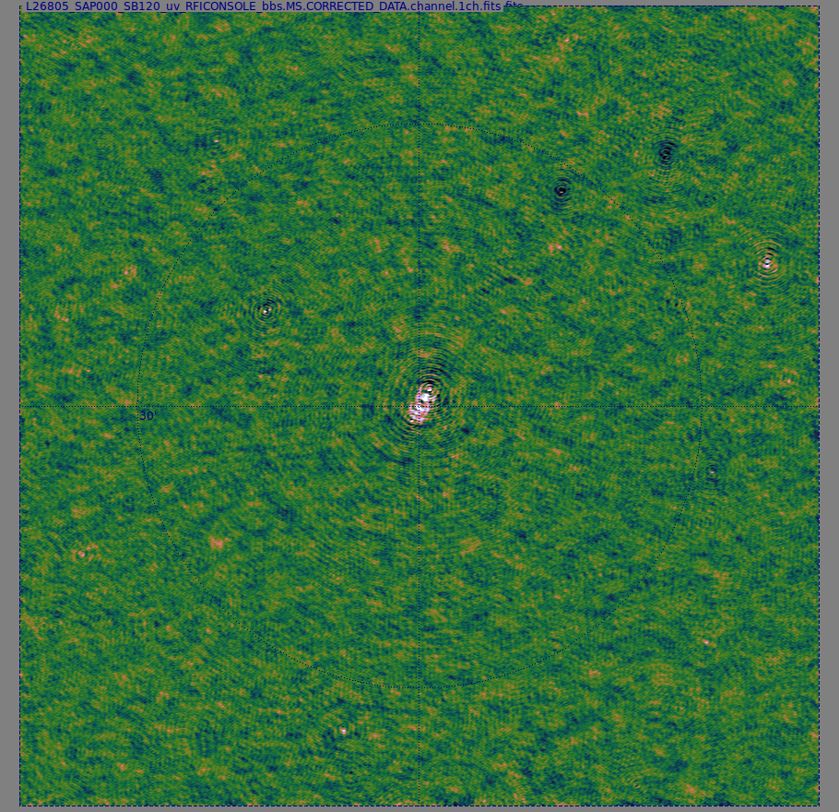
Does it work for LOFAR?
Yes, though more testing needed
LOFAR DD field,
2 directions: 7m
Scales linearly
with # of directions
9 directions: ~20m
Bonus:
improves G
at the same time
G + 2 dE's

Slide 17
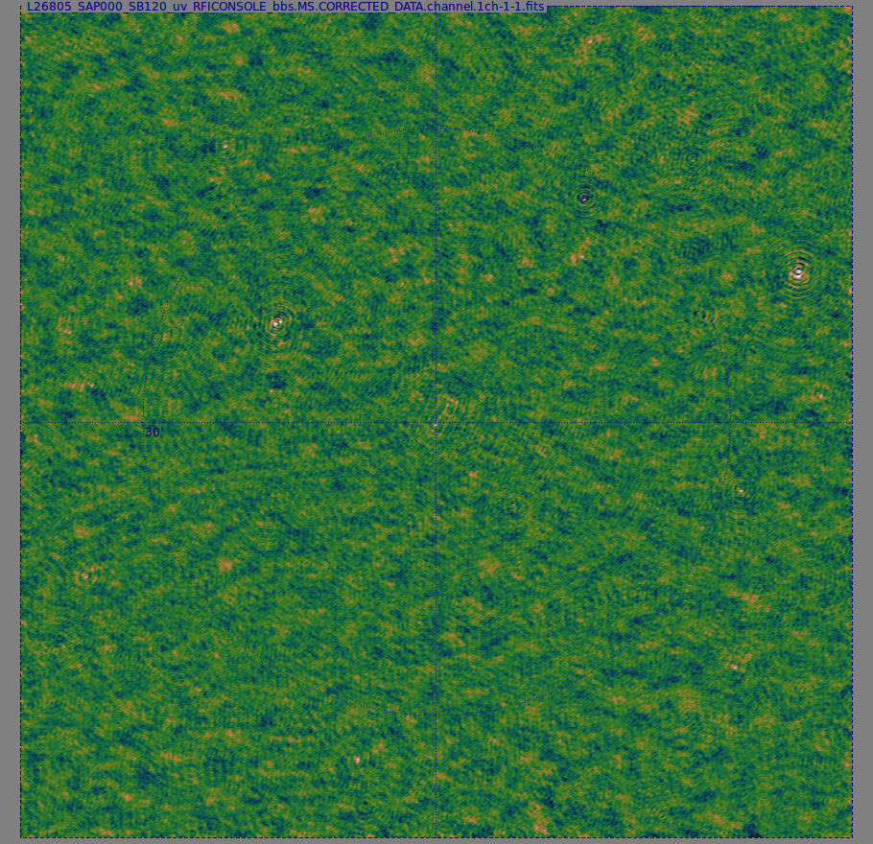
Does it work for LOFAR?
Yes, though more testing needed
LOFAR DD field,
2 directions: 7m
Scales linearly
with # of directions
9 directions: ~20m
Bonus:
improves G
at the same time
G + 9 dE's

Slide 18
Solution Intervals
Direction-dependent solutions need to be solved for on longer time intervals than G
Up till now, we achieved this by solving for e.g. one dE value per block of M timeslots
Very difficult to mix-and-match intervals in LSQ
  Hence, first do G (Δt=1),
  then dE (Δt=120)
equations for first dE
equations for second dE
Gp Mpq Gq^{H}
Dpq

Slide 19
Solution Intervals In Stefcal
In the stefcal update step calculation, larger solution intervals are just an extra summation. Instead of
...we use:
Trivial to mix-and-match solution intervals
...But we can do even better

Slide 20

The Ugly
This is a typical dE solution
Stepwise: each step corresponds to an interval
Nonphysical: causes artefacts at interval boundaries
To reduce artefacts, we're forced to make the intervals smaller

Slide 21
Can Something Be Done?
In principle, we could produce a “smooth” solution by solving for dE at every time point using a “sliding window” around that time point
With classical selfcal, this is utterly impractical: consider e.g. 1000 timeslots split into 10 intervals of 100 timeslots each:
  A stepwise dE requires 10 solutions
  A smooth dE requires 1000 solutions...
Thus a “sliding selfcal” requires 100 times more computational time

Slide 22
Smoothing In Stefcal
However, in stefcal we have this implicit summation over t:
Essentially, this averages equations over each discrete time interval
So why not do a sliding average instead?
  Or better yet, convolve with a Gaussian?
  Moderate extra CPU cost (~20%)
  Same result as “sliding selfcal”

Slide 23

Piecewise vs. smooth dEs

Slide 24

Effect on The Maps
For 3C147, the improvement is subtle, same scale as thermal noise
Difference
map
(piecewise dE
minus
smooth dE)

Slide 25
In Conclusion: What's The Catch?
Classic selfcal (and Levenberg-Marquardt) is not necessarily optimal, so why does there have to be one?
Convergence can be improved, see Stef's recent results
Quick-and-dirty Python implementation can be rewritten
  ...but probably doesn't need to be
The “fast” version (SVD) can be adapted to stefcal
More gains (factor of several) readily available

