Slide 1
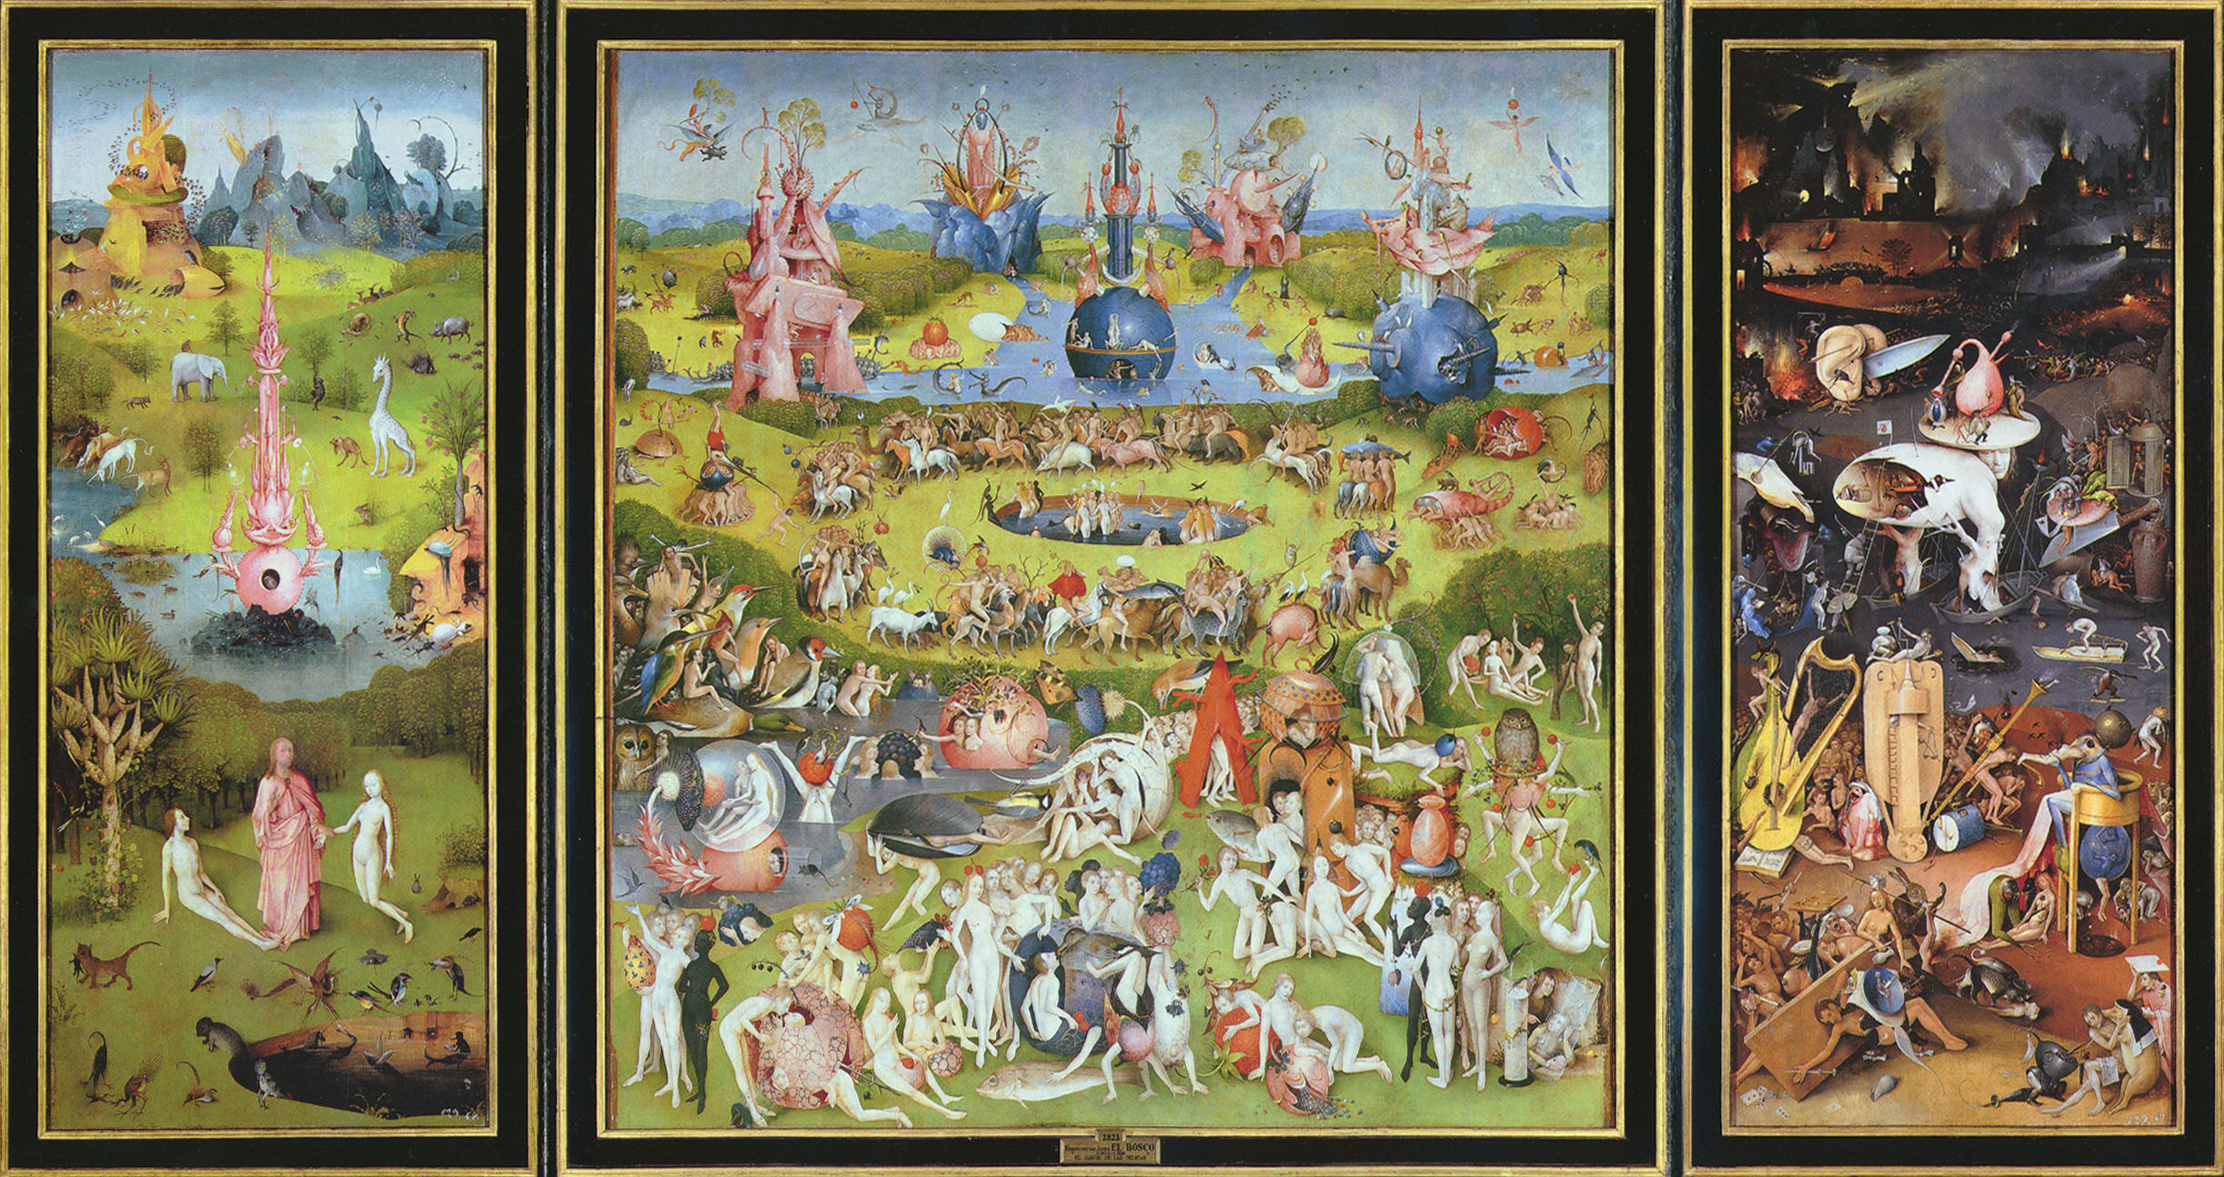
A773: The WSRT Field From Hell
O. Smirnov (Rhodes U. & SKA SA) (& ASTRON)
R. Pizzo, E. Orru (ASTRON)

Slide 2
A773: Introduction
Part of Roberto Pizzo et al.'s WSRT cluster observing program
Looking for extended halo & relic emission
Multi-wavelength, but 300 MHz the nastiest
  Standard 6x12h, filled uv-plane
  8 bands 315-376 MHz, only 7 usable
Initial strategy:
  selfcal and LSM construction in NEWSTAR
  DDE calibration in MeqTrees

Slide 3
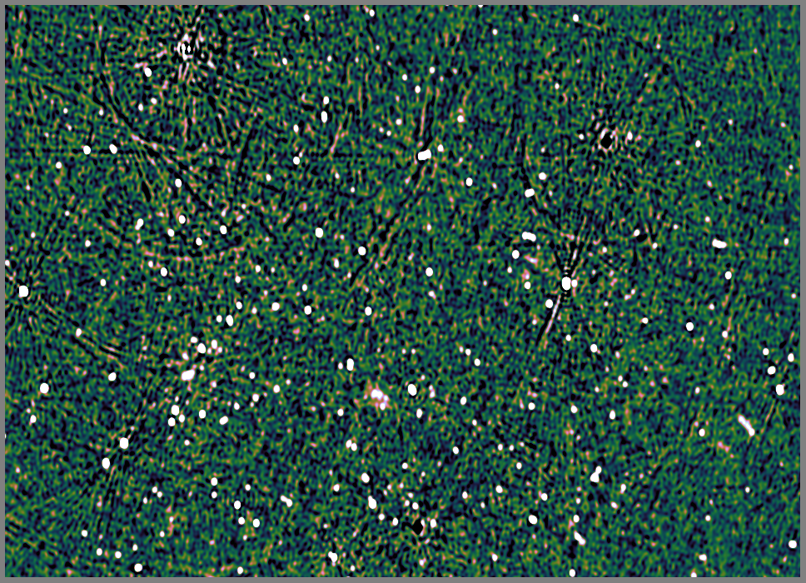
A773: NEWSTAR Selfcal + Peeling
1.1 Jy
750 mJy
1.1
470 mJy
σ=.09mJy thermal,
.3-.4 mJy confusion
620 mJy

Slide 4
A Few Small Problems
RFI
Odd telescope problems
All the dominant sources are off-axis
Affected by the ionosphere
...and also resolved

Slide 5
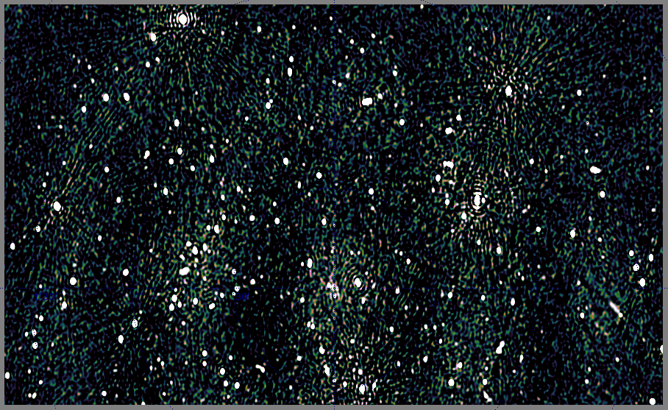
A Few Small Problems II
(a) resolved sources (b) RFI (c) ionospheric spokes

Slide 6

Why Is It So Difficult?
DR is a marketing ploy...
3C147 selfcal reaches
1.6 million to 1 on-axis
And ~1000:1 off-axis
(30-50 mJy sources leave
obvious residuals)
Differential gains produce
a noise-limited map
But this only proves we
can reach ~4000:1
...and that's good enough
to reach the noise because
everything off-axis is <50 mJy
σ =13.5 μJy
3C147 22Jy
30 mJy

Slide 7
Deconvolution Problems
Bright off-axis sources do not deconvolve well
Reasons:
  residual DDEs
  interaction with other sources in the map

Slide 8
The Postage Stamp Approach
Solve for G and all dEs
Per each source s0, make single-source corrected visibilities (SSCV):
...corrected by our best guess for the total gain towards s0
Residual visibilities for s0
Our current best prediction for the whole sky, sans s0

Slide 9
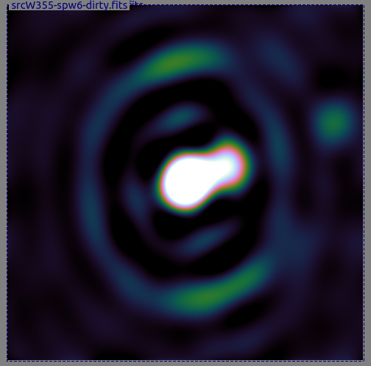
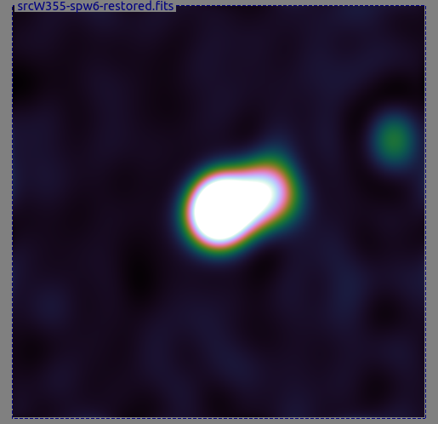
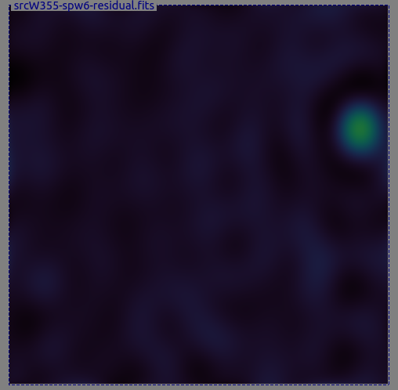
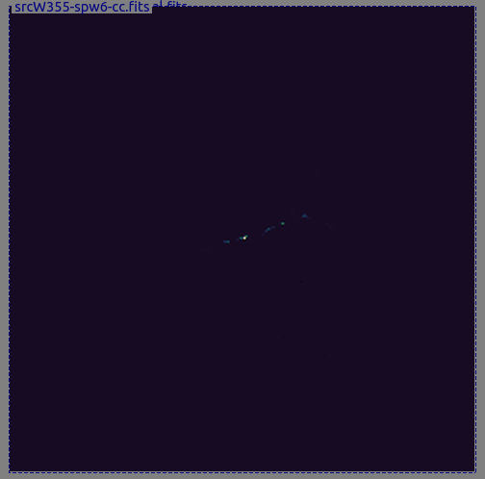
The Postage Stamp Approach II
3. Image the SSCV in a small box (“postage stamp”) centered on the source
  using all six nights
4. Deconvolve
  Using CLEAN
  Or shapelets?
  Or CS?
5. Build a hybrid LSM composed of source components and postage stamp models (CCs)

Slide 10
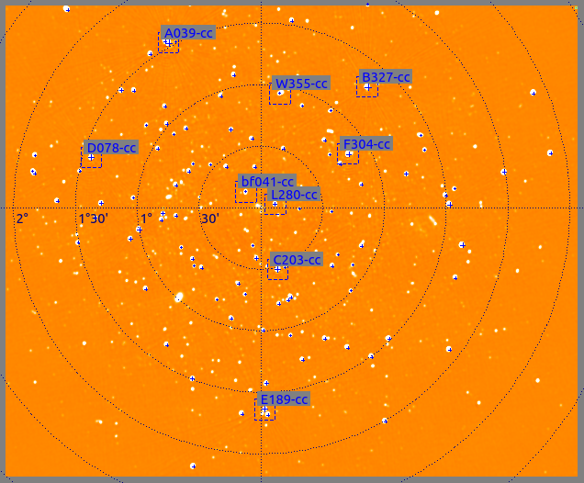
Hybrid LSMs & Tigger
The Tigger tool (FITS viewer and sky model manager) supports hybrid LSMs:
Point sources
Gaussian components
FITS images (multiple: thus different positions and resolutions)
Coming up:
Shapelets and other basis functions

Slide 11
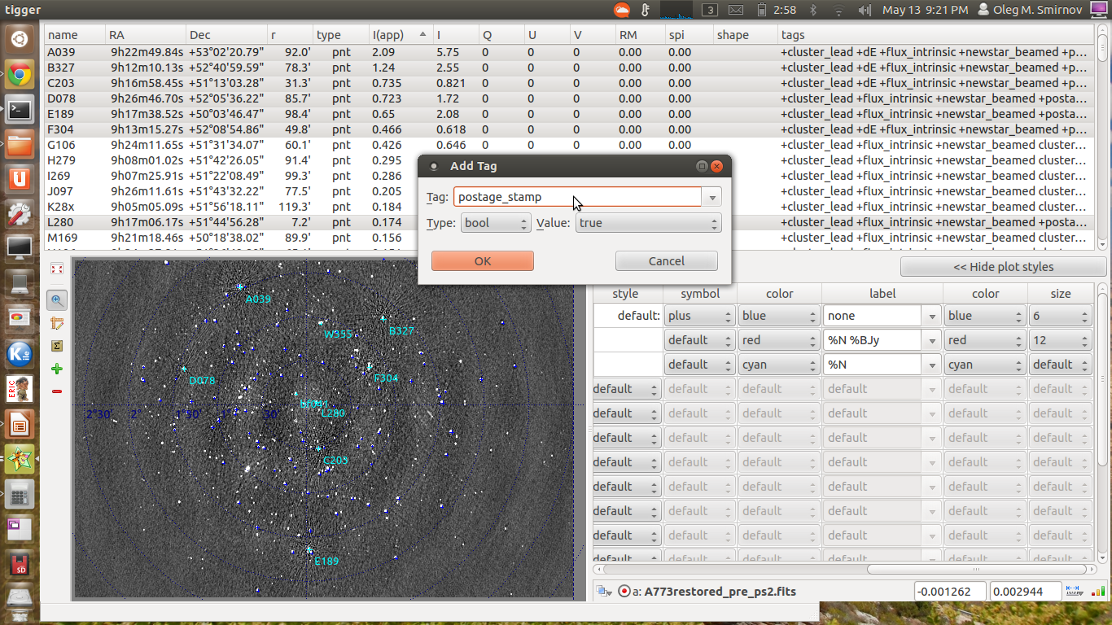
Postage Stamps In Practice
select
tag
select

Slide 12
Postage Stamps In Practice II
Designate sources for the “postage stamp” treatment using the Tigger GUI
  Useful to plot the LSM over a residual image while you do this
Assign them a “postage_stamp” tag
  similarly, the “dE” tag designates sources for a differential gain treatment
Run a script which will calibrate, generate SSCVs for designated sources, make postage stamp images, and insert them into the LSM

Slide 13
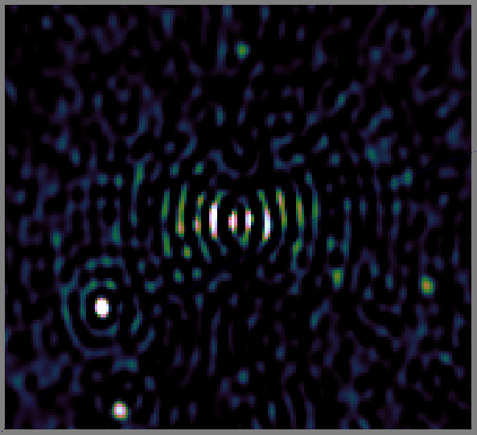
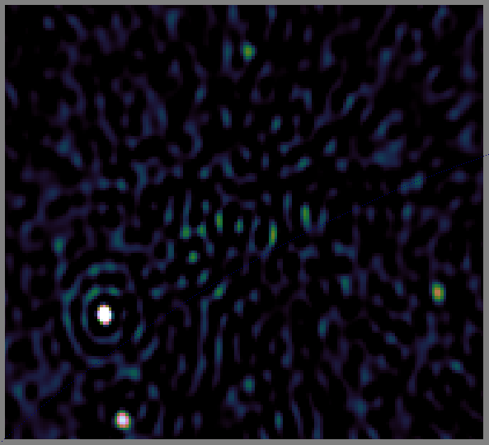
Postage Stamps: Before & After
Residual image for 1.1 Jy source in NE of field
Left: point source model; Right: postage stamp model
NB: the stamp can be at a higher resolution than we normally image at.

Slide 14
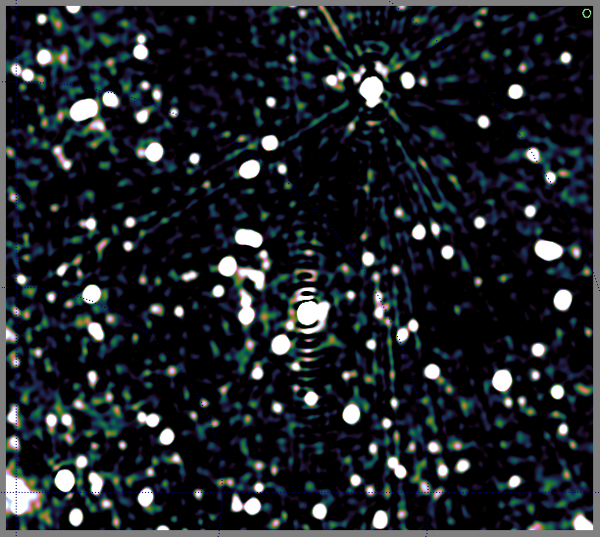
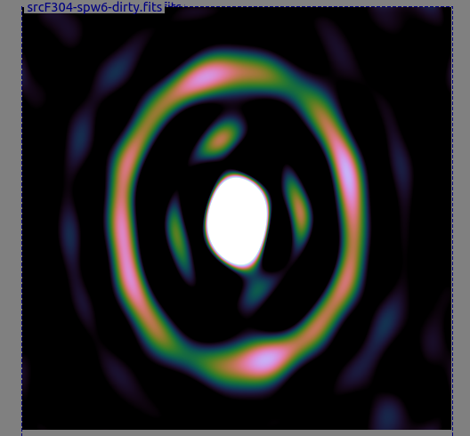
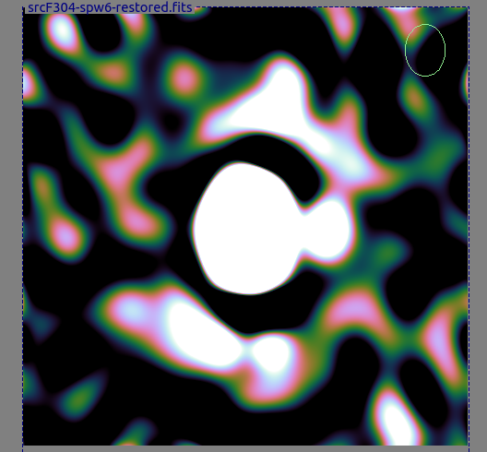
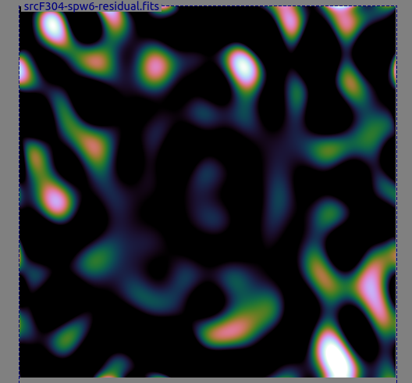
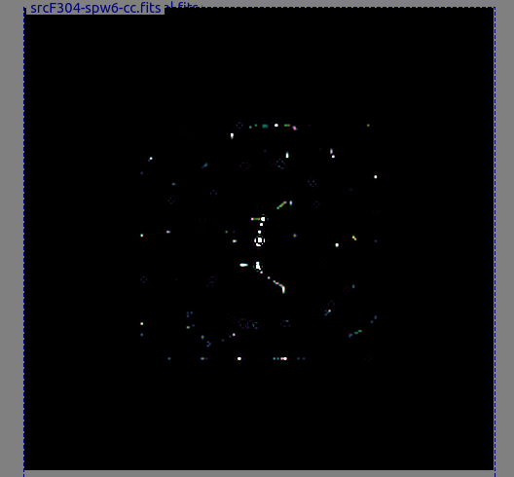
Not Always So Successful...
470 mJy source to NW of target
Needs something better than CLEAN

Slide 15

The Dangers Of
Direction-Dependent Solutions
Single-band residuals, no dEs (G only)

Slide 16

The Dangers Of
Direction-Dependent Solutions
Single-band residuals, with a few dEs – very nice map, right?

Slide 17
The Dangers Of
Direction-Dependent Solutions
Suppression of non-model sources
Our target

Slide 18

The Dangers Of
Direction-Dependent Solutions
Suppression is less with only one dE
Our target

Slide 19
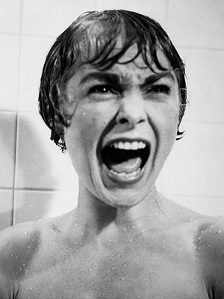
Source Suppression Via DD Solutions
Adding dE's will always suppress
some flux from non-LSM sources
(i.e. your science target!)
  See figure for correct response ➔
A clean, noise-limited map is
not necessarily good news!
Related to noise suppression,
familiar from selfcal
Basic mechanism: extra degrees
of freedom in the calibration model (the dE's) also absorb unmodeled flux

Slide 20
Mitingating Source Suppression
Source suppression can be mitigated by:
  Fewer direction-dependent solutions
  Longer solution intervals
  Split amplitude/phase solutions (longer intervals for amplitude)
  Having more baselines (good news for LOFAR, bad news for WSRT)
More investigation needed!
  Need quantitative estimates of the effect
  Can get a handle on it with some careful simulations, so watch this space

Slide 21
Putting It All Together
9 postage stamps, 3 dE source
Image tour at this point...
Resulting image still limited by DDEs, confusion and grating lobes of distant sources (incl. Cyg A and Cas A)
Still work to be done...
 | Single band | 7 bands
Thermal noise | .24 mJy | 0.09 mJy
Confusion noise |  | 0.3 ~ 0.4 mJy

Slide 22
Still To Be Done
Gaussian models (from PyBDSM) for some sources
Adding models of distant sources to the LSM
Z-Jones solution on short timescales
  possibly with smearing?
Shapelet deconvolution

Slide 23
The Data Problem
Lots of promising things still to try with this data, but turnaround time has been a problem
6x12h, 7 bands:
  ~26k integrations, 350 channels, 74 baselines
  x1000 more data than a typical single-band 1ch LOFAR MS
  x30 more data than the 3C147 experiment
Bad enough having to reduce this once, but running dozens of experiments??

Slide 24
Stefcal: Bring In The Cavalry
Stefcal is a new type of solver suggested by Stef Salvini (OeRC)
  Originally proposed for AA station calibration
  ...but can be readily adapted to the selfcal problem
Minimizes the same measurement equation as regular selfcal, but much faster
Implemented in MeqTrees as a Python prototype
Despite the Python “handicap”, is already x7-10 faster than the traditional LM solver

Slide 25
Selfcal Scaling
 | WSRT 74 baselines 28 ch 1437 t/s 300 sources | LOFAR 575 baselines 1 ch x 1280 t/s 42 sources full 2x2 solution | MeerKAT (64) 2016 baselines 8 ch x 480 t/s 884 sources | SKA1 (256)
MeqTrees stefcal time | 1m40s | 2m | 3m
MeqTrees selfcal (LSQ) time | 10m | 15m | 24m
“pure” stefcal time (minus I/O and model predict) | 1m | 1m | 1m20s
“pure” selfcal time | ~9m | ~13m | ~22m
speedup | x9 | x13 | x16 | xSilly
The Salvini time

Slide 26
Stefcal And A773
Typical runtime for 6x12h, 10s sampling,
7x50 channels
  Direction-independent cal (G-Jones)
  dE solutions for 3 directions
  Merge & image & clean 6 nights
  ~12 hours runtime for 7 bands
Old selfcal runtime >1 day
  Resampled to 30s out of necessity
Factor of several gained

Slide 27
Conclusions
Even the Field From Hell can eventually be tamed
Postage stamp approach is promising, but better alternatives to CLEAN need to be tried
Direction-dependent solutions are necessary
  But indiscriminate use may be hazardous to your health
  Noise-limited maps may mislead!
Stefcal is a game-changer
  Especially for the algorithm-development crowd

