Slide 1
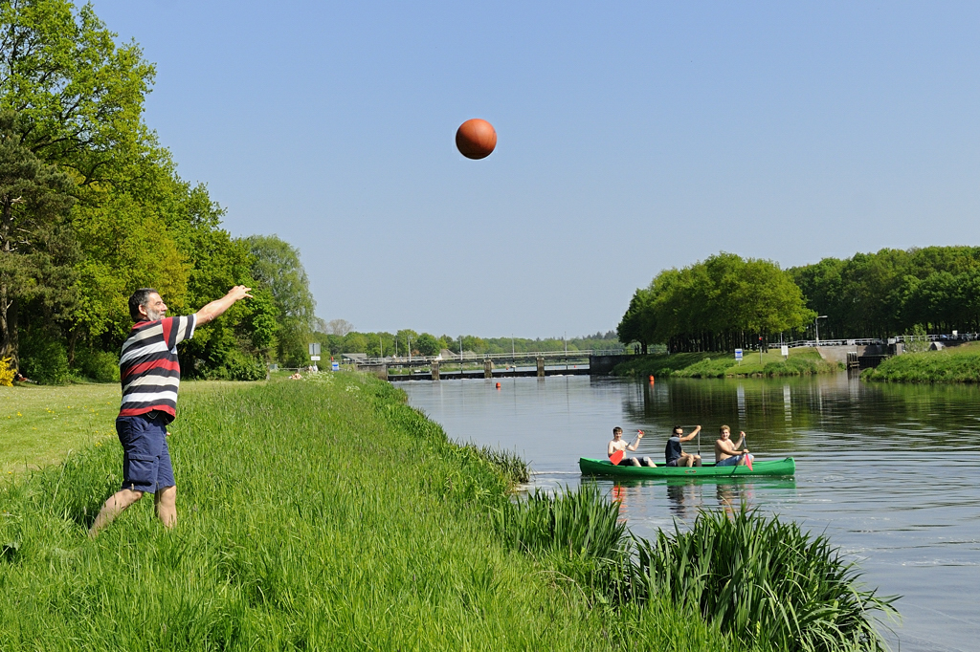
Jan, MeqTrees, 3GC

Slide 2
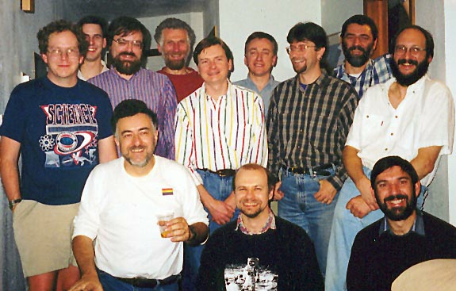
In The Beginning Was AIPS++...
(November 1998)

Slide 3
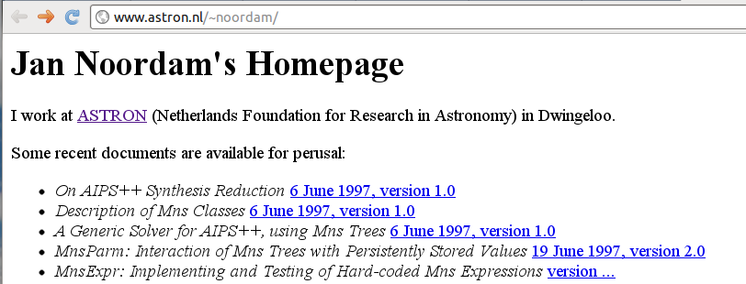

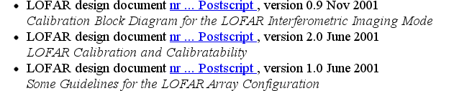
Then There Was MnsTrees...
An early adopter of this
new-fangled WWW gimmick...
...treating it as the passing
fad that it is...
...and yet designing LOFAR in passing,
four years ahead of its time

Slide 4
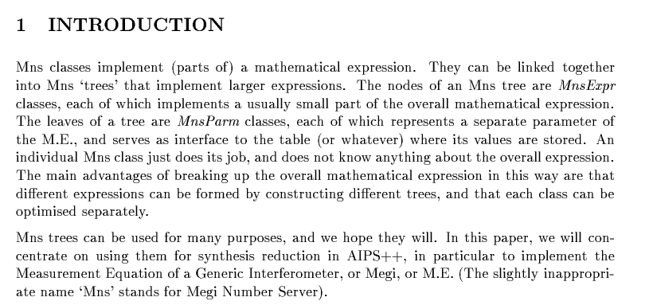
MnsTrees: The MeqTrees Prequel

Slide 5

Famous Far And Wide...
“The Chinese like to do everything in fours, such
as the Gang Of Four. Four is an easy
number to remember.” – J. Noordam

Slide 6
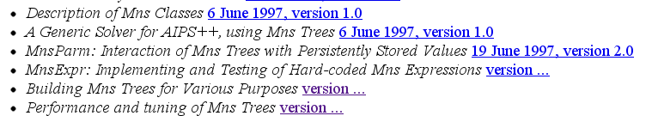

Designed In Detail...
“Premature optimization is the root of all evil.”
– the First Law Of Smirnov
(according to Noordam)
(but actually formulated by D. Knuth)

Slide 7
AIPS++ Is Dead, Long Live LOFAR
Little traction for these ideas in the AIPS++ project
  ...but at least a limited, specific form of the ME got adopted
  ...and (15 years and hundreds of man-years later) was made to work in CASA
In the meantime, LOFAR came along and saved us all
  (or at least me, from working on AIPS++)

Slide 8
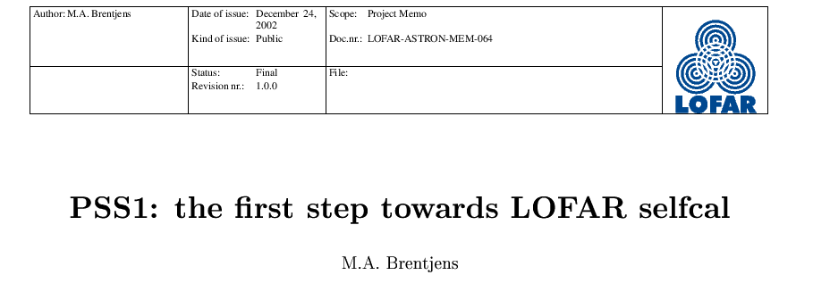
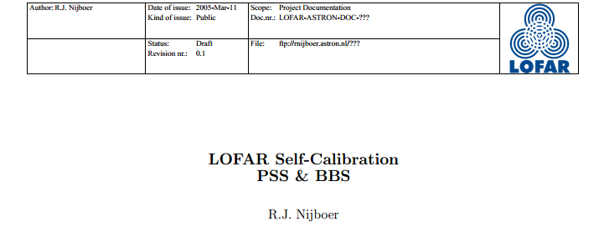
Taking The PSS Through 4+ Generations
PSS: Pilot Selfcal System for LOFAR
PSS0, PSS1, PSS2, PSS3, PSS4
Fluid team:
  Jan
  plus whoever was crazy enough to listen to him (Michiel Brentjens, Ger van Diepen)

Slide 9
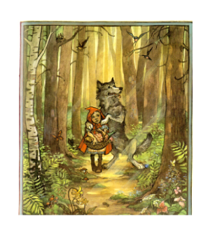
PSS4 → MeqTrees
PSS4 got renamed into MeqTrees
  after some naming controversies
Got vital contributions from Tony
Willis, Maaijke Mevius, Ronald
Nijboer Sarod Yatawatta
Michiel's 3C343 reduction the first success story
Sarod's CS1 maps – Christmas Card
SKADS: Oxford came on board (thanks to Steve Rawlings)
  Chris Williams (OeRC) rolls binary packages

Slide 10
Not All Just Fun & Games
Jan admitted being afraid of my jokes, so here's a few serious slides instead
...because MeqTrees has produced a number of impressive results over the years
(Besides all the early LOFAR calibration done by Sarod)

Slide 11

World Record Dynamic Range
(still, after 2 years...)
3C147 @21cm
12h WSRT synthesis
160MHz BW
22 Jy peak
13.5 μJy noise
1,600,000:1
Regular selfcal does not
reach noise, leaves
off-axis artefacts (“luxury
problems”) due to
direction-dependent
effects (left inset)
Addressed via differential
gains (right inset)
3C147 22Jy
30 mJy

Slide 12

“Rogues' Gallery” Plot
(solving for pointing errors)
Blind experiment: pointing errors deliberately introduced on a few (secret) antennas, with MeqTrees recovering them

Slide 13

Yet Another Twist: Solving For P.E.
On Shorter Time Scales
Solutions every 30 sec, 2.5 min and 5 min.
Longer time scales: decreased variance (higher SNR)
Diminishing returns above 5 min.
Show a striking feature unnoticed on the previous
(30 min.) plots...

Slide 14

And Now, Applying Sophisticated
Model Fitting Techniques...
Westerbork Wobble!
WW

Slide 15

EVLA 8.4 GHz, WHDF
(Courtesy of Ian Heywood)
EVLA 8.4 GHz: Looking for sub-mm galaxies and QSOs in the William Herschel Deep Field.
Dominant effect: bright calibrator source rotating through first sidelobe of the primary beam.
(This also has a horrible PSF, being an equatorial field.)
This is your science
(good luck!)
This is your
phase calibrator
Brightness scale 0~50μJy

Slide 16

Keep Your Friends Close, and your calibrators as far away as you can...
An approximation of the primary beam response, overlaid on top of the image.
As the sky rotates, the sidelobes of the PB sweep over the source, thus making it effectively time-variable.
This is your science
(good luck!)
This is your
phase calibrator
(Brightness scale 0~50μJy)

Slide 17

Deconvolution Doesn't Help...
Residual image, after deconvolution.
The contaminating source cannot be deconvolved away properly, due to its instrumental time-variability.
...5 years ago this would observation would probably be a complete write-off.
(Brightness scale 0~50μJy)

Slide 18

Differential Gains To The Rescue
Residual image after applying differential gain solutions to the contaminating source
Brightness scale 0~50μJy

Slide 19

Multi-Band Image
Multi-band residual image:
noise-limited, no trace of contaminating source.
Phase calibrator
used to be here
Brightness scale 0~50μJy

Slide 20
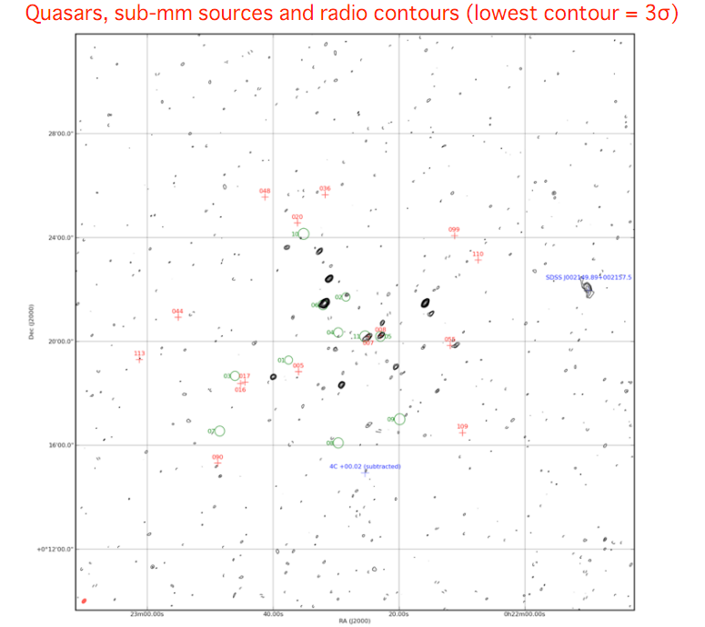

Slide 21


MeerKAT BeamSims
Prime-focus vs. offset Gregorian
Pick your poison?

Slide 22
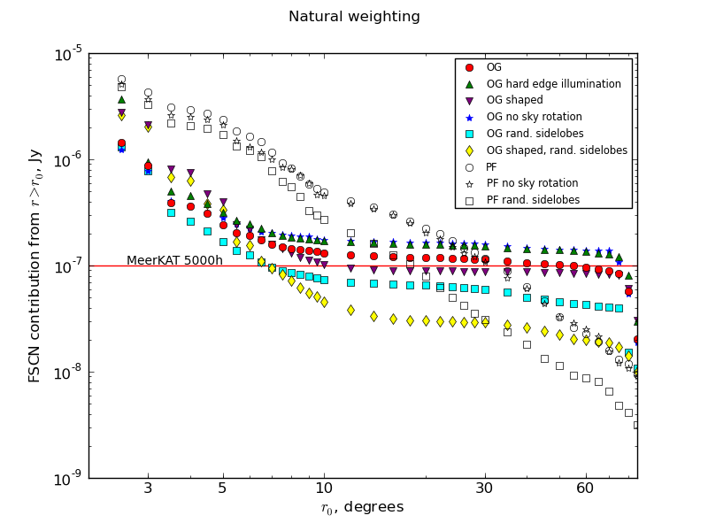
Cost curves: image size vs. sidelobe confusion

Slide 23
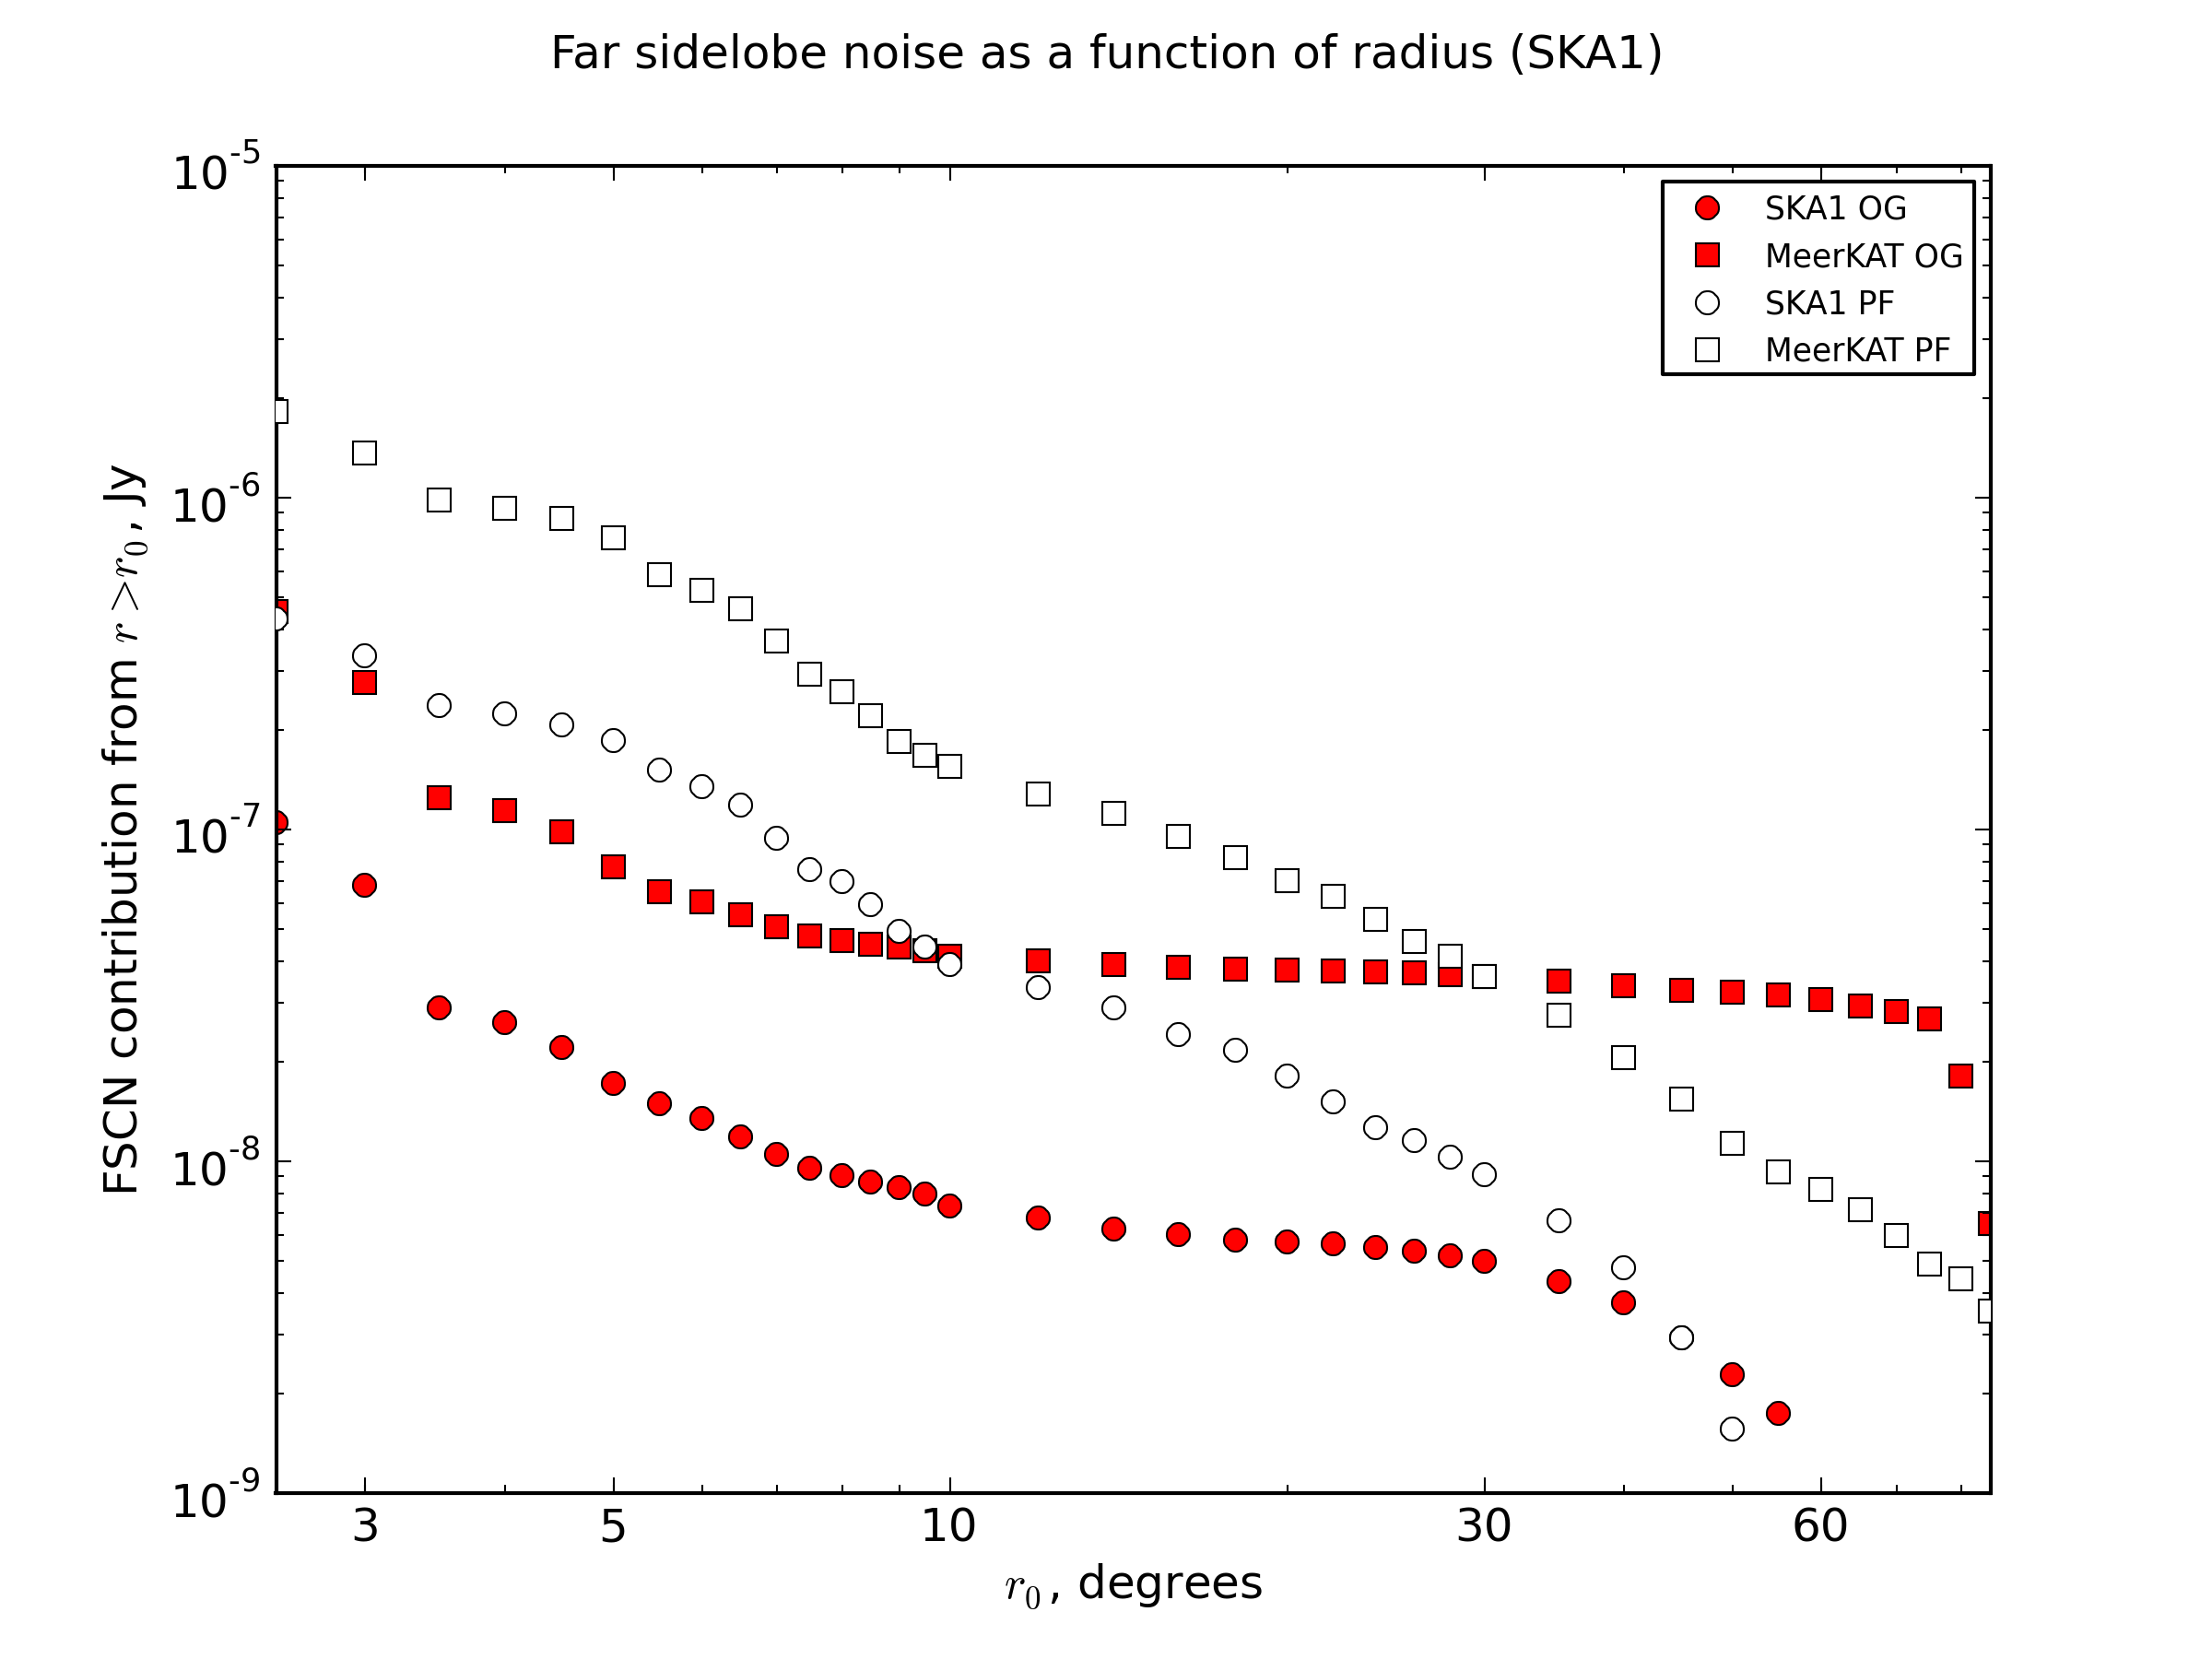
Hot Off The Press: SKA1

Slide 24
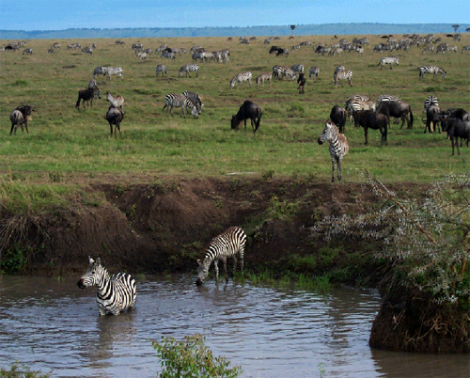
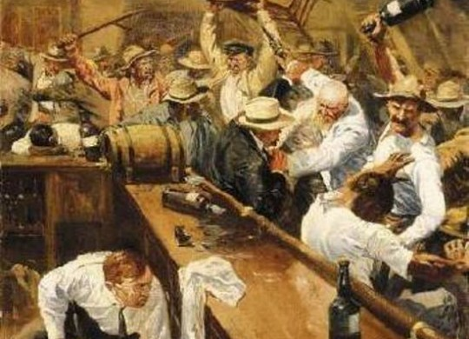
The Waterhole
A place where all the animals come together
A place of serenity and enlightment, where MeqTree users exchange scripts and ideas

Slide 25
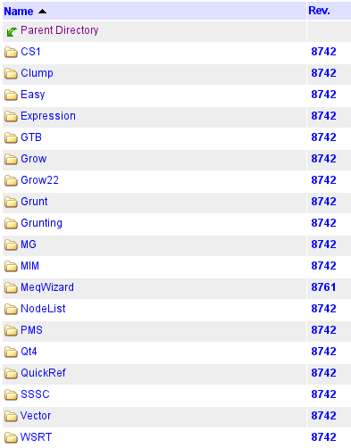
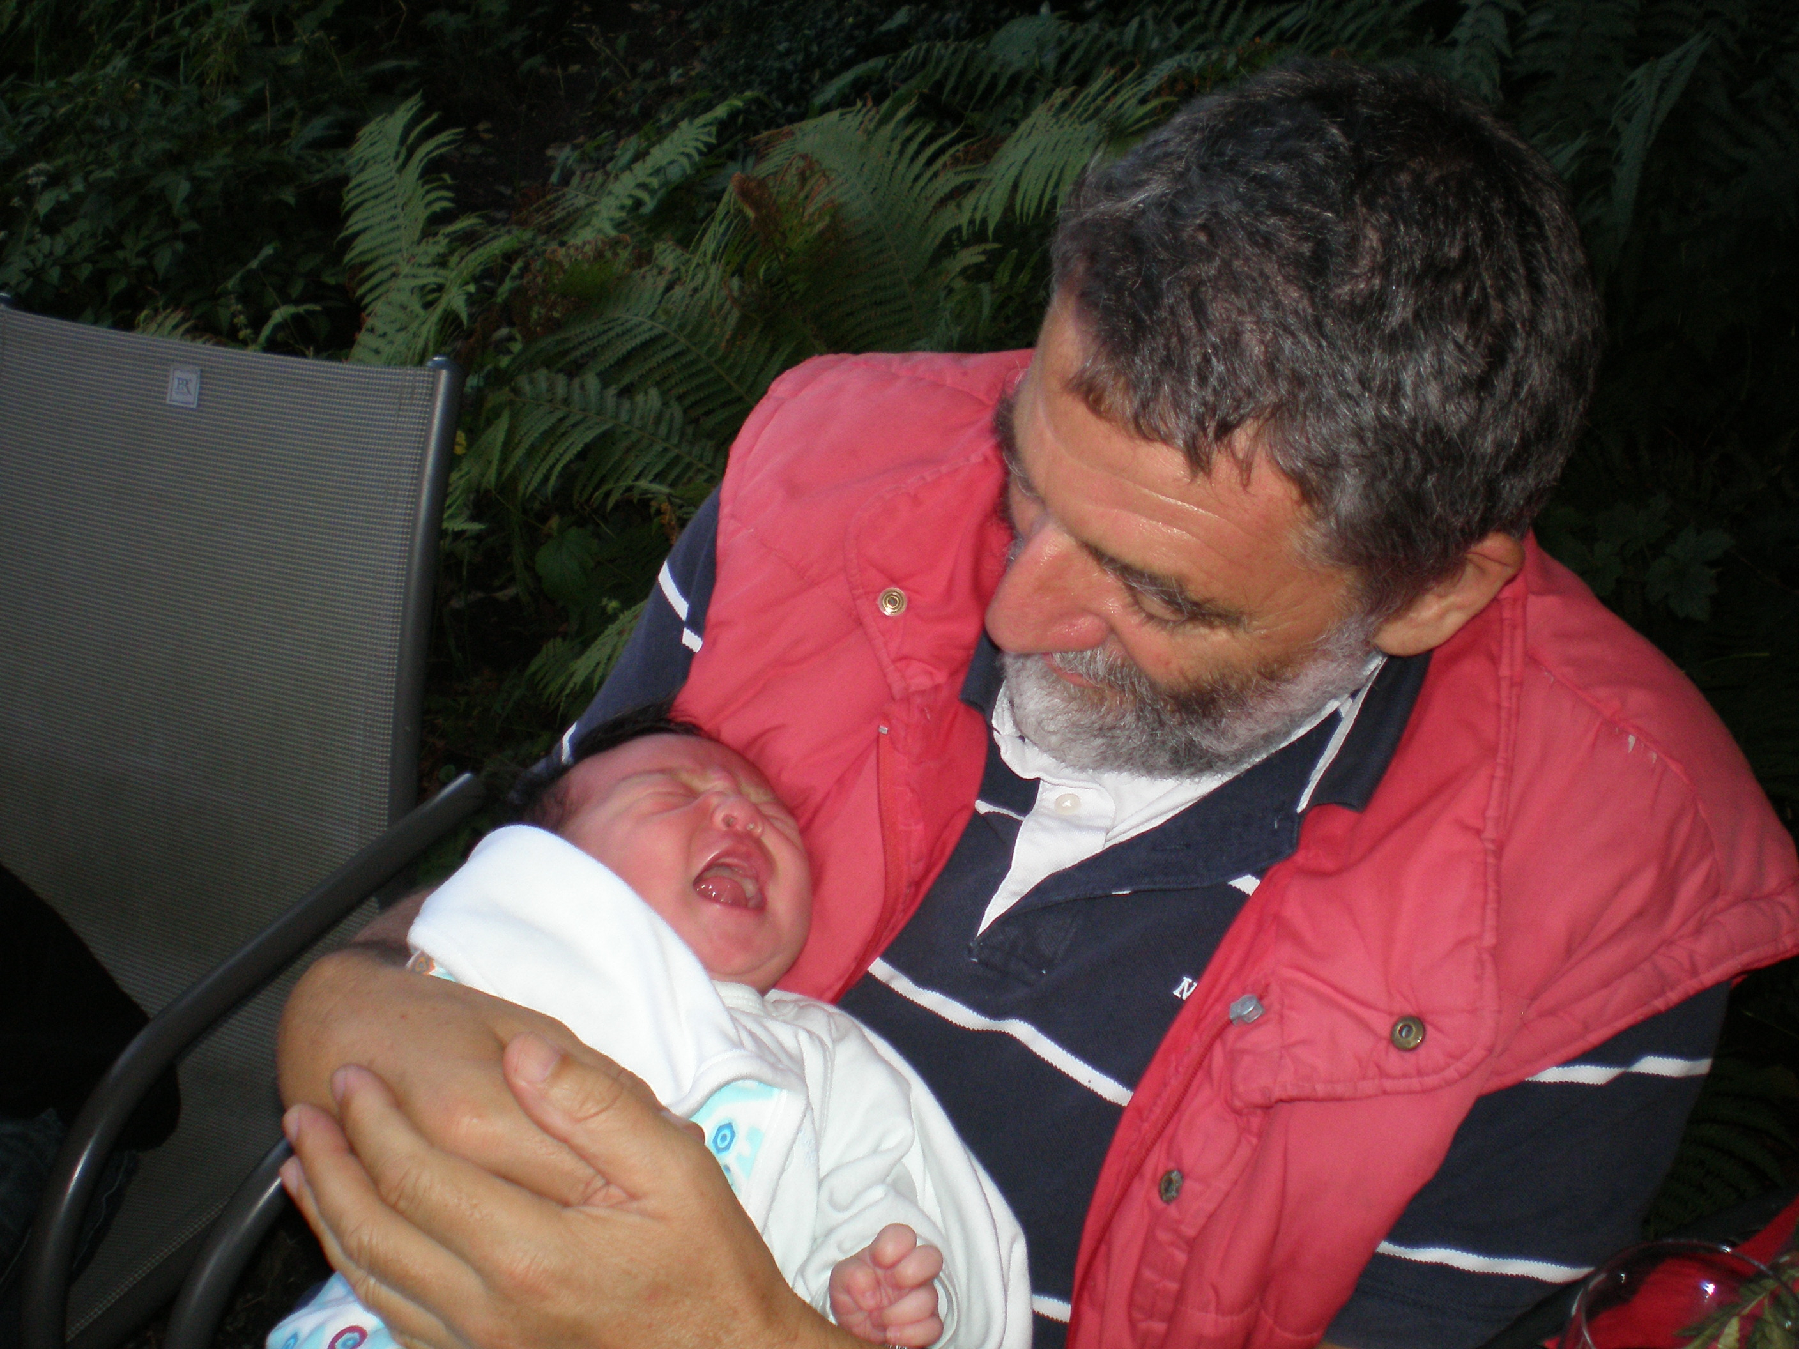
Nurturing a Community
Jan leads the way
Subversion repository
shows a furious activity
of projects with
mysterious names

Slide 26
Power To The People
The dream: a community of happy users sharing trees & scripts
But, too few people find it intuitive enough
  User's Guide,
  MeqWizard was supposed to address it
The reality: at least we have people running my pre-cooked scripts, and testing the algorithms that way
It's the start of a “Third-Generation Calibration” (3GC) community

Slide 27
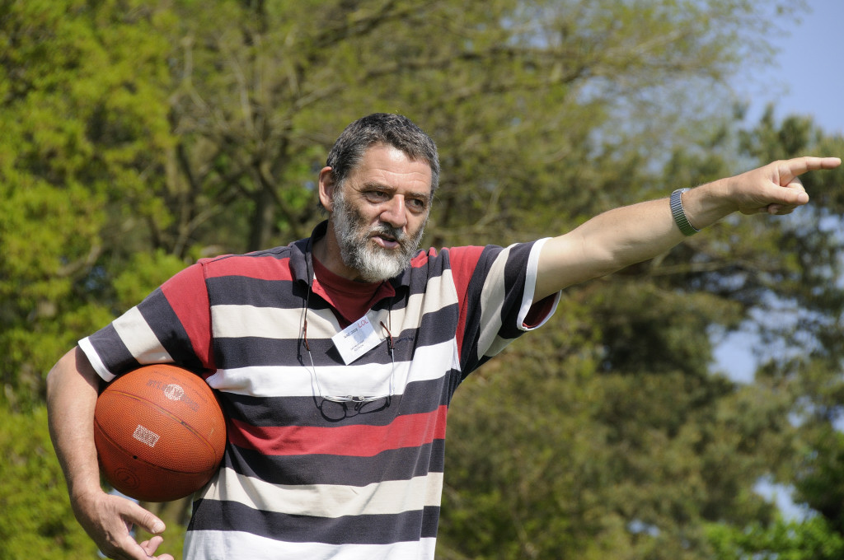
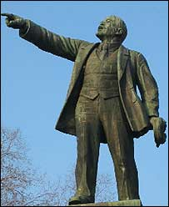
Onwards To 3GC

Slide 28
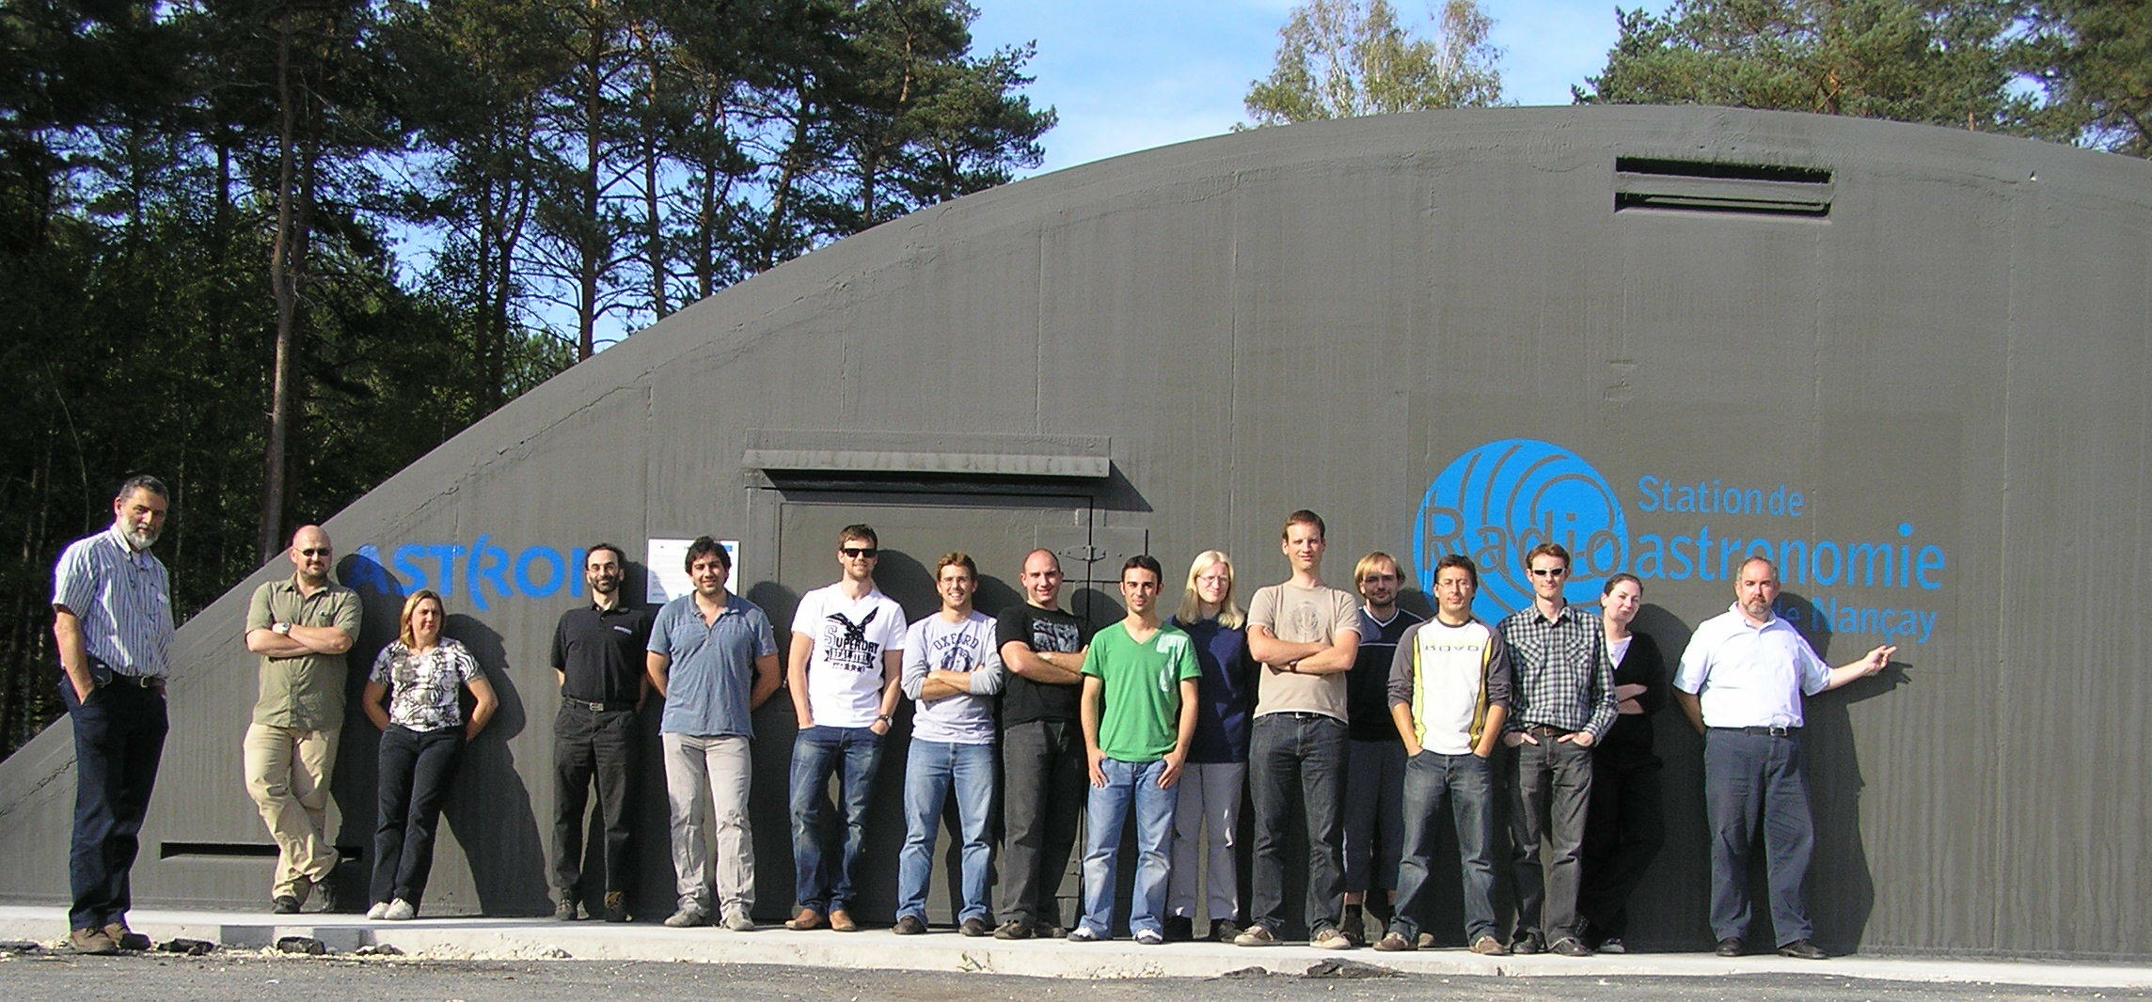
“Towards 3GC”: Nancay 2009
MCCT SKADS Mixed Workshop
“Towards third generation calibration in radio astronomy”

Slide 29
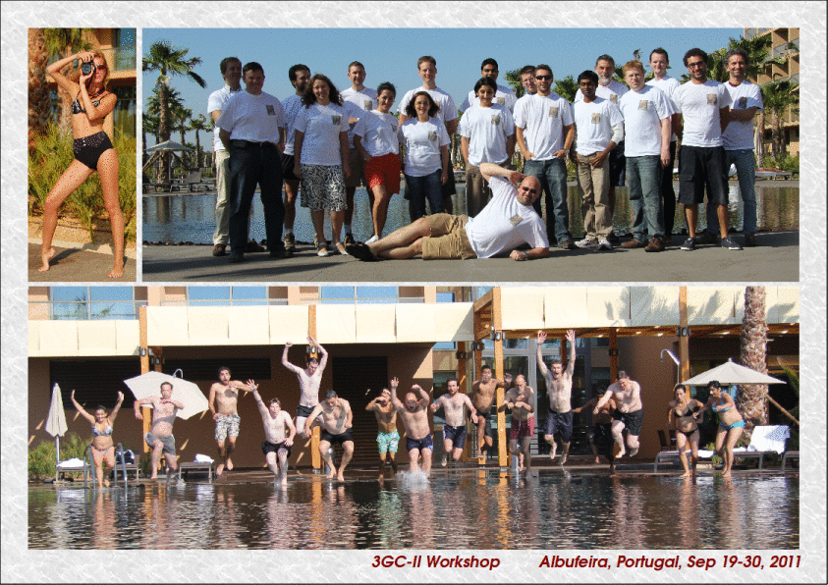
3GC-II: Portugal 2011

Slide 30
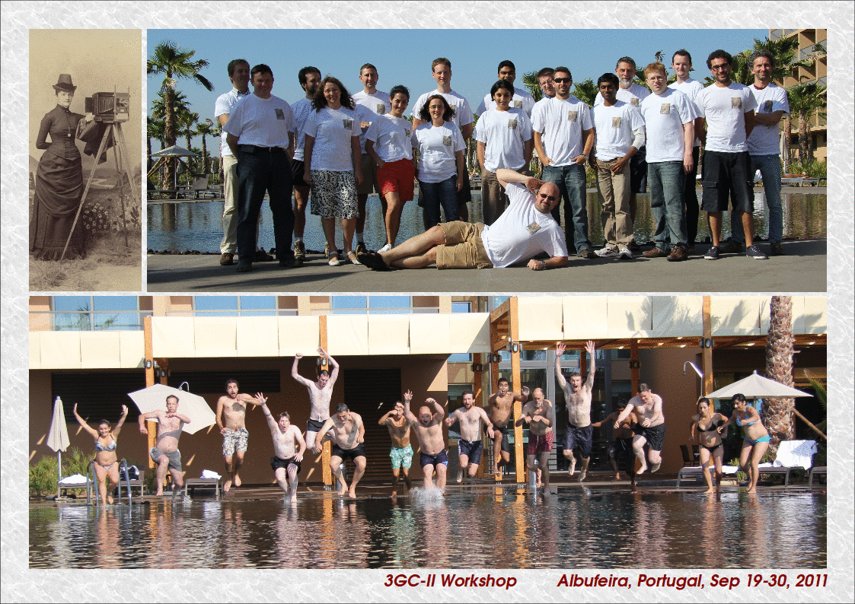
3GC-II: Portugal 2011

Slide 31
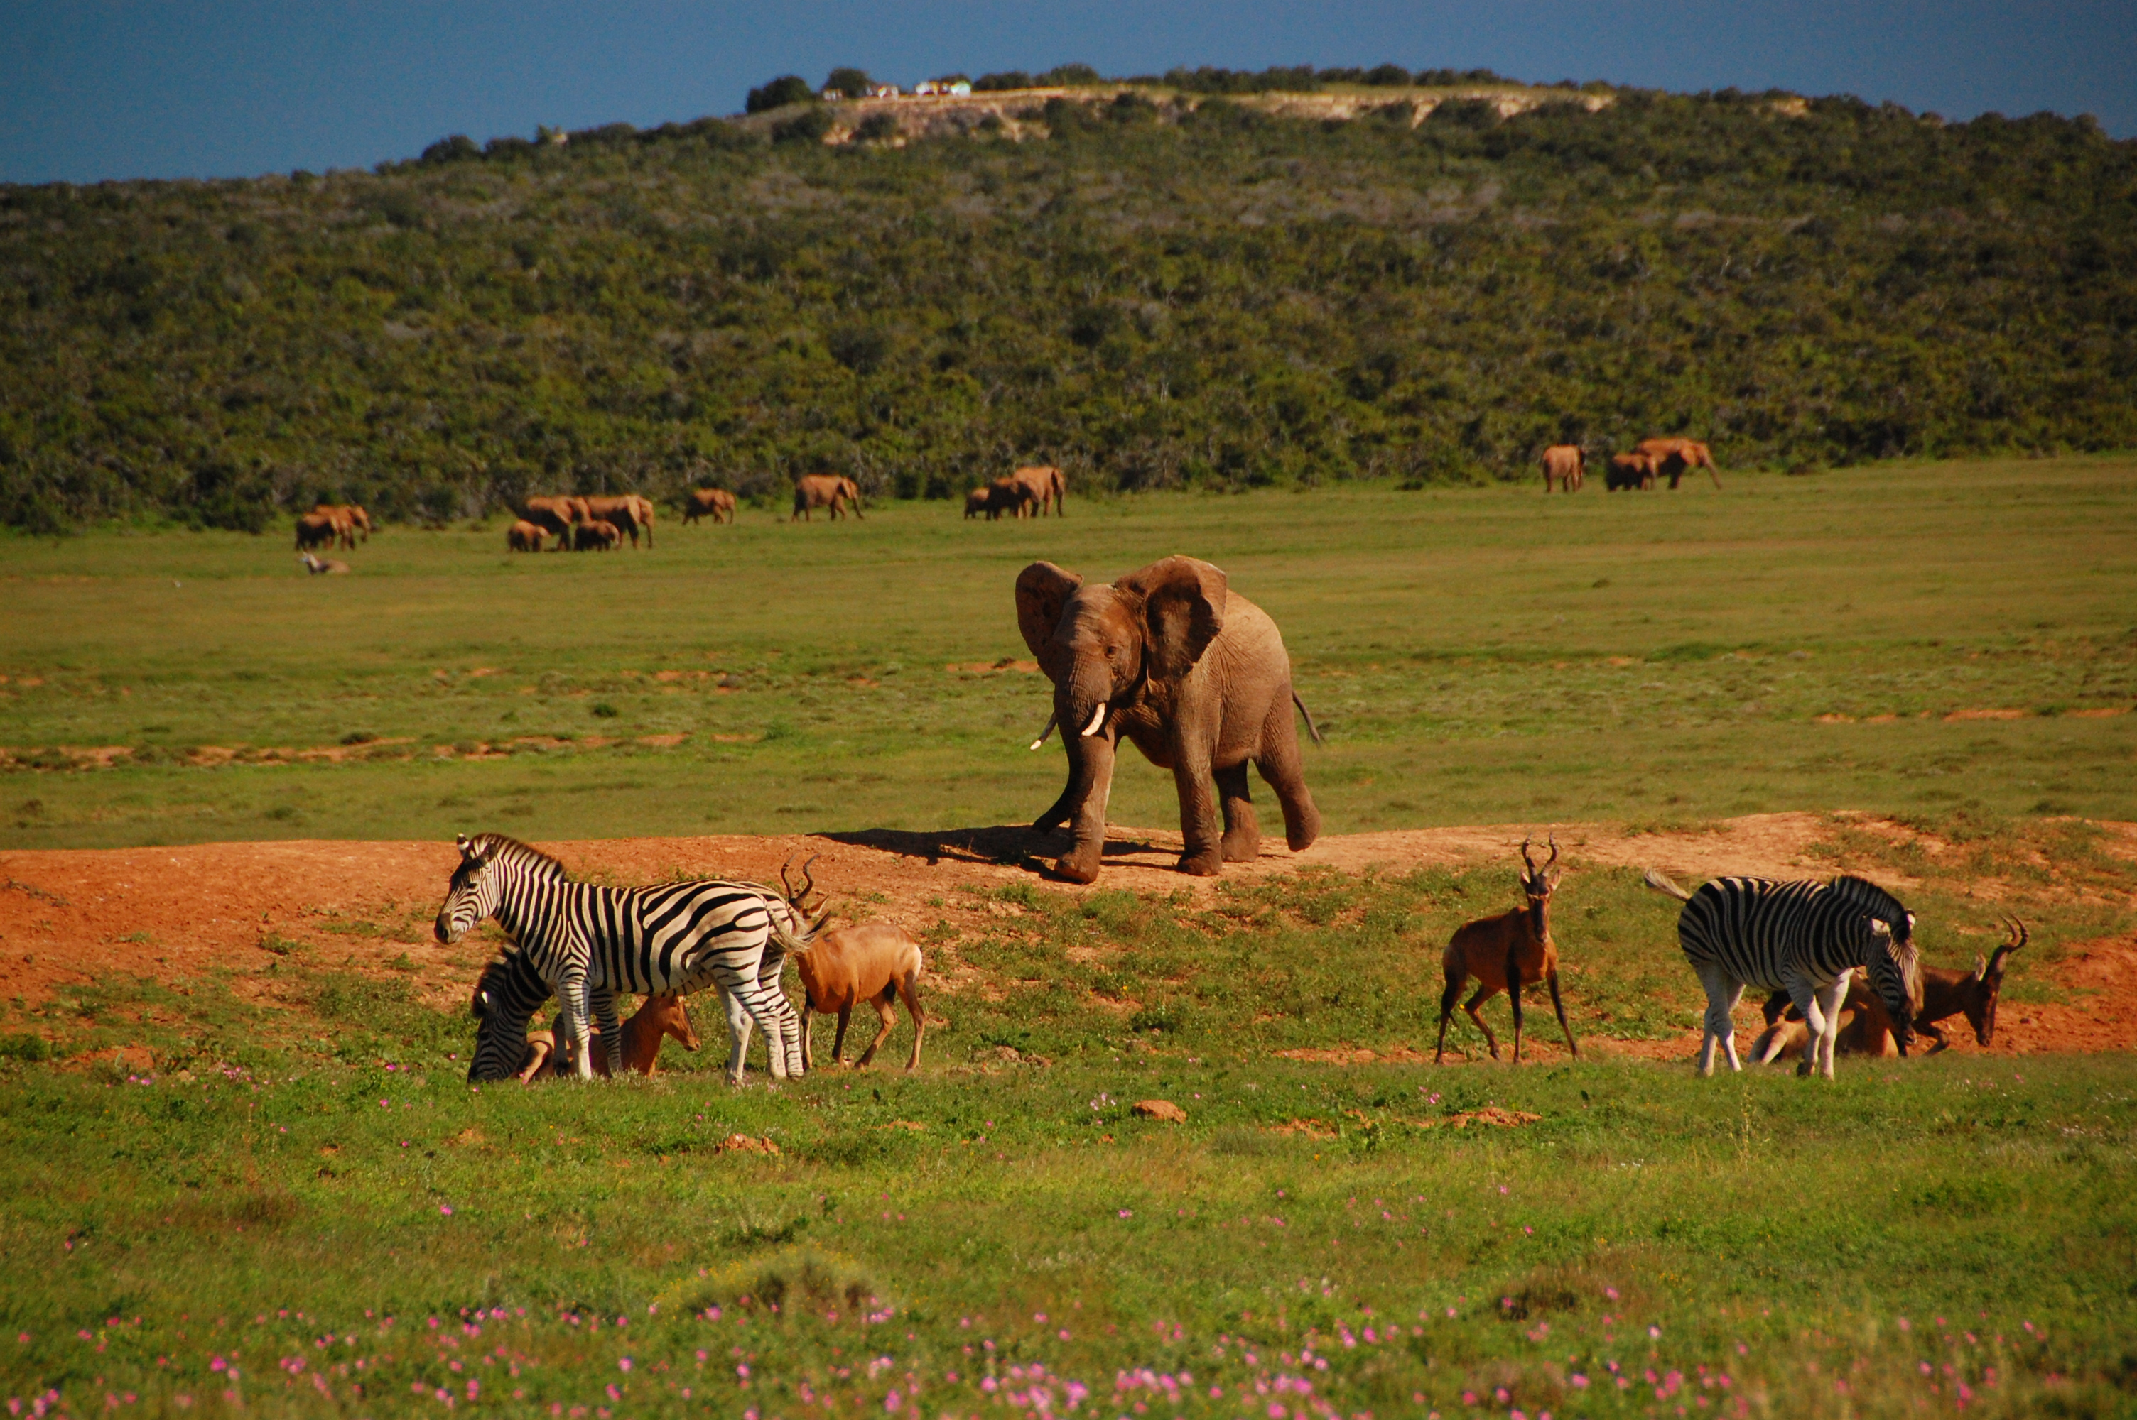
3GC3 (2013):
Back To The Waterhole

Slide 32
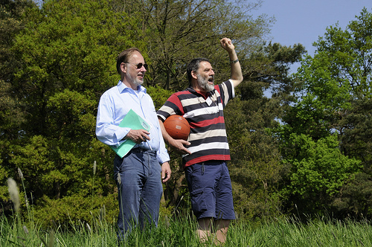
Conclusions
Jan may be retiring, but neither MeqTrees nor 3GC is going anywhere
  except maybe South Africa, but then many things are lately...
“I think MeqTrees might be the package that saves radio astronomy."
– Anon., priv. comm.

