Slide 1

Primary Beams, Dynamic Range,
The Westerbork Wobble
& Other
Marketing Ploys
O. Smirnov (Rhodes University & SKA SA)

Slide 2
Setting The Scene: Quotes
“Sensitivity is king, and dynamic range is the dominant queen.” –Justin Jonas
“The Devil in E-Jones†” –Brad Frank
“Everybody in the world has an E-Jones problem.”
–Jan Noordam
“My sidelobes are better than your sidelobes!”
–Tony Willis sums up the SKA Dish CoDR
“Know Thy Beams.” –me
“Where's the nearest pub?” –Steve Rawlings
†The E-Jones term of the RIME describes the primary beam pattern.

Slide 3

World Record Dynamic Range
(still, after 2 years...)
3C147 @21cm
12h WSRT synthesis
160MHz BW
22 Jy peak
13.5 μJy noise
1,600,000:1
Regular selfcal does not
reach noise, leaves
off-axis artefacts (“luxury
problems”) due to
direction-dependent
effects (left inset)
Addressed via differential
gains (right inset)
3C147 22Jy
30 mJy

Slide 4
The Competition...
EVLA: 2x number of dishes, massive bandwidth – 900,000:1 (same field @21cm)
LOFAR: 3x number of stations, massive bandwidth, massive sensitivity – 400,000:1
  Which is extremely impressive, considering the low-frequency, wide-field regime
DR is not important 

Slide 5
Differential Gains, In a Nutshell

Slide 6
A.k.a. “The Flyswatter”
The Good:
  dE's can completely eliminate contaminating sources, making for great maps!
  See also talks by Ian Heywood, Panos Labropoulos
The Bad:
  Computationally feasible for a “handful” of sources at most
  Proliferation of degrees of freedom
The Ugly:
  Mashes together all information on both the source and all instrumental effects towards it

Slide 7

The Ugly, continued...
...and makes no use of spatial continuity.
So we'd really like to learn to fit some “global” DDE models instead
Example: 3C147 field, dE-phase solutions:
WTF is
it doing
that?

Slide 8
Alternatives:
Fitting a “Global” DDE Model
Pointing selfcal (S. Bhatnagar)
  Uses EVLA PB model, with a solvable pointing offset Δl,Δm
  First-order approximation to ∂χ²/∂(Δl), ∂χ²/∂(Δm)
  using FFTs and convolutional functions
  Uses entire sky model (image) as input
  Results (so far): seems to improve pointing solutions, but little reduction in imaging artefacts
  Possibly due to inadequate PB model?
AW-projection can apply “global” correction during imaging

Slide 9
The QMC* Project
Pick a field containing a cluster of reasonably bright off-axis sources
Observe with WSRT @21cm
Introduce deliberate (and secret!) pointing errors during observation
Attempt to recover these during the reduction
*) Named in honour of the long-defunct WSRT Quality Monitoring Committee. Yes, the Dutch do love their committees. Fortunately, so do the Russians.

Slide 10

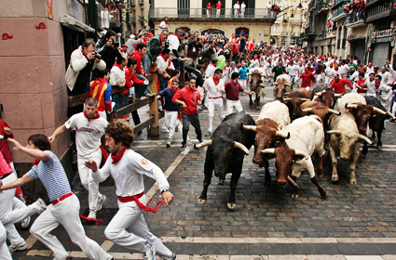
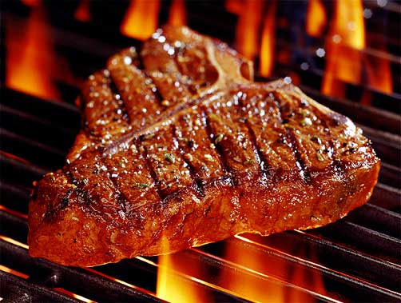
The QMC2 Field (01515+6736)
(a radio astronomer's worst nightmare)
>10 moderately bright off-center sources
The type of field that usually has radio astronomers running away screaming...
But perfect for our purposes!

Slide 11

Gifts Of QMC2
Initial observation (2010Jul3) was an “error-free” 12h synthesis, in order to build up a sky model
“I have never seen such
a terrible WSRT map!”
– Ger de Bruyn
Differential gains sorted
out the issue as usual

Slide 12


QMC2 2010Jul3 dE amplitudes
||dE|| solutions show large offsets on RT8, consistent with a significant mispointing to the North
Problem was reported to the Observatory, and they discovered a faulty encoder on RT8's declination axis

Slide 13

QMC2 2010Jul21:
Now mispointed
||dE|| solutions suggest a static mispointing of RT2, RT6, RT8
...and a time-variable mispointing of RTB
(“Hans's surprise”)
Hans confirmed that this was consistent with the mispointings he had put in.

Slide 14

“Rogues' Gallery” Plot
Plots of mean ||dE|| per antenna, at proper positions within the field.
Colour/size indicates
||dE||>1, <1.
(Note 3C source at NW!)

Slide 15
Solving For Pointing Errors
||dE|| plots are a reliable indicator of mispointing
  But only a very rough one...
Can we recover the actual pointing offsets?
A MeqTrees variation on pointing selfcal: DFT pointing solutions (see also “pointing selfcal” by S. Bhatnagar)
MeqTrees can “solve for anything”: we need to construct a suitable model where the pointing offsets are parameters, then designate them as solvable and say “go”.

Slide 16
DFT Pointing Solutions

Slide 17

P.E. Solutions (QMC2 2011Jul21)
Recovered solutions consistent with deliberate mispointings, but underestimate them:

Slide 18

Not so impressive...
Residual image,
post-selfcal

Slide 19

A Marginal Improvement
Residual image,
post-selfcal,
with pointing error solutions
(Note how this relative lack of improvement is consistent with Sanjay's pointing selfcal results.)

Slide 20

Nowhere Near The Flyswatter...
Residual image,
post-selfcal,
with differential
gains.

Slide 21
Parameterizing The Beam
The advantage of the DFT approach is that we can introduce other parameters into the primary beam model.
Just as a random example, we can introduce a per-antenna beam scale sp:
And then treat sp as a solvable.

Slide 22
P.E. Solution Only
Residual image,
post-selfcal,
with pointing error solutions

Slide 23

P.E. + Beam Extent
Residual image,
post-selfcal,
with pointing error and beam extent solutions
...not as good as differential gains, but an improvement!

Slide 24


Now Back To The Pretty Plots
Beam extent and pointing offset solutions are strongly coupled
Beam extent solutions are non-physical (±10%!)
More of the poitning
Obviously the extra degree of freedom is compensating for something else, but what exactly?

Slide 25
Compare To The PE-Only Case
P.E. solutions without a beam extent show more variance
...and underestimate the true mispointing to a larger degree
Tentative conclusion: P.E. solutions are limited by the accuracy of the beam model
...as are the final maps
There may also be a directional coupling determined by the configuration of sources in the field.

Slide 26
QMC2 “8-Way” Observations
To check for directional coupling, we asked for another observation of QMC2 with 8 antennas mispointed to 8 points of the compass (by 60 mdeg each)
This was done in March 2011, but due to some problems only 90 minutes of data were taken
Thus no imaging was possible
...but we could still do P.E. solutions
  (we'd been solving at 30-minute intervals before)

Slide 27


8-Way Pointing Solutions
Expected vs. fitted pointing offsets
With a solvable beam extent
Without a solvable beam extent

Slide 28
Know Thy Beams
(and the incestousness of selfcal)
Why not throw more parameters at the beam model?
We do NOT have absolute, intrinsic source fluxes. Selfcal gives us fluxes attenuated by some average primary beam.
Our solution is then only sensitive to differences between antennas (and timeslots).
Given a perfectly-pointed observation and identical PBs, our method is completely insensitive to beamshape.
Pointing errors give us a handle on the gradient of the beamshape.
  (this also explains why the beam extent solutions above are non-physical!)

Slide 29
The Next Step: A QMC2 Mosaic
Latest observation (2011Jul17): a 10-pointing mosaic, ~1 hour per pointing.
1 pointing to field centre,
9 pointings to off-axis
sources around the
half-power point.
8-way mispointed.
Will use this to
simultaneously constrain
source fluxes and PB
models.

Slide 30

Yet Another Twist: Solving For P.E.
On Shorter Time Scales
Solutions every 30 sec, 2.5 min and 5 min.
Longer time scales: decreased variance (higher SNR)
Diminishing returns above 5 min.
Show a striking feature unnoticed on the previous
(30 min.) plots...

Slide 31

And Now, Applying Sophisticated
Model Fitting Techniques...
Westerbork Wobble!
WW

Slide 32

The Wobble
A periodic (~20 min) variation in the pointing by 10-20 mdeg.
Shows up in other observations, on other antennas (to varying extent)
We can identify dominant “wobbly modes” by taking a Fourier transform of the P.E. solutions, and examining the amplitudes:

Slide 33
Wobbling Across 5 Epochs (Dec)

Slide 34
Wobbly Features
RA & Dec coupled, Dec wobbles more
Only some antennas wobble
  But they differ epoch-to-epoch
Wobble amplitude varies epoch-to-epoch
  Can reach 20 mdeg (10 is nominal accuracy!)
  Some epochs much worse than others, why? (waiting for wind data)
Wobble period is 5 to 60 minutes
  Quite stable (up to 4 hours)

Slide 35
An Inconvenient Question
All very interesting and
challenging for it own sake,
but where's the science?
That is, what results has
this enabled that we
couldn't have achieved
otherwise?

Slide 36

An Inconvenient Question
The answer (as of a few months ago) was, not very much
But if so, then high DR...
  ...consumes an excessive amount
  of time and resources
  ...and is only good for showing off?
Is it the trophy wife of
radio interferometry?

Slide 37
World Record Dynamic Range
(still, after 2 years...)
3C147 @21cm
12h WSRT synthesis
160MHz BW
22 Jy peak
13.5 μJy noise
1,600,000:1
Regular selfcal does not
reach noise, leaves
off-axis artefacts due to
direction-dependent
effects (left inset)
Eliminated these via the
application of differential
gains (right inset)
3C147 22Jy
30 mJy

Slide 38

Example 1: EVLA 8 GHz, WHDF
(Courtesy of Ian Heywood)
EVLA 8 GHz: Looking for sub-mm galaxies and QSOs in the William Herschel Deep Field.
Dominant effect: bright calibrator source rotating through first sidelobe of the primary beam.
(This also has a horrible PSF, being an equatorial field.)
This is your science
(good luck!)
This is your
phase calibrator
Brightness scale 0~50μJy

Slide 39

Keep Your Friends Close, and your calibrators as far away as you can...
An approximation of the primary beam response, overlaid on top of the image.
As the sky rotates, the sidelobes of the PB sweep over the source, thus making it effectively time-variable.
This is your science
(good luck!)
This is your
phase calibrator
(Brightness scale 0~50μJy)

Slide 40

Deconvolution Doesn't Help...
Residual image, after deconvolution.
The contaminating source cannot be deconvolved away properly, due to its instrumental time-variability.
...5 years ago this would observation would probably be a complete write-off.
(Brightness scale 0~50μJy)

Slide 41

Differential Gains To The Rescue
Residual image after applying differential gain solutions to the contaminating source
Brightness scale 0~50μJy

Slide 42

Multi-Band Image
Multi-band residual image:
noise-limited, no trace of contaminating source.
Phase calibrator
used to be here
Brightness scale 0~50μJy

Slide 43
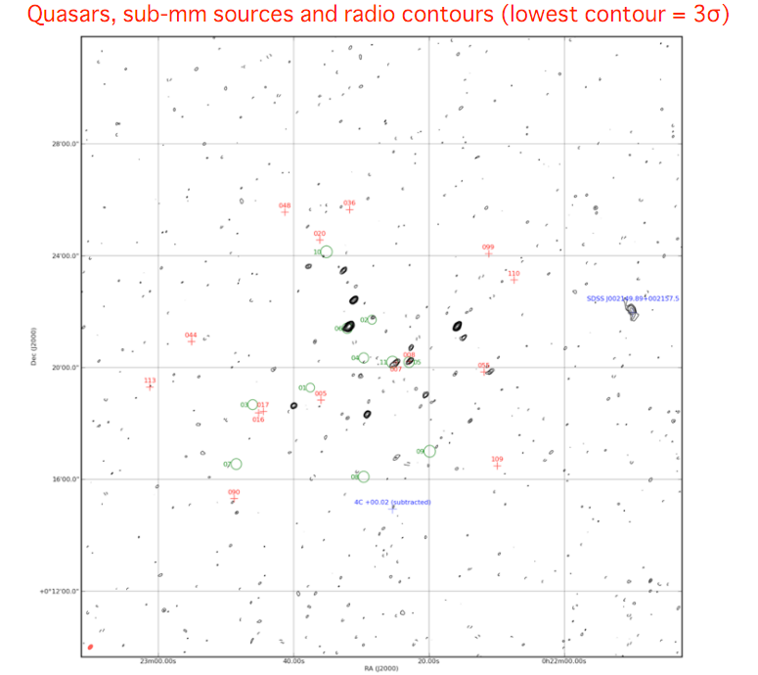

Slide 44
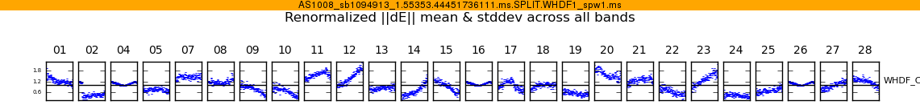
WTF Is It Doing That?
Above: Differential gain-amplitude solutions, as a function of time, per each antenna.
To first order beam patterns are identical across antennas and rotate the same way, so why the huge differences?
Answer: small pointing errors.
This is your science
(good luck!)
This is your
phase calibrator
Not a bad spot to put a calibrator in --
– it's The Worst Place In The World
to put a calibrator in.

Slide 45
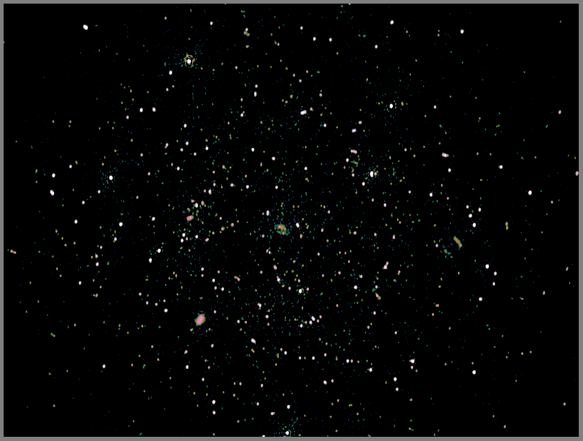
Example 2: Galaxy Clusters,
Radio Halos & Relics (PI: R. Pizzo)
WSRT multi-wavelength project (18, 21, 25, 92cm).
Looking for very faint extended emission.
Very steep spectrum, so mostly visible at 92cm...
! ...where DDEs (from the ionosphere) are at their worst.
! Lots of bright sources in the field.

Slide 46
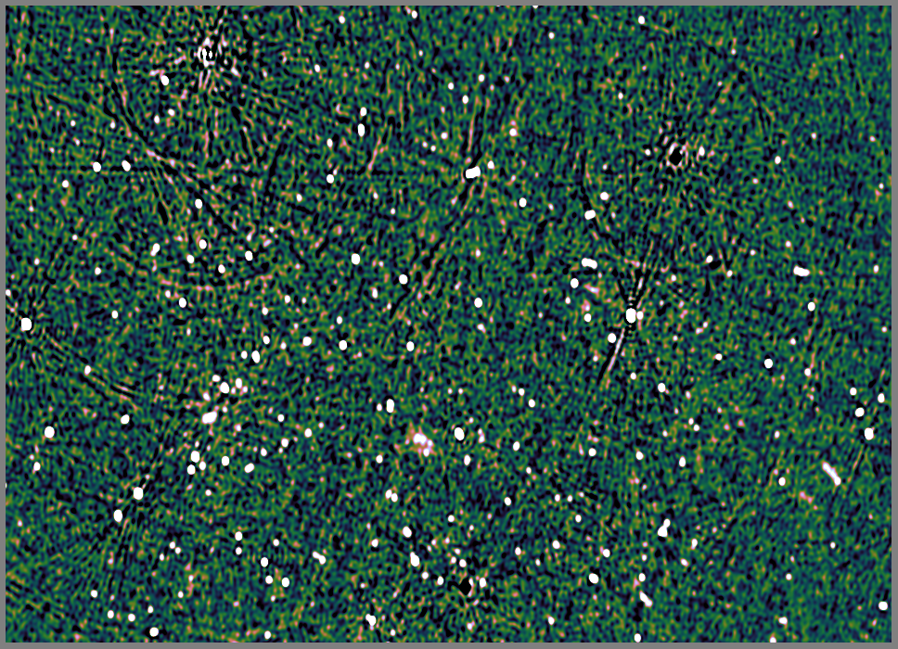
A773: Classic Selfcal + Peeling

Slide 47
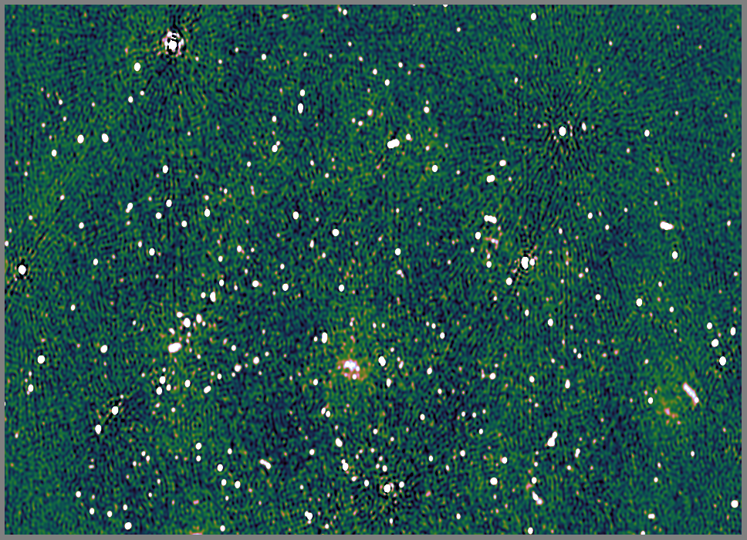
A773: Differential Gains ++
1.1 Jy
750 mJy
620 mJy

Slide 48
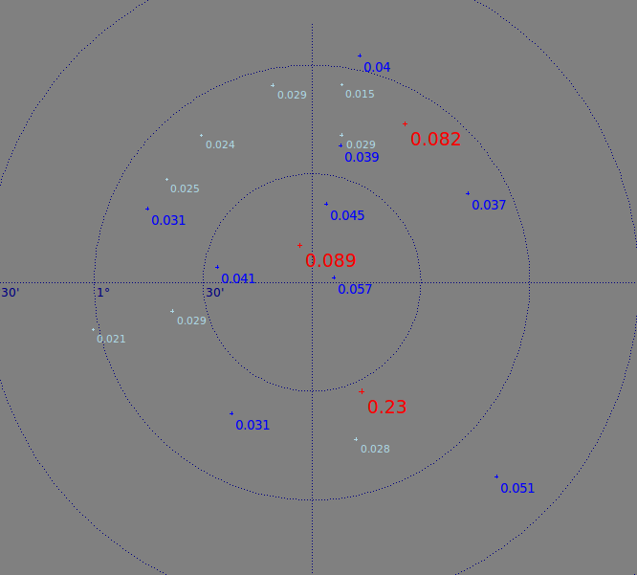
Lessons For MeerKAT
LADUMA deep field
NVSS apparent fluxes (with an approximate PB model)
24 sources > 10 mJy
12 sources > 30 mJy
big 3: 230, 89, 82 mJy
(Fornax A: ~4º East
~3000 attenuation)
Target: 0.1 μJy
DR: 0.5 – 2.3 million

Slide 49
DR is a Marketing Ploy!
What does this prove?
Selfcal can go to
1.6 million on-axis
...with an extrinsic sky
model – the 3C147 model
is derived from VLBI!)
Final DR number is just
a function of how bright
the big source is.
Pointing error here is a
3000:1 effect
We've only proven
we can get to 3000:1
off-axis
σ =13.5 μJy
3C147 22Jy
30 mJy

Slide 50
A Far Less Benign Case
Abell 773 –
WSRT at 330 MHz
No single dominant on-axis source
0.12 mJy noise
Struggling to reach 5000:1 here...
1.1 Jy
750 mJy
620 mJy
Main culprit is ionosphere – “only” a low-frequency problem, right? (effect is ~λ²)
A 5000:1 problem at 330 MHz is a 100,000:1 problem at 1.4 GHz

Slide 51
Back To MeerKAT...
Target: 0.1 μJy
DR: 0.5 – 2.3 million
off-axis
We're still far from showing this
Ionosphere may become important
Though having lots more baselines will help, as LOFAR has shown

Slide 52
Conclusion:
No More Luxury Problems
We've come a long way...
...but it's nowhere near enough for (deep) MeerKAT
  and certainly not the SKA!
Lots more work needed:
  Primary beam models (Know Thy Beams!)
  Ionosphere (LOFAR driving progress there)
  Calibration methods
We can already simulate most of this fairly well, so we can at least quantify the problems that we cannot solve yet.

