Slide 1
Calibration & Imaging
Research at Rhodes University & SKA SA
Oleg Smirnov
(Rhodes & SKA SA, ex-ASTRON)

Slide 2

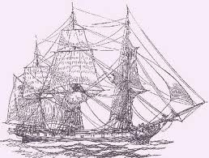
Who We Are
Rhodes Centre for Radio Astronomy
Techniques & Technologies (RATT):
  Justin Jonas & myself
  2 postdocs
  4-5 students
Radio Astronomy Research Group (RARG) at the SKA office in Pinelands:
  myself
  3 Senior Astronomers
  2 postdocs

Slide 3
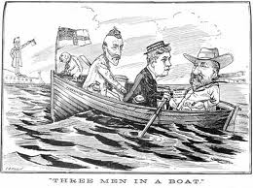
Who We Are (Currently)
Rhodes Centre for Radio Astronomy Techniques & Technologies (RATT):
  Justin Jonas & myself
  2 postdocs
  4-5 students
Radio Astronomy Research Group (RARG) at the KAT office in Pinelands:
  myself
  3 Senior Astronomers
  Cyril Tasse

Slide 4
Research Directions
Telescope simulations
  As an experimental and (SKA) design tool
Direction-dependent effects (DDEs):
  E.g. calibration of primary-beam related effects
Imaging algorithms
Source modeling & deconvolution
Solvers & minimization techniques
Massively parallel & GPU implementations

Slide 5
I. Simulations
End-to-end instrument simulations
  Sky model to simulated visibilities
  Impressive, unwieldy & mostly useless
Simulators as an experimental tool:
  What-if scenarios
  Design decisions
Filling in the gap in understanding between engineering specs & scientific performance
  Difficult to make progress analytically
  Use brute-force simulations to explore the problem

Slide 6


Example: MeerKAT BeamSims
Prime focus vs. offset Gregorian beam

Slide 7

Sidelobe Confusion Noise

Slide 8


Sensitivity to Pointing Error
Repeat this experiment for PF and OG beam patterns
Calibration “noise” for OG lower by a factor ~3
PF: rms 3.6 μJy
OG: rms 1.2 μJy

Slide 9
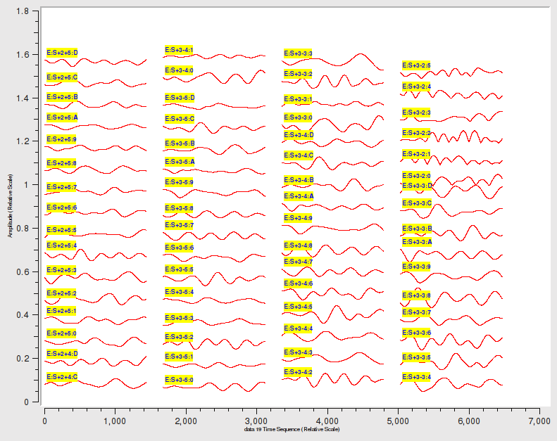
Collaboration Opportunities
Directly relevant to APERTIF, AAVP & LOFAR
Example: APERTIF beam stability
  Compound beam tends to “breathe” due to drifting LNA gains
  How frequently do we need
  to recalibrate the beamformers
  to achieve a given DR?
Working with M. Ivashina
(Chalmers U., ex-ASTRON), Wim van Capellen, Stefan Wijnholds (ASTRON)

Slide 10

II. Calibration of DDEs
3C147 WSRT
WR dynamic range
(>1 million)
Using differential
gains (aka DD
solutions)

Slide 11
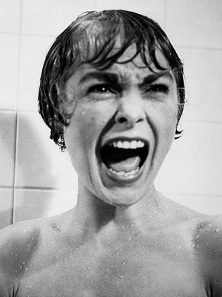
Dangers of DD Solutions
Excessive use of DD solutions is dangerous:
  Makes very clean maps
  ...but your science target is also
  suppressed!
  ...due to an excess of degrees of freedom
Need to explore parameterized models
to decrease the DoFs:
  Pointing error solutions
  Beam models
  Ionospheric models

Slide 12

Example: WSRT Pointing Error
Experiments
to fit for
deliberate
pointing offsets
in WSRT data
Blind test
Pointing errors
[somewhat]
recovered
Along with some
surprises...

Slide 13

The Westerbork Wobble
WW

Slide 14
Collaboration Opportunities
EVERYONE needs this
Upcoming 3CG3 workshop (Feb 2013) to focus on this
  large Dutch presence

Slide 15
III. Imaging
Parameterized calibration solutions need to be applied during imaging
AW-projection does this
  Only two people in the world fully understand it: Sanjay Bhatnagar & Cyril Tasse
Cyril is responsible for the awimager software used in the LOFAR pipeline
  >10x gains last week, now FASTER than CASA
  Currently adapting to MeerKAT
Collaboration opportunities obvious

Slide 16
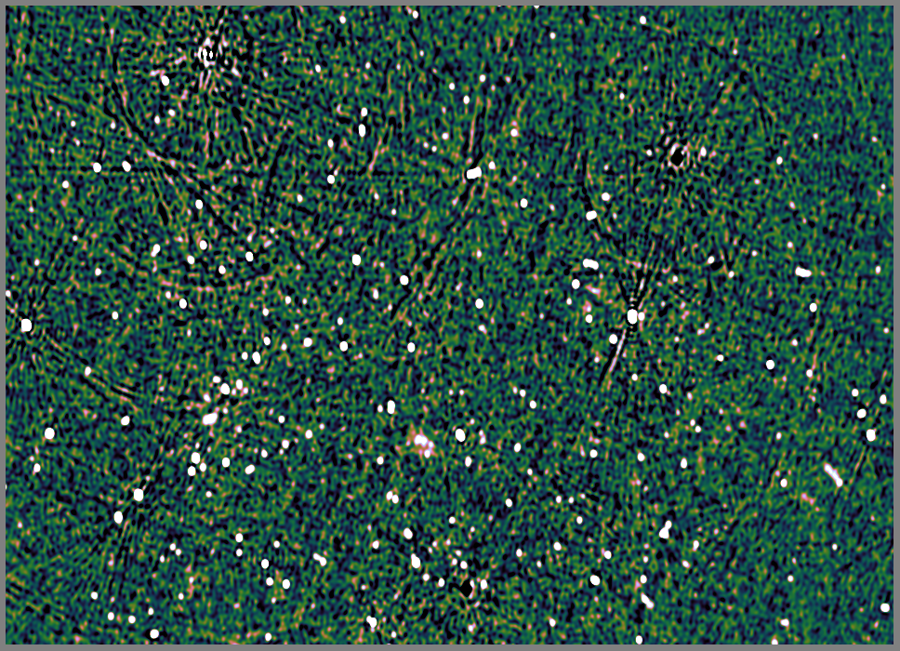
IV. Source Modeling & Deconvolution
1.1 Jy
750 mJy
1.1
470 mJy
σ=.09mJy thermal,
.3-.4 mJy confusion
620 mJy
A773: The WSRT Field From Hell
(ASTRON Italian mafia + myself)

Slide 17
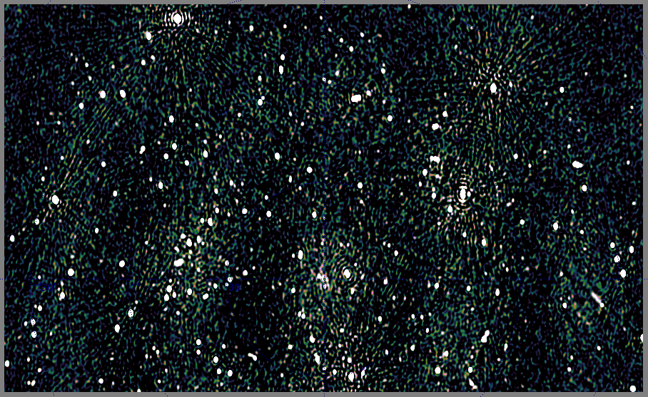
DD Solutions Not Enough...
DD solutions leave artefacts
due to slightly extended sources

Slide 18
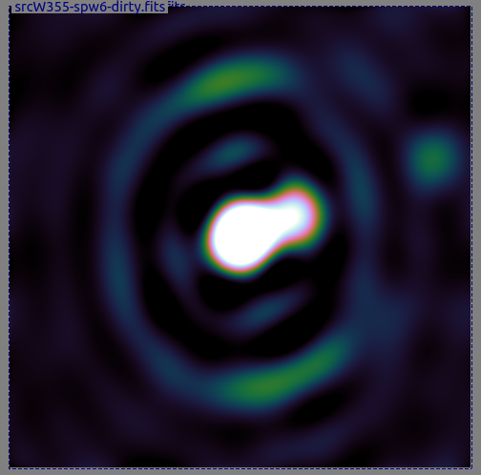
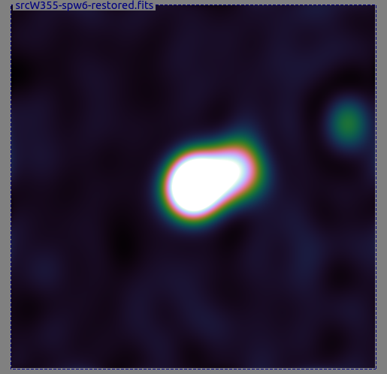
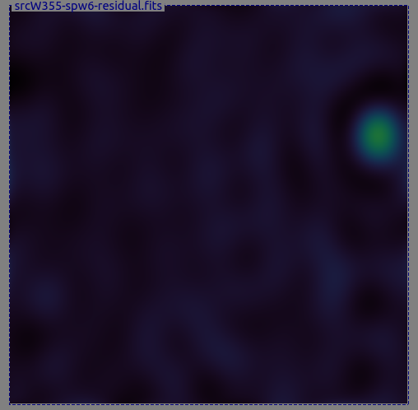
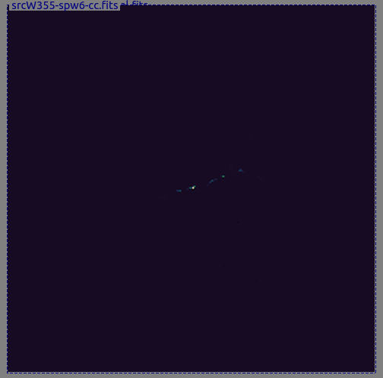
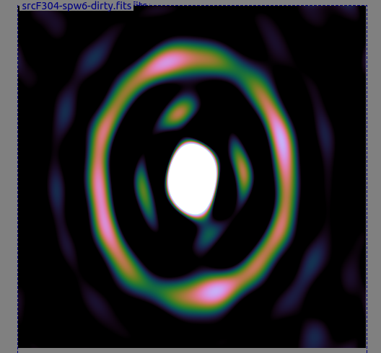
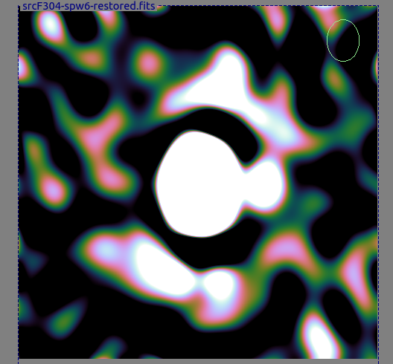
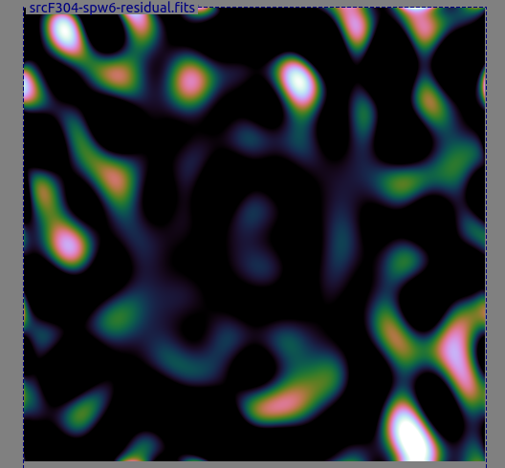
Extended Sources
Slightly extended sources are the bane of
any data reduction
Some of these are amenable
to CLEANing:
...and some less so:

Slide 19
Advanced Source Modeling
Shapelets, prolate spheroids (S. Yatawatta, ASTRON)
ASP-CLEAN, MSMF-CLEAN (NRAO)
Compressive sensing (CS)
  Using wavelets for source extraction
  In collaboration with C. Ferrari & A. Dabbech
  (Le Observatoire de la Cote d'Azur & LOFAR)
EVERYONE needs this

Slide 20
V. Advanced Solvers
DD-solutions and parameterized DDEs make for SLOOOOW calibration
Need faster solvers!

Slide 21
Stefcal (Stef Salvini, Oxford)
...a quick-and-dirty Python implementation
 | WSRT 74 baselines 28 ch 1437 t/s 300 sources | LOFAR 575 baselines 1 ch x 1280 t/s 42 sources full 2x2 solution | MeerKAT (64) 2016 baselines 8 ch x 480 t/s 884 sources | SKA1 (256)
MeqTrees stefcal time | 1m40s | 2m | 3m
MeqTrees selfcal (LSQ) time | 10m | 15m | 24m
“pure” stefcal time (minus I/O and model predict) | 1m | 1m | 1m20s
“pure” selfcal time | ~9m | ~13m | ~22m
speedup | x9 | x13 | x16 | xSilly
The Salvini time

Slide 22
Beyond Stefcal
As formulated, Stefcal does direction-independent solutions
Cyril Tasse has extended this approach to direction-dependent solutions
  Works in prototype... watch this space
EVERYONE needs this

Slide 23

Conclusions
Prospects are good
  Everyone needs most (or all)
  of the above
  Once fully manned,
  RATT & RARG will have a
  critical mass of expertise
  Good links to ASTRON & Dutch universities
3GC3 Workshop at Port Alfred (Feb 2013) to flesh out collaborations

