Slide 1
Radio Interferometry,
Calibration & Dynamic Range
(How To Do It & Stay Sane)
O. Smirnov (Rhodes University & SKA SA)

Slide 2
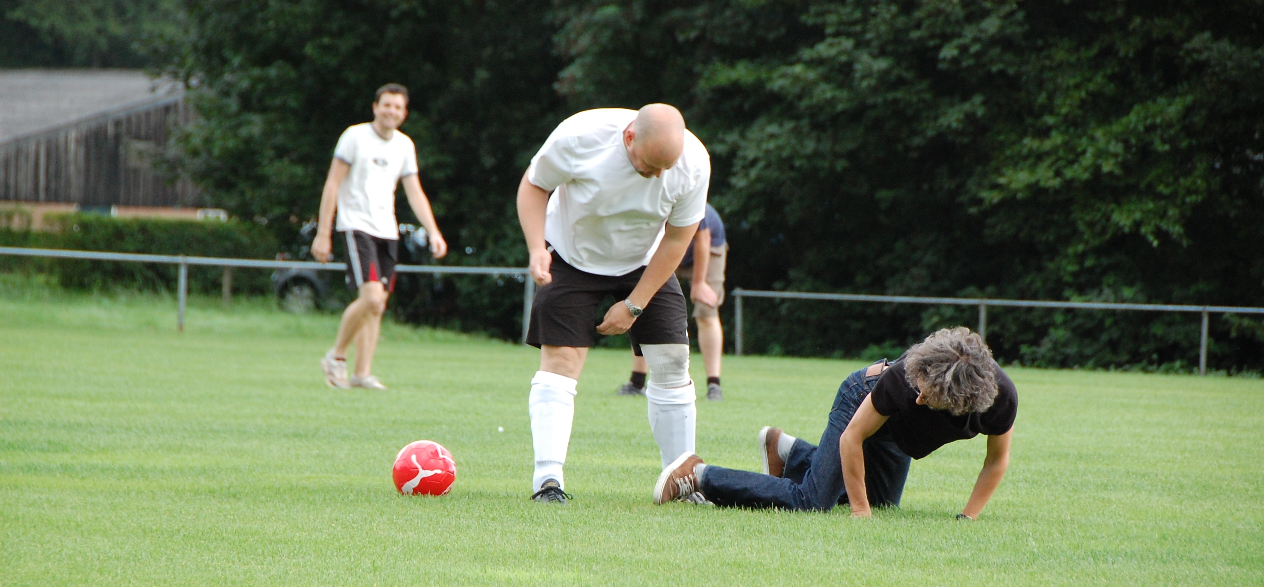
About myself
Served out almost 13 years at ASTRON, Dwingeloo, The Netherlands (home of WSRT, LOFAR, a million sheep & bland food)
Moved to South Africa this year: Rhodes University & SKA SA (Cape Town). Similar sheep counts. Much better food.
Research
interests are
interferometry,
calibration,
imaging,
algorithms,
software,
football.

Slide 3
Basic Laws Of Interferometry
I. Thou DOST NOT understand interferometry.
II. Thou SHALT talk about interferometry.
III. When caught talking crap, thou shalt
invoketh The First Law.

Slide 4
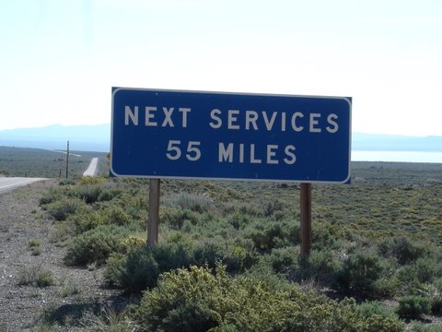
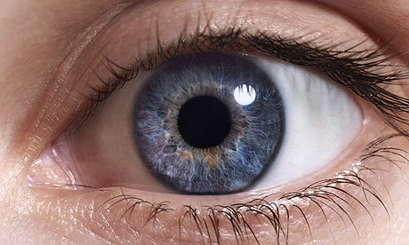
The Problem With Radio Waves...
...is that they're just too bloody long!
Resolution ~ λ / D, and λ is just too big
  What's the radio analogue of the human eye?
Need a clever solution here...
= ?

Slide 5
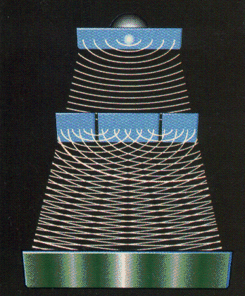
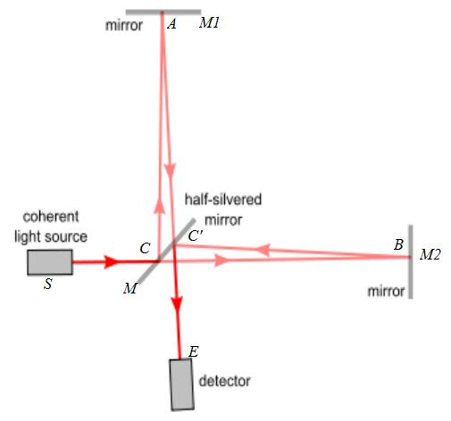
A Simple Interferometer
Double-slit experiment: interfering waves from the two slits make a pattern of dark and light bands
Position of bands is a probe of the source location
  ...to a resolution of λ / D
Intensity of bands is a probe of the source extent
Michelson
interferometer
uses the same
principle
Not an imaging
instrument!

Slide 6
Interferometric Imaging
Early interferometers could be used to measure certain object properties, but were not true imaging devices
The development of the [Earth rotation] aperture synthesis technique by Sir Martin Ryle's group changed this dramatically
  Interferometers could now be used to make detailed images!

Slide 7
The Ron Ekers Seven-Step Program
To Producing A Radio Interferometer
Step 0. Admit that you have a problem:
You want to (need to/are forced to by peers/supervisors) to do interferometry.
“My name is Oleg Smirnov, and I am an interferometrist.”

Slide 8

How To Make An Interferometer 1
Start with a normal reflector telescope....

Slide 9

How To Make An Interferometer 2
Then break it up into sections...

Slide 10

How To Make An Interferometer 3
Replace the optical path with electronics

Slide 11

How To Make An Interferometer 4
Move the electronics outside the dish
...and add cable delays

Slide 12

How To Make An Interferometer 5
Why not drop the
pieces onto the ground?

Slide 13

How To Make An Interferometer 6
...all of them

Slide 14
How To Make An Interferometer 7
And now replace them with proper radio dishes.
...and that's all! (?)
Well almost, what about the other pixels?

Slide 15

How Does Optical Imaging Do It?
This bit sees the EMF
from all directions,
added up together.
This bit sees the EMF
from all parts of the
dish surface,
added up together.

Slide 16
Fourier Transforms
An optical imaging system implicitly performs two Fourier transforms:
  1. Aperture EMF distribution = FT of the sky
  2. Focal plane = FT⁻¹ of the aperture EMF
A radio interferometer array measures (1)
  Then we do the second FT in software
  Hence, “aperture synthesis” imaging

Slide 17
A Few Problems
Gaps in the aperture... see later
Can't really measure & FT the EMF directly
  e.g. 1 GHz signal: that's a LOT of FTs per second
Instead, we can measure the coherency:
  i.e. sample fast, then
  integrate in the correlator,
  so the output sample
  rate is slow (~seconds)
...because that has all the interesting information

Slide 18
Why Coherency?
Recall the double slits: what does the photographic plate really measure?
  ...average intensity:
e(x) is a superposition of the signal from the two slits p and q:

Slide 19


The uv-Plane
Image plane
uv-plane
(12 hours!)
FT
One baseline samples
one visibility at a time
In a sense, the two are entirely equivalent

Slide 20
The uv-Plane
Image plane
uv-plane
(12 hours!)
FT
One baseline samples
one visibility at a time
In a sense, the two are entirely equivalent

Slide 21
Earth Rotation Aperture Synthesis
Every pair of antennas (baseline) is correlated, measures one complex visibility = one point on the uv-plane.
As the Earth rotates, a baseline sweeps out an arc in the uv-plane
  See uv-coverage plot (previous slide)
Even a one-dimensional East-West array (WSRT = 14 antennas) is sufficient

Slide 22
Where's The Catch?
We don't measure the full uv-plane, thus we can never recover the image fully (missing information)
  Interferometer = high & low-pass filter
Every visibility measurement is distorted (complex receiver gains, etc.), needs to be calibrated.
(Doesn't work the same way in optical interferometry at all...)
  Can't really form up complex visibilities, etc.

Slide 23


Catch 1: Missing Information
Response to a point source: Point Spread Function (PSF)
PSF = FT(uv-coverage)
Observed “dirty image” is convolved with the PSF
Structure in the PSF = uncertainty in the flux distribution (corresponding to missing data in the uv-plane)
(12-hour WSRT PSF)
4
2

Slide 24

Deconvolution: from dirty to clean images
Real-life WSRT dirty image
Dirty image dominated by PSF sidelobes from the stronger sources
Deconvolution required to get at the faint stuff underneath.
A whole continuum of skies fits the dirty image (pick any value for the missing uv-components)
Deconvolution picks one = interpolates the missing info from extra assumptions (e.g.: “sources are point-like”).

Slide 25
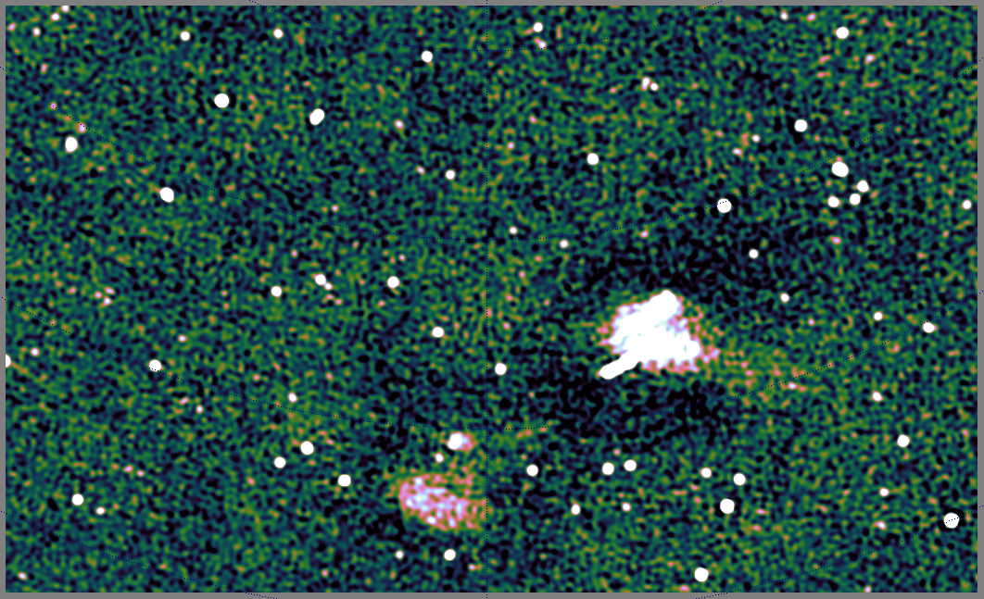
Deconvolution Gone Bad
Extended sources always troublesome
Plus we're missing the zero-order spacing measurement (=total power)
...end up with a “negative bowl” problem
Ultimately, interpolating missing uv-components requires a better choice of basis functions
...and better deconvolution methods
Compressed sensing (CS) is promising

Slide 26
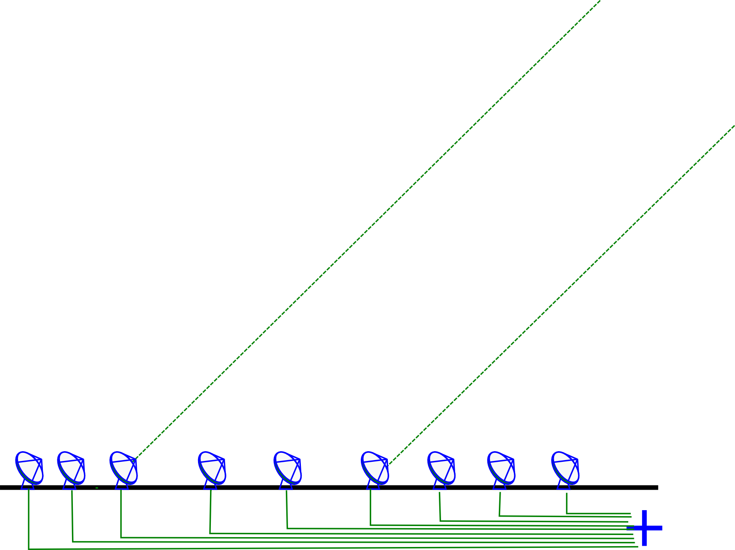
Catch 2: Measurement Errors
Incoming signal is subject to distortions (refraction, delay, amplitude loss)
  atmospheric and electronic

Slide 27
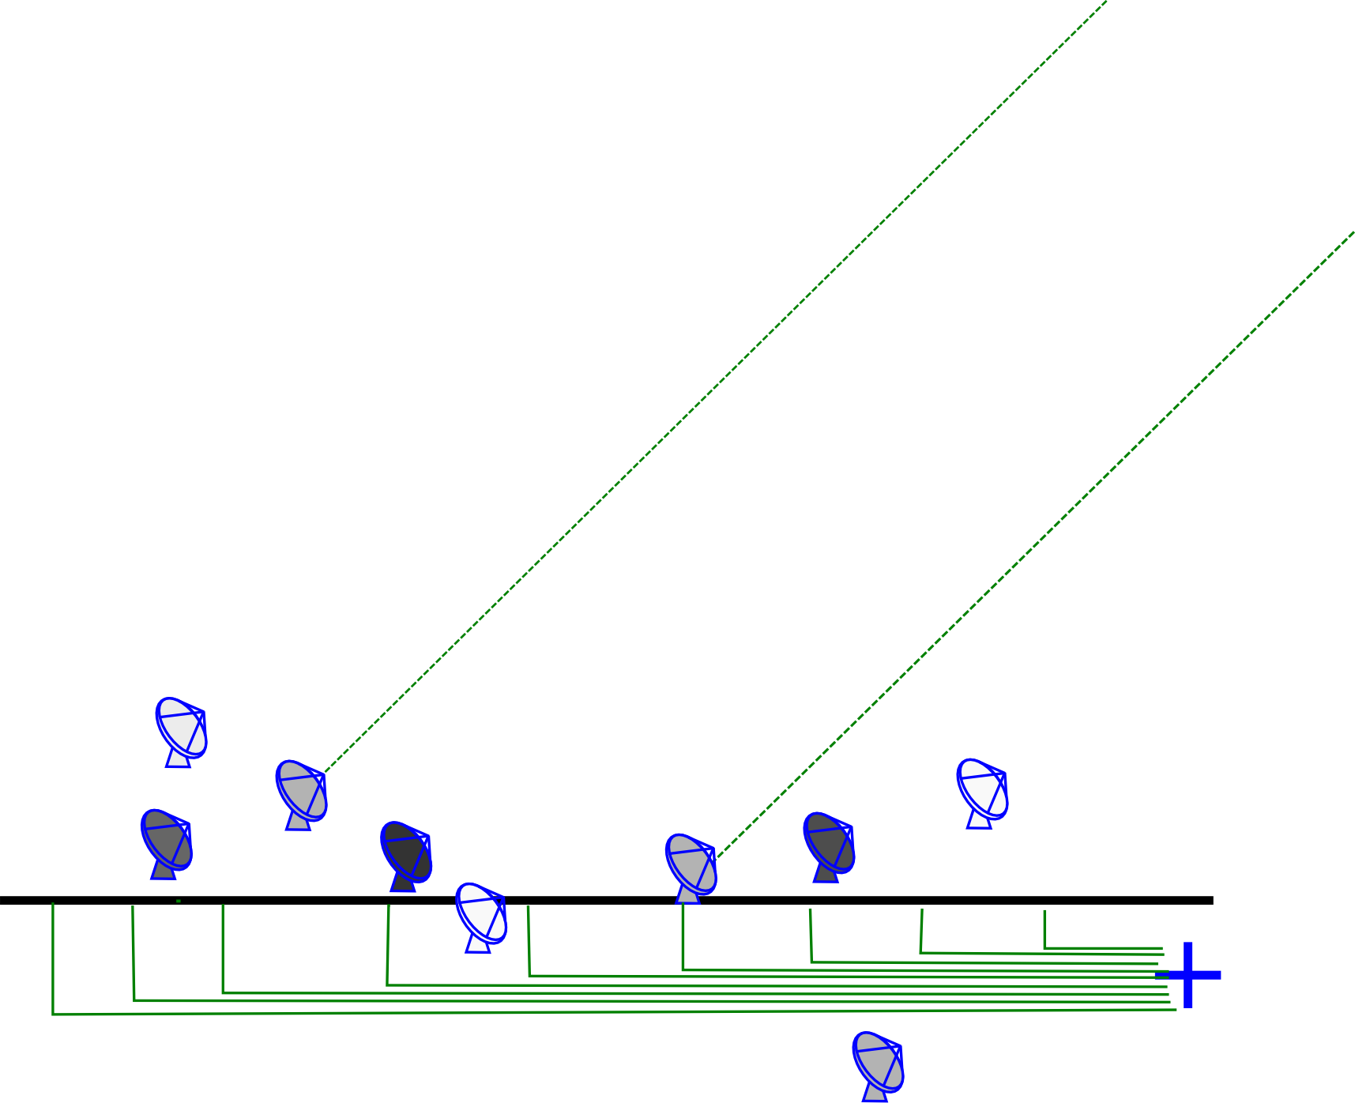
An Uncalibrated Interferometer
Complex gain error: signal multiplied by a amplitude and phase delay term
Delay errors correspond to differences in arrival time, i.e. random shifts of antennas towards and away from the source
Amplitude errors = different sensitivities

Slide 28
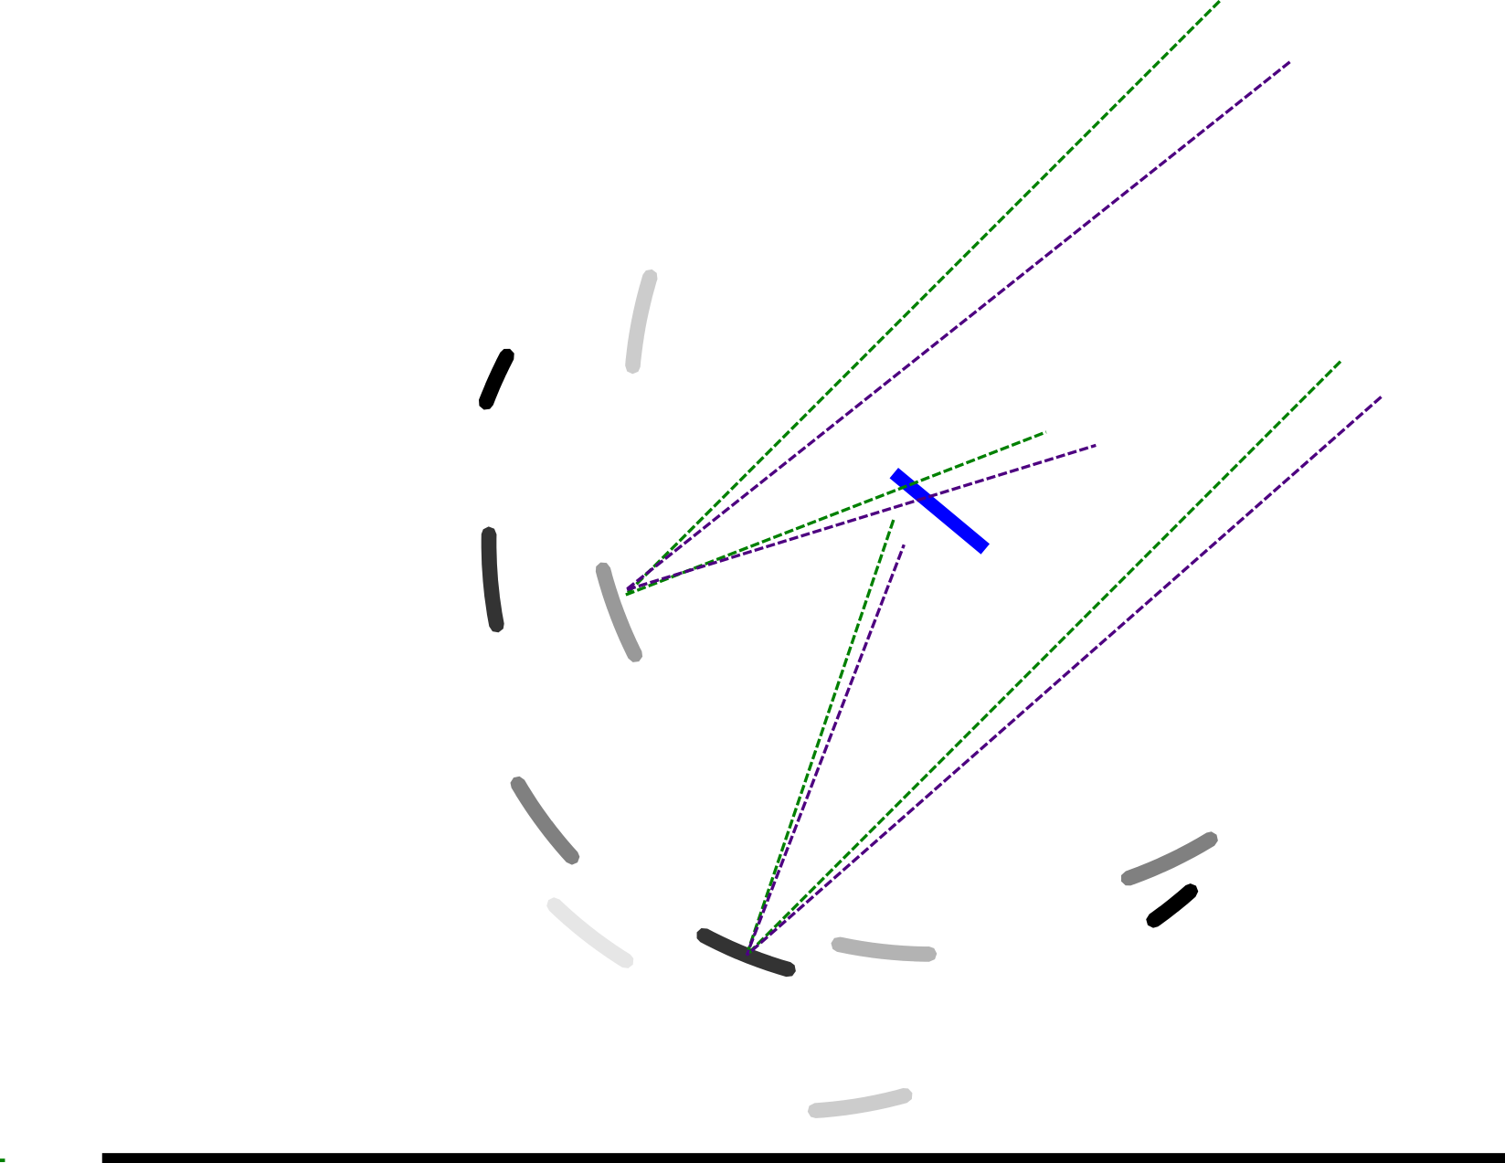
...And Its Optical Equivalent

Slide 29
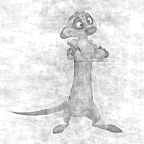
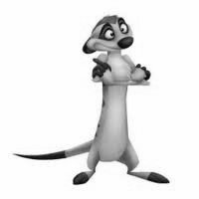
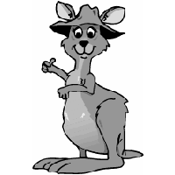
Amplitude Or Phase?
(a complex metaphor for the SKA Site Decision)
In the Fourier plane, what's more “important”, amplitude or phase?

Slide 30

And The Result...
One point-like source, but observed with phase errors
In the uv-plane, phase encodes information about location
Phase errors tends to spread the flux around
Calibration of complex gains required before we can see anything at all

Slide 31
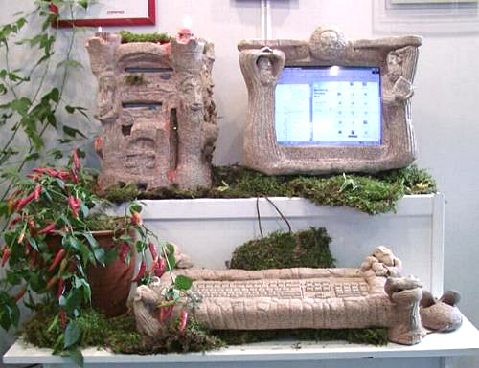
Stone-Age Calibration
(First-Generation, or 1GC)
Calibrate gains using a known calibrator source
Move antennas to target, cross your fingers, and hope that everything stays stable enough to get an image
Dynamic range:
~100:1
Observed
visibility
Model
visibility
Gain of
interferometer
(i.e. antenna pair)
p-q

Slide 32
The Selfcal Revolution (2GC)
Per-baseline gains are actually products of per-antenna complex gains!
  Vpq: observed visibility
  Mpq: model visibility
  gp: antenna p complex gain
N(N-1)/2 visibilities >> N gains
  Start with simple M
  Solve for g's
  Improve M, rinse & repeat
dynamic range > 10⁶:1

Slide 33
Typical selfcal cycle
Pre-calibrate g using external calibrators
Correct with g⁻¹, make dirty image, deconvolve
Generate rough initial sky model
Solve for g using the current sky model
Correct with g⁻¹, make dirty image, deconvolve
  Optional: subtract model and work with residuals
Update the sky model
pre-cal
Selfcal loop
Huge body of experience suggests that this works rather well, BUT there's no formal proof (!!!) Current practice is a collection of ad hoc methods, dark art and lore passed down the generations in what is virtually an oral tradition.

Slide 34
The Essence Of Selfcal
Essentially, selfcal is model fitting:
  Sky model (image of the sky): M(x,y,υ)
  Instrument model (set of gains): {gp(υ,t)}
Fit this to the observed data
  With alternating updates of M and g
Selfcal is “just” model fitting!

Slide 35
Dynamic Range
Dynamic range is...
…a marketing exercise done for bragging rights
…or the ratio between the brightest and faintest features in your image
  If the latter is noise,
  you're golden
  But usually, it's calibration
  artefacts: well above the
  noise
Broadly speaking: DR =
ability to subtract sources
Example of low DR!!!

Slide 36

World Record Dynamic Range
(still, after 2 years...)
3C147 @21cm
12h WSRT synthesis
160 MHz bandwidth
22 Jy peak (3C147)
13.5 μJy noise
1,600,000:1
Regular selfcal does not
reach noise, leaves
off-axis artefacts (“luxury
problems”) due to
direction-dependent
effects (left inset)
Addressed via differential
gains (right inset)
3C147 22Jy
30 mJy

Slide 37
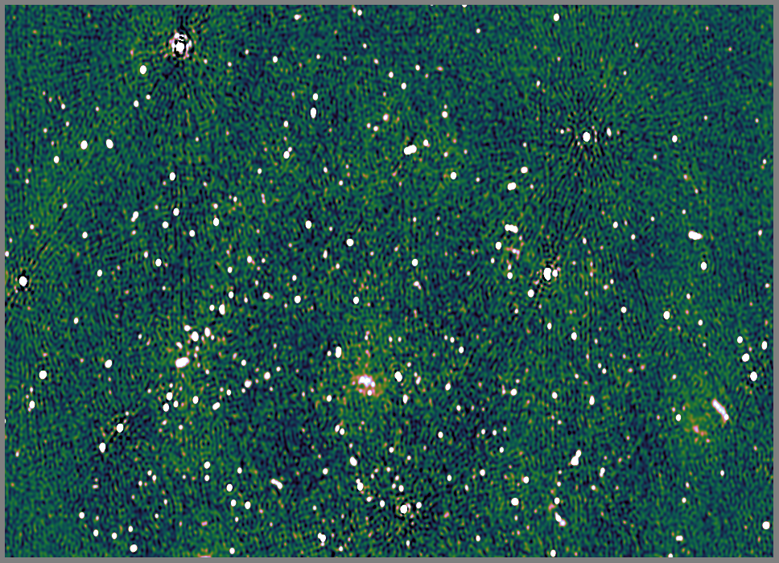
Not Always So Rosy...
Abell 773 –
WSRT at 330 MHz
a.k.a. The Westerbork Field From Hell
No single dominant on-axis source
0.12 mJy noise
Struggling to reach 5000:1 here...
1.1 Jy
750 mJy
620 mJy

Slide 38
What Limits Dynamic Range?
DR is limited when we can't subtract the brighter sources without leaving artefacts
Artefacts are caused by direction-dependent effects
  Selfcal assumes a single direction-independent gain (per antenna), across the whole field of view
  DDEs violate that assumption
Main causes of DDEs:
  Ionospheric refraction
  Primary beams

Slide 39
A773: The Ionosphere At Work
330 MHz
Artefacts caused
by variations in
the ionospheric phase screen across the
field of view
1.1 Jy
750 mJy
620 mJy
“Only” a low-frequency problem, right? (effect is ~λ²)
A 5000:1 problem at 330 MHz is a 100,000:1 problem at 1.4 GHz

Slide 40


The (Simulated) Ionosphere At Work
Selfcal rests on a few assumptions, main one being:
  One complex gain per antenna, per entire field of view.
Ionospheric phase is only approximately constant over the field of view
  Not so at low frequencies
  Not so with wide fields of view
A simulation of ionospheric effects at LOFAR frequencies before and after selfcal

Slide 41
Your Friend, The Primary Beam
The primary beam is your antenna's spatial sensitivity pattern
Restricts your interferometry to a given field of view

Slide 42
Why Is It Good To Have a PB?
Restricted field-of-view means...
  Fewer bright sources to worry about (and subtract)
  Less scope for atmospheric variations (gains are direction-independent to first order)
This is why
“wide FoV” is
considered so
difficult

Slide 43


Real-Life Primary Beams
KAT-7
MeerKAT
Doesn't completely restrict the FoV – only attenuates the rest of the sky, but the sidelobes are non-zero!

Slide 44
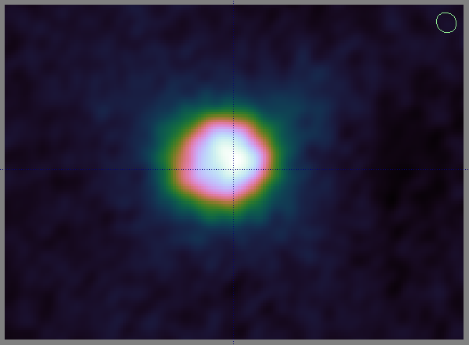
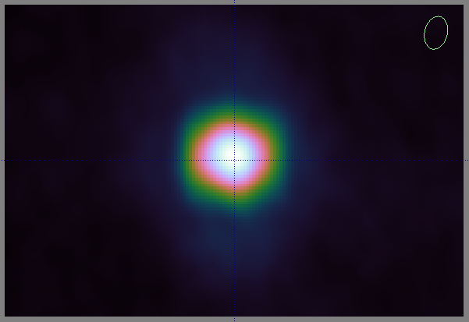
“Restricted” FoV?
Sidelobes attenuate the rest of the sky, but don't completely eliminate it
Example from the Westerbork Field From Hell: CasA and CygA (~60 and ~90 degrees away!):

Slide 45
When Is The Primary Beam a DDE?
The selfcal assumption: all antennas in your array have identical PBs that are stable in time
  ...your final images will be attenuated by that pattern, but not otherwise distorted
Real-life primary beams:
  Rotate w.r.t. the sky (alt-az mounts)!
  Differ between antennas due to pointing offsets
  Vary in time due to mechanical deformations (wind load, differential heating, gravitational load, etc.)
This causes direction-dependent amplitude and phase errors

Slide 46

When Primary Beams Go Bad...
(Courtesy of Ian Heywood)
EVLA 8 GHz: Looking for sub-mm galaxies and QSOs in the William Herschel Deep Field.
Dominant effect: bright calibrator source rotating through first sidelobe of the primary beam.
(This also has a horrible PSF, being an equatorial field.)
This is your science
(good luck!)
This is your
phase calibrator
Brightness scale 0~50μJy

Slide 47

Keep Your Friends Close, and your calibrators as far away as you can...
An approximation of the primary beam response, overlaid on top of the image.
As the sky rotates, the sidelobes of the PB sweep over the source, thus making it effectively time-variable.
This is your science
(good luck!)
This is your
phase calibrator
(Brightness scale 0~50μJy)

Slide 48

Deconvolution Doesn't Help...
Residual image, after deconvolution.
The contaminating source cannot be deconvolved away properly, due to its instrumental time-variability.
...5 years ago this would observation would probably be a complete write-off.
(Brightness scale 0~50μJy)

Slide 49
Same Problem Here
The original artefacts in
this image have the same
underlying cause.
But here, the dominant
source is at the centre
(where variaiton is minimal)
and the “offending” sources
are faint.
But we did address them
via differential gains...
3C147 22Jy
30 mJy

Slide 50
3GC: Direction-Dependent Solutions
Differential gains, a.k.a. peeling, a.k.a. direction-dependent gains, a.k.a. SAGEcal
All this is “just” more complicated model fitting!

Slide 51

Differential Gains To The Rescue
Residual image after applying differential gain solutions to the contaminating source
Brightness scale 0~50μJy

Slide 52

Multi-Band Image
Multi-band residual image:
noise-limited, no trace of contaminating source.
Phase calibrator
used to be here
Brightness scale 0~50μJy

Slide 53
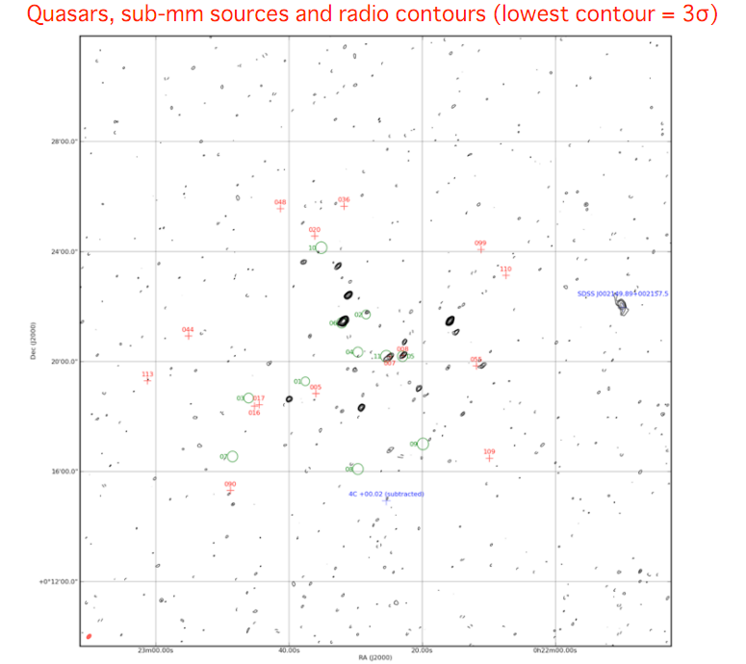

Slide 54
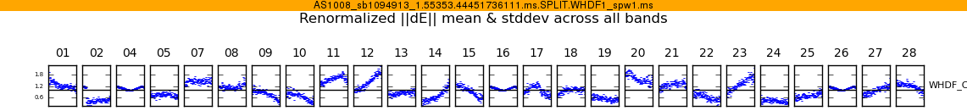
WTF Is It Doing That?
Above: Differential gain-amplitude solutions, as a function of time, per each antenna.
To first order beam patterns are identical across antennas and rotate the same way, so why the huge differences?
Answer: small pointing errors.
This is your science
(good luck!)
This is your
phase calibrator
Not a bad spot to put a calibrator in --
– it's The Worst Place In The World
to put a calibrator in.

Slide 55
So What's The Catch?
Differential gains (and variations on the theme) have produced some very high-DR maps
The cost: proliferation of degrees-of-freedom in our calibration models (especially when many directions are in play)
  We know this is bad in principle
  We can see this is bad in practice: “ghost” sources, flux suppression, etc.
What we need: better models that can capture the same effects with fewer degrees of freedom.

Slide 56

The Past: Massive Overengineering
(Built For 1GC, used with 2GC)

Slide 57

The Future:
Four Sticks In The Ground (+Software)

Slide 58

...and Dishes Made Of Plastic
(+Compatible Software)

Slide 59
Conclusions
Radio interferometry has achieved incredible results (>10⁶:1 dynamic range), despite using incestuous calibration methods held together with spit, duct tape, baling wire and oral tradition.
New telescopes will not let us get away with this
  Upcoming “radio telescope bubble”
Fortunately, we sort of know where to look for answers
This is a great time to be an instrumentalist.

