Slide 1
I. Radio Interferometric Imaging
Challenges In The SKA Era
II. Know Thy Beams
Oleg Smirnov (Rhodes University & SKA South Africa)

Slide 2
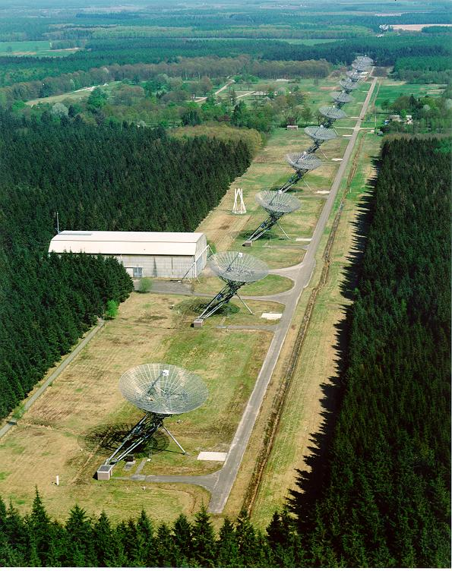
Radio Interferometry 1970
WSRT (Westerbork Synthesis Radio Telescope), The Netherlands
14x25m dishes on an East-West line
Max baseline 2.7km
Completed 1970, upgraded since
World record dynamic
range, still

Slide 3
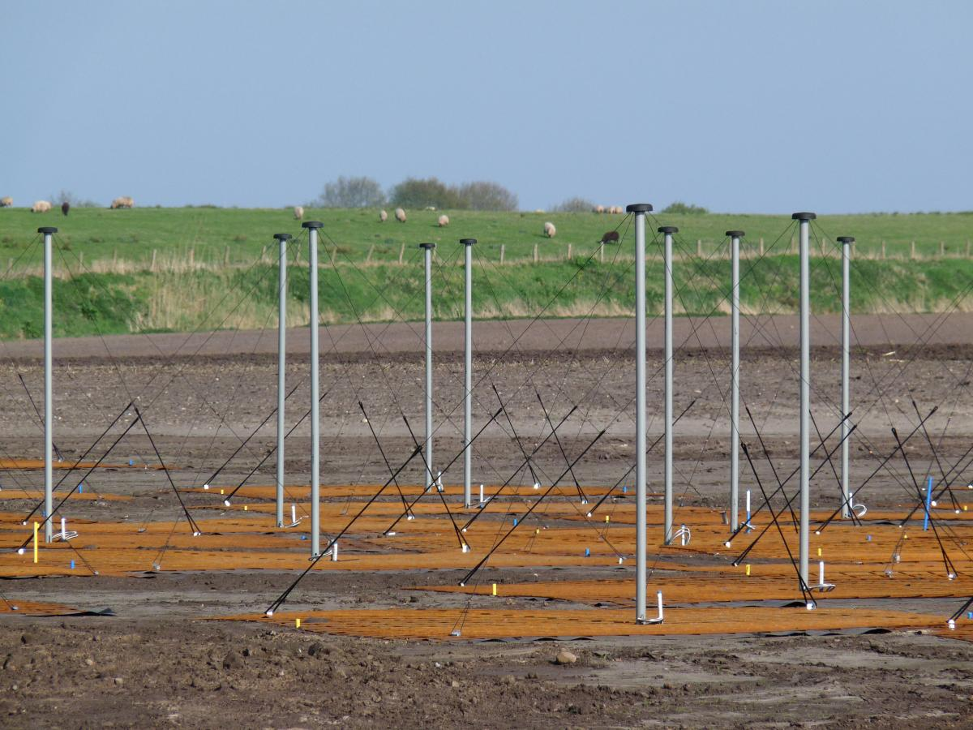
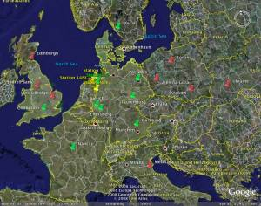
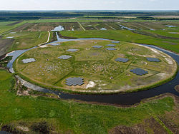
Radio Interferometry 2010
Low Frequency Array (LOFAR)
36 stations (not dishes!) across The Netherlands
8 (and counting) international stations
Inaugurated 2010

Slide 4
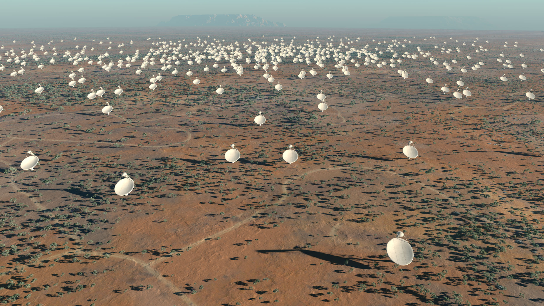
Radio Interferometry 2024
Square Kilometre Array: ~2500 dishes, plus hundreds of aperture array elements

Slide 5
Scary SKA Statistics
Data rates: today's global internet traffic...
...times 10-100!!!
Conservative estimates of computing requirements suggest that the SKA will require:
  A world-class (2024) supercomputer
  Moore's Law holding out until then
  ...plus algorithmic breakthroughs on a regular
  basis between now and 2024

Slide 6
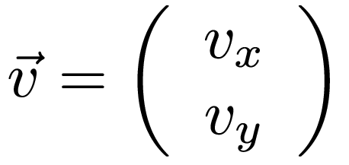
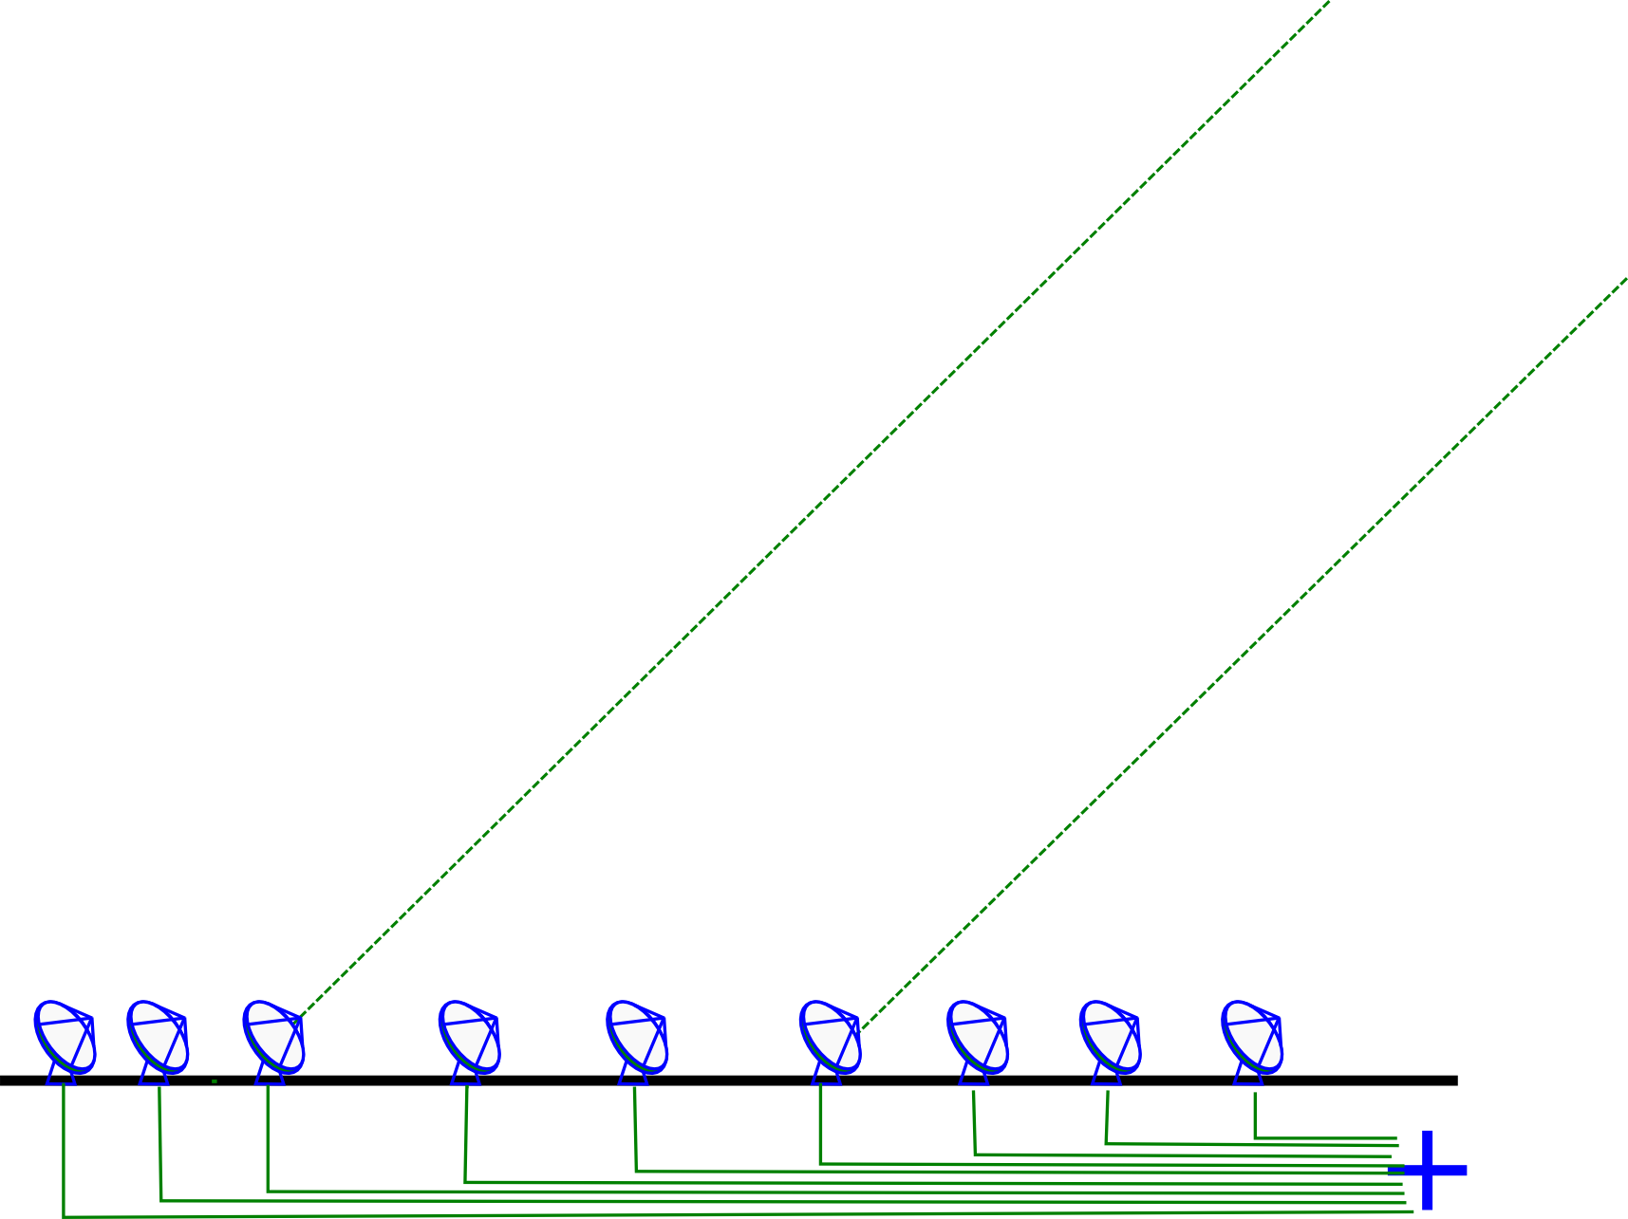
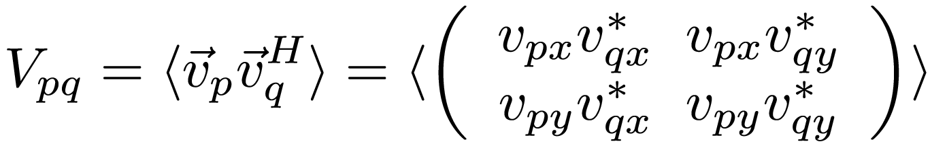
Radio Interferometry 101
One station (i.e. dish or aperture array) measures two complex voltages
A correlator computes the complex visibility for each pair of stations p,q:

Slide 7

The Classical Approach To Polarization
V
Q
U

Slide 8
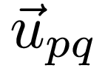
Radio Interferometry 102
Complex visibility = Fourier component
Thus, each pair of stations p,q measures one point in the Fourier plane (the uv-plane), corresponding to the separation between the stations (baseline vector)
With N stations, N(N-1)/2 baselines can be measured instantaneously
  WSRT, 14 stations: 91 baselines
  LOFAR, 44 stations: 946 baselines
  SKA, 2500 stations: >3 million baselines

Slide 9
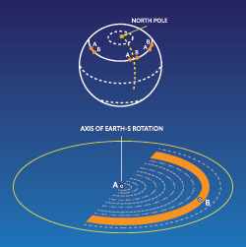
Radio Interferometry 103
As the Earth rotates, each
baseline sweeps out an arc in
uv-space
Thus over hours, many more
uv-points are measured
Basic business plan:
  1. Measure Fourier components
  2. Do an inverse FT to recover image
  3. ???
  4. PROFIT!!!

Slide 10
The Devil Is In The Details
Measured visibilities subject to instrumental response (direction-independent and direction-dependent gains)
  Calibration & correction difficult
We also measure unwanted junk
  both from Man and Universe
uv-coverage is incomplete, so the resulting image is convolved with a point spread function (PSF):
  Deconvolution needed, fundamentally an ill-posed problem

Slide 11


Point Spread Functions
Response to a point source: Point Spread Function (PSF)
Observed “dirty image” is convolved with the PSF
Structure in the PSF = uncertainty in the flux distribution (corresponding to missing data in the uv-plane)
Strong near-in PSF sidelobes;
far sidelobes that do not go
to 0 with distance
PSF of the WSRT.
The regular rings are due to the regular spacing of its antennas in the
East-West direction.
PSF of MeerKAT

Slide 12

The Problem With Sidelobes
“Dirty image” dominated
by PSF sidelobes of the
brightest sources
Deconvolution is
fundamentally ill-posed
  But sky is sparse
CLEAN, MEM, etc.
Promising new methods are being proposed
Bayesianally sparse (BS) techniques
Prospects are good...

Slide 13
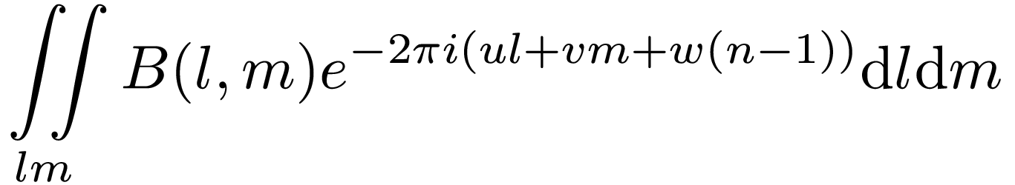
FT On a Sphere
Sky intensity maps to a sphere, so the Fourier transform is actually 3D:
(So far) only a 2D FFT has been computationally feasible

Slide 14
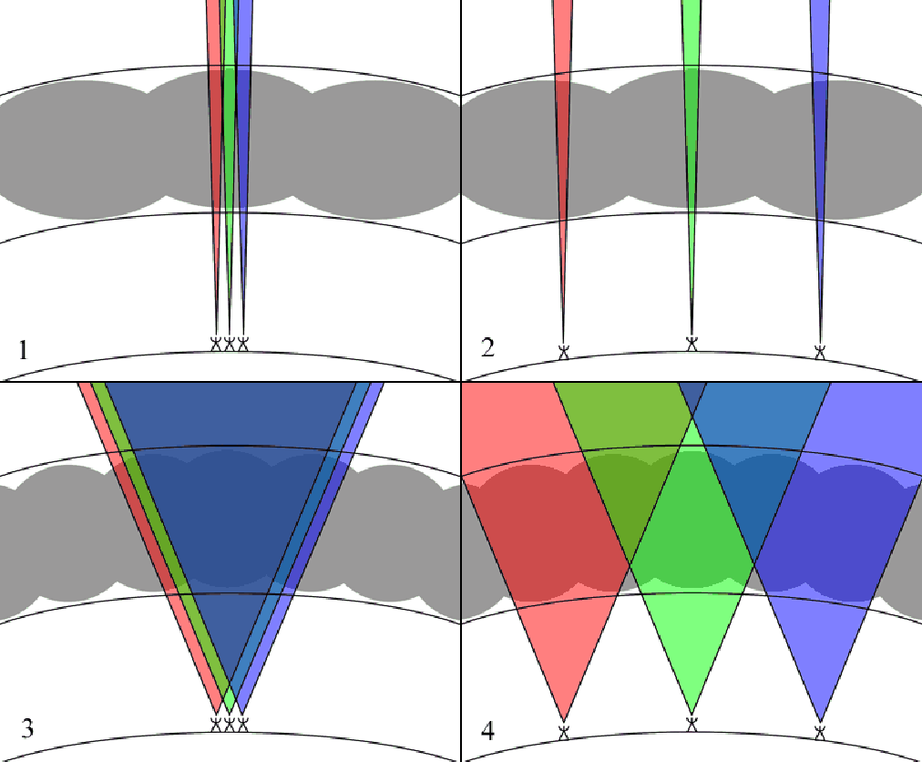
Direction-Dependent Effects
Sky “seen” at each station is subject to distortion by ionosphere and the primary beam.
(image: H. Intema)

Slide 15
Apparent Skies
“Classic” interferometry:
  sky B(l,m) ←^{FT}→ visibilities V(u,v)
Interferometry in the presence of DDEs:
  sky B(l,m) + per-station effect Ep(l,m)
  each station pair sees an “apparent sky”
  Bpq(l,m) = Ep(l,m) B(l,m) Eq^{H}(l,m) ←^{FT}→ Vpq(u,v)
  each visibility point sampled from a different “apparent uv-plane”
(The Devil In)
E-Jones

Slide 16
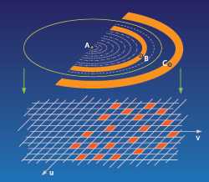
Convolutional Gridding & Imaging
uv-points are measured along
elliptical tracks
Traditional imaging performs
a gridding step to resample
these onto a regular grid
(for the FFT):
Vgrid = V○G
If we know the DDE distribution Ep(l,m), then we can correct for it via some extra convolutions:
Vgrid = Fp○V○Fq^{H}○G ( Fp ←^{FT}→ Ep⁻¹ )

Slide 17
AW-Projection
Application of DDEs via convolutional gridding forms the basis of the AW-projection algorithm
  (Initially formulated as w-projection for correcting the w-term)
  Current state-of-the-art
Problems:
  Need to know the DDE (calibration!)
  If support of Fp is extended, convolution is expensive

Slide 18
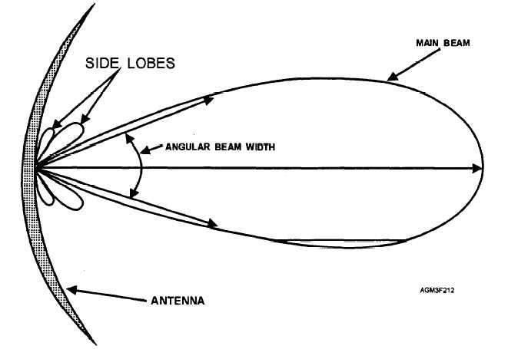
Primary Beams
Field of view of an
interferometer is determined
by the main lobe of the
primary beam (PB) pattern
PB sidelobes are
unavoidable, pick up
unwanted signal
Interferometer measures the sky multiplied by the square of the PB
  ...assuming stable and identical beams!

Slide 19
Primary Beam Problems
PB's stable and identical only to first order
  Pointing errors
  Mechanical deformations
  Beamformer gain drifts (for AAs/PAFs)
PB variations = change in apparent source phase and amplitude, per uv-point
FT translates this into spatial artefacts
  Can be attenuated via calibration
Plus, PB sidelobes pick up unwanted junk

Slide 20
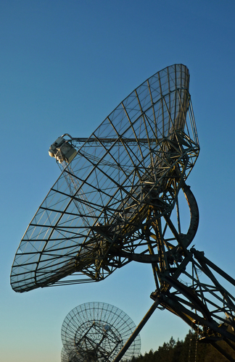
Radio Telescope Design Trends
Problems are exacerbated by (financially inevitable) design trends...
1970: massive overengineering
2024: cheap junk

Slide 21
Know Thy Beams
SKA Dish CoDR (2011), as summarized by Tony Willis:
“My sidelobes are better than your sidelobes.”
What makes “good” sidelobes, anyway?
  or more broadly, a “good” primary beam (PB)?
Big gap between our understanding of scientific performance and engineering specs
Difficult to make progress analytically
  (Though see recent work by Carozzi, Wijnholds, Braun)

Slide 22

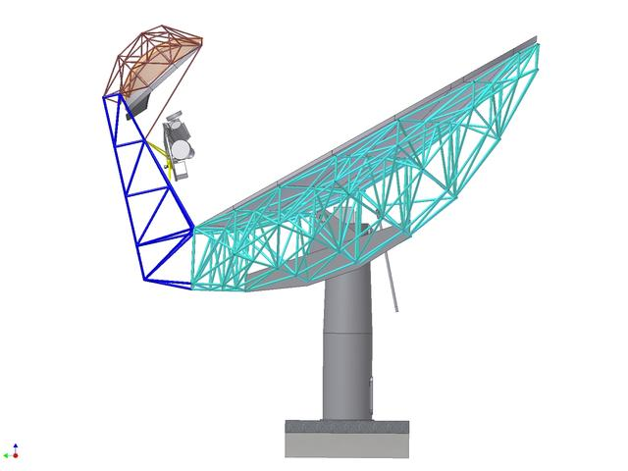
Case Study: KAT-7 vs. MeerKAT
MeerKAT: offset Gregorian dishes
KAT-7 (MeerKAT precursor): prime focus dishes

Slide 23


KAT-7 vs. MeerKAT Beams
Prime focus vs. offset Gregorian
Pick your poison?

Slide 24
What Limits Dynamic Range?
Thermal noise
  lucky if we can reach it
Classical confusion ← resolution
Sidelobe confusion noise (SCN)
  ← PB sidelobes
Residual calibration artefacts
(calibration “noise”)
  ← beamshape smoothness
  ← other PB properties (?)
this
talk

Slide 25
Sidelobe Confusion Noise I
PSF far sidelobes ≠0, so every image pixel contains contributions from entire sky
  Deconvolution takes care of sources within the image
Distant sources are attenuated by
  Far PSF sidelobes
  Far PB sidelobes
  Time/bandwidth smearing
Brightest sources nearly always visible from anywhere, but can be taken care of individually
At SKA sensitivities, we start to worry about the far more numerous fainter sources

Slide 26
Sidelobe Confusion Noise II
No such thing as an “empty” field:
  You may image and deconvolve to any radius r₀
  ...but even assuming perfect deconvolution (ha ha)...
  ...each pixel will have a non-zero, noise-like contribution from the “sea” of sources at r > r₀
  This is sidelobe confusion noise (SCN)
In principle, can be driven down by imaging and deconvolving the entire sky
  hard limit with single pointing (sink into the noise!)
  this is a serious cost driver

Slide 27
Primary Beams & SCN
Does choice of PB influence SCN?
  of course, PB sidelobes are a modulator
So how do we
  estimate this
  quantify this
  ...and turn it into a performance metric?

Slide 28
BeamSims
Strategy: “brute force” interferometric simulation
NVSS catalog: a realistic all-sky model
  Cutoff I>.5 Jy (for performance reasons)
  Use S³-SEX to derive correction factor (to account for sources <.5 Jy)
Use simulated primary beam patterns
  full 2x2 complex voltage patterns, given as gridded “images” (in spherical coordinates)

Slide 29
Doughnut Sky Models
Split the sky into n rings
For each ring i, simulate sources at r_{i}≤r<r_{i+1} Image the [nominally] empty sky in the middle
The rms pixel value is the SCN contribution from ring i

Slide 30
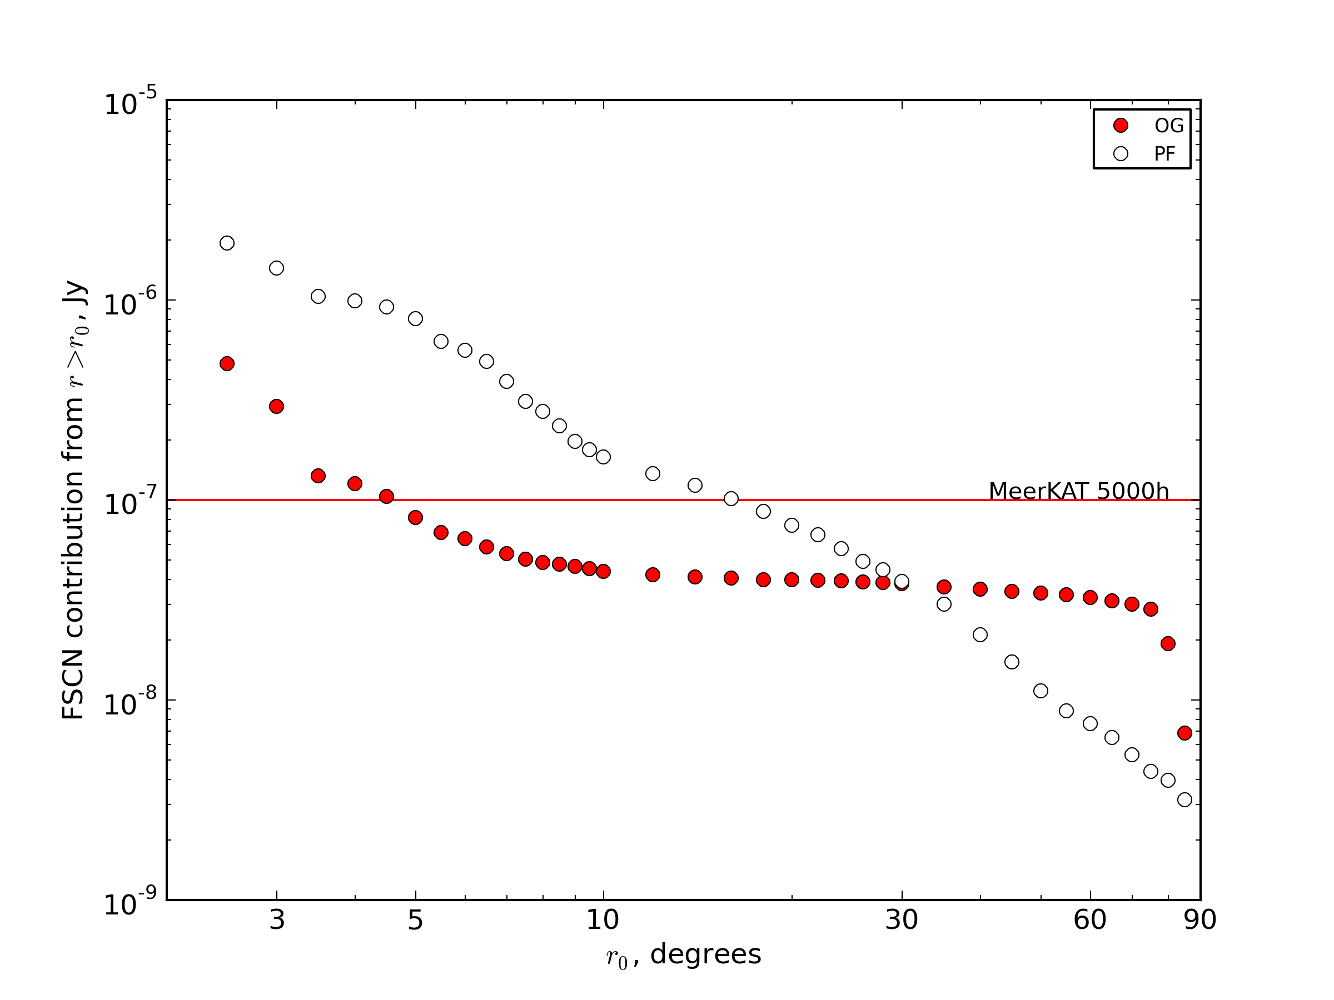
SCN Cost Curves
This shows, as a function of r, the SCN contribution from sources r≥r₀
i.e. how far out do
we have to image
& deconvolve
to drive SCN
below a given
level?

Slide 31
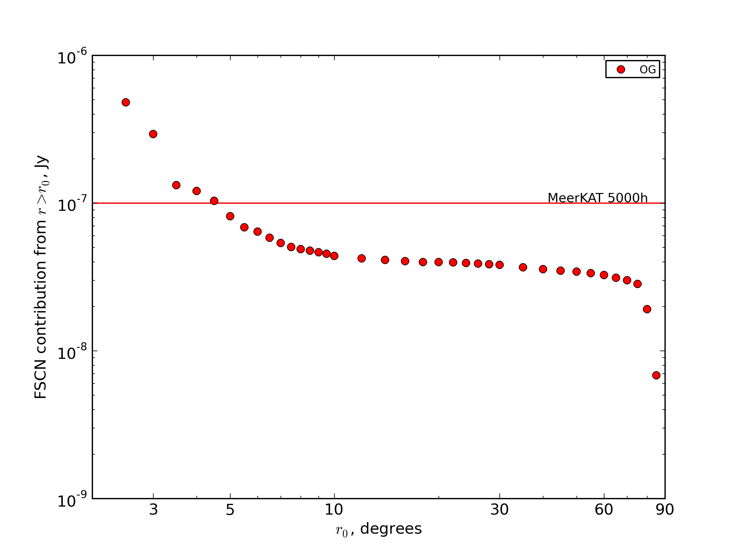
Cost Curve: Offset Gregorians

Slide 32
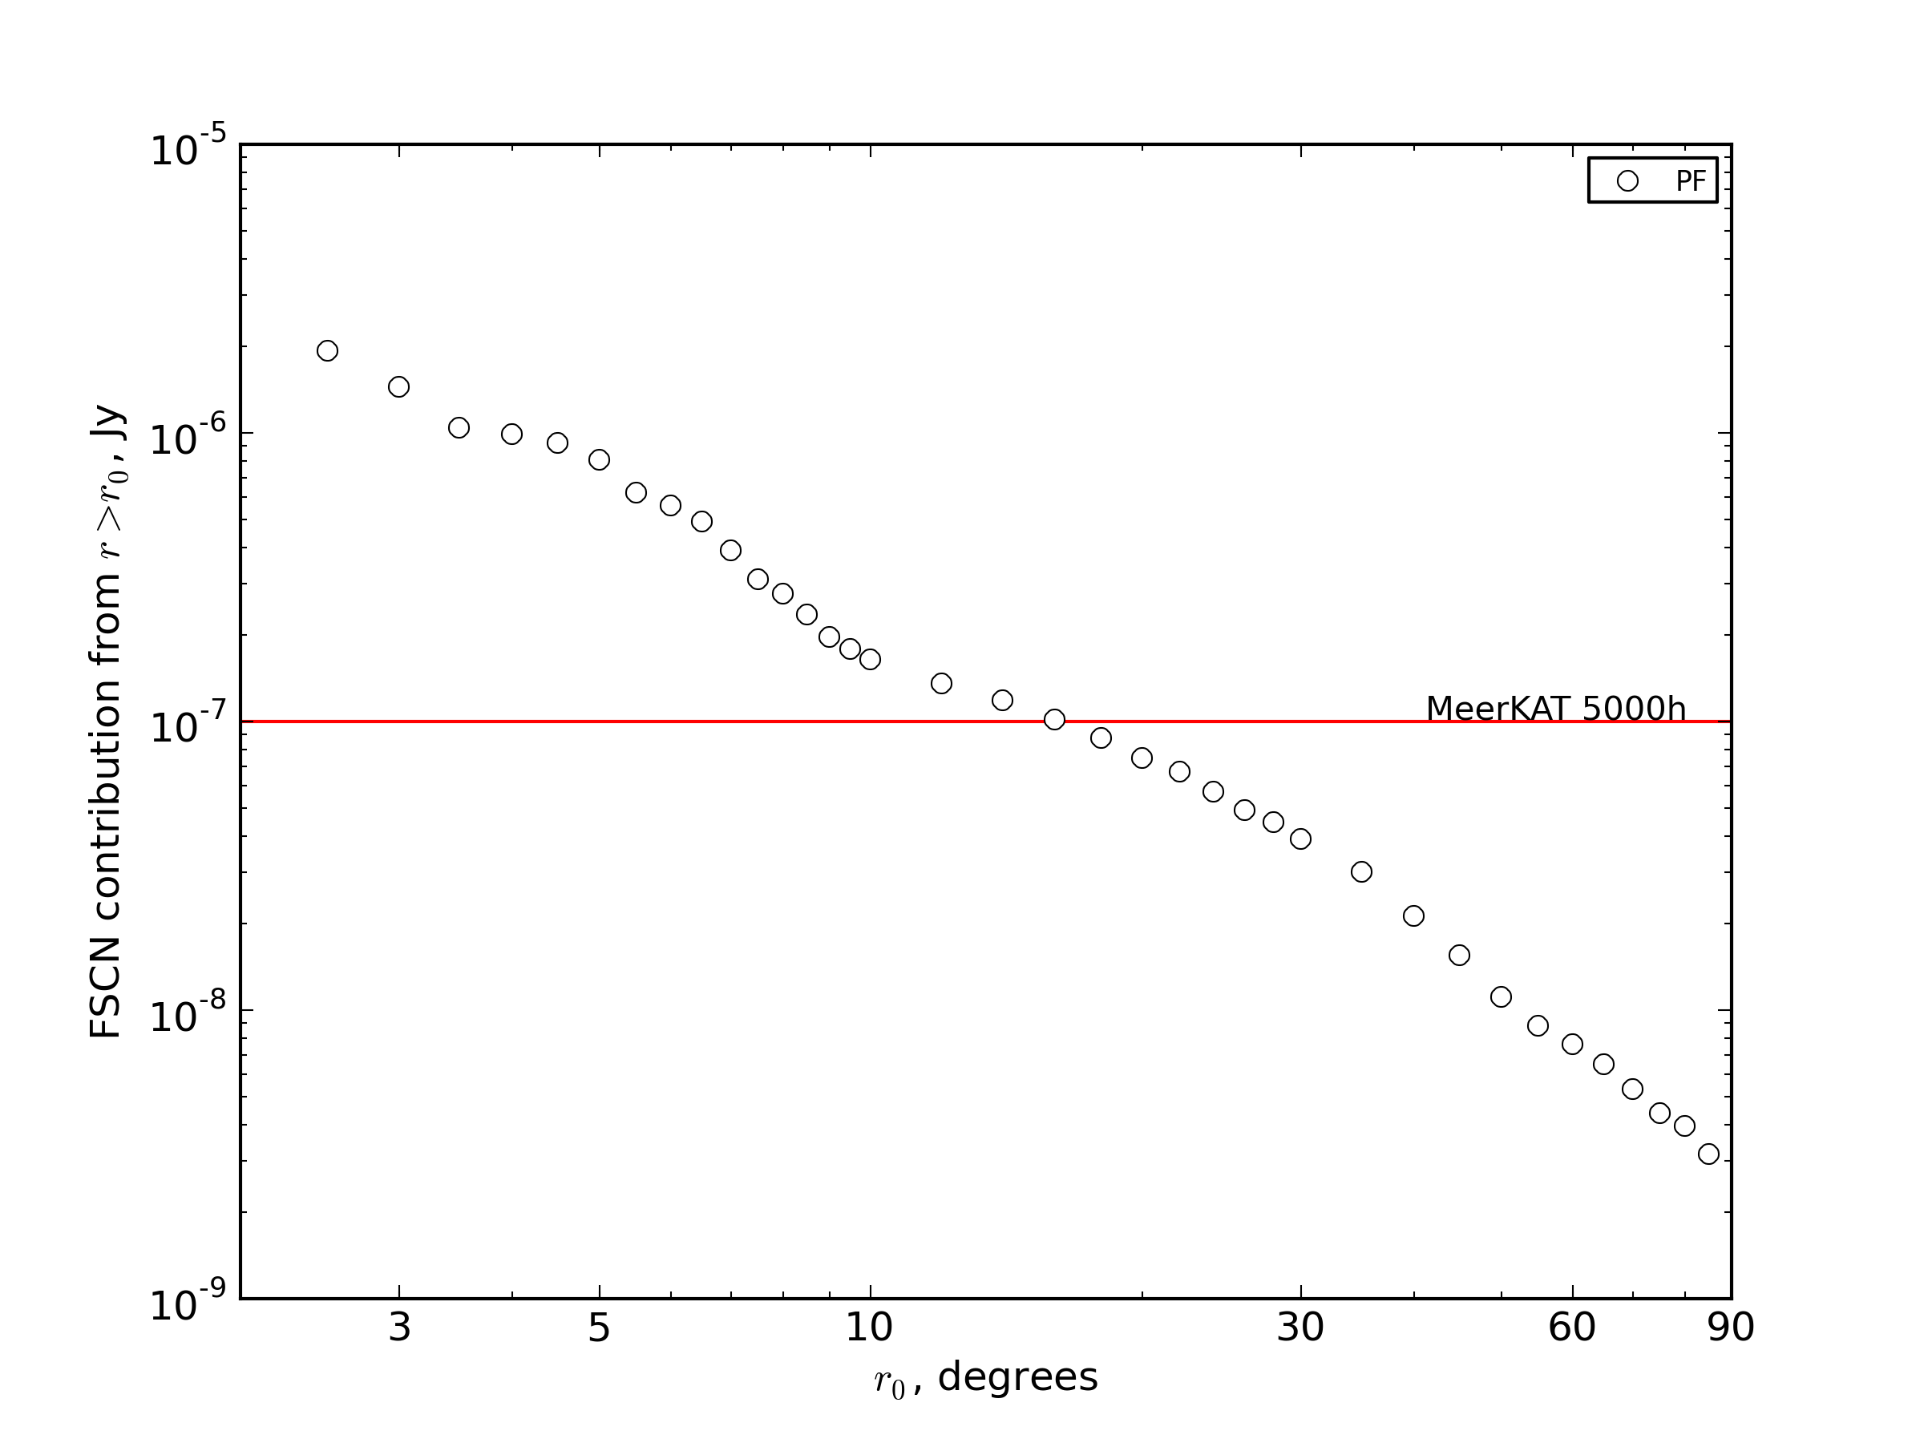
Cost Curve: Prime focus

Slide 33

For Many Different Dishes

Slide 34
Asymptotic SCN
The results above implicitly assume that we can deconvolve and subtract ALL sources
  Thus, only provide an upper bound on performance
In practice, some fraction of the sources will not be accessible
  Too close to the noise
  Too complicated to deconvolve
  Uncertainty in sidelobe beam patterns
Thus, a fraction of the SCN becomes “locked in”
  rough sim: “lock in” the fainter X% of sources

Slide 35
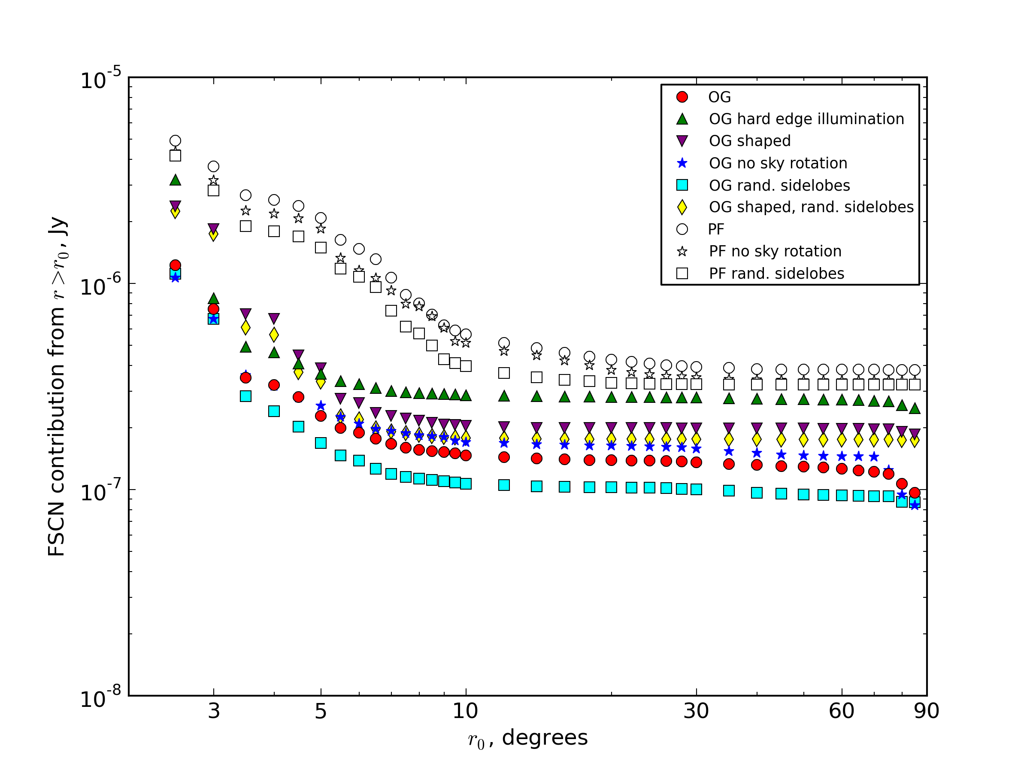
Asymptotic SCN
EXTREMELY
PRELIMINARY!

Slide 36
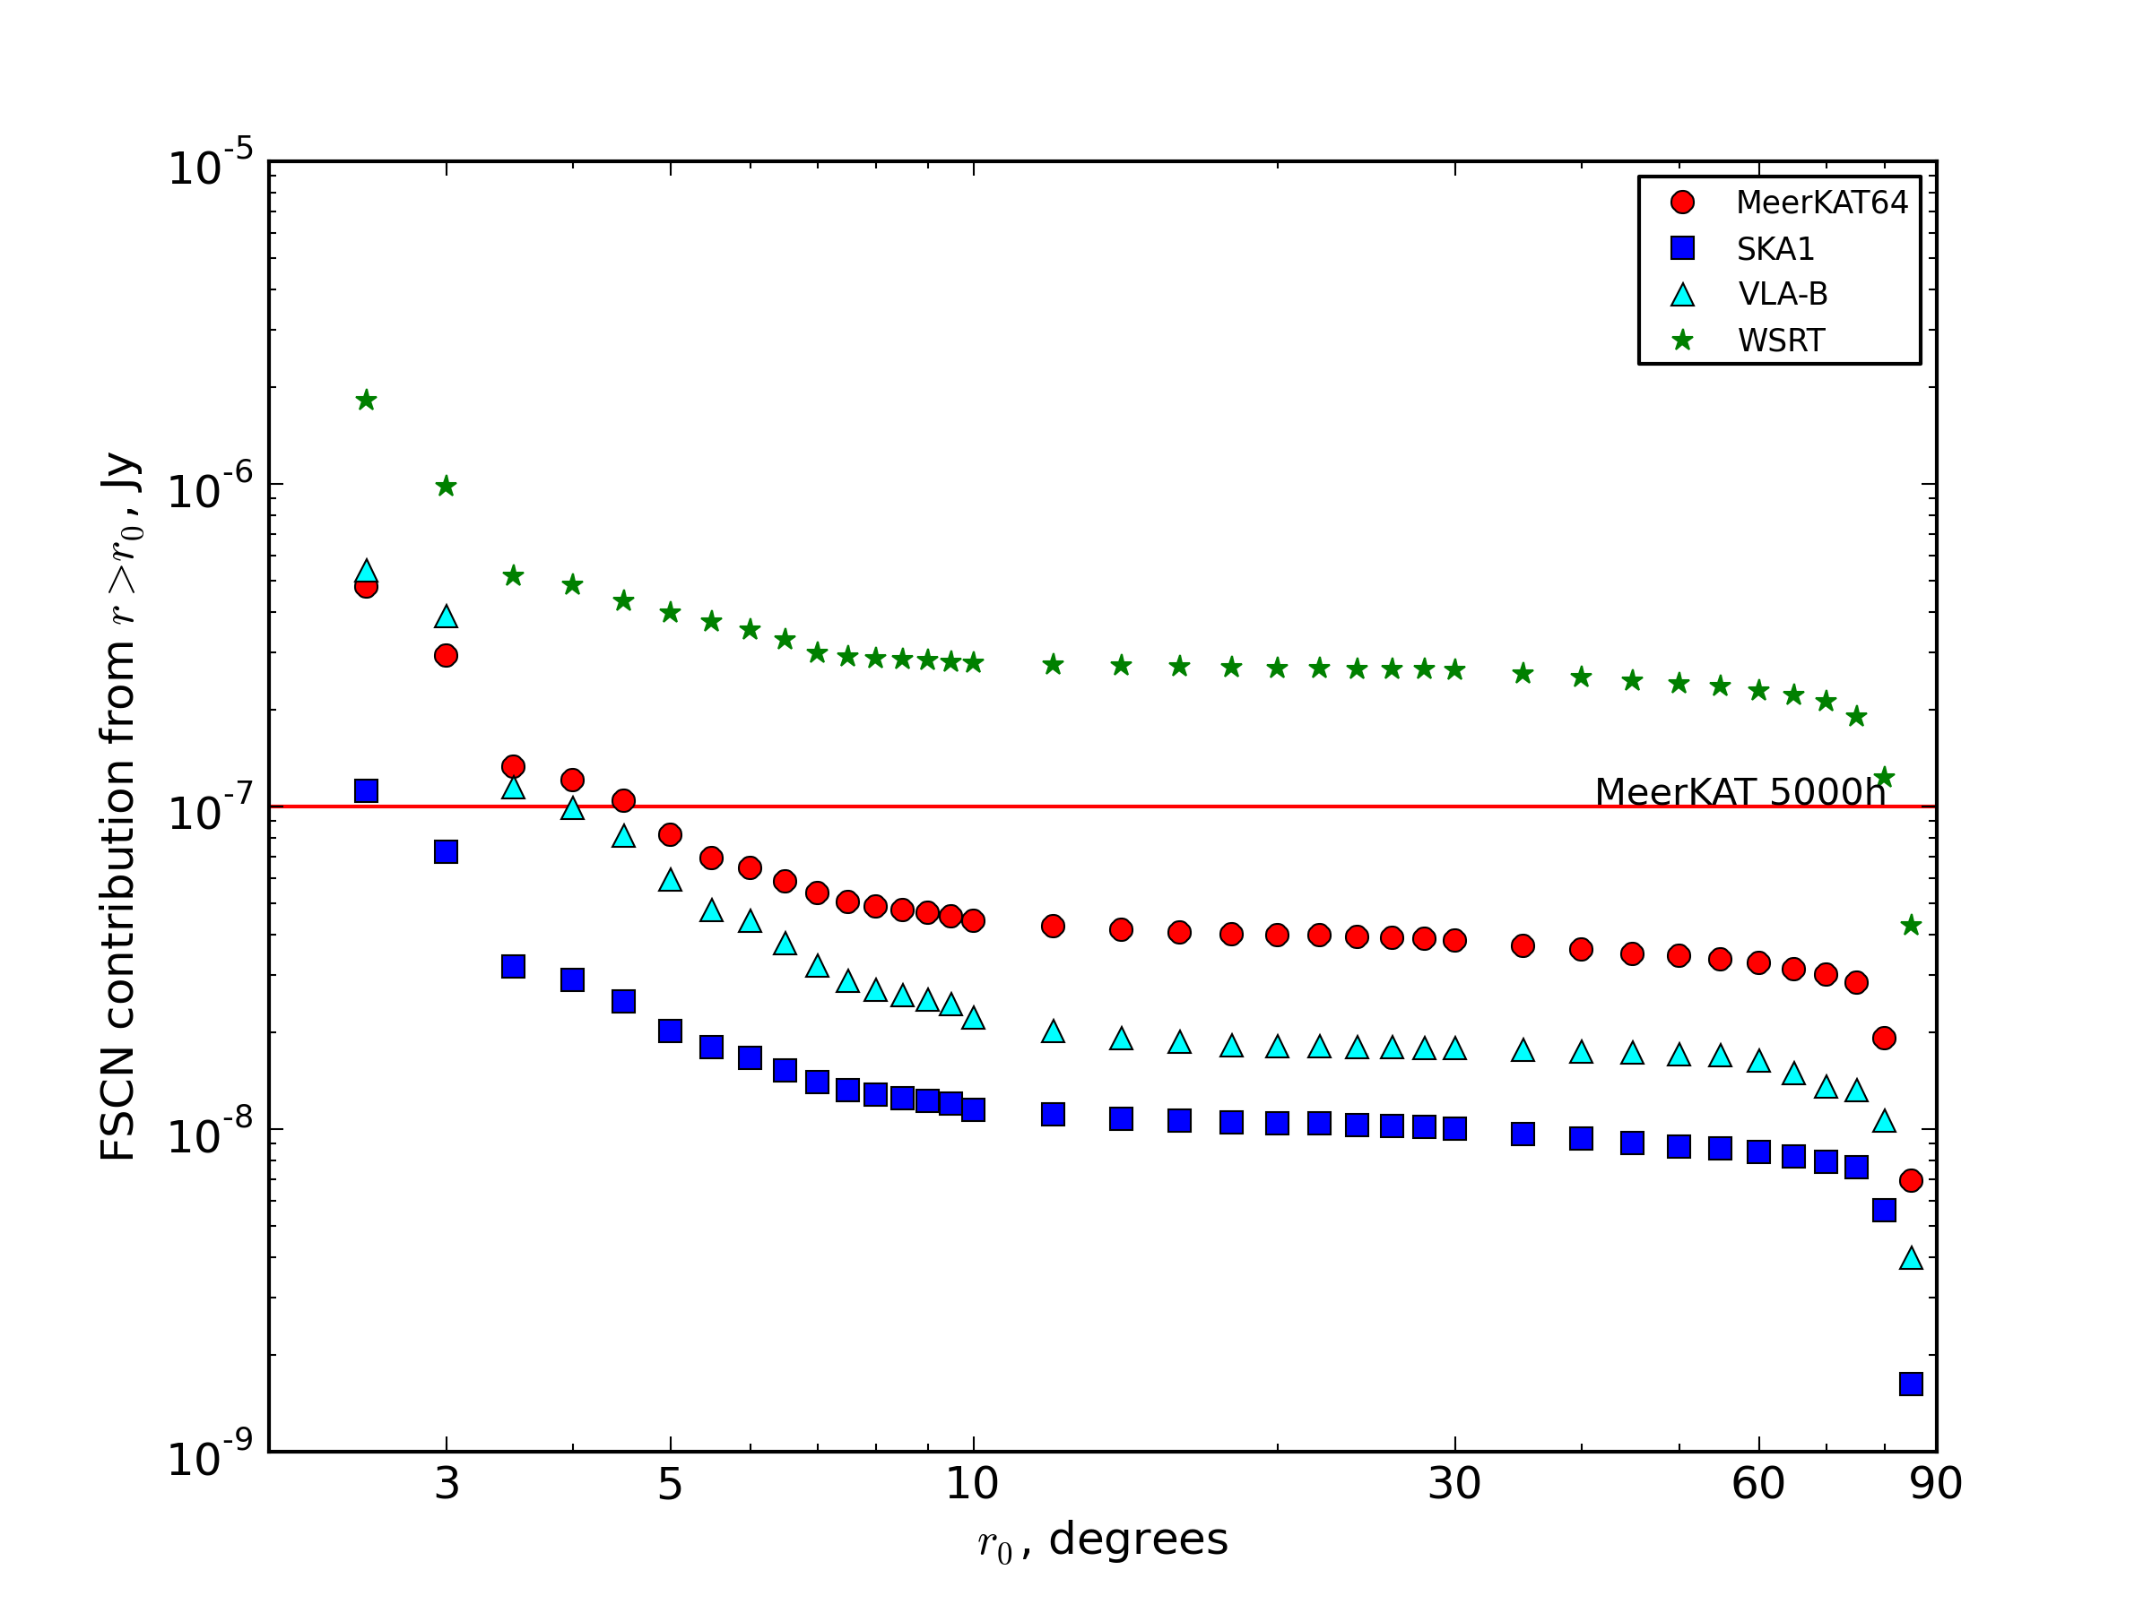
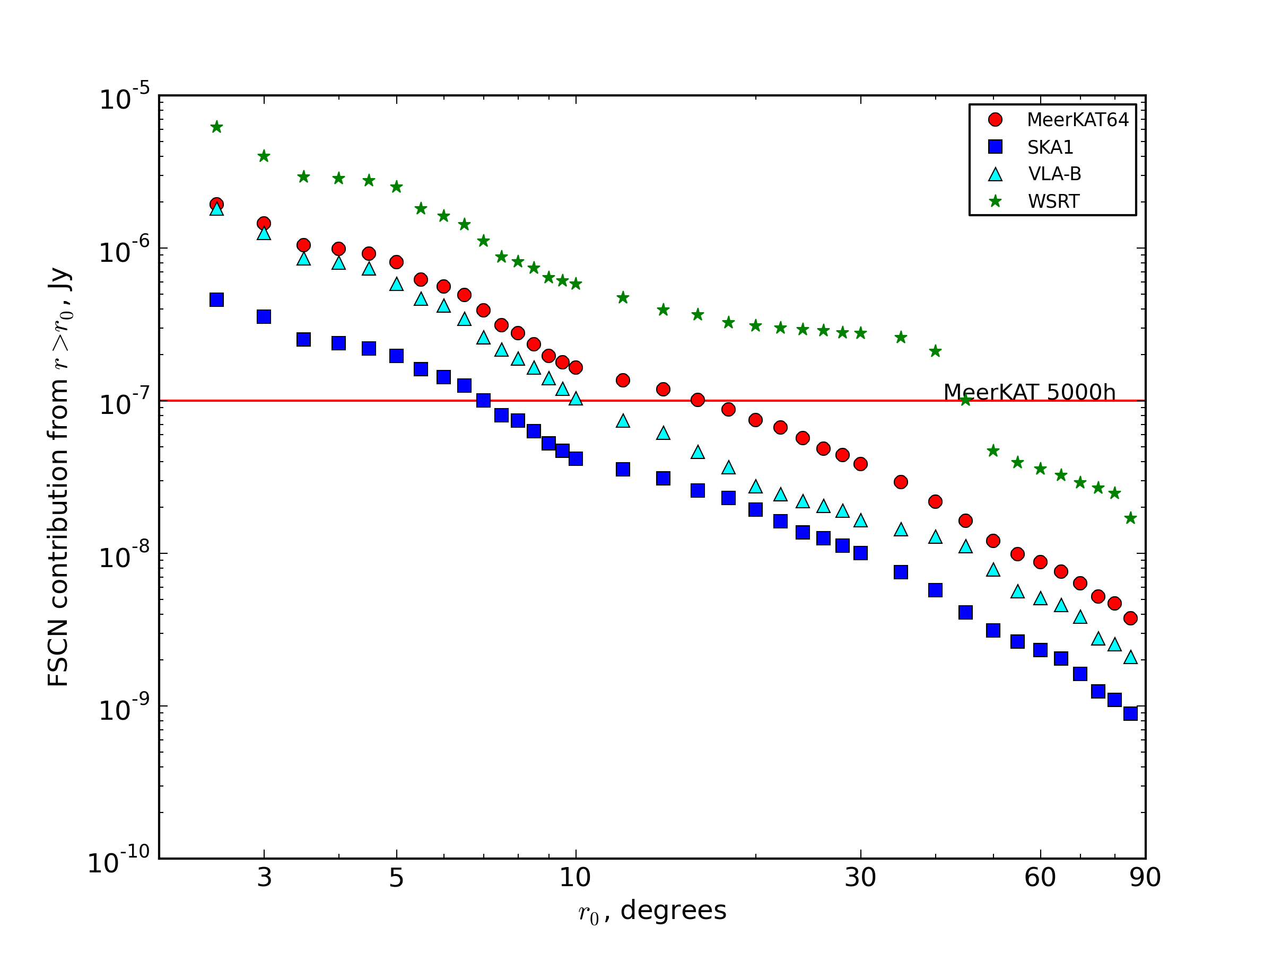
SCN & Array Size
Same simulation for OG/PF dish with WSRT (14 dishes), VLA-B (27 dishes) and SKA1 (256 dishes) layouts.
To first order O(N), but interaction with interferometer PSF evident
EXTREMELY
PRELIMINARY!

Slide 37
Things To Take Away From This
SCN can be ignored for less-sensitive telescopes, but can become a DR limitation for the SKA
SCN induces a computing cost vs. noise floor trade-off, as we need to image larger areas in order to suppress SCN
SCN (and the trade-off curves) can be significantly influenced by choice of primary beam
  But at least we can measure this via simulations

Slide 38
Part II. Calibration “Noise”
Imperfect calibration leaves residual artefacts
We have been very successful at eliminating these via direction-dependent solutions
And by “eliminating” we mean “driving below the (thermal) noise”
  ...by which we really mean “sweeping under the carpet”
So, how do we estimate what we have “swept”, in case it comes back to haunt us?
  ...and does this depend on primary beam choice?

Slide 39
Distilling Out The Artefacts
Model a field that includes one or two 1 Jy sources (the contaminators)
Make two full interferometric simulations, including receiver gains (G-Jones) and pointing errors (E-Jones)
  full sky model + thermal noise → simulated DATA
  just the contaminators → CONTAM_DATA
  using the same simulated G & pointing errors!

Slide 40
Distilling G
1. Run standard calibration to obtain G solutions on DATA using some bright subset of the model
2. Image the residuals: this contains artefacts, noise and fainter sources. How to tease these apart?
3. Subtract the contaminators alone from CONTAM_DATA while applying the same G solutions
4. Make an image of the residuals from (3)
This is an image of distilled artefacts, i.e. exactly the contribution of the contaminator sources to the image obtained at step 2.

Slide 41

Calibration Noise (G solutions)
We've isolated “calibration noise” per unit flux
Here, rms
4.2 μJy
(but very
non-Gaussian)

Slide 42
Distilling DDEs
But nevermind, because direction-dependent solutions can take care of it, right?
If we run a DD solution on the two contaminator sources, the resulting image (of the full residuals) becomes thermal noise limited; remaining artefacts are below the noise.
But we can repeat the same trick with CONTAM_DATA to distill them out anyway

Slide 43

Calibration Noise (DD solutions)
Here, rms 2.6 μJy, and far less spatially correlated

Slide 44
Why Do We Care?
Just an extra noise-like contribution that's below the thermal noise, so what's the big deal?
But it can be a big deal if its statistics are non-Gaussian

Slide 45
Scenario: Deep Survey
Consider a deep survey where we obtain many pointings of the same field
  MeerKAT MIGHTEE/LADUMA surveys: 5000 hours
Each pointing must have independent DDE solutions
  Beam stability, ionosphere, etc. always different
  So for each pointing we leave an independent set of calibration artefacts buried in the thermal noise
We now combine the pointings – thermal noise adds up as √n (0.1 μJy after 5000 hours)
How do the artefacts add up?

Slide 46
Distill, Rinse, Repeat
We can repeat the distillation experiment multiple times, with different random realizations of G/dE errors
...and add up the “distilled” maps

Slide 47

Mean Of 10 DD-Distills
Structure shows up
Does not scale as a Gaussian
EXTREMELY
PRELIMINARY!
1 distill, rms 2.6 μJy
10 distills, rms 1.2 μJy

Slide 48

PF vs OG
Repeat this experiment for PF and OG beam patterns
Calibration “noise” for OG lower by a factor ~3
PF: rms 3.6 μJy
OG: rms 1.2 μJy

Slide 49
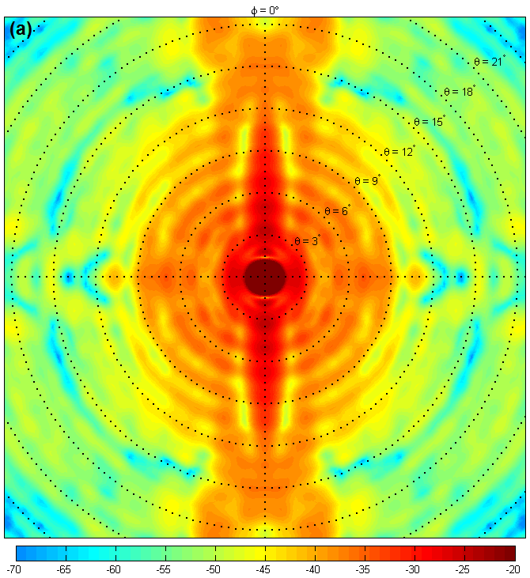
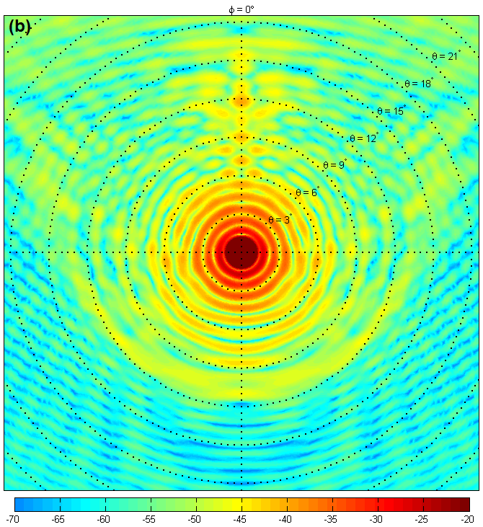
Why The Difference?
Difference probably due to OG's smoother beam pattern
same amount of pointing error causes more gain variation in the PF case

Slide 50
Conclusions
Radio interferometry is hard
High dynamic range is even harder
This SKA idea is crazy
  ...which is exactly why we should build it
Specific design decisions (such as choice of primary beam) can make things harder or easier in entirely non-obvious ways

