Slide 1
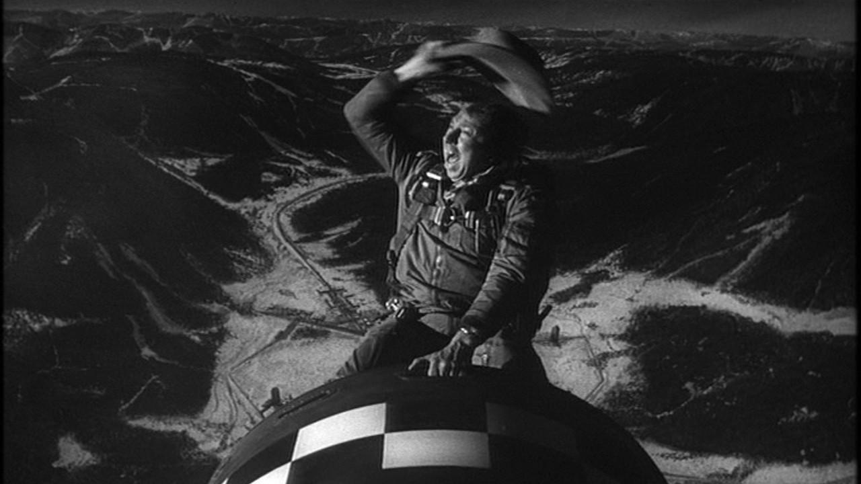
Dr. Sidelobes, Or How I Learned To Stop Worrying & Love Simulations
O. Smirnov (Rhodes University & SKA SA)

Slide 2
Introduction
“A high quality radio map is a lot like a sausage, you might be curious about how it was made, but trust me you really don't want to know.”
– Jack Hickish, Oxford
Interferometry is just too damn hard and unintuitive, but we've carved out some comfort zones
New observatories and new surveys will be [are] boldly going where no man has made sausage before
Radio astronomers know their science requirements [somewhat], but don't understand the instrumental response
Engineers understand the instrumental response [somewhat], but not the science requirements
Result: potential surprises and bad news

Slide 3
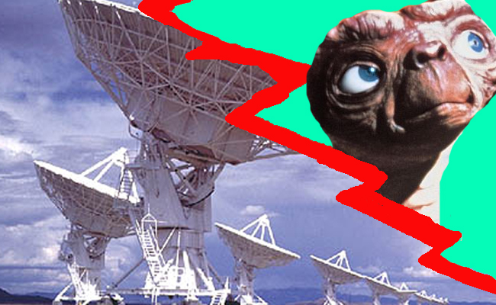
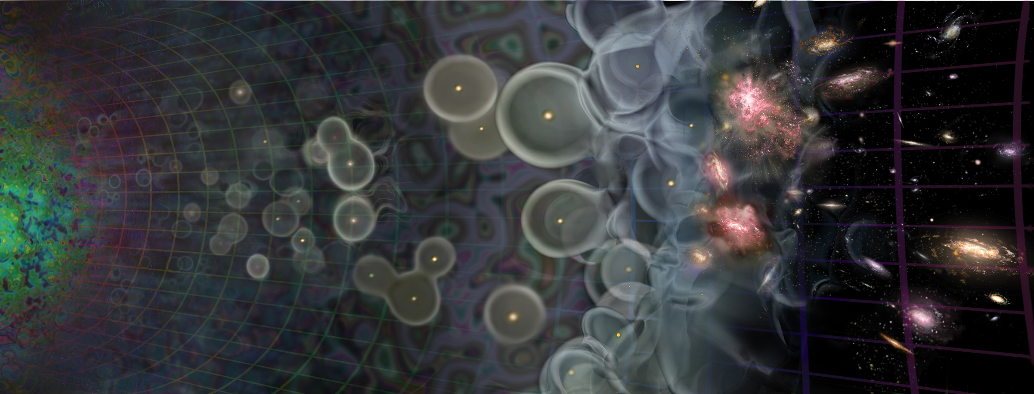

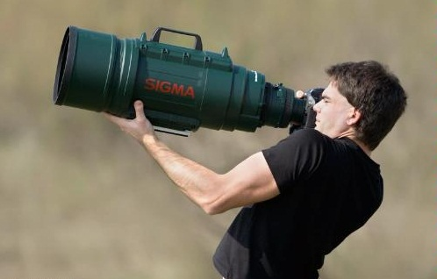
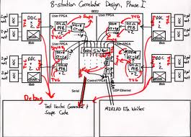
Radio Interferometer...
(In celebration of the passing of an extremely lame but blissfully short-lived internet meme)
What lay people think I do
What funding agencies
think I do
What cosmologists & astrophysicists think I do
What my engineers think I do
What I actually do

Slide 4

How To Make An Interferometer 1
Start with a normal reflector telescope....

Slide 5

How To Make An Interferometer 2
Then break it up into sections...

Slide 6

How To Make An Interferometer 3
Replace the optical path with electronics

Slide 7

How To Make An Interferometer 4
Move the electronics outside the dish
...and add cable delays

Slide 8

How To Make An Interferometer 5
Why not drop the
pieces onto the ground?

Slide 9

How To Make An Interferometer 6
...all of them

Slide 10
How To Make An Interferometer 7
And now replace them with proper radio dishes.
...and that's all! (?)
Well almost, what about the other pixels?

Slide 11

How Does Optical Imaging Do It?
This bit sees the EMF
from all directions,
added up together.
This bit sees the EMF
from all parts of the
dish surface,
added up together.

Slide 12
Fourier Transforms
An optical imaging system implicitly performs two Fourier transforms:
  1. Aperture EMF distribution = FT of the sky
  2. Focal plane = FT⁻¹ of the aperture EMF
A radio interferometer array measures (1)
  Then we do the second FT in software
  Hence, “aperture synthesis” imaging

Slide 13


The uv-Plane
Image plane
uv-plane
(12 hours!)
FT
One baseline samples
one visibility at a time
In a sense, the two are entirely equivalent

Slide 14
Where's The Catch?
We don't measure the full uv-plane, thus we can never recover the image fully (missing information)
Every visibility measurement is distorted (complex receiver gains, etc.), needs to be calibrated.

Slide 15



Catch 1: Missing Information
Response to a point source: Point Spread Function (PSF)
PSF = FT(uv-coverage)
Observed “dirty image” is convolved with the PSF
Structure in the PSF = uncertainty in the flux distribution (corresponding to missing data in the uv-plane)
PSF of WSRT.
The regular rings are due to the regular spacing of its antennas in the
East-West direction.
PSF of MeerKAT
4
2

Slide 16
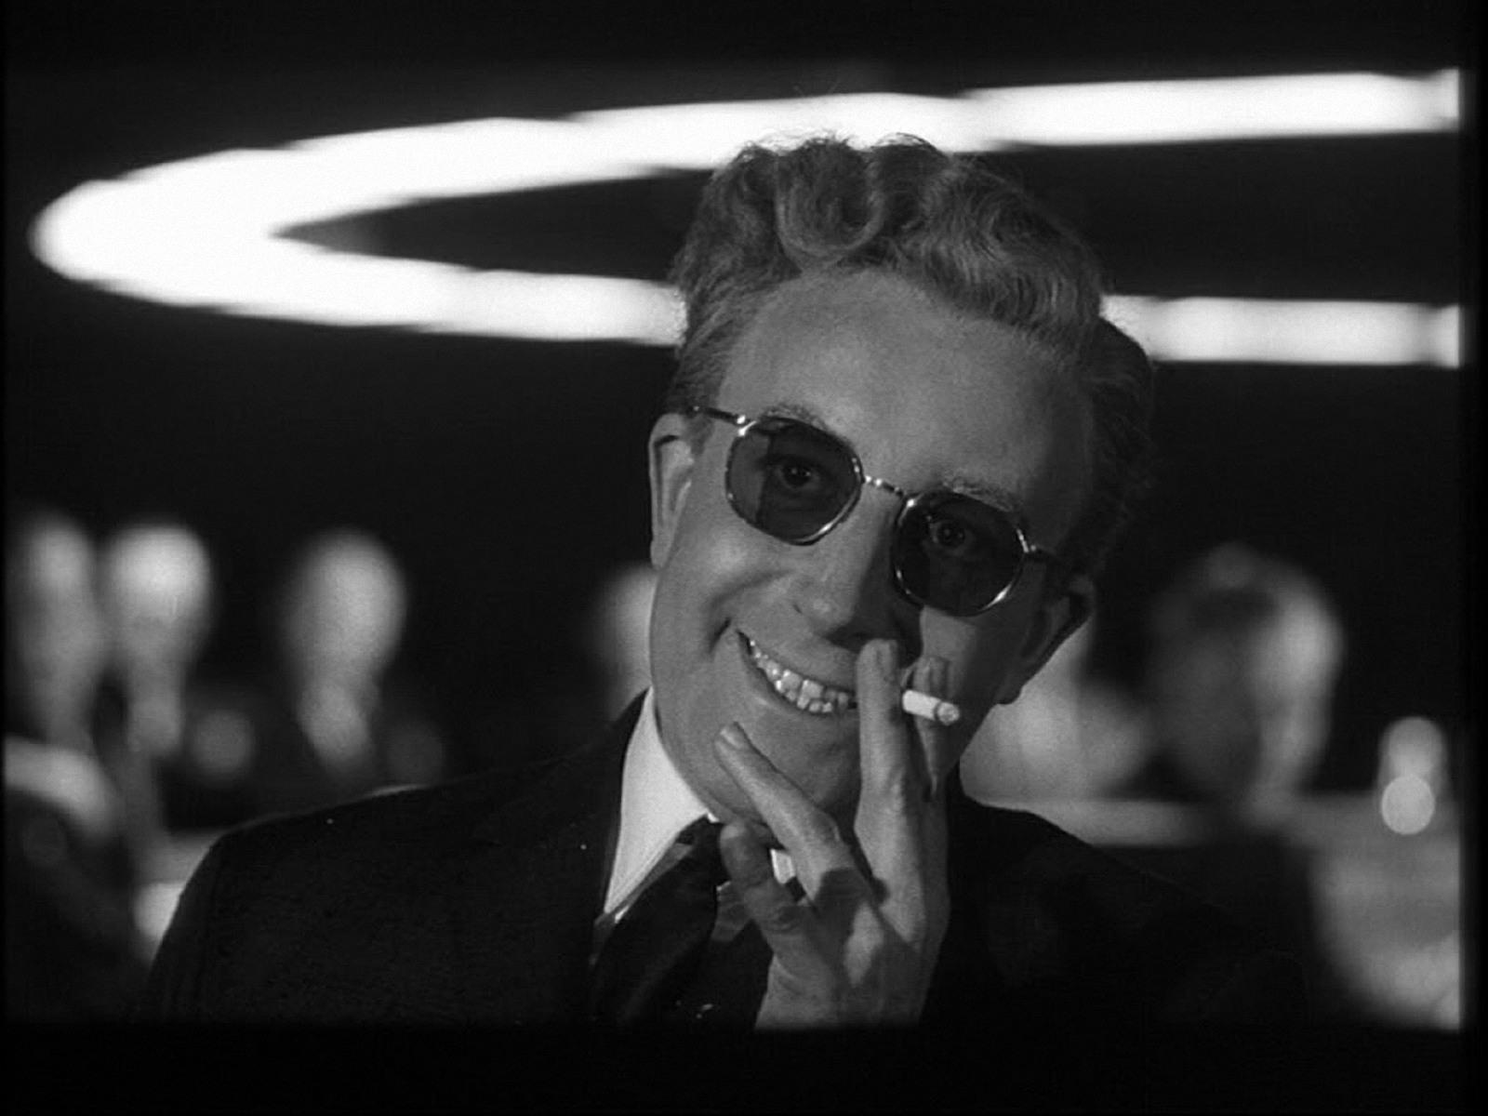
Dr. Sidelobes
The Villain of The Piece
PSF sidelobes
extend over the
entire sky

Slide 17

Deconvolution: from dirty to clean images
Real-life WSRT dirty image
Dirty image dominated by PSF sidelobes from the stronger sources
Deconvolution required to get at the faint stuff underneath.
A whole continuum of skies fits the dirty image (pick any value for the missing uv-components)
Deconvolution picks one = interpolates the missing info from extra assumptions (e.g.: “sources are point-like”).

Slide 18
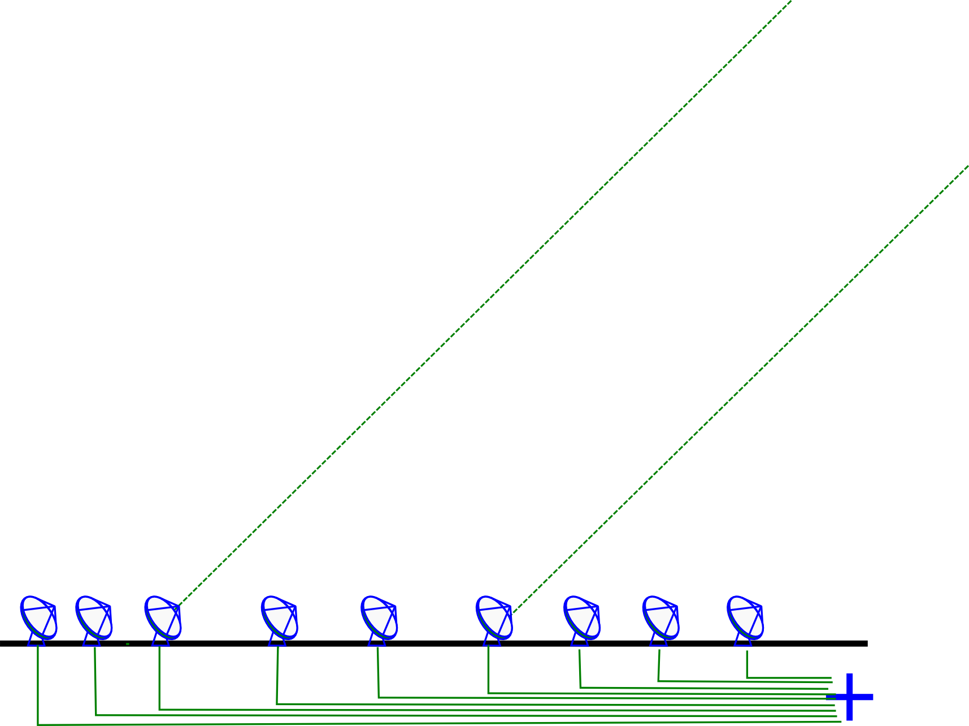
Catch 2: Measurement Errors
Incoming signal is subject to distortions (refraction, delay, amplitude loss)
  atmospheric and electronic

Slide 19
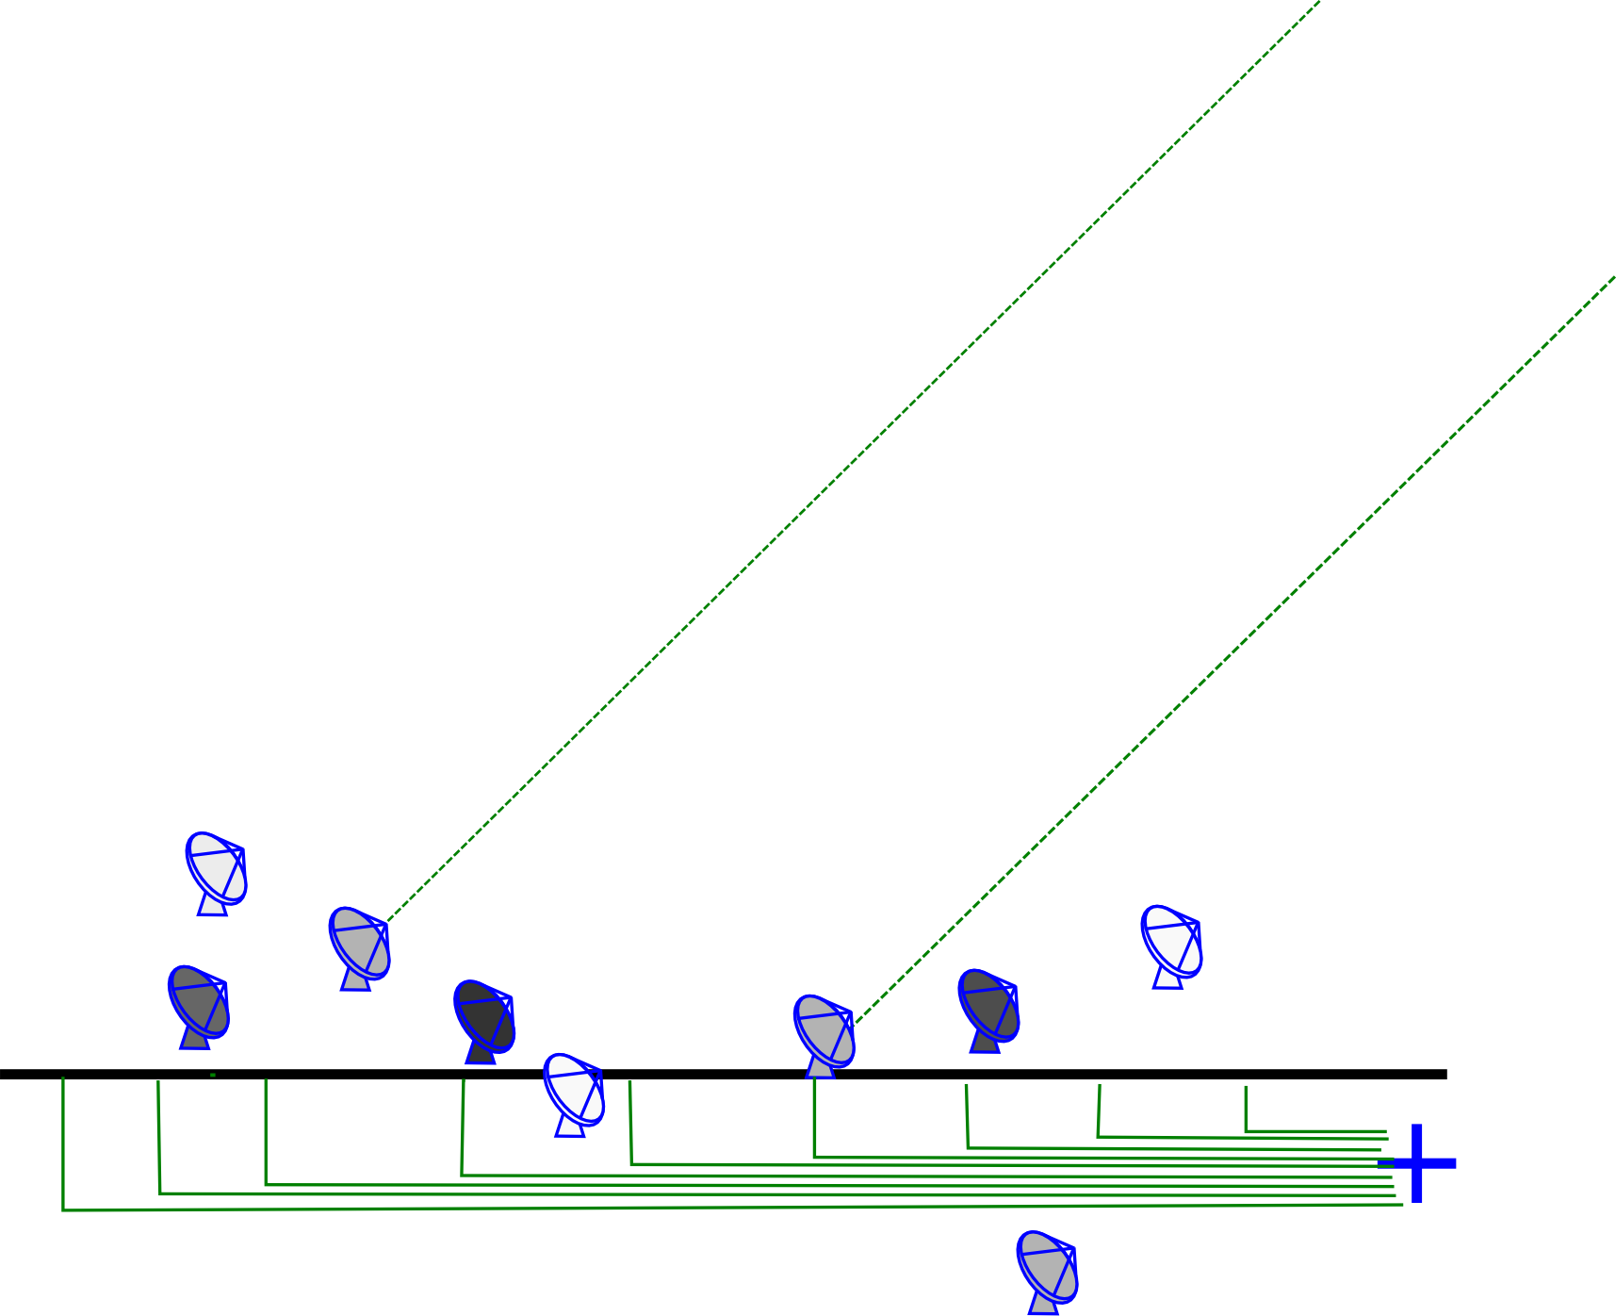
An Uncalibrated Interferometer
Complex gain error: signal multiplied by a amplitude and phase delay term
Delay errors correspond to differences in arrival time, i.e. random shifts of antennas towards and away from the source
Amplitude errors = different sensitivities

Slide 20
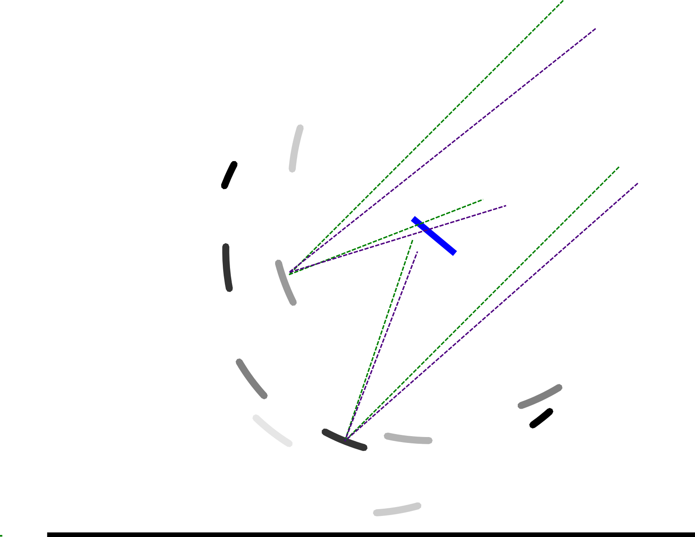
...And Its Optical Equivalent

Slide 21

And The Result...
One point-like source, but observed with phase errors
In the uv-plane, phase encodes information about location
Phase errors tend to spread the flux around
Amplitude errors distort structure
And Dr Sidelobes ensures that the damage is distributed democratically

Slide 22
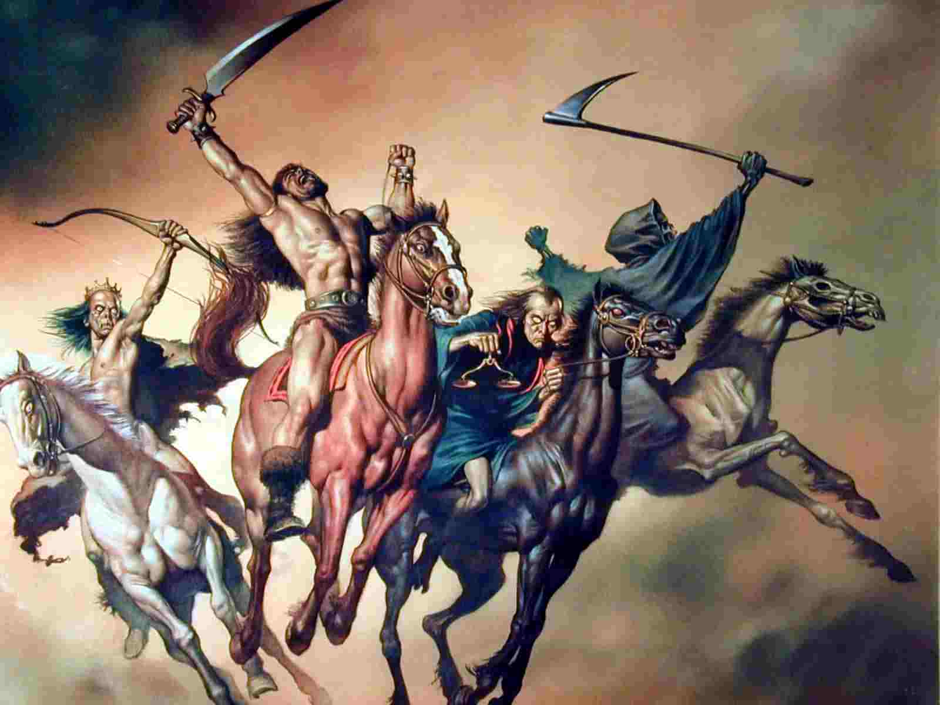
The Four Horsemen of interferometer limitations
Thermal noise
  lucky if we can
  reach it
Classical confusion
  (i.e. depth limited by resolution)
Residual calibration and deconvolution artefacts (& calibration “noise”)
Dr. Sidelobes
Well-understood (?)
this
talk

Slide 23

Good News First
3C147 @21cm
12h WSRT synthesis
160 MHz bandwidth
22 Jy peak (3C147)
13.5 μJy noise
1,600,000:1 DR
thermal noise-limited
Regular calibration does
not reach the noise,
leaves off-axis artefacts
due to direction-dependent
effects (left inset)
Addressed via differential
gains (right inset)
3C147 22Jy
30 mJy

Slide 24
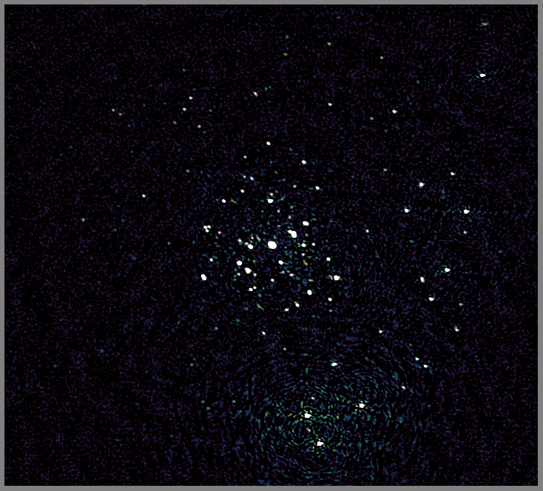
JVLA Can Do It Too
Recent result from 3GC3 workshop
3C147
JVLA-D @1.4 GHz
Best image after
regular selfcal

Slide 25
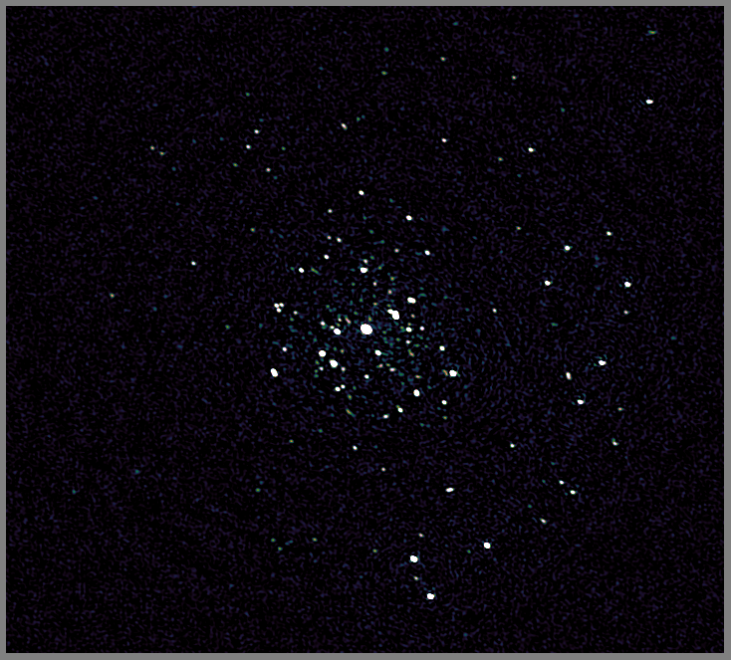
JVLA Can Do It Too II
Recent result from 3GC3 workshop
3C147
JVLA-D @1.4 GHz
Best image after
regular selfcal
...and direction-dependent (DD)
calibration on a few
sources

Slide 26
Your Friend, The Primary Beam
The primary beam is your antenna's spatial sensitivity pattern
Restricts your interferometry to a given field of view
  ...restricts your problems, too

Slide 27
Why Is It Good To Have a PB?
Restricted field-of-view means...
  Fewer bright sources to worry about (and subtract)
  Less scope for atmospheric variations (gains are direction-independent to first order)
This is why
“wide FoV” is
so difficult

Slide 28


Real-Life Primary Beams
KAT-7
MeerKAT
Doesn't completely restrict the FoV – only attenuates the rest of the sky, but the PB sidelobes are non-zero!

Slide 29
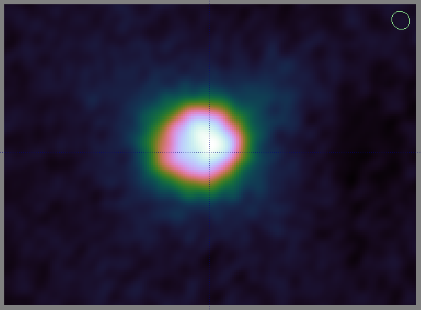
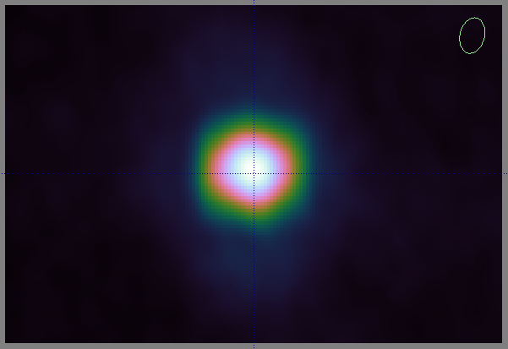
“Restricted” FoV?
Sidelobes attenuate the rest of the sky, but don't completely eliminate it
Example from a WSRT 300MHz observation: CasA and CygA (~60 and ~90 degrees away!):

Slide 30

When Primary Beams Go Bad...
(Courtesy of Ian Heywood)
EVLA 8 GHz: Looking for sub-mm galaxies and QSOs in the William Herschel Deep Field.
Dominant effect: bright calibrator source rotating through first sidelobe of the primary beam.
(This also has a horrible PSF, being an equatorial field.)
This is your science
(good luck!)
This is your
phase calibrator
Brightness scale 0~50μJy

Slide 31

Keep Your Friends Close, and your calibrators as far away as you can...
An approximation of the primary beam response, overlaid on top of the image.
As the sky rotates, the sidelobes of the PB sweep over the source, thus making it effectively time-variable.
This is your science
(good luck!)
This is your
phase calibrator
(Brightness scale 0~50μJy)

Slide 32

Deconvolution Doesn't Help...
Residual image, after deconvolution.
The contaminating source cannot be deconvolved away properly, due to its instrumental time-variability.
...5 years ago this would observation would probably be a complete write-off.
(Brightness scale 0~50μJy)

Slide 33
Same Problem Here
The artefacts in this
image have the same
underlying cause.
But here, the dominant
source is at the centre
(where PB variation is
minimal) and the
“offending” sources are
relatively faint.
But we did address them
via differential gains...

Slide 34

Differential Gains To The Rescue
Residual image after applying differential gain solutions to the contaminating source
Brightness scale 0~50μJy

Slide 35

Multi-Band Image
Multi-band residual image:
noise-limited, no trace of contaminating source.
Phase calibrator
used to be here
Brightness scale 0~50μJy

Slide 36
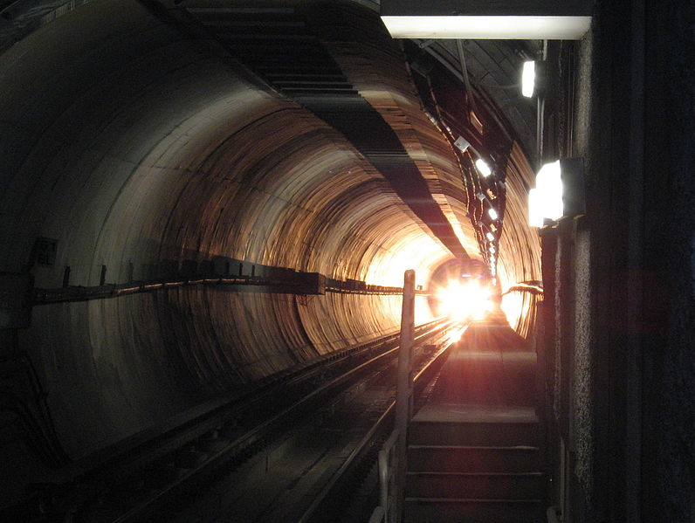
Flush With Success
3C147, WDHF, new LOFAR maps: some real successes
Thermal noise-limited maps are being produced
  Though nowhere near routinely...
  T&Cs apply: extended
  sources are still notoriously
  hard to deconvolve
  ….though new algorithms
  are emerging
Is this the light at the end of the
tunnel?

Slide 37

2004: The Ghosts Of Cyg A
WSRT 92cm observation of J1819+3845 by Ger de Bruyn
String of ghosts connecting brightest source to Cyg A
(20° away!)
“Skimming pebbles in a pond”
Positions correspond to rational fractions
(1/2, 1/3, 2/3, 2/5, etc...)
Wasn't clear if they were a one-off correlator error, a calibration artefact, etc.
  (...and if you did low-frequency in 2004, you had it coming anyway.)

Slide 38

2010: Ghosts Return
WSRT 21cm observation
...with intentionally strong instrumental errors
String of ghosts extending through dominant sources A (220 mJy) and B (160 mJy)
Second, fainter, string from source A towards NNE
Qualitatively similar to Cyg A ghosts

Slide 39

Don't Mess With My L-Band!
Eventually nailed via simulations

Slide 40
Ghosts In The (Selfcal) Machine
Ghosts arise due to missing flux in the calibration sky model
Mechanism: selfcal solutions try to compensate for this by moving flux around
  Not enough DoFs to do this perfectly
  ...so end up dropping flux all over the map
  ...with a lot of help from the good Dr Sidelobes
Regular structure in this case due to WSRT's redundant layout = regular sidelobes
  JVLA, MeerKAT: “random” (but not Gaussian!)

Slide 41

JVLA Ghost Sim

Slide 42
Ghastly Questions
Does calibration always introduce ghosts?
  YES. But most of the time they're buried in the noise.
  ...unless you have a complete sky model (i.e. if all your science targets are known in advance)
Why don't we always see them?
  Not enough sensitivity
Will they average out?
  NO. Push the sensitivity, they pop out.
What will they do to my statistical detections (hello EoR)?
  Dunno. Simulations needed.
What else is that redistributed flux doing?

Slide 43

Ghosts, The Flip Side
WSRT “Field From Hell” (Abell 773 @300 MHz),
residual map

Slide 44

Getting There, Right?
After diligent (direction-dependent) calibration

Slide 45
Noise-limited Is Not Always Good
Suppression of non-model sources
Our target

Slide 46

The Dangers Of
Direction-Dependent Solutions
Suppression is less with more conservative calibration
Our target

Slide 47
Ghosts & Source Suppression
Both ghosts and suppression operate via the same mechanism, and Dr Sidelobes pulls the strings
Ghosts are usually buried in the noise
Suppression always present, but more severe with DD calibration (more DoFs...)
  A noise-limited map is not necessarily a good science map!
“What if we were to somehow break the thermal noise barrier, but
all we'd find beneath would be the bones of Jan's* enemies?”
– Anon., 3GC-II Workshop
*) referring to Jan Noordam

Slide 48
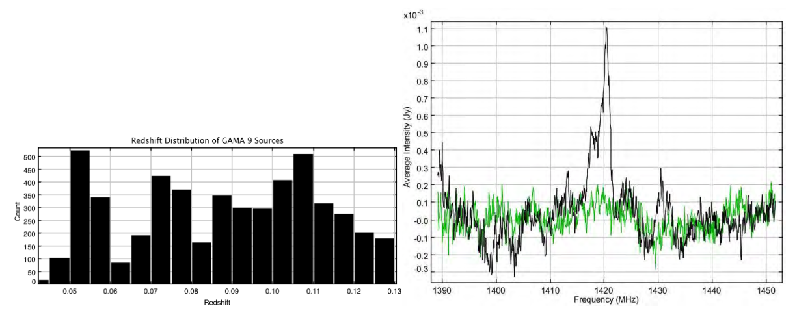
HI Stacking:
Picking through the bones of Jan's enemies
Individual HI lines hidden in the noise
  So apply priors from optical surveys...
  ...by shifting each spectrum to its known redshift
  ...and probe the total signal by co-adding spectra
HI lines add up, noise suppressed by ~N ⁻²
For bonus points, use optical positions to stack sources that are
sub-noise in radio
(Delhaize & Staveley-Smith)

Slide 49
HI Stacking:
The Ian “Bad News” Heywood Simulation I
Simulated HI emission (S³-SAX)
Pure sky model
No noise
No continuum
No interferometer
response
So, what happens when Dr. Sidelobes shows up?

Slide 50
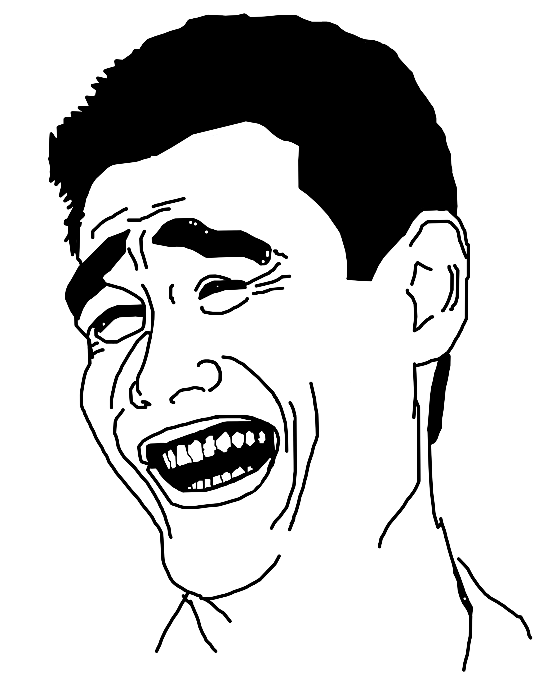
“Stacking experiment for high-z HI on the celestial equator? LOL!” – Anon.
No noise
No continuum
No calibration or deconvolution residuals
SKA-Mid sim
Equatorial field: high N-S sidelobes

Slide 51
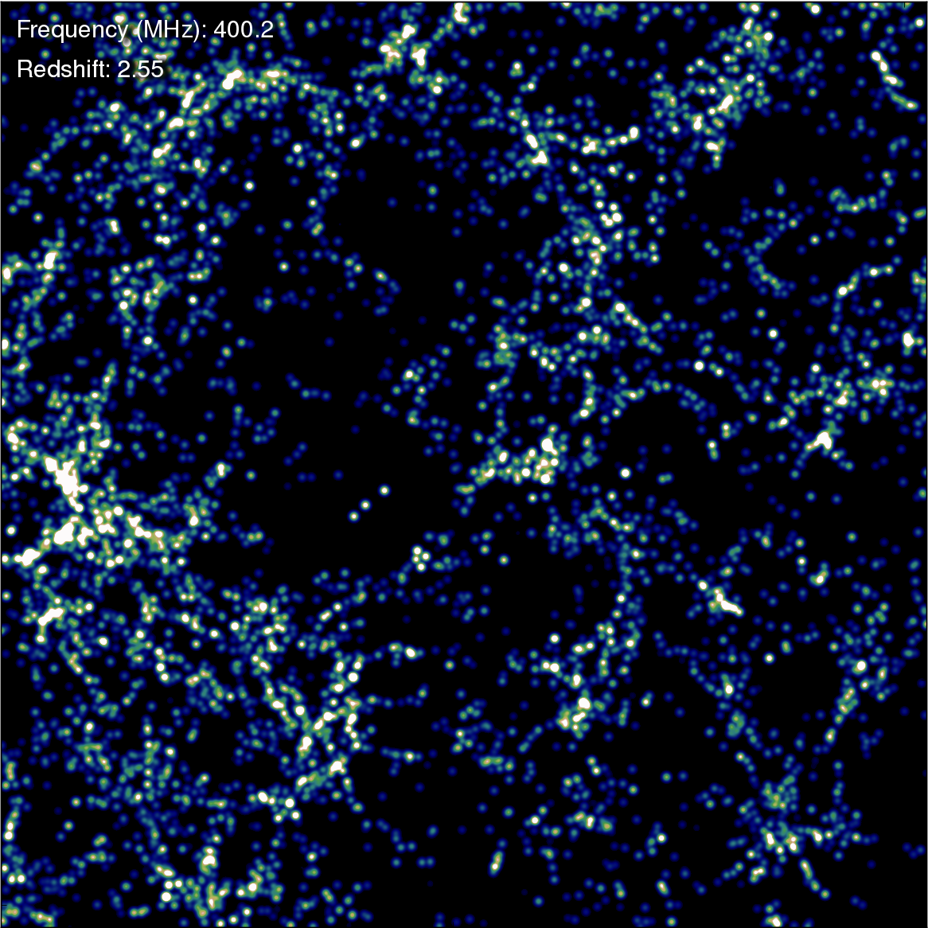
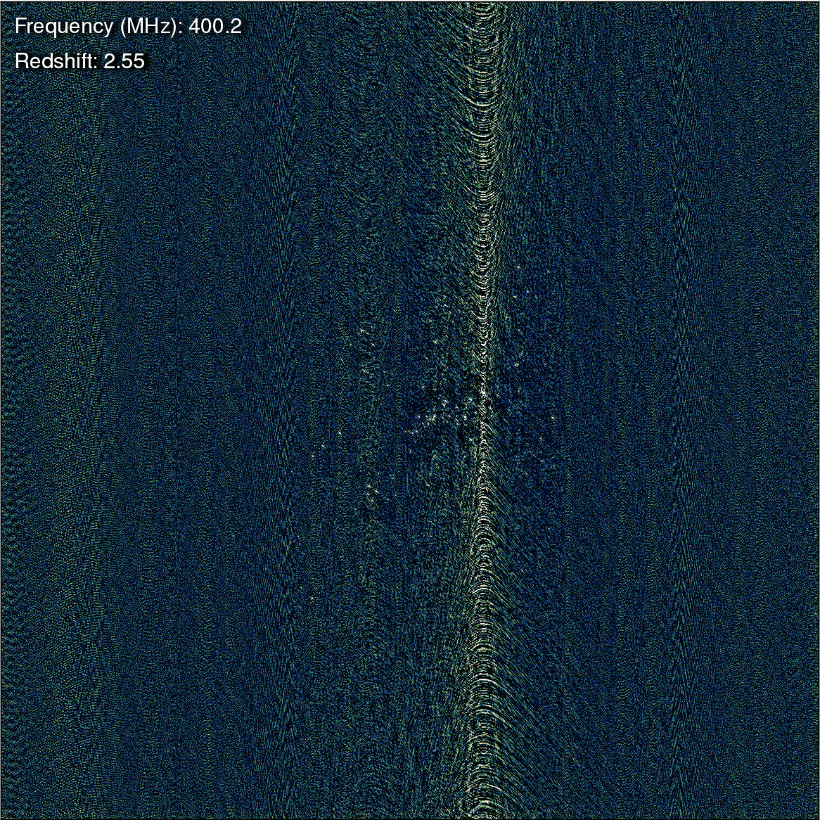
True vs. Observed
How many of these galaxies will stack up coherently?

Slide 52
LADUMA Stacking Sim
No noise
No continuum
No calibration or deconvolution residuals
MeerKAT sim
(... with some YouTube artefacts...)

Slide 53
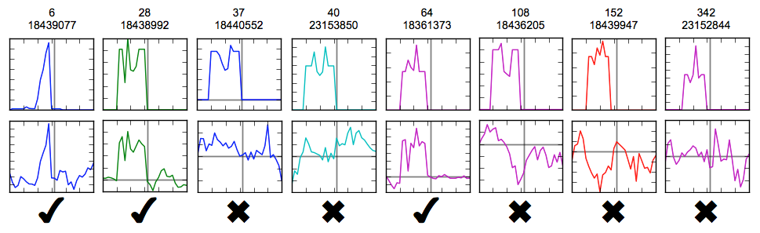
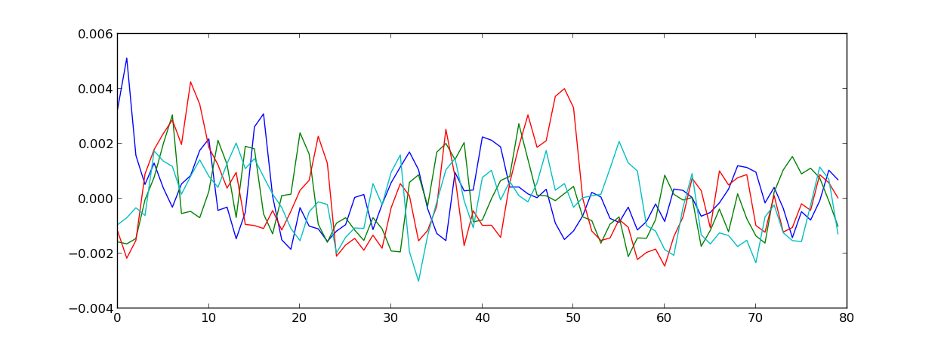
Dr Sidelobes at Work
TOP: A selection of individual galaxy spectra
BOTTOM: A selection of
“Dr. Sidelobes's spectra”

Slide 54
HI + Dr. Sidelobes
Ordinal number of galaxy
(in order of HI mass)
TOP: original HI signal
BOTTOM: HI + Dr. Sidelobes
  ...most of which originate with undetected sources
75% of the top 500...

Slide 55
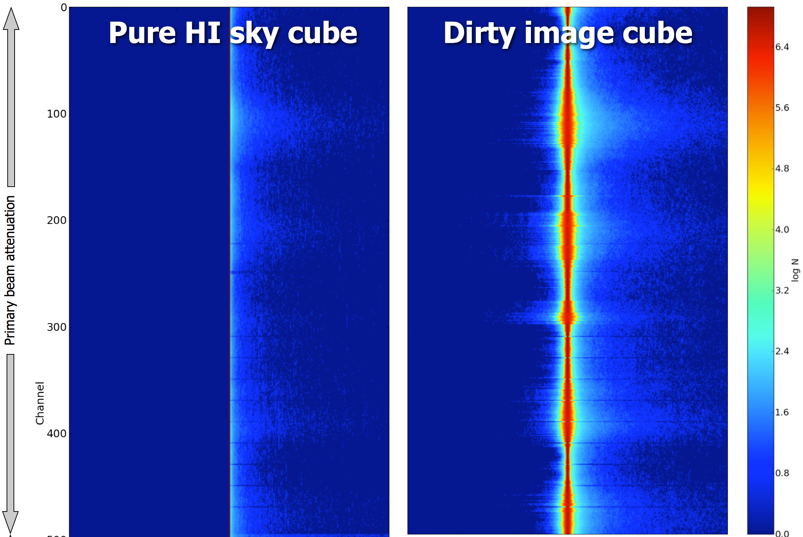
Pixel Values Histogram
dominant
sources
negative sidelobes
of dominant
sources
no negative
values
Most HI signal
lives here
positive sidelobes
of dominant
sources

Slide 56
How Radio Interferometry
Really Works
Bright sources
(DD solutions, uv-subtraction, deconvolution)
thermal noise
Faint sources
(DDE interpolation, deconvolution)
1-2σ sources
(stacking)
<1σ sources
(a stiff drink?)

Slide 57
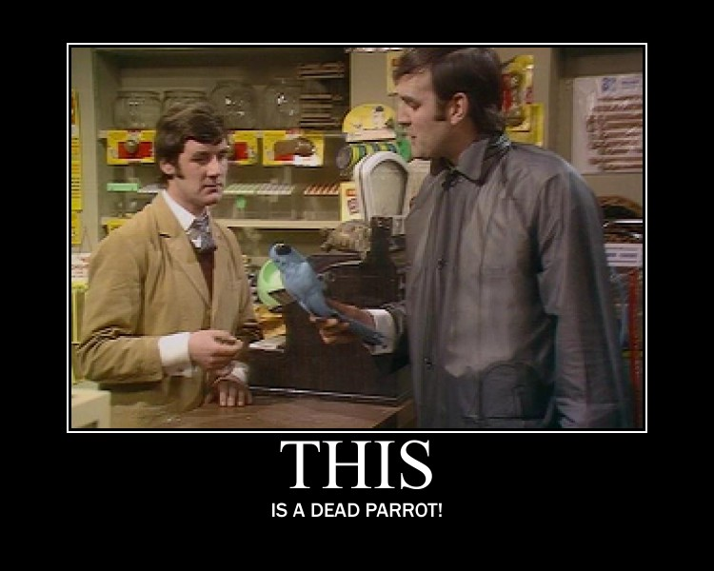
Dead, Or Sleeping?
In the form currently mooted, it seems that HI stacking can at best “skim” the top of the sub-noise sources
Perhaps with more
clever techniques?
Simulations
needed (and can
be done!)

Slide 58

And Things Can Only Get Worse...
Radio interferometers of the past: simple machines built of beautiful, massively over-engineered
components
“Simple”
experiments

Slide 59

The Future
Complex machines built out of cheap junk
  “We'll just solve it in software!”
Increasingly
subtle and
elaborate
experiments

Slide 60
The Answer?
Radio interferometers are full of surprises
SKA will be the biggest surprise of them all
We now have the technology for incredibly elaborate simulations
  Smirnov et al. (BeamSims), Patel et al. (weak lensing), …
So perhaps some surprises can be avoided

Slide 61
Conclusion
Do we want our surprises now?
...or do we wait until a pyramid of actual data is perched over our heads?

