Slide 1
Spit, Duct Tape,
Baling Wire & Oral Tradition:
Dealing With Radio Data
“A high quality radio map is a lot like a sausage,
you might be curious about how it was made,
but trust me you really don't want to know.”
– Jack Hickish, Oxford
O. Smirnov (Rhodes University & SKA SA)

Slide 2
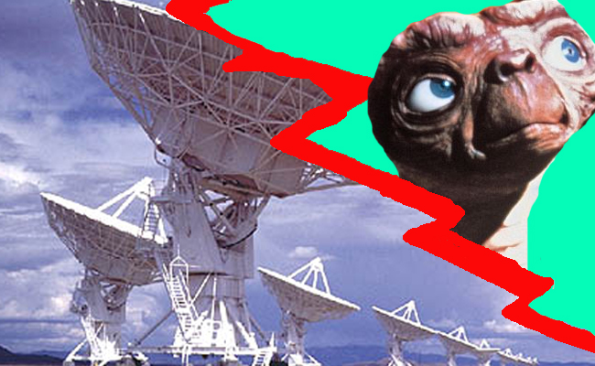
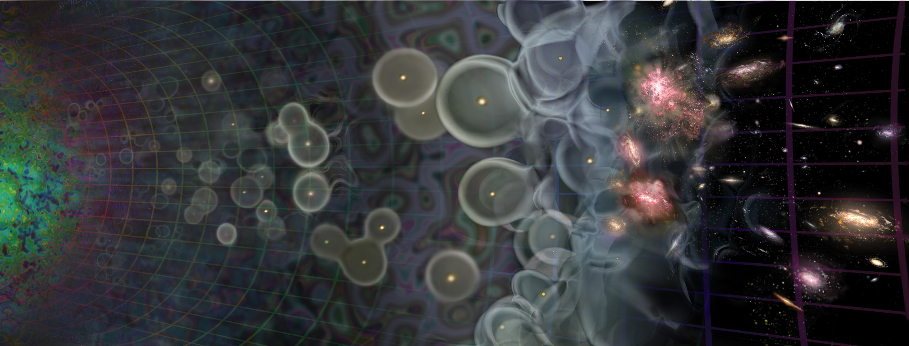

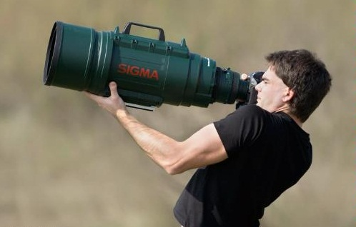
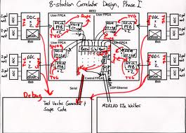
Radio Interferometer...
(In celebration of the passing of an extremely lame but blissfully short-lived internet meme)
What lay people think I do
What funding agencies
think I do
What cosmologists & astrophysicists think I do
What my engineers think I do
What I actually do

Slide 3
The Ron Ekers Seven-Step Program
To Producing A Radio Interferometer
Step 0. Admit that you have a problem:
You want to (need to/are forced to by peers/supervisors) to do interferometry.
“My name is Oleg Smirnov, and I am an interferometrist.”

Slide 4

How To Make An Interferometer 1
Start with a normal reflector telescope....

Slide 5

How To Make An Interferometer 2
Then break it up into sections...

Slide 6

How To Make An Interferometer 3
Replace the optical path with electronics

Slide 7

How To Make An Interferometer 4
Move the electronics outside the dish
...and add cable delays

Slide 8

How To Make An Interferometer 5
Why not drop the
pieces onto the ground?

Slide 9

How To Make An Interferometer 6
...all of them

Slide 10

How To Make An Interferometer 7
And now replace them with proper radio dishes.
...and that's all! (?)
Well almost, what about the other pixels?

Slide 11

How Does Optical Imaging Do It?
This bit sees the EMF
from all directions,
added up together.
This bit sees the EMF
from all parts of the
dish surface,
added up together.

Slide 12
Fourier Transforms
An optical imaging system implicitly performs two Fourier transforms:
  1. Aperture EMF distribution = FT of the sky
  2. Focal plane = FT⁻¹ of the aperture EMF
A radio interferometer array measures (1)
  Then we do the second FT in software
  Hence, “aperture synthesis” imaging

Slide 13


The uv-Plane
Image plane
uv-plane
(12 hours!)
FT
One baseline samples
one visibility at a time
In a sense, the two are entirely equivalent

Slide 14
Earth Rotation Aperture Synthesis
Every pair of antennas (baseline) is correlated, measures one complex visibility = one point on the uv-plane.
As the Earth rotates, a baseline sweeps out an arc in the uv-plane
  See uv-coverage plot (previous slide)
Even a one-dimensional East-West array (WSRT = 14 antennas) is sufficient

Slide 15
Where's The Catch?
We don't measure the full uv-plane, thus we can never recover the image fully (missing information)
  Interferometer = high & low-pass filter
Every visibility measurement is distorted (complex receiver gains, etc.), needs to be calibrated.
(Doesn't work the same way in optical interferometry at all...)
  Can't really form up complex visibilities, etc.

Slide 16


Catch 1: Missing Information
Response to a point source: Point Spread Function (PSF)
PSF = FT(uv-coverage)
Observed “dirty image” is convolved with the PSF
Structure in the PSF = uncertainty in the flux distribution (corresponding to missing data in the uv-plane)
(12-hour WSRT PSF)
4
2

Slide 17

Deconvolution: from dirty to clean images
Real-life WSRT dirty image
Dirty image dominated by PSF sidelobes from the stronger sources
Deconvolution required to get at the faint stuff underneath.
A whole continuum of skies fits the dirty image
(pick any value for the missing uv-components)
Deconvolution picks one = interpolates the missing
info from extra assumptions
(e.g.: “sources are point-like”).

Slide 18
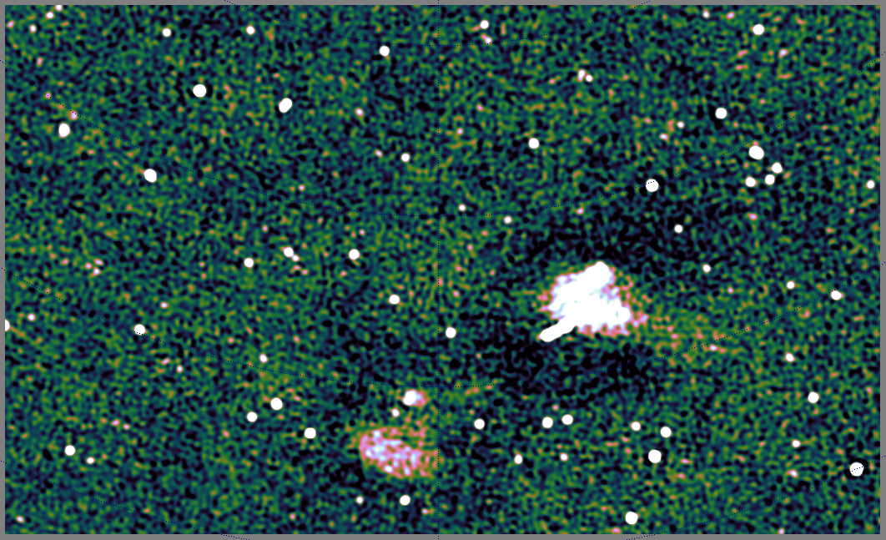
Deconvolution Gone Bad
Extended sources always troublesome
Plus we're missing the zero-order spacing measurement (=total power)
...end up with a “negative bowl” problem
Ultimately, interpolating missing uv-components requires a better choice of basis functions
...and better deconvolution methods
Compressive sensing (CS) is promising

Slide 19
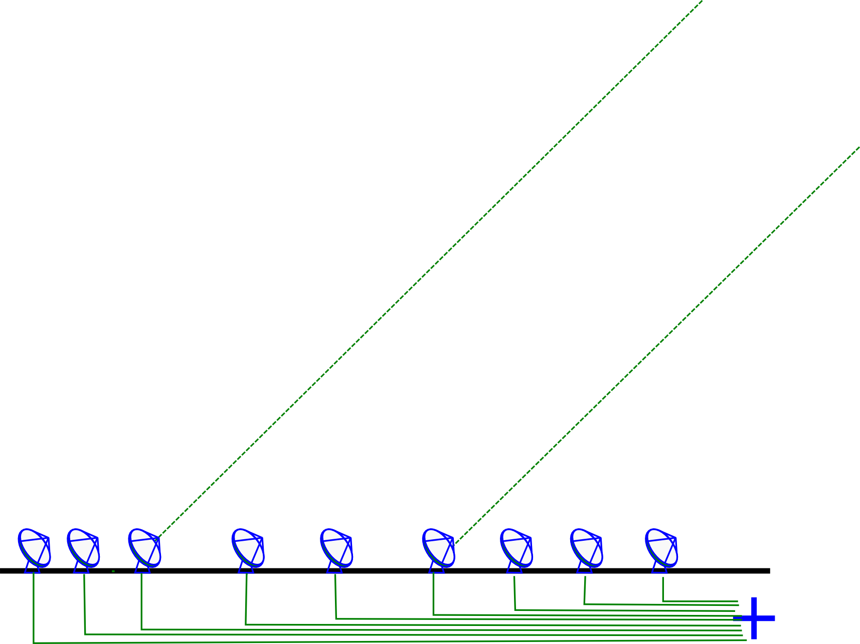
Catch 2: Measurement Errors
Incoming signal is subject to distortions (refraction, delay, amplitude loss)
  atmospheric and electronic

Slide 20
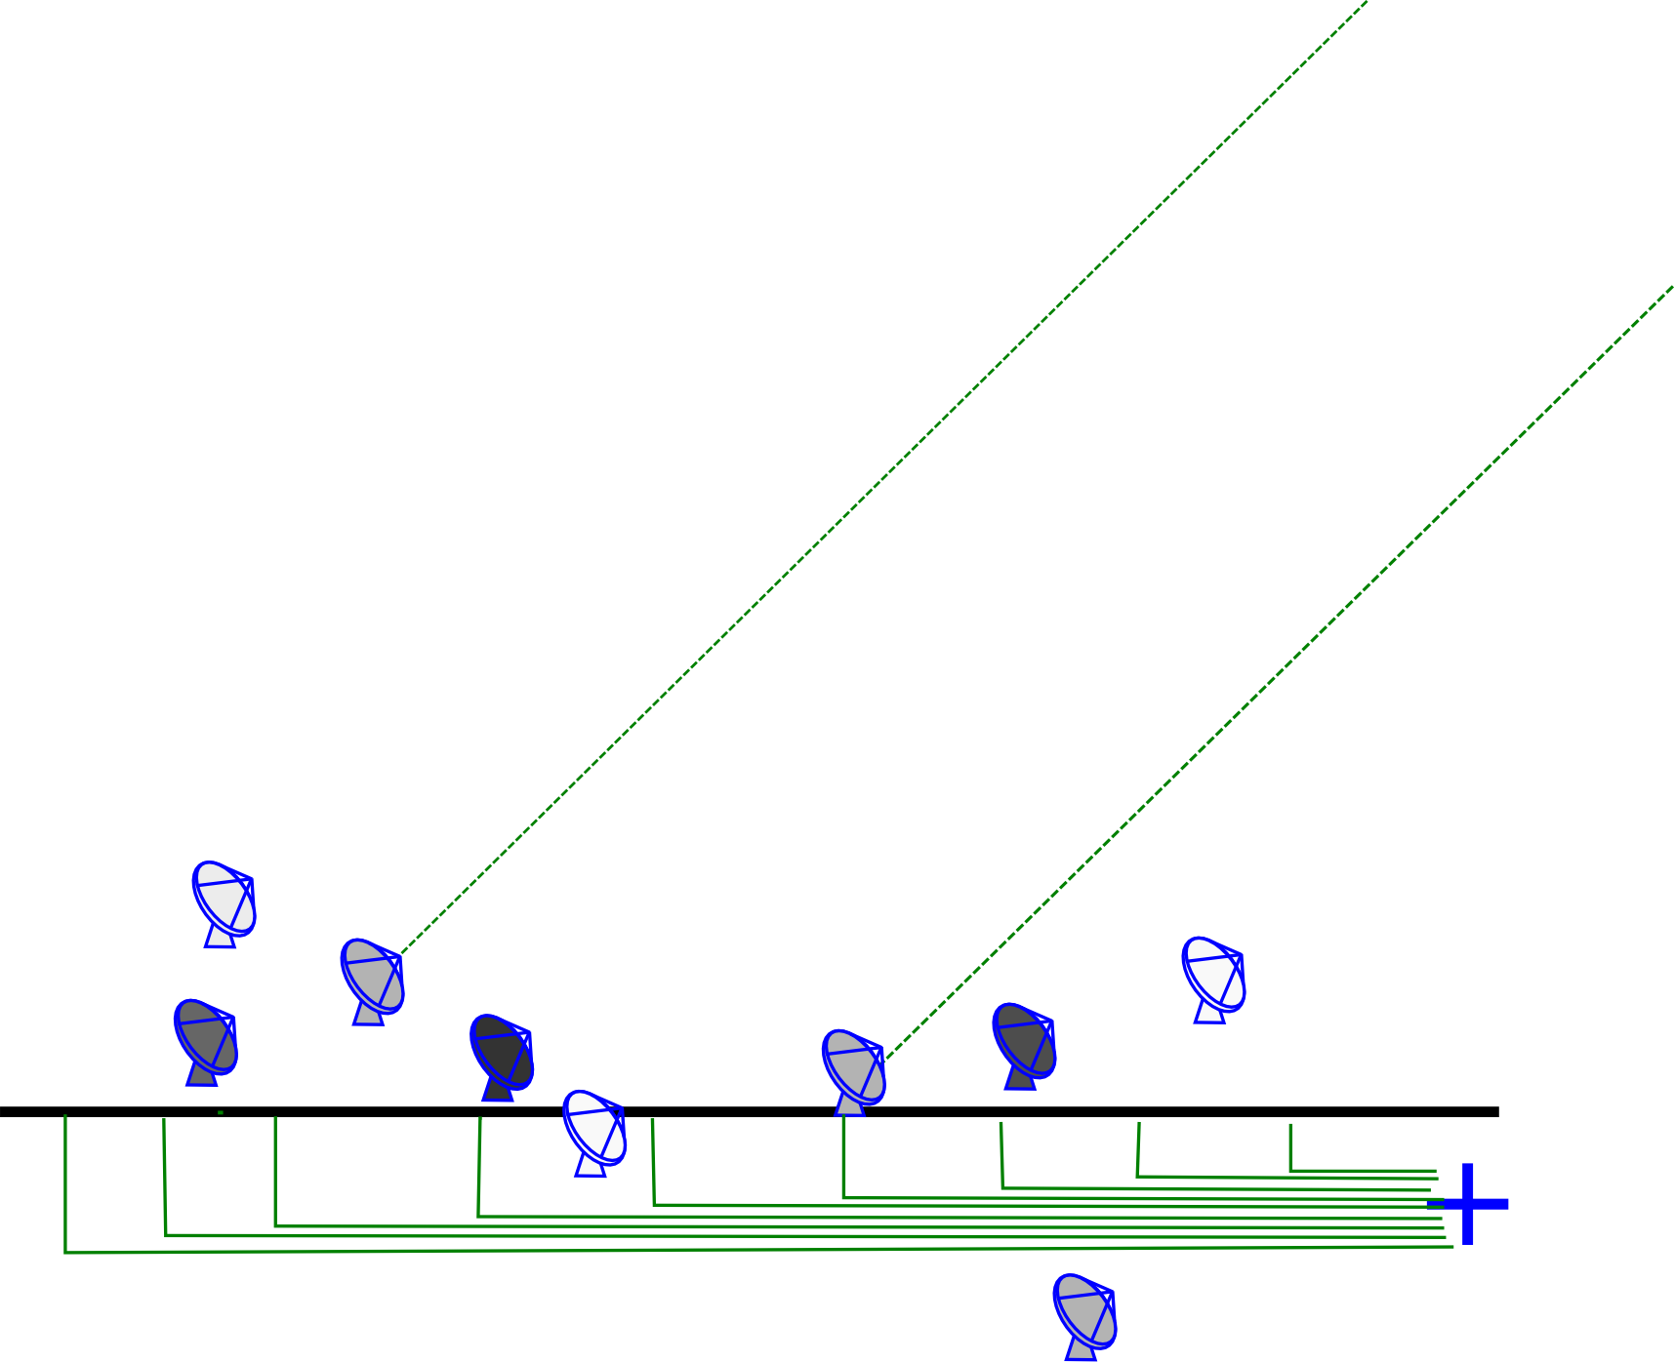
An Uncalibrated Interferometer
Complex gain error: signal multiplied by a amplitude and phase delay term
Delay errors correspond to differences in arrival time, i.e. random shifts of antennas towards and away from the source
Amplitude errors = different sensitivities

Slide 21
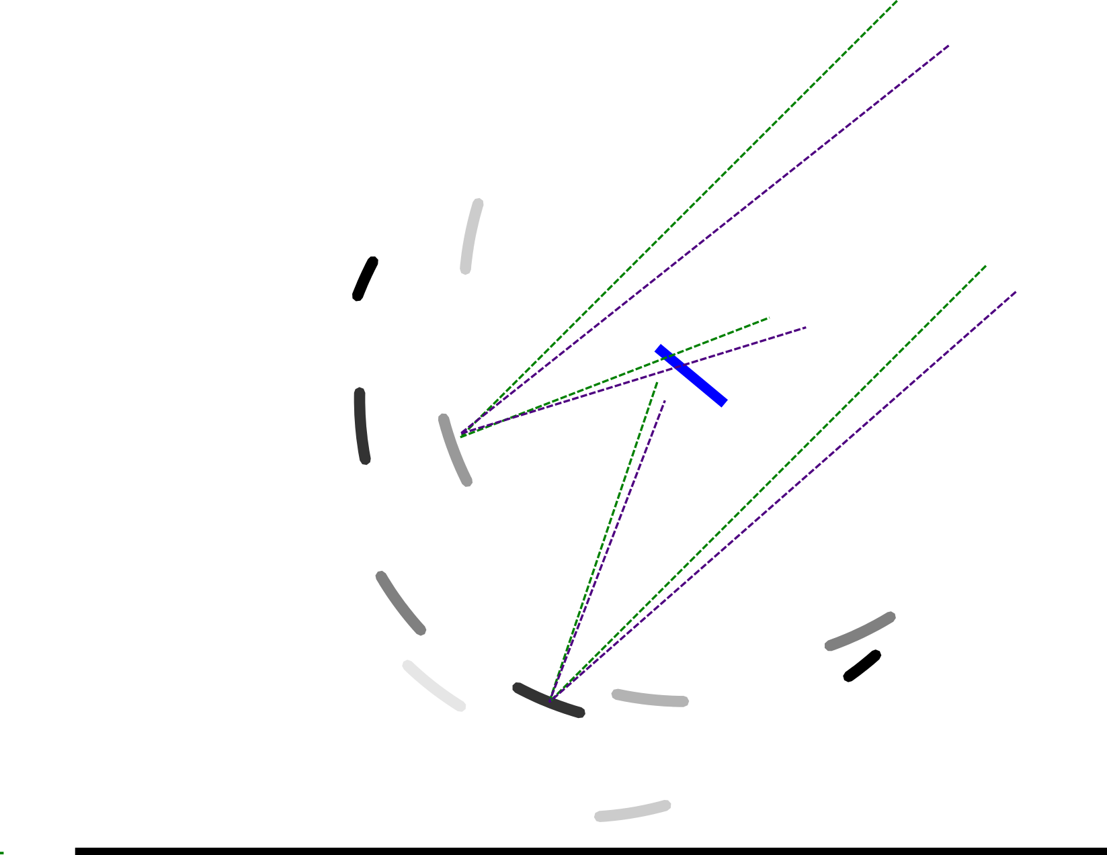
...And Its Optical Equivalent

Slide 22

And The Result...
One point-like source, but observed with phase errors
In the uv-plane, phase encodes information about location
Phase errors tend to spread the flux around
Amplitude errors distort structure
And Dr Sidelobes ensures that the damage is distributed democratically

Slide 23
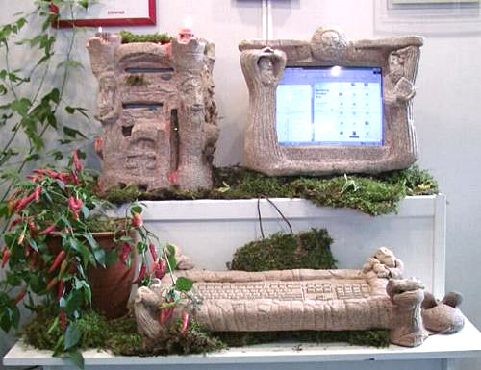
Stone-Age Calibration
(First-Generation, or 1GC)
Calibrate gains using a known calibrator source
Move antennas to target, cross your fingers, and hope that everything stays stable enough to get an image
Dynamic range:
~100:1
Observed
visibility
Model
visibility
Gain of
interferometer
(i.e. antenna pair)
p-q

Slide 24
The Selfcal Revolution (2GC)
Per-baseline gains are actually products of per-antenna complex gains!
  Vpq: observed visibility
  Mpq: model visibility (FT of sky)
  gp: antenna p complex gain
N(N-1)/2 visibilities >> N gains
  Start with simple M
  Solve for g's
  Improve M, rinse & repeat
dynamic range > 10⁶:1

Slide 25
Typical Selfcal Cycle
Pre-calibrate g using external calibrators
Correct with g⁻¹, make dirty image, deconvolve
Generate rough initial sky model
Solve for g using the current sky model
Correct with g⁻¹, make dirty image, deconvolve
  Optional: subtract model and work with residuals
Update the sky model
pre-cal
Selfcal loop
Huge body of experience suggests that this works rather well, BUT there's no formal proof (!!!) Current practice is a collection of ad hoc methods, dark art and lore passed down the generations in what is virtually an oral tradition.

Slide 26
The Essense Of Selfcal
Essentially, selfcal is model fitting:
  Sky model (image of the sky): M(x,y,υ)
  Instrument model (set of gains): {gp(υ,t)}
Fit this to the observed data
  With alternating updates of M and g

Slide 27
Fundamental Assumption
Basic assumption of selfcal:
every antenna sees the same (constant) sky, but has its own (time-variable) complex gain term.

Slide 28

The Past: Massive Overengineering
(Built For 1GC, used with 2GC)

Slide 29

The Future:
Four Sticks In The Ground (+Software)

Slide 30

...and Dishes Made Of Plastic
(+Compatible Software)

Slide 31
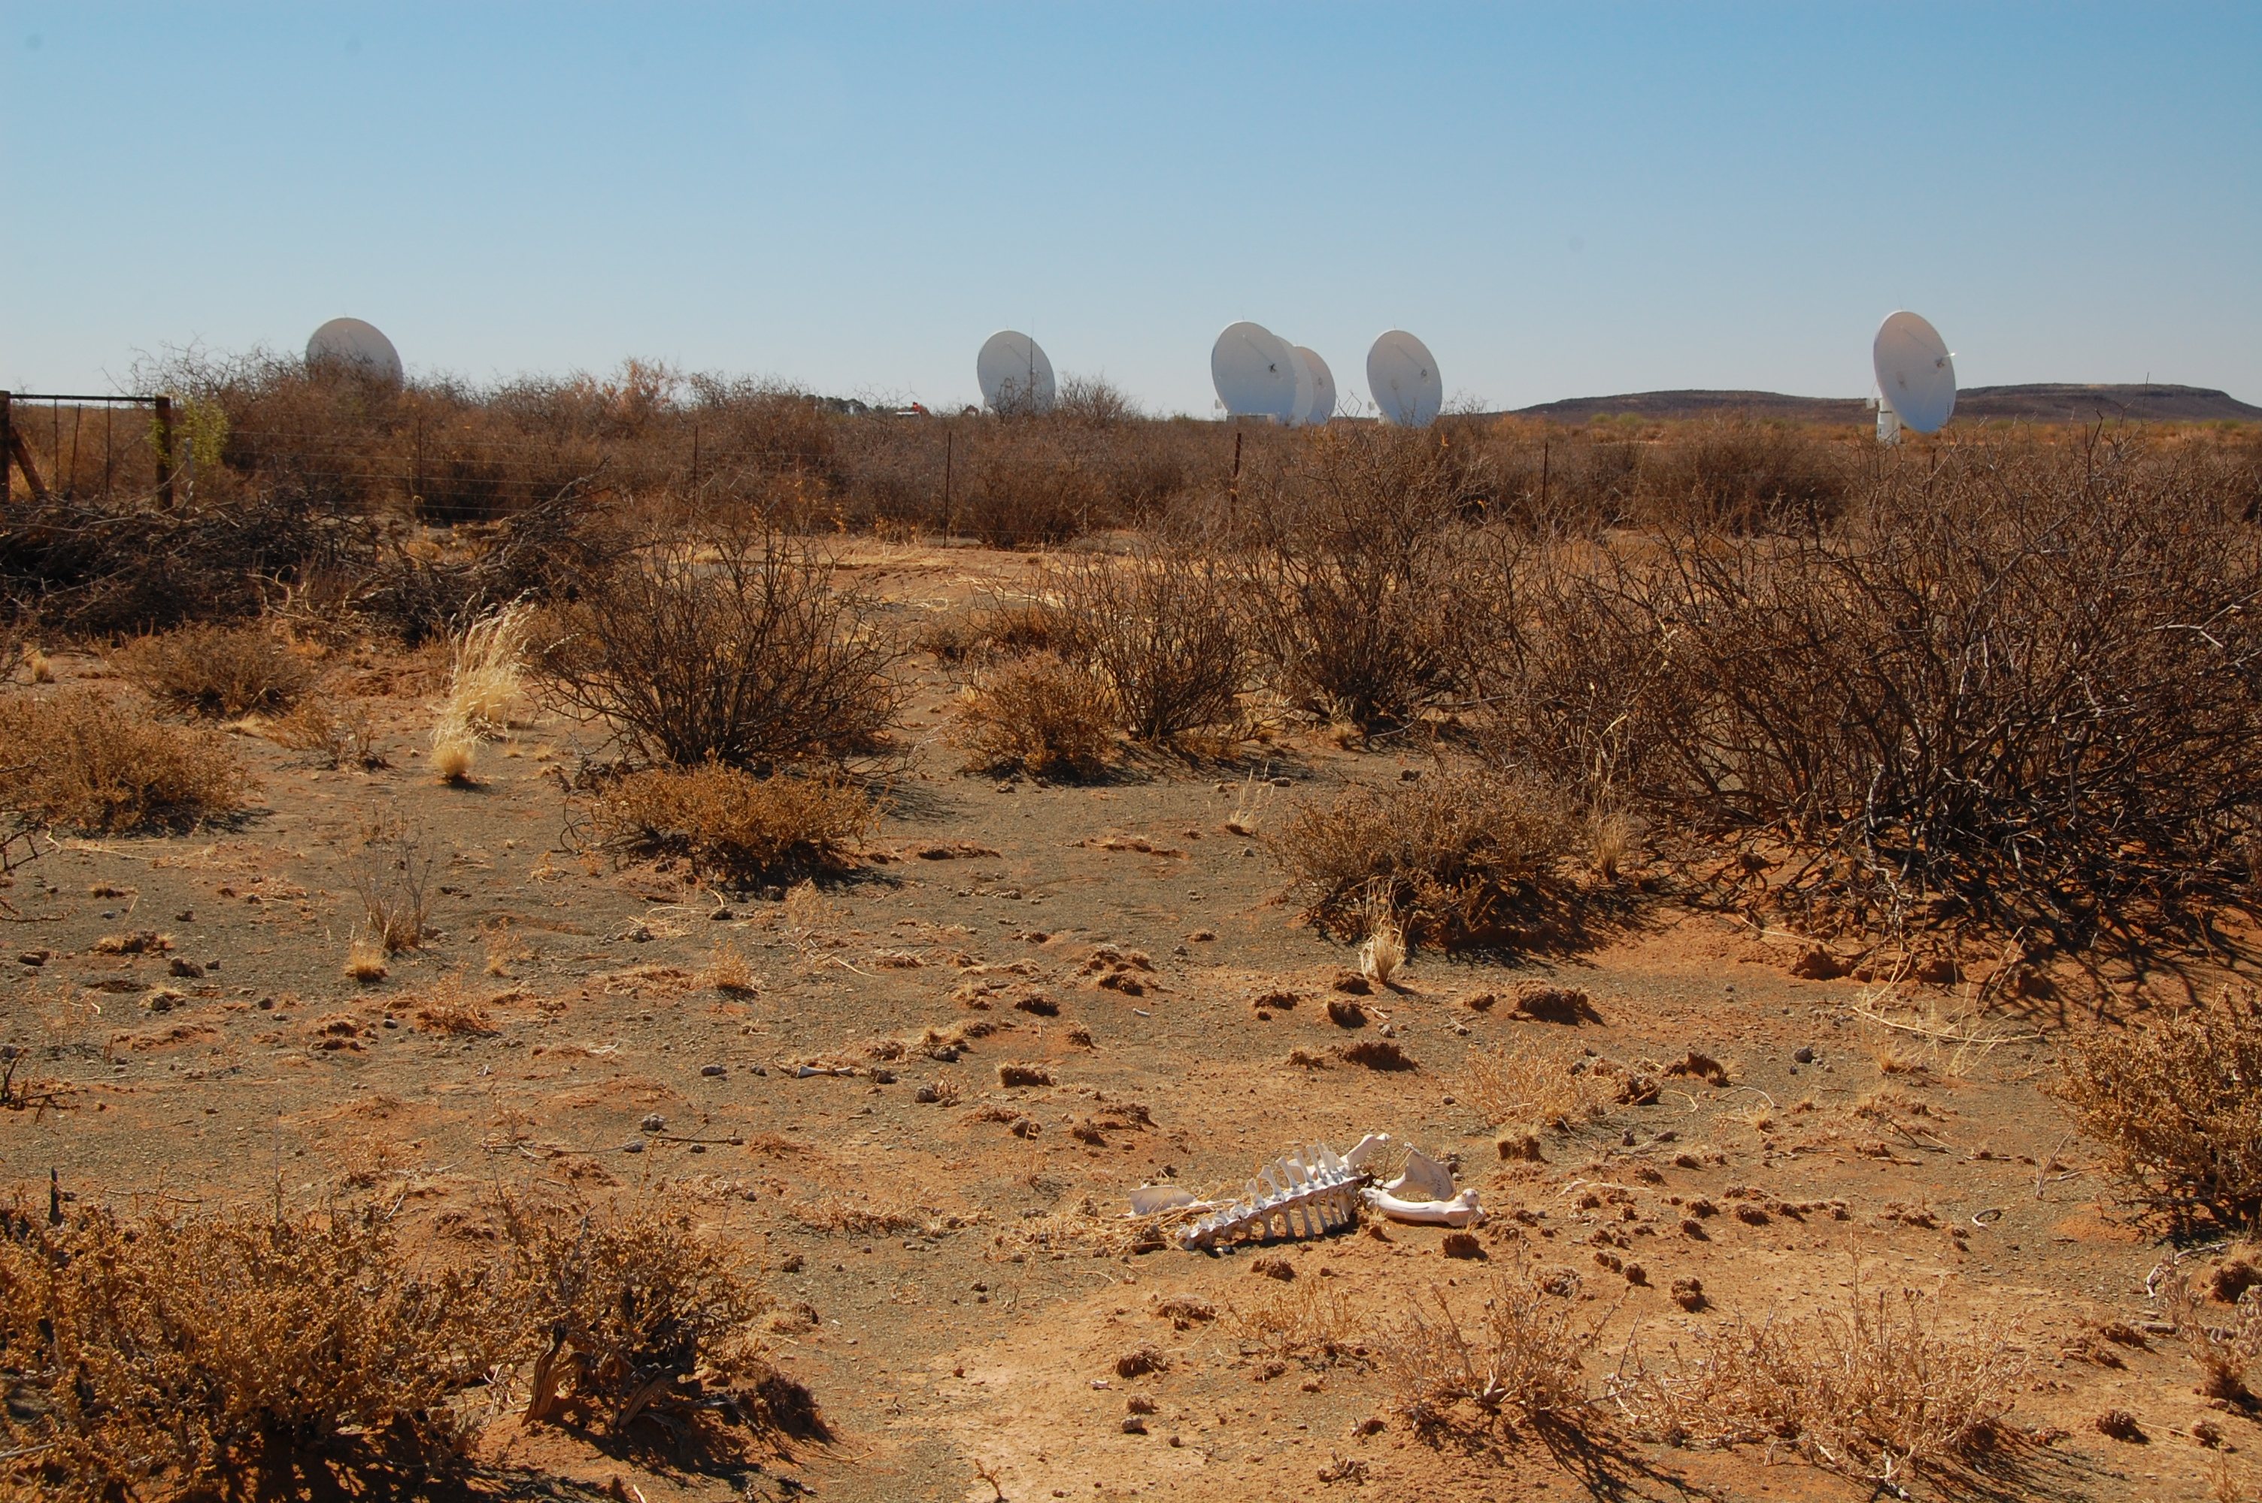

Slide 32
Catch 3: Direction Dependence
Distortions on incoming signal depend on time, antenna and direction
Esp. with wide field/low frequency/high sensitivity
Fortunately, have a formalism to describe this:
the RIME (Radio Interferometer Measurement Equation)

Slide 33


The Basics:
Vectors & Jones Matrices
A transverse EM field can be described by a complex vector:
x
A dual-receptor feed measures two complex voltages
(polarizations):
z
y
We assume all propagation effects
are linear. Any linear transform of a vector can be described by a matrix:

Slide 34

Correlation
The same signal reaches antennas p and q along two different paths. We then correlate the two sets of complex voltages.

Slide 35
The 2×2 Visibility Matrix

Slide 36
Coherencies & Stokes Parameters

Slide 37
And That's The RIME!
The RIME, in its simplest form:
measured
antenna p
source
antenna q

Slide 38
Accumulating Jones Matrices

Slide 39

The Classical (2GC) Approach To Polarization Calibration
V
Q
U

Slide 40

Scalar Equations For
Polarization Selfcal
RIME version:

Slide 41

Off-Axis Effects
3C147 @21cm
12h WSRT synthesis
160 MHz bandwidth
22 Jy peak (3C147)
13.5 μJy noise
1,600,000:1 DR
thermal noise-limited
Regular calibration does
not reach the noise,
leaves off-axis artefacts
due to direction-dependent
effects (left inset)
Addressed via differential
gains (right inset)
3C147 22Jy
30 mJy

Slide 42
Differential Gains, In a Nutshell

Slide 43
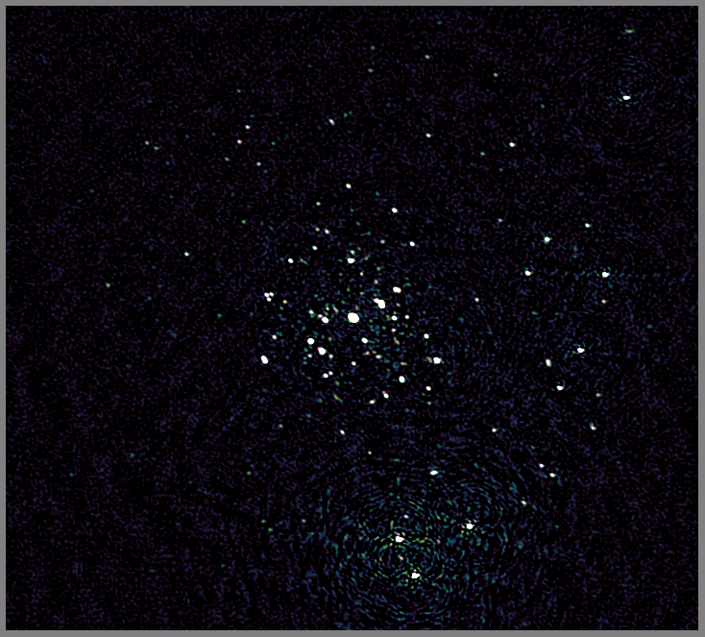
JVLA Version
Recent result from 3GC3 workshop
3C147
JVLA-D @1.4 GHz
Best image after
regular selfcal

Slide 44
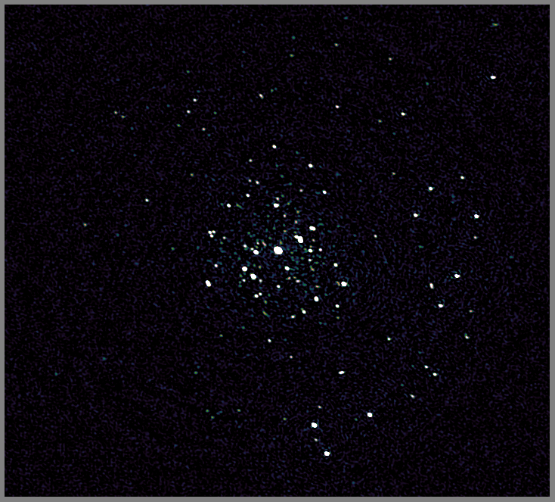
JVLA Version
Recent result from 3GC3 workshop
3C147
JVLA-D @1.4 GHz
Best image after
regular selfcal
...and direction-dependent (DD)
calibration on a few
sources

Slide 45
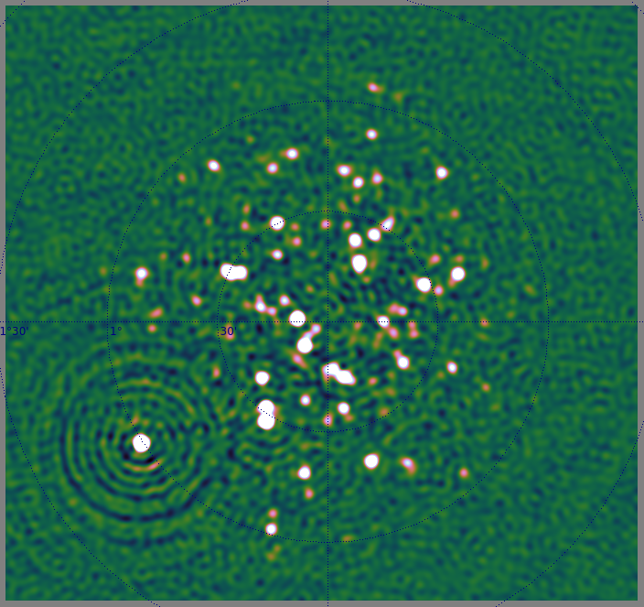
KAT-7 Version

Slide 46
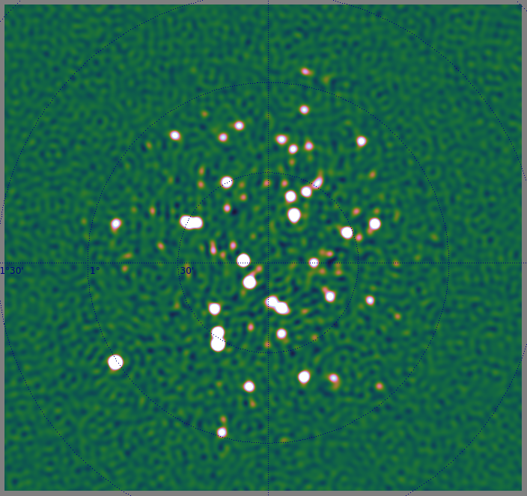
KAT-7 Version

Slide 47

When Primary Beams Go Bad...
(Courtesy of Ian Heywood)
EVLA 8 GHz: Looking for sub-mm galaxies and QSOs in the WHDF.
Dominant effect: bright calibrator source rotating through first sidelobe of the primary beam.
(This also has a horrible PSF, being an equatorial field.)
This is your science
(good luck!)
This is your
phase calibrator
Brightness scale 0~50μJy

Slide 48

Keep Your Friends Close, and your calibrators as far away as you can...
An approximation of the primary beam response, overlaid on top of the image.
As the sky rotates, the sidelobes of the PB sweep over the source, thus making it effectively time-variable.
This is your science
(good luck!)
This is your
phase calibrator
(Brightness scale 0~50μJy)

Slide 49

Deconvolution Doesn't Help...
Residual image, after deconvolution.
The contaminating source cannot be deconvolved away properly, due to its instrumental time-variability.
...5 years ago this would observation would probably be a complete write-off.
(Brightness scale 0~50μJy)

Slide 50
Same Problem Here
The artefacts in this
image have the same
underlying cause.
But here, the dominant
source is at the centre
(where PB variation is
minimal) and the
“offending” sources are
relatively faint.
But we did address them
via differential gains...

Slide 51

Differential Gains To The Rescue
Residual image after applying differential gain solutions to the contaminating source
Brightness scale 0~50μJy

Slide 52

Multi-Band Image
Multi-band residual image:
noise-limited, no trace of contaminating source.
Phase calibrator
used to be here
Brightness scale 0~50μJy

Slide 53
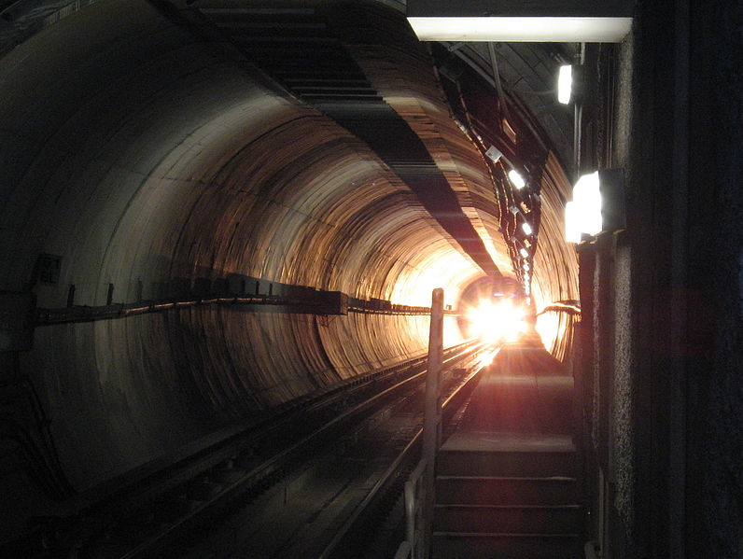
Flush With Success?
Thermal noise-limited maps are being produced
  Though not routinely...
  T&Cs apply: extended
  sources are still notoriously
  hard to deconvolve
  ….though new algorithms
  are emerging
Is this the light at the end of the
tunnel?
“A high quality radio map is a lot like a sausage, you might be curious about how it was made, but trust me you really don't want to know.”
– Jack Hickish, Oxford

Slide 54

2004: The Ghosts Of Cyg A
WSRT 92cm observation of J1819+3845 by Ger de Bruyn
String of ghosts connecting brightest source to Cyg A
(20° away!)
“Skimming pebbles in a pond”
Positions correspond to rational fractions
(1/2, 1/3, 2/3, 2/5, etc...)
Wasn't clear if they were a one-off correlator error, a calibration artefact, etc.
  (...and if you did low-frequency in 2004, you had it coming anyway.)

Slide 55

2010: Ghosts Return
WSRT 21cm observation
...with intentionally strong instrumental errors
String of ghosts extending through dominant sources A (220 mJy) and B (160 mJy)
Second, fainter, string from source A towards NNE
Qualitatively similar to Cyg A ghosts

Slide 56

If You Can Simulate It...
Eventually nailed via simulations

Slide 57
Ghosts In The (Selfcal) Machine
Ghosts arise due to missing flux in the calibration sky model
Mechanism: selfcal solutions try to compensate for this by moving flux around
  Not enough DoFs to do this perfectly
  ...so end up dropping flux all over the map
  ...with a lot of help from the good Dr Sidelobes
Regular structure in this case due to WSRT's redundant layout = regular sidelobes
  JVLA, MeerKAT: “random” (but not Gaussian!)

Slide 58

JVLA Ghost Sim

Slide 59
Ghastly Questions
Does selfcal always introduce ghosts?
  YES. But most of the time they're buried in the noise.
  ...unless you have a complete sky model (i.e. if all your science targets are known in advance)
Why don't we always see them?
  Not enough sensitivity
Will they average out?
  NO. Push the sensitivity, they pop out.
What will they do to my statistical detections (hello EoR)?
  Dunno. Simulations needed.
What else is that redistributed flux doing?

Slide 60

Ghosts, The Flip Side
WSRT “Field From Hell” (Abell 773 @300 MHz),
residual map

Slide 61

Getting There, Right?
After diligent (direction-dependent) calibration

Slide 62
Noise-limited Is Not Always Good
Suppression of non-model sources
Our target

Slide 63

The Dangers Of
Direction-Dependent Solutions
Suppression is less with more conservative calibration
Our target

Slide 64
KAT-7 Source Suppression

Slide 65
KAT-7 Source Suppression

Slide 66
Ghosts & Source Suppression
Both ghosts and suppression operate via the same mechanism
Ghosts are usually buried in the noise
Suppression always present with selfcal, but more severe with DD calibration (more DoFs...)
  A noise-limited map is not necessarily a good science map!
“What if we were to somehow break the thermal noise barrier, but
all we'd find beneath would be the bones of Jan [Noordam]'s enemies?”
– Anon., 3GC-II Workshop
(names and places changed to protect the guilty)

Slide 67
And The Really Dodgy Bit...
Calibration+imaging is an inverse problem
D→S+G (sky+gains)
The (G)ains we don't care about, but would like to put error bars on (S)ky.
...but at present we don't...
Operational approach:
  Noise-limited images good
  Artefacts bad (but we have no ways of classifying them)

Slide 68
Bayesian C&I?

Slide 69
A Bayesian Formulation
Of Interferometric Calibration
data D = observed visibilities
model M = S+G, where S is a sky model,
and G are the instrumental errors
A fully Bayesian approach: find M=S+G that maximizes P(D|M)P(M)
Legacy data reduction methods are a divide-and-conquer approximation to this.
  How would a Bayesian see selfcal?

Slide 70
Legacy Selfcal in Bayesian Terms
Calibration: fix sky S, solve for G:
  maximize P(G|D)=P(D|G)P(G)
  ...assuming P(G)=const => just an LSQ fit!
  solve for one time/frequency domain at a time
Form up “corrected data” as DC =G⁻¹(D).
Imaging: make the dirty image ID=FT⁻¹(DC )
Deconvolution: use ID as a proxy for the “data”
  maximize P(IM|ID)=P(ID|IM )·P(IM )
IM becomes S at the next step.
CLEAN: point-like IM
NNLS: IM>0
MEM: P(IM ) ~ H
CS: promote sparsity

Slide 71
Why So Clumsy?
Too much data, too few computers
  Too many parameters: selfcal solves for a few at a time
  the FFT is incredibly fast: a lot of clumsiness stems from kludging our algorithms around the FFT
This may be changing! (Cheap clusters & GPUs.)
EM-, ML-, CS-imaging: given calibrated data
DC , find the sky S that maximizes
P(S|DC )=P(DC|S)P(S)
Supplants both traditional FFT-based imaging and deconvolution.

Slide 72
One More Step Needed
Need to add calibration into the mix:
find M=S+G that maximizes P(D|M)P(M)
We have the math to compute P(D|M) (the RIME, etc.), but this is still pretty expensive.
With a few more PhD students thrown into the breach, may be tractable soon.

Slide 73
Big Data?
Current state-of-the-art data reductions are one-off, “heroic” exercises
  Pipelined reductions exist, but only to lower quality
SKA data stream will fill a few gazillion iPods per millijiffy
  Pipeline it, or >/dev/null it
Significant algorithmic advances still needed
  In terms of efficiency
  In terms of “smartness”

Slide 74
Conclusions
Radio interferometry has achieved incredible results (>10⁶:1 dynamic range), despite using incestuous calibration methods held together with spit, duct tape, baling wire and oral tradition.
New telescopes will not let us get away with this
  Upcoming “radio telescope bubble”
Fortunately, we know where to look for answers
  The RIME
  Bayesian methods
This is a good time to be an instrumentalist.

