Slide 1
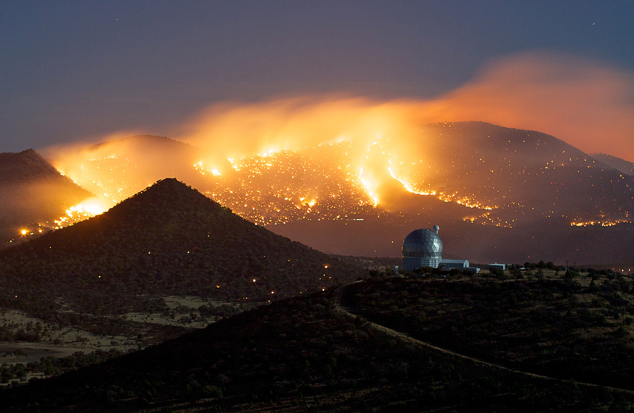
Radio Interferometry:
Techniques, Technologies & Burning Issues
O. Smirnov (Rhodes University & SKA SA)

Slide 2
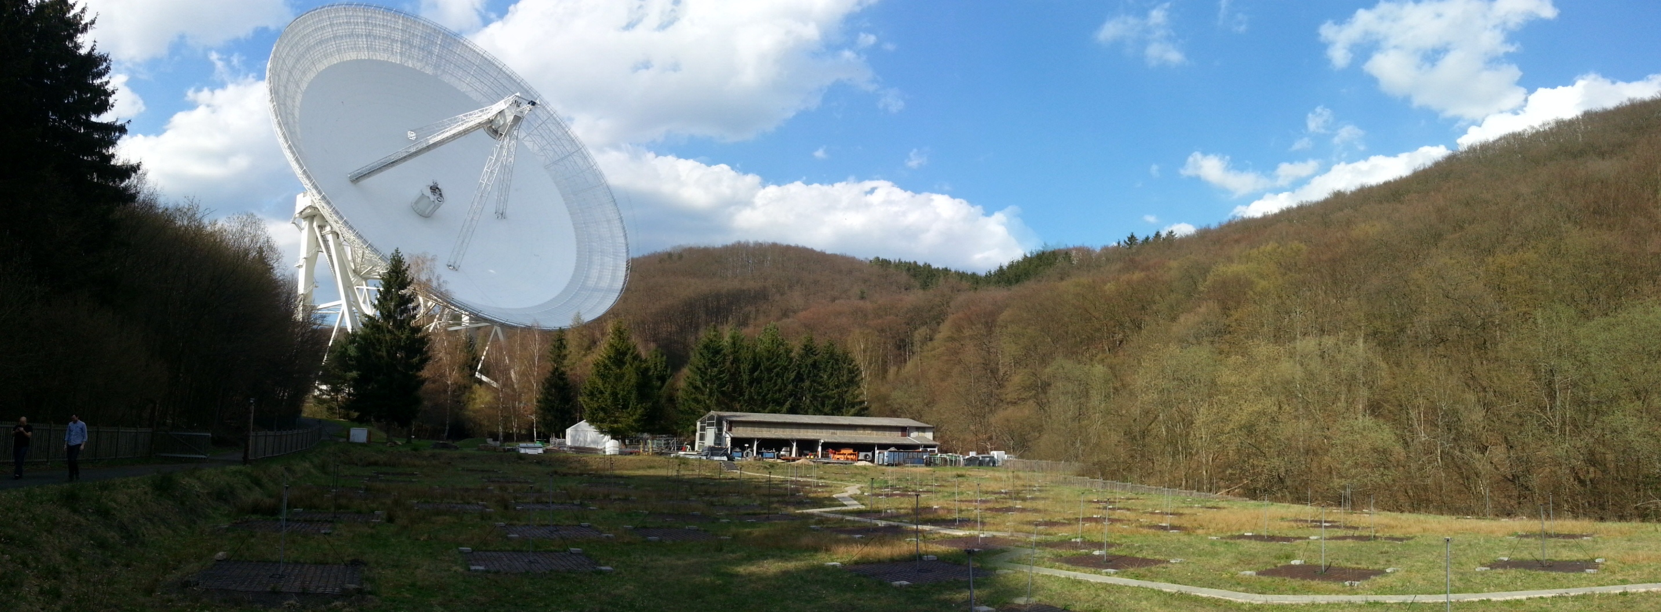
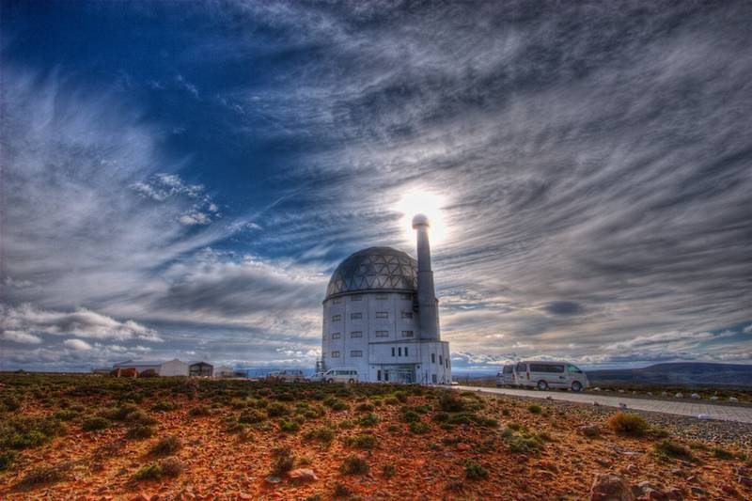
Why Interferometry?
Aperture size D is crucial:
  Resolution ~ λ / D
  Sensitivity ~ D²
Very poor resolution in radio due to
long wavelengths
SALT resolution: ~1000 km radio dish?
D ~ 11m
λ ~10⁻⁷ m
D~100m λ ~10⁻¹ m

Slide 3
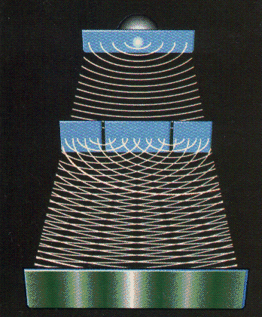
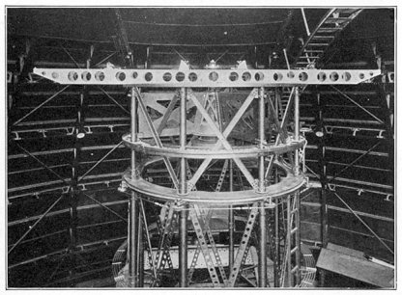
Early Interferometry
Measure fringe pattern produced by two interfering wave fronts
Resolution ~ λ / B (baseline length)
Long baselines cheaper than large apertures
B
B
Young's double-slit experiment (1800s)
20 ft Michelson interferometer
Mount Wilson Observatory
(1920)

Slide 4
Aperture Synthesis Interferometry
Pieoneering interferometry: specialized experiments
  e.g. measuring the diameter of stars (optical, 1920)
  localizing solar bursts (radio: single dish sea-cliff interferometer, 1946)
The development of aperture synthesis (1950s) turned interferometers into imaging devices

Slide 5

How To Make An Interferometer 1
Start with a normal reflector telescope....

Slide 6

How To Make An Interferometer 2
Then break it up into sections...

Slide 7

How To Make An Interferometer 3
Replace the optical path with electronics

Slide 8

How To Make An Interferometer 4
Move the electronics outside the dish
...and add cable delays

Slide 9

How To Make An Interferometer 5
Why not drop the
pieces onto the ground?

Slide 10

How To Make An Interferometer 6
...all of them

Slide 11
How To Make An Interferometer 7
And now replace them with proper radio dishes.
...and that's all! (?)
Well almost, what about the other pixels?

Slide 12

How Does Optical Imaging Do It?
This bit sees the EMF
from all directions,
added up together.
This bit sees the EMF
from all parts of the
dish surface,
added up together.

Slide 13
Fourier Transforms
An optical imaging system implicitly performs two Fourier transforms:
  1. Aperture EMF distribution = FT of the sky
  2. Focal plane = FT⁻¹ of the aperture EMF
A radio interferometer array measures (1)
  (Need to measure it at enough points!)
  Then, we can do the second FT in software
  Hence, “aperture synthesis” imaging

Slide 14
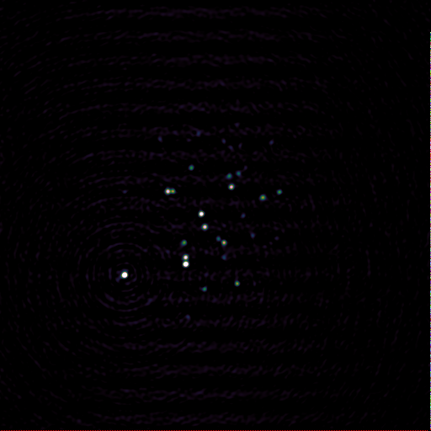
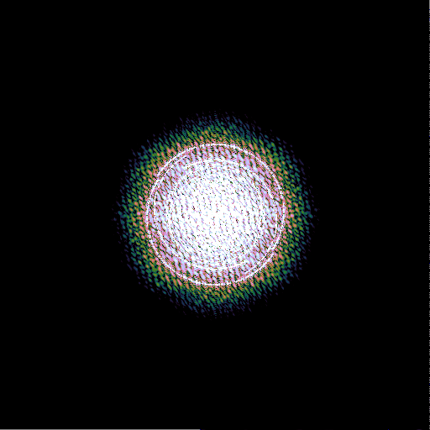
Image-plane vs. uv-plane
“Image plane”
“uv-plane”
“Image plane”
uv-plane
(12 hours!)
Fourier
Transform
The image plane and uv-plane are, in a sense, equivalent.
If we measure one, we can recover the other via a Fourier transform.
Bonus (in radio): we get the spectrum at every pixel “for free”

Slide 15
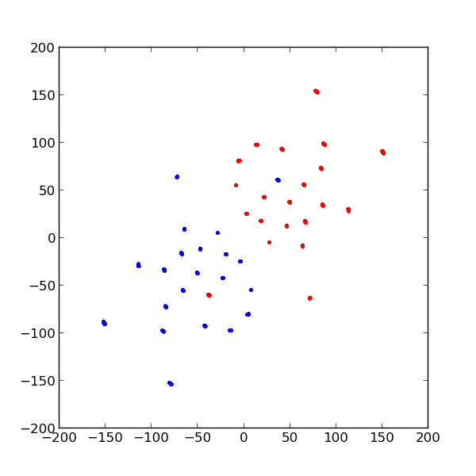
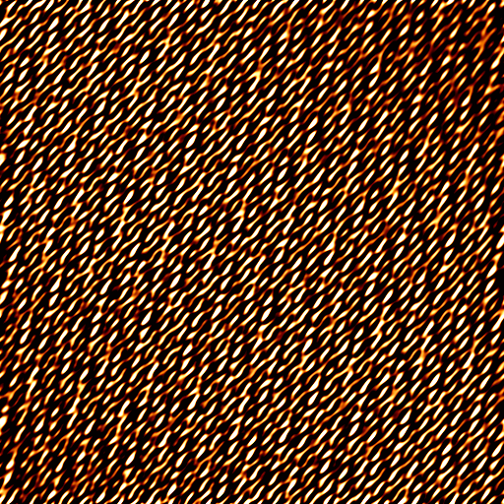
KAT-7 uv-coverage
Every pair of dishes (“baseline”) measures a point (plus its conjugate) in the uv-plane.
N dishes (stations) give us N(N-1)/2 baselines.
Above: KAT-7 uv-coverage (7 antennas, 21 baselines), and the corresponding snapshot image.

Slide 16

Earth Rotation Aperture Synthesis
KAT-7 building up uv-coverage over a 12-hour observation.

Slide 17
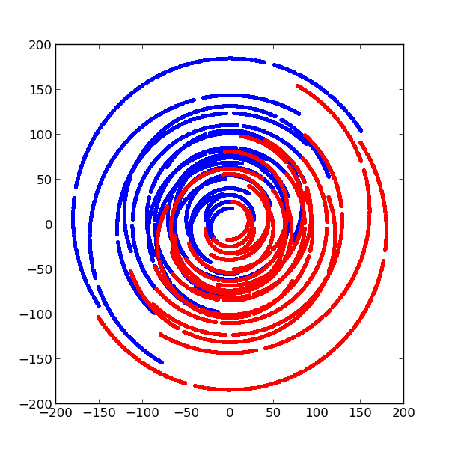
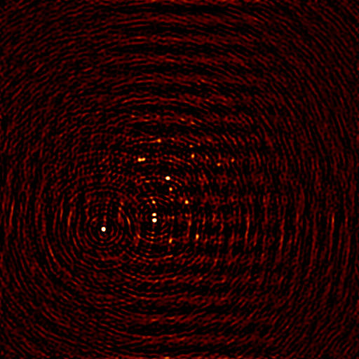
12-hour uv-coverage
KAT-7 uv-coverage and simulated image for a 12-hour observation

Slide 18
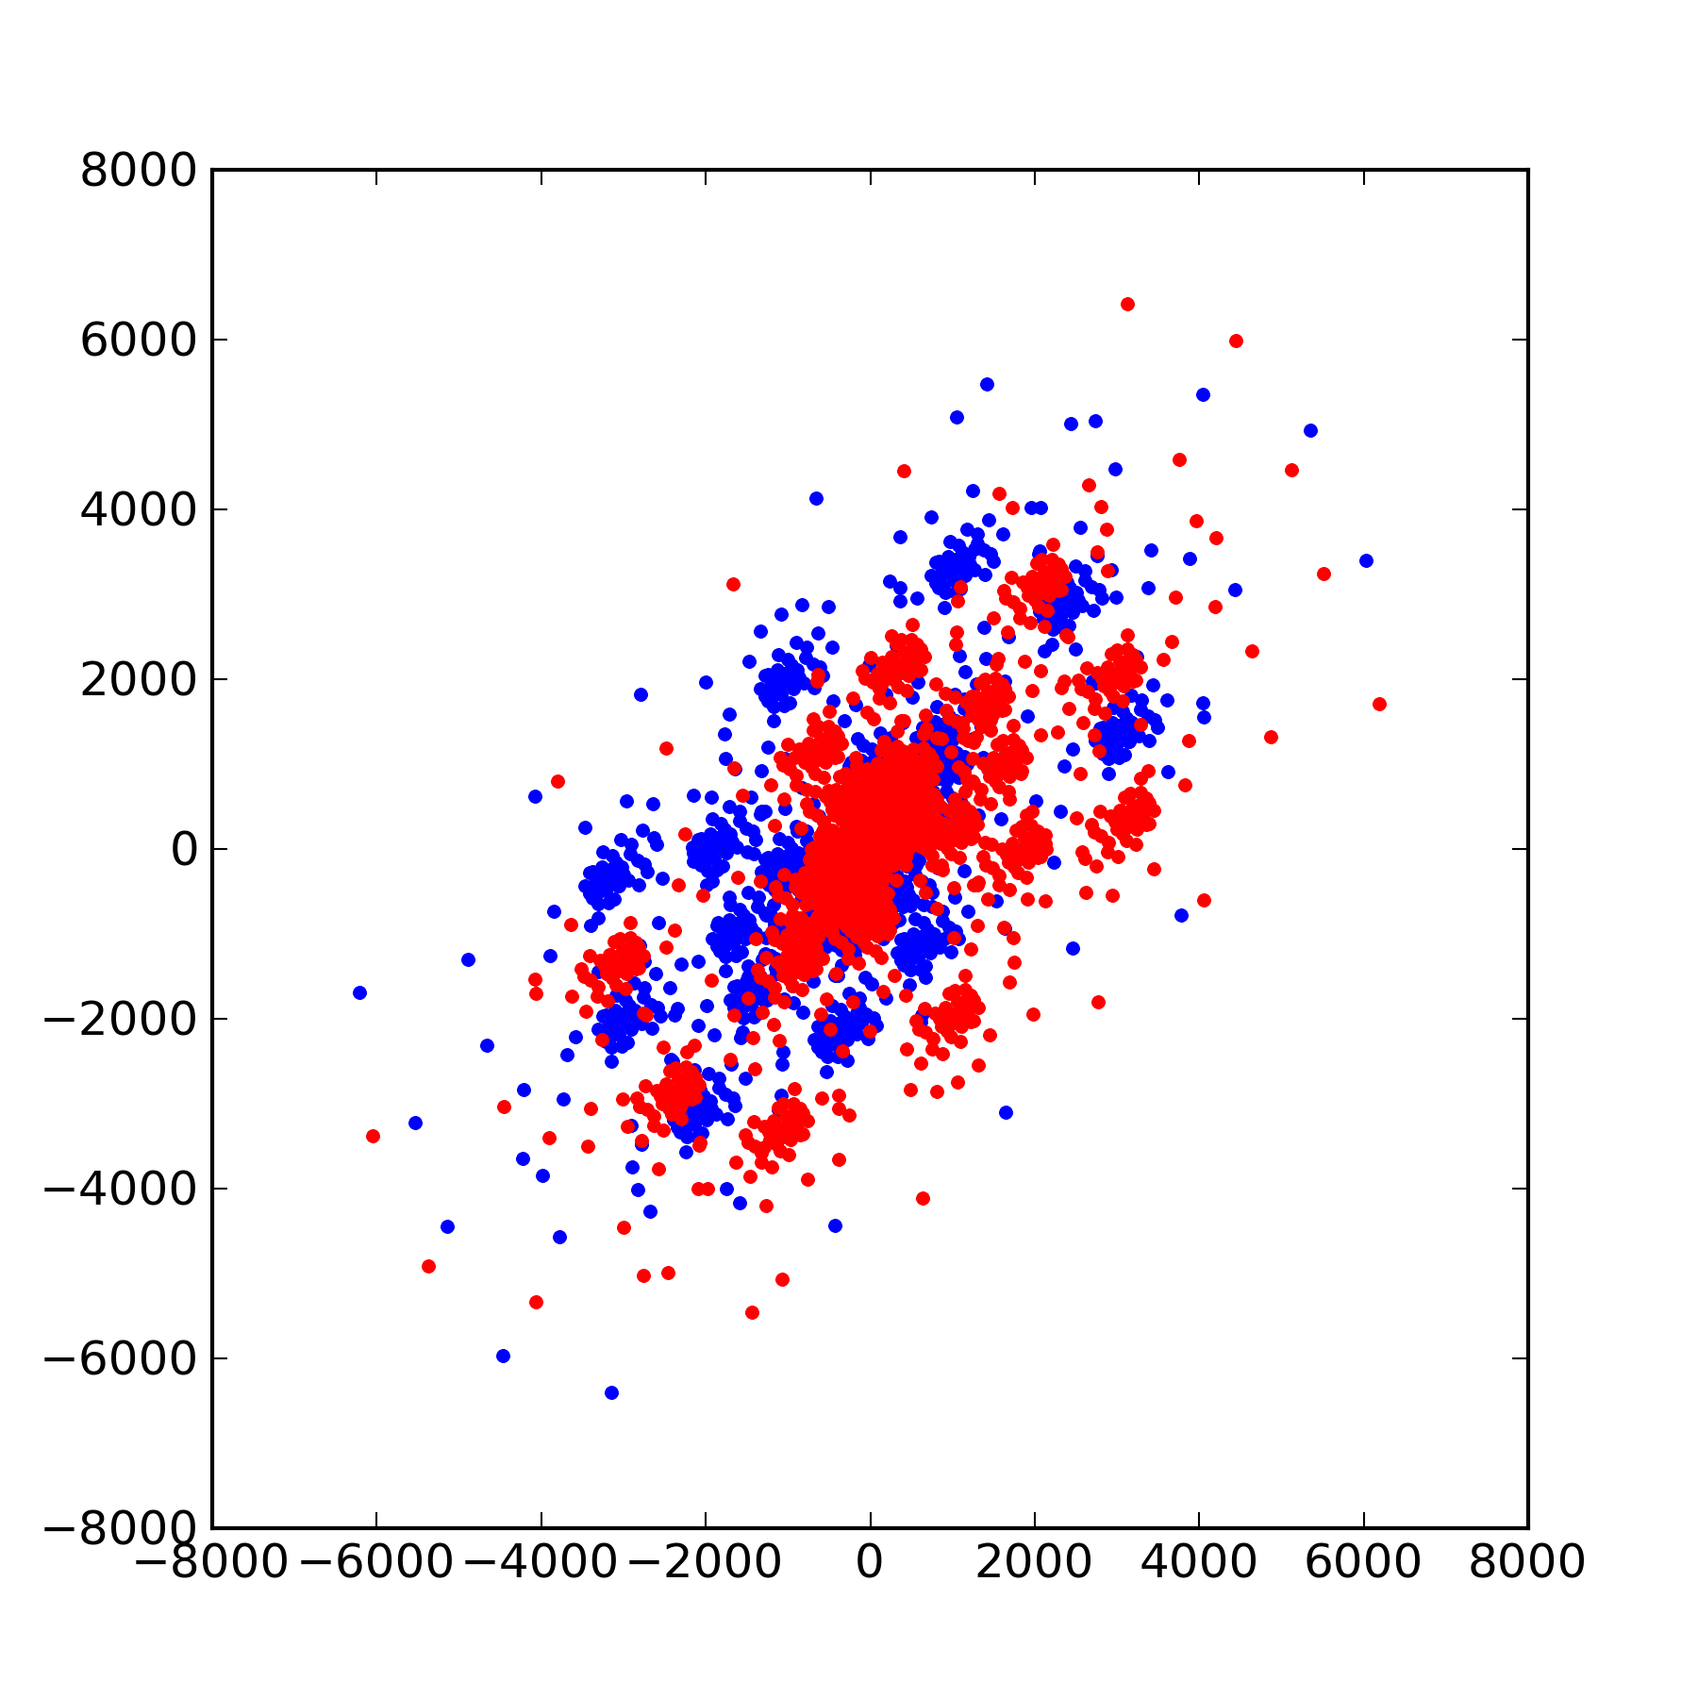
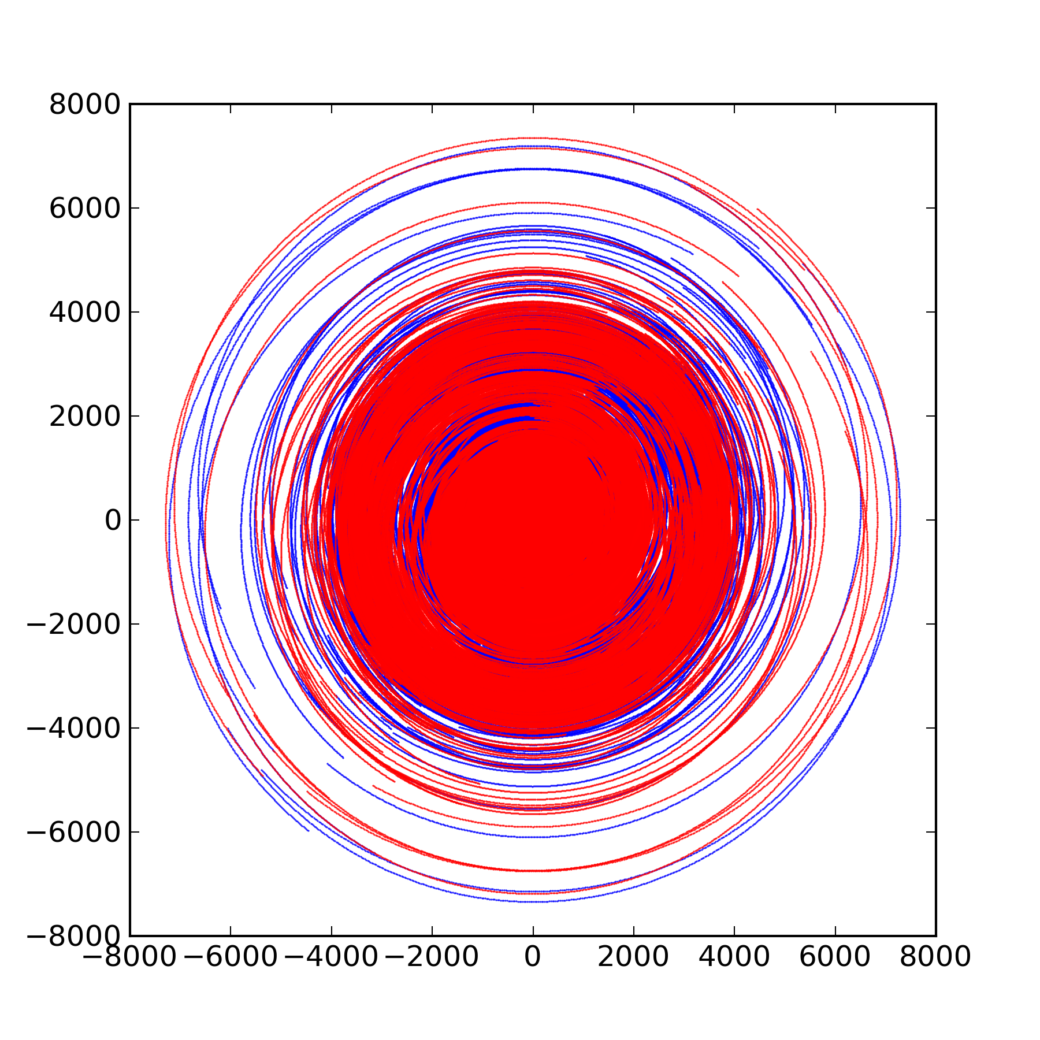
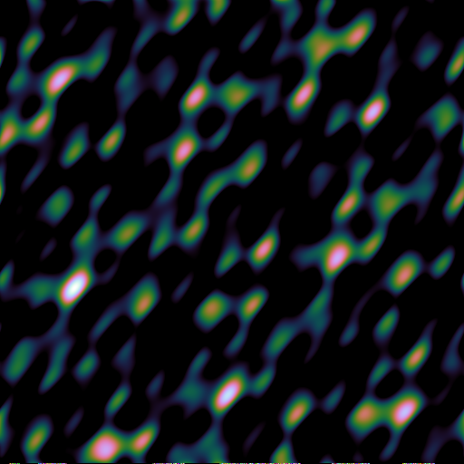
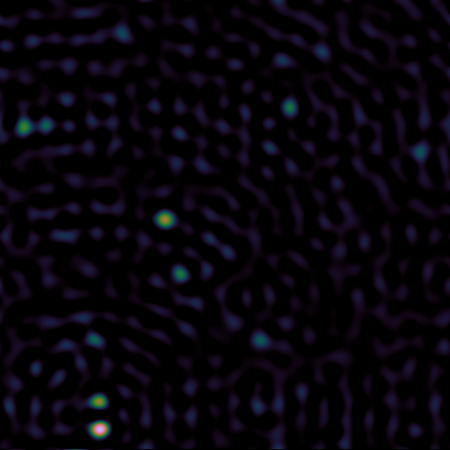
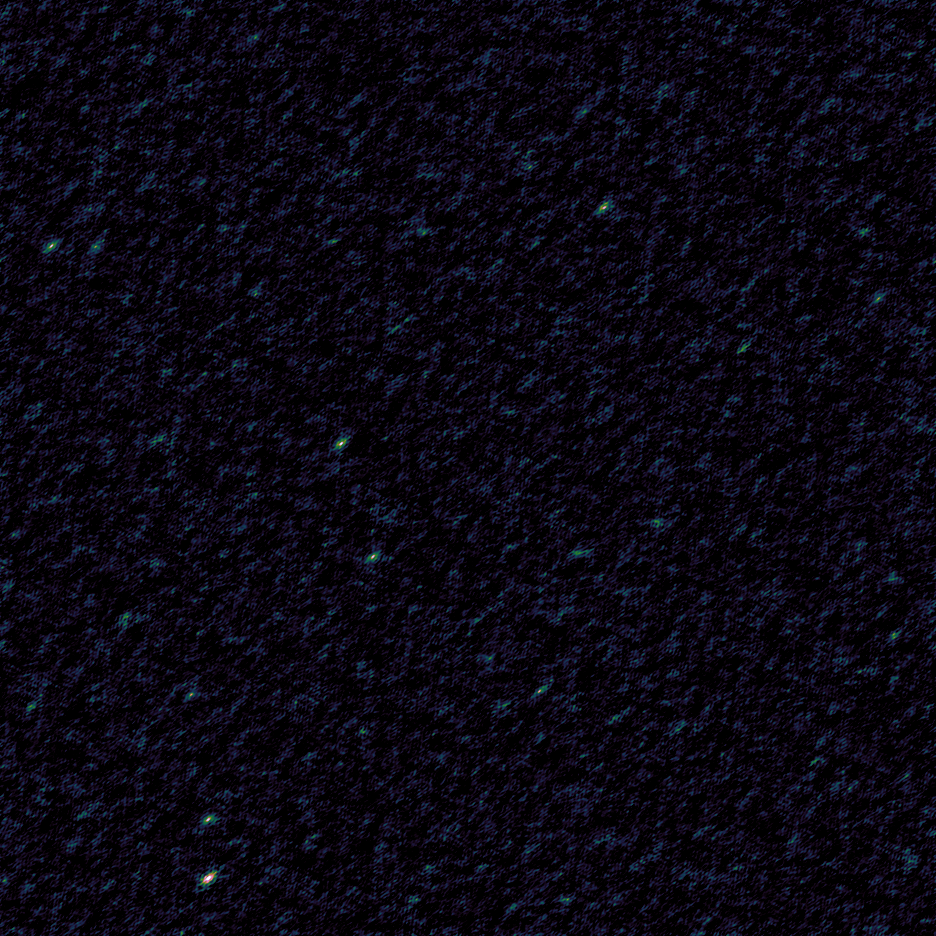
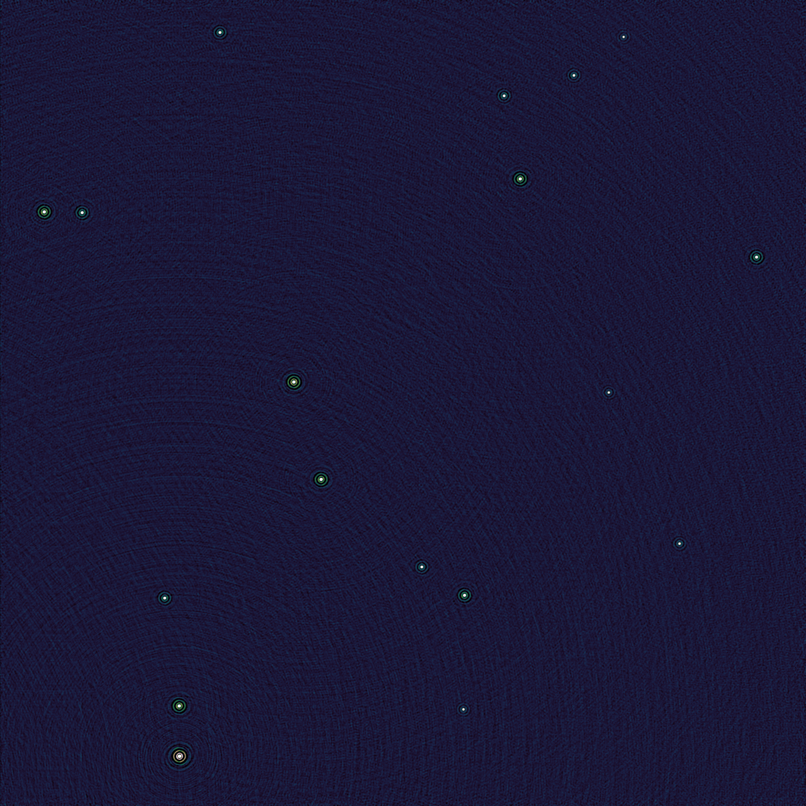
More Antennas = Good
KAT-7 snapshot
7 antennas
21 baselines
KAT-7 12h
MeerKAT snapshot
64 antennas
2016 baselines
MeerKAT 12h

Slide 19
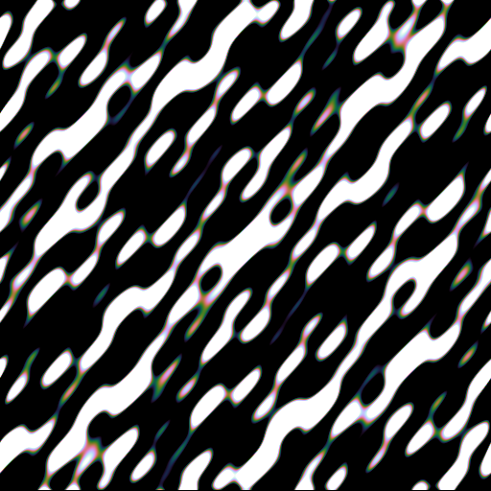
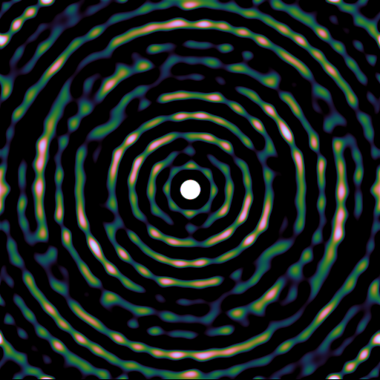
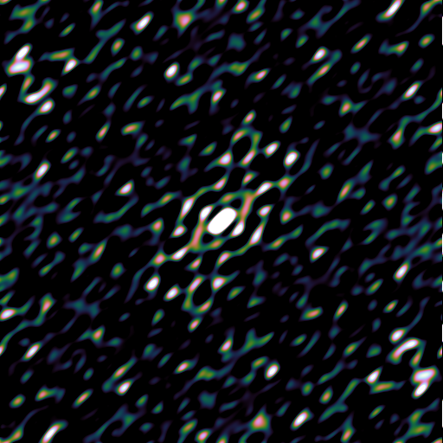
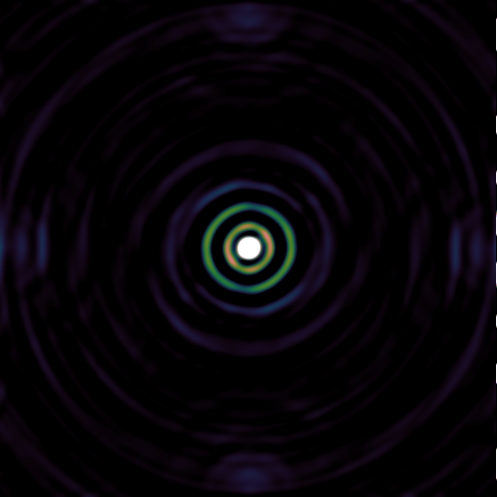
Gaps = Bad
Point Spread Function (PSF) = response to a point source.
Gaps in the uv-plane = missing information = structure in the PSF sidelobes.
PSF sidelobe level is one of the main imaging limitations.

Slide 20
Historical Trade-Offs
“Compact” arrays
  Continuous operations, dense uv-coverage, low-medium resolution
  MeerKAT (64 stations, max baseline 8km), LOFAR-NL (36, ~200km), JVLA (28, 1~30km), WSRT (14, ~3km)
  Routine imaging of very complex fields
Very Long Baseline Interferometry (VLBI)
  Ad hoc operations, sparse uv-coverage, very high resolution
  EVN, AVN (small #s, 1000~10000 km)
  High-resolution imaging of relatively simple objects
Extreme baselines, very small #s
  Event Horizon Telescope, Space VLBI (Radioastron)
  Extreme resolution, very sparsely sampled uv-plane
  One-off experiments
SKA

Slide 21
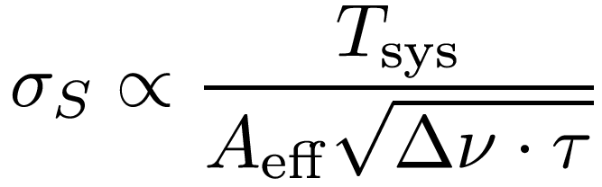
Sensitivity
What is the faintest object we can detect?
How can we push this?
“System temperature”:
Build colder receivers,
better cryogenics
“Bandwidth”:
Build wideband receivers.
Integration time:
Observe for longer
(Four times as long to
go twice as deep)
“Aperture” (collecting area)
Build more antennas.
(SKA: 1 km²)

Slide 22
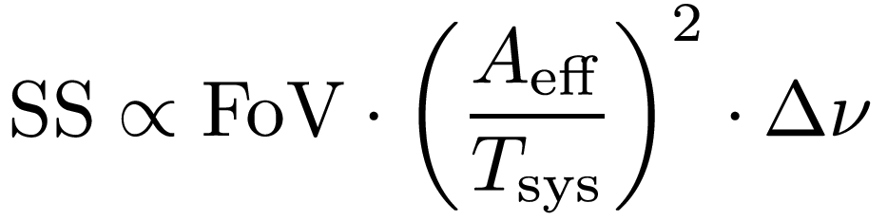
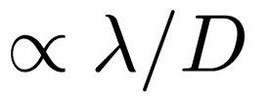
Survey Speed
How quickly can we map a certain area on the sky down to a certain depth?
SS improves as the square of
collecting area, and
inverse square of temperature
Field of view (of a single dish/station):
Smaller dishes, low frequency = bigger FoV

Slide 23
Pushing The Survey Speed
Increase the FoV
  Many smaller antennas vs. fewer large ones
  but watch out for computing and infrastructure costs!
  (N antennas: ~N ² correlator and post-processing resources)
  Aperture arrays (AAs) and Phased Array Feeds (PAFs)
  Simultaneously form multiple beams on the sky.
A↑: Build more aperture
  Straightforward but expensive
T↓: Build colder receivers
  Engineering limits

Slide 24
Low Frequency: Aperture Arrays
Effelsberg
LOFAR station
AA: many small elements (fixed on the ground)
combined electronically (“in software”) into a single station

Slide 25

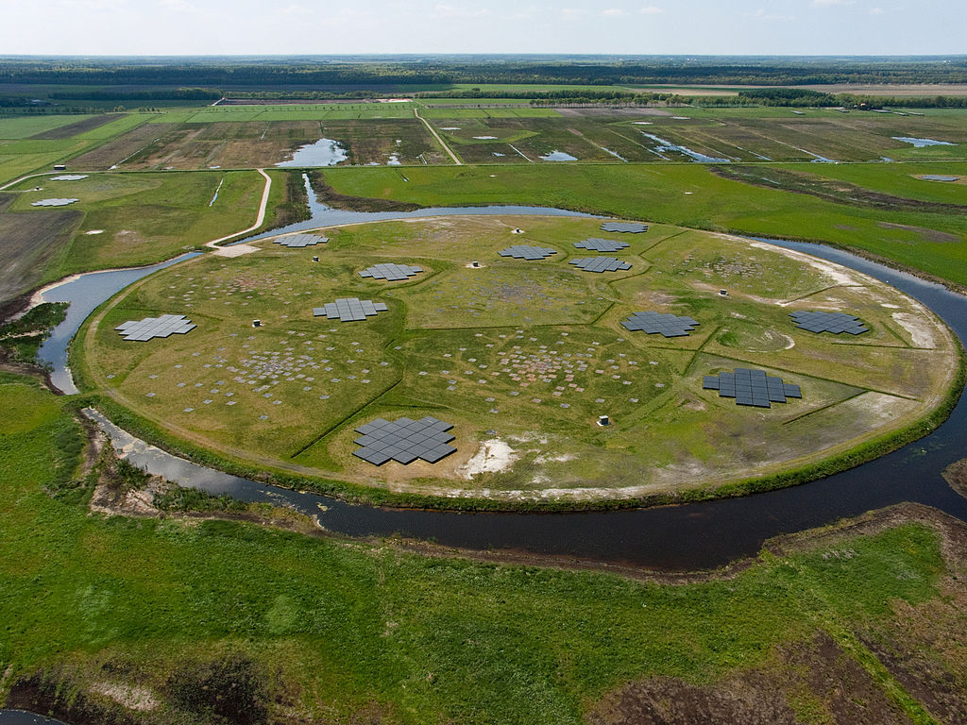
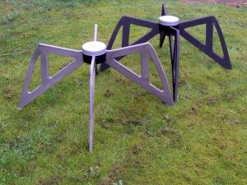
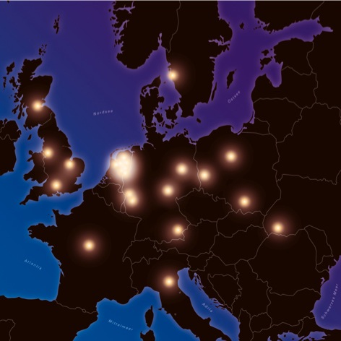
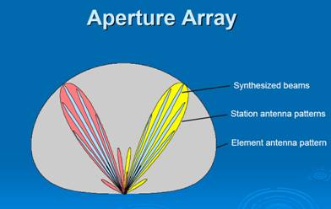
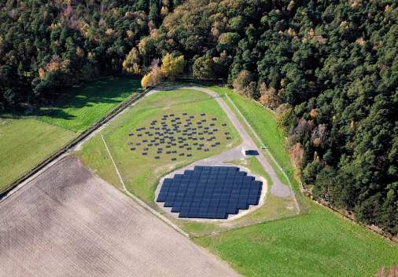
LOFAR: “Software telescope”
Single element
(LBA)
“Superterp” (6 stations)
HBA
Dutch & international
stations
Multiple beams
Single station

Slide 26
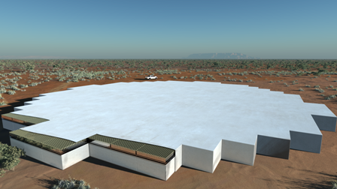
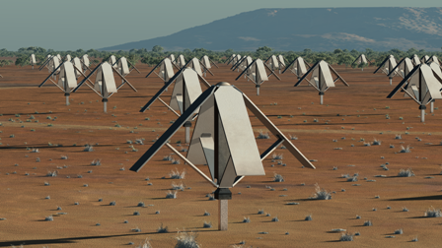


AA Pros & Cons
Relatively cheap way to get lots of collecting area
No moving parts
Easy to form up multiple beams (increased FoV)
Impractical to cool (but doesn't matter at low frequency)
Complicated instrumental response
⇒ complicated calibration
Costly electronics
Not photogenic
Can be a cost-effective solution for
frequencies below ~500 MHz
  But see HERA design: dishes

Slide 27
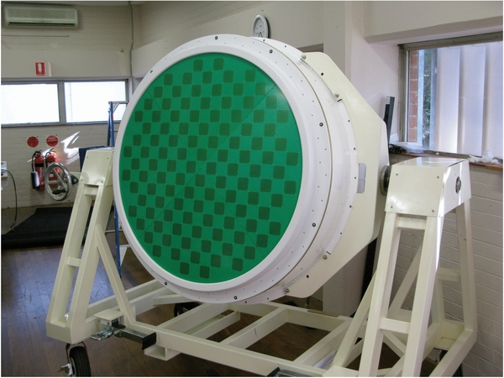
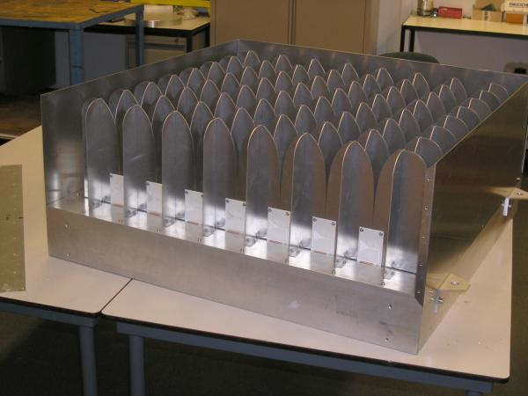
Dishes
Above ~500 Mhz, dishes remain
the optimal collecting solution
Two ways to push survey speed:
  Colder single-pixel feeds (MeerKAT, SKA-Mid)
  Phased Array Feeds (PAFs): increasing the FoV via multiple beams (Apertif, ASKAP, SKA-Survey)
Prototype ASKAP feed
Digestif (Apertif prototype)

Slide 28
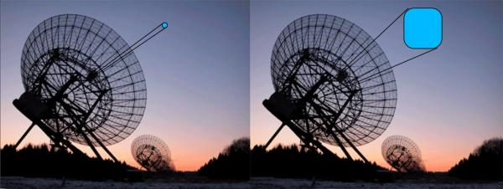
PAFs
“An AA at the focus
of a dish”
Increased FoV per
same aperture
Ability to form up beams of desired shape?
Difficult to cool: lose on A/T
 Survey speed of SKA-Survey (PAFs) comparable to SKA-Mid (SPFs);
MeerKAT comparable to ASKAP
Complexity and cost
Complicated instrumental response ⇒ complicated calibration

Slide 29
Calibration & Calibratability
My favourite subject, but not nearly enough time to cover it
Four performance limits:
  Sensitivity (or survey speed): need FoV, A/T
  Confusion limit: need resolution
  Sidelobe confusion noise: need low PSF sidelobes (good uv-coverage) & good primary beams
  Calibration artefacts: need smooth instrumental response
In a well-designed telescope, none of the four should dominate

Slide 30
Conclusions
Radio interferometer design is difficult
  Many subtle trade-offs
  Some of which we're only beginning to understand
Optimal trade-off depends on your science
  So read the SKA Baseline design document carefully!

