Slide 1
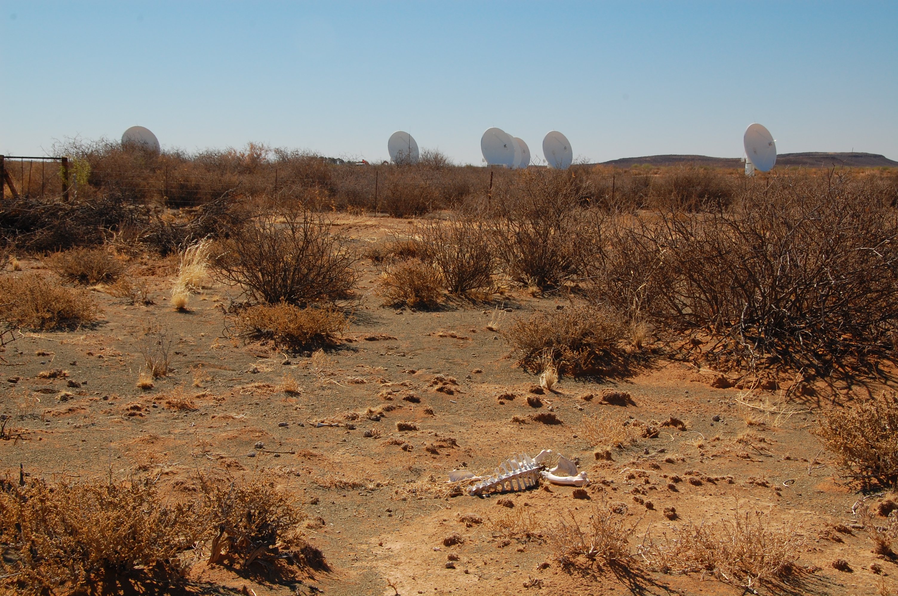
The Karoo RF Environment
O. Smirnov (Rhodes University & SKA SA)

Slide 2

Executive Summary
(Disclaimer: this may be entirely due to blissful ignorance)

Slide 3
Guess The Site

Slide 4
Guess The Site II

Slide 5
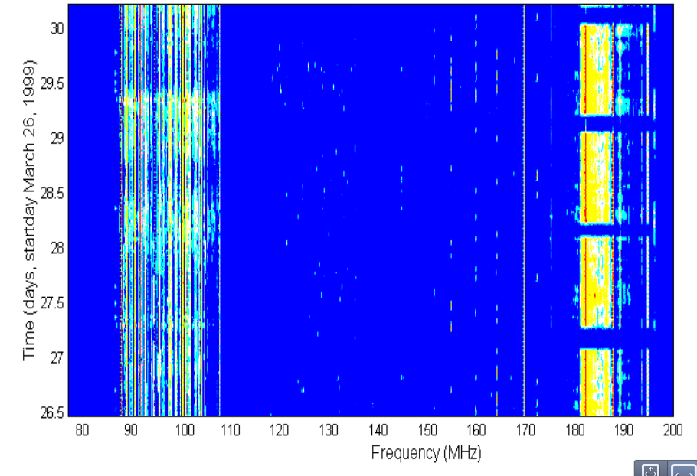
Guess The Site III

Slide 6
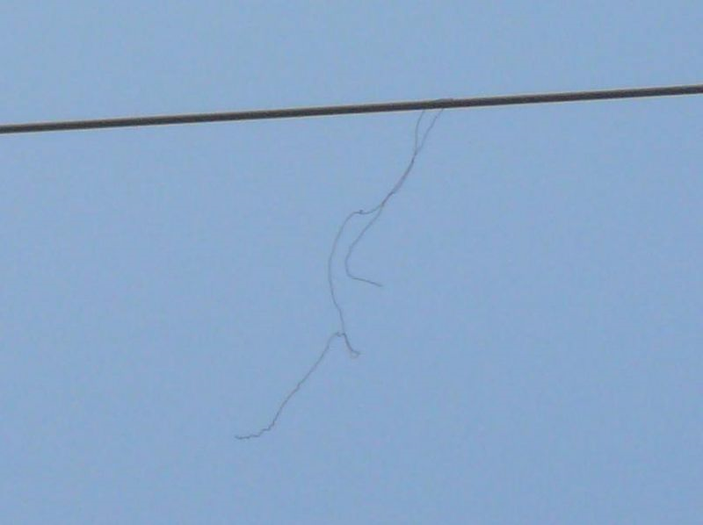
Good, Bad & Ugly RFI
The Good: LOFAR's been a pleasant surprise
  “Building a low-frequency radio telescope in Western Europe? What a crazy idea!”
  As long as response is linear (high ADC bits), only low-level flagging is needed (1-2%)
The Bad
  High spectral occupancy (e.g. DTV channels)
  Hardware (& probably software)
  mitigation required
The Ugly:
  Broadband

Slide 7
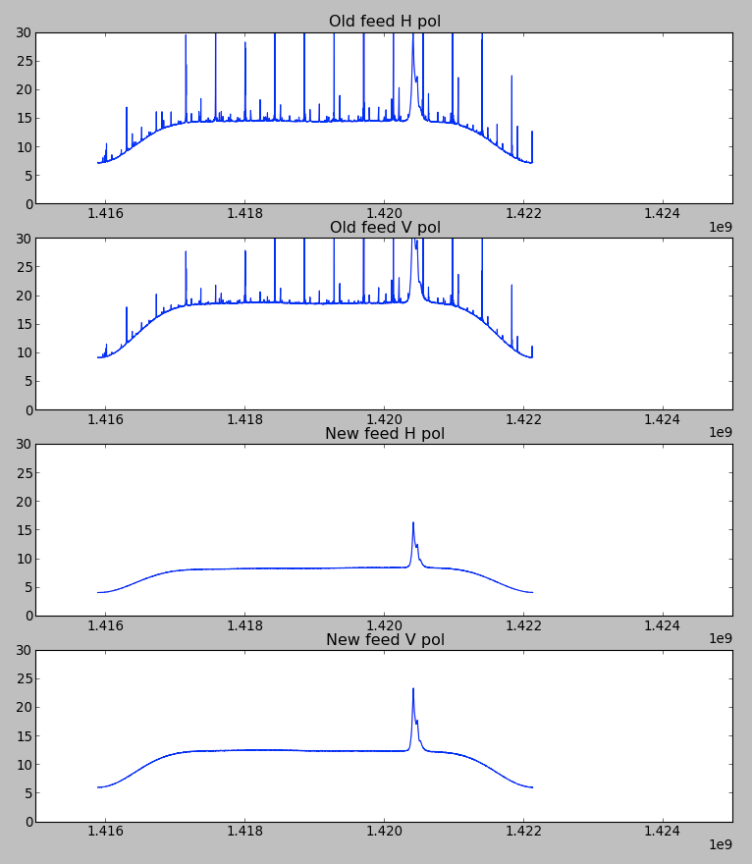
KAT-7 L-band Autocorrelations
Self-generated RFI (in the feed) has been a nagging issue
Problem identified, and a fix has been installed in the feeds
Remaining RFI entirely attributable to sattellites
NO terrestrial sources

Slide 8
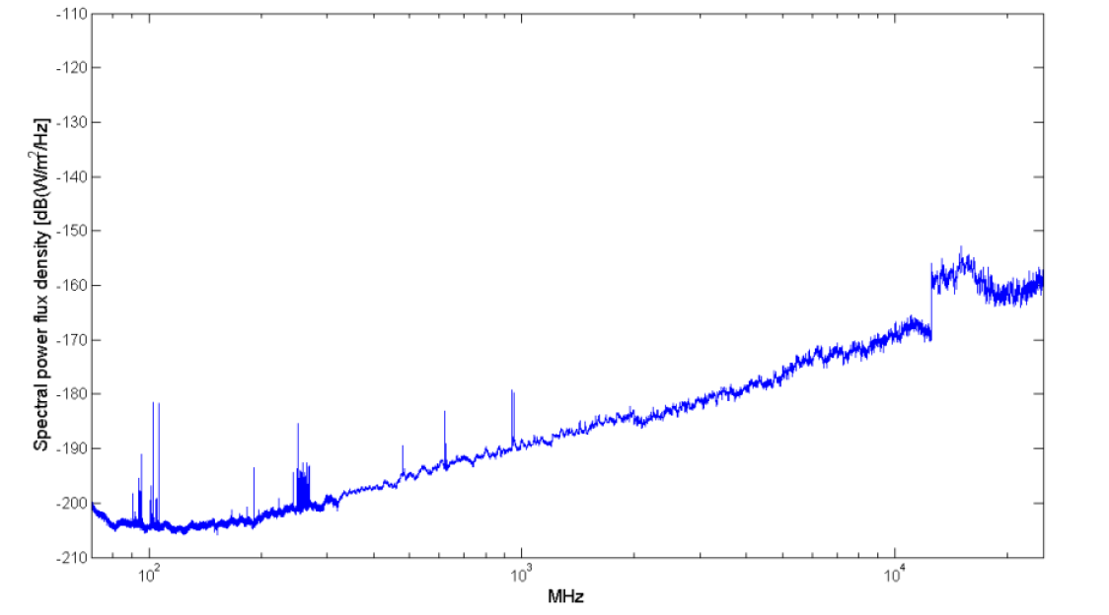
Main Offenders
GSM
900
FM
UHF
TV
VHF
TV

Slide 9
Spectrum Protection
Goals:
Protect the RFI-free parts of the spectrum
Minimize and/or eliminate current RFI sources
Ensure that RF environment remains optimal for radio astronomy in the long term
How do we do this?

Slide 10
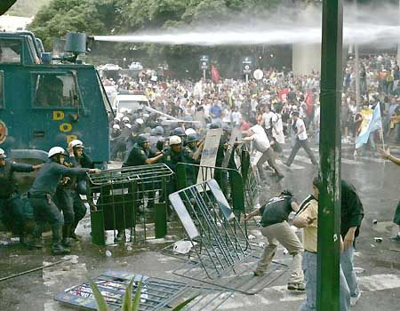
Spectrum Protection: Russia

Slide 11
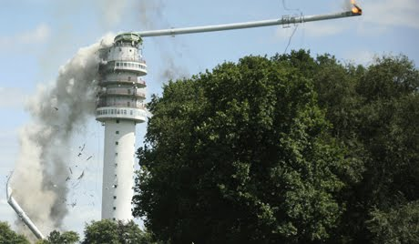
Spectrum Protection: NL

Slide 12
Astronomy Geographical Advantage Act (2008)
Empowers the Minister for Science and Technology to declare protected areas around strategic astronomy sites by publication in the Government Gazette.
Empowers the Minister to prohibit overflights
Establishes an AGA Management Authority to regulate and enforce three tiers of protected AAAs:
  Core AAA – the physical area of the observatory
  Central AAA – surrounds the core area. Minister prohibits certain activities / categories of activities in this area
  Coordination AAA – Minister sets standards which activities must comply with
Prevails over existing Electronic Communications Act, where protection of radio astronomy is concerned

Slide 13
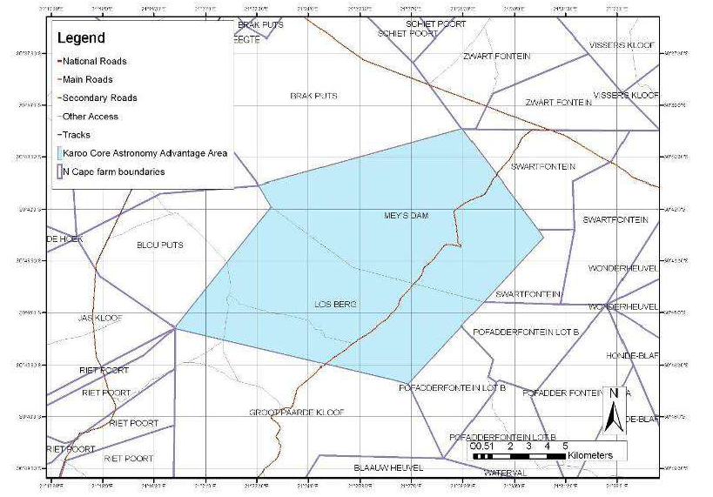
Core AAA

Slide 14
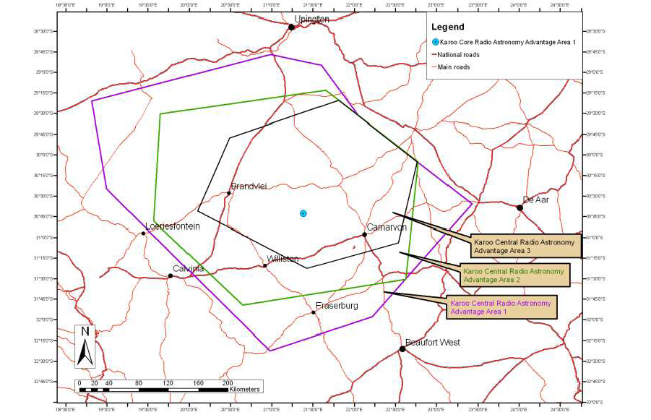
Freq-dependent Central AAAs

Slide 15
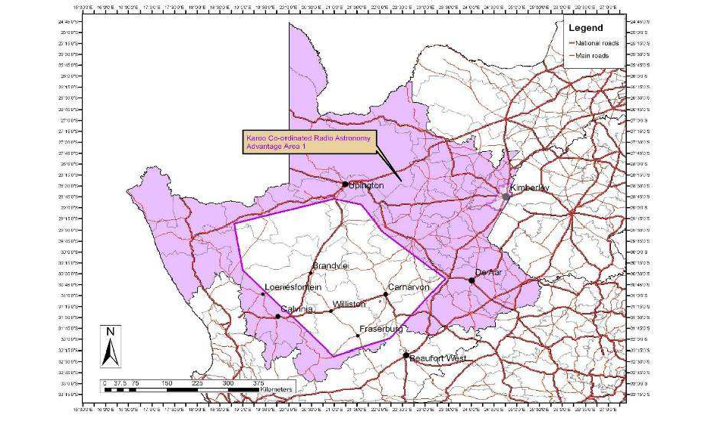
Coordinated AAA, 70 to 1710 MHz

Slide 16
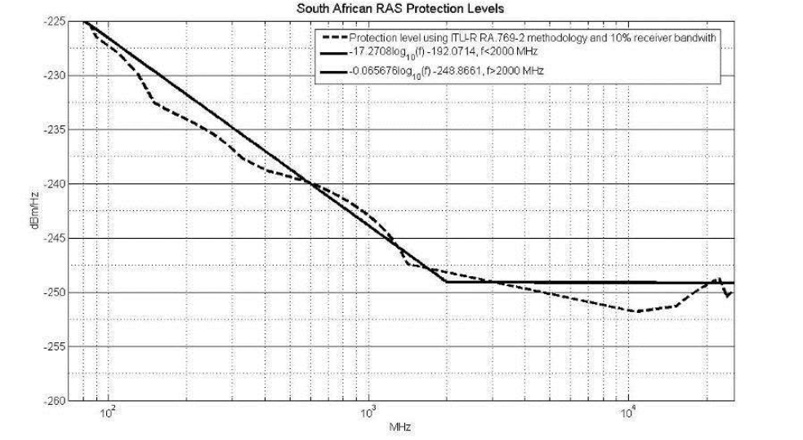
SARAS Spectrum Protection Levels

Slide 17
AGA Implementation Strategies
Work with stakeholders to reduce current impact, (although not necessarily to SARAS protection levels), by using alternative means of signal distribution
  Development of alternative technologies
Protect unused spectrum to SARAS protection levels
At all times, no saturation can be experienced by the radio astronomy facility

Slide 18
Stakeholders
GSM
900
FM
UHF
TV
VHF
TV

Slide 19
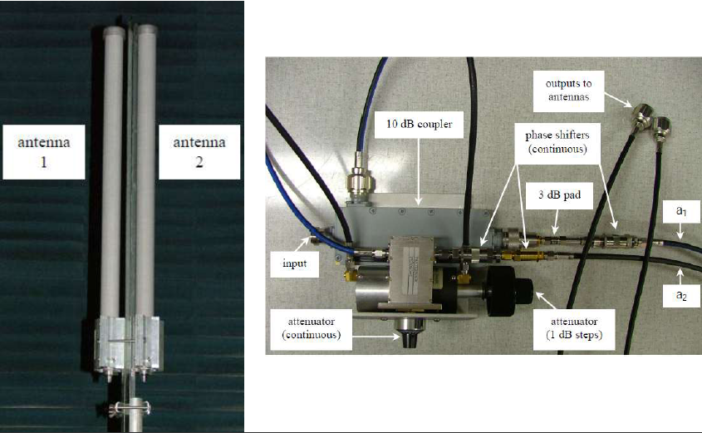
GSM: Development of Phased Antennas

Slide 20
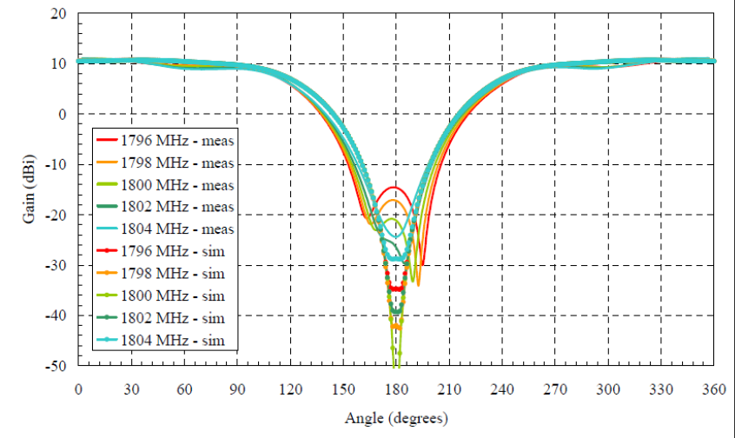
Resulting Directivity

Slide 21
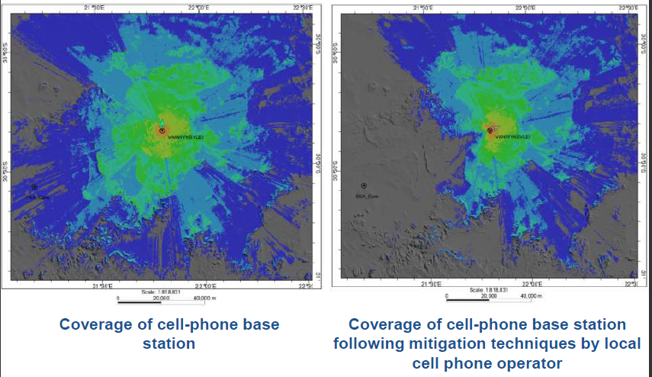
Resulting Coverage

Slide 22
FM & TV
FM services consolidating below 100 MHz
TV-VHF band (174-267 MHz) being vacated (migration to DTV)
TV-UHF (470-862 MHz):
  low-power broadcasting plan for towns
  digital sattelite solutions for rural communities
  co-channel freq. allocation possible (only 2x8 MHz channels will then be used)

Slide 23
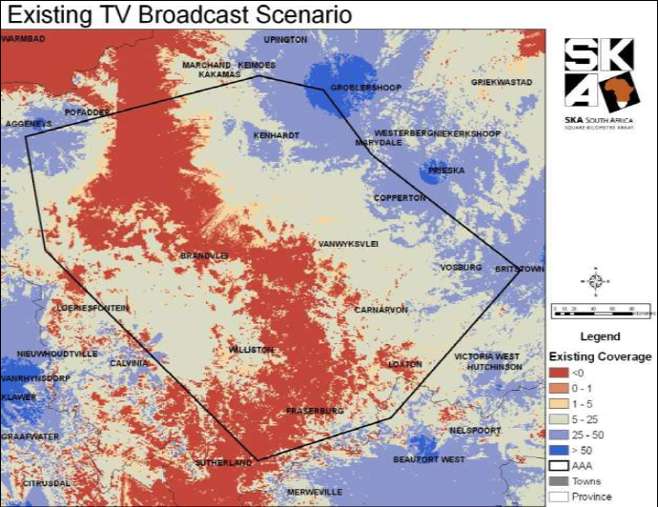
TV: Current Situation

Slide 24
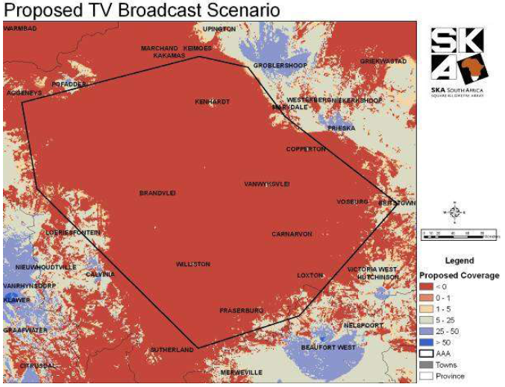
TV: Proposed Scenario

Slide 25
Mitigation vs. Flagging?
Measured RFI occupancy levels are quite low
LOFAR experience: flagging is sufficient (1-2% of data!), as long as signal path remains linear
This is easily achievable:
  250MHz BW, 50K receiver: only 1 extra ADC bit required at median measured levels, 4 bits at max levels.

Slide 26
Conclusions
Present RF environment
should not pose any major challenges to MeerKAT or SKA
  The “Good” regime: simple
  flagging should suffice
  LOFAR experience very
  encouraging
Strong measures (AGA) are in
place to protect (and improve)
this environment

