Slide 1
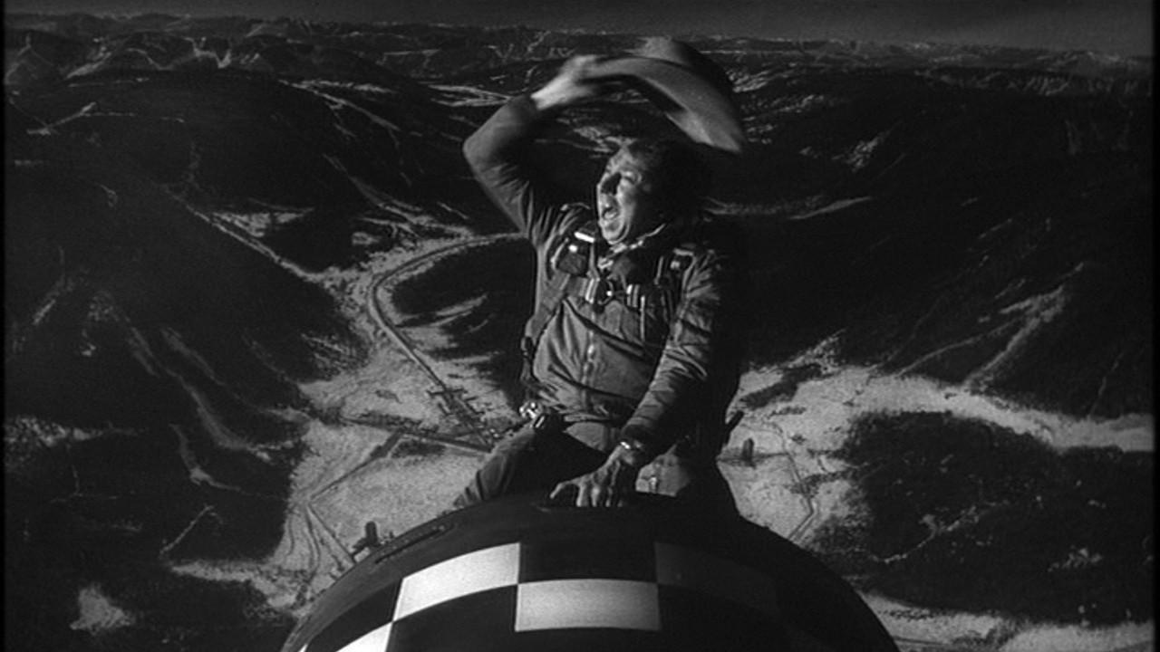
Dr. Sidelobes, Or How I Learned To Stop Worrying & Love Simulations
O. Smirnov (Rhodes University & SKA SA)

Slide 2
Introduction
“A high quality radio map is a lot like a sausage, you might be curious about how it was made, but trust me you really don't want to know.”
– Jack Hickish, Oxford
Interferometry is hard and unintuitive, but we've carved out some comfort zones
New technologies, new observatories and new surveys will be [already are] boldly going where no man has made sausage before
Results in surprises – of the good & bad variety
  Many subtle mechanisms – this talk concentrates on sidelobes

Slide 3
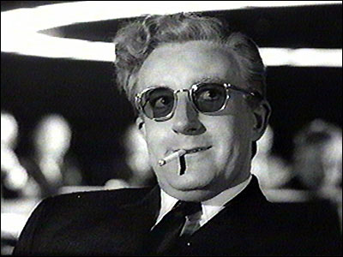
Dr Sidelobes
Primary beam (PB)
sidelobes:
  Making sure you pick
  up signal you don't
  need
PSF sidelobes:
  Making sure that
  signal you don't need shows up where you least need it (i.e. all over your map)

Slide 4

Good News First
3C147 @21cm
12h WSRT synthesis
160 MHz bandwidth
22 Jy peak (3C147)
13.5 μJy noise
1,600,000:1 DR
thermal noise-limited
Regular calibration does
not reach the noise,
leaves off-axis artefacts
due to direction-dependent
effects (left inset)
Addressed via differential
gains (right inset)
3C147 22Jy
30 mJy

Slide 5
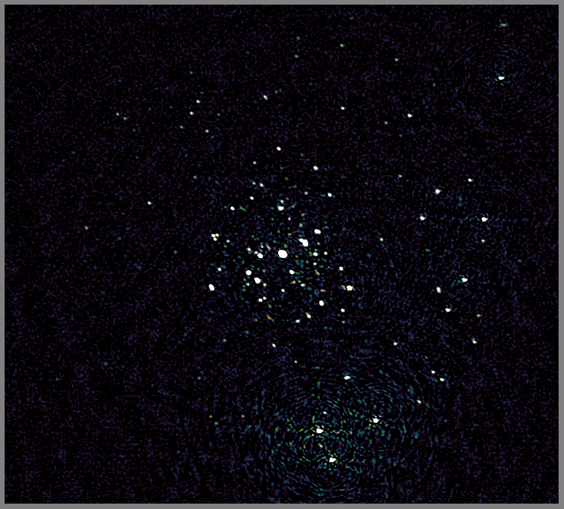
JVLA Version
Recent result from 3GC3 workshop
3C147
JVLA-D @1.4 GHz
Best image after
regular selfcal

Slide 6
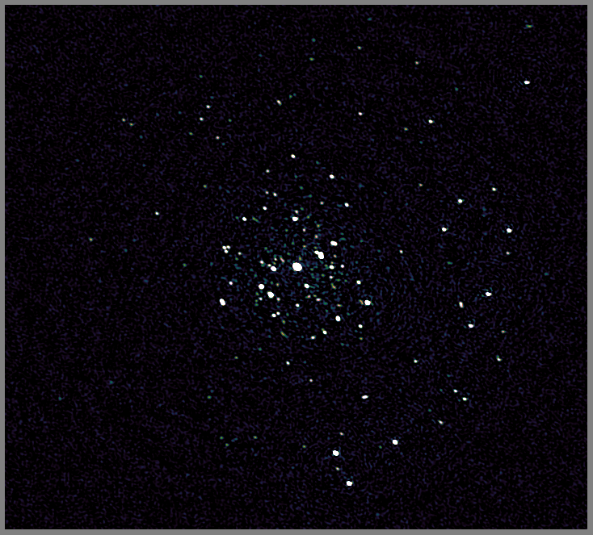
JVLA Version
Recent result from 3GC3 workshop
3C147
JVLA-D @1.4 GHz
Best image after
regular selfcal
...and direction-dependent (DD)
calibration on a few
sources

Slide 7
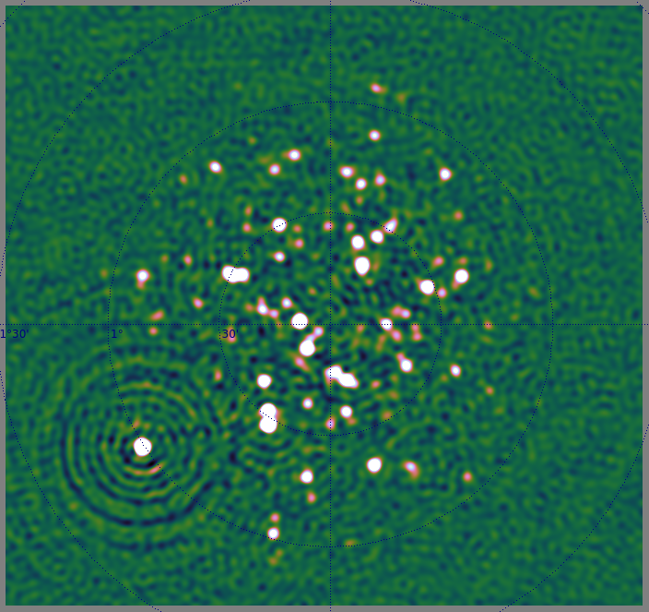
KAT-7 Version

Slide 8
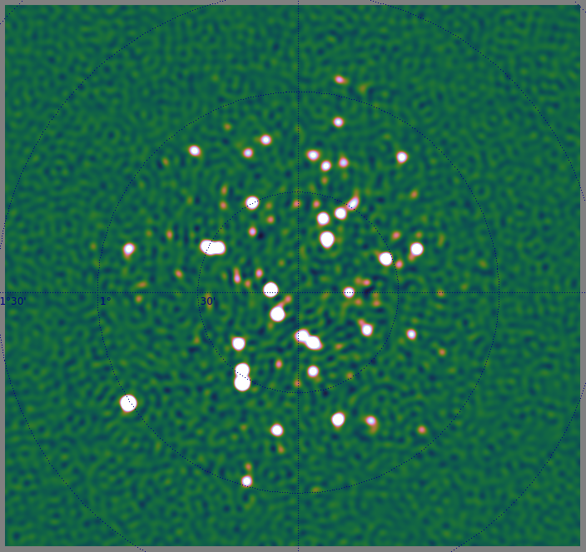
KAT-7 Version

Slide 9

When Primary Beams Go Bad...
(Courtesy of Ian Heywood)
EVLA 8 GHz: Looking for sub-mm galaxies and QSOs in the WHDF.
Dominant effect: bright calibrator source rotating through first sidelobe of the primary beam.
(This also has a horrible PSF, being an equatorial field.)
This is your science
(good luck!)
This is your
phase calibrator
Brightness scale 0~50μJy

Slide 10

Keep Your Friends Close, and your calibrators as far away as you can...
An approximation of the primary beam response, overlaid on top of the image.
As the sky rotates, the sidelobes of the PB sweep over the source, thus making it effectively time-variable.
This is your science
(good luck!)
This is your
phase calibrator
(Brightness scale 0~50μJy)

Slide 11

Deconvolution Doesn't Help...
Residual image, after deconvolution.
The contaminating source cannot be deconvolved away properly, due to its instrumental time-variability.
...5 years ago this would observation would probably be a complete write-off.
(Brightness scale 0~50μJy)

Slide 12
Same Problem Here
The artefacts in this
image have the same
underlying cause.
But here, the dominant
source is at the centre
(where PB variation is
minimal) and the
“offending” sources are
relatively faint.
But we did address them
via differential gains...

Slide 13

Differential Gains To The Rescue
Residual image after applying differential gain solutions to the contaminating source
Brightness scale 0~50μJy

Slide 14

Multi-Band Image
Multi-band residual image:
noise-limited, no trace of contaminating source.
Phase calibrator
used to be here
Brightness scale 0~50μJy

Slide 15
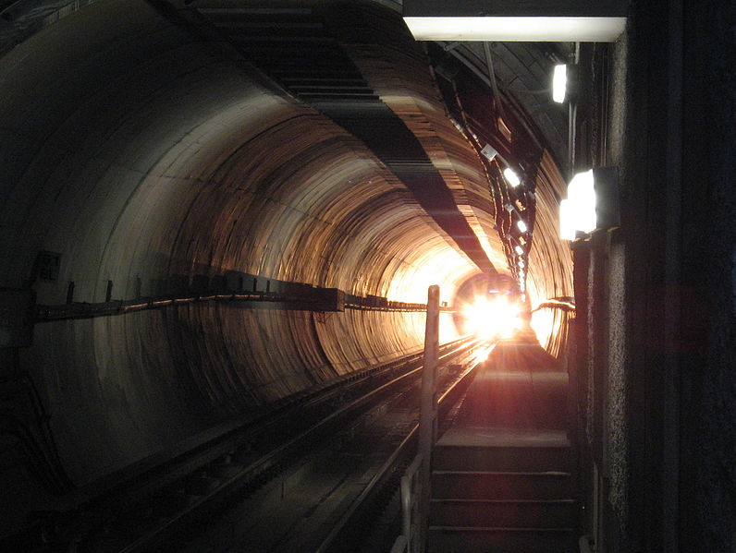
Flush With Success
3C147, WHDF, LOFAR maps: some real successes
Thermal noise-limited maps are being produced
  Though nowhere near routinely...
  T&Cs apply: extended
  sources are still notoriously
  hard to deconvolve
  ….though new algorithms
  are emerging
Is this the light at the end of the
tunnel?

Slide 16

2004: The Ghosts Of Cyg A
WSRT 92cm observation of J1819+3845 by Ger de Bruyn
String of ghosts connecting brightest source to Cyg A
(20° away!)
“Skimming pebbles in a pond”
Positions correspond to rational fractions
(1/2, 1/3, 2/3, 2/5, etc...)
Wasn't clear if they were a one-off correlator error, a calibration artefact, etc.
  (...and if you did low-frequency in 2004, you had it coming anyway.)

Slide 17

2010: Ghosts Return
WSRT 21cm observation
...with intentionally strong instrumental errors
String of ghosts extending through dominant sources A (220 mJy) and B (160 mJy)
Second, fainter, string from source A towards NNE
Qualitatively similar to Cyg A ghosts

Slide 18

If You Can Simulate It...
Eventually nailed via simulations

Slide 19
Ghosts In The (Selfcal) Machine
Ghosts arise due to missing flux in the calibration sky model
Mechanism: selfcal solutions try to compensate for this by moving flux around
  Not enough DoFs to do this perfectly
  ...so end up dropping flux all over the map
  ...with a lot of help from the good Dr Sidelobes
Regular structure in this case due to WSRT's redundant layout = regular sidelobes
  JVLA, MeerKAT: “random” (but not Gaussian!)

Slide 20

JVLA Ghost Sim

Slide 21
Ghastly Questions
Does selfcal always introduce ghosts?
  YES. But most of the time they're buried in the noise.
  ...unless you have a complete sky model (i.e. if all your science targets are known in advance)
Why don't we always see them?
  Not enough sensitivity
Will they average out?
  NO. Push the sensitivity, they pop out.
What will they do to my statistical detections (hello EoR)?
  Dunno. Simulations needed.
What else is that redistributed flux doing?

Slide 22

Ghosts, The Flip Side
WSRT “Field From Hell” (Abell 773 @300 MHz),
residual map

Slide 23

Getting There, Right?
After diligent (direction-dependent) calibration

Slide 24
Noise-limited Is Not Always Good
Suppression of non-model sources
Our target

Slide 25

The Dangers Of
Direction-Dependent Solutions
Suppression is less with more conservative calibration
Our target

Slide 26
KAT-7 Source Suppression

Slide 27
KAT-7 Source Suppression

Slide 28
Ghosts & Source Suppression
Both ghosts and suppression operate via the same mechanism, and Dr Sidelobes pulls the strings
Ghosts are usually buried in the noise
Suppression always present with selfcal, but more severe with DD calibration (more DoFs...)
  A noise-limited map is not necessarily a good science map!
“What if we were to somehow break the thermal noise barrier, but
all we'd find beneath would be the bones of Jan [Noordam]'s enemies?”
– Anon., 3GC-II Workshop
(names and places changed to protect the guilty)

Slide 29
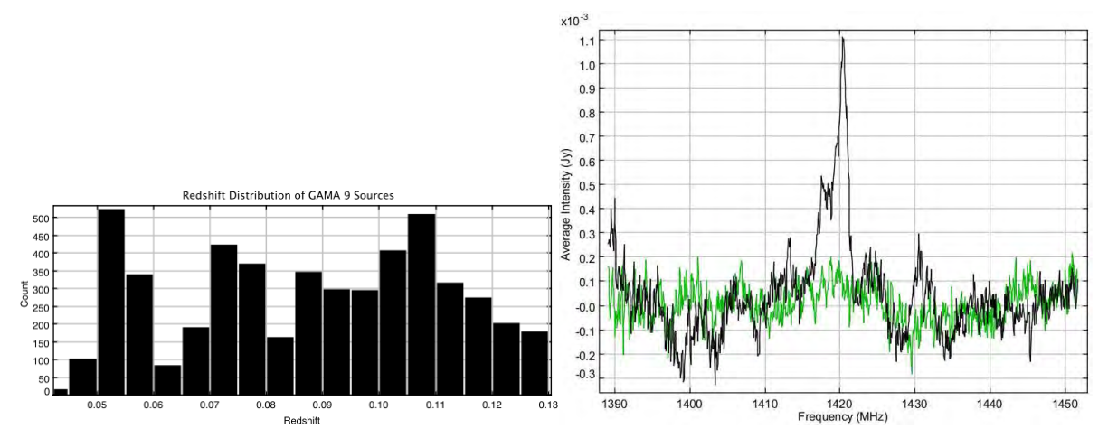
Spectral Line Stacking:
Picking over the bones of Jan's enemies
Individual lines hidden in the noise
  So apply priors from optical surveys...
  ...by shifting each spectrum to its known redshift
  ...and probe the total signal by co-adding spectra
Lines add up, noise suppressed by ~N ⁻²
For bonus points, use optical positions to stack sources that are
sub-noise in radio
(Delhaize & Staveley-Smith)

Slide 30
Interferometric HI Stacking:
The Ian “Bad News” Heywood Simulation I
Simulated HI emission (S³-SAX)
Pure sky model
No noise
No continuum
No interferometer
response
So, what happens when Dr. Sidelobes shows up?

Slide 31
Stacking On The Celestial Equator?... Ouch!
No noise
No continuum
No calibration or deconvolution residuals
SKA-Mid sim
Equatorial field: high N-S sidelobes

Slide 32
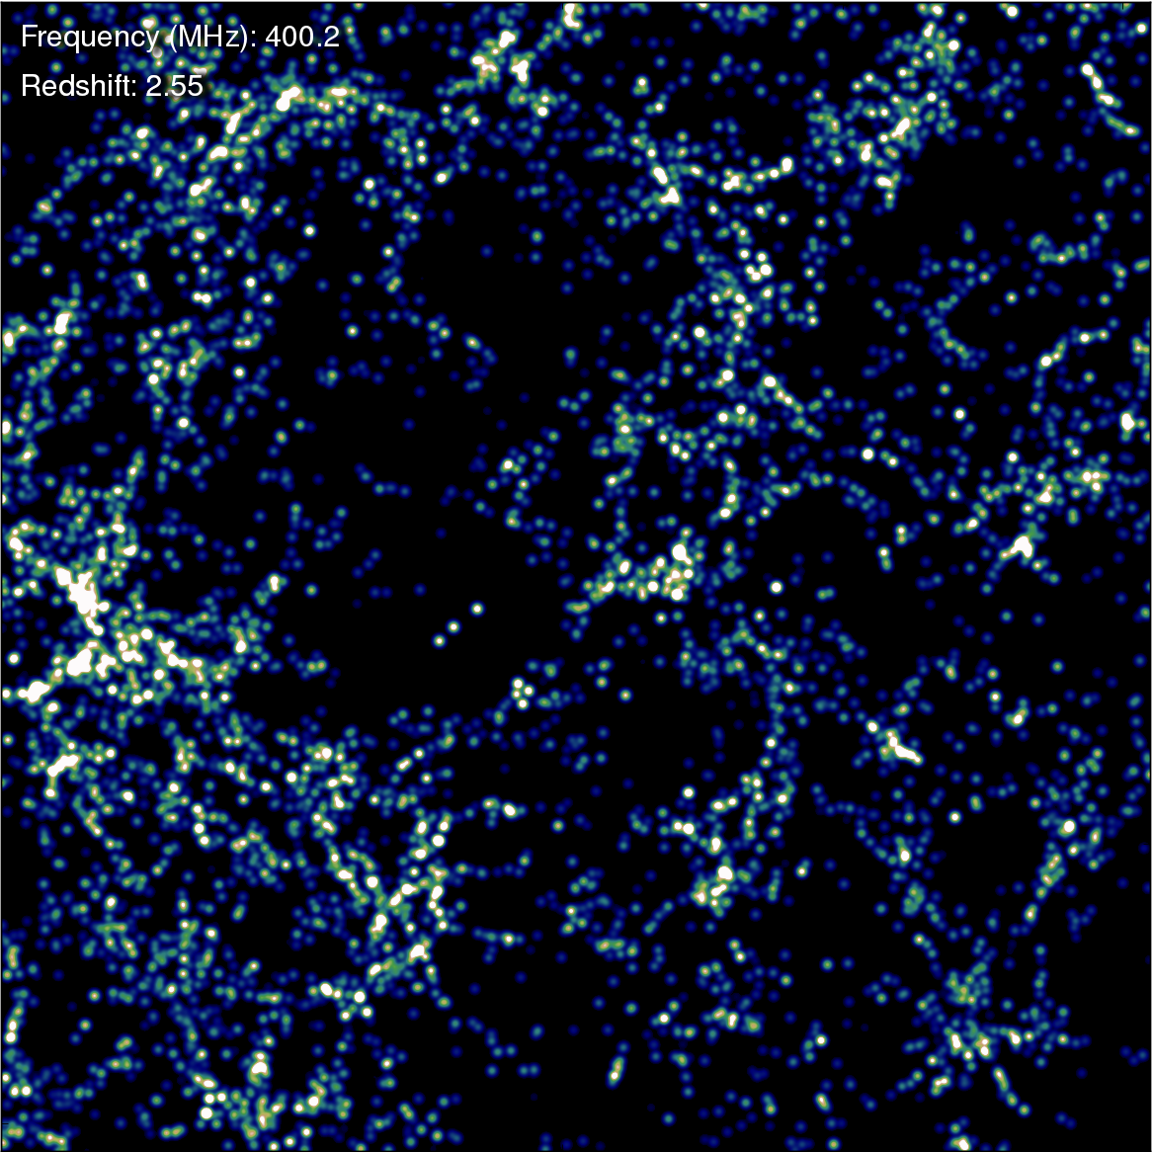
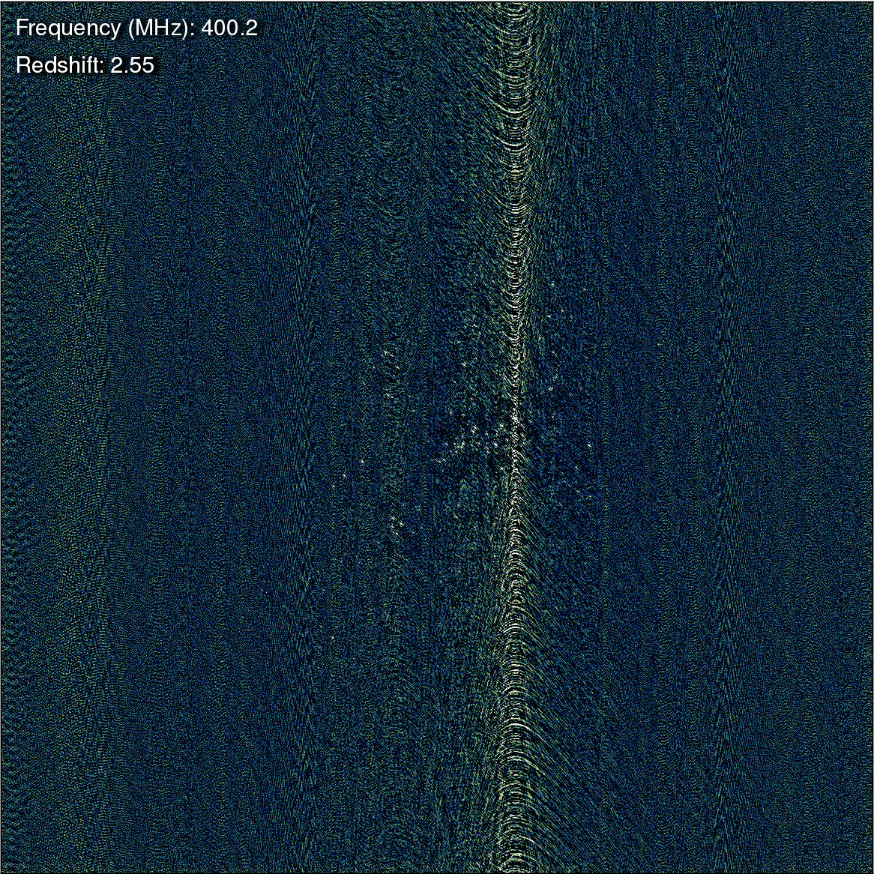
True vs. Observed
How many of these galaxies will stack up coherently?

Slide 33
LADUMA Stacking Sim
No noise
No continuum
No calibration or deconvolution residuals
MeerKAT sim
(... with some YouTube artefacts...)

Slide 34
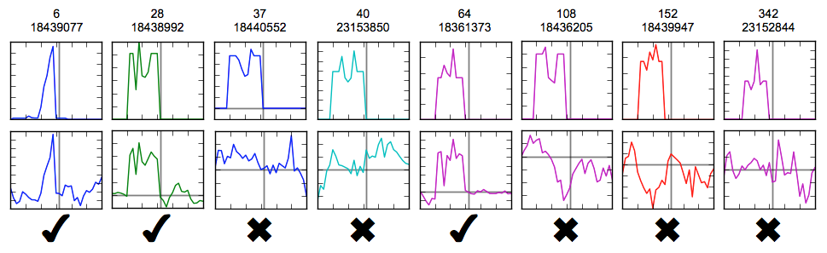

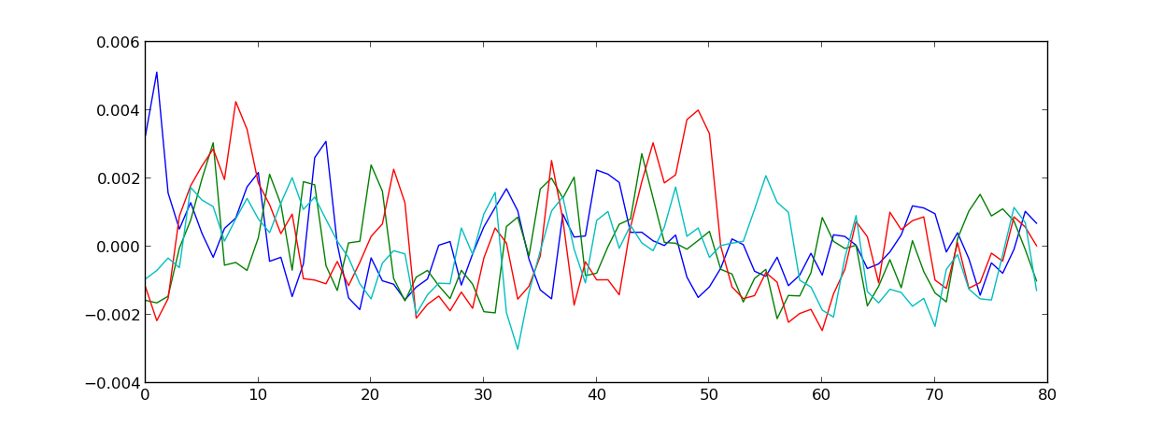
Dr Sidelobes at Work
TOP: A selection of individual galaxy spectra
BOTTOM: A selection of
“Dr. Sidelobes's spectra”

Slide 35
HI + Dr. Sidelobes
Ordinal number of galaxy
(in order of HI mass)
TOP: original HI signal
BOTTOM: HI + Dr. Sidelobes
  ...most of which originate with undetected sources
75% of the top 500...

Slide 36
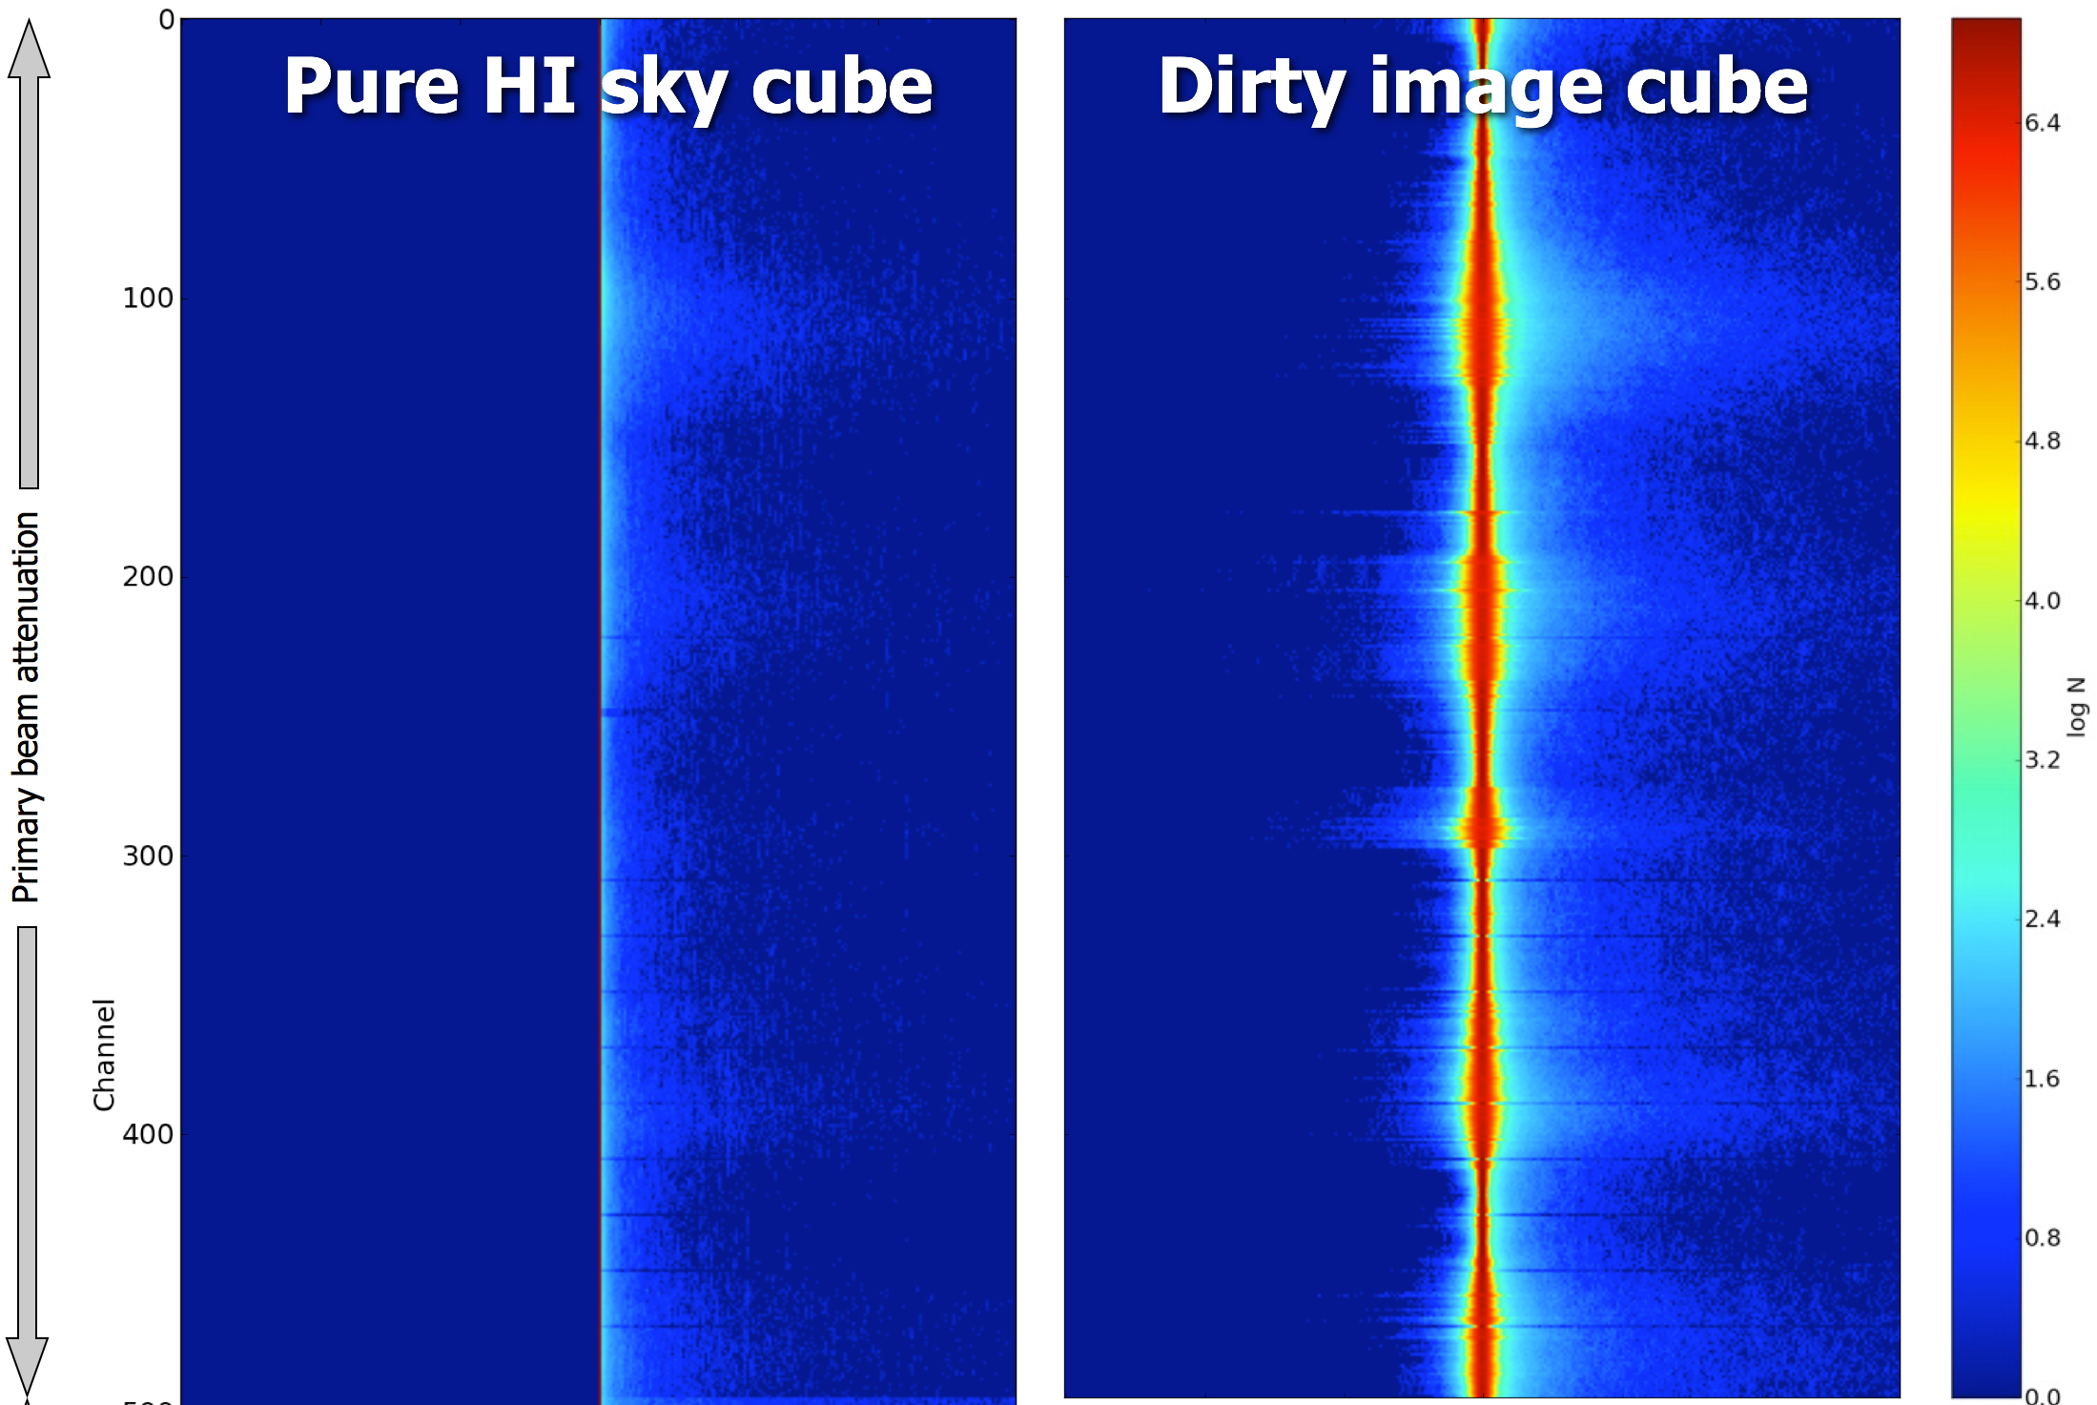
Pixel Values Histogram
dominant
sources
negative sidelobes
of dominant
sources
no negative
values
Most HI signal
lives here
positive sidelobes
of dominant
sources

Slide 37
How Radio Interferometry
Really Works
Bright sources
(DD solutions, uv-subtraction, deconvolution)
thermal noise
Faint sources
(DDE interpolation, deconvolution)
1-2σ sources
(stacking)
<1σ sources
(a stiff drink?)

Slide 38
Stacking In WHDF
Simulations were just the ideal scenario...
(No continuum, no calibration errors)
WHDF: should have been stackable: ~1700 optical positions available in this field.
Miserable failure.
Prime suspect: the bones of Jan's enemies left behind by the phase calibrator.
Can simulate the whole scenario...

Slide 39
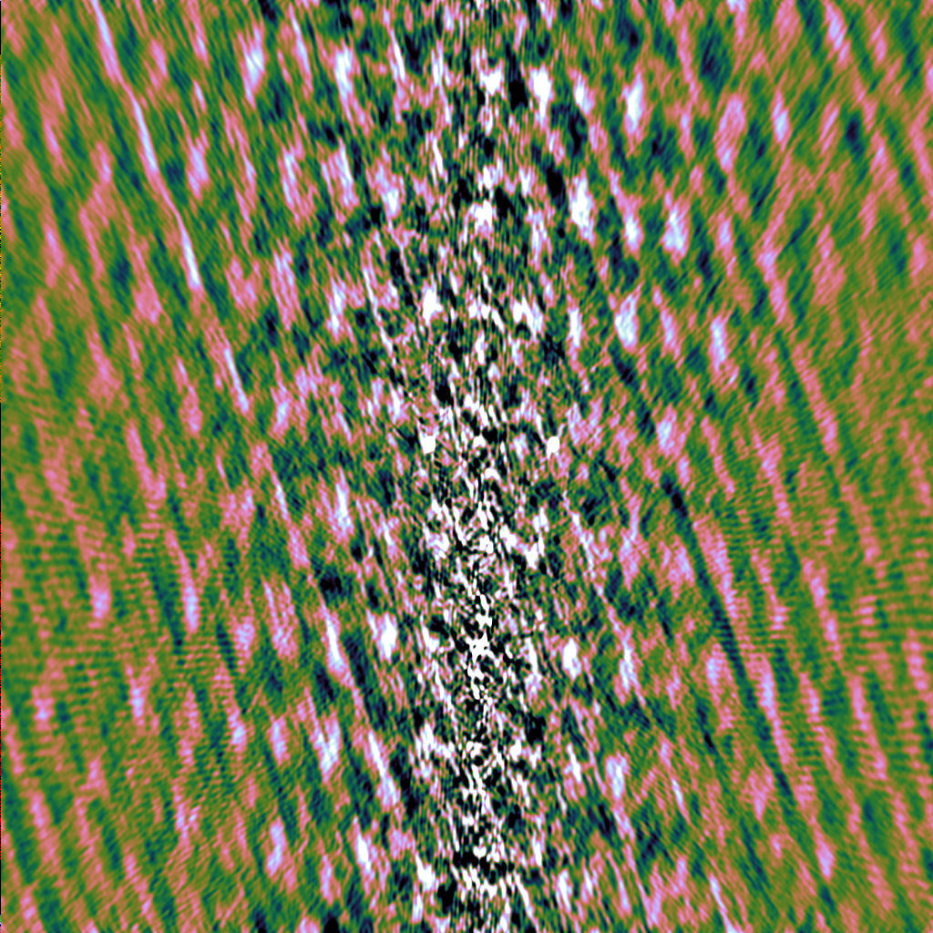
Stacking In WHDF
Simulated field (including calibrator), with beam rotation and pointing errors.
Calibrated and peeled off the calibrator.
Removed noise.
This is what lives in the noise.

Slide 40
Conclusions
Interferometry is counterintuitive
We're pushing the boundaries
This leads to “surprises” (look up!)
Simulations are coming of age
  can be a powerful tool for discovering some of the surprises before they land on our heads...

