Slide 1
Spit, Duct Tape,
Baling Wire & Oral Tradition:
Algorithmic & Computational Problems Of
Radio Interferometric
Data Reduction
O. Smirnov (Rhodes University & SKA SA)

Slide 2
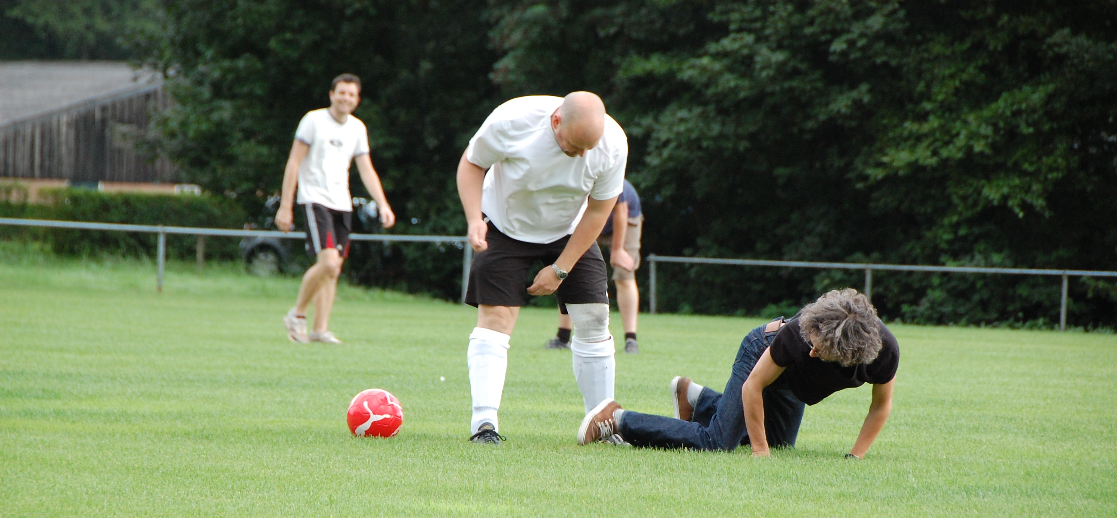
About myself
Served almost 12 years at ASTRON, Dwingeloo, The Netherlands (home of WSRT, LOFAR, a million sheep & bland food)
Moved to South Africa this year:
SKA SA (Cape Town) & Rhodes University
Research
interests are
interferometry,
calibration,
algorithms,
methods,
football.

Slide 3
Basic Laws Of Interferometry
I. Thou DOST NOT understand interferometry.
II. Thou SHALT talk about interferometry.
III. When caught talking crap, thou shalt
invoketh The First Law.

Slide 4
The Ron Ekers Seven-Step Program
To Producing A Radio Interferometer
Step 0. Admit that you have a problem:
You want to (need to/are forced to by peers/supervisors) to do interferometry.
“My name is Oleg Smirnov, and I am an interferometrist.”

Slide 5

How To Make An Interferometer 1
Start with a normal reflector telescope....

Slide 6

How To Make An Interferometer 2
Then break it up into sections...

Slide 7

How To Make An Interferometer 3
Replace the optical path with electronics

Slide 8

How To Make An Interferometer 4
Move the electronics outside the dish
...and add cable delays

Slide 9

How To Make An Interferometer 5
Why not drop the
pieces onto the ground?

Slide 10

How To Make An Interferometer 6
...all of them

Slide 11

How To Make An Interferometer 7
And now replace them with proper radio dishes.
...and that's all! (?)
Well almost, what about the other pixels?

Slide 12

How Does Optical Imaging Do It?
This bit sees the EMF
from all directions,
added up together.
This bit sees the EMF
from all parts of the
dish surface,
added up together.

Slide 13
Fourier Transforms
An optical imaging system implicitly performs two Fourier transforms:
  1. Aperture EMF distribution = FT of the sky
  2. Focal plane = FT⁻¹ of the aperture EMF
A radio interferometer array measures (1)
  Then we do the second FT in software
  Hence, “aperture synthesis” imaging

Slide 14
A Few Problems
Gaps in the aperture... see later
Can't really measure & FT the EMF directly
  e.g. 1 GHz signal: that's a LOT of FTs per second
Instead, we can measure the coherency:
  i.e. sample fast, then
  integrate in the correlator,
  so the output sample
  rate is slow (~seconds)
...because that has all the interesting information

Slide 15
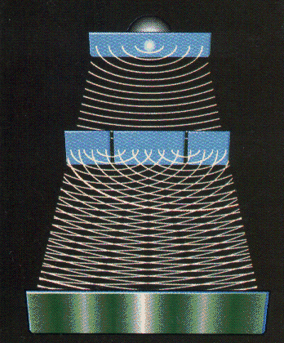
Why Coherency?
Recall the double slits: what does the photographic plate really measure?
  ...average intensity:
e(x) is a superposition of the signal from the two slits p and q:

Slide 16


The uv-Plane
Image plane
uv-plane
(12 hours!)
FT
One baseline samples
one visibility at a time
In a sense, the two are entirely equivalent

Slide 17
Earth Rotation Aperture Synthesis
Every pair of antennas (baseline) is correlated, measures one complex visibility = one point on the uv-plane.
As the Earth rotates, a baseline sweeps out an arc in the uv-plane
  See uv-coverage plot (previous slide)
Even a one-dimensional East-West array (WSRT = 14 antennas) is sufficient

Slide 18
Where's The Catch?
We don't measure the full uv-plane, thus we can never recover the image fully (missing information)
  Interferometer = high & low-pass filter
Every visibility measurement is distorted (complex receiver gains, etc.), needs to be calibrated.
(Doesn't work the same way in optical interferometry at all...)
  Can't really form up complex visibilities, etc.

Slide 19


Catch 1: Missing Information
Response to a point source: Point Spread Function (PSF)
PSF = FT(uv-coverage)
Observed “dirty image” is convolved with the PSF
Structure in the PSF = uncertainty in the flux distribution (corresponding to missing data in the uv-plane)
(12-hour WSRT PSF)
4
2

Slide 20

Deconvolution: from dirty to clean images
Real-life WSRT dirty image
Dirty image dominated by PSF sidelobes from the stronger sources
Deconvolution required to get at the faint stuff underneath.
A whole continuum of skies fits the dirty image (pick any value for the missing uv-components)
Deconvolution picks one = interpolates the missing info from extra assumptions (e.g.: “sources are point-like”).

Slide 21

Catch 2: Distorted Measurements
One point-like source, but observed with phase errors
  Ionosphere, troposphere, electronics
In the uv-plane, phase encodes information about location
Phase errors tends to spread the flux around
Calibration of complex gains required before we can see anything at all

Slide 22
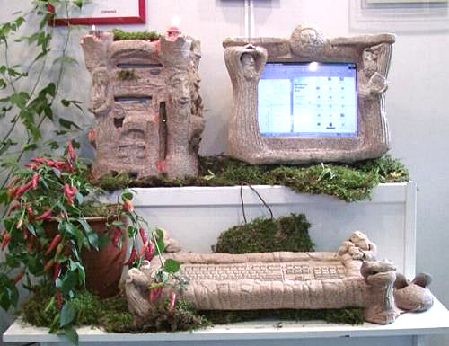
Stone-Age Calibration
(First-Generation, or 1GC)
Calibrate gains using a known calibrator source
Move antennas to target, cross your fingers, and hope that everything stays stable enough to get an image
Dynamic range:
~100:1
Observed
visibility
Model
visibility
Gain of
interferometer
(i.e. antenna pair)
p-q

Slide 23
The Selfcal Revolution (2GC)
Per-baseline gains are actually products of per-antenna complex gains!
  Vpq: observed visibility
  Mpq: model visibility
  gp: antenna p complex gain
N(N-1)/2 visibilities >> N gains
  Start with simple M
  Solve for g's
  Improve M, rinse & repeat
dynamic range > 10⁶:1

Slide 24
Typical selfcal cycle
Pre-calibrate g using external calibrators
Correct with g⁻¹, make dirty image, deconvolve
Generate rough initial sky model
Solve for g using the current sky model
Correct with g⁻¹, make dirty image, deconvolve
  Optional: subtract model and work with residuals
Update the sky model
pre-cal
Selfcal loop
Huge body of experience suggests that this works rather well, BUT there's no formal proof (!!!) Current practice is a collection of ad hoc methods, dark art and lore passed down the generations in what is virtually an oral tradition.

Slide 25

The Past: Massive Overengineering
(Built For 1GC, used with 2GC)

Slide 26

The Future:
Four Sticks In The Ground (+Software)

Slide 27

...and Dishes Made Of Plastic
(+Compatible Software)

Slide 28


The Limits Of 2GC
Selfcal rests on a few assumptions, main one being:
  One complex gain per antenna, per entire field of view.
Direction-dependent effects (DDEs) are suddenly a problem
  Due to new regimes
  Due to wider FoV
  Due to increased sensitivity
Polarization is a problem
Need a proper mathematical description
Enter the RIME...
A simulation of ionospheric effects at LOFAR frequencies before and after selfcal

Slide 29
What is The RIME
For almost 50 years, we did (R)adio (I)nterferometry without a (M)easurement (E)quation
First formulated by Hamaker, Bregman & Sault (1996), further developed by Hamaker.
A mathematically complete and elegant description of what you actually measure with an interferometer
  all we had before were hints and approximations (i.e. the selfcal equation.)
Like most great things, is utterly obvious in hindsight

Slide 30


The Basics:
Vectors & Jones Matrices
A transverse EM field can be described by a complex vector:
x
A dual-receptor feed measures two complex voltages
(polarizations):
z
y
We assume all propagation effects
are linear. Any linear transform of a vector can be described by a matrix:

Slide 31

Correlation
The same signal reaches antennas p and q along two different paths. We then correlate the two sets of complex voltages.

Slide 32
The 2×2 Visibility Matrix

Slide 33
Coherencies & Stokes Parameters

Slide 34
And That's The RIME!
The RIME, in its simplest form:
measured
antenna p
source
antenna q

Slide 35
Jones Matrices:
The Crucial Ingredient
Each J is called a Jones matrix
With multiple effects in the signal path, overall J is a product of individual Jones terms:
Order of Js corresponds to the physical order of effects in your signal path.
Matrices (usually) don't commute!

Slide 36
Accumulating Jones Matrices

Slide 37
A Nursery RIME

Slide 38
Why Is This Great?
A complete and simple framework for describing all kinds of signal propagation effects.
...including those in the sky & at the antenna, e.g.:
  Ionosphere, troposphere
  beam & receiver gain
  parallactic angle rotation
  receptor cross-leakage
  “weird” antenna designs (aperture arrays, etc.)
Effortlessly incorporates polarization.

Slide 39

Polarization
“You may not be interested in the polarization, but the polarization is interested in you.”
– (wrongly) attributed to Leon Trotsky
Older telescopes were designed
to minimize instrumental polarization effects
So unless you were a masochpolarimetrist, you could dodge the issue entirely
Not so for the new regimes:
  Focal plane & aperture arrays, offset feeds: severe instrumental polarization
  Low frequencies: ionospheric FR

Slide 40

The Classical Approach To Polarization Calibration
V
Q
U

Slide 41

Scalar Equations For
Polarization Selfcal
RIME version:

Slide 42
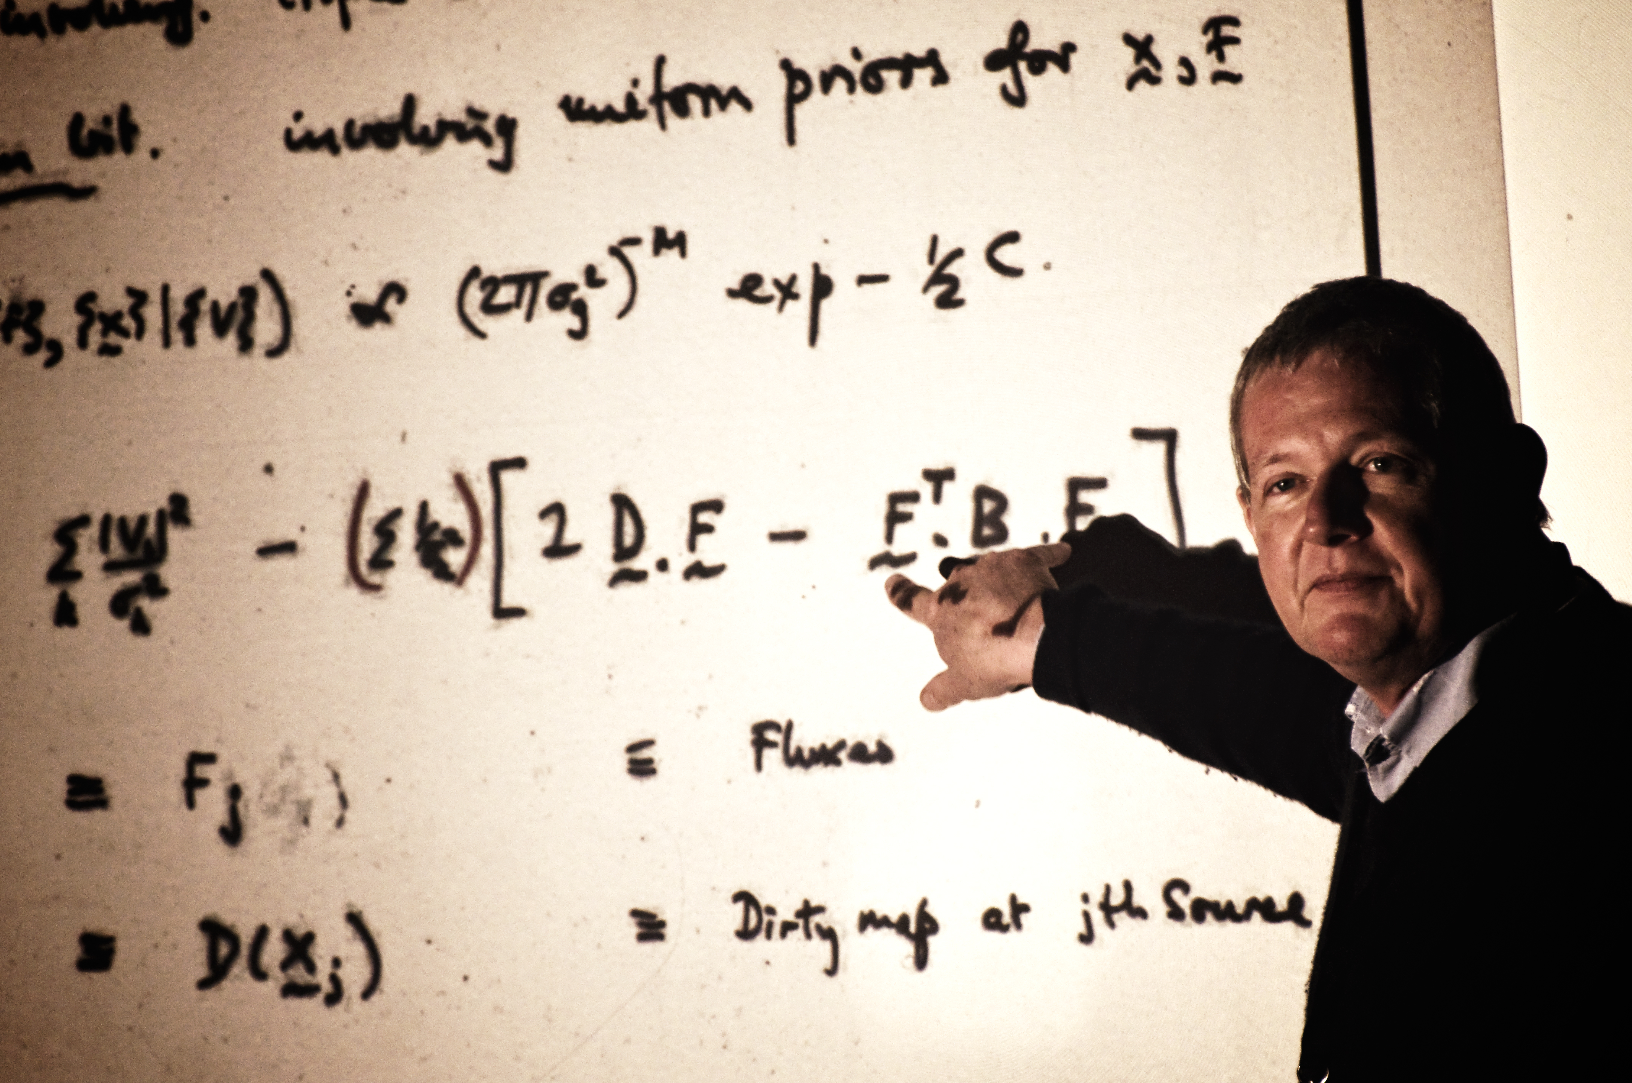
The Future Is Bayesian?
“I first came out of the closet as a Bayesian in 198...” --Steve Gull

Slide 43
Bayes' Theorem
Posterior
Probability of the model
given this set of data.
We want to find an
M that maximizes this.
Likelihood
Probability of this data
given the model.
From e.g. a ²-sum.
Prior
Probability of
the model
from prior
knowledge
or assumptions
Marginal probability
Unconditional probability
of this particular data,
assumed constant

Slide 44
A Bayesian Formulation
Of Interferometric Calibration
data D = observed visibilities
model M = S+G, where S is a sky model,
and G are the instrumental errors
A fully Bayesian approach: find M=S+G that maximizes P(D|M)P(M)
Legacy data reduction methods are a divide-and-conquer approximation to this.
  How would a Bayesian see selfcal?

Slide 45
Legacy Selfcal in Bayesian Terms
Calibration: fix sky S, solve for G:
  maximize P(G|D)=P(D|G)P(G)
  ...assuming P(G)=const => just an LSQ fit!
  solve for one time/frequency domain at a time
Form up “corrected data” as DC =G⁻¹(D).
Imaging: make the dirty image ID=FT⁻¹(DC )
Deconvolution: use ID as a proxy for the “data”
  maximize P(IM|ID)=P(ID|IM )·P(IM )
IM becomes S at the next step.
CLEAN: point-like IM
NNLS: IM>0
MEM: P(IM ) ~ H

Slide 46
Why So Clumsy?
Too much data, too few computers
  Too many parameters: selfcal solves for a few at a time
  the FFT is incredibly fast: a lot of clumsiness stems from kludging our algorithms around the FFT
This may be changing! (Cheap clusters & GPUs.)
EM-, ML-, MEM-imaging: given calibrated data
DC , find the sky S that maximizes
P(S|DC )=P(DC|S)P(S)
Supplants both traditional FFT-based imaging and deconvolution.

Slide 47
One More Step Needed
Need to add calibration into the mix:
find M=S+G that maximizes P(D|M)P(M)
The RIME tells us how to compute P(D|M), but this is still pretty expensive.
With a few more PhD students thrown into the breach, will probably be tractable soon.

Slide 48
Conclusions
Radio interferometry has achieved incredible results (>10⁶:1 dynamic range), despite using incestuous calibration methods held together with spit, duct tape, baling wire and oral tradition.
New telescopes will not let us get away with this
  Upcoming “radio telescope bubble”
Fortunately, we know where to look for answers
  The RIME
  Bayesian methods
This is a good time to be an instrumentalist.

