Slide 1
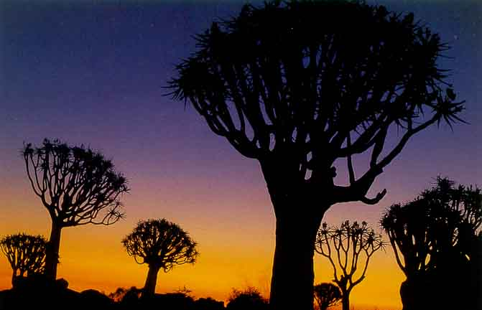

MeqTrees at
1,000,000:1
O. Smirnov (ASTRON)

Slide 2
Introduction:
Calibration In MeqTrees
MeqTrees is (mostly) about building measurement equations, e.g.:
An m.e. decomposes the observed visibility Vpq into intrinsic source properties and per-antenna Jones terms.
Can describe an endless variety of (linear) physics.

Slide 3

“Beat NEWSTAR” Project
Aim: demonstrate the advantages of ME-based calibration
  by doing better than a legacy package
  pick the right target...
NEWSTAR (Netherlands East-West Synthesis Telescope Array Reduction)
  not a terribly wide user base
  WR holder in dynamic range
  (→2 million)
...but a very tall one!

Slide 4
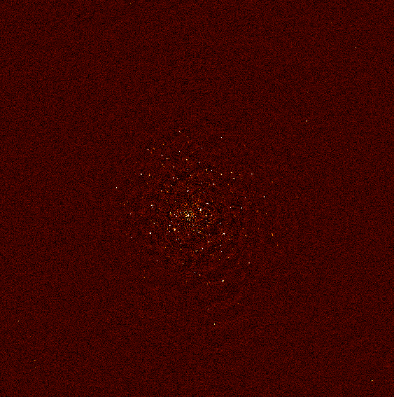
The 3C147 Field
1x12 hr WSRT 21cm observation
30sec. integration
8x64 channels 21cm B=160 MHz
3C147 is 22Jy
NEWSTAR DR:
  1.5 million on-axis
  1000 off-axis

Slide 5


Best NEWSTAR Image
Single band (56 channels)
298 sources subtracted
σ ~ 30uJy
dominated by residuals from imperfectly-subtracted fainter sources
...which are caused by:
(a) imperfect sky model (more deconvolving would help)
(b) image plane effects: pointing errors, tropospheric refraction, ...
  no direct cure in NEWSTAR
polarized, 40 mJy
3C147, 22 Jy
20 mJy
35 mJy

Slide 6
Calibrating For
Image-Plane Effects I
“Peeling” is different things to different people, but here we'll define it as:
  selfcal on brightest source, subtract source
  shift phase center to next source
  selfcal, subtract, rinse & repeat
Proven to work...
  3C343, 3C84, 3C196, etc. (Ger de Bruyn, Tom Oosterloo, Michiel Brentjens – NEWSTAR, Miriad)
...but cumbersome to use (miles of scripts)

Slide 7
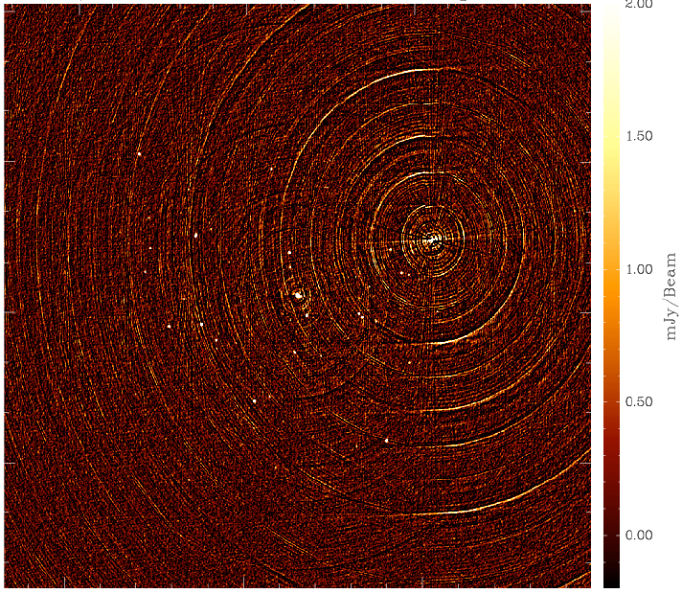
3C343: A Typical
Peeling Candidate

Slide 8
Calibrating For
Image-Plane Effects II
Weakness of peeling: interacting solutions when sources have comparable flux
  need to iterate back and forth
Alternative: simultaneous off-axis gain solutions (some call it “peeling” too.)
  3C343 (Michiel Brentjens -- MeqTrees)
Alternative: solving for pointing errors
  Sanjay Bhatnagar – CASA?
  EVLA Memo 84, and this conference

Slide 9
The MeqTree Approach
All sorts of ME's can be implemented. Let's start with this one:

Slide 10


Bandpass Artifacts
Residual pattern from 3C147 due to bandpass instability.
We do a separate B solution every 30 min.
Error pattern caused by variations in actual bandpass over the solution interval
  error ~ 1/10,000
We can mitigate this by making B a 1st-degree polynomial in time
  error ~ 1/500,000
  close to noise level but plainly visible
Further increase polynomial degree?
  or spline?

Slide 11
Dropping The Bandpass
Do a per-channel selfcal
  with sufficient S/N, why not?
  this is what Ger does in NEWSTAR
In M.E. terms:

Slide 12

Seeing The Pointing Errors
Residual image, 298 sources subtracted
Per-channel selfcal + closure errors
Qualitatively similar to NEWSTAR map
(uniform vs. radial weighting was used)
Dominant feature is residuals from off-axis sources
polarized, 40 mJy
3C147, 22 Jy
20 mJy
35 mJy

Slide 13
Solving For Pointing Errors
Bhatnagar's approach, in terms of our ME:

Slide 14
Differential Gains
Or we can introduce differential gains:

Slide 15
Flyswatter I
The “before” image.
polarized, 40 mJy
3C147, 22 Jy
20 mJy
35 mJy

Slide 16

Flyswatter II
Solved for ΔE for
5 sources.
polarized, 40 mJy
3C147, 22 Jy
20 mJy
35 mJy

Slide 17

Flyswatter III
Solved for ΔE for
10 sources.
polarized, 40 mJy
3C147, 22 Jy
20 mJy
35 mJy

Slide 18
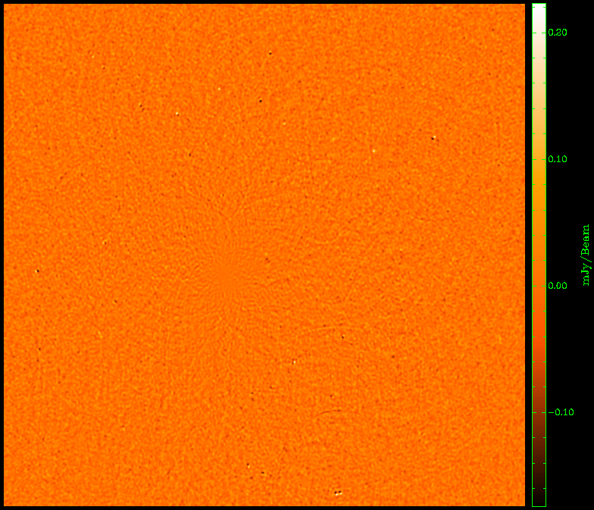
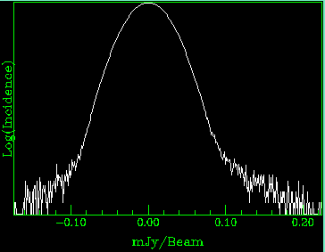
The Best Map So Far
Solved for ΔE for
12 sources.
Small problems remain, but the improvement over NEWSTAR is undeniable.

Slide 19
Some Parameter Counts
We're throwing extra degrees of freedom (the ΔE's) at the model, how bad is this?
Per-channel selfcal (14 antennas, 70 baselines, 30 frequency channels):
2*14 complex gains per t/ν point,
2*70 complex measurements per t/ν point
One extra ΔE term:
2*14 complex gains per 30*60 t/ν points,
~.015 of a parameter per t/ν point!
But with bandpass calibration:
2*14 G-gains per 30 t/ν points ~ 1 per t/ν point
2*30 B-gains per 60 t/ν points ~ 1 per t/ν point

Slide 20
PURR
“PURR is Useful for Remembering Reductions”
Disciplined people keep notes.
Undisciplined people write software to keep notes for them.

Slide 21
The TTU
Inspired by the BTU – The Brouw Time Unit (≈ ½ quiet afternoon)
1 Tree Time Unit ≈ 45 minutes
  which is how long a Sony extended capacity laptop battery lasts under decent CPU load.
...by a fortunate coincidence, is also how long it takes (me) to try something out in MeqTrees, from idea to image.
  differential gains
  tropospheric refraction

Slide 22
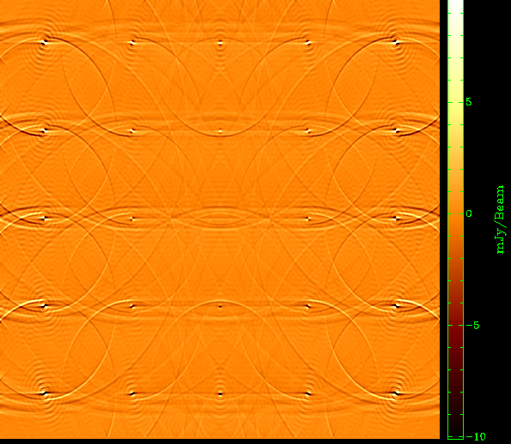
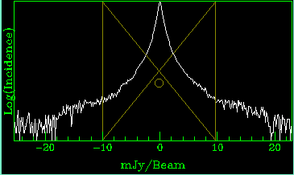
Tropospheric Refraction
(A 1 TTU Simulation)
Tropospheric refraction increases at low elevation
Sources wobble around within the primary beam
Time-variable effect
25”

Slide 23
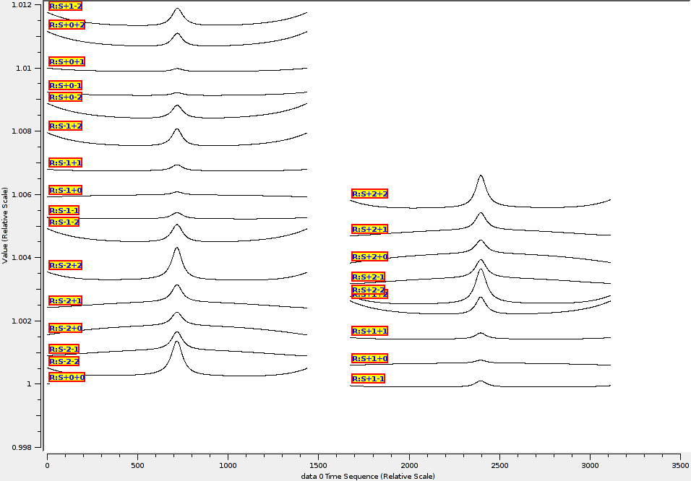
Beam Gain
As a Function Of Time

Slide 24
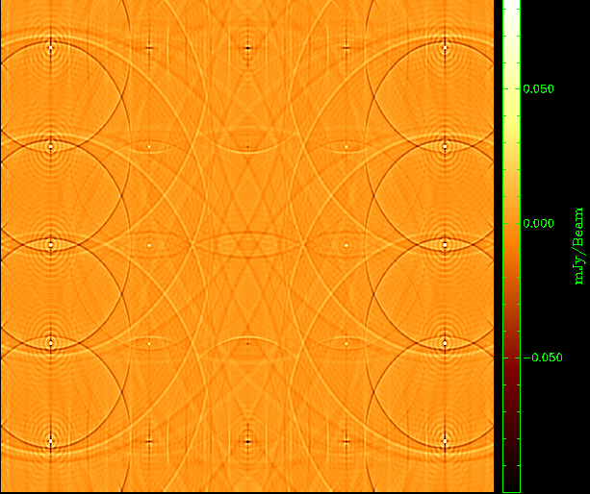
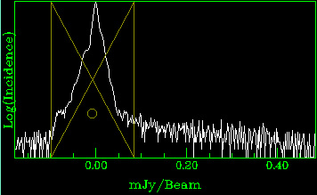
Differential Refraction
Effect is variable across the FOV (FOV is “compressed”.)
Adjusting pointing only corrects the central source
Simulated residual error is ~10⁻⁴ at 30” off-axis.
A bright source will ruin your day.
25”

Slide 25
Conclusions
NEWSTAR beaten.
Differential gains boldly go where no peeling has gone before:
  cleans up sources 1000 fainter than 3C147,
  ...whose discernible effects are close to noise,
  with very few extra parameters.
Noordam Conjecture: “If it's bright enough to cause trouble, it's bright enough to be solved for.”
Smirnov Corollary: usually within 1 TTU.

