Slide 1
Multi-Beaming
And
Calibration

Slide 2
Multi-Beaming
And
Calibration

Slide 3
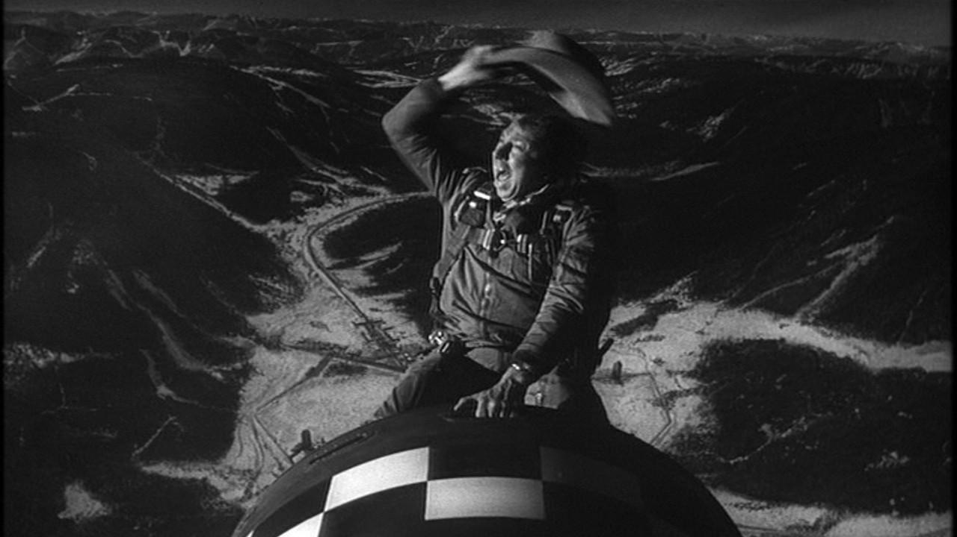
Dr. Sidelobes, Or How I Learned To Stop Worrying & Love Simulations
O. Smirnov (Rhodes University & SKA SA)

Slide 4
Introduction
“A high quality radio map is a lot like a sausage, you might be curious about how it was made, but trust me you really don't want to know.”
– Jack Hickish, Oxford
Interferometry is hard and unintuitive, but we've carved out some comfort zones
New technologies, new observatories and new surveys will be [are] boldly going where no man has gone before
  A lot of this thanks to Arnold
Result: we live in interesting times

Slide 5
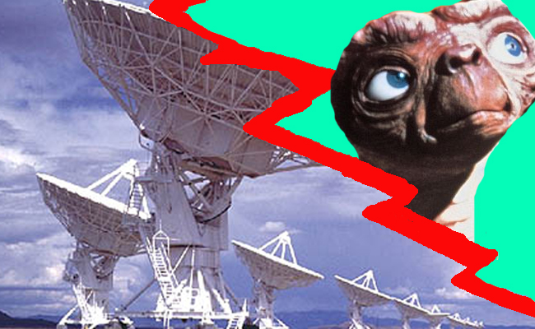
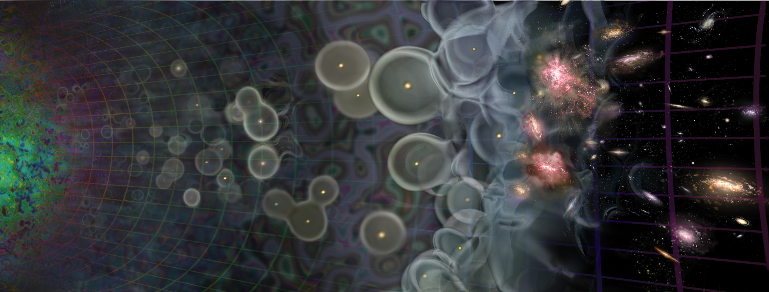

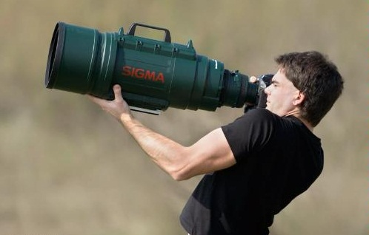
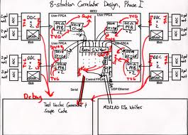
Radio Interferometer...
(In celebration of the passing of an extremely lame but blissfully short-lived internet meme)
What lay people think I do
What funding agencies
think I do
What cosmologists & astrophysicists think I do
What my engineers think I do
What I actually do

Slide 6
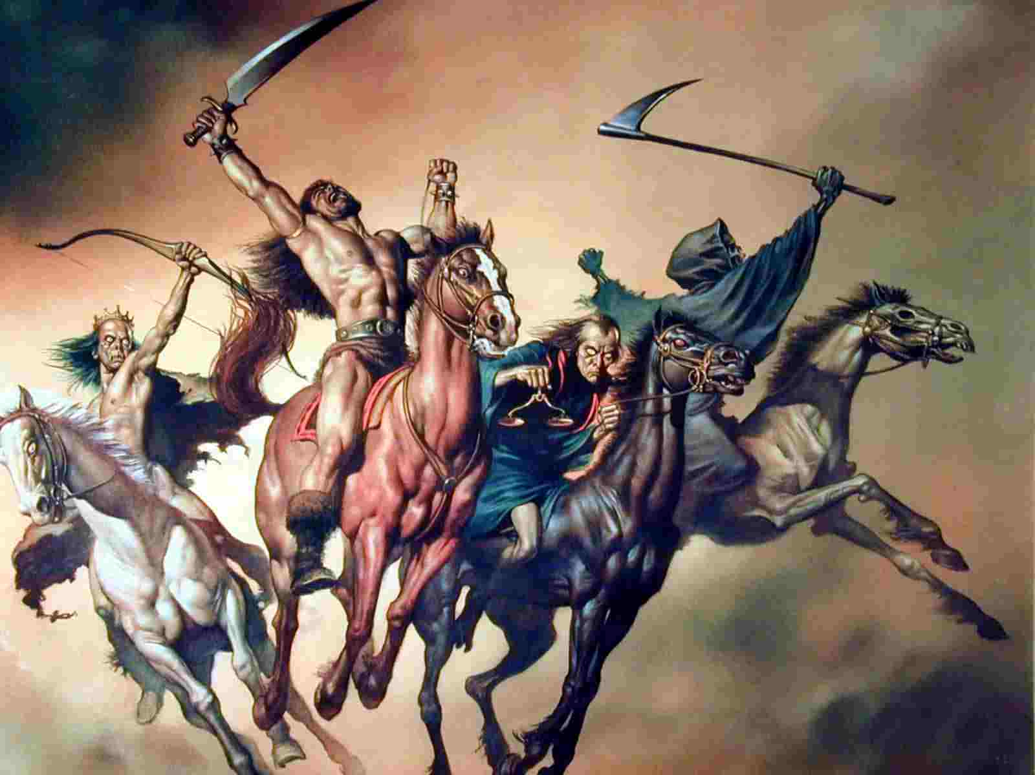
The Four Horsemen of interferometer limitations
Thermal noise
  lucky if we can
  reach it
Classical confusion
  (i.e. depth limited by resolution)
Residual calibration and deconvolution artefacts (& calibration “noise”)
Dr. Sidelobes
Well-understood (?)
this
talk

Slide 7



Dr Sidelobes: Missing Information
Response to a point source: Point Spread Function (PSF)
PSF = FT(uv-coverage)
Observed “dirty image” is convolved with the PSF
Structure in the PSF = uncertainty in the flux distribution (corresponding to missing data in the uv-plane)
PSF of WSRT.
The regular rings are due to the regular spacing of its antennas in the
East-West direction.
PSF of MeerKAT
PSF sidelobes
extend over the
entire sky
4
2

Slide 8

Why Is This Bad?
Real-life WSRT dirty image
Dirty image dominated by PSF sidelobes from the stronger sources
Deconvolution required to get at the faint stuff underneath.
A whole continuum of skies fits the dirty image (pick any value for the missing uv-components)
Deconvolution picks one = interpolates the missing info from extra assumptions (e.g.: “sources are point-like”).

Slide 9

Good News First
3C147 @21cm
12h WSRT synthesis
160 MHz bandwidth
22 Jy peak (3C147)
13.5 μJy noise
1,600,000:1 DR
thermal noise-limited
Regular calibration does
not reach the noise,
leaves off-axis artefacts
due to direction-dependent
effects (left inset)
Addressed via differential
gains (right inset)
3C147 22Jy
30 mJy

Slide 10
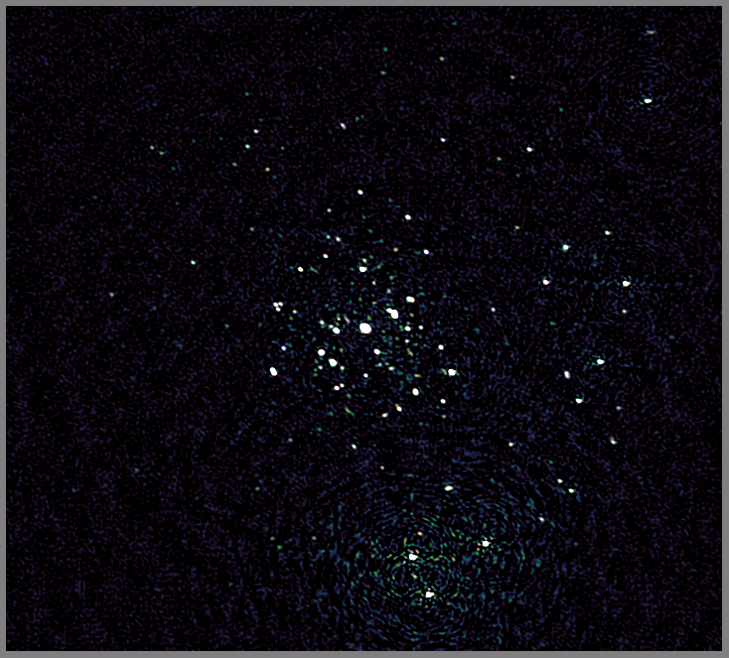
JVLA Can Do It Too
Recent result from 3GC3 workshop
3C147
JVLA-D @1.4 GHz
Best image after
regular selfcal

Slide 11
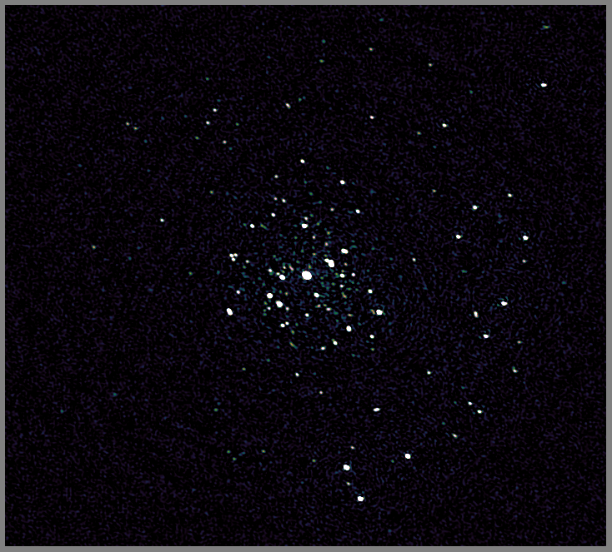
JVLA Can Do It Too II
Recent result from 3GC3 workshop
3C147
JVLA-D @1.4 GHz
Best image after
regular selfcal
...and direction-dependent (DD)
calibration on a few
sources

Slide 12

When Primary Beams Go Bad...
(Courtesy of Ian Heywood)
EVLA 8 GHz: Looking for sub-mm galaxies and QSOs in the William Herschel Deep Field.
Dominant effect: bright calibrator source rotating through first sidelobe of the primary beam.
(This also has a horrible PSF, being an equatorial field.)
This is your science
(good luck!)
This is your
phase calibrator
Brightness scale 0~50μJy

Slide 13

Keep Your Friends Close, and your calibrators as far away as you can...
An approximation of the primary beam response, overlaid on top of the image.
As the sky rotates, the sidelobes of the PB sweep over the source, thus making it effectively time-variable.
This is your science
(good luck!)
This is your
phase calibrator
(Brightness scale 0~50μJy)

Slide 14

Deconvolution Doesn't Help...
Residual image, after deconvolution.
The contaminating source cannot be deconvolved away properly, due to its instrumental time-variability.
...5 years ago this would observation would probably be a complete write-off.
(Brightness scale 0~50μJy)

Slide 15
Same Problem Here
The artefacts in this
image have the same
underlying cause.
But here, the dominant
source is at the centre
(where PB variation is
minimal) and the
“offending” sources are
relatively faint.
But we did address them
via differential gains...

Slide 16

Differential Gains To The Rescue
Residual image after applying differential gain solutions to the contaminating source
Brightness scale 0~50μJy

Slide 17

Multi-Band Image
Multi-band residual image:
noise-limited, no trace of contaminating source.
Phase calibrator
used to be here
Brightness scale 0~50μJy

Slide 18
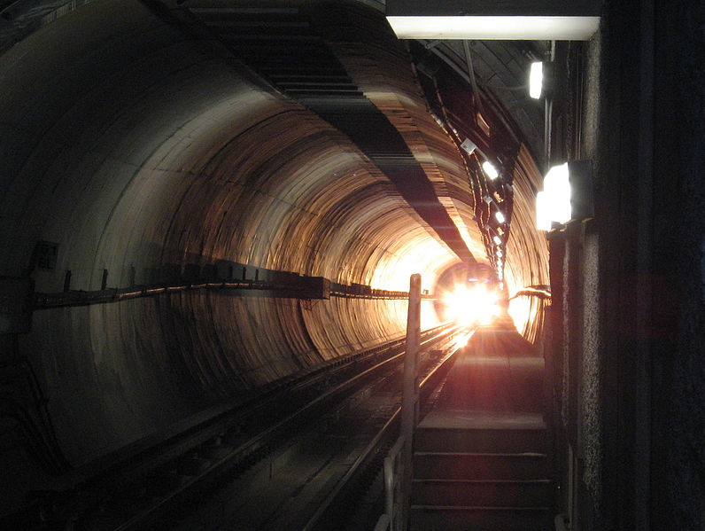
Flush With Success
3C147, WHDF, LOFAR maps: some real successes
Thermal noise-limited maps are being produced
  Though nowhere near routinely...
  T&Cs apply: extended
  sources are still notoriously
  hard to deconvolve
  ….though new algorithms
  are emerging
Is this the light at the end of the
tunnel?

Slide 19

2004: The Ghosts Of Cyg A
WSRT 92cm observation of J1819+3845 by Ger de Bruyn
String of ghosts connecting brightest source to Cyg A
(20° away!)
“Skimming pebbles in a pond”
Positions correspond to rational fractions
(1/2, 1/3, 2/3, 2/5, etc...)
Wasn't clear if they were a one-off correlator error, a calibration artefact, etc.
  (...and if you did low-frequency in 2004, you had it coming anyway.)

Slide 20

2010: Ghosts Return
WSRT 21cm observation
...with intentionally strong instrumental errors
String of ghosts extending through dominant sources A (220 mJy) and B (160 mJy)
Second, fainter, string from source A towards NNE
Qualitatively similar to Cyg A ghosts

Slide 21
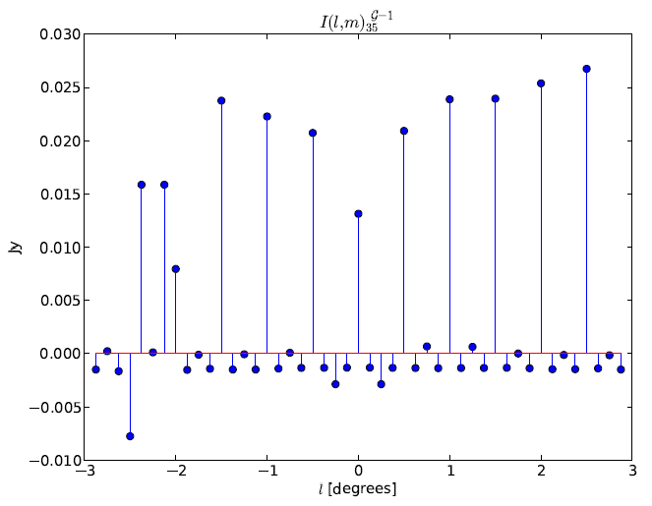
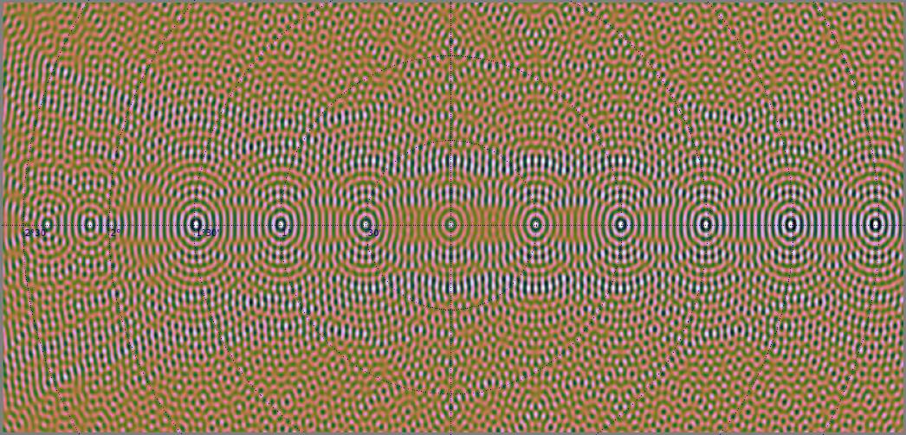

Slide 22

JVLA Ghost Sim

Slide 23
Ghastly Questions
Does calibration always introduce ghosts?
  YES. But most of the time they're buried in the noise.
  ...unless you have a complete sky model (i.e. if all your science targets are known in advance)
Why don't we always see them?
  Not enough sensitivity
Will they average out?
  NO. Push the sensitivity, they pop out.
What will they do to my statistical detections (hello EoR)?
  Dunno. Simulations needed.
What else is that redistributed flux doing?

Slide 24

Ghosts, The Flip Side
WSRT “Field From Hell” (Abell 773 @300 MHz),
residual map

Slide 25

Getting There, Right?
After diligent (direction-dependent) calibration

Slide 26
Noise-limited Is Not Always Good
Suppression of non-model sources
Our target

Slide 27

The Dangers Of
Direction-Dependent Solutions
Suppression is less with more conservative calibration
Our target

Slide 28
Ghosts & Source Suppression
Both ghosts and suppression operate via the same mechanism, and Dr Sidelobes pulls the strings
Ghosts are usually buried in the noise
Suppression always present, but more severe with DD calibration (more DoFs...)
  A noise-limited map is not necessarily a good science map!
“What if we were to somehow break the thermal noise barrier, but
all we'd find beneath would be the bones of Arnold's enemies?”
– Anon., 3GC-II Workshop
(names and places changed to protect the guilty)

Slide 29
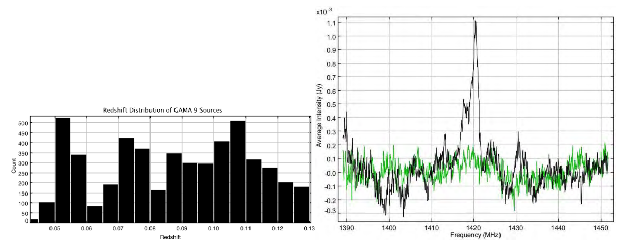
HI Stacking:
Picking over the bones of Arnold's enemies
Individual HI lines hidden in the noise
  So apply priors from optical surveys...
  ...by shifting each spectrum to its known redshift
  ...and probe the total signal by co-adding spectra
HI lines add up, noise suppressed by ~N ⁻²
For bonus points, use optical positions to stack sources that are
sub-noise in radio
(Delhaize & Staveley-Smith)

Slide 30
HI Stacking:
The Ian “Bad News” Heywood Simulation I
Simulated HI emission (S³-SAX)
Pure sky model
No noise
No continuum
No interferometer
response
So, what happens when Dr. Sidelobes shows up?

Slide 31
“Stacking experiment for high-z HI on the celestial equator? LOL!” – Anon.
No noise
No continuum
No calibration or deconvolution residuals
SKA-Mid sim
Equatorial field: high N-S sidelobes

Slide 32
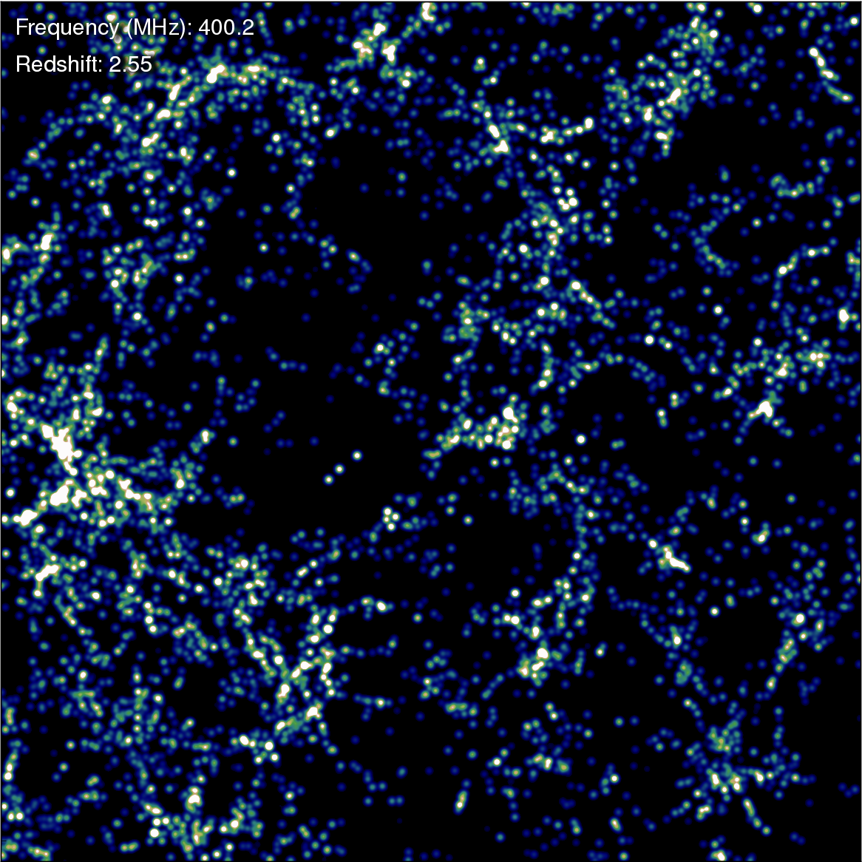
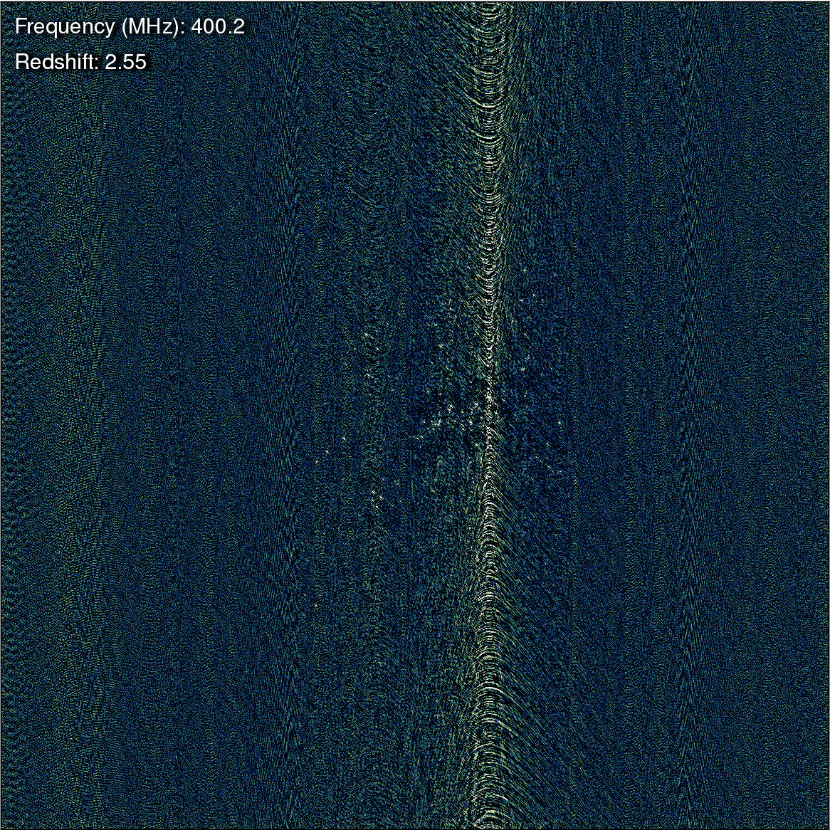
True vs. Observed
How many of these galaxies will stack up coherently?

Slide 33
LADUMA Stacking Sim
No noise
No continuum
No calibration or deconvolution residuals
MeerKAT sim
(... with some YouTube artefacts...)

Slide 34
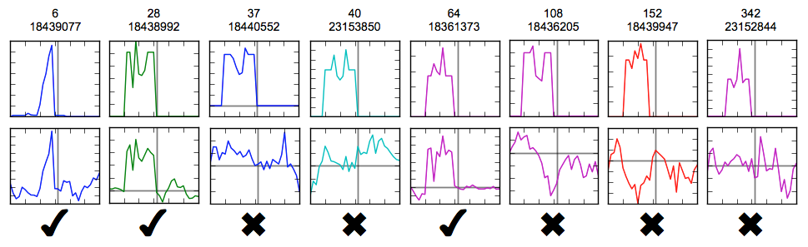
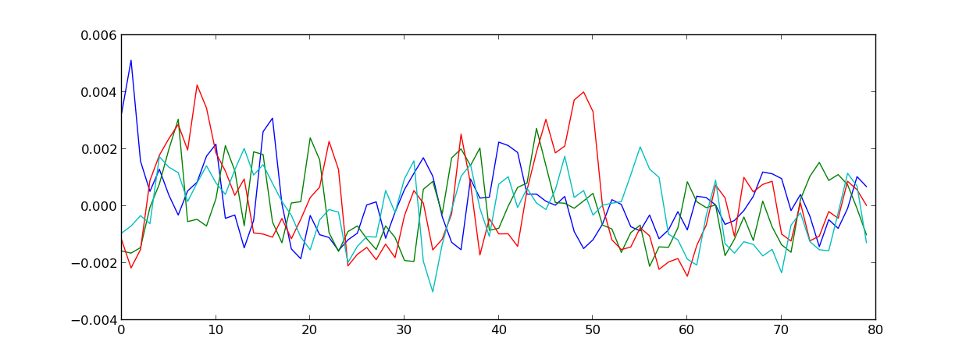
Dr Sidelobes at Work
TOP: A selection of individual galaxy spectra
BOTTOM: A selection of
“Dr. Sidelobes's spectra”

Slide 35
HI + Dr. Sidelobes
Ordinal number of galaxy
(in order of HI mass)
TOP: original HI signal
BOTTOM: HI + Dr. Sidelobes
  ...most of which originate with undetected sources
75% of the top 500...

Slide 36
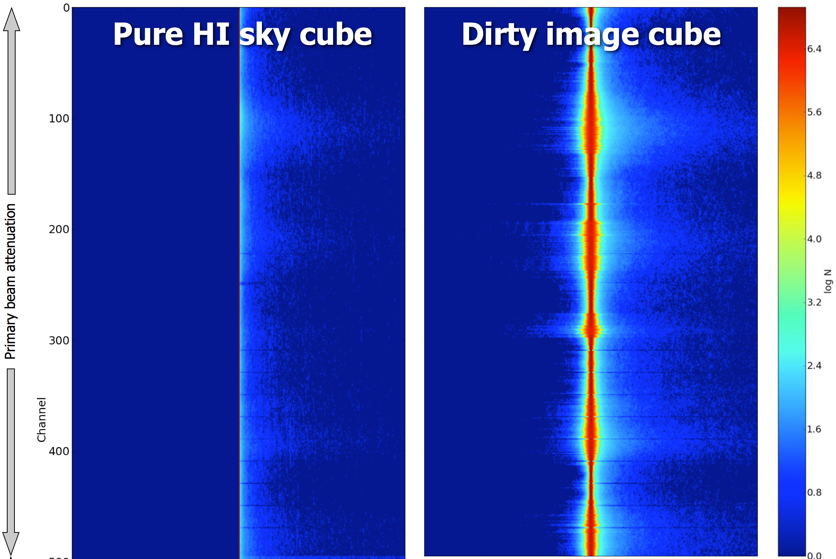
Pixel Values Histogram
dominant
sources
negative sidelobes
of dominant
sources
no negative
values
Most HI signal
lives here
positive sidelobes
of dominant
sources

Slide 37
How Radio Interferometry
Really Works
Bright sources
(DD solutions, uv-subtraction, deconvolution)
thermal noise
Faint sources
(DDE interpolation, deconvolution)
1-2σ sources
(stacking)
<1σ sources
(a stiff drink?)

Slide 38
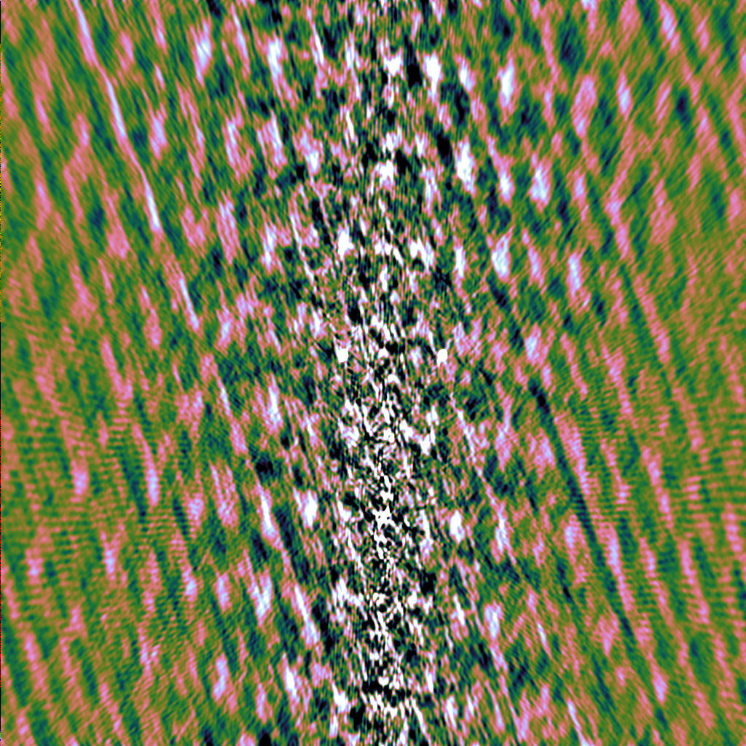
Stacking In WHDF
Should have been possible: ~1700 optical positions available in this field.
Failed miserably.
Prime suspect: the bones of Arnold's enemies left behind by the phase calibrator.
Can simulate the whole thing...

Slide 39

And Things Can Only Get Worse...
Radio interferometers of the past: simple machines built of beautiful, massively over-engineered
components
“Simple”
experiments

Slide 40

The Future
Complex machines built out of cheap junk
  “We'll just solve it in software!”
Increasingly
subtle and
elaborate
experiments

Slide 41
Conclusion
It's a brave new world that Arnold's had a hand in building
And it's also full of surprises
But we have the tools to discover them, and hopefully avoid the bad ones
Another Golden Age in instrumental radio astronomy?

