Slide 1
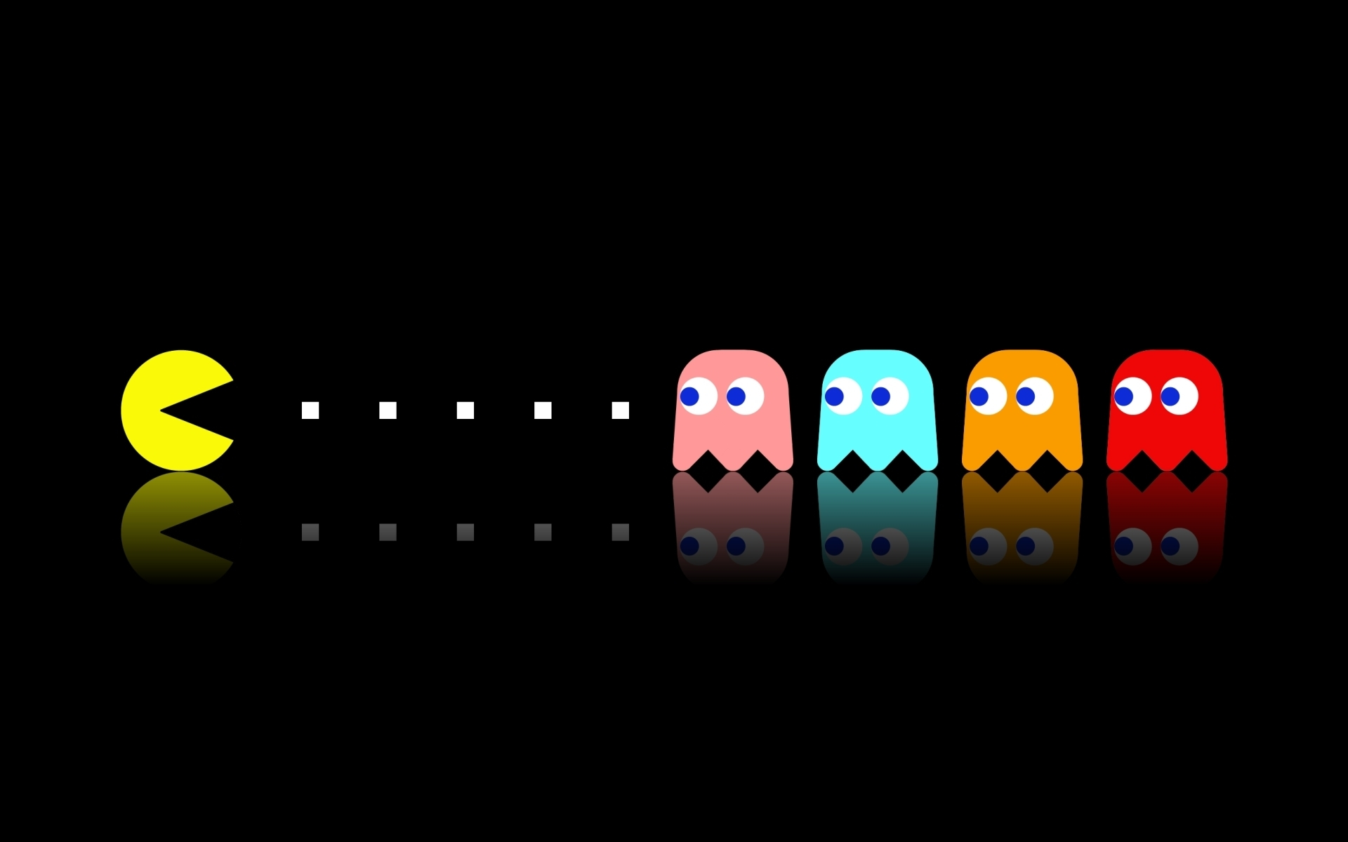
Ghostbusted
O. Smirnov, T. Grobler (Rhodes U. & SKA SA)
C.D. Nunhokee (Rhodes U.)

Slide 2

Ghosts Of Selfcal Past
The early mystery:
WSRT 92cm observation of J1819+3845 by Ger
String of ghosts connecting brightest source to Cyg A
(20° away!)
“Skimming pebbles in a pond”
Positions correspond to rational fractions
(1/2, 1/3, 2/3, 2/5, etc...)
Wasn't clear if they were a one-off correlator error, a calibration artefact, etc.
  (...and if you did low-frequency in 2004, you had it coming to you anyway.)

Slide 3

2010: Ghosts Return
WSRT 21cm observation
(QMC2 field)
...with intentionally high pointing errors
String of ghosts through dominant sources A (220 Jy) and B (160 mJy)
Second, fainter, string from source A towards NNE
Qualitatively similar to CygA ghosts
Went away after DD calibration & repeated selfcal

Slide 4

Ghostbusters (CALIM 2010)
Ghosts reproduced via simulations

Slide 5
Ghosts In The (Selfcal) Machine
Ghosts arise due to missing flux in the calibration sky model
Mechanism: selfcal solutions try to compensate for this by moving flux around
  Not enough DoFs to do this perfectly
  ...so end up dropping flux all over the map
Regular structure suspected to be due to WSRT's redundant layout
  JVLA, MeerKAT: “random” (but not Gaussian!)

Slide 6

JVLA Ghost Sim

Slide 7
Ghastly Mysteries
Shown empirically (2010) but not understood:
  Why do they form on lines passing through unmodelled sources?
  Why do they sit on rational fractions?
  Why do they have different PSFs?
  Why do they seem to scale with the missing flux, but not with the model flux?

Slide 8
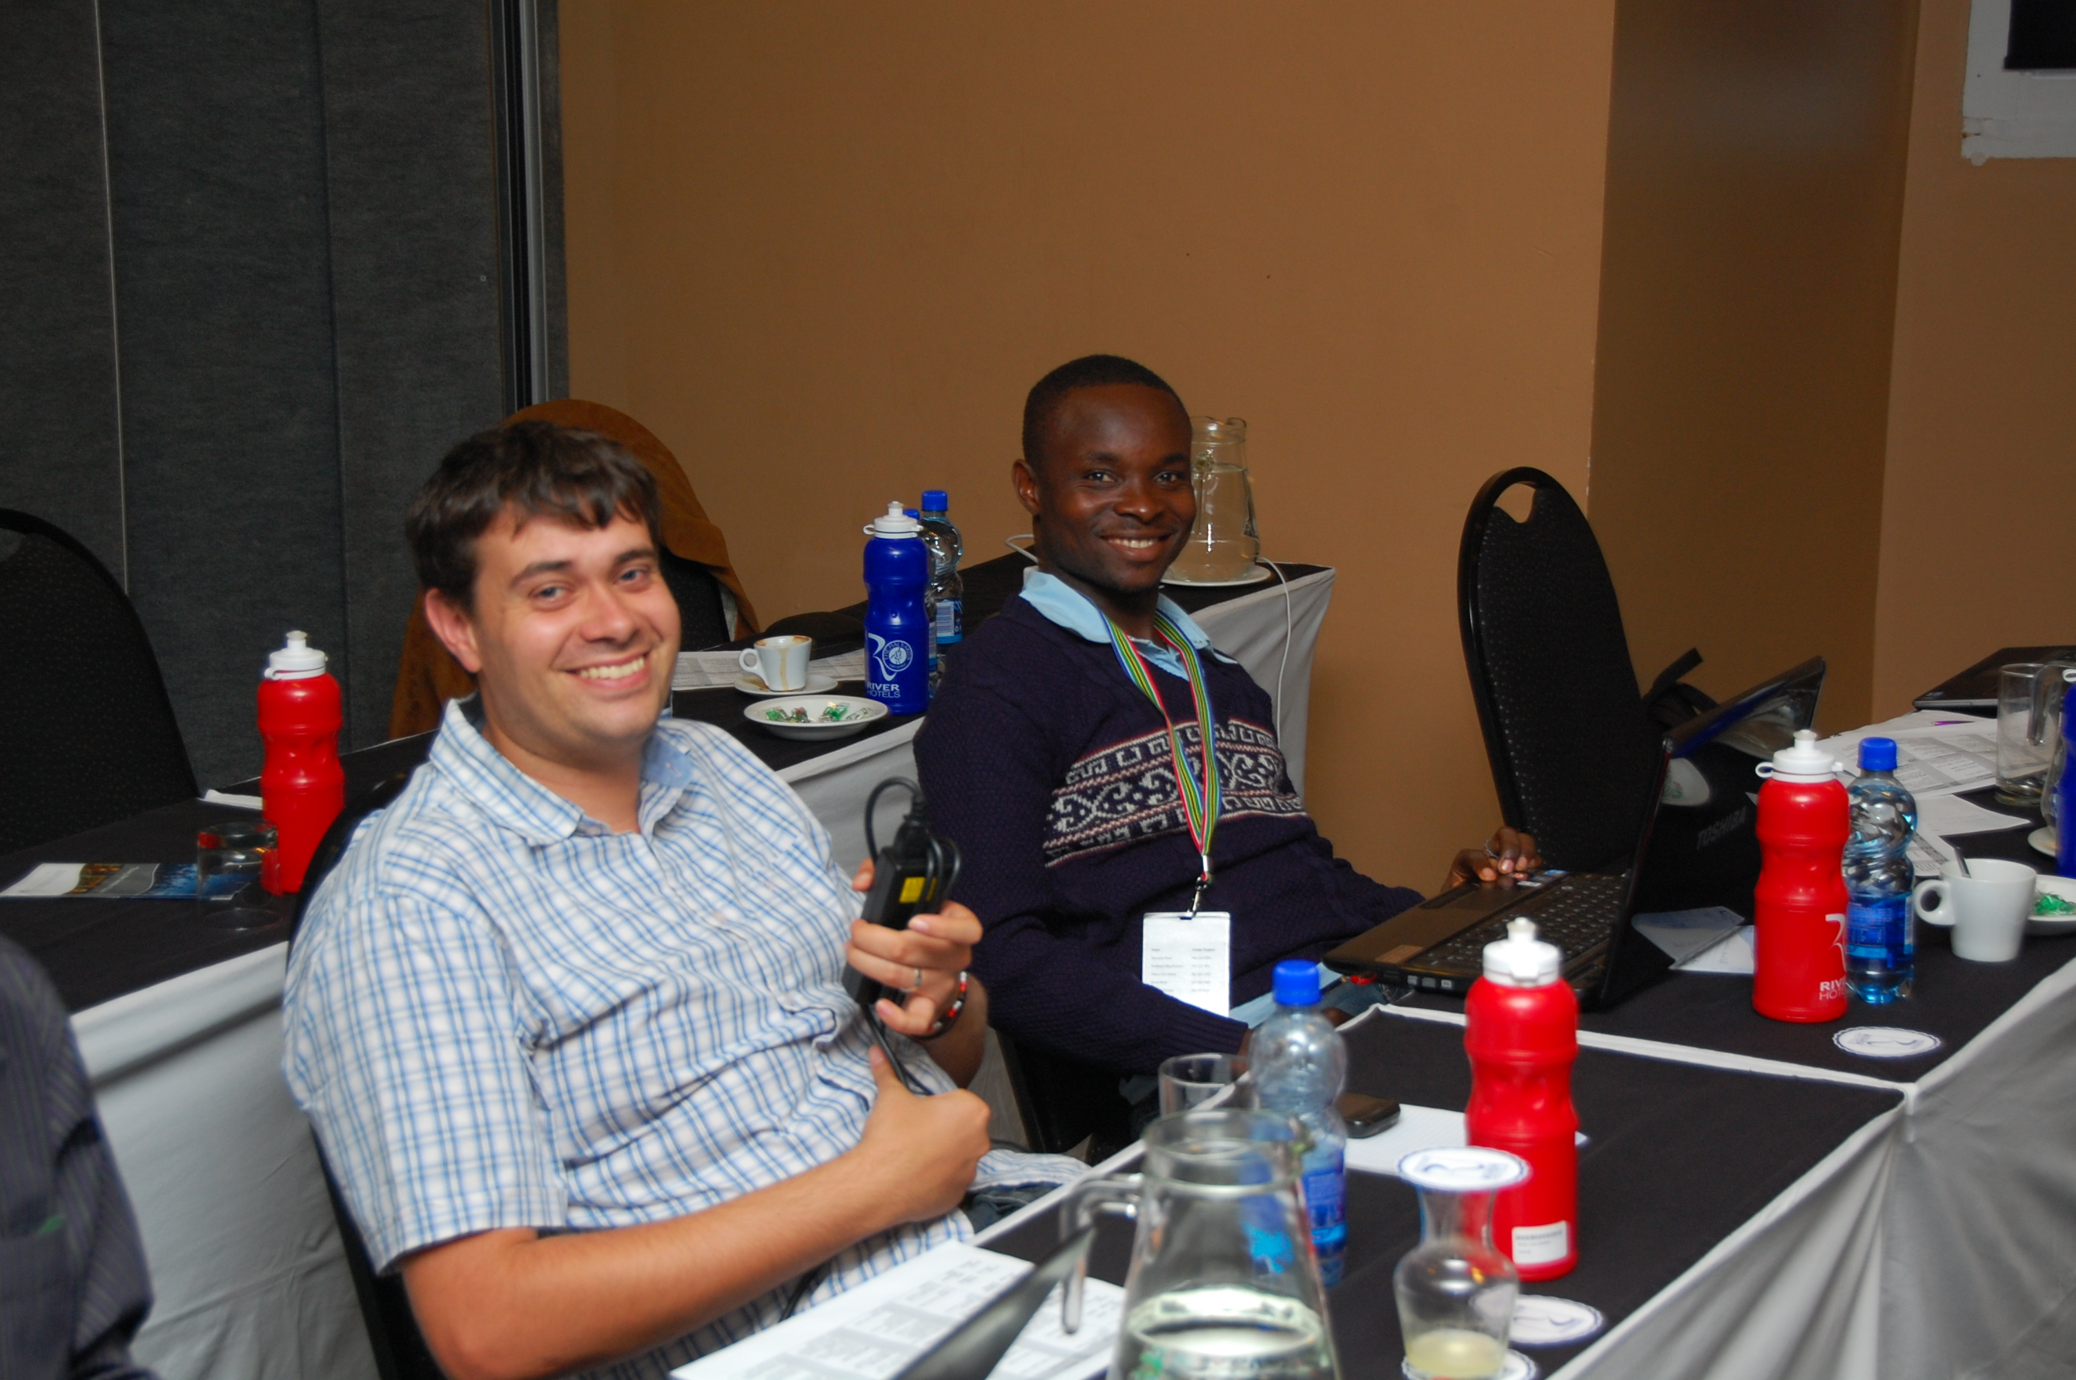

Understanding Ghosts
Results suggest ghosts are fundamental to selfcal
  ...and we really couldn't let Ger retire with the mystery unsolved
Trienko Grobler and Ridhima Nunhokee worked on the problem

Slide 9
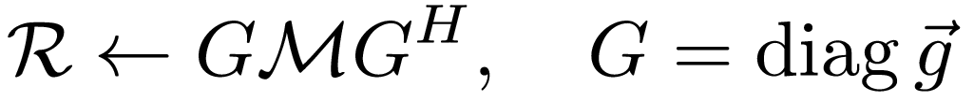
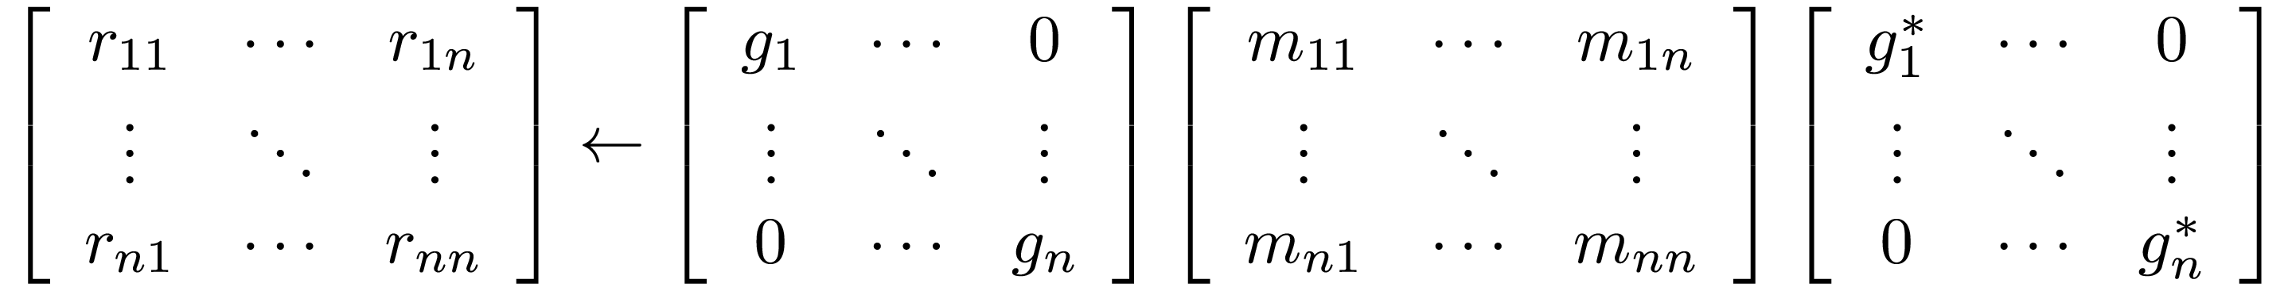
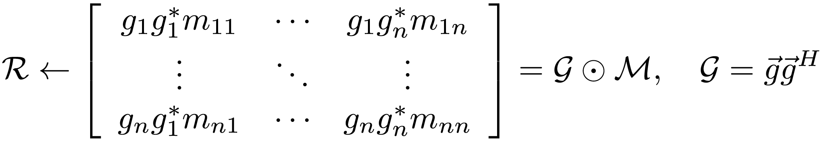
Fundamentals
Calibration:
...or equivalently:
Correction:
observed
gains
model
gains
Element-by-element
multiplication
Element-by-element
inverse

Slide 10

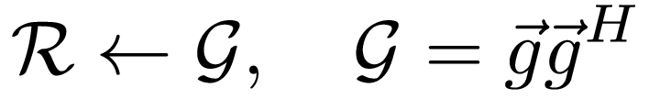
The Simplest Case
R: two point sources (1 Jy at centre, <1 at )
M: 1 Jy source at centre = matrix of all ones
Conventional calibration: “←” is an LSQ fit of off-diagonal terms (=Gaussian ML)
  (though: see robust calibration, Kazemi & Yatawatta)
  what does it do? God only knows, very difficult to understand analytically...
  ...some crucial insights were needed
“calibrated
sky”

Slide 11
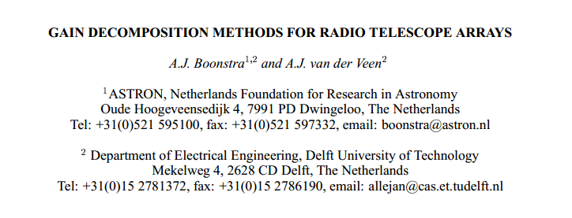
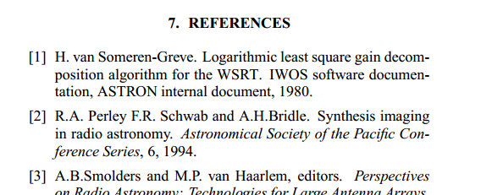
Some Familiar Names...
(Boonstra A.J., van der Veen A.J., 2003, IEEE Trans. Sig. Proc., 51, 25)
“The phantom memo”

Slide 12
ALS Calibration
R is rank two (for two sources), G is rank one by construction
ALS – “deranking” – builds G by taking just the largest eigenvalue/eigenvector of R
  Not exactly the same as off-diagonal LSQ...
  ...but we've empirically shown that this produces similar ghost patterns
  ...and deranking can be studied analytically

Slide 13
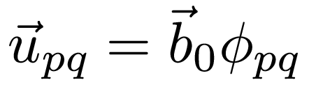
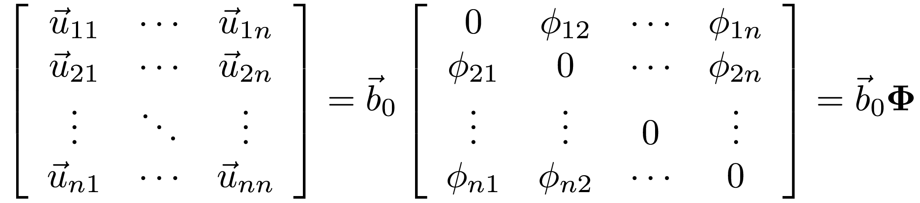
Regular spacing
WSRT is regularly-spaced: there's always a “common quotient baseline” (CQB) b0 such that for all baselines there is a whole-number scaling relationship:
whole number
“array geometry
matrix”

Slide 14
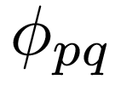
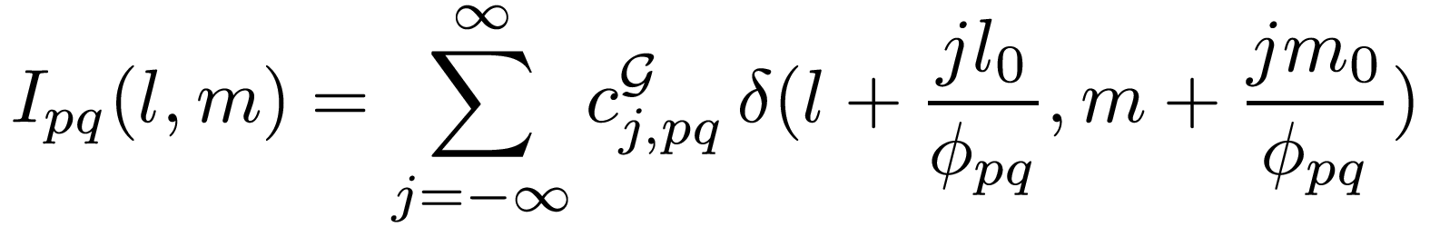
Per-baseline “calibrated sky”
Deranking allows us to work out G analytically...
  (...lots of math skipped, see paper...)
Key result: the “calibrated sky” seen by each baseline pq is an infinite string of delta-functions of varying intensity, placed at intervals inversely proportional to :
ghost intensity coefficients
(can be worked out numerically)

Slide 15
Putting It Together
Each baseline “sees” its own ghost string with intervals of
The combined effect is some sort of average (depends on imaging weights, etc.)
Because of the whole-number scaling relationship, ghosts occupy a discrete set of positions (i.e. rational fractions of )
  redundancy means that some positions are “preferred”
  Amplitude coefficients differ per baseline, hence each ghost position exhibits its own “GSF” ≠ PSF

Slide 16
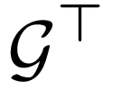
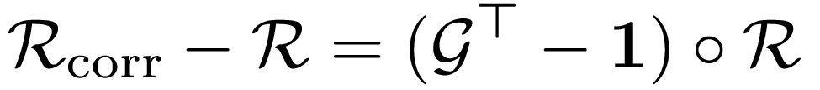
Distilled Ghost Pattern
This pattern is then translated into the “corrected sky” image, given by
  ...because actually has the same string-like structure (with different values for the c coefficients)
The interesting thing is the “distilled” ghost pattern:
convolution
“atomic” ghost pattern

Slide 17
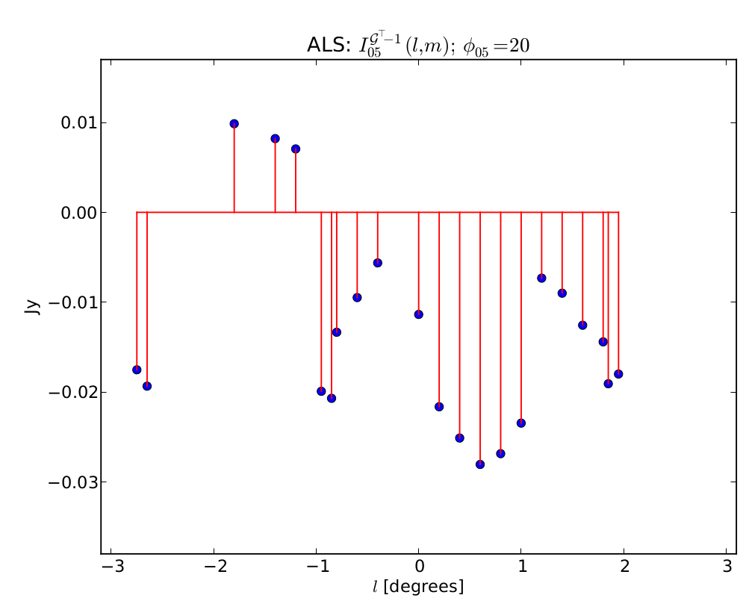
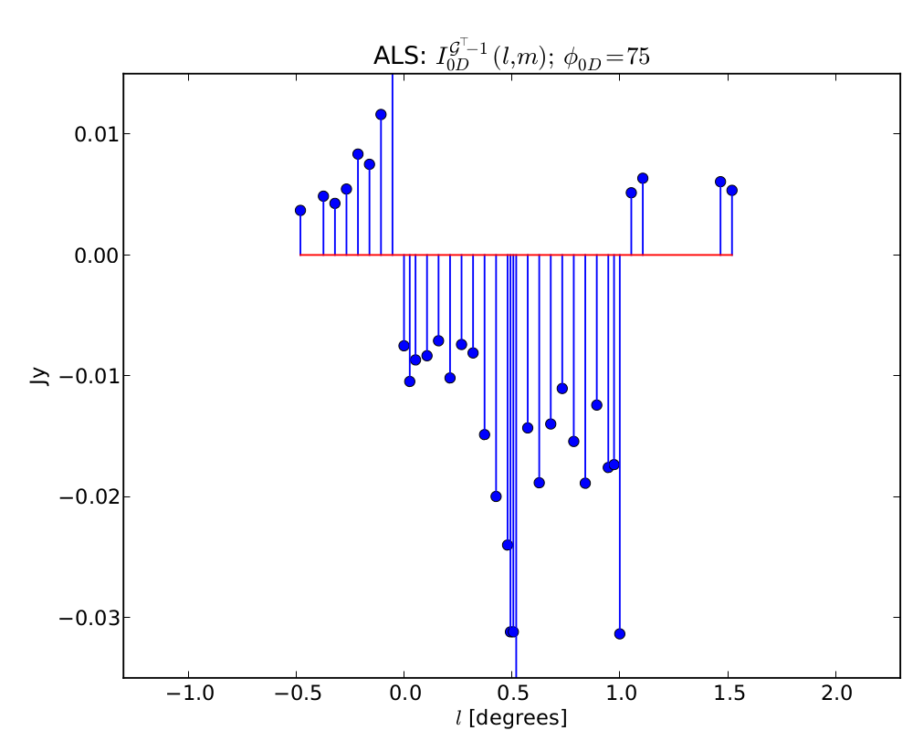
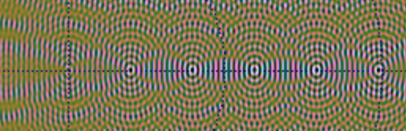
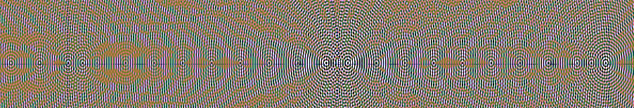
Predicted vs. Observed Patterns
Baseline 0-5
Baseline 0-D
“flux suppression” ghost
Baseline 0-5
Baseline 0-D

Slide 18
Ghost Intensity
Empirical observation (2010): ghost pattern scaled with intensity of secondary source As, but did not seem to depend on primary source Ap
This can now be explained:
...but the full picture is even more interesting...
Dominated by Ap
Dominated by
As/Ap flux ratio

Slide 19
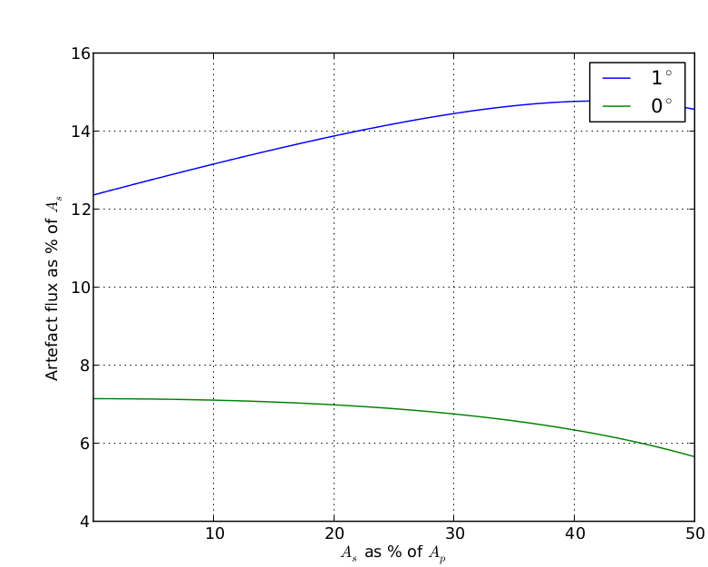
Flux Suppression vs. Flux Ratio
Ghost at 1 deg
sits on top of
missing source
Ghost at 0 deg
sits on top of
primary source
Responsible for
what we know as
flux suppression
Note the non-trivial dependence!

Slide 20
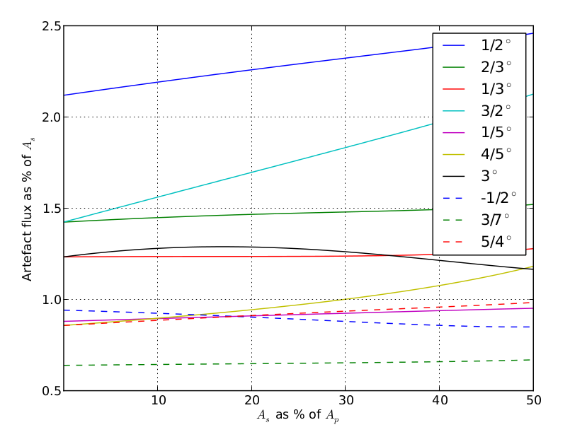
Flux Of Others

Slide 21
Why Is This Important?
Affects all instruments
  Only regularity is special to WSRT
Ghosts will always exist (in the noise, at least), until you build up a complete sky model
  Which is very laborious and/or compute-intensive
  What about other calibration approaches?
What does this do to the noise statistics?
Shallow calibration pipelines (AARTFAAC, etc.)
  Need to identify how deep a model is needed to keep ghosting within acceptable levels

Slide 22
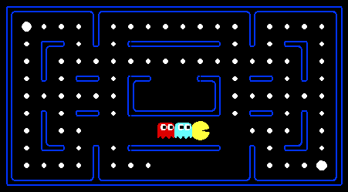
Conclusions
Ghosts (and WSRT regularity) explained
  Ger can retire now
We have a theoretical framework to predict ghost formation, which can and should be extended to other instruments

