Slide 1
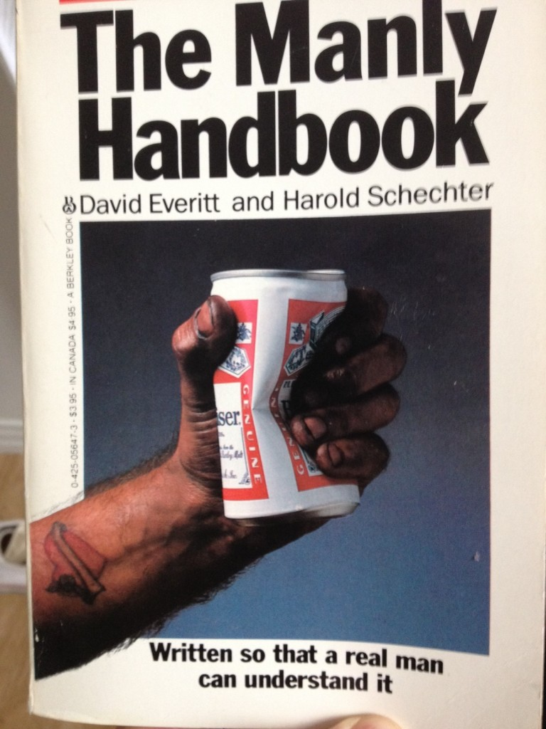
MeerKAT Algorithmic
Requirements
& Macho Imaging
O. Smirnov (Rhodes U. & SKA SA)

Slide 2
MeerKAT Requirements
1. Calibrate down to the noise
  Deep surveys: sub-μJy
  Automatically...
2. (Before SKA1 comes along)
3. Understand the noise
  Statistical detection experiments (IM, stacking) assume Gaussian noise properties
  A clean map is not necessarily a good map!

Slide 3
“Macho Imaging” (after R. Perley)
New DR record: 3.2M
Most science happy with 10~50,000
  Typical JVLA field: ~50 mJy foreground, so 1 μJy noise means DR ~50,000 (L-band)
  So why bother?
MeerKAT: 4x FoV area: brighter foregrounds
  ...and SKA1 looms
Subtle instrumental effects can kill statistical detections
Answer: do high DR to understand the instrument

Slide 4
The Plan
Overview of the 3.2M result
  Identify the warts
Describe the current pipeline & tools
  near-term improvements, including established tools from CASA
Long-term algorithmic innovations

Slide 5
The 3C147 Data
D-config (6h) and C-config (8h) L-band observed by R. Perley
2x3 relatively RFI-free subbands pulled out and merged into 192 MHz spws (LO and HI)
Averaged to 5s and 64 channels
~few 1000 integrations
Moderate MS sizes (12-24 Gb)
Images presented are for LO

Slide 6
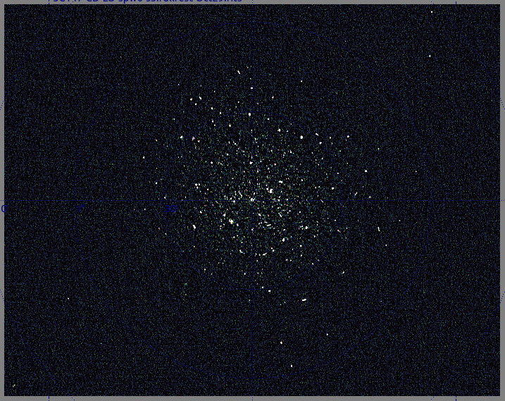
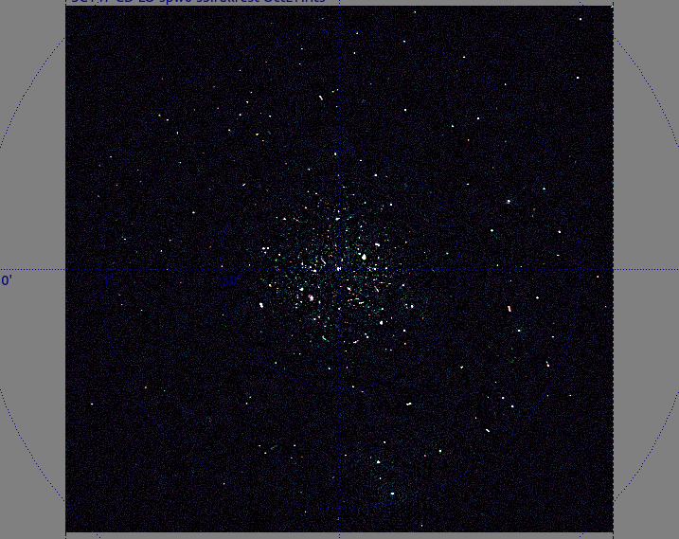
Full image: JVLA
JVLA: full image
JVLA: full image

Slide 7
WSRT: full image

Slide 8
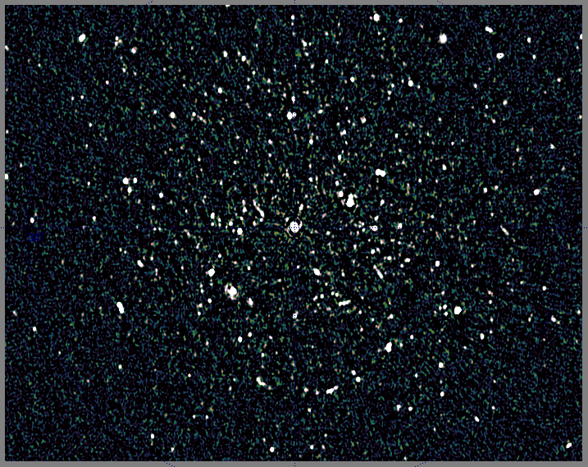
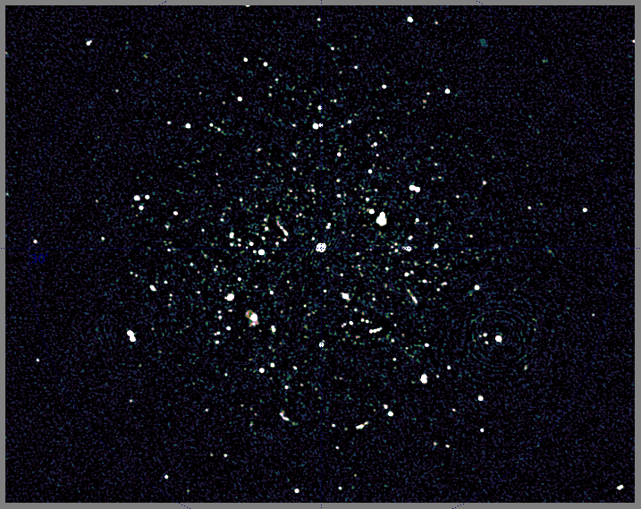
WSRT: full image
JVLA: zoom 1

Slide 9
WSRT: zoom 1

Slide 10
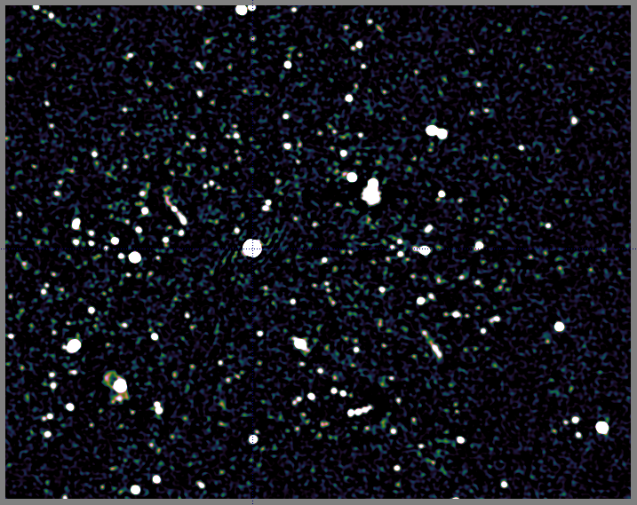
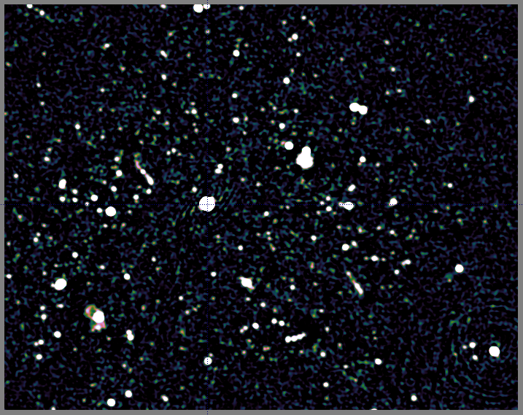
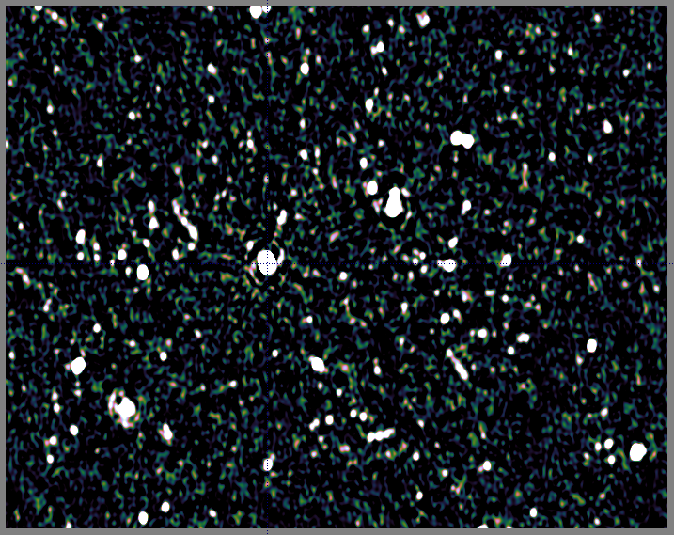
JVLA: zoom 1
WSRT: zoom 2

Slide 11
JVLA: zoom 1
JVLA: zoom 2

Slide 12
JVLA: zoom 2, smaller dE solution intervals

Slide 13
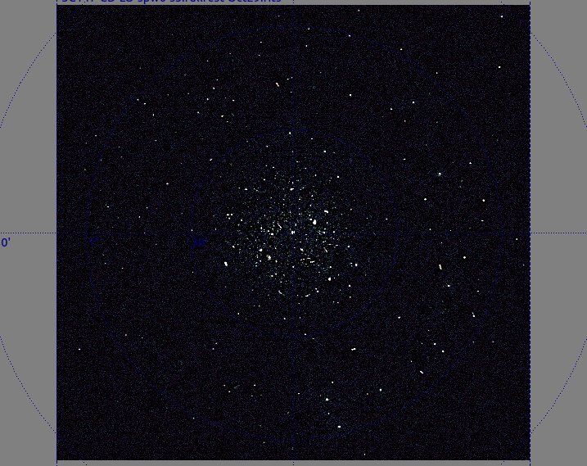
JVLA: full image, smaller dE solution intervals

Slide 14
JVLA: full image, larger dE solution intervals

Slide 15
Pipeline 1
Rick did initial flagging and calibrator transfer in AIPS
Merge C and D into a single multi-MS
(CASA: ms.fromfits, ms.virtconcat)
Add BITFLAG column (MeqTrees extension)
Initial selfcal per-subMS with a sky model for 3C147 itself (“model 0”) with MeqTrees/StefCal:
  6 components (from Ger de Bruyn: VLBI: VLA-A)
  ~20m per sub-MS
Joint 1ch residual image (of multi-MS) and csclean

Slide 16
Pipeline 2
Run shallow source find (PyBDSM) at 50 sigma
Identifies ~60 sources (deltas and Gaussians)
Merge them into model 0 → model 1
Self-cal with model 1 per-subMS
  Including dE solutions for 7-10 directions
  Smooth in freq/time (36x32)
  ~2h per sub-MS
Repeat to apply per-baseline gain offsets
Joint residual image (model 1 subtracted) and csclean

Slide 17
Pipeline 3
Run deep source find (PyBDSM) at 10 sigma
Identifies ~300 sources (deltas and Gaussians)
Merge them into model 1 → model 2
Self-cal with model 2 per-subMS
  Including dE solutions for 7-10 directions
  Smooth in freq/time (36x32)
  ~2h per sub-MS
Repeat to apply per-baseline gain offsets
Joint residual image (model 2 subtracted) and csclean

Slide 18
Pipeline 4
Add clean components to model 2 → model 3
  Hybrid LSM: deltas, Gauhssians, +image
Self-cal with model 3 per-subMS
  Including dE solutions for 7-10 directions
  Smooth in freq/time (36x32)
  ~2h per sub-MS
Joint residual image (model 3 subtracted) and csclean
Restore full model 3 into residual image

Slide 19
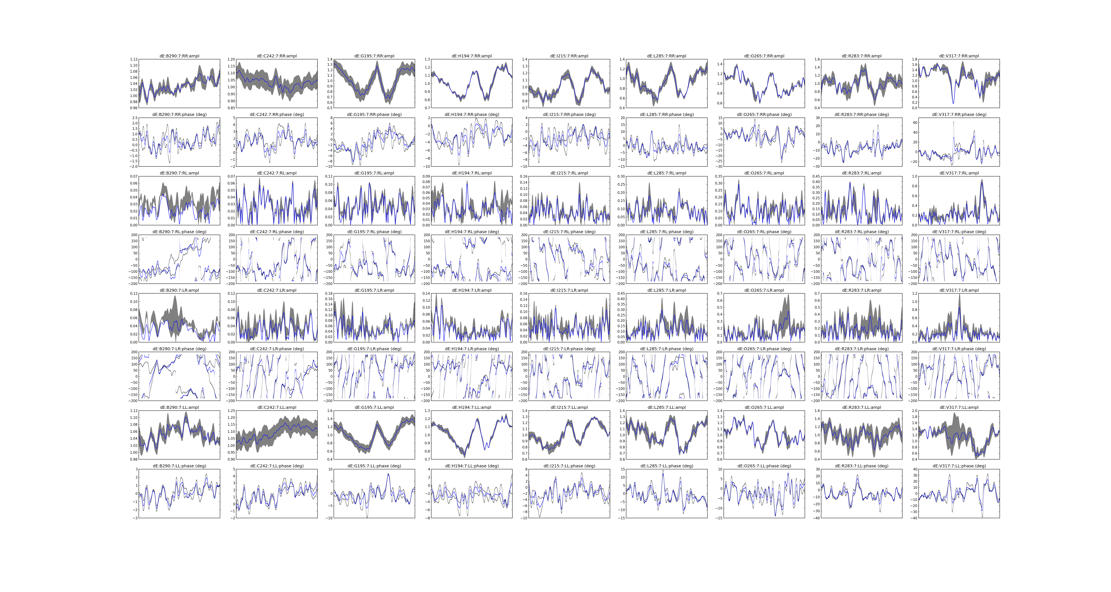
dE Plots: Antenna 7

Slide 20
dE's:
per antenna,
per source summary

Slide 21
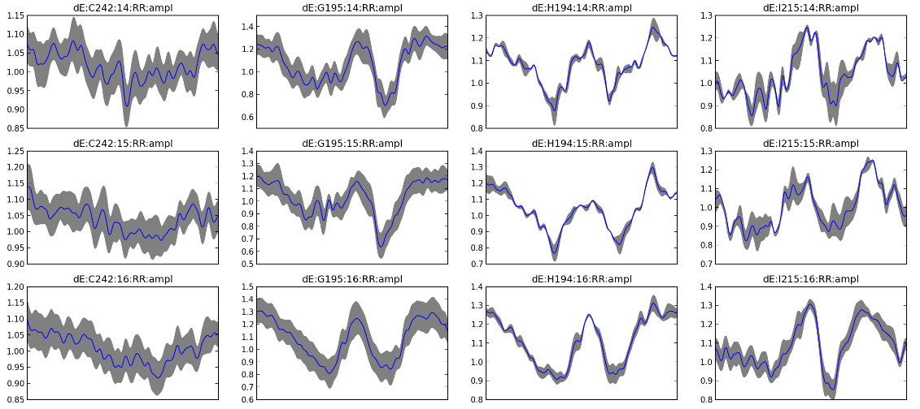
Frequency Variation

Slide 22
Pipeline 1
Rick did initial flagging and calibrator transfer in AIPS
Merge C and D into a single multi-MS
(CASA: ms.fromfits, ms.virtconcat)
Add BITFLAG column (MeqTrees extension)
Initial selfcal per-subMS with a sky model for 3C147 itself (“model 0”) with MeqTrees/StefCal:
  6 components (from Ger de Bruyn: VLBI: VLA-A)
  ~20m per sub-MS
Joint 1ch residual image (of multi-MS) and csclean

Slide 23
Pipeline 2
Run shallow source find (PyBDSM) at 50 sigma
Identifies ~60 sources (deltas and Gaussians)
Merge them into model 0 → model 1
Self-cal with model 1 per-subMS
  Including dE solutions for 7-10 directions
  Smooth in freq/time (36x32)
  ~2h per sub-MS
Repeat to apply per-baseline gain offsets
Joint residual image (model 1 subtracted) and csclean

Slide 24
Pipeline 3
Run deep source find (PyBDSM) at 10 sigma
Identifies ~300 sources (deltas and Gaussians)
Merge them into model 1 → model 2
Self-cal with model 2 per-subMS
  Including dE solutions for 7-10 directions
  Smooth in freq/time (36x32)
  ~2h per sub-MS
Repeat to apply per-baseline gain offsets
Joint residual image (model 2 subtracted) and csclean

Slide 25
Pipeline 4
Add clean components to model 2 → model 3
  Hybrid LSM: deltas, Gauhssians, +image
Self-cal with model 3 per-subMS
  Including dE solutions for 7-10 directions
  Smooth in freq/time (36x32)
  ~2h per sub-MS
Joint residual image (model 3 subtracted) and csclean
Restore full model 3 into residual image

Slide 26
Near-term improvements
Image several channels and include frequency info in LSM
  PyBDSM can fit spectral indices
  Runtime issues (currently, >50% imaging)
Apply AW-proj during imaging (currently w-proj only)
  PyBDSM will fit QUV, just need corrected maps
Incorporate MSMF-CLEAN
Hence, interoperability issues...

Slide 27
Macho dE-gains
Macho dE gains are “mostly flat”
  Which means most of your instrumental knowledge is incorporated into the sky model
We're a long way off

Slide 28
Longer-term Developments 1
Extend AW-proj to arbitrary (tabulated) beam patterns
  We have detailed MeerKAT/KAT-7 beam models
  Beam modelling (deformations, etc.)
Come up with a generic gridding/degridding library and build different imagers on top of that
  Joint project with ASTRON
  Python interface for outer loop etc.

Slide 29
Longer-term Developments 2
CS-based deconvolution
  Collaborations with multiple groups
  Needs gridder/degridder library
Bayesian source modelling and bayesian calibration
  Needs gridder/degridder
  How do instrumental effects interact with sky model construction? (beam vs pointing vs source parmeters)
Machine learning
  How to get away from “hero mode” reduction?

Slide 30
Longer-term Developments 3
What lives in the noise?
  Stacking, intensity mapping, blind surveys, etc. all to some extent rely on knowing the noise statistics
  “knowing” == “ah, it's just Gaussian, it will average out”

Slide 31

Example: Selfcal Ghosts

Slide 32
Selfcal Ghosts
ALWAYS arise during calibration with an incomplete sky model
Happily live in the noise
...until you go to really deep images, or start doing statistics

Slide 33
Conclusion
The deeper you go, the more work there is to be done still...
“A high quality radio map is a lot like a sausage, you might be curious about how it was made, but trust me you really don't want to know.”
– Jack Hickish, Oxford

