Slide 1
Using Correlator
Windowing Functions
For Cheaper Surveys?
A. Marcellin, O. Smirnov,
C. Tasse, G. Foster, J. Jonas

Slide 2


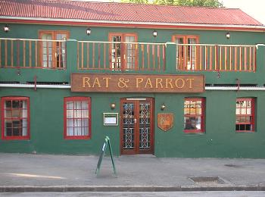

Credits

Slide 3
Smearing
A correlator produces visibilities averaged over time/frequency bins
  ...and we often want to average down further in post-processing, to save space & computing time
Complex averaging: loss of amplitude
  off-center sources, long baselines
  Time- and bandwidth smearing
For surveys, this imposes a limit on how much you can average (need to retain sensitivity over FoV)
For VLBI, this imposes tiny FoVs (much smaller than the available primary beam)

Slide 4

What Causes Smearing, 1

Slide 5
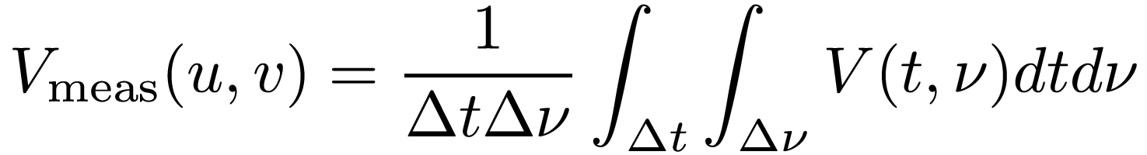
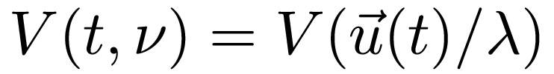
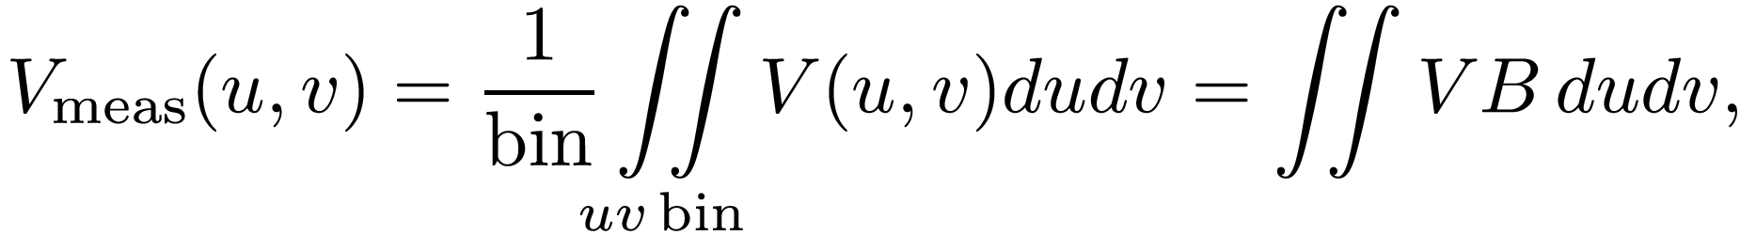
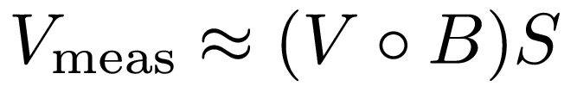
What Causes Smearing, 2
Averaging:
where B is a boxcar (“tophat”) function for the bin. This is a convolution:

Slide 6
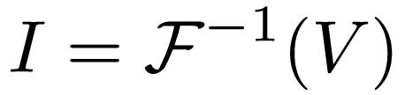
Averaging ≈ Convolution
Smearing
response
R

Slide 7
Windowing Functions
The smearing response R(l,m) = F⁻¹(B) is unity at 0, decreases radially, but too rapidly initially and not rapidly enough afterwards
So, why not play with B to optimize smearing response?
  Replace it with some windowing function W
  Bread-and-butter filter theory
The trade-off: increased thermal noise
  Noise is minimal when sum is unweighted

Slide 8
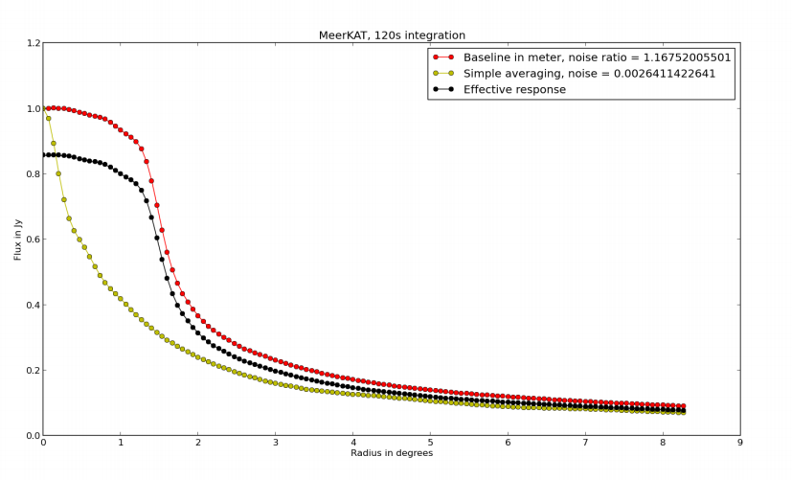
Early Results

Slide 9
Oversized Filters?
Why not use overlapping windows?
Can we win back some of our noise losses perhaps?

Slide 10
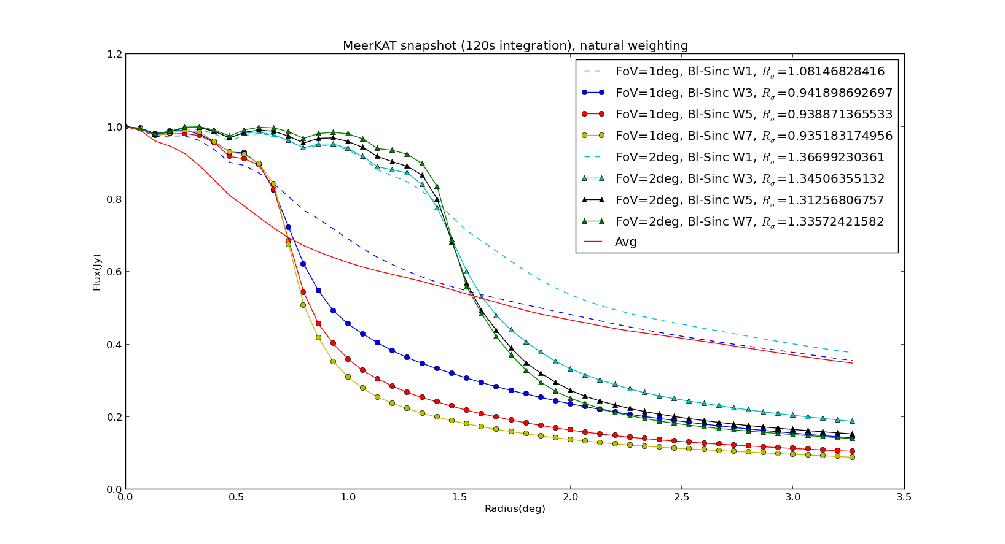
Results: Sinc Filter

Slide 11
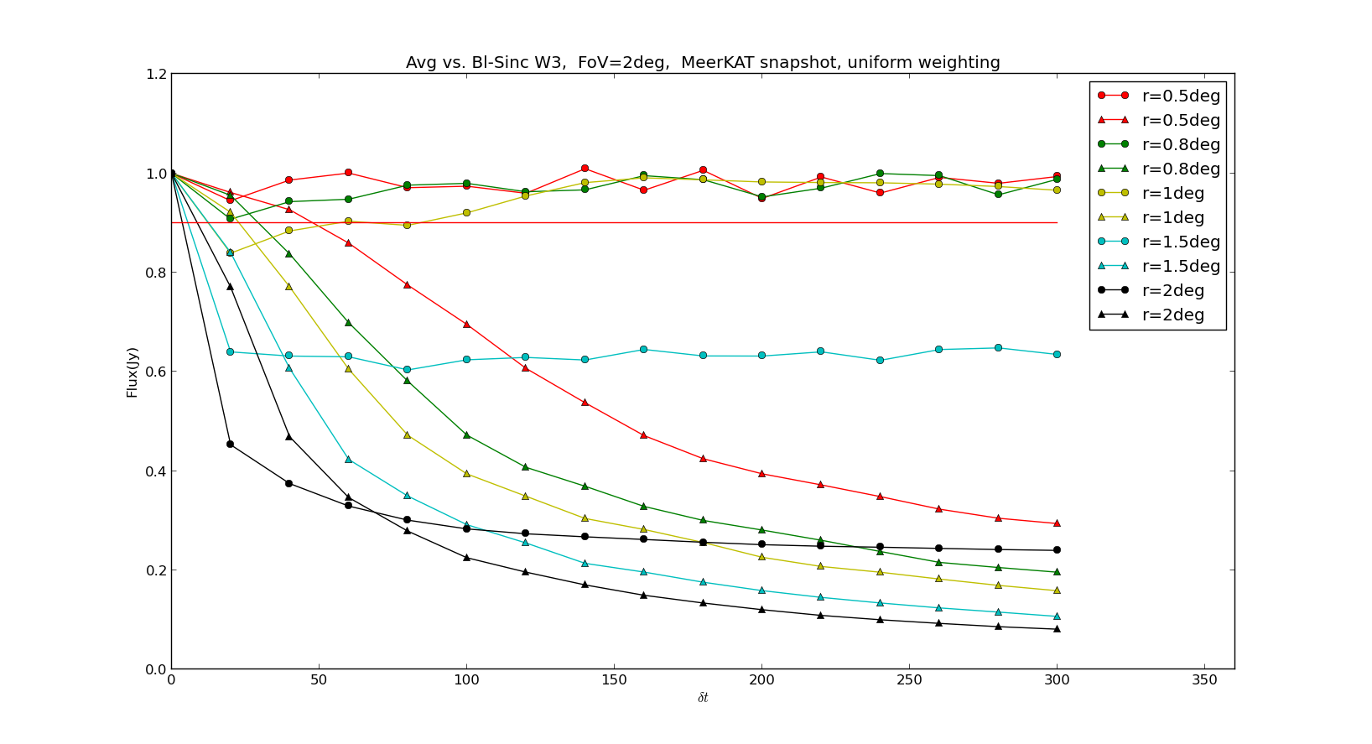
Increasing Integration Time

Slide 12
Early Prospects
We can practically eliminate smearing over a given FoV
...and better suppress sources outside the FoV
...with little to no increase in noise
...while averaging the data down at will:
  natural limit: spectral resolution
  natural limit: uv sampling
  natural limit: calibration
  but factors of several to orders of magnitude seem within reach

Slide 13
Correlator Implications?
Same input rate
Output rate reduced by factor of many
For an overlap factor of N, xN more ops (and registers)

